Slide 1
Transformers
The Technology Behind ChatGPT

Slide 2
Origins:
Dec 2017 Paper: “Attention Is All You Need”(Vaswani et al. – Google Brand and Google Research)
Designed to process and understand sequences of data
Trained the model faster and better:
Sentences are processed as a whole rather than word by word
Non sequential (parallelism)
No risk to lose/forget past information
Notes:
Transformers do not suffer from long dependency issues.
The original transformers do not rely on past hidden states to capture dependencies with previous words.
Multi-head attention and positional embedding both provide information about the relationship between different words.

Slide 3
Origins:
Powerful for Natural Language Processing (NLP)
Outperformed existing state-of-the-art ones
First transduction model relying entirely on self-attention
Compute representations without using sequence-aligned RNNs or CNNs.
Notes:
Self-Attention:
- Introduced unit used to compute similarity scores between words in a sentence
- Each step has direct access to all the other steps
- Looks at both future and past elements at the same time (benefit of bi-directional RNNs without the 2x computation)
- Happens in parallel -> much faster
RNNs:
- Can’t be trained in parallel
- Sequential processing (word by word)
- Each state is assumed to be dependent only on the previously seen state
- The encoding of a specific word is retained only for the next time step -> its influence is quickly lost after a few time steps
- Could still be better on very long sequences
CNNs:
- Fast to train and effective with short texts
- Handle dependencies using different kernels (k) to the same sentence
- Ex: k-2 learn relationship between 2 words, k=3 between 3 words, etc.
- The number of different kernels required to capture dependencies amount all possible combinations of words in a sentence would be enormous/impractical (exponential)

Slide 4
Attention:
Differentiate the relative importance of one element to another
Focus on the more important elements in the sequence
Mechanism:
Query
Keys
Values
Notes:
Each word in an input sentence are attributed its own query, key, and value vectors.
These vectors are generated by multiplying the encoder’s representation of the specific word under consideration with three different weight matrices that would have been generated during training.
When the generalized attention mechanism is presented with a sequence of words, it takes the query vector attributed to some specific word in the sequence and scores it against each key in the database.
It captures how the word under consideration relates to the others in the sequence. Then it scales the values according to the attention weights (computed from the scores) to retain focus on those words relevant to the query.
It produces an attention output for the word under consideration.

Slide 5
Model Evolutions Since 2017:
Adapted from the original base model:
BERT (introduced bi-directional attention)
Variants of BERT: RoBERTa, ALBERT, DistilBERT
GPT (Generally Pre-Trained Transformer)
Transformer XL (introduced notion of recurrence)
ELECTRA (Efficiently Learning an Encoder that Classifies Token Replacements Accurately)
Notes:
BERT:
- Only has an encoder
- Processes the input text in both forward and backward directions (capture contextual info from both the left and right of a word)
RoBERTa:
- Developed by Facebook
- Trained on a much larger dataset (160G of text) than BERT (10x smaller)
- Used a more effective training procedure: dynamic masking technique -> more robust and generalizable representations of words)
ALBERT and DistilBERT were both developed to make training faster.
ALBERT:
- Trained from scratch
- Uses 18x fewer params and can be trained 1.7x faster than BERT
- No loss in BERT functionality
DistilBERT:
- Trained using BERT as the teacher
- 40% smaller, 60% faster than BERT
- Kept 97% of BERT’s original functionality
GPT:
Transformer XL:
- Allows to model long-range dependencies while not disrupting the temporal coherence
- It is the first self-attention model that achieves substantially better results than RNNs on both character-level and word-level language modeling
ELECTRA:
- Model created in 2020
- BERT: the input is replaced by some tokens with [MASK] and then a model is trained to reconstruct the original tokens
- ELECTRA:
- Instead of masking the input, it corrupts it by replacing some input tokens with plausible alternatives sampled from a small generator.
- A discriminative model is trained that predicts whether each token in the corrupted input was replaced by a generator sample or not
- This new pre-training task is more efficient because the model learns from all input tokens rather than just the small subset that was masked out

Slide 6
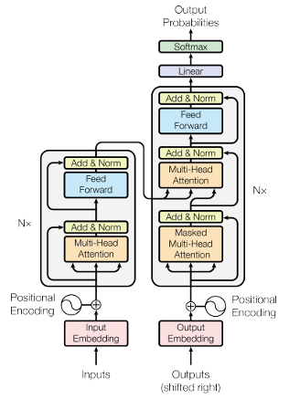
Base Transformer Architecture:
Notes:
The encoder extracts important features from the input sequence and encode them
The decoder generates an output sequence based on the encoded information
Each layer is composed of two sublayers:
- Self-attention mechanism (A transformer model can “attend” or “focus” on all previous tokens that have been generated)
- Position-wise, fully connected, feed-forward network (regular NN)
Additional techniques are used to enhance performance and to train very deep networks (Add & Norm section):
- Residual connections:
- Layer normalization
Core components is the attention mechanism
- Allows the model to weigh the importance of different parts of the input
- Captures global context
- Learns intricate relationships between words or elements in the sequence
- Enables parallelization

Slide 7
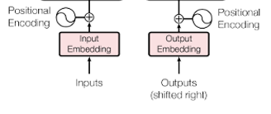
Input/Output Embeddings:
Word embedding layer:
Neural networks learn through numbers
Layer resembles a lookup table
Associates learned vector representation for each word/short sentences
Different models will use different embedding

Slide 8
Positional Encoding:
Provide positional information for the word within the sequence
Original model used sine and cosine to determine the position of the word in the sequence

Slide 9
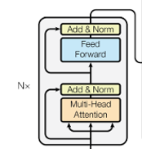
Encoder Layer:
Maps all input sequences into abstract continuous representation
Holds the learned information for the entire sequences
Multi-Head Attention: Associates each word in the input to other words
Feed Forward: Regular NN

Slide 10
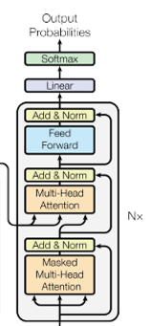
Decoder Layer:
Set to generate text sequences
Masked multi-head attention: prevent “cheating”/look forward
Some of the sub-layers mimic the encoder’s
Capped off with a linear layer that acts as a classifier
Uses a SoftMax function to get the word probability

Slide 11
Use Cases:
Transformers are good for:
Machine translations
Question answering
Sentiment analysis
Text classification
Language generation

Slide 12
What Problems Does It Solve?
Handle larger sequences
Improve Natural Language Processing models over RNNs:
Cannot capture long-term dependencies in sequence
Process input sequence sequentially (forward and backward passes)
Can only handle unidirectional contact
Update their hidden states at each step
Notes:
Cannot capture long-term dependencies in sequences:
Vanishing and exploding gradients (influence of past inputs diminishes/amplifies exponentially as the sequence unfolds)
Struggle to effectively model long-range dependencies
The sequential processing happens both during the forward and backward passes of training
Limit their efficiency on modern hardware architectures like GPUs
Hinders parallelism
Slows down training
Can only handle unidirectional contact:
Handle sequences left-to-right: Limits access to future information (crucial for some NLP tasks)
Update their hidden states at each step:
Based on the current input and the previous hidden state

Slide 13
How Does It Solve These Problems?
Self-attention mechanism:
Global context
Bidirectional context (past and future elements)
Process all elements of the sequence simultaneously
Improved training performance
Notes:
Capture global context and explicitly attend to relevant parts of the sequence
-> can model long-term dependencies
Capture bidirectional context by attending to both past and future elements of the sequence simultaneously
-> more comprehensive understanding of the data
Can process all elements of the sequence simultaneously
-> highly parallelizable and more computationally efficient
Improves training performance
-> parallel processing happening during the forward and backward passes

Slide 14
When Does It Not Make Sense
Simple or low-dimensional data
Limited training data
Real-time or low-latency application
Situations where explainability is important
Resource-constrained environments
Notes:
Simple or low-dimensional data:
Numerical data with few features (Decision trees, regression)
Basic image classification (CNNs)
Limited training data:
Transformers require a large amount of training data to perform well
Real-time or low-latency applications:
Transformers need a lot of time and processing to train, esp. for large models or tasks with long sequences
Situations where explainability is important
Transformers are highly complex models with many parameters, making them difficult to interpret/explain.
Resource-constrained environments
Transformers require systems high in memory and processing capabilities

