Slide 1
Reticulate
Combining Python & R

Slide 2
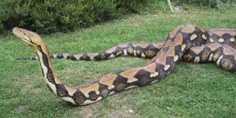
Reticulate
Type of python from Asia
Very large & camouflaged skin
Camouflage Python in R
Interoperability between Python & R

Slide 3
Why Choose?
R
Python
Statistical Modeling
Visualizations
User Interface Environment
16,000+ packages
Machine Learning
Computational Power
Web development
Automated Testing
Object Oriented Programming

Slide 4
Reticulate
Use Python code within R
Scripts
Modules
Objects
Functions
Convert Objects

Slide 5
Setup

Slide 6


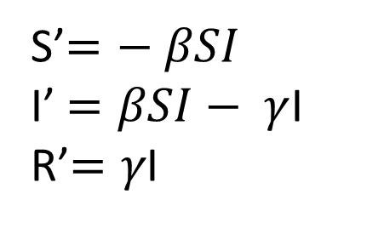
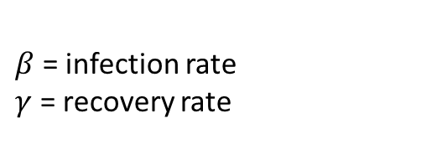
SIR Modeling
$$β$$
$$γ$$
Susceptible
Infectious
Recovered
S’$=− βSI$
I’$=βSI− γ$I
R’$=γ\text{I}$
$β$ = infection rate
$γ$ = recovery rate

Slide 7

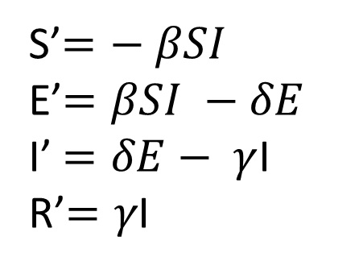
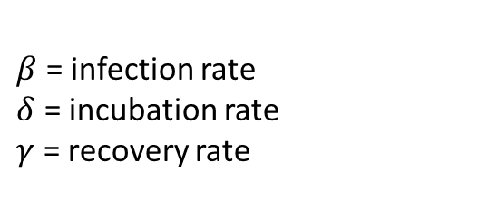

SEIR Modeling
$$β$$
$$δ$$
$$γ$$
Susceptible
Exposed
Infectious
Recovered
S’$=− βSI$
E’$=βSI −δE$
I’$=δE− γ$I
R’$=γ\text{I}$
$β$ = infection rate
$δ$ = incubation rate
$γ$ = recovery rate

Slide 8



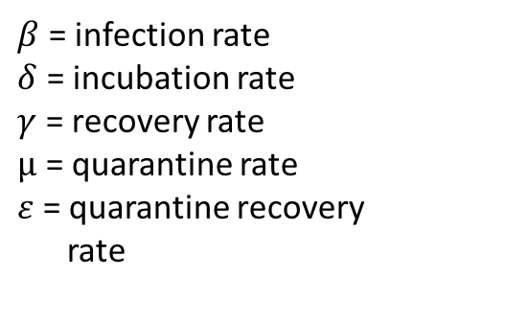
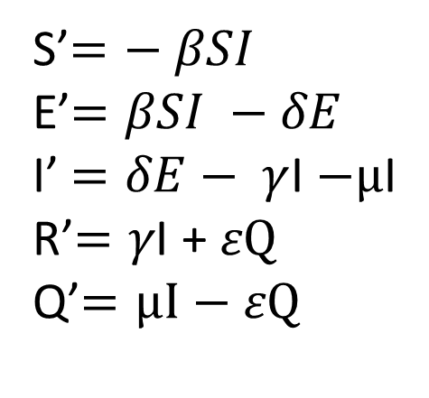
SEIRQ Modeling
$$ε$$
Quarantined
$$β$$
Susceptible
Exposed
μ
Recovered
$$δ$$
$$γ$$
S’$=− βSI$
E’$=βSI −δE$
I’$=δE− γ$I $−μ$I
R’$=γ\text{I}$ + 𝜀Q
Q’$=μI−\text{ε}\text{Q}$
Infectious
$β$ = infection rate
$δ$ = incubation rate
$γ$ = recovery rate
$μ$ = quarantine rate
$ε$ = quarantine recovery
rate

Slide 9
Questions

