Slide 1
Component diagram
Encryption
DataAccess
Feature Layers
Security
<<Infrastructure>>
UtahWells
<<UI>>
FeatureLayers
AccessControl
DataAccess
Base Map
Persistence
<<Infrastructure>>
UtahWellsDB
<<Database>>
BaseMap
Persistence
DataBase

Slide 2
Deployment diagram
<<device>>
Windows PC/server
<<device>>
Workstation
<<execution environment>>
GUI in Web browser
<<device>>
Database server
<<device>>
Document server
<<execution environment>>
RDBMS
Document Management System
Feature layers
<<device>>
Base map server
Base map with coordinates

Slide 3
User interface
Index
Layout
App
LayerControl
Basemap
MapService
useMap
SpatialData
GeojsonData

Slide 4
UtahWellsDB
featureData: .csv/.Geojson
fetchData(): void + getData(): fData
MainMenu
DB: UtahWellsDB BaseMap: Base map library
loadBaseMap(): void changeBaseMap():void chooseLocation(): void transData(fData): fLayer selectFeatureLayer(): void findData(selectFeature): fData popupData(): fData compareData(fData, fData): void outputData(): fData
1
queries
1
1
retrieves
0..*
featureData
API: Long WellName: String Latitude: Float Longitude: Float …
1
1
queries
Base map library
baseMap: base map
+ getBaseMap(): baseMap
fData: featureData
fLayer: featureLayer

Slide 5
CO2 Transport Data
CO2 Transport
CO2 Source Data
Structural Data
Connect
CO2 Source
CO2 Storage
Display
Seismic Data
Seismic Data
Borehole Data
Borehole Data
Petrophysical Data
Petrophysical Data
Property
Map
Entity
Spatial Data
Relationship

Slide 6
UtahWells Data
2.1 Well name and API
WellName | API | Location | Elevation | TotalDepth | GR | TD | KB
MapID
Latitude | Longitude | Township | Range | Section | UTM
WellType | WellStatues
Operator | Field | County
WellReports | Drilling | Permits
2.2 Formation top depths, thickness
WellName | API
Formation top depths | Thickness | NetSand | NetPay | Extent
2.3 Production and injection volumes
WellName | API
ProductionVolume | InjectionVolume
2.4 Fluid Chemistry
WellName | API
FluidChemistry
2.5 Groundwater Data
WellName | API
Depths | ExtentOfUSDWs | Salinity | TDS | Chemistry

Slide 7
Basin Data
BasinName | BasinExtent | FieldName | FieldExtents
BasinName | BasinExtent | FaultMaps
MapID
BasinName | BasinExtent | GeologyMaps
MapID
BasinName | BasinExtent | StratigraphicColumns
BasinName | BasinExtent | IsopachMaps
MapID
BasinName | BasinExtent | DEMs
BasinName | BasinExtent
WellName | API
Primary Key
Foreign Key
Properties

Slide 8
Petrophysical Data
Will a well have more than one Core data or logs?
3.1 Core data
WellName | API | Porosity | Permeability | Lithology | Cementation
Geomechanics | USC | Brazilian | TriComStr
3.2 Logs
WellName | API
Porosity | Permeability | GR | NPHI | Sonic | Density(RHOB) | Caliper
Pressure(DTS) | Temperature | Lithology | Cements

Slide 9
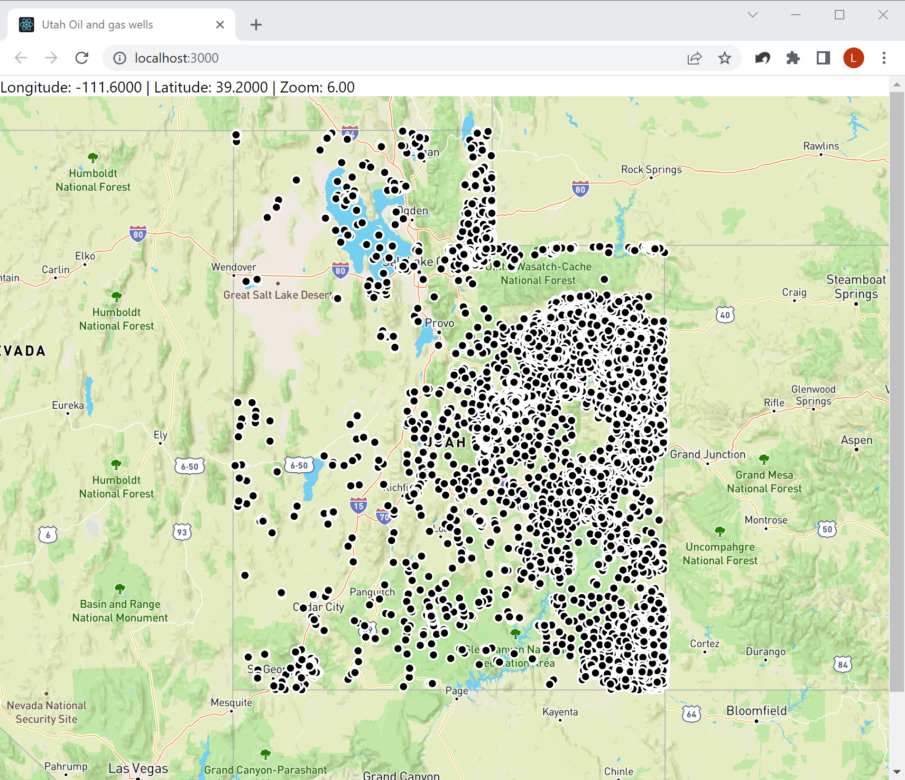

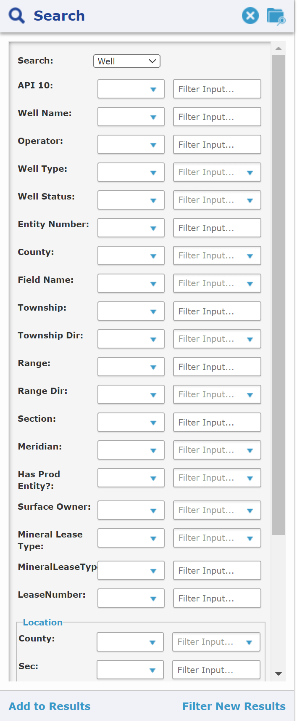
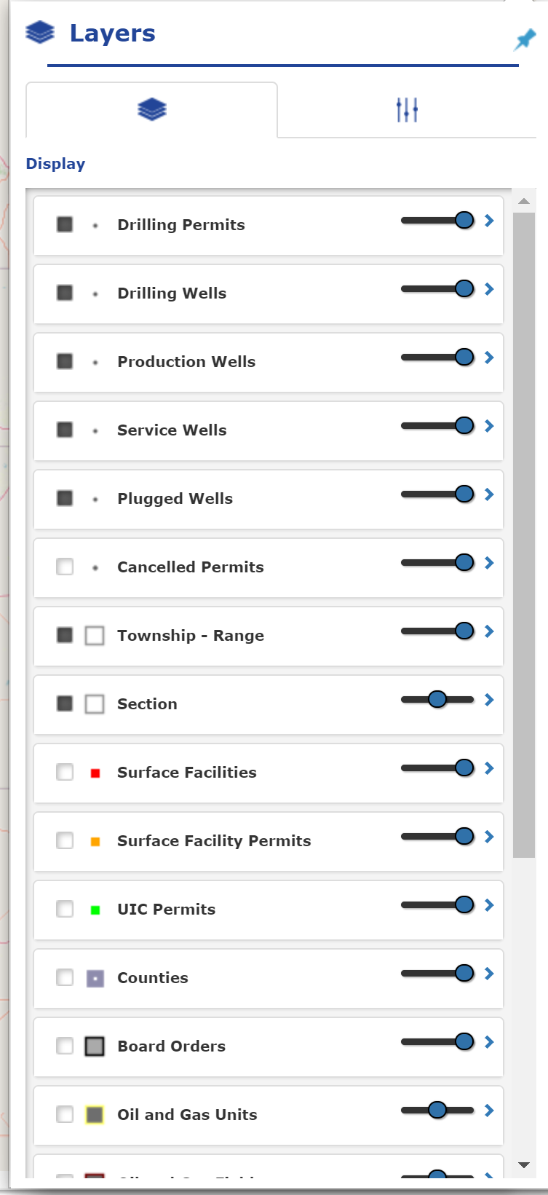
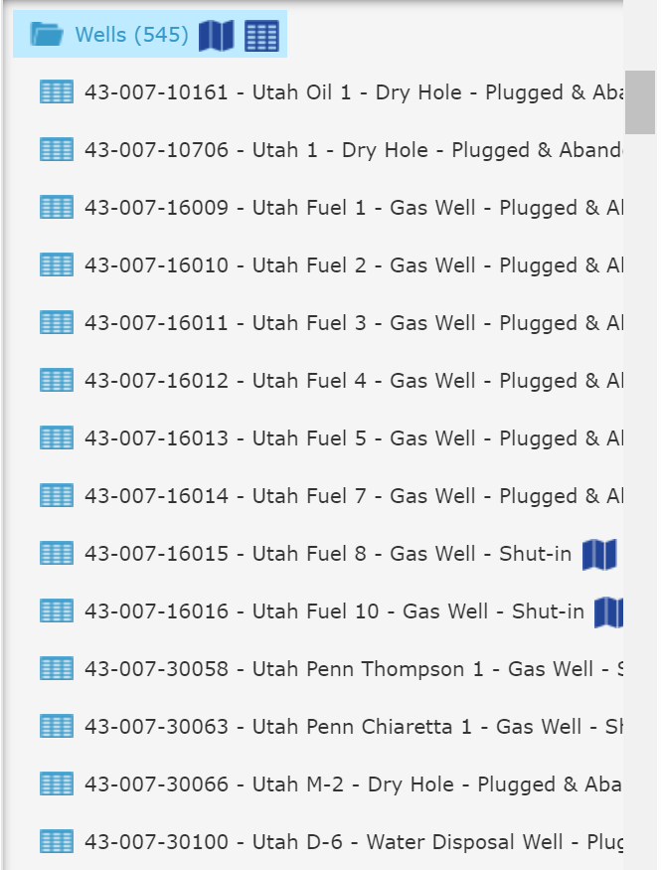
User interface design
Title
URL
Base map
Location information
Tool bar
API: | 43-013-33360
Well Name: | Ute Tribal 10-26D-55
Well Type: | Oil Well
Well Status: | Producing
Layer control panel
Search panel
Popup box
Feature layer (in point mode)
Search result

Slide 10
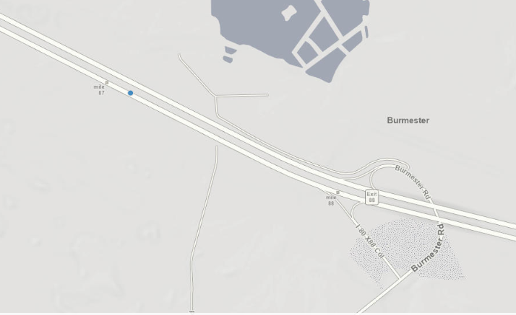
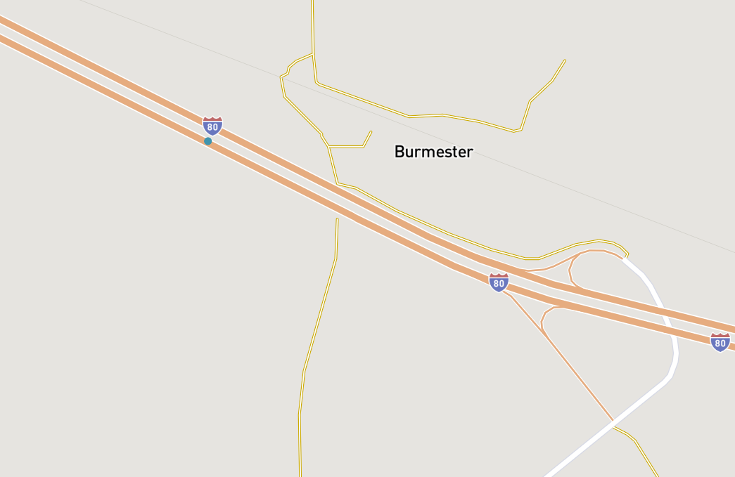
1
2
C
Latitude | ‎40.690932
Longitude | ‎-112.463301
A
B
Latitude | ‎40.690932
Longitude | ‎-112.463301
Latitude | ‎40.690587
Longitude | ‎-112.4778811

