Slide 1
Welcome to
Learning about Recursion
Presented by
sldeskins

Slide 2
Outline
What is Recursion
    Definition of Recursion
    Discussion and an Example
Coding Exercise
    Palindrome string test using recursion
Question and Answers
Resources and References

Slide 3
What is Recursion?
Definitions
Definition of recursion Merriam-Webster
1
: return 1
2
: the determination of a succession of elements (as numbers or functions) by operation on one or more preceding elements according to a rule or formula involving a finite number of steps
3
: a computer programming technique involving the use of a procedure, subroutine, function, or algorithm that calls itself one or more times until a specified condition is met at which time the rest of each repetition is processed from the last one called to the first — compare iteration

Slide 4
What is Recursion?
Definitions
In mathematics and computer science, a class of objects or methods exhibit recursive behavior when they can be defined by two properties:
1) A simple base case (or cases)—a terminating scenario that does not use recursion to produce an answer
2) A set of rules that reduce all other cases toward the base case

Slide 5
Example
The Fibonacci sequence is a classic example of recursion:
Fib(0)=0 as base case 1,
Fib(1)=1 as base case 2,
For all integers n>1, Fib(n):=Fib(n-1) +Fib(n-2).

Slide 6
Walking Through the Example
n = 4
Fib(4) := Fib(4-1)+Fib(4-2)
Fib(4) := Fib(3)+Fib(2)
For all integers n>1
Fib(n):=Fib(n-1) +Fib(n-2)
Fib(3):=Fib(2)+Fib(1)
Fib(2):=Fib(1)+Fib(0)
Fib(1):=1
Fib(0):=0

Slide 7
Walking Through the Example
n = 4
Fib(4) := Fib(4-1)+Fib(4-2)
Fib(4) := Fib(3)+Fib(2)
= 2+1
For all integers n>1
Fib(n):=Fib(n-1) +Fib(n-2)
Fib(3):=1+1
Fib(2):=1+0
Fib(1):=1
Fib(0):=0

Slide 8
Fib(0)-Fib(7)
int[] fibarray = new int[] { 0, 1, 1, 2, 3, 5, 8, 13 };
foreach (int element in fibarray)
{
System.Console.WriteLine(element);
}
System.Console.WriteLine();

Slide 9
Hands on Coding
https://dotnetfiddle.net/
- Language: C#
- Project type: Console
- Compiler: 4.5

Slide 10
using System;
public class Program
{
public static void Main()
{
for (int i =0;i<6; i++){
Console.WriteLine(string.Format("n is {0} and the value is {1}", i, Fib(i)));
};
}
public static int Fib(int n)
{
if (n == 0){
return 0;
}
else if(n==1){
return 1;
}
else{
return Fib(n-1)+Fib(n-2);
}
}
}

Slide 11
Check in
Palindrome (time enough)?
redivider, noon, civic, radar, level, rotor, kayak, reviver, racecar, redder, madam, and refer
Factorial
Stepping through the code in Visual Studio

Slide 12
On Your Own
Factorial
n>0, Fct(n):= n * Fct(n-1)
n=0, Fct(0)=1

Slide 13
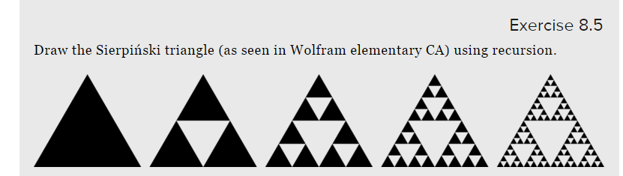
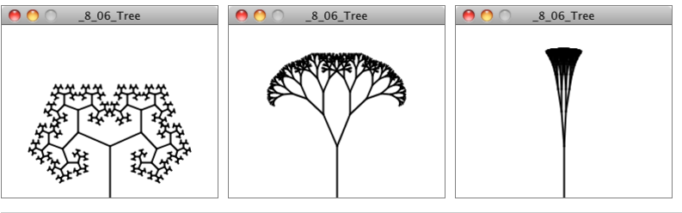
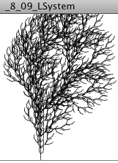
Comments / Asides
Fractals
http://natureofcode.com/book/chapter-8-fractals/

Slide 14
Resources and References
https://en.wikipedia.org/wiki/Recursion
Structure and Interpretation of Computer Programs by Harold Abelson and Gerald Jay Sussman (https://mitpress.mit.edu/sicp/full-text/book/book-Z-H-38.html#%_index_start)

