Slide 1
Text Analytics Lecture 12: Multilinguality and Cross-Lingual Transfer
Prof. Dr. Goran Glavaš

Slide 2
Learning outcomes
After today’s lecture, you’ll...
Understand what is multilingual NLP and why we need it
Know the mechanisms for inducing multilingual representations spaces
Cross-lingual word embeddings (CLWEs)
Massively multilingual transformers (MMTs)
Understand how to use multilingual representations spaces for CL transfer

Slide 3
Outline
Why Multilingual NLP?
Cross-lingual word embeddings
Multilingual transformers
Notes:
Sworn testimony is evidence given by a witness who has made a commitment to tell the truth. If the witness is later found to have lied whilst bound by the commitment, they can often be charged with the crime of perjury.
The commitment can come in different forms depending on the situation of the witness.
Oath: A commitment made to the witness's deity, or on their holy book.

Slide 4

Why Multilingual NLP?
Because we want to understand and model the meaning of texts in...
[Image from: epthinktank.eu]
...without manual (i.e., human) input and without perfect MT!
How many different languages are there in the world?
How many have more than 10M speakers?

Slide 5
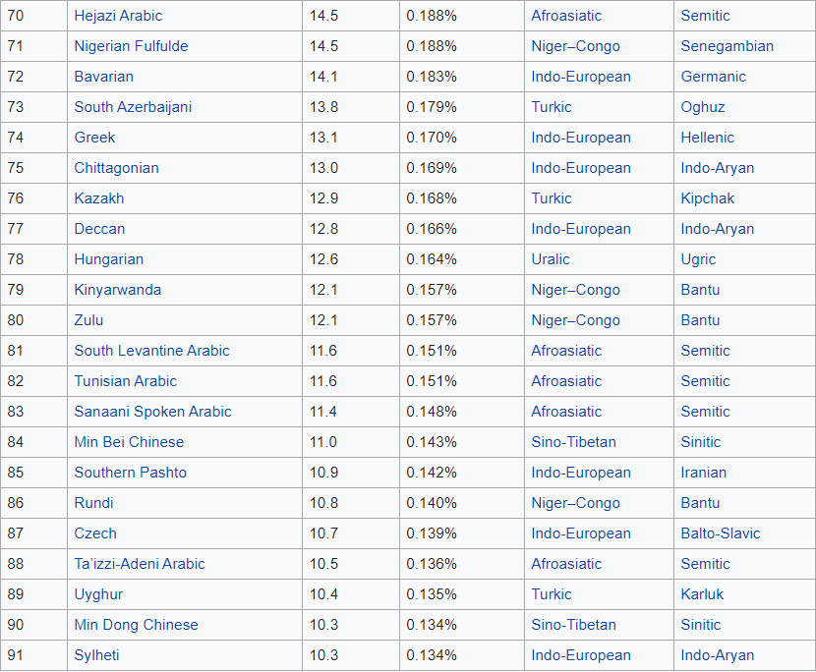
Why Multilingual NLP?
According to Ethnologue (2020) there are 7,117 living languages

Slide 6
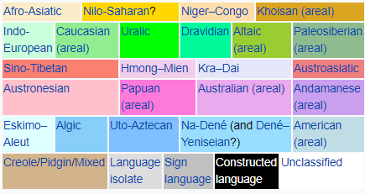
Language variety
Language family: group of languages that originate from the same ancestral/parental language (proto-language)
[Image from: Wikipedia]
Language isolates: no known/demonstrable genealogical relationship with any other language:
Basque, Korean
Indo-European language isolates: Albanian, Armenian, Greek

Slide 7


Why Cross-Lingual NLP?
Because we want to transfer supervised models for NLP tasks...
Trained on annotated datasets we have in resource-rich languages
Make predictions in resource-lean target languages

Slide 8
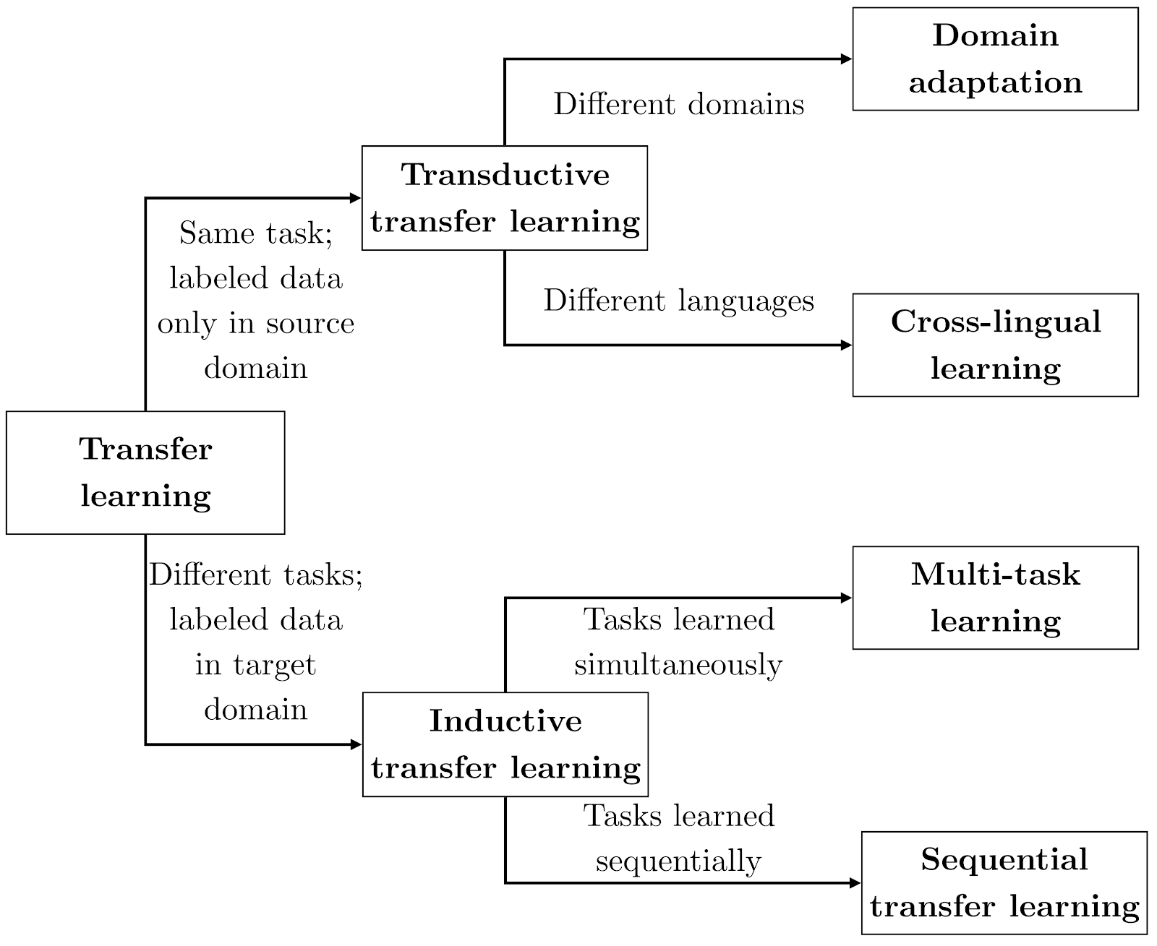
Language Transfer
Image from [Ruder, 2019]

Slide 9

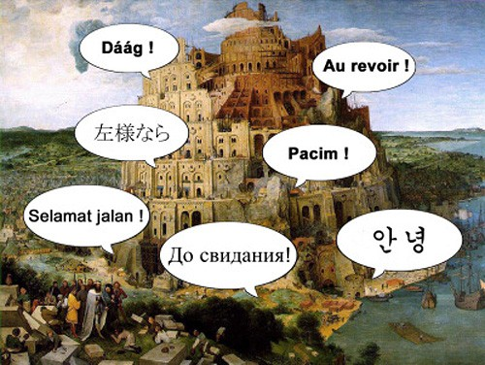
Crossing the Language Chasm
Old paradigm:
Language-specific NLP models
Language-specific feature computation (i.e., preprocessing)
New paradigm(s):
Representation learning: semantic vectors (embeddings)
Multilingual / cross-lingual representation learning

Slide 10


Crossing the Language Chasm: symbolic approaches
Full-Blown MT (SMT or NMT)
Parallel data needed, critical for under-resourced languages
Translate everything from the target language to the source language
Multilingual KBs
Texts represented using entities from a multilingual KB
Same entity ID for same concepts across languages
Issues: coverage, entity linking

Slide 11
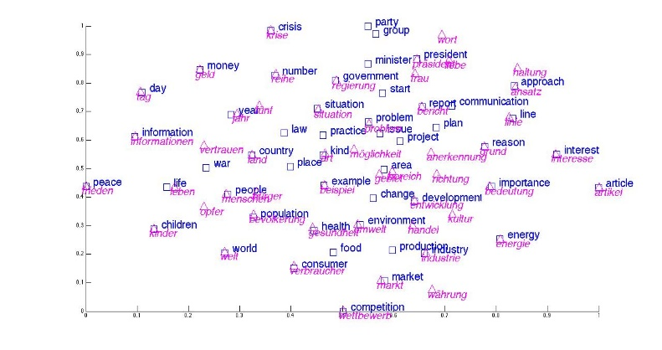
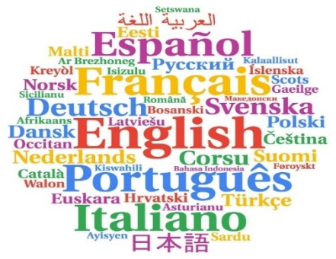

Crossing the Language Chasm: representation learning
Multilingual / Cross-lingual representations of meaning
Word-level
Cross-lingual word embeddings
Words with similar meaning across languages have similar vectors
Text encoding
Multilingual unsupervised pretraining
Multilingual BERT [Devlin et al., ‘19]
XLM(-R) [Conneau & Lample, ’19, Conneau et al., 2020]
mT5 [Xue et al., 2020]

Slide 12
Outline
Why Multilingual NLP?
Cross-lingual word embeddings
Multilingual transformers
Notes:
Sworn testimony is evidence given by a witness who has made a commitment to tell the truth. If the witness is later found to have lied whilst bound by the commitment, they can often be charged with the crime of perjury.
The commitment can come in different forms depending on the situation of the witness.
Oath: A commitment made to the witness's deity, or on their holy book.

Slide 13
Cross-Lingual (Word) Embeddings (CLWE)
Different methodologies but the same end goal:
Induce a semantic vector space in which words with similar meaning end up with similar vectors, regardless of whether they come from the same language or from different languages.

Slide 14
Cross-Lingual (Word) Embeddings (CLWE)
Typology of methods for inducing CLWEs
Type of bilingual / multilingual signal
Document-level, sentence-level, word-level, no signal (i.e., unsupervised)
Comparability
Parallel texts, comparable texts, not comparable (i.e., randomly aligned)
Point (time) of alignment
Joint embedding models vs. Post-hoc alignment
Modality
Text only vs. using images for alignment (e.g., [Kiela et al., ‘15])

Slide 15
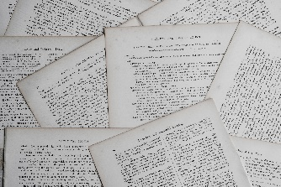
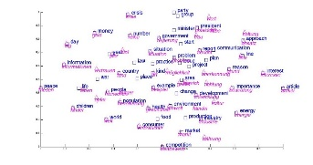
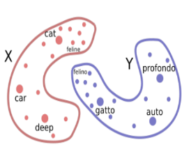
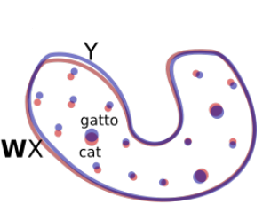
Joint Models vs. Post-hoc alignment
Regardless of the source of supervision, there are two main strategies for inducing a bilingual/multilingual word embedding space:
Joint embedding models
Start from raw texts in two (or more) languages
Induce a bilingual (multilingual) space from scratch
Post-hoc alignment models (aka projection models)
Start from two independently pretrained monolingual embedding spaces
E.g., We apply word2vec on EN Wikipedia; then (independently) on ES Wikipedia
Learn the alignment/projection between the two monolingual spaces
Texts

Slide 16
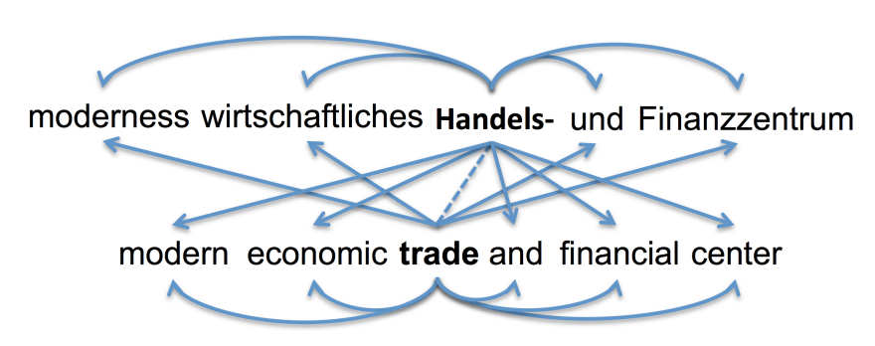
Joint CLWE induction
A number of models
Example: Bilingual Skip-Gram
Luong, M. T., Pham, H., & Manning, C. D. (2015, June). Bilingual word representations with monolingual quality in mind. In Proceedings
of the 1st Workshop on Vector Space Modeling for Natural Language Processing (pp. 151-159).
Skip-Gram extended with cross-lingual context prediction
Parallel data (mutual sentence translations) needed!
Automatic word alignment

Slide 17
Joint CLWE alignment
Some shortcomings
Expensive model training for every pair of languages
Bilingual models – not multilingual models
Bilingual models not comparable, e.g., EN-DE vs. EN-ES
Parallel sentences not so easily obtainable for all language pairs
Although there are extensions of Bilingual Skip-Gram that require only word-level supervision (i.e., word translations)
More elegant and less-resource demanding solution:
Train monolingual vectors independently
Light-weight post-hoc alignment between those spaces?
Easy to induce truly multilingual spaces through post-hoc projections
Projection-based CLWE models

Slide 18

Post-hoc embedding alignment
Monolingual embeddings independently trained
Can be trained even with different embedding algorithms, e.g., GloVe vs. SkipGram
Post-hoc aligning monolingual spaces
X is dist. space of L1, Y of L2
In general, we are looking for functions f and g that produce a meaningful bilingual embedding space f(X) ∪ g(Y)
Image from [Conneau et al., ‘18]

Slide 19
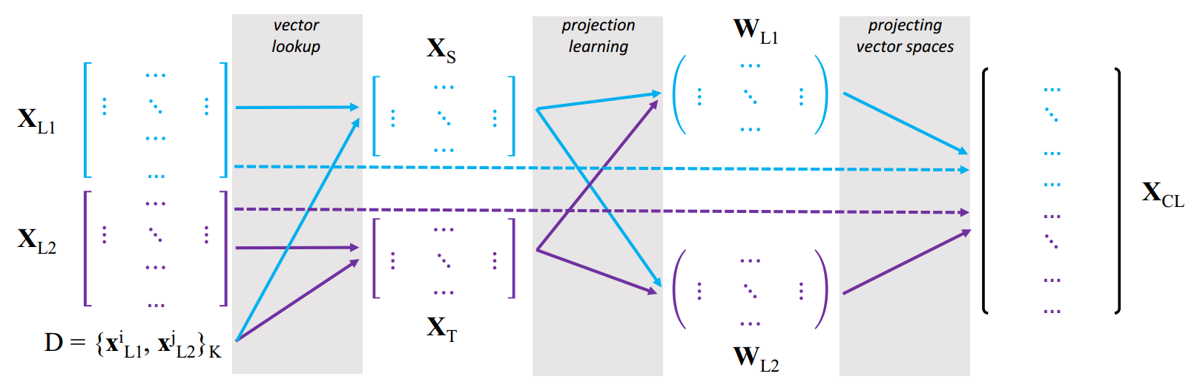
Projection-Based CLWE
Post-hoc alignment of independently trained monolingual distributional word vector spaces
Alignment based on word translation pairs (dictionary D)
Supervised models use pre-obtained D, unsupervised automatically induce D
Image from [Glavaš et al., ACL ‘20]

Slide 20
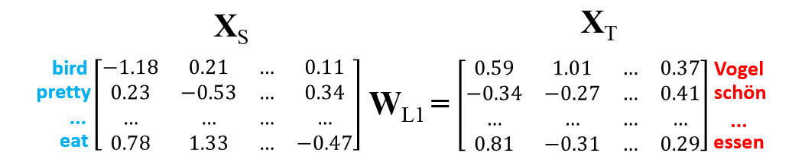
Projection-Based CLWE
Most models learn a single projection matrix W_{L1} (i.e., W_{L2} = I)
How do we find the „optimal” projection matrix W_{L1}?
We minimize the mean square distance

Slide 21
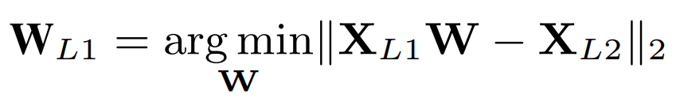
Minimizing Euclidean Distance
Minimize the Euclidean distances for translation pairs after projection
The optimization problem has no closed-form solution
SGD-based iterative optimization
More complex mapping – DFFN instead of linear projection matrix yields worse performance
Better (word translation) results when W_{L1} is constrained to be orthogonal
X_{S}
X_{T}

Slide 22
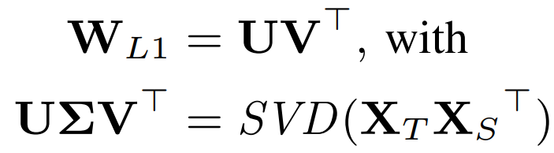
Solving the Procrustes Problem
If W is orthogonal, the above optimization problem is the so-called Procrustes problem with a closed-form solution
All projection-based CLWE models, supervised and unsupervised, solve the Procrustes problem in the final step
Supervised: clean, prepared word-translation dictionary (e.g., 5K entries)
Unsupervised: initial translation dictionary automatically induced
X_{S}
X_{T}

Slide 23
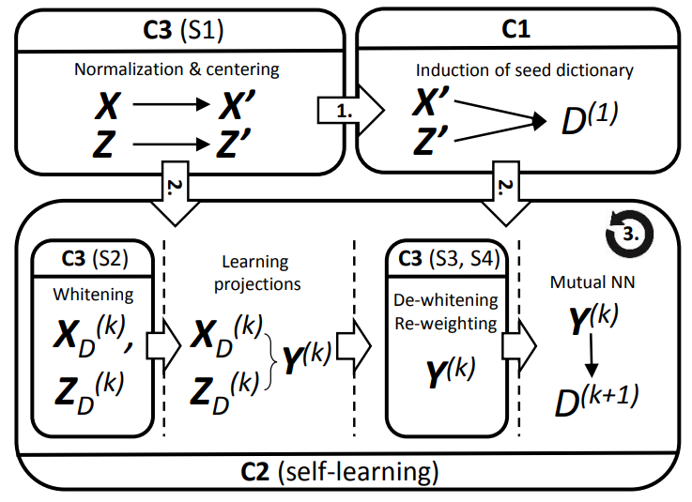
Unsupervised CLWE induction framework
The same general framework for all unsupervised CLWE models
Induce (automatically) initial word alignment dictionary D⁽¹⁾
Repeat:
Learn the projection(s) using D^{(k)}
Induce new dictionary D^{(k+1)} from the shared space Y^{(k)}

Slide 24
Unsupervised CLWE induction
The same general framework for all unsupervised CLWE models
Different approaches for step C1, i.e., inducing the initial dictionary D⁽¹⁾:
Adversarial learning [Conneau et al., ‘18]
Similarities of similarity distributions
[Artetxe et al., 2018]
PCA [Hoshen & Wolf, ‘18]
Solving optimal transport problem [Alvarez-Melis & Jaakkola, ’18]
...
All assume (approximate) isomorphism of monolingual spaces!

Slide 25
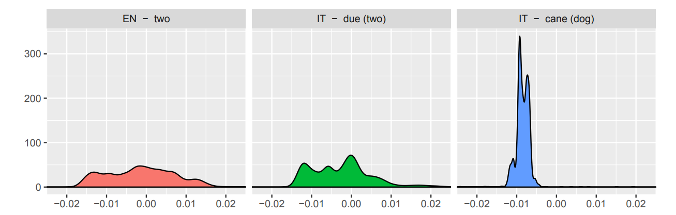
Unsupervised CLWE: Example
VecMap [Artetxe et al., 2018]
Heuristic induction of the initial word translation dictionary D⁽¹⁾
Word with similar meanings will have similar monolingual similarity distributions (i.e., distributions of similarity across all words of the same lang.)

Slide 26
Why Unsupervised CLWE induction?
Original motivation:
Does not require any bilingual/multilingual supervision, thus suitable for under-resourced languages
However...
Assumptions on which the automatic induction of an initial dictionary is based (approximate isomorphism of monolingual spaces) do not hold for
Pairs of etymologically and typologically distant languages
Assumption that we „cannot find” clean word translations for low-resource languages is simply false
PanLex – a lexico-semantic resource covering 9000+ languages and dialects
For all languages some lexical alignment with other langs (for most with EN)
Language „X” – no word translations to any other language
Then you probably don’t have enough digital texts in X to induce reliable monolingual X embeddings in the first place

Slide 27
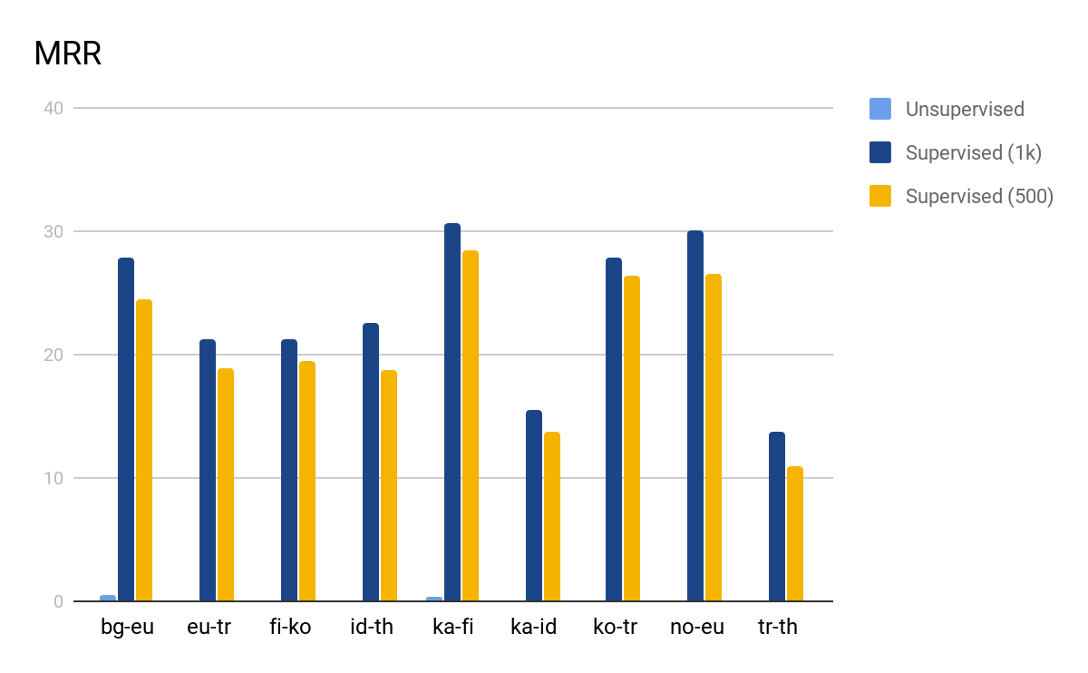
CLWEs – Evaluation
Common evaluation: Bilingual Lexicon Induction (BLI)
Word translation task
Given a translation pair (w_{s}, w_{t}), rank all the words in the target language according to vector similarity with w_{s} and find where w_{t} is in the ranking
Supervised vs. unsupervised CLWEs for low-resource setups
Vulić, I., Glavaš, G., Reichart, R., & Korhonen, A. (2019, November). Do We Really Need Fully Unsupervised Cross-Lingual Embeddings? In Proceedings of the 2019 Conference on Empirical Methods in Natural Language Processing and the 9th International Joint Conference on Natural Language Processing (EMNLP-IJCNLP) (pp. 4398-4409).

Slide 28
Cross-Lingual Transfer with CLWEs
Use CLWEs for cross-lingual transfer of supervised NLP tasks?
Assumption: zero-shot transfer
Only task- annotated data for the source language L_{S}, no annotated data in target language L_{T}
Steps:
Induce the bilingual shared word embedding space X_{TS}
E.g., by projecting the target lang. space X_{S} to the source lang. Space X_{T}
Train the (neural) model using the task-specific data in Ls
E.g., for Named Entity Recognition, train a Bi-LSTM+classifier using embeddings of source language words from the shared space X_{TS} as input
At prediction time, for texts in target language L_{T}, feed as input the embeddings of target language words from the same shared space X_{TS}

Slide 29
Outline
Why Multilingual NLP?
Cross-lingual word embeddings
(Massively) Multilingual transformers
Notes:
Sworn testimony is evidence given by a witness who has made a commitment to tell the truth. If the witness is later found to have lied whilst bound by the commitment, they can often be charged with the crime of perjury.
The commitment can come in different forms depending on the situation of the witness.
Oath: A commitment made to the witness's deity, or on their holy book.

Slide 30
Massively Multilingual Transformers
Deep Transformer nets pretrained on large multilingual corpora via (masked) language modeling objectives
Multilingual BERT, XLM-R, mT5
Automatically induces shared (subword) vocabulary across all languages
Unsupervised from the perspective of explicit cross-lingual signal
Deemed very effective for zero-shot CL transfer
„Suprising cross-lingual effectiveness of BERT”
„mBERT surprisingly good at zero-shot CL model transfer”

Slide 31
Massively Multilingual Transformers
Assumption: after multilingual MLM pretraining mBERT can encode text from any of the languages seen in pretraining
Automatically lends itself to zero-shot language transfer for downstream NLP tasks
mBERT has its own tokenizer that can tokenize input texts from all languages seen in pre-training
Caveat: words from larger languages mostly have their own tokens
Words from smaller languages broken down into subwords
which can be found across languages
Worst case scenario: input broken into characters

Slide 32
Cross-Lingual Transfer with MMTs
Zero-shot language transfer for downstream NLP tasks with mBERT:
Couple the mBERT Transformer with the task-specific classifier („head”)
Train the mBERT+classifier model jointly on source language data
Classifier parameters trained from scratch
mBERT’s Transformer parameters fine-tuned
Predict by feeding the target language text (tokenized with mBERT’s tokenizer) into the fine-tuned mBERT+classifier model

Slide 33
So...has mBERT solved zero-shot CL transfer?
No! Settings in which they were evaluated were simply too favorable
„How multilingual is Multilingual BERT?” [Pires et al., ACL 19]
Tasks: NER, POS; Target languages: DE, NL, ES
„Cross-lingual Ability of mBert: Empirical Study” [Karthikeyan et al., ICLR 20]
Tasks: NER, NLI; Target languages: ES, HI, RU
In most studies, the selected target languages were:
(1) from the same language family,
(2) with large corpora in pretraining

Slide 34
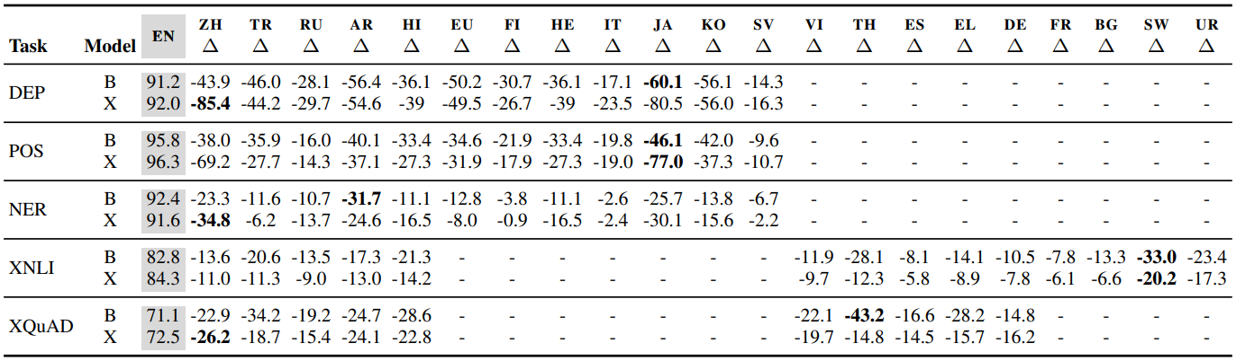
Zero-shot transfer performance drops
Lauscher, A., Ravishankar, V., Vulić, I., & Glavaš, G. (2020). From Zero to Hero: On the Limitations of Zero-Shot Cross-Lingual Transfer with Multilingual Transformers. In Proceedings of the 2020 Conference on Empirical Methods in Natural Language Processing (EMNLP), 4483-4499).
B = mBERT (Base), X = XLM-R (Base)
Drops huge for:
Distant target languages and
Target languages with small pretraining corpora

Slide 35
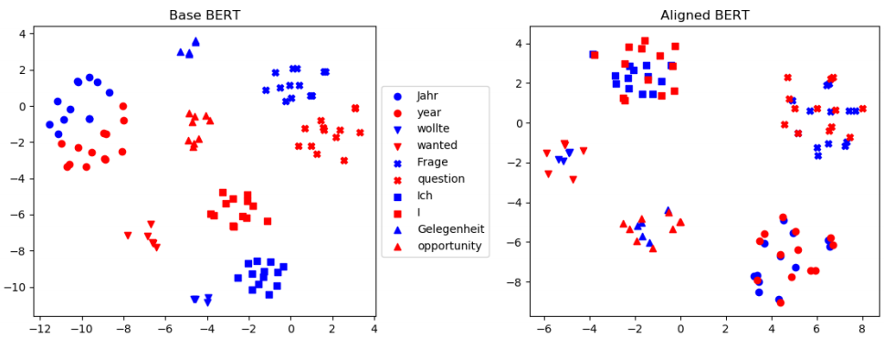
Language-Specific Representation Subspaces
In representation spaces produced by MMTs, one can still relatively easy discern language-specific subspaces
Image from [Cao et al., ‘20]

Slide 36
Better alignment between language subspaces...
...can be achieved with bilingual supervision (word translations of parallel data) [Wu & Conneau, ACL 20; Cao et al., ICLR 20; Hu et al., 2020]
As with CLWEs: some bilingual/multilingual supervision ➔ better bilingual/multilingual representation space
Image from [Cao et al., ‘20]

Slide 37
Choosing a Language Sample for CL Transfer Experiments
Multilingual evaluation benchmarks should assess the expected performance of a model across languages
Sample of languages should be representative – but of what exactly?
Findings can critically depend on the selection of languages
Most studies sample languages with the largest digital footprint
Such languages tend to belong to the same families (e.g., Indo-European)
Expected transfer performance is overestimated!

Slide 38
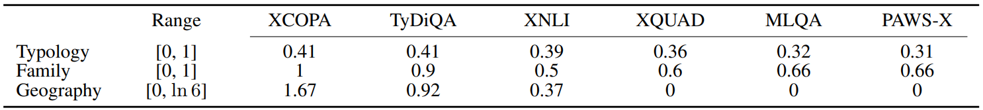
Variety sampling of languages
Ponti, E. M., Glavaš, G., Majewska, O., Liu, Q., Vulić, I., & Korhonen, A. (2020). XCOPA: A Multilingual Dataset for Causal Commonsense Reasoning. In Proceedings of the 2020 Conference on Empirical Methods in Natural Language Processing, pp. 2362-2376.
Idea: selection according to the distribution of linguistic properties
Variety sampling favors the inclusion of outlier languages
Typological diversity: entropy of distribution of linguistic properties
Family index: number of different families / sample size
Geography index: entropy of lang. distr. over 6 geographic macro-areas

Slide 39
Learning outcomes
Now you...
Understand what multilingual NLP is and why we need it
Know the mechanisms for inducing multilingual representations spaces
Cross-lingual word embeddings (CLWEs)
Massively multilingual transformers (MMTs)
Understand how to use multilingual representations spaces for CL transfer

