Slide 1
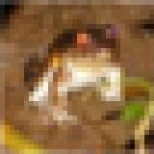
Input: cifar10 frog
with dim 32x32x3
Model heart:
Stacked CNN layers
Output:
MLP layer with Softmax
Airplane
Auto
Bird
Cat
Deer
Dog
Frog
Horse
Ship
Truck

