Slide 2
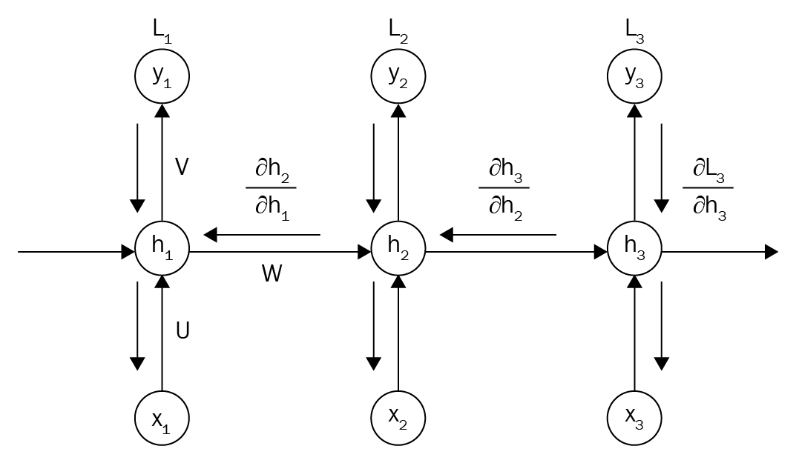
Many values > 1:
exploding gradient
Gradient clipping to
scale big gradient

Slide 3
Many values < 1:
vanishing gradient
1. Activation function
2.Weight initialization
3. Network architecture

