Slide 1
f
f^{[t-1]}
f^{[t]}
f^{[t+1]}

Slide 2
f

Slide 3
f

Slide 4
f
f
Z_{1:3}
z₁
z₂
z₃
X_{1:5}
x₁
x₂
x₃
x₄
x₅

Slide 5
f

Slide 6
f
f^{[t-1]}
f^{[t]}
f^{[t+1]}

Slide 7
y^{[T]}
L^{[T]}
f^{[T]}
z^{[T]}
x^{(...)}
x^{[T]}

Slide 8
f^{[t]}

Slide 9
f
f^{(...)}
f^{[t-1]}
f^{[t]}
f^{[t+1]}

Slide 10
y^{[T]}
L^{[T]}
f^{[T]}
z^{[T]}
x^{(...)}
x^{[T]}

Slide 11
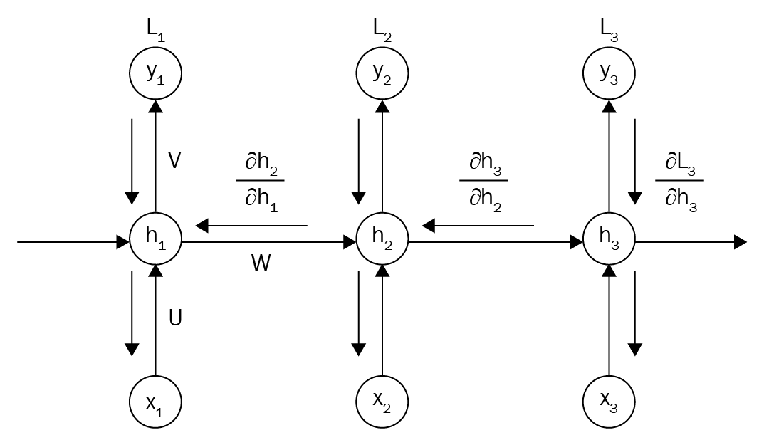
Many values > 1:
exploding gradient
Gradient clipping to
scale big gradient

Slide 12




Many values > 1:
exploding gradient
Gradient clipping to
scale big gradient
f^{[t-1]}
f^{[t]}
f^{[t+1]}

Slide 13
Many values < 1:
vanishing gradient
1. Activation function
2.Weight initialization
3. Network architecture
f^{[t-1]}
f^{[t]}
f^{[t+1]}

Slide 14
Many values < 1:
vanishing gradient
1. Activation function
2.Weight initialization
3. Network architecture

