Slide 1

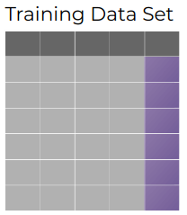

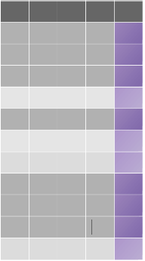
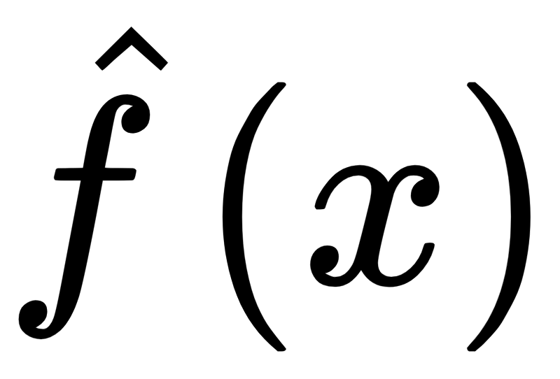


Inducer
Dataset D
Training Dataset
Fit
Model
Split into
Tain and Test
Predict
Test Dataset
Test Error

