Slide 1
Training Data Set
Full Data Set
Split into Train & Test
Test / Holdout Data Set

Slide 2


Data Set D
ML Inducer
Prediction Model
f(x)
A ML algorithm (inducer)
given a data set D
and hyper parameter α
produces a prediction model f(x)
α
Hyperparameter

Slide 3
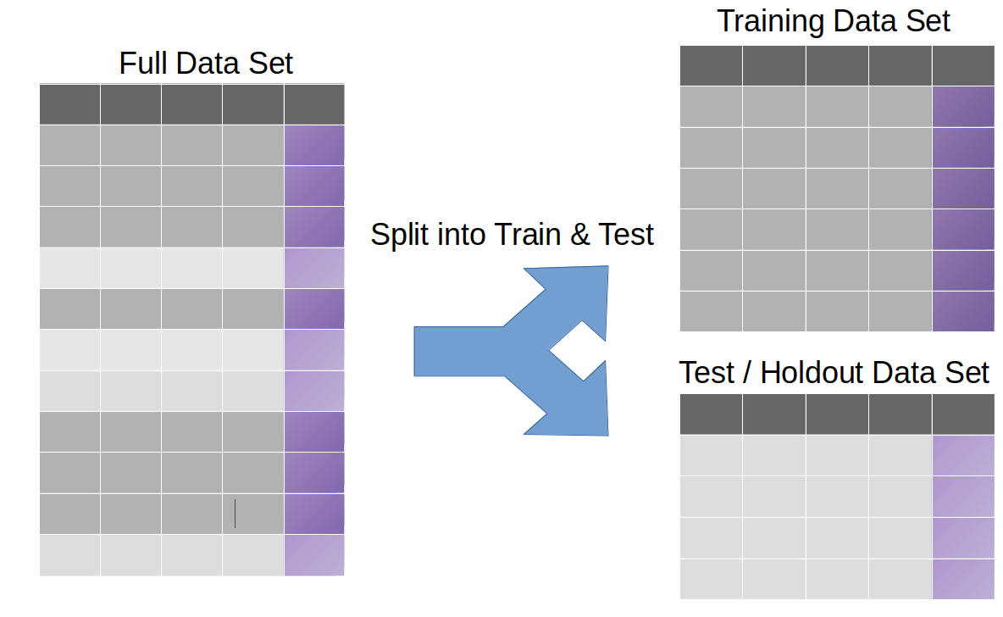
ML Inducer
Fit
Model
f(x)
Test Error
Predict
on test set

Slide 4

Training Data Set
Train model
Predict on train data
Train Error
Prediction Model
f(x)

