Slide 1
Classifier Output
Probability
Brier Score
Area under the Curve
LogLoss
...
Class
Accuracy
Balanced Accuracy
True Positive Rate
F1-Score
...
Probability
Threshold

Slide 2
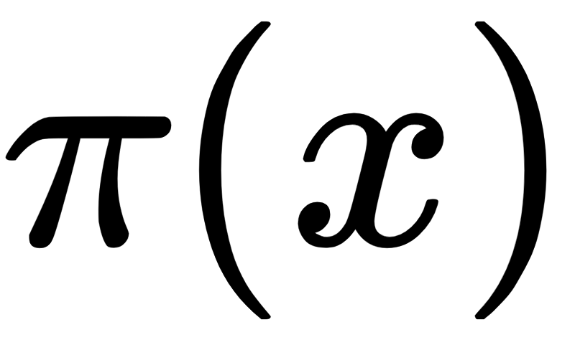
Classifier Output
E.g: = 0.37
E.g: y = “healthy”
Probability
Brier Score
Area under the Curve
LogLoss
...
Class
Accuracy
Balanced Accuracy
True Positive Rate
F1-Score
...
Probability
Threshold
IF < 0.7
=>
y = “healthy”

Slide 3
TRUE VALUE
FRAUD
NO FRAUD
TRUE
POSITIVE
FALSE
POSITIVE
FRAUD
PREDICTED VALUE
FALSE
NEGATIVE
TRUE
NEGATIVE
NO
FRAUD

Slide 4
TRUE VALUE
FRAUD
NO FRAUD
TRUE
POSITIVE
FALSE
POSITIVE
FRAUD
PREDICTED VALUE
FALSE
NEGATIVE
TRUE
NEGATIVE
NO
FRAUD
(TP + TN) /
Total
Accuracy =

Slide 5
TRUE VALUE
FRAUD
NO FRAUD
TRUE
POSITIVE
FALSE
POSITIVE
FRAUD
PREDICTED VALUE
FALSE
NEGATIVE
TRUE
NEGATIVE
NO
FRAUD
Balanced Accuracy =
TP / Positives
TN / Negatives
(TP / P + TN / N) / 2

