Slide 1

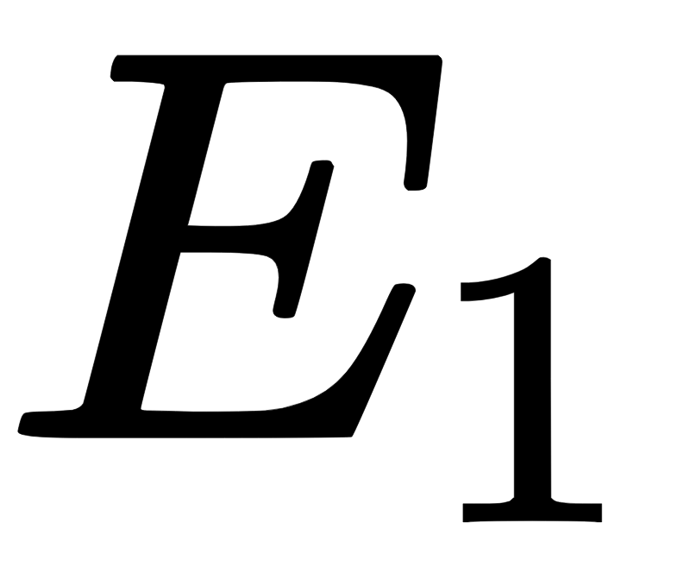
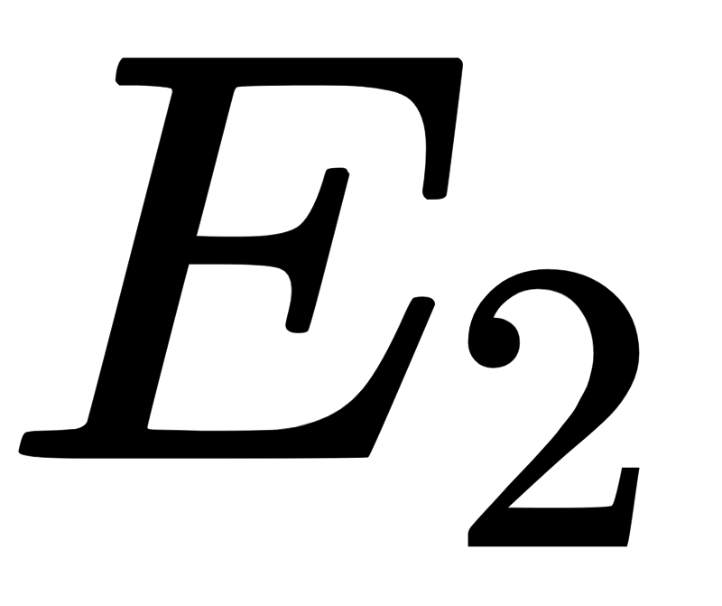
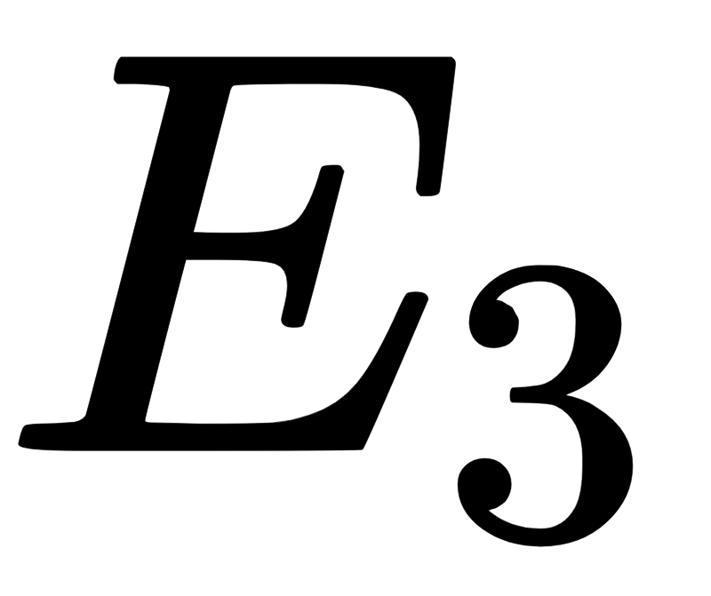
Test Errors
Train
Train
Test
Iter 1:
predict
Trained Model
Test
Train
Train
Iter 2:
Average
predict
Trained Model
Iter 3:
Train
Test
Train
predict
Trained Model

