Slide 1

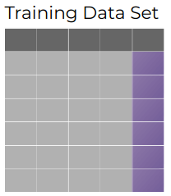

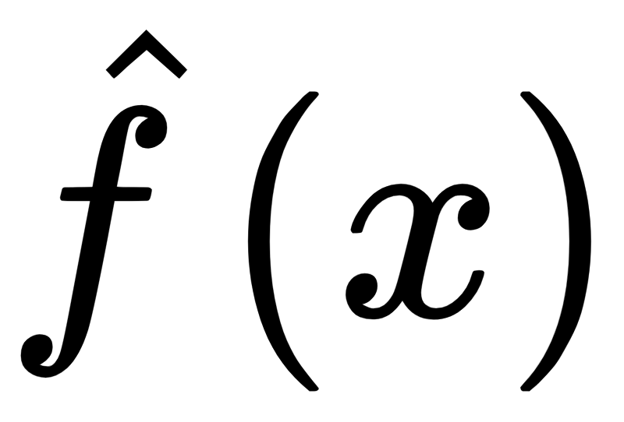

Inducer
Dataset D
Fit
Model
Predict
Dataset D
Train Error

