Slide 1
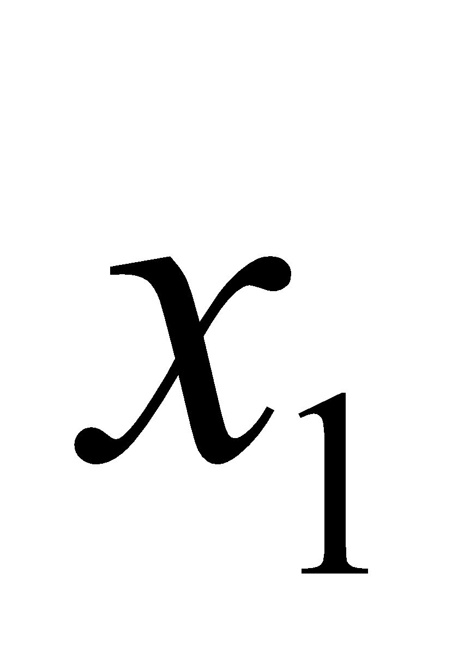
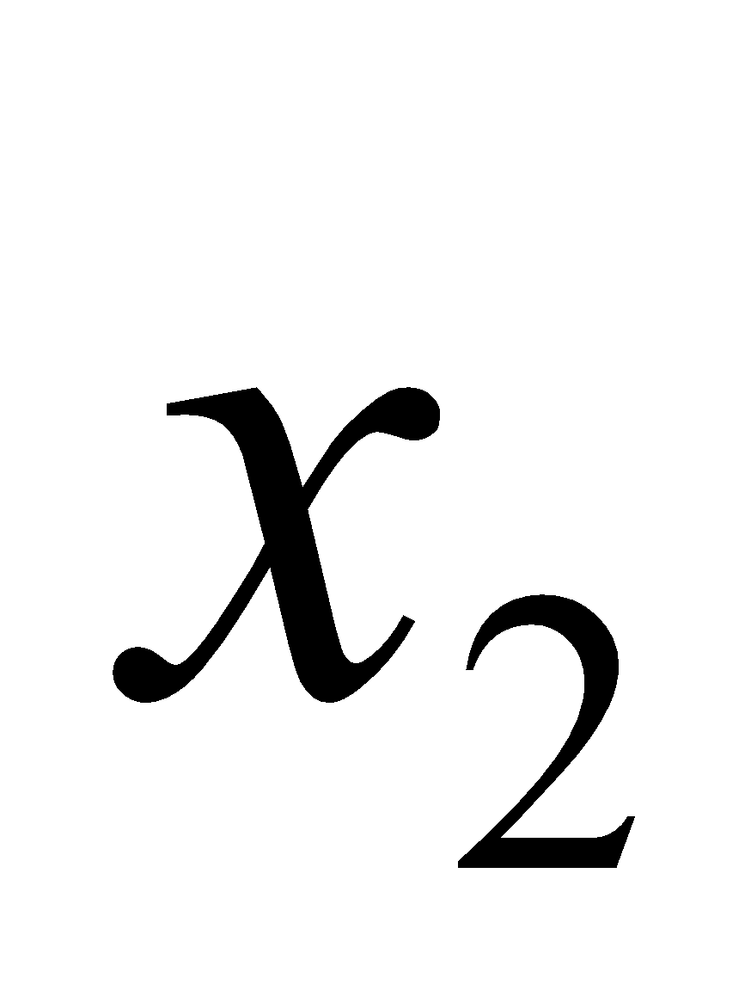

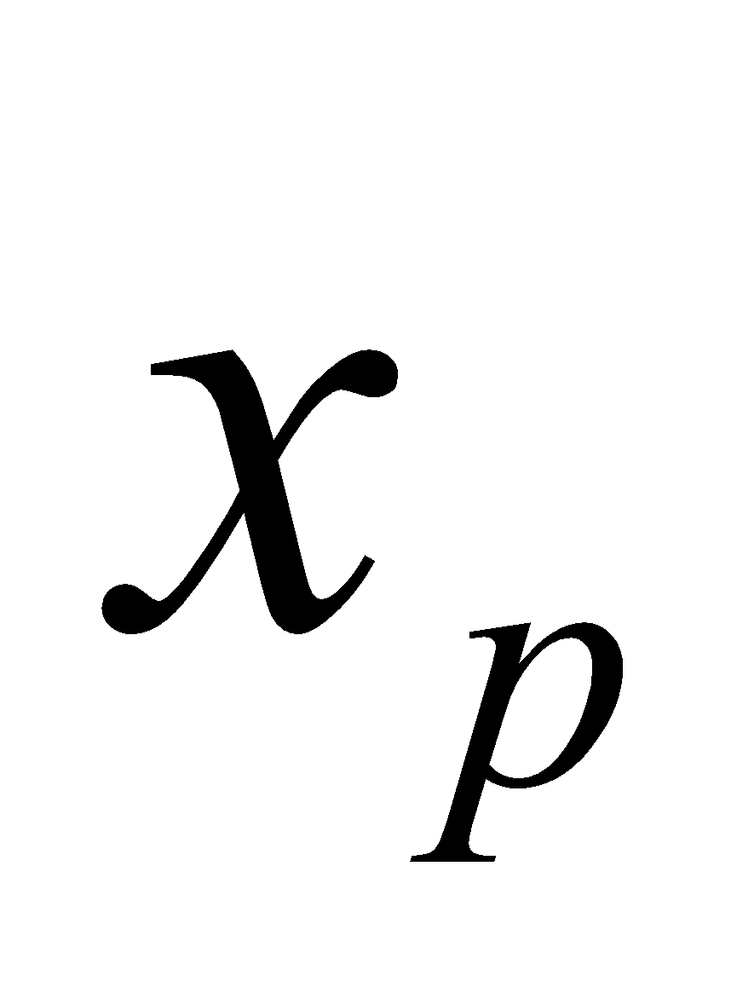


+
$$y∈\left\{0,1\right\}$$
$$∈ \left\{0,1\right\}$$

