Slide 1
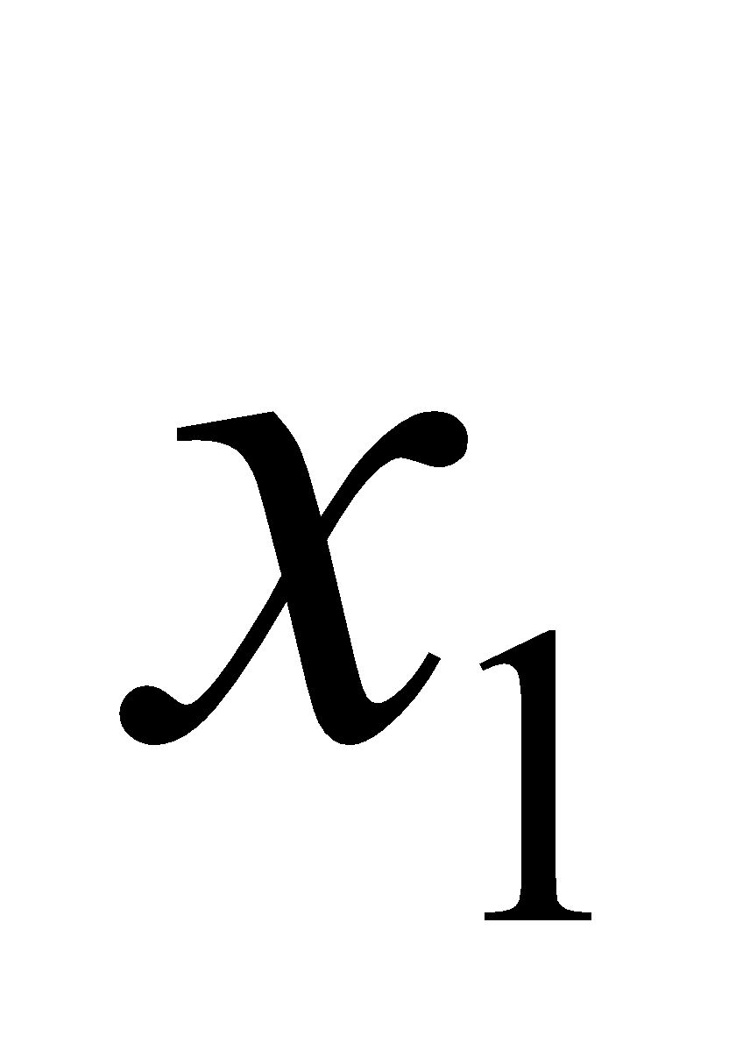
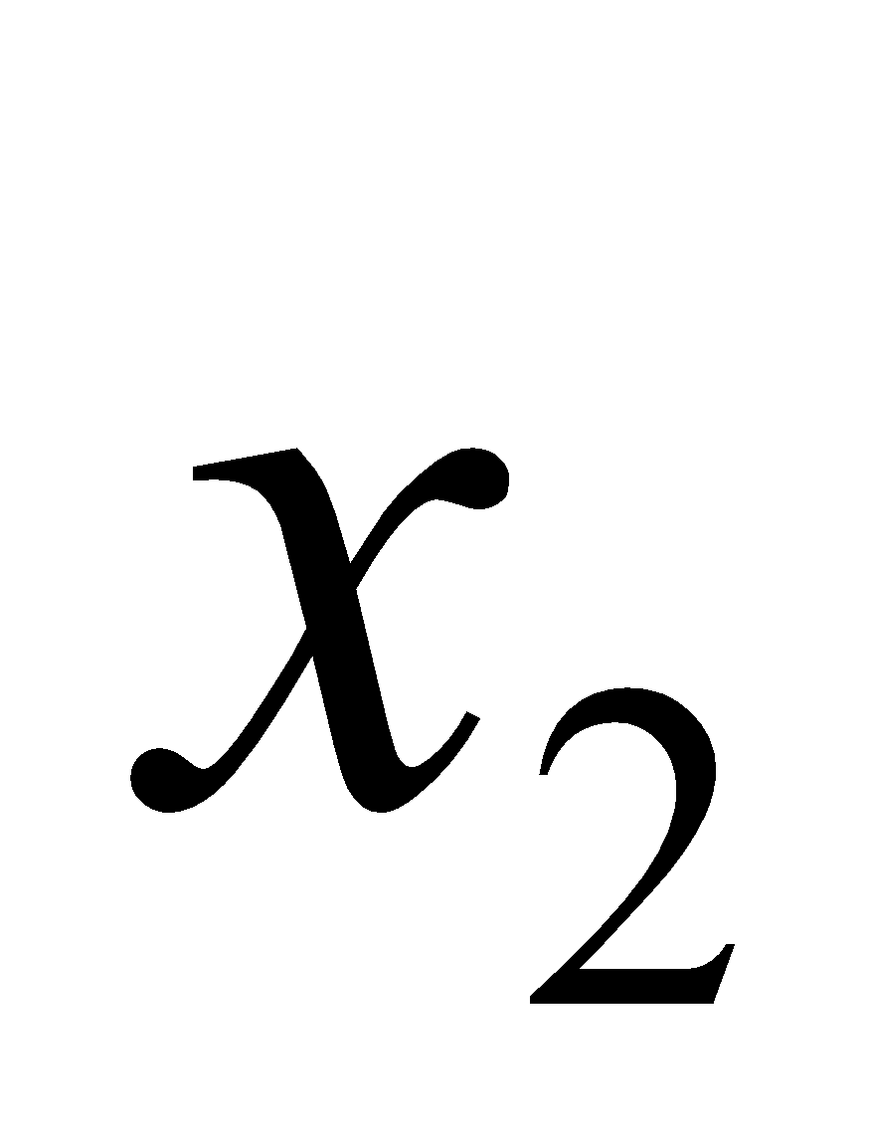

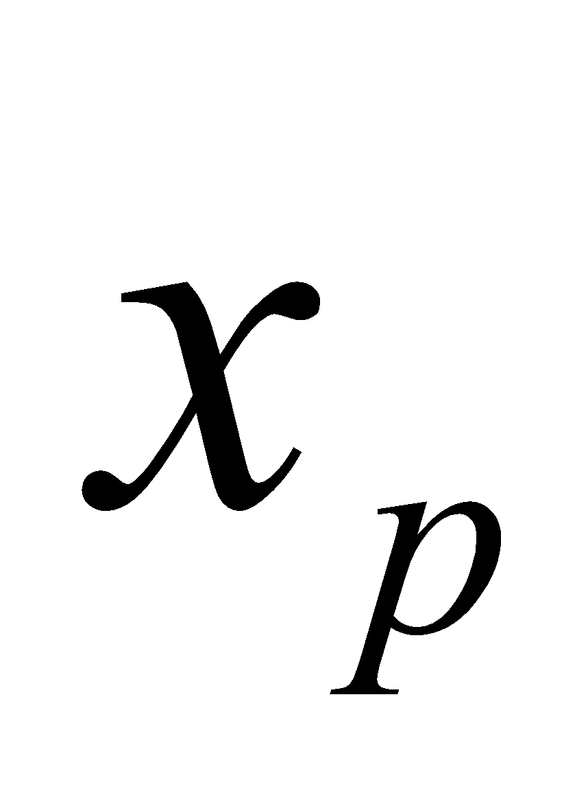




$$w_{1}$$
+
$$y∈\left\{0,1\right\}$$
$$w_{2}$$
$$w_{p}$$

