Slide 1
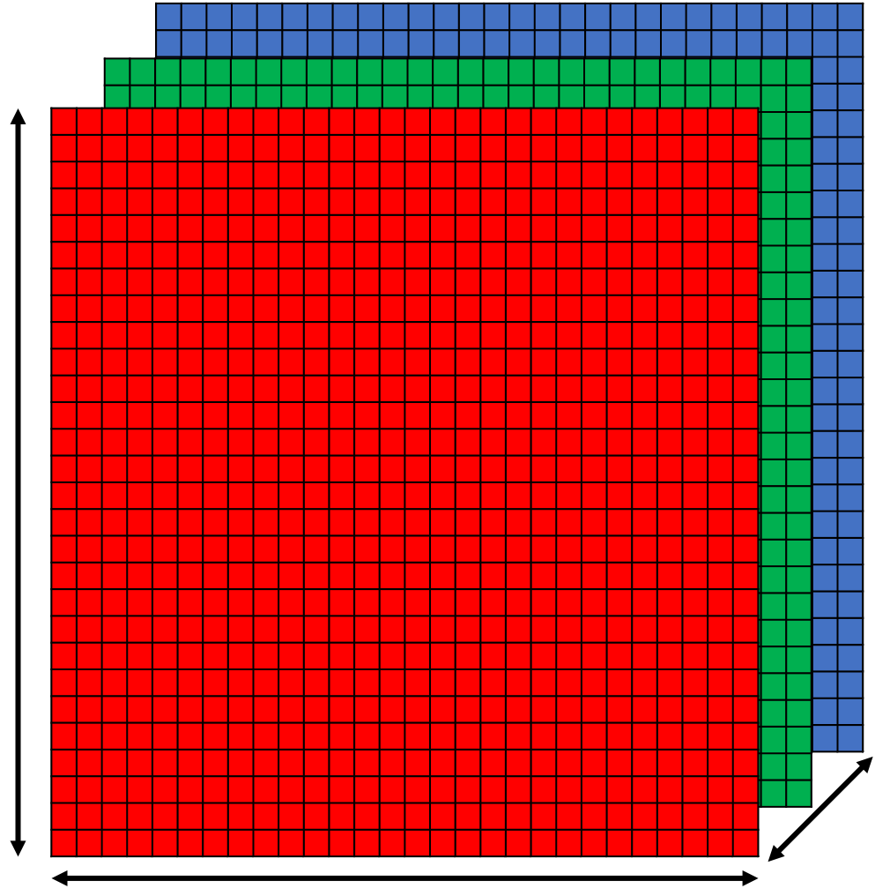
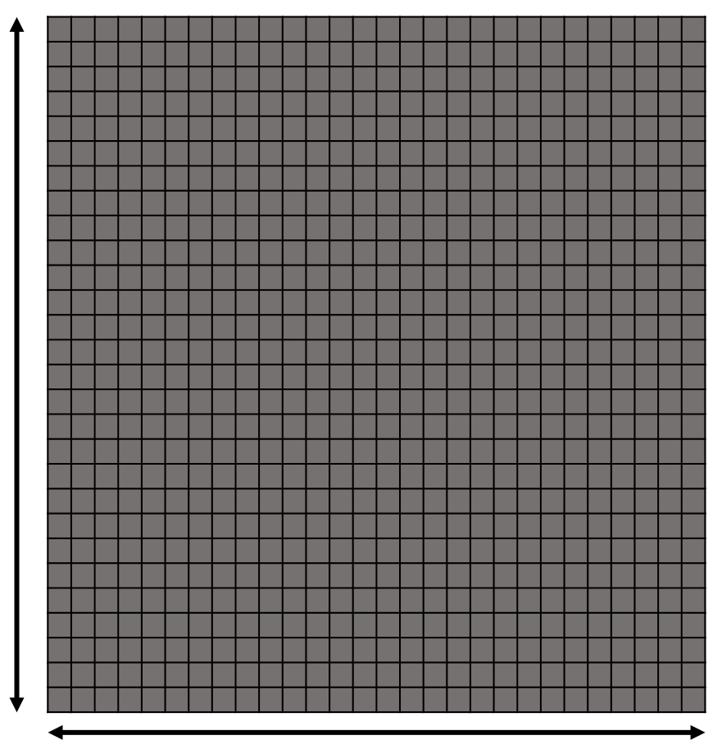


Greyscle (28$×$28$×$1)
RGB (28$×$28$×$3)
28 pixels
28 pixels
3 Channels
28 pixels
28 pixels

