Slide 1
TuitionBridge
Plan it, check it, prove it: an AI agent for cross-border tuition payments
2026 FinTechathon · International Track · Topic C: Cross-border & Student Finance
Team [TEAM NAME] · all execution SIMULATED in a sandbox
Notes:
Intro: the model never moves money or invents a number.

Slide 2
The problem: cost hides in the FX margin
Global average cost of sending remittances: 6.36% of amount sent (World Bank RPW, Sept 2025)
SDG 10.c target: 3%
Indian residents sent USD 29.56 bn abroad under LRS in FY2024-25 (RBI Bulletin, table 36)
Students make a few very large payments a year, under deadline, from a home-currency account
No safe way to let an assistant act under limits with a human approval
Notes:
Cite sources; note education share is secondary reporting.

Slide 3
What exists and what is missing
Comparison sites: headline rates, no execution, no affordability
Banking apps: execute, but no policy layer, no explanation
Chatbots: explain, but cannot be trusted with arithmetic or authority
Missing: an agent with limits, approval, evidence

Slide 4
The solution in five steps
1 Compare providers on the amount you actually send (fee + FX margin vs mid)
2 Check affordability against a minimum reserve
3 Lock a quote with an expiry
4 Run deterministic risk checks: caps, reserve, screening, corridor, duplicate
5 Execute only after explicit approval, in a sandbox, with a hash-chained audit log

Slide 5
Architecture: three trust boundaries
API: Pydantic validation, Decimal strings only, API-key principal, rate limit
Services: permission tiers 0–4, account scoping, idempotency, risk policy
AI layer quarantined: computed plan in, text out, number-grounding validator
SQLite persistence; SIMULATED provider adapter; optional Anthropic API for explanations
Notes:
Point to diagram 4 in docs/04.

Slide 6
Demo
Compare → Prepare → Approve → Execute (SIMULATED) → replay refused
Permission denial · Tier 4 refused · caps and screening block · timeout and retry · audit verified
Notes:
Run live from docs/10_DEMO_RUNBOOK.md or use the screenshot slides that follow.

Slide 7

Demo: provider comparison and affordability

Slide 8

Demo: approved and executed in sandbox

Slide 9
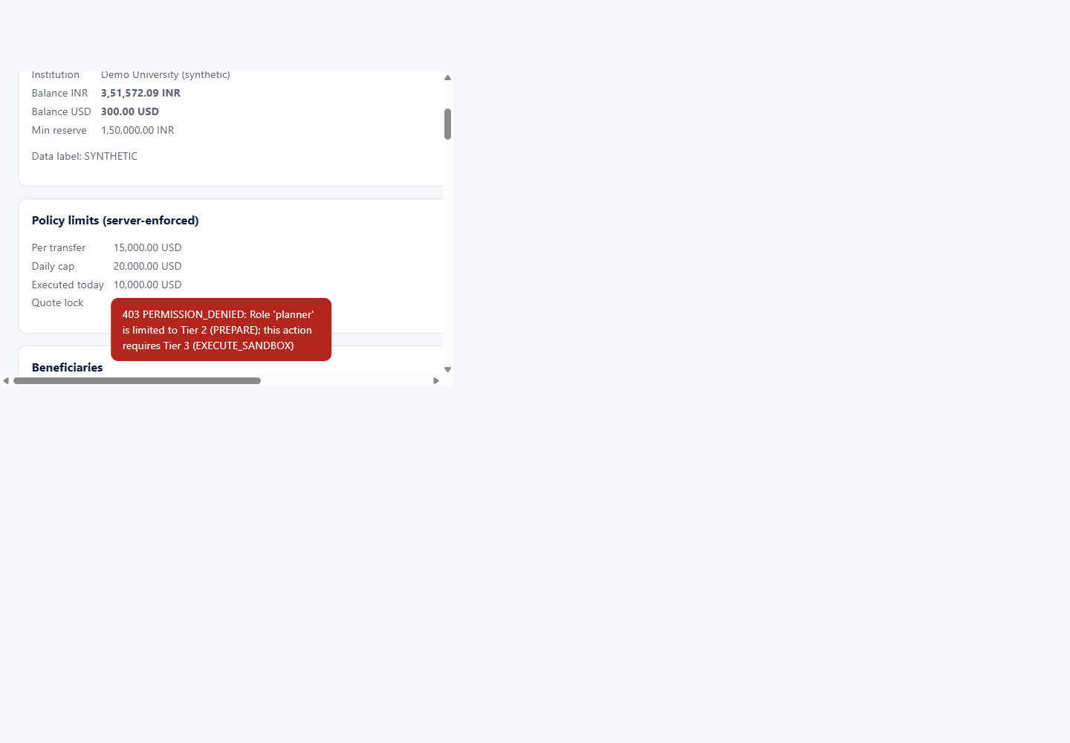
Demo: permission denied, logged

Slide 10
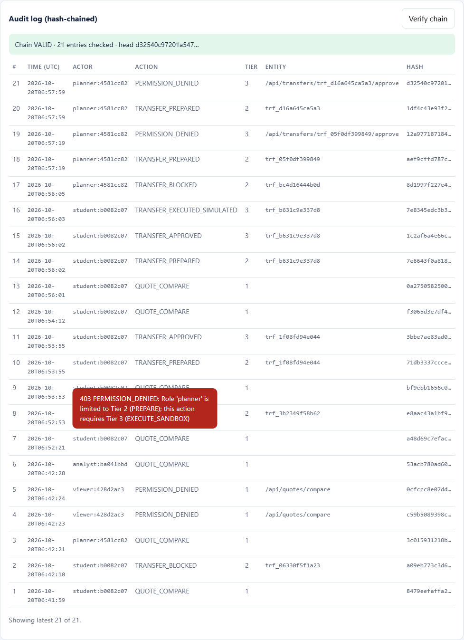
Demo: hash-chained audit log verified

Slide 11
Core algorithm and the AI boundary
customer_rate = mid × (1 − margin); fees = fixed + round(send × pct)
receive = round_down((send − fees) × customer_rate); cost_vs_mid = send − receive ÷ mid
Target mode solves send upward, re-quotes, nudges by one minor unit until receive ≥ target
Hand-checked: 1,000 USD via bank-wire archetype → send 92,269.24 INR (4.09% cost)
LLM may only restate plan numbers; any invented figure → rejected, labelled fallback

Slide 12
Security and compliance
Tier 0 read · 1 analyse · 2 prepare · 3 sandbox execute · 4 production = disabled in code
Enforced in the service layer for every request; denials audited
20 threats modelled; 16 controls implemented and tested; 4 marked recommended (TLS, IdP/MFA, real screening, multi-node)
Decimal-only money, injection guard, redaction, SHA-256 audit chain with verify endpoint

Slide 13
Evidence
60 automated tests: unit, security, integration — 60 passed in 2.85 s
7 scenario logs generated by the real application (evidence/operation_logs)
Screenshots of the running UI; everything labelled SIMULATED / SYNTHETIC
Reproducible: scripts/setup.sh · run.sh · test.sh · make_evidence.py

Slide 14
What is real, what is next
Real: the control plane — policy, approval, idempotency, recovery, audit, grounded explanations
Not real: rates, providers, screening list (labelled fixtures)
Next: live rates with provenance, provider sandbox APIs, identity + MFA for Tier 3, audit anchoring
Thank you

