Slide 1

Which subreddit
a post came from?
Steve Lee

Slide 2
Goal/Objective
Using Reddit's API, collect posts from two subreddits
Use NLP to train a classifier on which subreddit a given post came from
This is a binary classification problem (Convert target to 0 and 1)

Slide 3
Getting posts from subreddits
Using scrape(subreddit, times) function that runs a for loop
Scrape 25 x ‘times’ posts from a given ‘subreddit’
Then put posts into a new ‘subreddit’.csv file

Slide 4
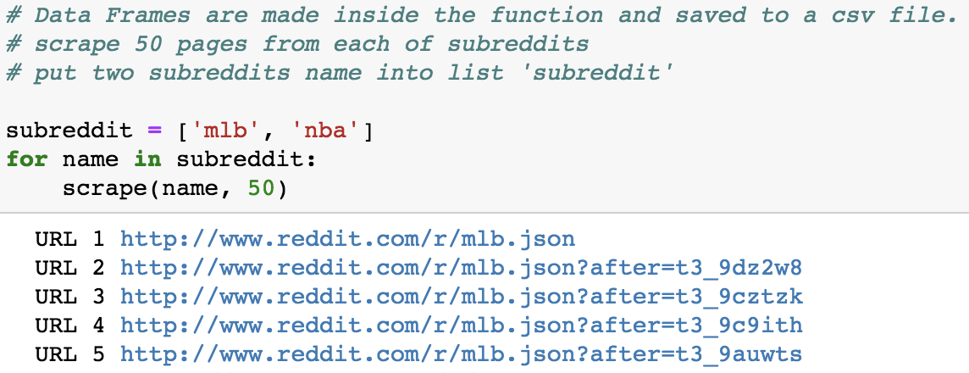
Running scrape function
By running a function using a for loop, we get one csv file for each subreddit
‘subreddit’ is a list of strings (names of reddit subreddits)

Slide 5
Cleaning data
Using a function data_clean(csv_file) that:
Read ‘csv_file’ then put needed information into a pandas dataframe with three columns:
‘Title’, ‘Description’, ‘Target’
Target = name of a subreddit
Removes posts:
Have no description, written by moderators

Slide 6
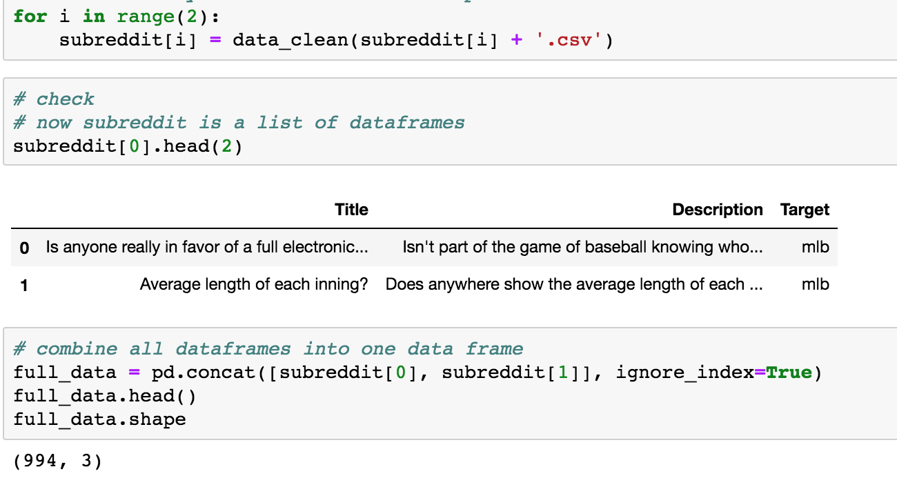
Running data_clean function
After using function as this example
‘subreddit’ is now a list of pd.DataFrame
After running this function,
Concatenate two dataframes into one

Slide 7
Predicting subreddits
Convert ‘Target’ to a binary variable
Train_test_split
Used TfidfVectorizer() from scikit-learn
Fit & Tested
lr - LogisticRegression
nb - MultinomialNB
gb - GradientBoostingClassifier
rf - RandomForest
gs - GridSearchCV with Pipeline
3 tv__stop_words: None, ENGLISH_STOP_WORDS, custom_stopwords
2 tv__max_features: 3000, 4000
2 tv__ngram_range: (1, 1), (1, 2)
3 rf__n_estimators: 50, 100, 150

Slide 8
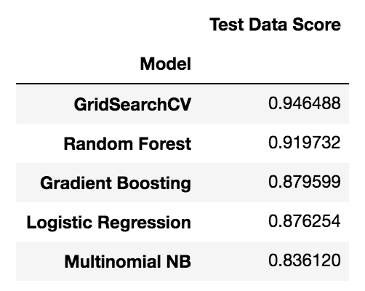
Results
Best parameters of GridSearchCV:
rf__n_estimators: 50
tv__max_features: 3000
tv__ngram_range: (1, 2)

Slide 9
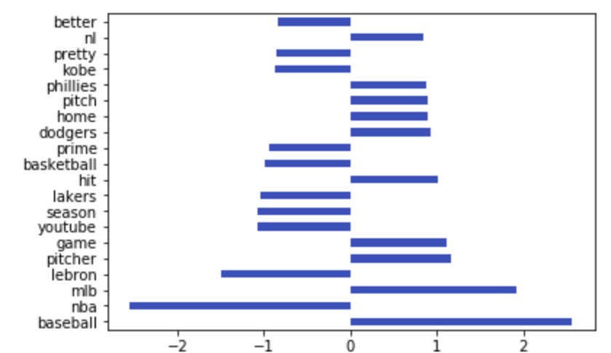
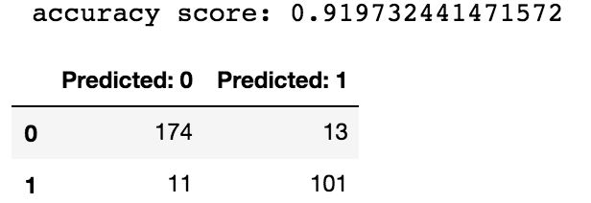
Results
Coefficient analyzing using Logistic Regression Accuracy Score using Random Forest
Confusion matrix on the test set

