Slide 1

Manager, Cross Carline Product Line Management | Candidate Assignment
Sangho Lee

Slide 2
Part 2: Strategic Assessment and Action Plan for Kona ICE Performance
Objective:
To provide data-driven insights and actionable strategies to improve sales, retail share, and profitability for Kona ICE in February 2021 and beyond.
Steps We Will Take:
Analyze Current Performance
Visualize Kona’s sales, inventory, and regional trends.
Highlight challenges: regional imbalances, high-MOS trims, pipeline issues.
Provide Recommendations
Target strategies: optimize inventory, improve high-MOS trims, enhance regional incentives.
Simulate Scenarios (What-If)
Use optimization technic to test strategies and combinations.
Identify actions for maximum sales impact.

Slide 3
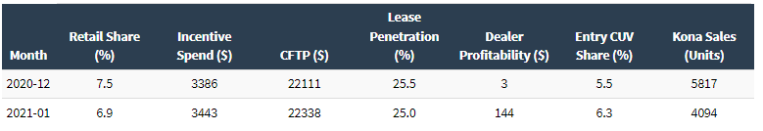
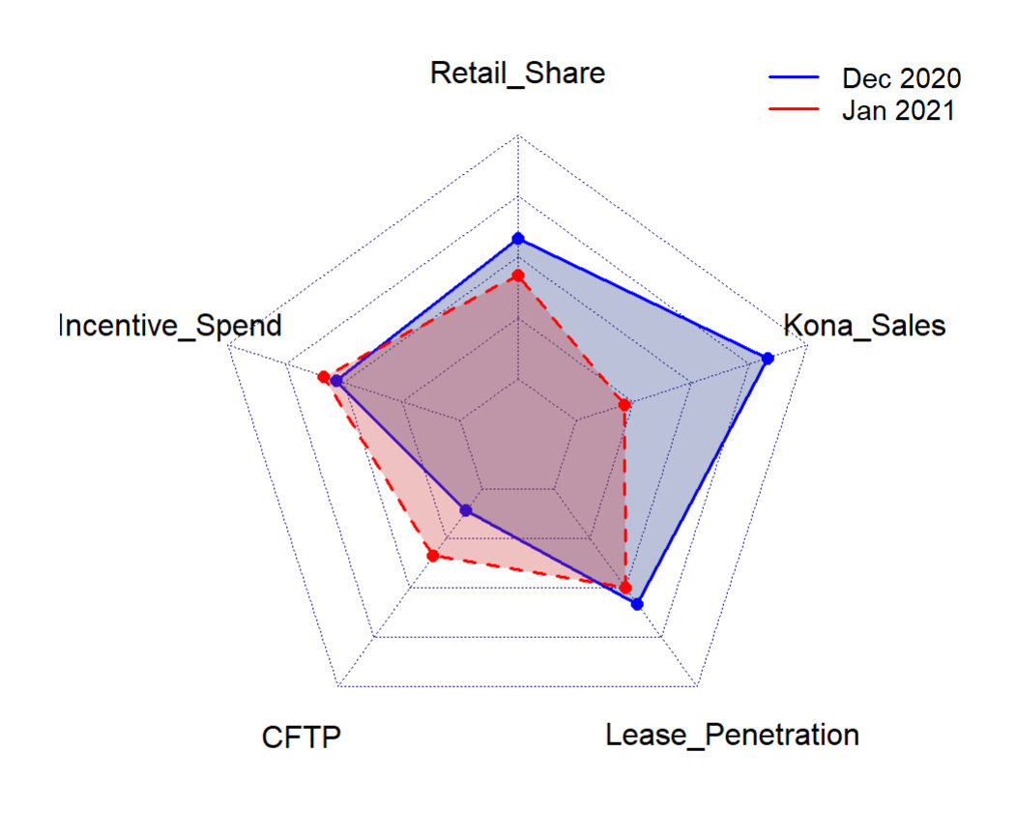
Kona ICE’s Indicator
Retail Share: Declined from 7.5% (Dec 2020) to 6.9% (Jan 2021), indicating competitive challenges.
Incentive Spend: Increased by $57, suggesting an effort to boost demand but with limited effectiveness.
CFTP: Increased from $22,111 to $22,338, potentially alienating price-sensitive customers.
Lease Penetration: Dropped by 0.5%.
Sales Volume: Dropped significantly from 5,817 units in Dec 2020 to 4,094 units in Jan 2021 (-29.6%).
Dealer Profitability: Jumped significantly from $3 to $144, reflecting improved margins for dealerships.

Slide 4
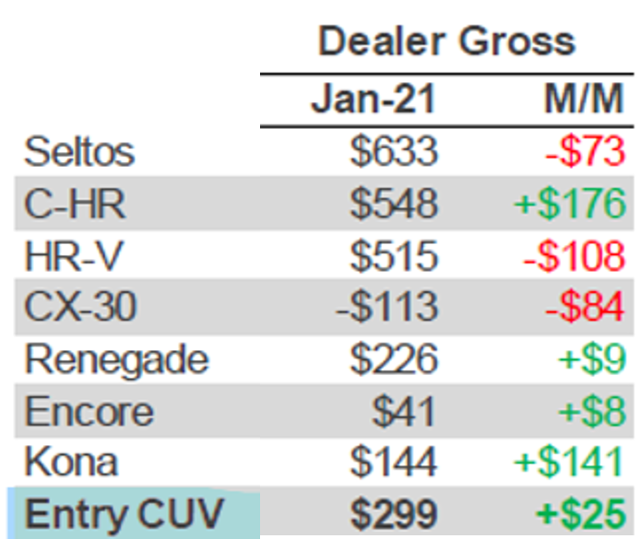
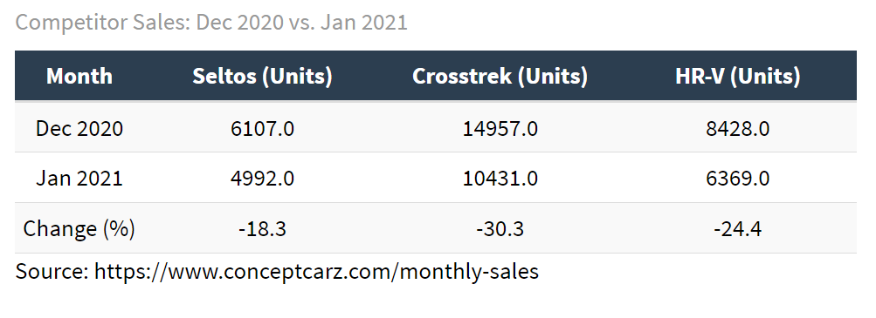
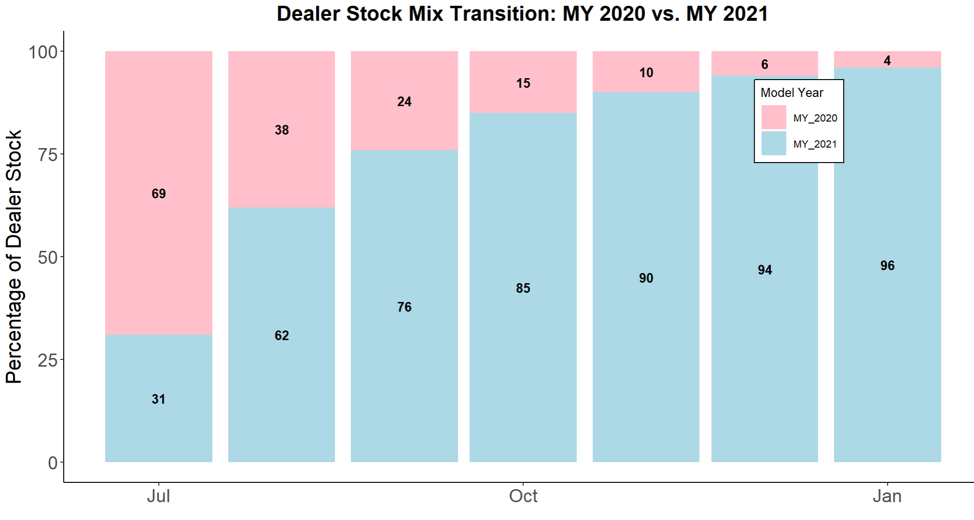



Month-over-month: 5,817 to 4,094 (-29.6%)
What Does This Mean by a Drastic Increase in Dealer Gross?
Year-over-year : 3,736 to 4,094 (+9.6%)
Minimal Loss on:
- Incentive Spend: Minimal increase in incentives (+$57), indicating that dealers relied less on price reductions to move inventory.
- CFTP Increase: $22,111 → $22,338, showing Hyundai's ability to command higher prices for Kona, reducing the need for deep discounts.
- Lease penetration: 25.5% → 25%

Slide 5
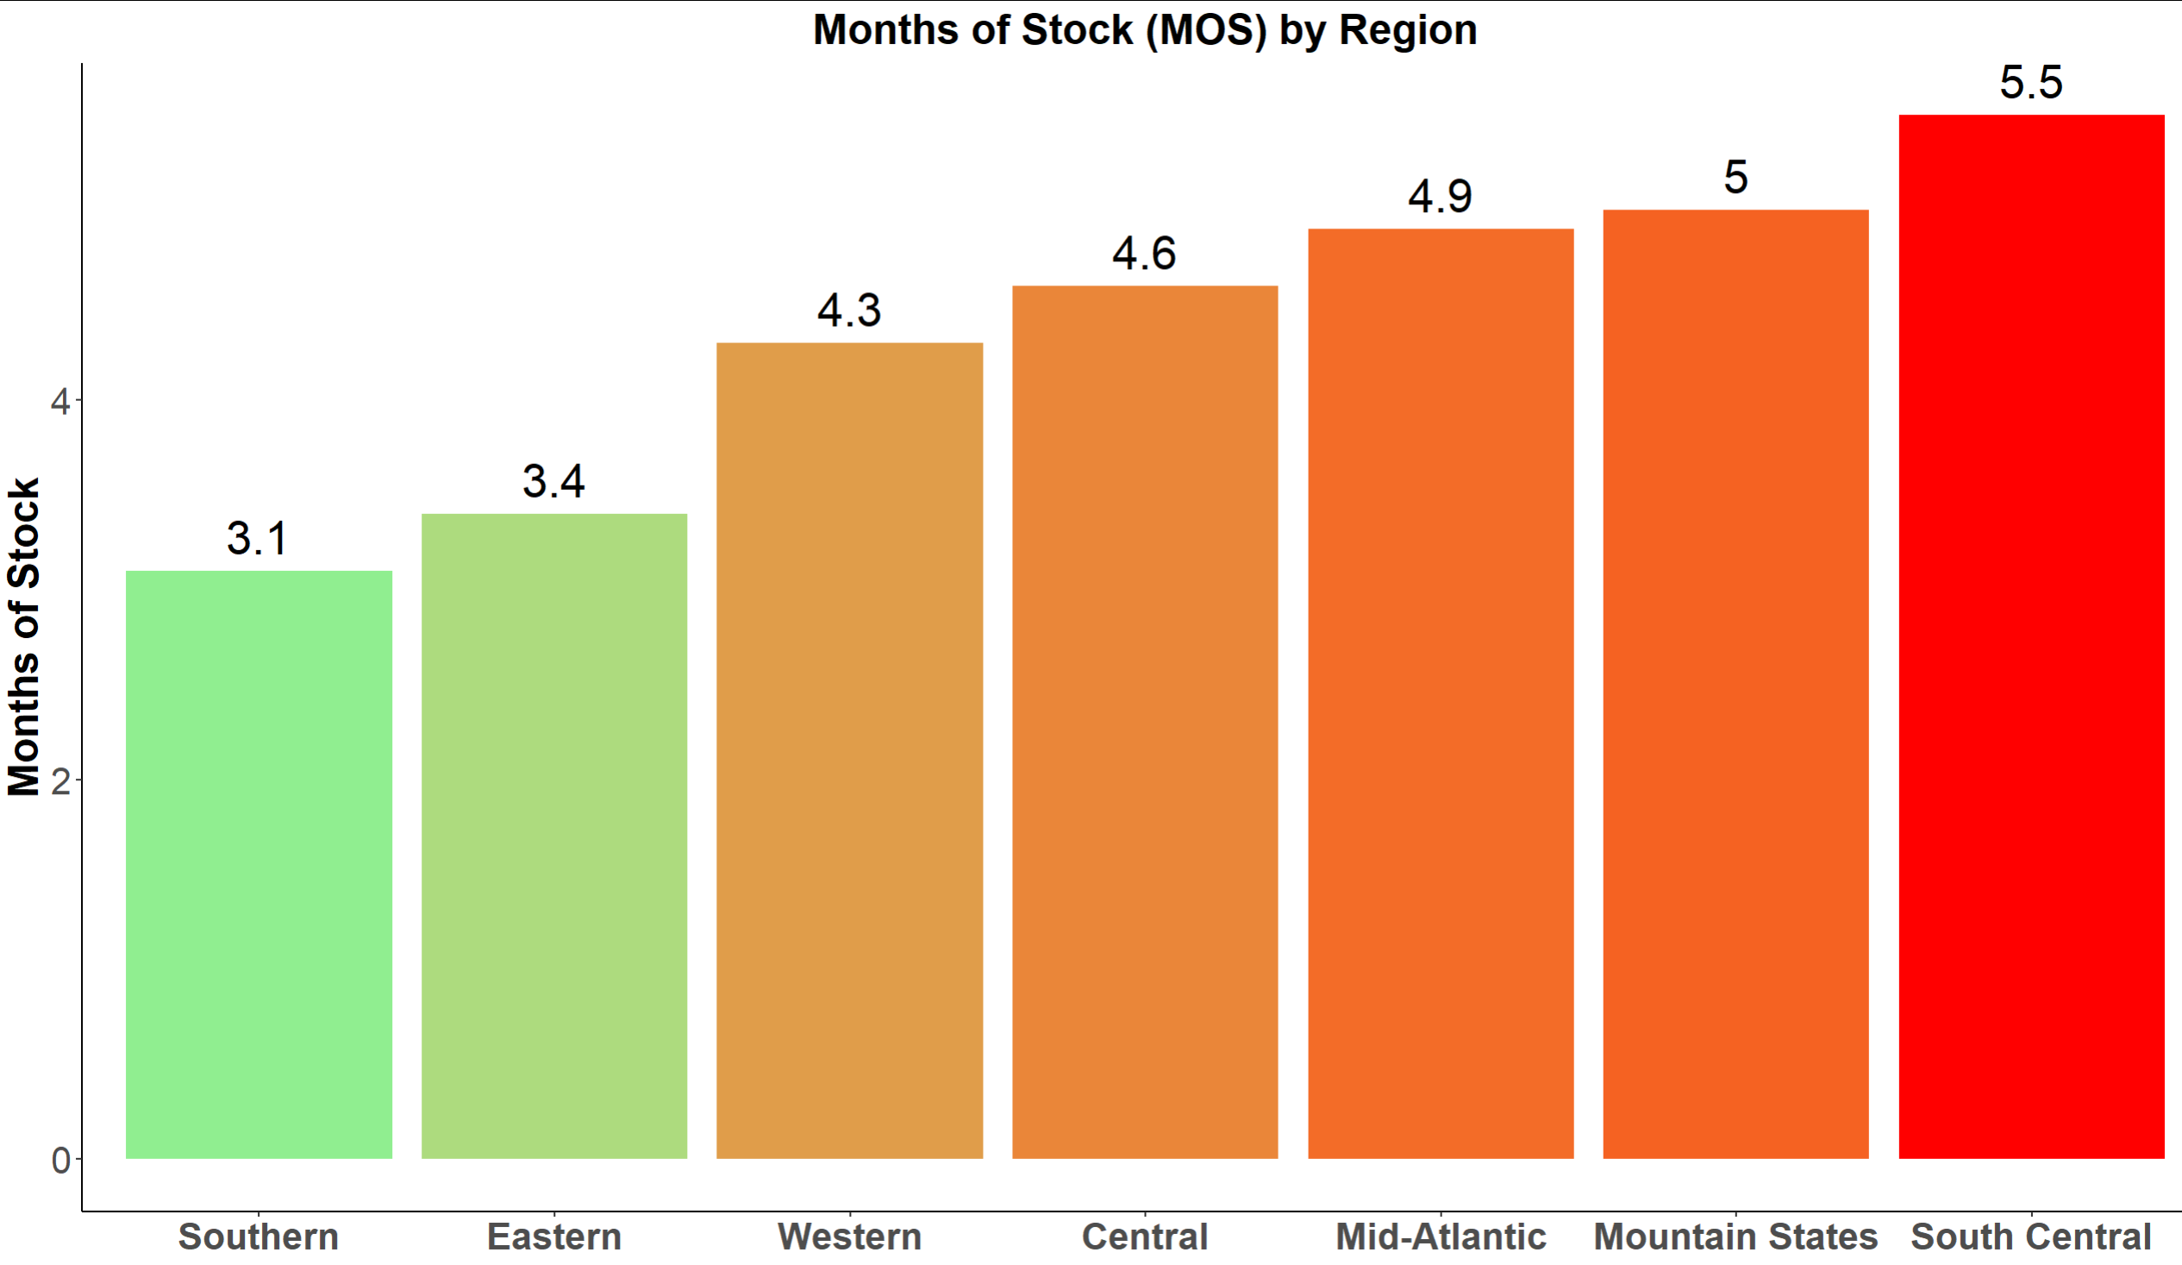
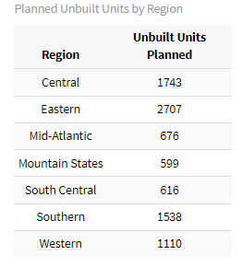
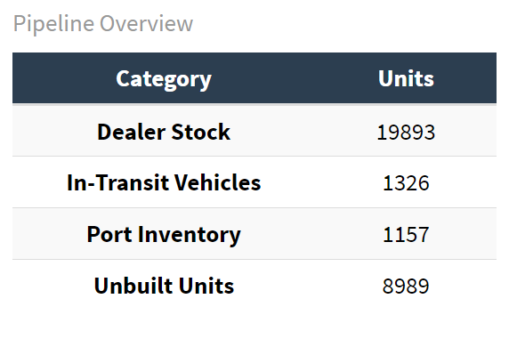
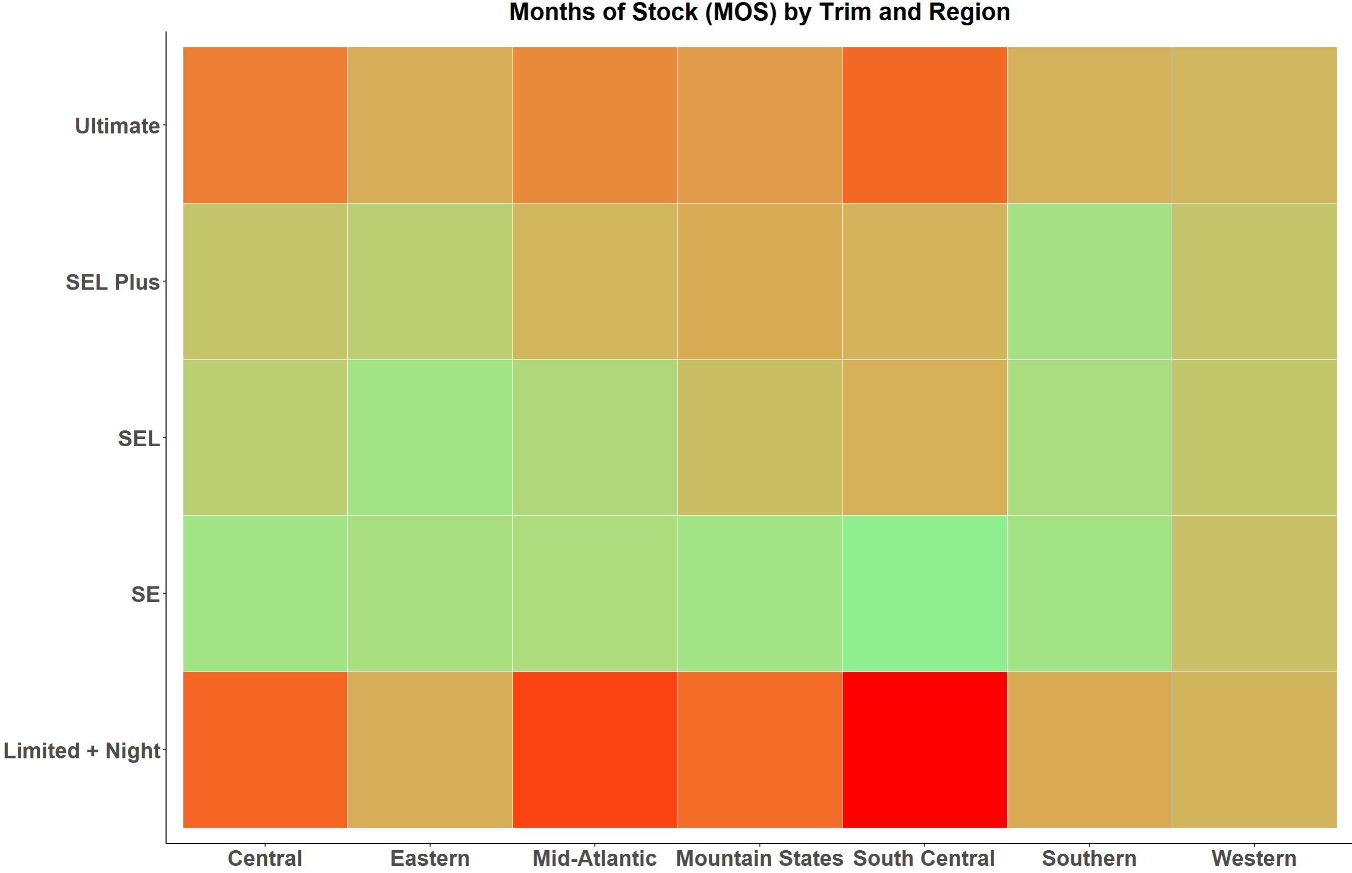
Recommendation: Focus on Region and Trim
Focus on high-demand trims and optimize unbuilt unit allocation.

Slide 6


Optimized What-If Analysis: Reallocation of Unbuilt Units Planning
1. Language and Tools used:
Language: R
Optimization Package: nloptr
4. Why This Works
Granular Trim-Level Optimization
- Addresses inefficiencies at both regional and trim levels
- Balances inventory allocation to minimize MOS holistically
Dynamic Weighting
- Lower MOS trims receive prioritized allocations, ensuring better stock distribution.
Data-Driven Strategy
- Uses advanced optimization to handle complex constraints and objectives
2. Objective
Minimize the average Months of Supply (New MOS) across all regions and trims by efficiently reallocating unbuilt inventory.
Incorporate trim-level priorities
5. Results
Optimized allocation improves average New_MOS across all regions.
Clear visibility into reallocation adjustments for Port Inventory and Unbuilt Units.
3. Optimization Process
New Trim-Level Scoring System:
- Lower MOS trims are prioritized with higher weights.
- Allocations guided by region-trim MOS and stock availability.
Process Steps:
- Iteratively adjust Unbuilt Units for each region and trim.
- Evaluate the weighted impact of MOS after every allocation
Constraints Applied
- Total allocation matches the planned unbuilt units
- Regional constraints ensure each region receives the planned total allocation
- No negative values in allocation
Ctr + Click below GitHub Icon for the code reference

Slide 7
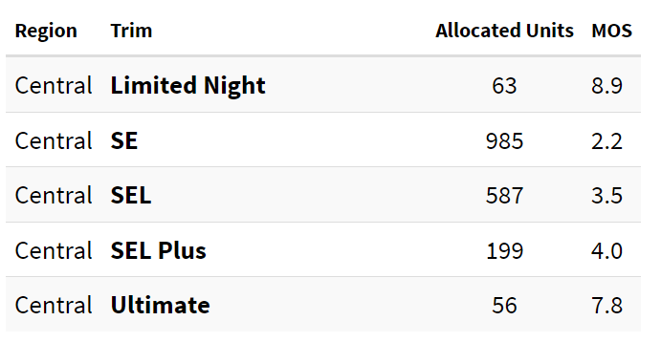
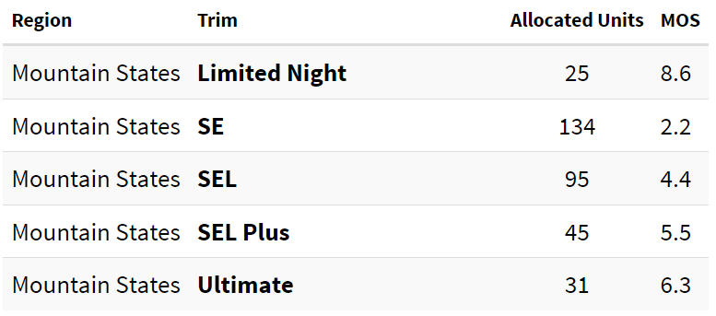
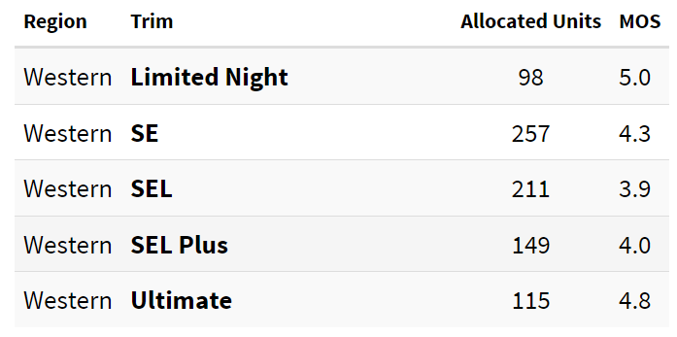
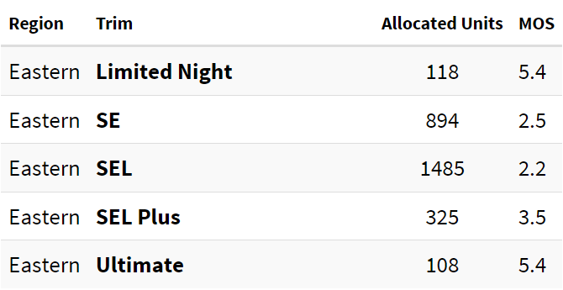
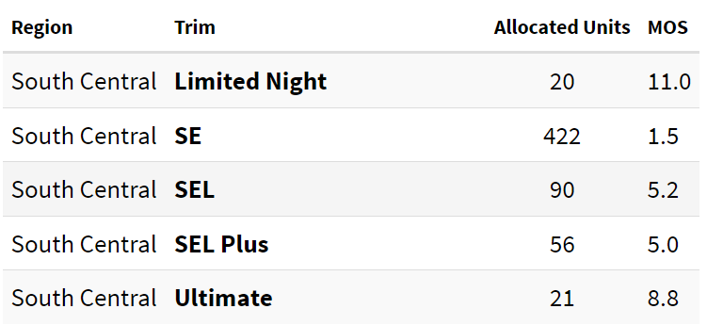
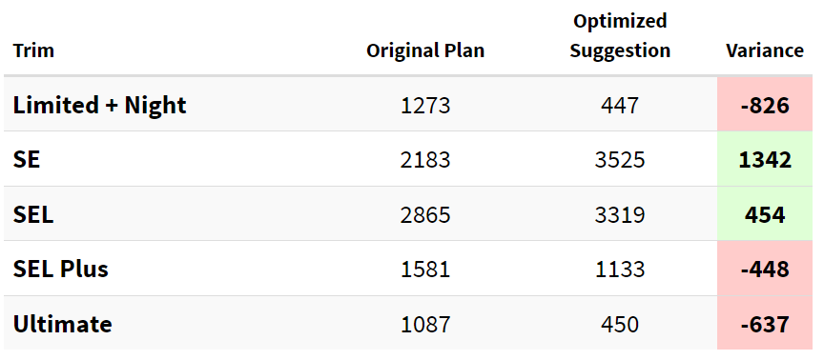
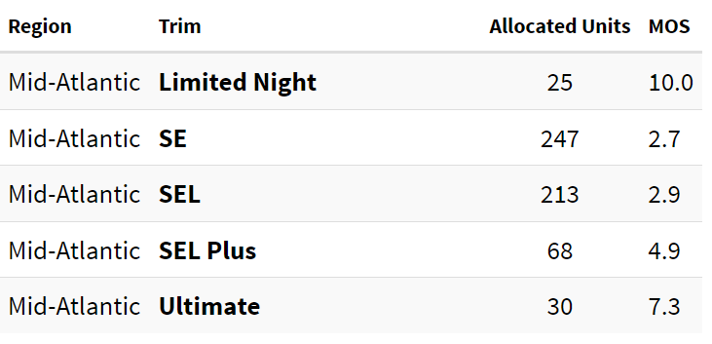
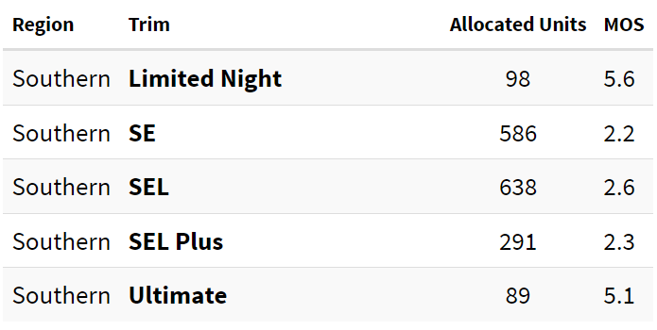
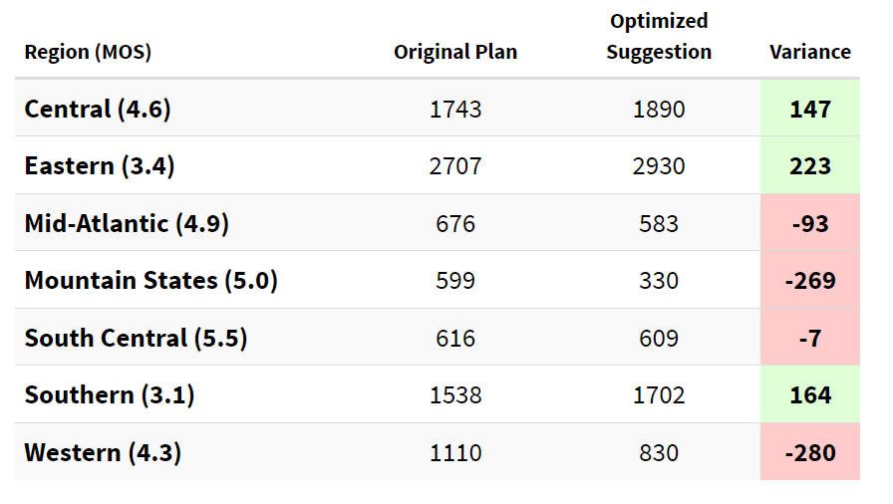
Final Recommendation on Unbuilt Units
** Domain knowledge and input from multiple SMEs must be applied to make the final decision.**

