Slide 1

Manager, Cross Carline Product Line Management | Candidate Assignment
Sangho Lee

Slide 2
Part 2: Strategic Assessment and Action Plan for Kona ICE Performance
Objective:
To provide data-driven insights and actionable strategies to improve sales, retail share, and profitability for Kona ICE in February 2021 and beyond.
Steps We Will Take:
Analyze Current Performance
Visualize Kona’s sales, inventory, and regional trends.
Highlight challenges: regional imbalances, high-MOS trims, pipeline issues.
Provide Recommendations
Target strategies: optimize inventory, improve high-MOS trims, enhance regional incentives.
Simulate Scenarios (What-If)
Use optimization technic to test strategies and combinations.
Identify actions for maximum sales impact.

Slide 3
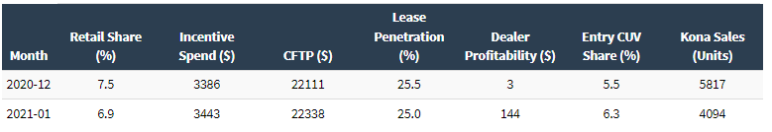
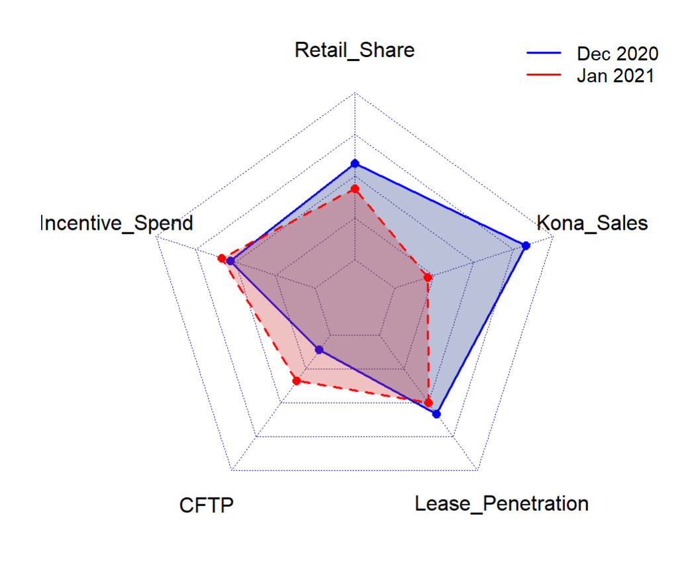
Kona ICE’s Indicator
Retail Share: Declined from 7.5% (Dec 2020) to 6.9% (Jan 2021), indicating competitive challenges.
Incentive Spend: Increased by $57, suggesting an effort to boost demand but with limited effectiveness.
CFTP: Increased from $22,111 to $22,338, potentially alienating price-sensitive customers.
Lease Penetration: Dropped by 0.5%.
Sales Volume: Dropped significantly from 5,817 units in Dec 2020 to 4,094 units in Jan 2021 (-29.6%).
Dealer Profitability: Jumped significantly from $3 to $144, reflecting improved margins for dealerships.

Slide 4
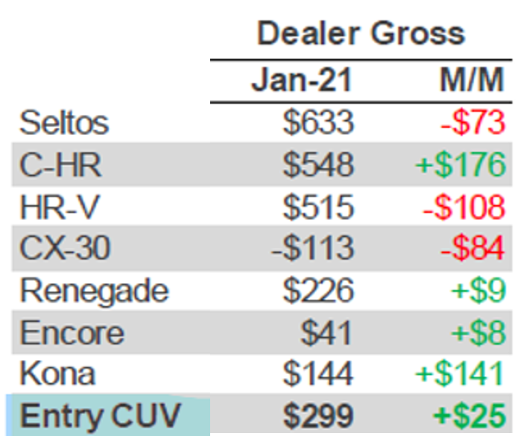
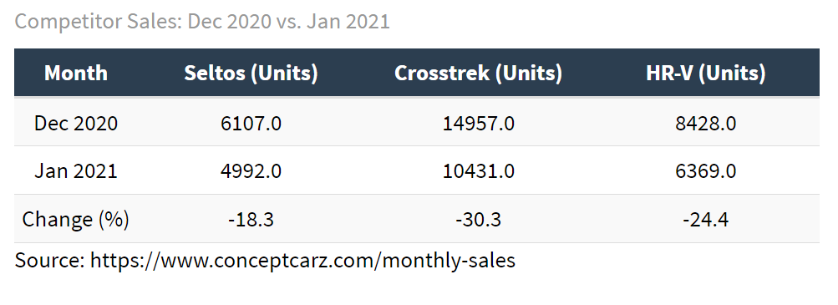
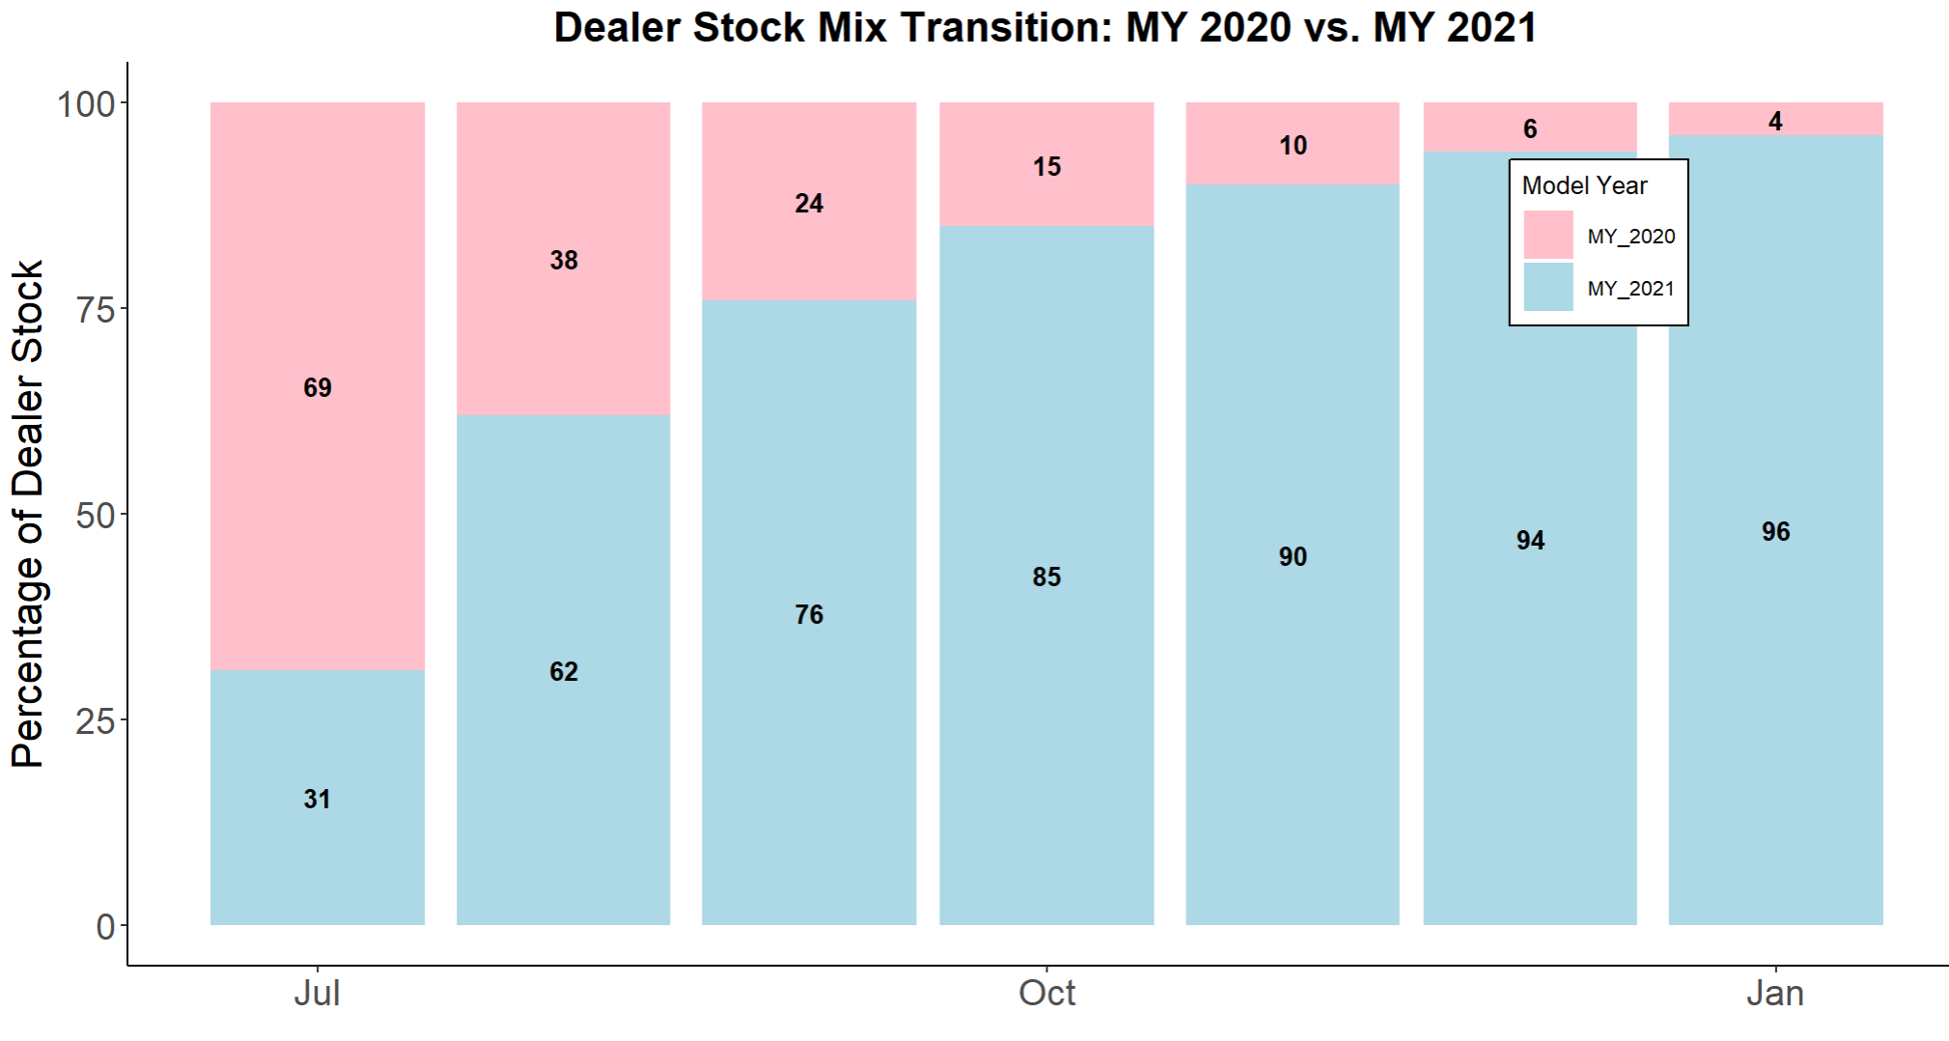



Month-over-month: 5,817 to 4,094 (-29.6%)
What Does This Mean by a Drastic Increase in Dealer Gross?
Year-over-year : 3,736 to 4,094 (+9.6%)
Minimal Loss on:
- Incentive Spend: Minimal increase in incentives (+$57), indicating that dealers relied less on price reductions to move inventory.
- CFTP Increase: $22,111 → $22,338, showing Hyundai's ability to command higher prices for Kona, reducing the need for deep discounts.
- Lease penetration: 25.5% → 25%

Slide 5
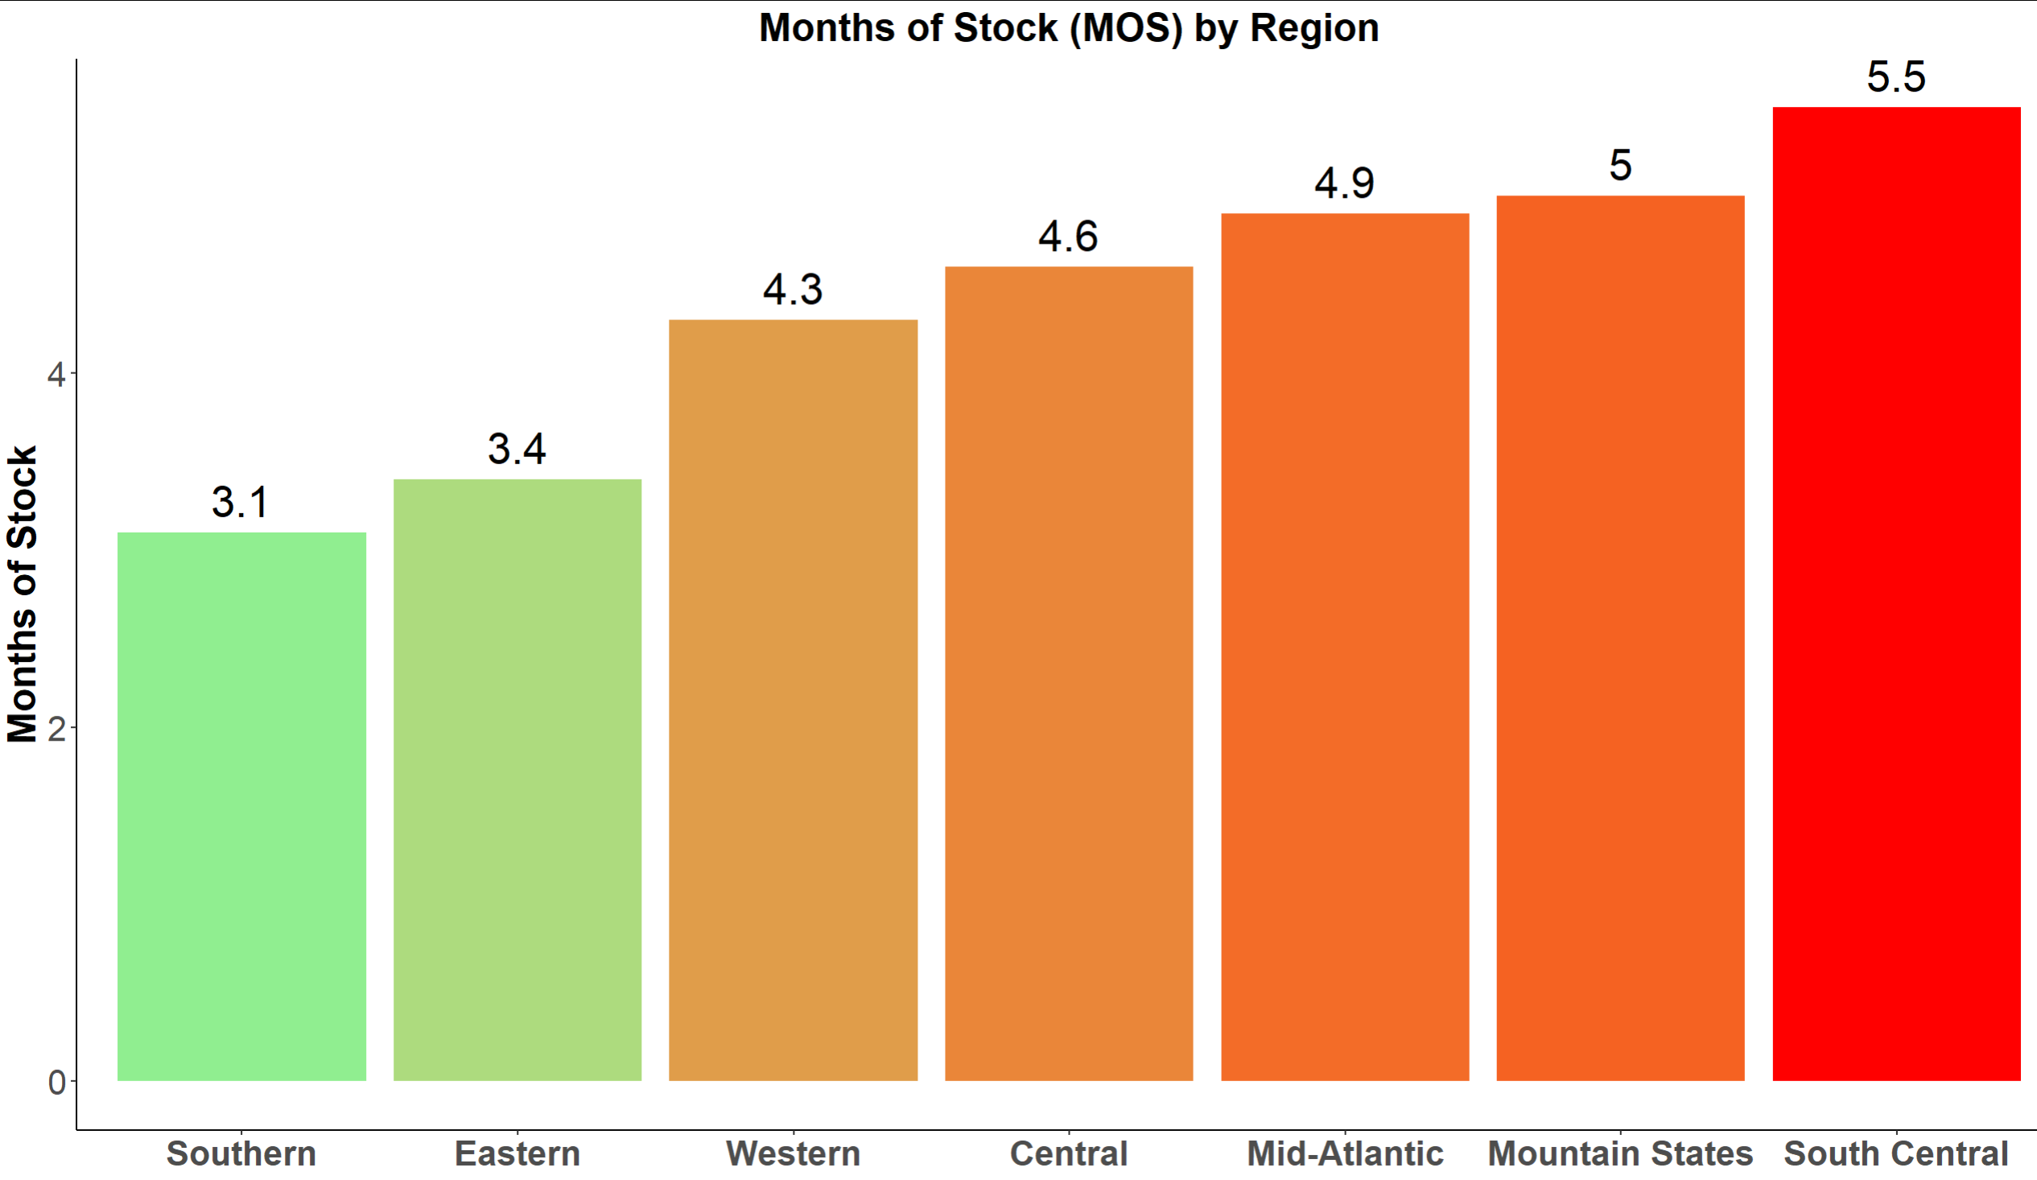
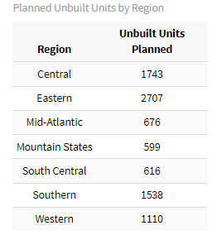
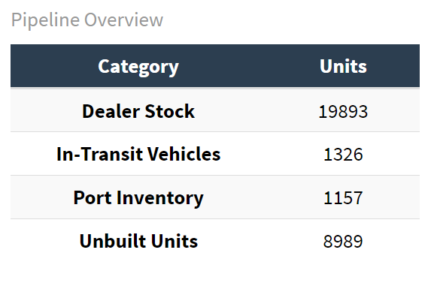
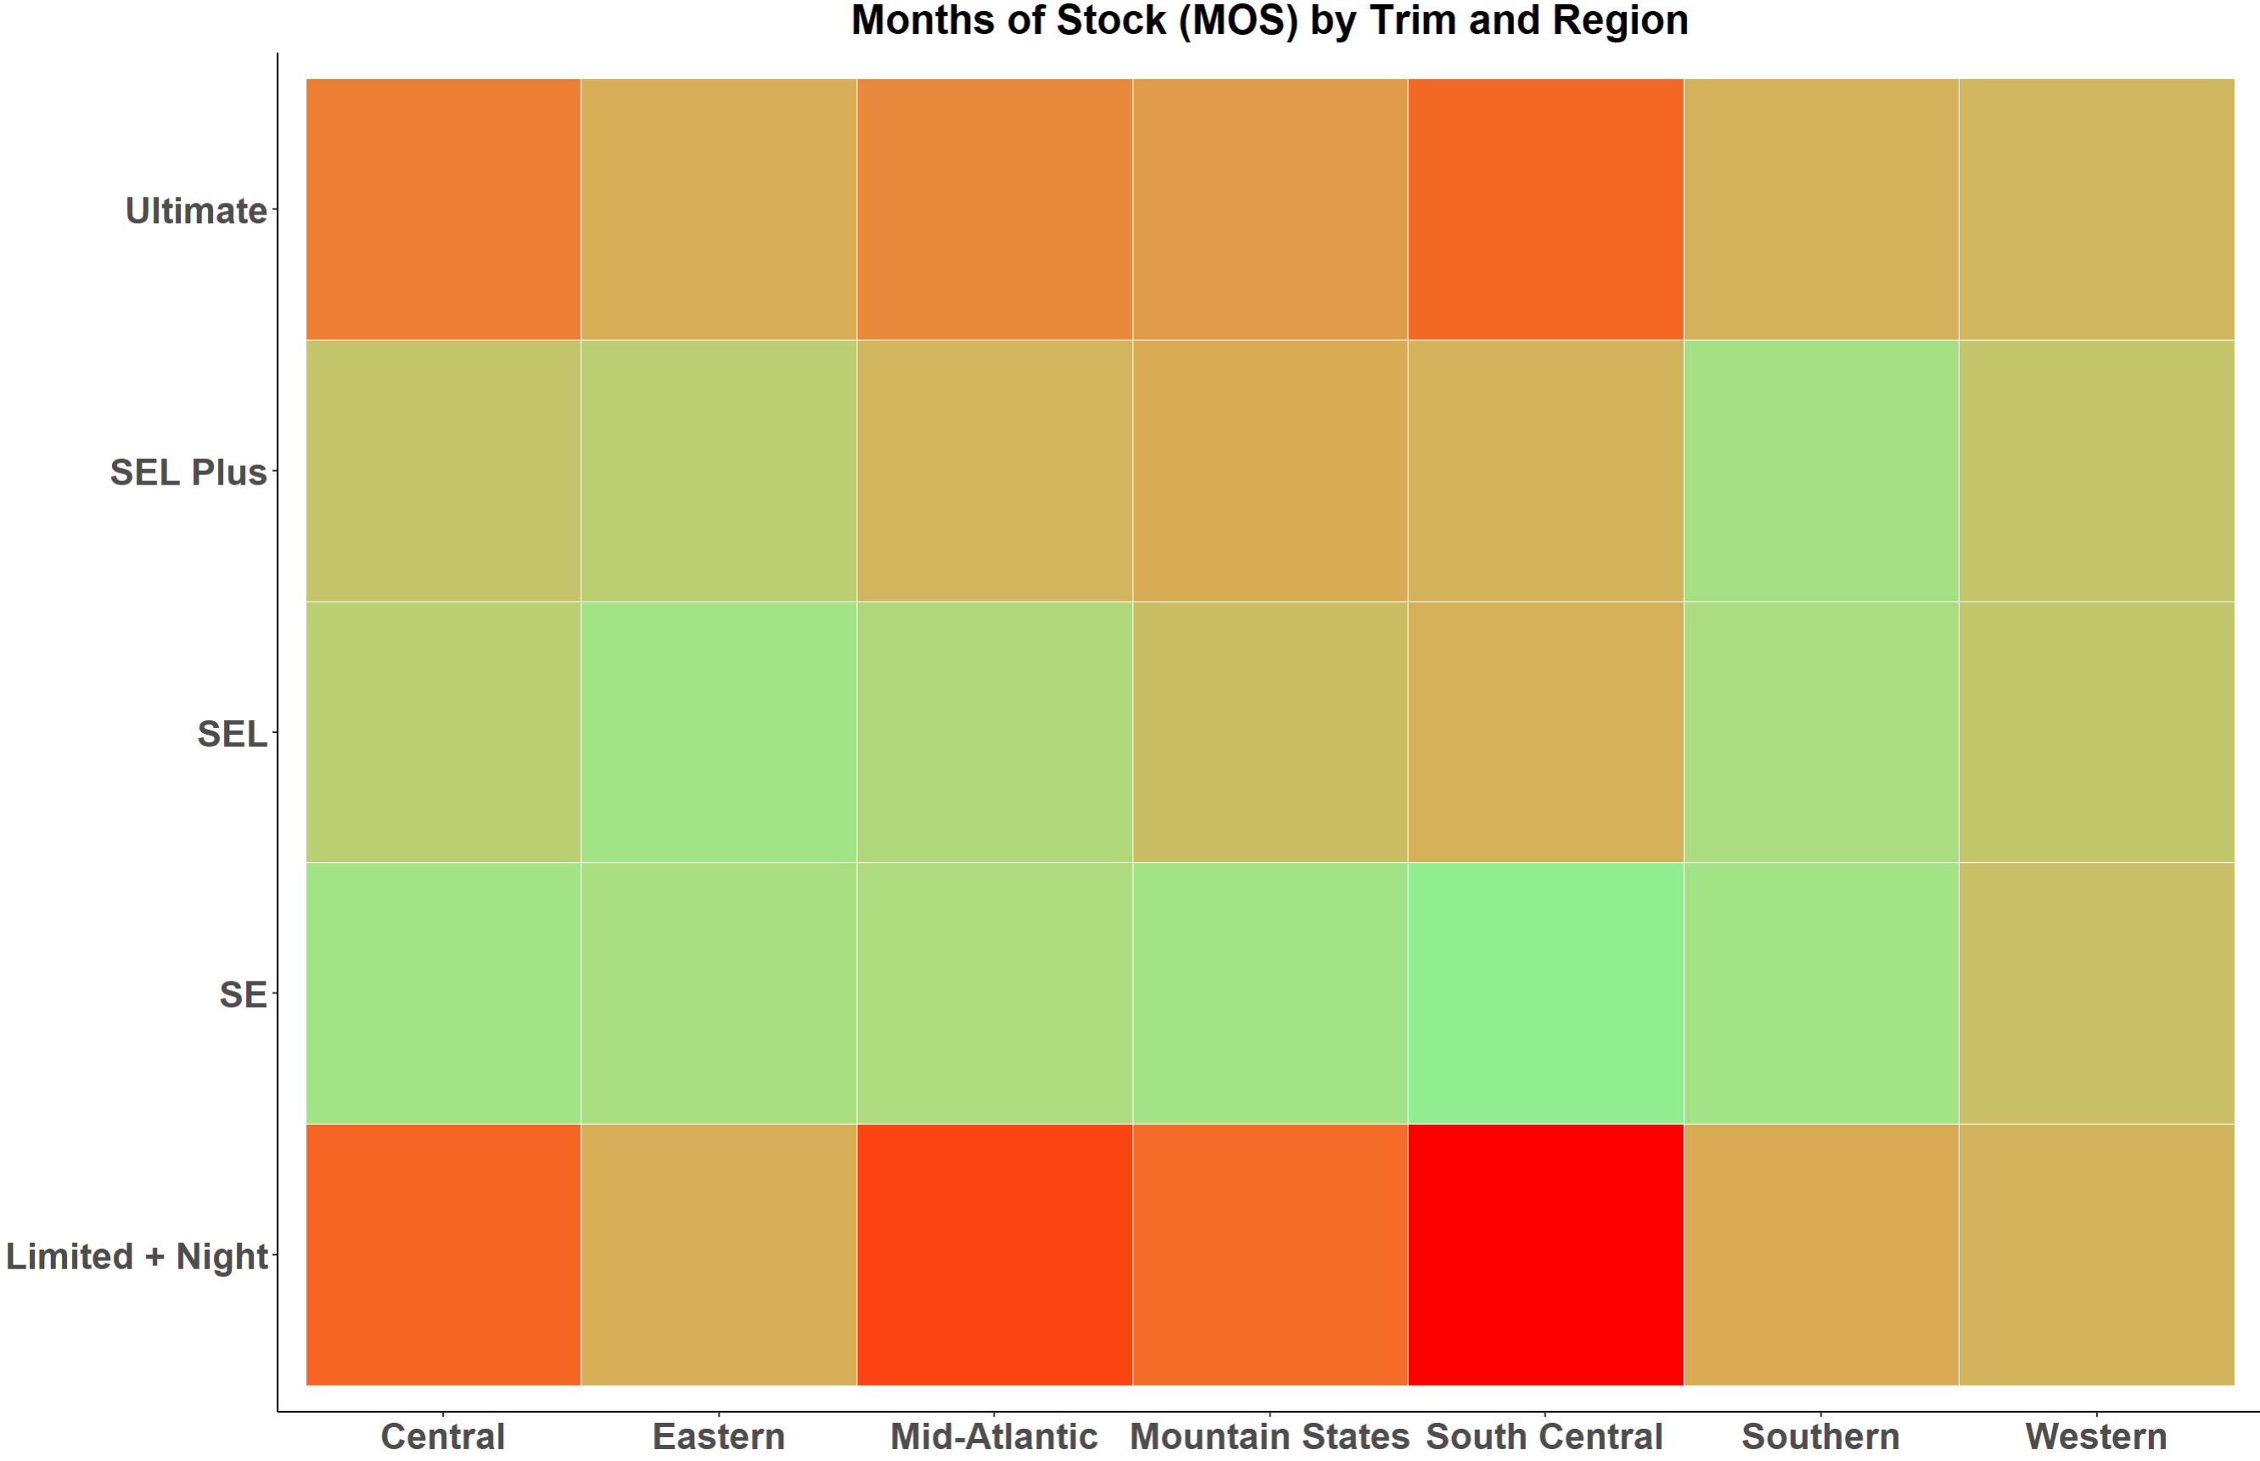
Recommendation: Focus on Region and Trim
Focus on high-demand trims and optimize unbuilt unit allocation.

Slide 6


Optimized What-If Analysis: Reallocation of Unbuilt Units Planning
4. Why This Works
Granular Trim-Level Optimization
- Addresses inefficiencies at both regional and trim levels
- Balances inventory allocation to minimize MOS holistically
Dynamic Weighting
- Lower MOS trims receive prioritized allocations, ensuring better stock distribution.
Data-Driven Strategy
- Uses advanced optimization to handle complex constraints and objectives
1. Language and Tools used:
Language: R
Optimization Package: nloptr
2. Objective
Minimize the average Months of Supply (New MOS) across all regions and trims by efficiently reallocating unbuilt inventory.
Incorporate trim-level priorities
5. Results
Optimized allocation improves average New_MOS across all regions.
Clear visibility into reallocation adjustments for Port Inventory and Unbuilt Units.
3. Optimization Process
New Trim-Level Scoring System:
- Lower MOS trims are prioritized with higher weights.
- Allocations guided by region-trim MOS and stock availability.
Process Steps:
- Iteratively adjust Unbuilt Units for each region and trim.
- Evaluate the weighted impact of MOS after every allocation
Constraints Applied
- Total allocation matches the planned unbuilt units
- Regional constraints ensure each region receives the planned total allocation
- No negative values in allocation
Ctr + Click below GitHub Icon for the code reference

Slide 7
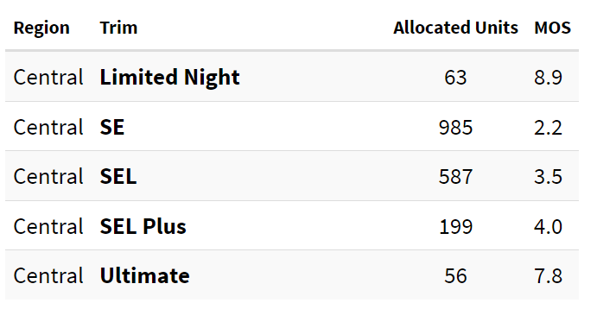
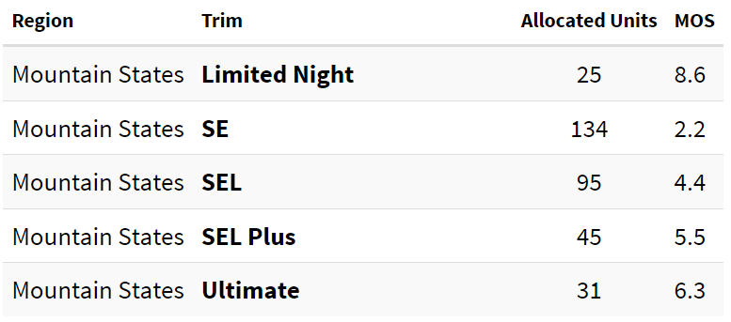
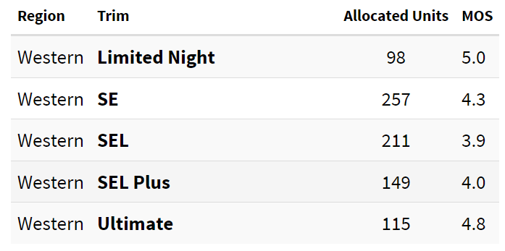
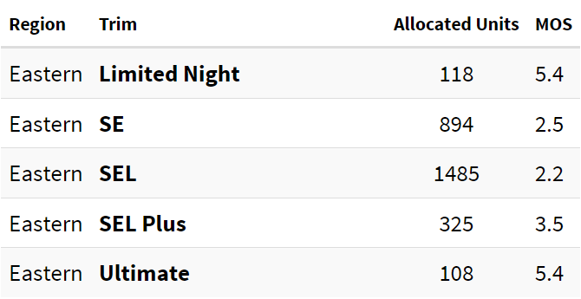
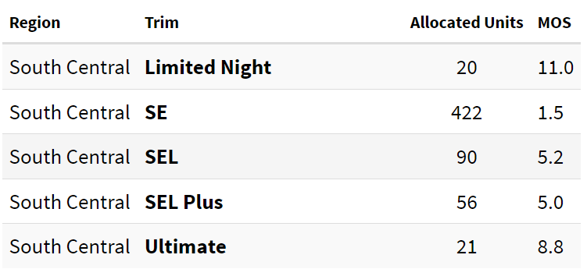
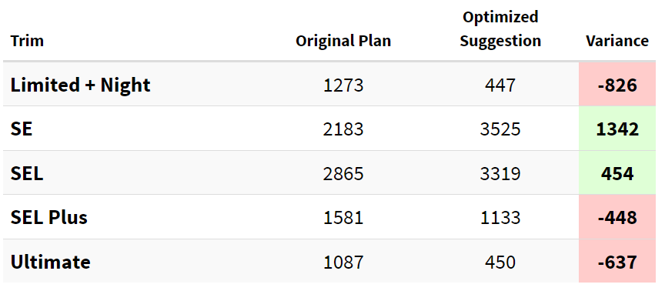
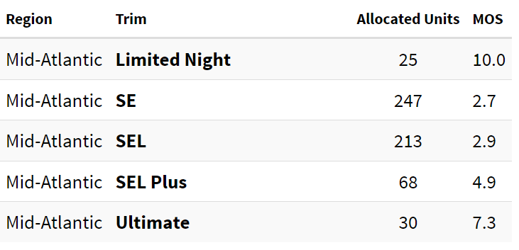
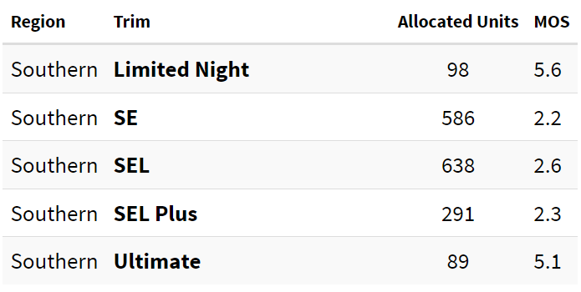
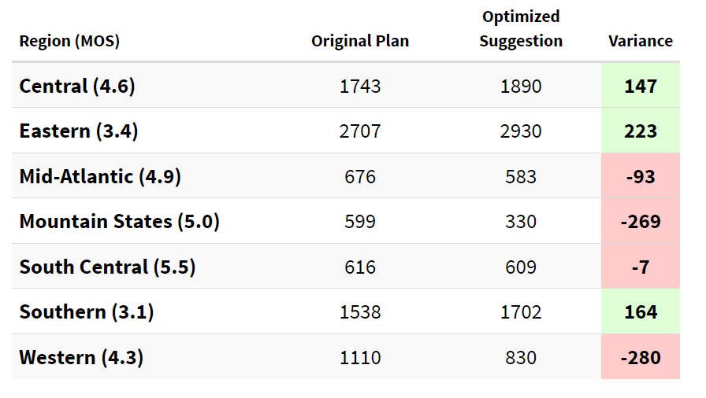
Final Recommendation on Unbuilt Units
** Domain knowledge and input from multiple SMEs must be applied to make the final decision.**

