Slide 1
Which Neighborhood to Live in Toronto?
Stacey Lee
Feb 14, 2020

Slide 2
Introduction/Business Problem
Scenario/Background: some enterprise expands its business in Northern America and an employee is sent to Toronto for a year to take care on-site implementation and training and this employee needs to find a neighborhood of his/her interest
This project aims to leverage the Foursquare location data to explore and compare neighborhoods of Toronto
It meant to help a group of stakeholders, the audiences can include the long term travelers or business visitors and by applying the same methodology, when data sources are available, it can be for people who want to move to major city in the world.

Slide 3
Data Acquisition and Cleaning
Toronto neighborhood data set on Wikipedia page; performed web scrapping to extract the necessary information: Postcode, Borough and Neighborhood into a postal codes table
List of Coordinates data set is required in order to utilize the Foursquare location data, the latitude and longitude coordinates of each postal code are obtained from List of Coordinates (http://cocl.us/Geospatial_data)
Foursquare provides venues and their assigned categories information; Foursquare API is used to explore and segment the neighborhoods

Slide 4
Methodology - web scrapping and data wrangling
pass out postal code Wiki URL into BeautifulSoup which analyzes the HTML content text and identify the HTML elements from which to extract postal codes table
data wrangling is to transform and map the data from the cells in postal codes table into a pandas dataframe.
In order to utilize the Foursquare location data, we need to get the latitude and the longitude coordinates of each neighborhood, a dataframe is built from this geospatial data CSV file http://cocl.us/Geospatial_data

Slide 5
Methodology - Data Cleaning
At data cleaning phrase, remove the data with borough that is "Not assigned”; combine more than one neighborhoods in same postal code area into one row separated with a comma; when borough has “Not assigned” neighborhood, make the neighborhood the same as borough
Perform data aggregation based upon postal code by merging postal code and geo spatial dataframes into a new 5 columns dataframe

Slide 6
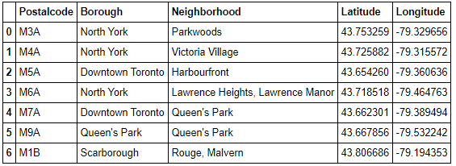
Methodology - Data Cleaning (cont.)
Here are first 7 rows of resulted dataframe:

Slide 7
Methodology - Exploratory Data Analysis (EDA) EDA – Data Visualization
In order to make choice the best fit interest neighborhood, analyze cleaned data sets to summarize the main characteristics
Utilize the Foursquare explore function to get the most common venue categories in each neighborhood, and then use this feature to group the neighborhoods into clusters, use the k-means clustering algorithm to complete this task
Finally use the Folium library to visualize the neighborhoods in Toronto and their emerging clusters.

Slide 8
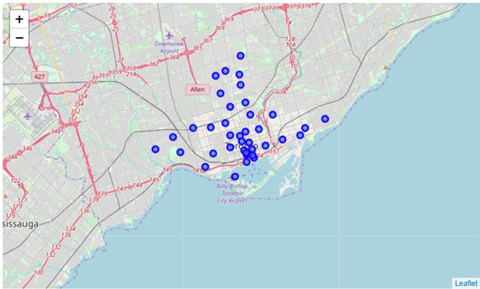
Methodology - Exploratory Data Analysis (EDA) EDA – Data Visualization (cont.)
Here is Toronto map with its neighborhoods:

Slide 9
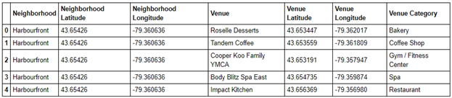
Methodology - Exploratory Data Analysis (EDA) EDA – Clustering
First explore via GET request: https://api.foursquare.com/v2/venues/explore, to get the top 100 venues that are in the first neighborhood within a radius of 500 meter; then filter the interested columns from the results and confirm things work as expected
I then repeat the same process to all neighborhoods in Toronto, create toronto_venues dataframe, here are the first 5 rows:

Slide 10
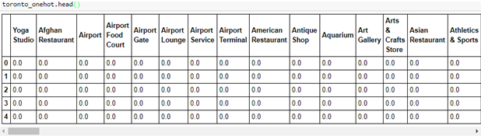
Methodology - Machine Learning – one-hot encoding
Categorical venue data has no ordinal relationship but machine learning requires all input and output variables to be numeric, I use one-hot encoding to apply the integer representation. Here are some outputs:

Slide 11
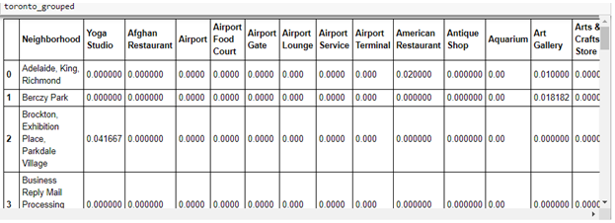
Methodology - Inferential Statistics Testing
In inferential statistics, data are analyzed from a sample to make inferences in the larger collection of the population. For this only venue category/group based project I use estimating parameters approach: take a sample mean from the sample/venue data using the dataframe created from one-hot encoding
Group rows by neighborhood and take the mean of the frequency of occurrence of each venue category. here are some outputs of frequency distribution:

Slide 12
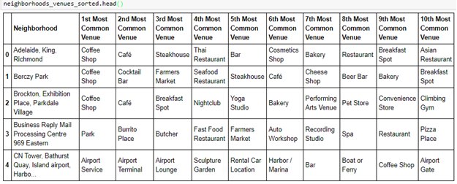
Methodology - Inferential Statistics Testing (cont.)
Verify the new dataframe size has correct number of neighborhoods and venue categories with shape method.
Finally, from the venues data and the frequency of occurrence of each category, create a new dataframe for the top 10 venues of each neighborhood, here are first 5 rows:

Slide 13
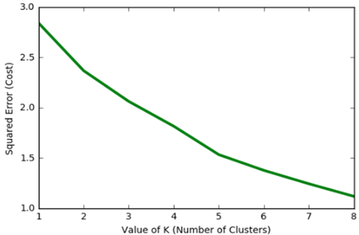
Methodology - Machine Learning – Clustering Analysis
Use the centroid-based clustering to organize and group Toronto neighborhoods into the clusters and use K-means clustering algorithm to complete this task
use K-means++ to ensure a smarter initialization of the centroids and improve the quality of the clustering. I then plot the cost against K values (number of clusters), here is the plot:

Slide 14
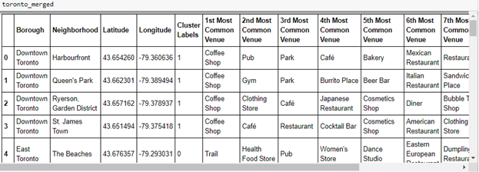
Methodology - Machine Learning – Clustering Analysis (cont.)
The above plot concludes the better choice for the given data is “5” as per error convergence so run K-means for 5 clusters neighborhoods, here is some outputs for a new dataframe that includes the clusters and top 10 venues for each neighborhood:

Slide 15
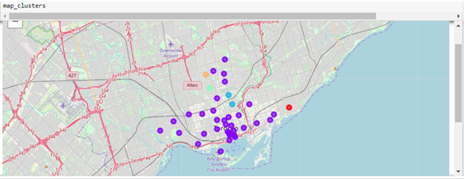
Methodology - Machine Learning – Clustering Analysis (cont.)
use Folium library to visualize the neighborhoods in Toronto and their emerging clusters: majority of neighborhoods are in Cluster 1, 2 neighborhoods in Cluster 2 and one neighborhood in Cluster 0, 3 and 4

Slide 16
Methodology - Machine Learning – Feature Learning
The best fit neighborhoods should be in Cluster 1 which has 34 neighborhoods, apply feature learning to automatically discover classification from raw data.
Currently there are 229 venue categories but some are similar so group those to be higher level categories of interests as follow:
Cafe_Coffee - keywords (Coffee Shop|Cafe|Bakery|Breakfast|Sandwich)
Restaurants - keywords (Restaurant|Sushi)
Fitness - keywords (Yoga|Gym|Dance Studio|Sports|Fitness)
Outdoors - keywords (Park|Trail|Field|Garden)
Arts - keywords (Art|Museum|Gallery|Paintings|Sculpture)
General -keywords(Supermarket|Grocery|Shopping|Hospital|Clinic|Salon)
Transportation - keywords (Metro|Bus|Train|Boat)

Slide 17
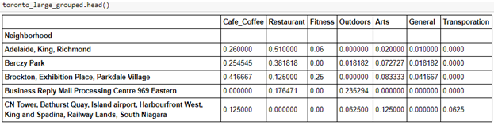
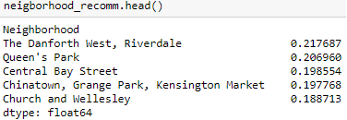
Methodology - Machine Learning – Feature Learning (cont.)
Here are first 5 rows of this new broad categories grouped dataframe:
Weight in user ratings priority: 1) Transportation, 2) Fitness, 3) Outdoors, 4) Arts, 5) Cafe Coffee, 6) Restaurants and 7) General. Here are the top 5 recommended neighborhoods:

Slide 18
Results
The top 5 recommended neighborhoods based upon user preferences on ratings priority is discovered after applying Feature Learning.
Decide top three options: 1) Queen’s Park 2) Riverdale and 3) The Danforth West after further analysis with three web sites, A view on cities - Toronto, Wiki Toronto and Google maps

Slide 19
Discussion
Foursquare provides useful venues and venues categories data for analyzing the neighborhoods in Toronto at the high level however for the large city like Toronto, most common venues are restaurants and café related, the clustering analysis with carefully choosing the optimal number of clusters may not be able to summarize main characteristics of neighborhoods, grouping the neighborhoods in different ways such as weighting in user ratings priority may be more practical than common venues categories grouping

Slide 20
Conclusion
Due to Toronto is a major city, many venues categories data provided by Foursquare are similar so regular clustering analysis didn’t obtain meaningful result; the top neighborhoods recommendation is finally concluded after applying feature learning, i.e. weighting in user ratings priority
Ideally this project can be enhanced to target both short and long terms residents and make it more user friendly, for example configurable such that users can specify their own ratings priority preferences, run the analysis real-time and do the adjustment interactively.

