Slide 1

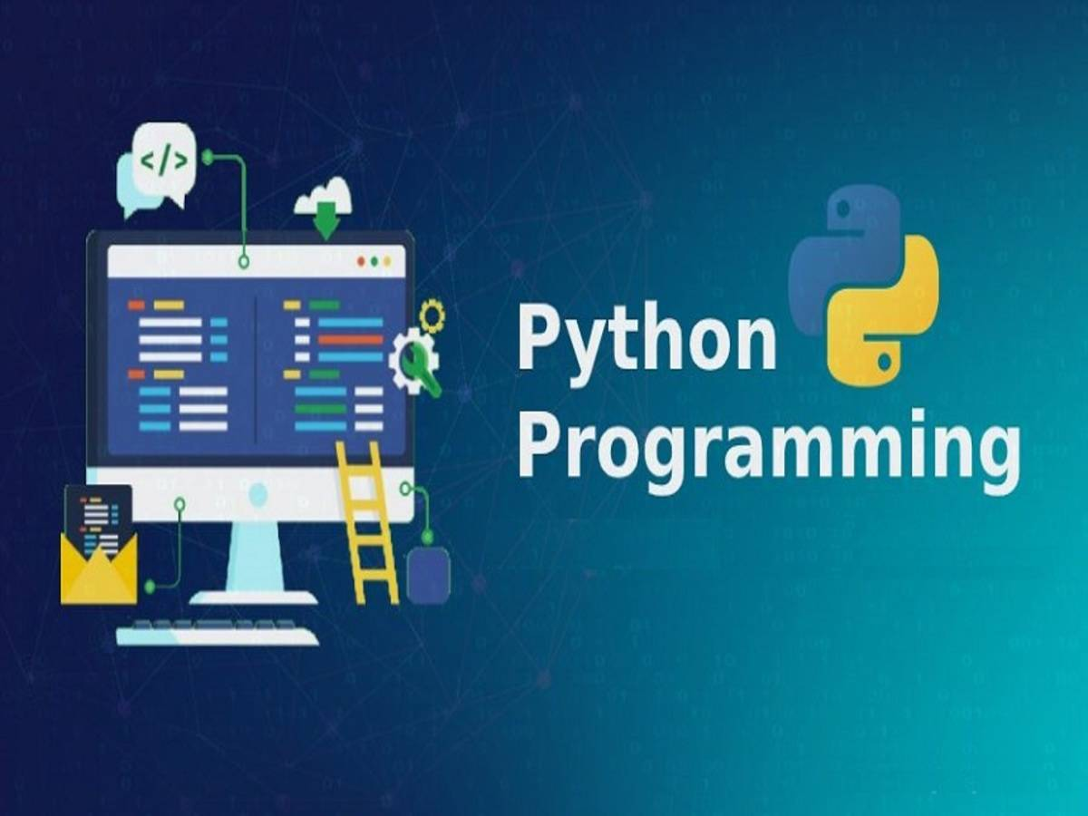
TRY AND EXCEPT

Slide 2
TRY AND EXCEPT
Python Try Except.

Slide 3
A Python program terminates as soon as it encounters an error. Error in Python can be of two types i.e. Syntax errors and Exceptions. Errors are the problems in a program due to which the program will stop the execution. On the other hand, exceptions are raised when some internal events occur which changes the normal flow of the program.
TRY AND EXCEPT

Slide 4
Exceptions in Python
Python has many built-in exceptions that are raised when your program encounters an error (something in the program goes wrong).
When these exceptions occur, the Python interpreter stops the current process and passes it to the calling process until it is handled. If not handled, the program will crash.
TRY AND EXCEPT

Slide 5
Catching Exceptions in Python
In Python, exceptions can be handled using a try statement.
The critical operation which can raise an exception is placed inside the try clause. The code that handles the exceptions is written in the except clause.
We can thus choose what operations to perform once we have caught the exception.
TRY AND EXCEPT

Slide 6
Catching Exceptions in Python
These exceptions can be handled using the try statement.
When the try block raises an error, then the except block will be executed.
Without the try block, the program will crash and raise an error.
The try block is used to check some code for errors i.e the code inside the try block will execute when there is no error in the program.
Whereas the code inside the except block will execute whenever the program encounters some error in the preceding try block.
TRY AND EXCEPT

Slide 7
SYNTAX
The try block
lets you test a block of code for errors.
The except block
lets you handle the error.
The finally block
lets you execute code, regardless of the result of the try- and except blocks.
TRY AND EXCEPT

Slide 8
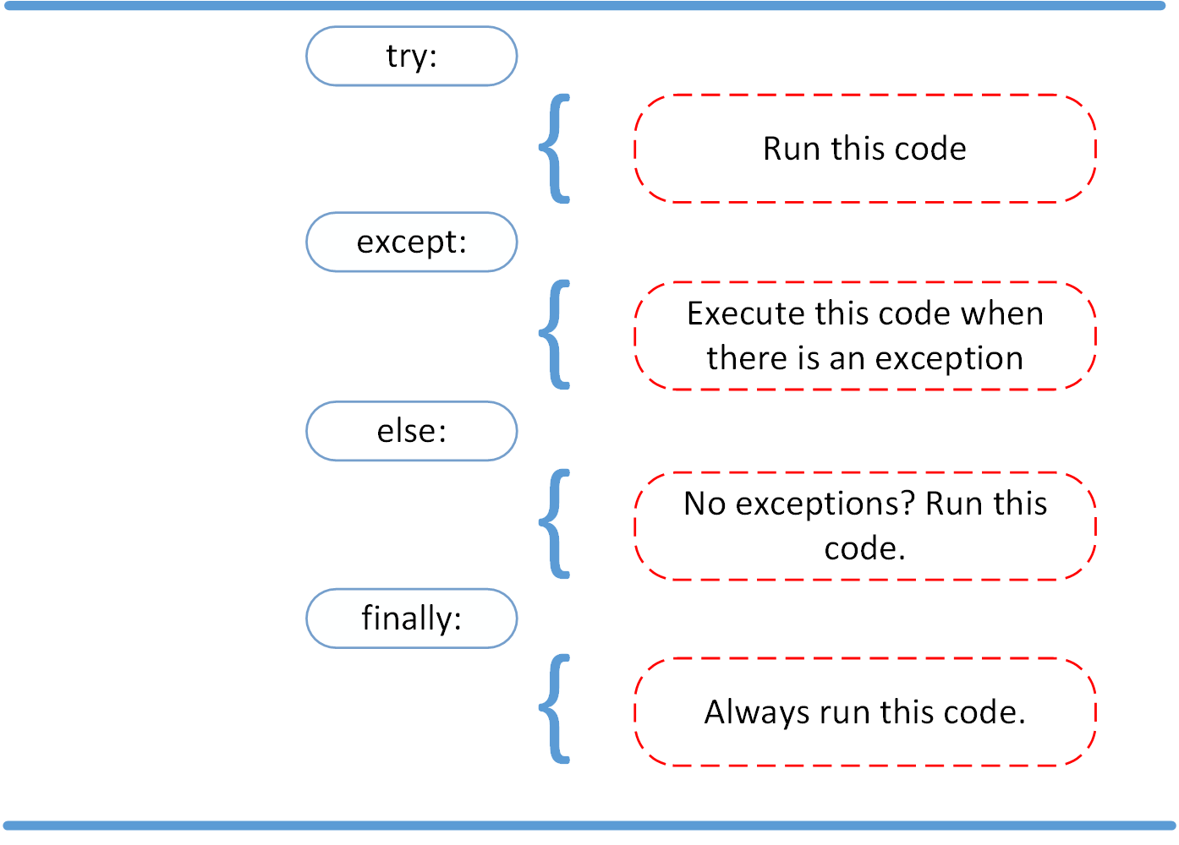
SYNTAX
TRY AND EXCEPT

Slide 9
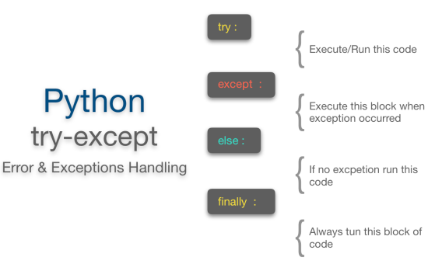
SYNTAX
TRY AND EXCEPT

Slide 10
SYNTAX
TRY AND EXCEPT

Slide 11
Python Errors and Built-in Exceptions
A python program terminates as soon as it encounters an unhandled error. These errors can be broadly classified into two classes:
1 .Syntax errors
2. Logical errors (Exceptions)
TRY AND EXCEPT

Slide 12
Python Errors and Built-in Exceptions
Syntax errors
Error caused by not following the proper structure (syntax) of the language is called syntax error or parsing error.
if a < 3
File "<interactive input>", line 1
if a < 3
^
SyntaxError: invalid syntax
TRY AND EXCEPT

Slide 13
Python Errors and Built-in Exceptions
Logical errors (Exceptions)
Errors that occur at runtime (after passing the syntax test) are called exceptions or logical errors.
For instance, they occur when we try to open a file(for reading) that does not exist (FileNotFoundError), try to divide a number by zero (ZeroDivisionError), or try to import a module that does not exist (ImportError).
Whenever these types of runtime errors occur, Python creates an exception object.
1/0
Open(’data.txt’)
TRY AND EXCEPT

Slide 14
Python Errors and Built-in Exceptions
There are plenty of built-in exceptions in Python that are raised when corresponding errors occur. We can view all the built-in exceptions using the built-in local() function as follows:
print(dir(locals()['__builtins__']))
locals()['__builtins__']
will return a module of built-in exceptions, functions, and attributes. dir allows us to list these attributes as strings.
TRY AND EXCEPT

Slide 15
Python Errors and Built-in Exceptions
SEE THE ATTACHED RTF FILE FOR A LIST OF INBUILT EXCEPTIONS
ALSO NOTE THAT
we can also define our own exceptions in Python.
TRY AND EXCEPT

Slide 16
TRY-EXCEPT
def divide(x, y):
try:
# Floor Division : Gives only Fractional Part as Answer
result = x // y
print("Yeah ! Your answer is :", result)
except ZeroDivisionError:
print("Sorry ! You are dividing by zero ")
# Look at parameters and note the working of Program
divide(3, 2)
divide(3, 0)
divide(0, 2)
TRY AND EXCEPT

Slide 17
TRY-EXCEPT
try:
with open('file.log') as file:
read_data = file.read()
except:
print('Could not open file.log')
If file.log does not exist, this block of code will output THE EXCEPT LINE
TRY AND EXCEPT

Slide 18
TRY-EXCEPT
To catch this type of exception and print it to screen, you could use the following code:
try:
with open('file.log') as file:
read_data = file.read()
except FileNotFoundError as fnf_error:
print(fnf_error)
TRY AND EXCEPT

Slide 19
TRY-EXCEPT
# import module sys to get the type of exception
import sys
randomList = ['a', 0, 2]
for entry in randomList:
try:
print("The entry is", entry)
r = 1/int(entry)
break
except Exception as e:
print("Oops!", e.__class__, "occurred.")
print("Next entry.")
print()
print("The reciprocal of", entry, "is", r)
TRY AND EXCEPT

Slide 20
TRY-EXCEPT
You can have more than one function call in your try clause and anticipate catching various exceptions. A thing to note here is that the code in the try clause will stop as soon as an exception is encountered. In the above example, we did not mention any specific exception in the except clause.
Catching Specific Exceptions in Python
We can specify which exceptions an except clause should catch.
TRY AND EXCEPT

Slide 21
Catching Specific Exceptions in Python
try:
# do something
pass
except ValueError:
# handle ValueError exception
pass
except (TypeError, ZeroDivisionError):
# handle multiple exceptions
# TypeError and ZeroDivisionError
pass
except:
# handle all other exceptions
pass
TRY AND EXCEPT

Slide 22
RAISE Specific Exceptions in Python
try:
a = int(input("Enter a positive integer: "))
if a <= 0:
raise ValueError("That is not a positive number!")
except ValueError as ve:
print(ve)
TRY AND EXCEPT

Slide 23
Python try with else clause
In python, you can also use the else clause on the try-except block which must be present after all the except clauses.
The code enters the else block only if the try clause does not raise an exception.
You might want to run a certain block of code if the code block inside try ran without any errors.
For these cases, you can use the optional else keyword with the try statement.
TRY AND EXCEPT

Slide 24
Python try with else clause
Syntax:
Try:
# Some Code
except:
# Executed if error in the
# try block
else:
# execute if no exception
TRY AND EXCEPT

Slide 25
Python try with else clause
# Program to depict else clause with try-except
# Function which returns a/b
def AbyB(a , b):
try:
c = ((a+b) / (a-b))
except ZeroDivisionError:
print "a/b result in 0"
else:
print c
TRY AND EXCEPT

Slide 26
Python try with else clause
# program to print the reciprocal of even numbers
try:
num = int(input("Enter a number: "))
assert num % 2 == 0
except:
print("Not an even number!")
else:
reciprocal = 1/num
print(reciprocal)
TRY AND EXCEPT
If we pass 0, we get ZeroDivisionError as the code block inside else is not handled by preceding except.

Slide 27
Python try...finally
Python provides a keyword finally, which is always executed after try and except blocks.
The final block always executes after normal termination of try block or after try block terminates due to some exceptions
This clause is executed no matter what, and is generally used to release external resources
In all these circumstances, we must clean up the resource before the program comes to a halt whether it successfully ran or not. These actions (closing a file, GUI or disconnecting from network) are performed in the finally clause to guarantee the execution.
TRY AND EXCEPT

Slide 28
Python Try with Finally clause
Syntax:
try:
# Some Code
except:
# Executed if error in the
# try block
else:
# execute if no exception
finally:
# Some code .....(always executed)
TRY AND EXCEPT

Slide 29
Python Try with Finally clause
Python program to demonstrate finally
# No exception Exception raised in try block
try:
k = 5//0 # raises divide by zero exception.
print(k)
# handles zerodivision exception
except ZeroDivisionError:
print("Can't divide by zero")
finally:
# this block is always executed
# regardless of exception generation.
print('This is always executed')
TRY AND EXCEPT

Slide 30
User-Defined Exception in Python
This program will ask the user to enter a number until they guess a stored number correctly.
To help them figure it out, a hint is provided whether their guess is greater than or less than the stored number.
See the rtf file
TRY AND EXCEPT

Slide 31
TRY AND EXCEPT

Slide 32
Python

