Slide 1
Descriptive Analysis of Petroleum and Gas Production in Queensland

Slide 2





Hello!
I am Uchechukwu Amua
I hope you enjoy my presentation.
Let’s connect:
https://www.linkedin.com/in/uchechukwu-amua87378480
https://github.com/sleekyu
Uchechukwu.amua@contech.university

Slide 3
Contents
Background
Motivation
Problem Statement
Goal
Analysis Questions
EDA
Data Cleaning
Data Analysis
Conclusions
Recommendations
Acknowledgements/Credits

Slide 4
Background
Petroleum and gas production in Queensland (a state in Australia covering the continent's northeast with a coastline stretching nearly 7,000km) involves the general processes of extracting oil and natural gas, from reservoir rocks and coal beds, through drilled wells, bringing them to the surface, for production in commercial quantities.
Some examples of petroleum products in Queensland are, natural gas, oil (petroleum), condensates, liquefied petroleum gas (LPG), and water. These products stem from two production types in Queensland; Coal Seam Gas, and Crude Oil production types.

Slide 5
Motivation
Oil companies in Queensland generate huge volumes of oil and gas data on a daily basis which are recorded in 6-monthly (semi-annually) spread sheets. As the amount of data in the oil industry in Queensland increases rapidly, there is need to handle such high volumes of data efficiently.
In 2006, a marketing commentator Michael Palmer said, “Data is just like crude. It’s valuable, but if unrefined it cannot really be used”.

Slide 6
Problem Statement
Simply recording of huge amounts of oil and gas data is of little use to the oil and gas industry in Queensland. For it to be useful, oil and gas data has to be analysed and rich insights be drawn from the analysis.

Slide 7
Goal
To effectively perform descriptive analysis on petroleum and gas production profile in Queensland for the period in review(2014 to 2020).

Slide 8
Analysis Questions
One
What was the Average Production Volume of Natural Gas, Oil, LPG, and Condensates per annum in Queensland?
Two
What Percentage of Gas was Flared in Queensland From 2014 to 2020?
Three
Between the Production Types "Coal Seam Gas" and "Crude Oil", What Type Produced the Most Amount of Natural Gas and Condensates in Queensland?
Four
Who was the Top Oil and Gas Producer in Queensland Between the Period of 2014 to 2020?
Five
What were the 5 Top Most Producing Basins, Reservoirs, and Fields During the Period of 2014 and 2020 in Queensland?

Slide 9
Exploratory Data Analysis
Exploring the petroleum and gas production dataset from Queensland with the aim of deriving maximum insight from them
The dataframe contained 6750 rows and 22 columns.
One of the columns “_id” contained unique values equal to the count of the rows and was set to be the index of the dataframe.
After setting the index, the columns were reduced to 21.
Of the 21 columns, 12 contained numeric data while the other 9 had categorical data.
The numeric columns contained data such as, the gas production volume, the number of wells on production, the gas flared volume, the oil production volume, the liquefied petroleum gas production (LPG) volume and so on.
The categorical columns contained data such as the production types, the different basins, fields, and reservoirs, names of companies permitted to produce, and so on
Two production types were seen from the dataset.
There were about 28,399 missing values from the dataset.

Slide 10
Data Cleaning
The dataframe was split in two, one containing numeric data and the other containing categorical data
4 of the numeric columns had a total number of missing values greater than 95% of their total values and were dropped bringing the number of numeric columns to 8.
The remaining 8 columns had missing values less than 10% of their total values and were filled with their mean values.
After which the numeric columns were renamed and rearranged.
The categorical columns had a total of 3 missing values filled with their most occurring values
Accessing the values of the columns showed 2 columns filled with meaningless data. These were dropped, bringing the number of categorical columns to 7.
After which the categorical columns were renamed, rearranged, and their data types changed to appropriate types.
Some of the columns contained values with irregular casing, characters, and spacing, all of which were regularized.
The numeric and categorical dataframes were then combined to form a single data frame.
An additional column which had the year values only extracted from a column of dates was created.

Slide 11
Data Analysis Average Production by Year of the Different Product Types
Year | Natural Gas (MM3) | Oil (MMBBL) | LPG (KT) | Condensates (MMBBL
2014 | 0.88 | 0.00025 | 0.00502 | 5.12012e-05
2015 | 17.16 | 0.00448 | 0.20025 | 0.00226
2016 | 29.94 | 0.00237 | 0.04465 | 0.00037
2017 | 46.10 | 0.0025 | 0.05031 | 0.00053
2018 | 47.08 | 0.00314 | 0.06708 | 0.00075
2019 | 35.24 | 0.00296 | 0.05433 | 0.00054
2020 | 51.35 | 0.00221 | 0.06495 | 0.00038

Slide 12
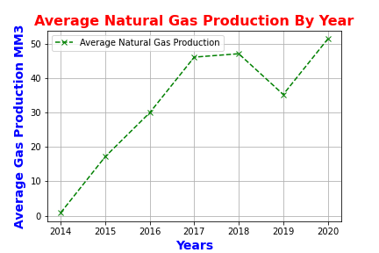
Data Analysis
Average Natural Gas Production By Year in Queensland

Slide 13
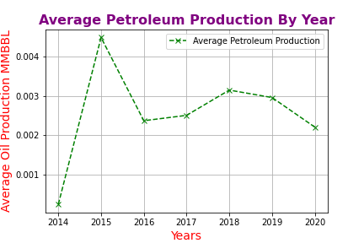
Data Analysis
Average Petroleum Production By Year in Queensland

Slide 14
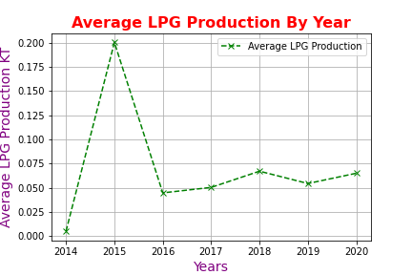
Data Analysis
Average Liquefied Petroleum Gas (LPG) Production By Year in Queensland

Slide 15
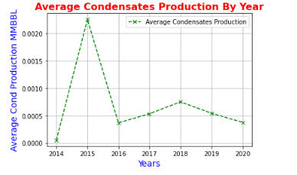
Data Analysis
Average Condensates Production By Year in Queensland

Slide 16
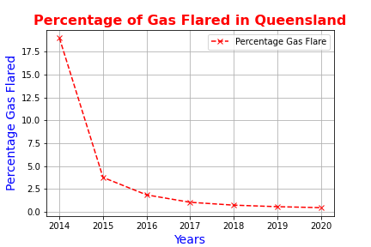
Data Analysis
The Percentage of Gas Flared By Year in Queensland

Slide 17
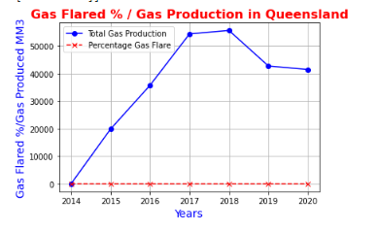
Data Analysis
Total Gas Produced vs. Percentage of Gas Flared By Year in Queensland

Slide 18
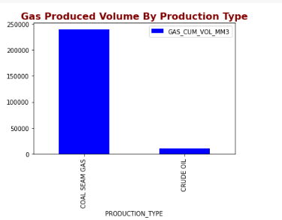
Data Analysis
Production Type That Produced the Most Gas in Queensland

Slide 19
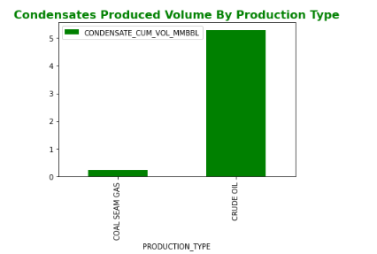
Data Analysis
Production Type That Produced the Most Condensates in Queensland

Slide 20
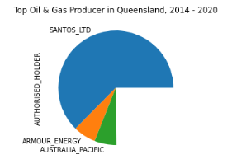
Data Analysis
The Top Oil and Gas Producer in Queensland

Slide 21
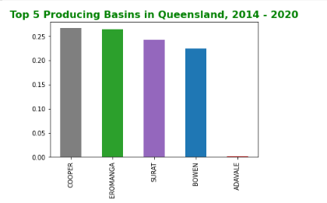
Data Analysis
The Top 5 Producing Basins in Queensland

Slide 22
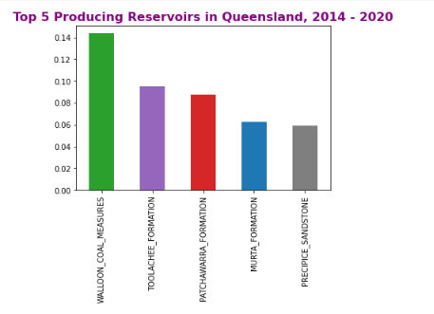
Data Analysis
The Top 5 Producing Reservoirs in Queensland

Slide 23
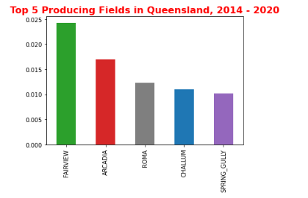
Data Analysis
The Top 5 Producing Fields in Queensland

Slide 24
Conclusions
The average gas production volume per annum in Queensland between 2014 and 2020 was 35.04 MM3.
The average oil production volume per annum in Queensland between 2014 and 2020 was 0.00276 MMBBL.
The average LPG production volume per annum in Queensland between 2014 and 2020 was 0.07486 KT.
The average condensates production volume per annum in Queensland between 2014 and 2020 was 0.00075 MMBBL.
The Percentage of Gas flared in Queensland in the year 2014, 2015, 2016, 2017, 2018, 2019, and 2020 were, 18.6%, 3.78%, 1.87%, 1.06%, 0.75%, 0.58%, and 0.48% respectively.
Coal Seam Gas production type produced more natural gas than condensates between the production types whereas the Crude Oil production type produced more condensates than natural gas.
The top oil producer in Queensland between 2014 and 2020 was Santos Limited.
The top 5 producing basins in Queensland from 2014 to 2020 were, Cooper, Eromanga, Surat, Bowen, and Adavale.
The top 5 producing reservoirs in Queensland from 2014 to 2020 were, Walloon Coal Measures, Toolachee Formation, Patchawarra Formation, Murta Formation, and Precipice Sandstone.
The top 5 producing fields in Queensland from 2014 to 2020 were, Fairview, Arcadia, Roma, Challum, and Spring Gully.

Slide 25
Recommendations
The average oil production volume showed a declining rate. Enhanced oil recovery methods could be used to increase production.
Although the amount of gas flared in Queensland was drastically reduced between 2014 and 2020, Oil and Gas Producers should aim to stop gas flaring entirely.

Slide 26
Thanks!

Slide 27
Credits
Special thanks to my instructor Prof Ali El-Sharif and to my teaching assistant Mr. Nail Senbas
The datasets for this analysis was got from Queensland government open data portal, https://www.data.qld.gov.au/dataset
This presentation template was got from https://www.slidescarnival.com

