Slide 1
Music in Motion: A Data Analysis of Spotify’s Daily Songs Ranking Across the Globe

Slide 2


HELLO!
I am Uchechukwu Amua
If you enjoy my presentation, let’s connect: https://linkedin.com/in/uchechukwu-amua

Slide 3
Exploring Global Listening Habits and Trends

Slide 4
One good thing about music, when it hits you, you feel no pain.
- Bob Marley

Slide 5
Here’s What You’ll be Expecting
Introduction
Data Collection and Storage
Exploratory Data Analysis (EDA)
Data Analysis Techniques
Conclusion
Roadmap
Q&A
Credits

Slide 6
Introduction
Spotify is a popular music streaming service used by millions of people around the world. As part of it’s platform, Spotify provides daily rankings of the top 200 most streamed songs in over 50 countries worldwide, giving us a unique opportunity to gain insights into global music trends and preferences. In this analysis, we will explore the daily ranking of songs or tracks on spotify and get to know the most popular songs or tracks over time among others.

Slide 7
Introduction (Objectives)
1.
To identify the top streaming songs of all time.
2.
To explore the distribution of songs across the regions.
3.
To analyze how the popularity of songs and artists varies by season or the time of the year.
4.
To investigate the correlation between the number of streams and the position on the chart.
5.
To determine whether different continents share the same top ranking songs or artists.
6.
To perform topic modeling on the artist and track names to explore trends and themes in the data.

Slide 8
Data Collection & Storage
The Spotify worldwide daily song ranking dataset was obtained from Kaggle, a platform for data science competitions and open datasets. The dataset contains daily rankings of the top 200 most streamed songs on Spotify across 53 countries and a “Global” category, from January 2017 to December 2018. The data was collected by scraping Spotify’s daily charts, and it includes information on the position, track, artist, streams, url, date , and region of the ranking.
To obtain the dataset, I used the Kaggle API to download the dataset directly into my Google Colab notebook. I then created a SQLite database named ‘spotify.db’, and a table ‘songs’ to store the data for further analysis.
It is essential to store data properly to avoid data loss, ensure data accuracy, and make data analysis more efficient.. Using the database to store the data made it easier to query and retrieve the needed data. After the analysis,, I was also able to save the results from my analysis back to the database. This ensures that data is well organized and easy to work with.

Slide 9
Exploratory Data Analysis (EDA)
Highlight how the popularity of songs and artists vary by season or month of the year
Show the distribution of songs across regions
Share the findings on whether continents share the same top ranking songs or artists
Present the top streaming songs of all time
Look at the correlation between the number of streams and the position on the chart

Slide 10
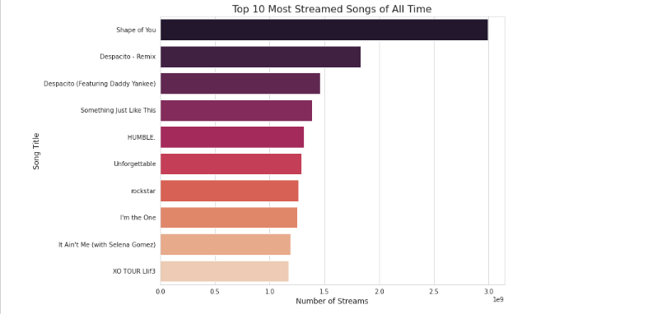
Top Streaming Songs of All Time

Slide 11
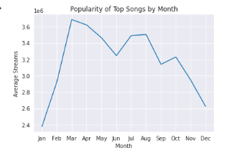
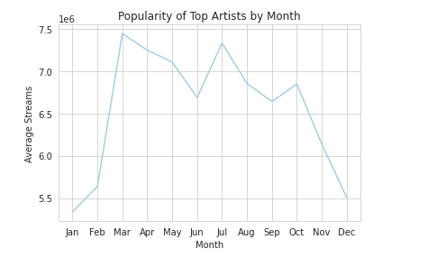
Popularity of Top Songs & Artists by Month

Slide 12
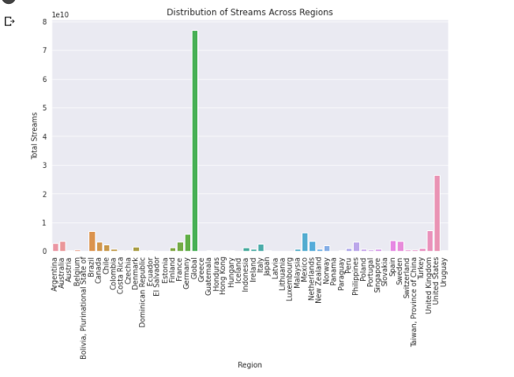
Distribution of Streams Across Regions

Slide 13
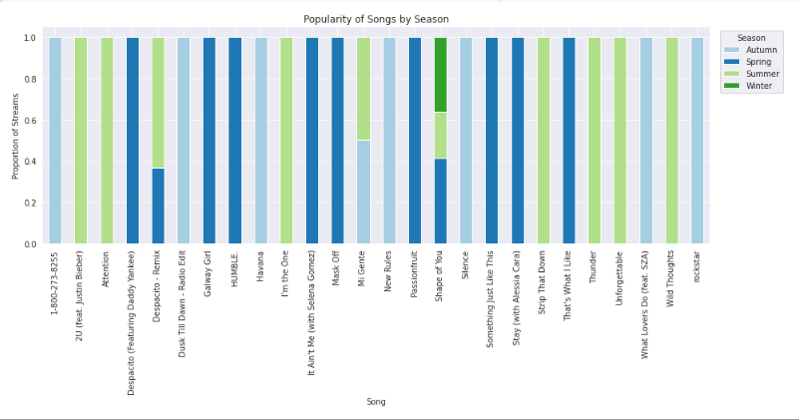
Popularity of Top Songs Across Seasons

Slide 14
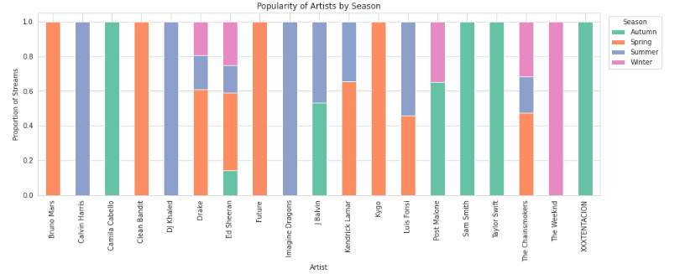
Popularity of Top Artists Across Seasons

Slide 15
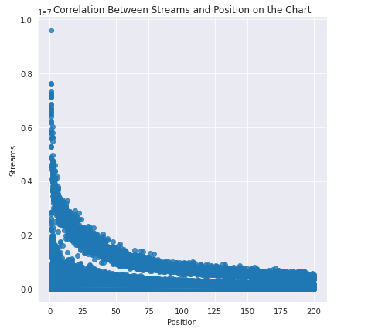
Correlation Between Number of Streams & Position on the Chart

Slide 16
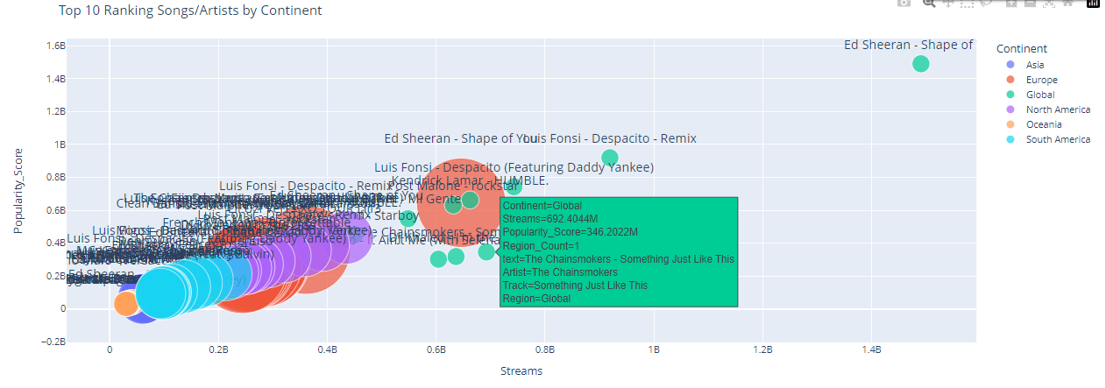
Do Continents Share Same Top Songs & Artists?

Slide 17
Data Analysis Techniques – Topic Modeling
LDA is a probabilistic model that generates a set of topics for a given document. Each topic is represented as a distribution over the words in the dictionary.
After generating the topic model, the next step was to interpret the topics and assign them labels based on their most frequent words.
This was done using a word cloud visualization, which shows the most frequent words in a topic as larger and bolder than less frequent words.
This was done using a Python library called Gensim, which allows for the creation of a corpus and a dictionary.
A corpus is a collection of text documents, while a dictionary is a list of all words in the corpus and their frequency of occurrence.
The corpus and dictionary were then used to build a topic model using the Latent Dirichlet Allocation (LDA) algorithm.
Topic modeling is a statistical technique used to identify abstract topics in a collection of text.
In this analysis, topic modeling was applied to the artist and track columns of the spotify dataset.
The goal was to identify trends and themes in the daily ranking songs data across the world.

Slide 18
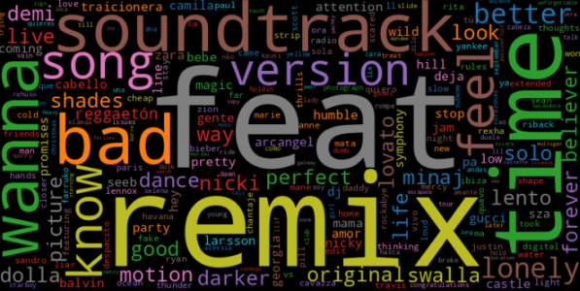
Top Trends & Themes in Tracks

Slide 19
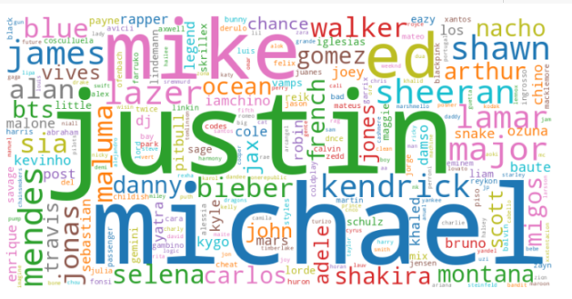
Top Trends & Themes in Artist

Slide 20
Conclusion
Based on my analysis of Spotify’s daily top songs ranking worldwide, I have discovered several key findings.
Firstly, the most streamed song of all time is “Shape of You” by Ed Sheeran.
Secondly, the distribution of streams across regions is highest in the “Global” category followed by the United States, and then the United Kingdom.
Thirdly, the popularity of songs and artists follow a seasonal pattern, with peaks in popularity during the summer months and declines during the autumn and winter months.
Interestingly, some top songs and artists displayed popularity across multiple seasons while others were only popular in one season.
Additionally, the analysis showed a strong negative correlation between the position on the chart and the number of streams.

Slide 21
Conclusion
Furthermore, the bubble plot revealed that some continents shared similar top songs and artists, with Europe and North America being the most similar.
The word clouds generated through topic modeling highlighted popular artists such as Justin Bieber and Ed Sheeran, and common themes in song titles such as feat (featuring) and remix (remixes). This suggests there were lots of featuring and remixes.
While this analysis provides valuable insights into Spotify’s daily top songs ranking, there are limitations to the study.
For instance, the data was limited to two years and may not be representative of trends over a longer period.
Overall, this analysis demonstrates the importance of proper data collection, storage, and analysis in gaining valuable insights into popular culture trends.
Future research could build on the findings by examining longer term trends, exploring the reasons behind seasonal patterns, and analyzing the impact of other factors on song and artist popularity.

Slide 22
ROADMAP
Data Collection and Storage
Data Visualization
Results Storage
1
3
5
2
4
6
Data Exploration and Cleaning
Data Analysis
Presentation and Reporting

Slide 23
THANKS!
Any questions?
You can find me at @ uchechukwu.amua@contech.university

Slide 24
CREDITS
Special thanks to all the people who made this analysis possible:
Alper Has – My Course Instructor for being a great instructor and providing detailed explanations on the course subject.
Nail Senbas – My Teaching Assistant for always being there to help.
Kaggle (https://www.kaggle.com/datasets/edumucelli/spotifys-worldwide-daily-song-ranking) – Where I obtained the data for this analysis
SlidesCarnival (https://www.slidescarnival.com) – For releasing this awesome template for free.

