Slide 1
DESCRIPTIVE AND INFERENTIAL STATISTICS By AMUA, Uchechukwu Roseline Supervisors: PROF. FEMIN YALCIN and MR. NAIL. SENBAS Department of COMPUTER SCIENCE CONTEMPORARY TECHNOLOGY University NOVEMBER, 2022

Slide 2
Contents
Introduction
Data Set
Descriptive Statistics
Visualizations
Interval Estimation
Simple Linear Regression
Interpretations
References
Acknowledgements

Slide 3
Introduction
Descriptive Statistics tells us about, displays, and summarizes the basic parameters or characteristics of a data set conducted in a given study.
Inferential Statistics helps us to come to conclusions and make predictions based on our observations or data..
Inferential Statistics are useful for making estimations or testing hypothesis.

Slide 4
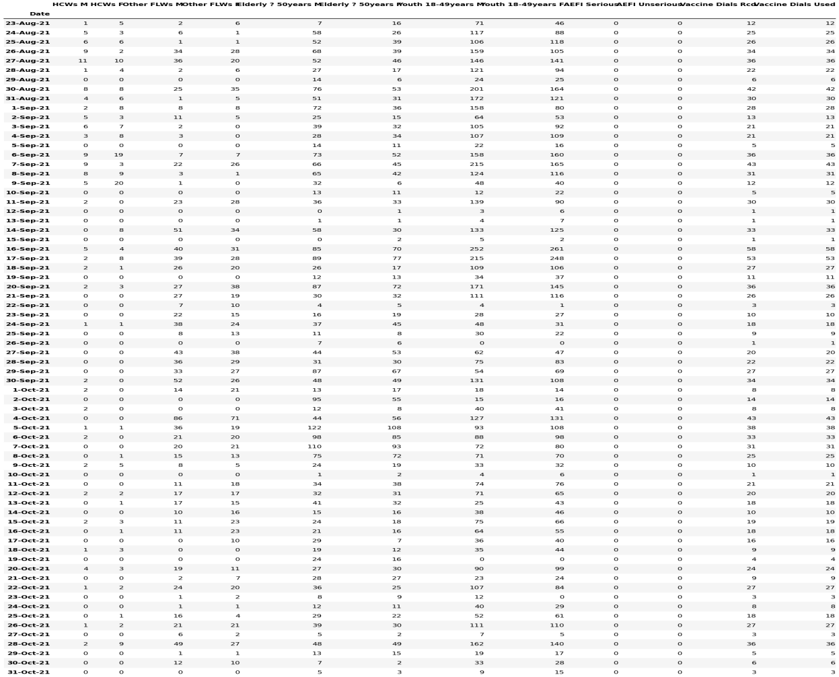
Data set
This data set was gotten from records of Covid-19 vaccinations in Obio Akpor Local Government Area of Rivers State, Nigeria between a period in August 2021 to October 2021 for first-dose **moderna** vaccinations only.

Slide 5
Descriptive Statistics
Summary Statistics
 | HCWs M | HCWs F | Other FLWs M | Other FLWs F | Elderly 50+ M | Elderly 50+ F | Youths 18-49 M | Youths 18-49 F
count | 70 | 70 | 70 | 70 | 70 | 70 | 70 | 70
mean | 1.86 | 2.57 | 15.21 | 13.24 | 37.58 | 30.18 | 76.88 | 70.41
std | 2.75 | 4.12 | 17.15 | 13.56 | 29.45 | 24.16 | 61.32 | 56.18
min | 0 | 0 | 0 | 0 | 0 | 1 | 0 | 0
25% | 0 | 0 | 1 | 1 | 13.25 | 11.25 | 25.75 | 25.5
50% | 0.5 | 0.5 | 10.5 | 10 | 29.5 | 26.5 | 67.5 | 63
75% | 2. | 3 | 23.75 | 21 | 52 | 44.25 | 115.5 | 107.5
max | 11 | 20 | 86 | 71 | 122 | 108 | 252 | 261

Slide 6
Descriptive statistics
Covariance Matrix
 | HCWs M | HCWs F | Other FLWs M | Other FLWs F | Elderly 50+ M | Elderly 50+ F | Youths 18-49 M | Youths 18-49 F
HCWs M | 7.57 | 7.42 | 4.62 | 3.02 | 30.78 | 17.36 | 107.89 | 89.38
HCWs F | 7.42 | 16.9 | 1.93 | -1.71 | 36.16 | 17.05 | 126.70 | 112.42
Other FLWs M | 4.62 | 1.93 | 294.28 | 211.05 | 230.81 | 242.95 | 563.94 | 553.20
Other FLWs F | 3.02 | -1.706 | 211.05 | 183.95 | 178.07 | 183.74 | 455.57 | 424.01
Elderly 50+ M | 30.78 | 36.16 | 230.81 | 178.07 | 867.32 | 663.42 | 1165.17 | 1116.68
Elderly 50+ F | 17.36 | 17.05 | 242.95 | 183.74 | 663.42 | 583.66 | 886.67 | 904.46
Youths 18-49 M | 107.89 | 126.70 | 563.94 | 455.57 | 1165.17 | 886.67 | 3759.93 | 3285.45
Youths 18-49 F | 89.38 | 112.42 | 553.20 | 424.01 | 1116.68 | 904.46 | 3285.45 | 3157.06

Slide 7
Descriptive statistics
Correlation Matrix
 | HCWs M | HCWs F | Other FLWs M | Other FLWs F | Elderly 50+ M | Elderly 50+ F | Youths 18-49 M | Youths 18-49 F
HCWs M | 1 | 0.65 | 0.09 | 0.08 | 0.38 | 0.26 | 0.64 | 0.58
HCWs F | 0.65 | 1 | 0.03 | -0.03 | 0.30 | 0.17 | 0.50 | 0.48
Other FLWs M | 0.09 | 0.03 | 1 | 0.91 | 0.45 | 0.58 | 0.53 | 0.57
Other FLWs F | 0.08 | -0.03 | 0.91 | 1 | 0.44 | 0.56 | 0.55 | 0.56
Elderly 50+ M | 0.38 | 0.30 | 0.45 | 0.44 | 1 | 0.93 | 0.64 | 0.67
Elderly 50+ F | 0.26 | 0.17 | 0.58 | 0.56 | 0.93 | 1 | 0.59 | 0.66
Youths 18-49 M | 0.64 | 0.50 | 0.53 | 0.55 | 0.64 | 0.59 | 1 | 0.95
Youths 18-49 F | 0.58 | 0.48 | 0.57 | 0.56 | 0.67 | 0.66 | 0.95 | 1

Slide 8
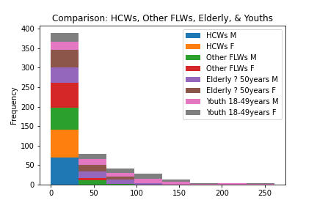
Visualizations
Stacked Histograms
Figure One: Frequency Distribution of Features

Slide 9
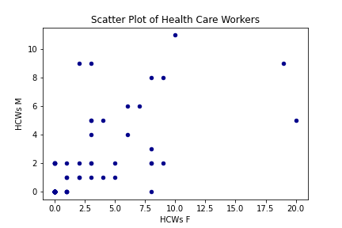
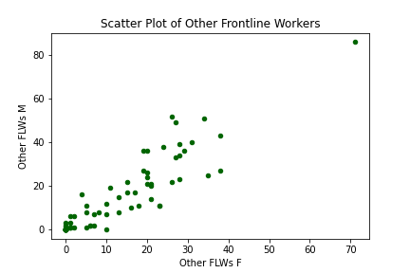
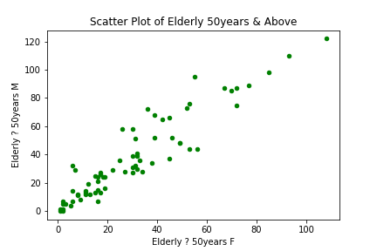
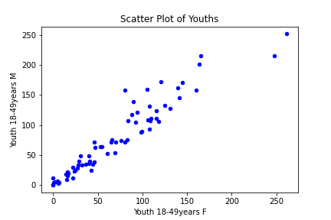
Scatter plots
Visualizations
Scatterplot of Healthcare Workers
Scatterplot of Other Frontline Workers
Scatterplot of Elderly 50years +
Scatterplot of Youths 18-49years

Slide 10
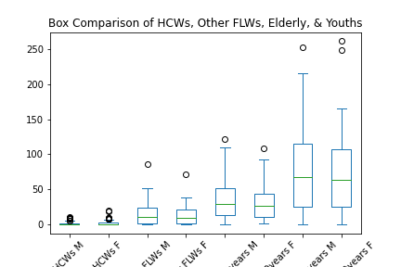
visualizations
Box comparison of features
Figure 3: Box plots

Slide 11
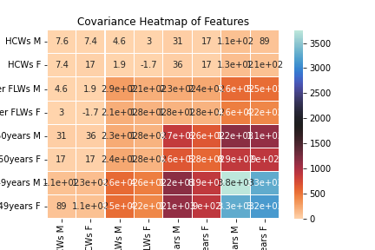
visualizations
Heat Map Display of Covariance Matrix of Features
Figure 4: Covariance Heatmap

Slide 12
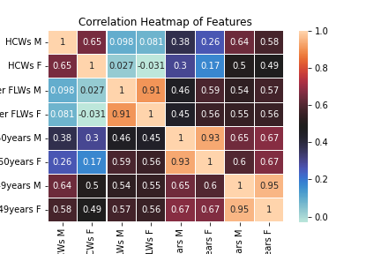
visualizations
Heat Map Display of Correlation Matrix of Features
Figure 4: Correlation Heatmap

Slide 13
Interval estimation
Feature One: Healthcare Workers
A 95% Confidence Interval for Mu When Sigma is Known
Sample size = n = 40
Xbar = sample mean
Sigma = population standard deviation
Rf = z_critical
Se = sigma/square root of n
Me = Rf * Se
CI = (Xbar – Me, Xbar + Me)
A 95% CI for mu: (0.738, 2.912)
Feature Two: Youths
A 99% Confidence Interval for Mu When Sigma is unknown
Sample size = n1 = 30
Sample_mean = sample mean
Sample_std = sample standard deviation(ddof=1)
Rf = t_critical
Se = sample_std/square root of n1
Me = Rf * Se
LCL = Sample_mean – Me,
UCL = Sample_mean + Me
CI = (LCL, UCL)
A 99% CI for mu: (56.52 , 115.67)

Slide 14
Simple linear regression
A Comparison Between the Output Variable & the Predicted Output
Date | Y | Y-Predicted
23-Aug-2021 | 12 | 14.15
24-Aug-2021 | 25 | 23.82
25-Aug-2021 | 26 | 30.71
26-Aug-2021 | 34 | 27.77
27-Aug-2021 | 36 | 36.00
28-Oct-2021 | 36 | 35.77
29-Oct-2021 | 5 | 7.4
30-Oct-2021 | 6 | 10

Slide 15
Interpretations
The descriptive statistics section gave a summary statistics of the data set.
The distribution of data in the stacked histogram showing comparison among features is right-skewed. Also, more females than their male counterparts in all features were vaccinated.
Some outliers can be seen at the tail end for some features.
The scattered plot for health workers showed a weak correlation among variables.
The scattered plot for other frontline workers showed a not strong relationship between variables.
The scattered plot for elderly 50+ showed a not so strong relationship among variables.
The scattered plot for youths showed a very strong relationship between variables.
The comparison box plots among features showed that all of the features have a right-skewed distribution. We can also see the outliers, some of which are very close to the range of values while others are farther from the range. The length of the box represents the interquartile range IQR. The longer the length of box the longer the distance between the third quartile and the first quartile. Hence, the larger the IQR. The edge of the lower whisker represents the minimum value, the lower edge of the box represents the first quartile, the middle line represents the second quartile or median, the upper edge of the box represents the third quartile, while the edge of the upper whisker represents the maximum value.
The covariance heat map makes it easy for us to visualize and understand the relationship between variables. The change in colour indicates an increase in covariance.

Slide 16
Interpretations
The larger the covariance, the closer the relationship as can be seen in the relationship
between "Youth 18-49years M" and "Youth 18-49years F".
The correlation heat map showed the relationship between features.
From the color scale it is easy to see this relationship. The correlation coefficient usually between -1 and 1 tells us the degree to which two features move in sequence.
From the correlation heat map, the features **Youth 18-49years M** and **Youth 18-49years F** had the strongest relationship between them with a correlation coefficient of 0.95
Whereas, the features **HCWs F**(female healthcare workers) and **Other FLWs F**(Other female frontline workers) had the weakest relationship between them with a correlation coefficient of -0.03
The first feature estimated the mean of the subset *Healthcare Workers* when sigma is known.We obtained a 95% confidence interval that our mu of feature one *healthcare workers* when sigma is known falls in the range(0.863, 3.037).
The second feature estimated the mean of the subset Youths when sigma is unknown.
We obtained a 99% confidence interval that our mu of feature two *youths* when sigma is unknown falls in the range(55.218, 123.582).
From our simple linear regression model, we obtained an Rsquared of 0.906. This is about 90.6% proportion of the variance in our dependent variable that is predictable from our independent variable.

Slide 17
REFERENCES
Adi Bronshtein (2017). Article on Simple and Multiple Linear Regression. Retrieved from http://towardsdatascience.com/simple-and-multiple- linear-regression-in-python-C92842516819
Contemporary Technology University (2022). Probability & Statistics Essentials. Contech.
Walpole, R.E, Myers, R.H, Myers, S.L, and Ye, K. (2007). Probability &
Statistics for Engineers & Scientists, 9th edition, Pearson Education, inc.

Slide 18
Acknowledgements
My appreciation goes to my instructor Professor Femin Yalcin for doing a great job of delivering the lectures in a friendly and easy to understand way through out the entire duration of the course.
My appreciation also goes to my Teaching Assistant, Mr. Nail Senbas, for always being supportive and ready to provide assistance when needed.
Lastly to my classmates, family, and friends, who one way or the other supported me through the length of the course.
I thank you all.

