Slide 1

FINDIND PALINDROMES, LONGEST PALINDROME AND PATTERN FINDING
Presented by : V Deelip Sai Ram, G Rohith Reddy, M Tejaswini Naga Pavani
Academic Year : 2025-26
Project Guide : Dr.Y.Praveen Kumar Reddy
Date : 13/05/2026

Slide 2


Abstract
This project focuses on the implementation of algorithms related to string processing, specifically finding palindromes, identifying the longest palindrome, and performing pattern matching in a given text. String analysis is an important area in computer science with applications in text processing, data validation, bioinformatics, and search engines.
A palindrome is a sequence of characters that reads the same forward and backward. The program developed in this project is capable of detecting whether a given string is a palindrome and also identifying the longest palindromic substring present in the input. In addition, the project includes pattern finding techniques to search for the occurrence of a specific pattern within a larger text efficiently.
The implementation uses fundamental programming concepts such as strings, arrays, Loops , and conditional statements. Efficient algorithms are applied to reduce the computational complexity and improve the performance of pattern searching and palindrome detection.
The project demonstrates the practical application of string manipulation and algorithm design in solving real-world text-processing problems. The results obtained show that the implemented solution correctly identifies palindromes, determines the longest palindromic substring, and successfully locates patterns in the given input text.
2

Slide 3
Introduction
String processing is one of the fundamental areas in computer science and plays an important role in applications such as text editing, search engines, data analysis, bioinformatics, and information retrieval systems. Among the many string-related problems, palindrome detection and pattern matching are widely studied due to their practical significance and algorithmic challenges.
A palindrome is a sequence of characters that remains the same when read from left to right and right to left. Examples include words such as “madam” and “level.” Finding palindromes within a string and identifying the longest palindromic substring are common problems in text analysis and computational linguistics.
Another important aspect of string processing is pattern finding, which involves searching for the occurrence of a specific pattern within a larger text. Pattern matching algorithms are extensively used in search engines, plagiarism detection, DNA sequence analysis, and data filtering applications.
The project utilizes concepts such as arrays, strings, loops, and algorithmic techniques to solve these problems effectively.
3

Slide 4
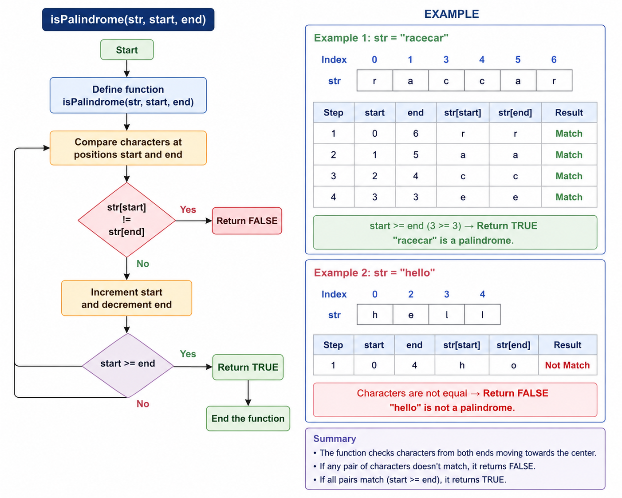
PALINDROME ALGORITHM
Algorithm 1 : Checking Whether a Substring is a Palindrome
Start the program.
Define a function is Palindrome(str, start, end).
Compare characters at positions start and end.
If the characters are not equal:
Return FALSE.
Increment start and decrement end.
Repeat Steps 3–5 until start is greater than or equal to end.
Return TRUE if all character match.
End the function.
4

Slide 5
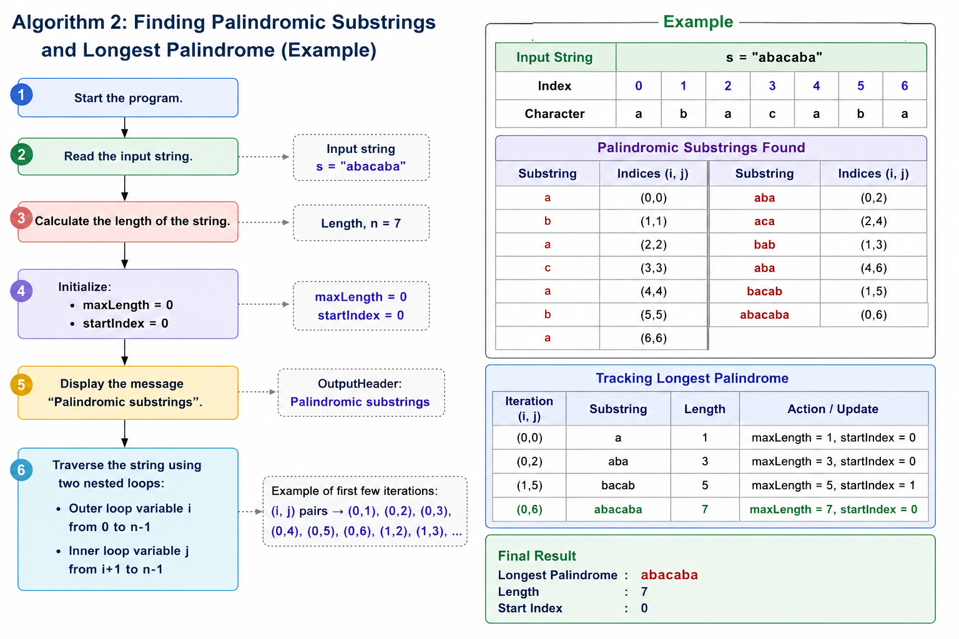
Algorithm 2:
Finding Palindromic Substrings and Longest Palindrome
1. Start the program.
2. Read the input string.
3. Calculate the length of the string.
4. Initialize:
a. maxLength = 0
b. startIndex = 0
5. Display the message “Palindromic substrings”.
6. Traverse the string using two nested loops:
a. Outer loop variable i from 0 to n-1
b. Inner loop variable j from i+1 to n-1
5

Slide 6
7. Call the function isPalindrome(str, i, j).
8. If the substring is a palindrome:
Print the substring
Calculate its length.
If the length is greater than maxLength:
– Update maxLength
– Update startIndex
9. Repeat until all substrings are checked.
10. If maxLength > 0:
Print the longest palindrome
Print “No palindrome found
11.Otherwise:
Print “No palindrome found”.
12. Stop thr program.
algorithm
6

Slide 7
Algorithm 3: Naive Pattern Searching
Start the program.
Read the input text string.
Read the pattern string.
Calculate:
Length of text = n
Length of pattern = m
Initialize a variable found = 0.
Traverse the text from index 0 to n-m
For each position:
Compare the pattern characters with the corresponding text characters.
If all characters match:
Print the starting index of the pattern.
Set found = 1.
7

Slide 8
9. Continue searching until the end of the text.
10. If no match is found:
• Print “None”.
11. Stop the program.
Time Complexity:
• Palindrome Checking: O(n)
• Finding All Palindromic Substrings: O(n3)
• Pattern Searching (Naive Method): O(n × m)
where:
• n = length of the text/string
• m = length of the pattern
Space Complexity:
The space complexity is approximately O(1) excluding input storage, since only a few
additional variables are used during execution.
8
8

Slide 9
EXAMPLE
Input: text = "geeksforgeeks", pattern = "geeks“
Output: [0, 8]
Explanation: The string "geeks" occurs at index 0 and 8 in text.
Input: text = "aabaacaadaabaaba", pattern = "aaba“
Output: [0, 9, 12]
9

Slide 10
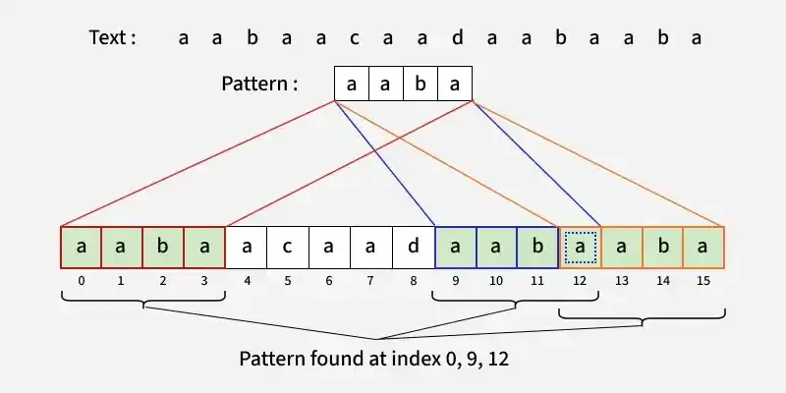
EXAMPLE
kmp-algorithm-for-pattern-searching
10

Slide 11
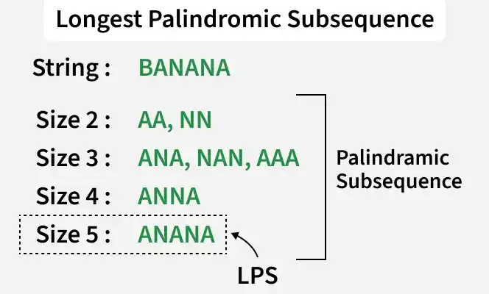
EXAMPLE
Longest Palindromic Subsequence (LPS)
10

Slide 12
Real Life Applications:
TEXT PROCESSING: Searching for keywords in a document, finding and replacing text, spell checking, and plagiarism detection.
INFORMATION RETRIVAL: Finding relevant documents in a database, web search, and data mining.
BIOINFORMATICS: Searching for DNA sequences in a genome, protein analysis, and gene expression analysis
NETWORK SECURITY: Detecting malicious patterns in network traffic, intrusion detection, and malware analysis.
DATA MINING: Identifying patterns in large datasets, customer segmentation, and fraud detection.
11

Slide 13
REFERENCES
GeeksforGeeks, “Palindrome in a String,” Available at: https://www.geeksforgeeks.org
GeeksforGeeks, “Pattern Searching Algorithms,” Available at: https://www.geeksforgeeks.org
ChatGPT
Yashavant P. Kanetkar, Let Us C, BPB Publications.
Aho, A. V., Sethi, R., and Ullman, J. D., Compilers: Principles, Techniques, and
Tools, Addison-Wesle
12

Slide 14
Thank You BY V Deelip Sai Ram (25261A04J9) G Rohith Reddy (25261A04J0) M Tejaswini (25261A04G1)
13

