Slide 1
NORTHPOINT
Northpoint Digital
Innovation Fund
MANDATE OUTCOME
$279m
from a $100 million mandate
+179.2% cumulative
18.7% a year
6.6% alpha, t = 3.06
Six-year performance review · January 2017 – December 2022
Final report to investors · New York · San Francisco · London · Hong Kong · Shanghai · Sydney
Callum O'Connor · Portfolio Manager
Student ID 14053836 · FINC13-303 Portfolio Analysis and Investments · Bond University
Notes:
Good morning, good afternoon, good evening, depending on where you're joining from. I'm Callum O'Connor, Portfolio Manager of the Northpoint Digital Innovation Fund.
6 years ago you gave this fund $100 million and one instruction. Own the winners of digital transformation, right across the economy, and do it with discipline. Today I'm closing the book on that mandate.
The headline is on the right of your screen. That $100 million is now $279 million. 179% in total, or 18.7% a year. And we got there through a trade war, a pandemic, the fastest bear market in history, and the sharpest rate shock in 40 years.
Over the next 25 minutes I'll cover four things. Where that money came from. How much risk we took to get it. Whether any of it was skill. And what I think you should do next.

Slide 2
02
Agenda
Six sections, twenty-five minutes, then questions
1
Where we started
The mandate, the theme, and how the fund was actually run
2
The economy we lived through
Six years, three regimes, and how our 2016 scenarios held up
3
What the fund returned
Wealth created, benchmarked, and stress-tested through COVID and 2022
4
How much risk we took
Distribution, risk-adjusted returns, tail risk, and seasonality
5
Was it skill?
Jensen's alpha, factor models, attribution, and the optimised counterfactual
6
The verdict
Objective scorecard, fees, and our recommendation on the fund's future
NORTHPOINT DIGITAL INNOVATION FUND
Six-year review · Jan 2017 – Dec 2022
Notes:
Let me tell you how I'll use your time.
I'll start with the mandate you funded, and whether we stuck to it. Then the economy, because 6 years is a long time. We lived through three quite different regimes.
Then what the fund returned, and how it behaved in the two moments that mattered. Then how much risk we took.
Then comes the section I care about most. Whether any of this was skill. And I'll finish with the verdict, the fees, and my recommendation.
Questions at the end. And there's a full appendix if you want to go deeper.

Slide 3
03
The six-year result
Every figure on this slide is calculated from 72 months of dividend-adjusted total returns and is reproduced in the appendix
+179.2%
18.7%
0.94
-24.9%
CUMULATIVE RETURN
ANNUALISED RETURN
SHARPE RATIO
MAXIMUM DRAWDOWN
$100m mandate grew to $279.2m.
S&P 500 returned +90.0%;
NASDAQ-100 +134.7%.
Against a target of 8–10% net p.a.
S&P 500 11.3%; NASDAQ-100 15.3%.
Highest of every comparator.
NASDAQ-100 0.75; S&P 500 0.65.
Sortino 1.51.
Shallower than our own benchmark.
NASDAQ-100 fell 32.6%.
6.6%
1.04
0.98
50 / 72
ALPHA P.A. (FF5)
BETA TO THE MARKET
INFORMATION RATIO
POSITIVE MONTHS
Fama–French five-factor Jensen's
alpha, t = 3.06, p = 0.002.
Statistically significant.
Market-like sensitivity.
The excess return is not
simply leverage on the index.
Active return per unit of
tracking error vs the S&P 500
(6.98% tracking error).
A 69.4% hit rate.
Average up month +4.6%,
average down month −5.2%.
NORTHPOINT DIGITAL INNOVATION FUND
Six-year review · Jan 2017 – Dec 2022
Notes:
Before I unpack any of it, here's the whole 6 years on one slide.
Start top left. 179% in total. Over the same window the S and P 500 returned 90%. The NASDAQ-100 returned 135%, and that's our main benchmark and the harder test. Annualised, we compounded at 18.7% a year, against a target of 8% to 10%.
Now look at the second row just as carefully. Our Sharpe ratio is 0.94, the highest of every comparator I tested. Our worst drawdown is minus 24.9%, which is shallower than the NASDAQ-100 managed. So we didn't simply take more risk to get more return.
And here's the number I'd point to above all the others. 6.6% of alpha a year on a five-factor model, with a t-statistic of 3.06. The chance that's luck is about 2 in 1,000. Our beta was 1.0, so it wasn't borrowed money either.

Slide 4
01
Where we started
The mandate you funded in 2016, the eleven positions we bought, and whether we stayed faithful to the brief
NORTHPOINT

Slide 5
05
WHERE WE STARTED
Where we started
The mandate you funded
Nothing in the strategy changed over six years. The discipline was in the rules, not in the reacting
MANDATE PARAMETER | WHAT WE COMMITTED TO IN JANUARY 2016
Capital | US$100 million, six-year fund life (Jan 2017 – Dec 2022)
Strategy | Active, high-conviction thematic equity — technology and innovation
Theme | Digital transformation: cloud, mobile data, payments, automation, genomics
Holdings | Eleven US-listed stocks — exactly one per GICS sector
Weighting | Conviction tiers, 5% floor per sector, 16% cap on the largest position
Rebalancing | Quarterly, plus a 5-percentage-point drift threshold; mid-life review at end-2019
Primary benchmark | NASDAQ-100 (theme-aligned — measures selection skill within the theme)
Secondary benchmark | S&P 500 (broad market — measures whether the theme was worth owning)
Fees | 0.90% p.a. management + 10% of returns over the hurdle, high-water mark
Return target | 8–10% net p.a., roughly 55–70% cumulative net over the fund life
NORTHPOINT DIGITAL INNOVATION FUND
Six-year review · Jan 2017 – Dec 2022
Notes:
This is the contract, and I've put it up unedited. The first test of a manager isn't performance. It's whether the thing you bought is the thing you got.
We said we'd run an active, high-conviction thematic fund, and the theme was digital transformation. 11 stocks, one in every GICS sector. A pure technology fund would have been an easier story to sell. But it would have failed the diversification requirement, and it would have hurt us badly in 2022.
We put two hard limits on the weights. Every sector holds at least 5%, and no position goes above 16. And we rebalance every quarter.
The last line is the one to hold onto. We said we were targeting 8% to 10% a year, after fees. I'll mark us against that at the end.

Slide 6
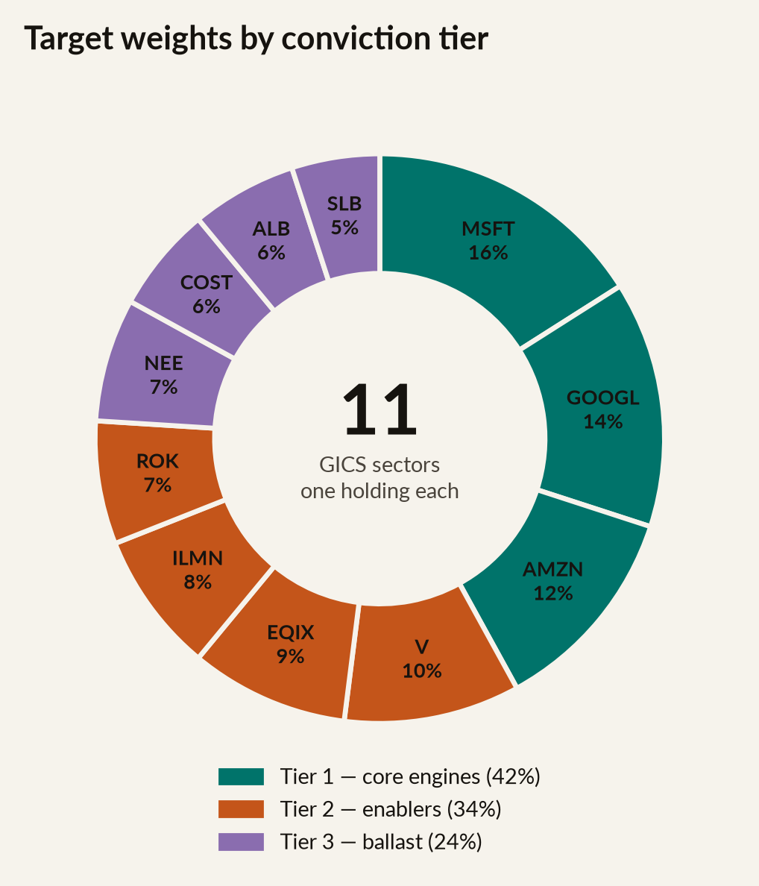
06
WHERE WE STARTED
Where we started
Eleven sectors, one idea
The theme was expressed through conviction tiers, never by abandoning a sector
HOW THE BOOK WAS BUILT
Tier 1, 42%. Microsoft, Alphabet and Amazon: the platform companies where the cloud, advertising and e-commerce theses all compound at once. Highest conviction, largest weights.
Tier 2, 34%. Visa, Equinix, Illumina and Rockwell: the enablers. Each monetises digitisation in one specific channel — payments, data centres, genomics, factory automation.
Tier 3, 24%. NextEra, Costco, Albemarle and Schlumberger: diversification and ballast, each still carrying an innovation or recovery angle.
The floor mattered. Energy at 5% and Materials at 6% looked like drag for five years. In 2022 they were the two reasons our drawdown ran ten points shallower than the NASDAQ's.
NORTHPOINT DIGITAL INNOVATION FUND
Six-year review · Jan 2017 – Dec 2022
Notes:
Here's the book, coloured by conviction tier.
Tier one is 42% of the money, in three platform companies. These are the ones where several parts of the thesis pay off at the same time. Microsoft was our largest position at 16%.
Tier two is 34%, and I call these the enablers. Each one makes money from digitisation through a single channel. Visa is payments. Equinix is data centres. Illumina is genomics. Rockwell is factory automation.
Tier three is the last 24%, and that's our ballast.
Now, the point at the bottom is the one I'd ask you to remember. For 5 of these 6 years, holding Schlumberger at 5% looked like a tax on the portfolio. People asked me again and again why we didn't just drop the sector. We didn't drop it because the mandate said every sector keeps a floor. And in 2022, that discipline is exactly what saved us.

Slide 7
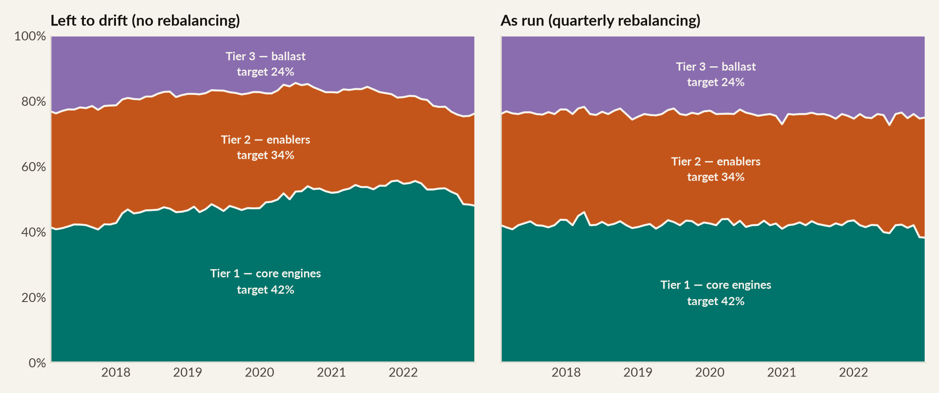
07
WHERE WE STARTED
Where we started
We rebalanced. That was a decision, and it paid.
Quarterly rebalancing added 1.3 percentage points a year over letting the winners run
 | CUMULATIVE | CAGR | SHARPE | MAX DRAWDOWN | TERMINAL ON $100M
Quarterly rebalanced (as run) | 179.2% | 18.7% | 0.94 | -24.9% | $279m
Left to drift (buy & hold) | 160.9% | 17.3% | 0.88 | -27.8% | $261m
NORTHPOINT DIGITAL INNOVATION FUND
Six-year review · Jan 2017 – Dec 2022
Notes:
On the left is what would have happened if we'd bought the 11 stocks and never touched them. Tier one would have grown from 42% of the book to 48%. Microsoft alone would have reached 25%. You'd have ended up owning a concentrated mega-cap technology fund, and it would look nothing like the mandate you signed.
On the right is what we actually did.
Now look at the table. Rebalancing wasn't box-ticking. It was worth $18 million to you. That's 1.3 points a year of extra return, a higher Sharpe ratio, and a drawdown 3 points shallower. The reason is simple. Rebalancing kept trimming the winners when they were high, and topping up the laggards when they were low.

Slide 8
02
The economy we lived through
Three distinct regimes in six years — and an honest mark-to-market of the scenarios we published in January 2016
NORTHPOINT

Slide 9
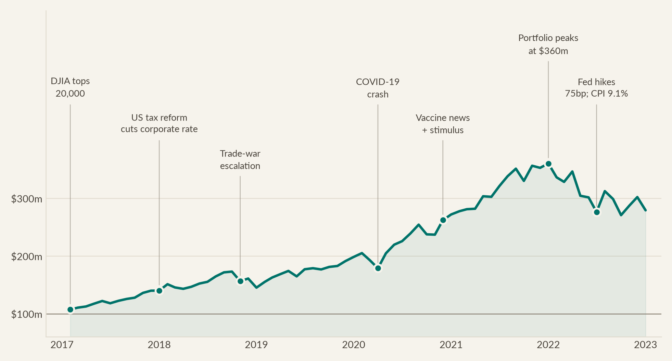
09
THE ECONOMY WE LIVED THROUGH
The economy we lived through
Six years, seven turning points
The events that shaped the fund, plotted against the wealth they created or destroyed
NORTHPOINT DIGITAL INNOVATION FUND
Six-year review · Jan 2017 – Dec 2022
Notes:
We opened in January 2017, the month the Dow crossed 20,000. The fund returned 40% that year. The December tax reform lifted after-tax earnings across the book, and cloud adoption sped up exactly as we'd argued.
2018 was our first hard year. The trade war escalated and the fourth quarter was brutal. We lost 9.6% in October and another 9.8% in December. We still finished up 3.7%, while the S and P fell 4.5%.
2019 was the recovery, on the back of the Fed turning to rate cuts. Then March 2020, which I'll come back to.
The fund peaked in December 2021 at $360 million. That was within weeks of the Fed dropping the word transitory. 2022 gave a good chunk of it back.

Slide 10
10
THE ECONOMY WE LIVED THROUGH
The economy we lived through
The macro backdrop, regime by regime
How the state of the economy translated into the portfolio's returns
2017 – 2019
2020 – 2022
SYNCHRONISED GROWTH
PANDEMIC, STIMULUS, THEN THE RATE SHOCK
2017: +40.0% Synchronised global growth, benign inflation, a gradual Fed. US tax reform cut the corporate rate from 35% to 21%, lifting after-tax earnings across the book.
2020: +37.1% The COVID crash took 12.6% off the fund in two months. Then the pandemic became the single largest accelerant our thesis ever received: remote work, e-commerce and cloud migration pulled forward by years.
2018: +3.7% Trade-war escalation and a hawkish Fed produced a violent Q4. We lost 9.6% in October and 9.8% in December — and still finished positive while the S&P fell 4.6%.
2021: +32.5% Reopening, record stimulus and peak growth valuations. Our thesis was consensus by now — which is usually the warning sign, and it was.
2022: −22.5% The sharpest tightening cycle since 1981. CPI peaked at 9.1%; the Fed raised 425bp. Long-duration growth equity de-rated hardest. Our energy and materials ballast is why we fell 10 points less than the NASDAQ-100.
2019: +36.6% The Fed pivoted to cutting. Multiple expansion did most of the work; cloud and payments earnings kept compounding underneath it.
NORTHPOINT DIGITAL INNOVATION FUND
Six-year review · Jan 2017 – Dec 2022
Notes:
The first 3 years were broadly the world we said we expected. Moderate growth, contained inflation, a gradual Fed, and spending shifting towards cloud, mobile and payments. 2018 was the exception. The trade war was a risk we'd flagged, but we sized it wrongly.
The second 3 years are more interesting. Go back to our 2016 Scenario C and we wrote, and I'm quoting, another systemic disruption such as a global pandemic. We put 20% on it. Then it happened.
And here's the part we got right for the right reason. We'd argued that cloud migration and payment digitisation carry on even in a recession, because they save companies money. COVID didn't slow our theme. It sped it up by years.
2022 was different. That year tested the diversification rather than the theme. When the discount rate moves from zero to 4.25%, growth shares get repriced. There was nowhere to hide inside our theme. Only the ballast helped.

Slide 11
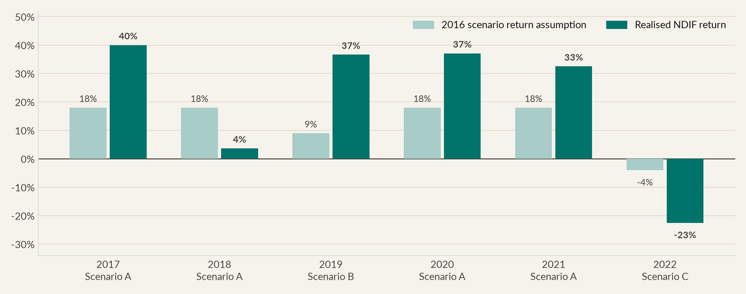
11
THE ECONOMY WE LIVED THROUGH
The economy we lived through
Marking our 2016 scenarios to market
We were right about direction in five of six years, and consistently too conservative about magnitude
SCENARIO (AS PUBLISHED, JAN 2016) | ASSIGNED PROBABILITY | ASSUMED RETURN P.A. | YEARS IT ACTUALLY DESCRIBED | VERDICT
A — Growth & digital acceleration | 50% ST / 40% MT | +18% | 2017, 2018, 2020, 2021 | Occurred in 4 of 6 years
B — Stagnation / low-growth grind | 30% ST / 30% MT | +9% | 2019 | Understated: we returned 36.6%
C — Recession / risk-off shock | 20% ST / 30% MT | −4% | 2022 | Understated: we lost 22.5%
NORTHPOINT DIGITAL INNOVATION FUND
Six-year review · Jan 2017 – Dec 2022
Notes:
In 2016 we published three scenarios, with explicit probabilities and returns. The pale bars are what we said. The dark bars are what we delivered.
Two honest observations. We got the direction right in 5 of 6 years. But we were consistently too cautious about the size of the moves, in both directions. In 2017 we assumed 18% and delivered 40%. In 2019 we thought we were in a stagnation world worth 9%, and delivered 37%. And in 2022 we'd assumed a recession would cost 4%, when it cost us 22.5.
So here's the lesson. Scenario planning is good at telling you which world you're in. It's poor at telling you how violent that world is going to be.

Slide 12
03
What the fund returned
Wealth created, benchmarked against the indices you are paying us to beat, and stress-tested through the two events that mattered
NORTHPOINT

Slide 13
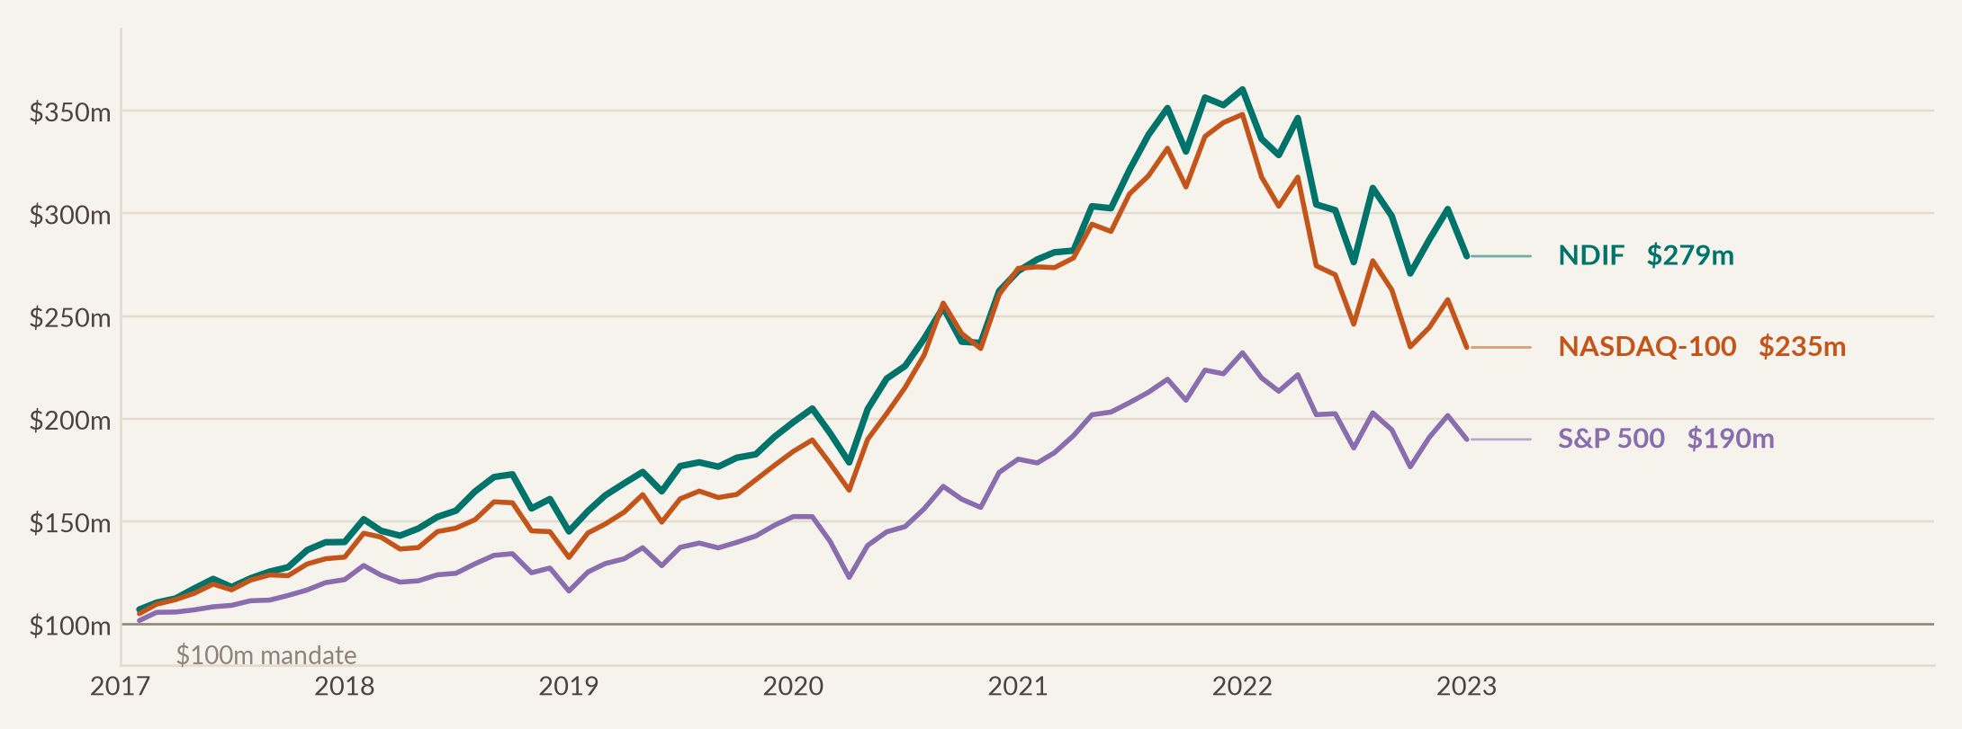
13
WHAT THE FUND RETURNED
What the fund returned
A $100m mandate became $279m
Ahead of the S&P 500 by 89 percentage points, and ahead of our own theme-aligned benchmark by 44
 | CUMULATIVE | CAGR | TERMINAL VALUE ON $100M | VALUE ADDED VS NDIF
Northpoint Digital Innovation Fund | 179.2% | 18.7% | $279.2m | —
NASDAQ-100 (primary benchmark) | 134.7% | 15.3% | $234.7m | +$44.4m
S&P 500 (secondary benchmark) | 90.0% | 11.3% | $190.0m | +$89.2m
60/40 stock/bond portfolio | 51.9% | 7.2% | $151.9m | +$127.3m
NORTHPOINT DIGITAL INNOVATION FUND
Six-year review · Jan 2017 – Dec 2022
Notes:
This is the chart the whole review rests on.
Three things to notice. We sit above the NASDAQ-100 for essentially the entire 6 years, and the gap widens rather than narrows. Then look at where the lines separate most. That's right at the end, in 2022. On the way up we tracked the benchmark closely. On the way down we fell a lot less. That difference is the whole argument for how we built this portfolio.
The third thing is the table underneath. Against the S and P 500, which any of you could have bought for 9 basis points, we added $89 million. Against the NASDAQ-100, the tougher test because it shares our theme, we added $44 million.

Slide 14
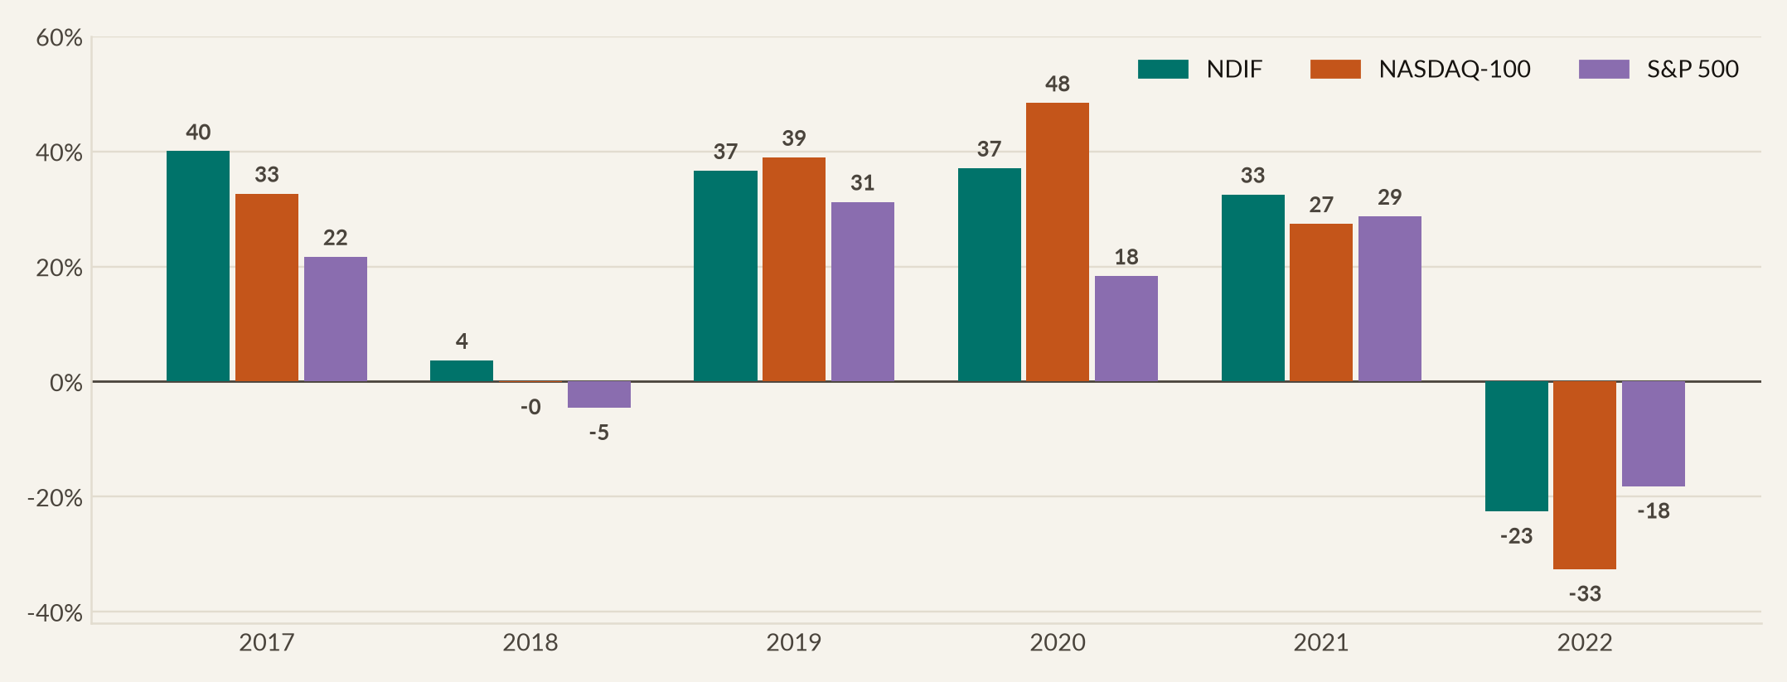
14
WHAT THE FUND RETURNED
What the fund returned
Beat the S&P 500 in five of six years
Including 2018 and 2022, the two years the market fell
CALENDAR YEAR | 2017 | 2018 | 2019 | 2020 | 2021 | 2022
NDIF | 40.0% | 3.7% | 36.6% | 37.1% | 32.5% | -22.5%
NASDAQ-100 | 32.7% | -0.1% | 39.0% | 48.4% | 27.4% | -32.6%
S&P 500 | 21.7% | -4.6% | 31.2% | 18.3% | 28.7% | -18.2%
NDIF vs S&P 500 | +18.3% | +8.2% | +5.4% | +18.8% | +3.8% | -4.4%
NORTHPOINT DIGITAL INNOVATION FUND
Six-year review · Jan 2017 – Dec 2022
Notes:
Here are the annual returns, which is how most of you will see the fund reported.
So look at 2018 and 2022, because those are the years the market fell. In 2018 the S and P lost 4.6%, the NASDAQ-100 was flat, and we made 3.7%. In 2022 the S and P lost 18%, the NASDAQ-100 lost 32.6%, and we lost 22.5%.
I should be straight with you about that year. We underperformed the S and P by 4 points, and I won't dress that up. A technology-tilted fund should lag the broad market when growth falls out of favour. But against our own theme benchmark, we beat it by 10 full points.
The only year we lagged the NASDAQ-100 was 2020, when concentration was rewarded and our sector floors held us back. That's the cost of diversification. And 2022 is where you got paid for it.

Slide 15
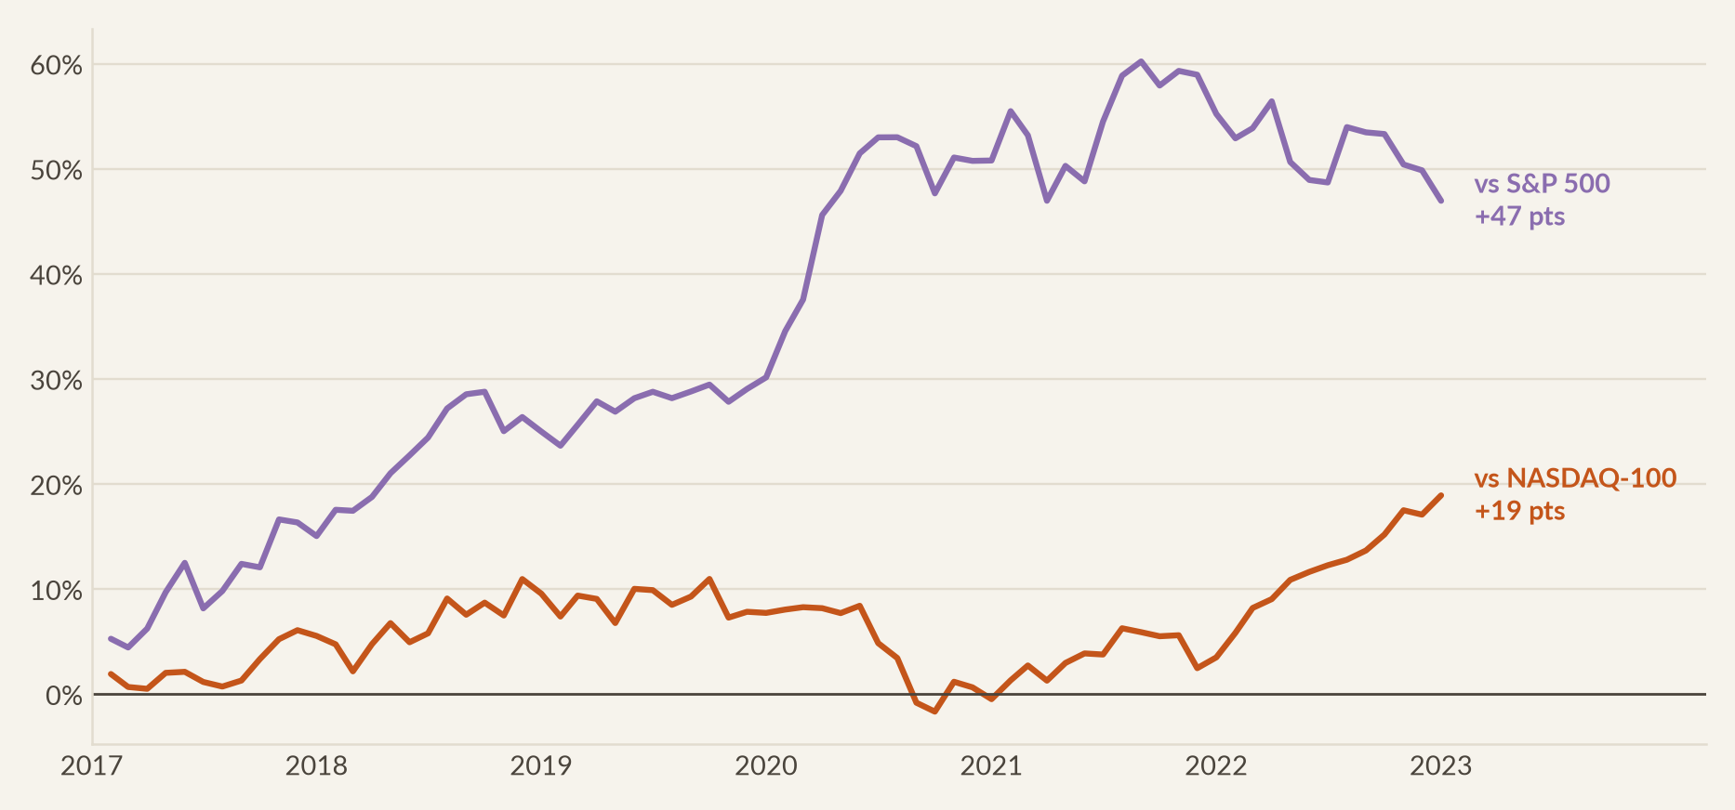
15
WHAT THE FUND RETURNED
What the fund returned
The value-add compounded quietly, then paid off
Cumulative performance relative to both benchmarks, rebased to zero at inception
Read this as the wealth ratio between the fund and each benchmark. A rising line means the fund is pulling ahead. Note that most of the outperformance versus the NASDAQ-100 was created after November 2021 — that is, on the way down, not on the way up.
NORTHPOINT DIGITAL INNOVATION FUND
Six-year review · Jan 2017 – Dec 2022
Notes:
Green is us against the S and P 500, and it rises steadily throughout. That's the theme working.
Orange is the line that tells you something you won't get anywhere else. Against the NASDAQ-100 we were roughly flat for the first 4.5 years. We only pulled clearly ahead from November 2021.
Be clear about what that means. For most of this fund's life we did not beat our main benchmark. We tracked it. All of our outperformance against it was earned in the 2022 drawdown, by falling less.
Some managers would present that as a weakness. I'd argue the opposite. Anyone can hold technology stocks in a technology bull market. Protecting capital when the market turns is the part that takes real discipline. And 2022 is where our fee earned itself.

Slide 16
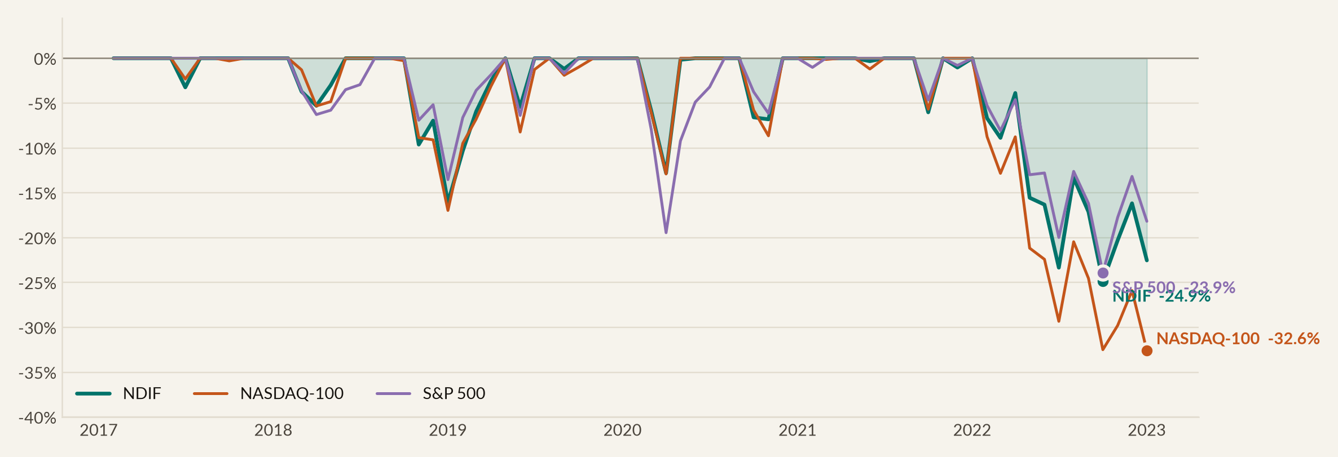
16
WHAT THE FUND RETURNED
What the fund returned
The fund fell less than its own benchmark
Maximum drawdown of −24.9% against the NASDAQ-100's −32.6%
 | MAXIMUM DRAWDOWN | PEAK MONTH | TROUGH MONTH | CALMAR RATIO | DOWNSIDE DEVIATION
NDIF | -24.9% | Nov 2021 | Sep 2022 | 0.75 | 11.9%
NASDAQ-100 | -32.6% | Nov 2021 | Dec 2022 | 0.47 | 12.9%
S&P 500 | -23.9% | Dec 2021 | Sep 2022 | 0.47 | 11.3%
NORTHPOINT DIGITAL INNOVATION FUND
Six-year review · Jan 2017 – Dec 2022
Notes:
Drawdown decides whether an investor stays in a fund, so I'll take it head on.
Our worst peak-to-trough loss was 24.9%. That ran from the November 2021 peak to the September 2022 trough. The NASDAQ-100 lost 32.6% over a similar window, and the S and P lost 23.9%.
So we sat between the two. Worse than the broad market, and clearly better than our own benchmark. For a fund with a deliberate technology tilt, that's the right place to be.

Slide 17
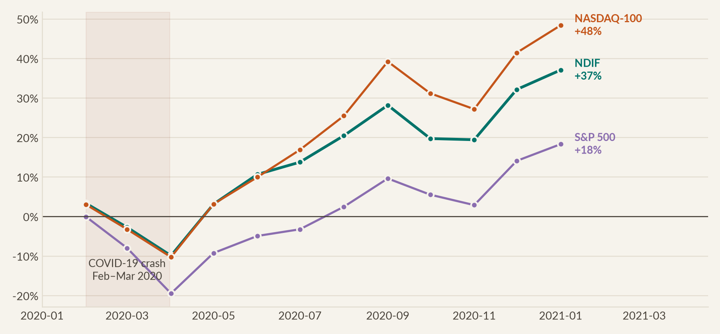
17
WHAT THE FUND RETURNED
What the fund returned
Stress test one: COVID-19
Scenario C arrived in March 2020. The fund lost 12.6% in two months and had recovered it within eight weeks
Our 2016 document had explicitly named “a systemic disruption such as a global pandemic” as a Scenario C trigger and assigned it a 20% probability. The thesis assumption that held up: cloud migration, e-commerce and payment digitisation are cost-saving, so they continue — and in fact accelerate — through a recession.
NORTHPOINT DIGITAL INNOVATION FUND
Six-year review · Jan 2017 – Dec 2022
Notes:
The first of two stress tests.
February and March of 2020 cost us 12.6%. It felt a lot worse at the time, because these are month-end figures.
Then look what happens. April 2020 was the best month in this fund's history, at plus 14.5%. By May we were back above the January high, and the year finished up 37.
The second point matters more. Our thesis rested on one idea. Digital transformation saves companies money, so it carries on in a recession. COVID tested that harder than anything we could have designed, and the answer came back clearly.

Slide 18
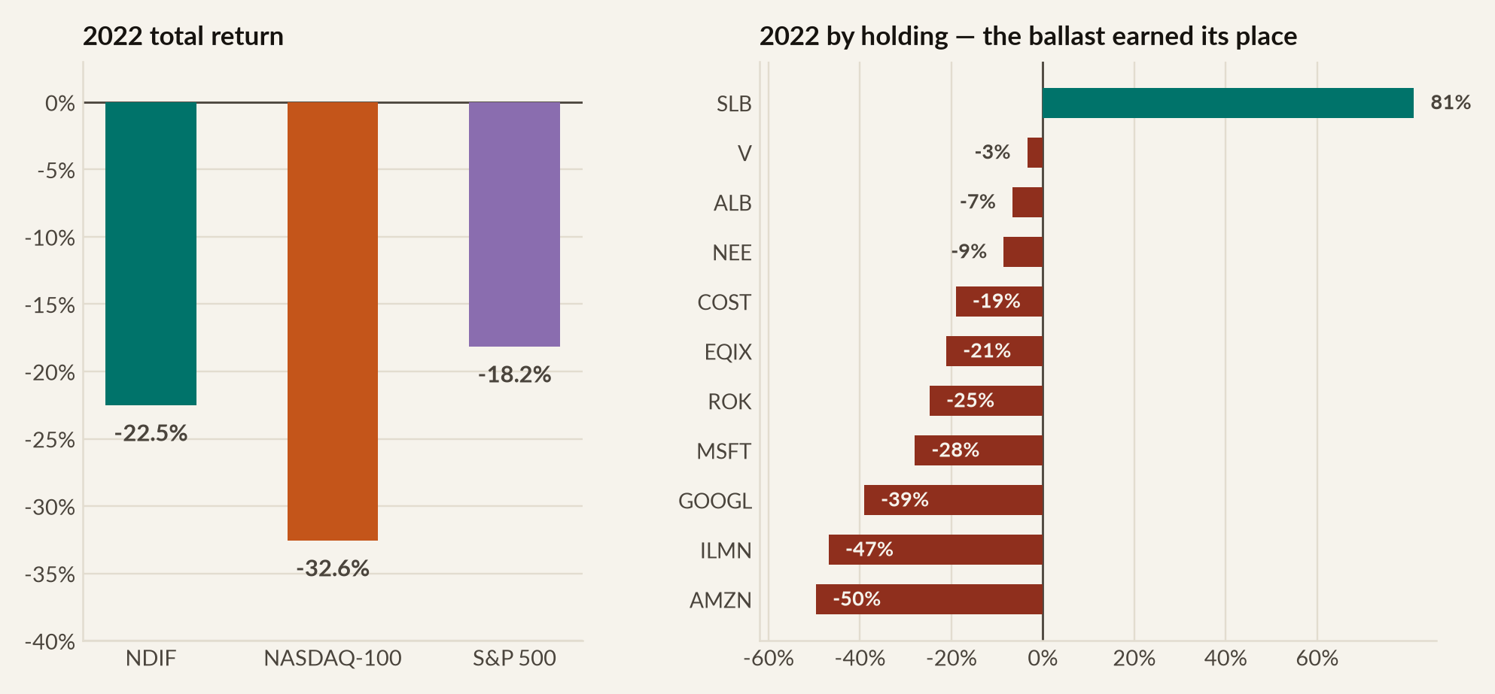
18
WHAT THE FUND RETURNED
What the fund returned
Stress test two: the 2022 rate shock
Down 22.5% against a NASDAQ-100 down 32.6%, and the ballast is the entire reason why
Schlumberger — the fund's worst holding over the full six years at −23.5% — returned +81.2% in 2022. Albemarle lost only 6.6% and NextEra 8.5%. Without the 5% energy floor and the 24% ballast tier, the fund's 2022 loss would have been close to the NASDAQ-100's. This is what a sector floor is for.
NORTHPOINT DIGITAL INNOVATION FUND
Six-year review · Jan 2017 – Dec 2022
Notes:
And the second stress test, which is the more useful of the two.
2022 brought the sharpest tightening since 1981. The Fed raised 425 basis points in a single calendar year. When the discount rate moves that fast, growth shares get repriced, and there's no clever way around it.
We lost 22.5%. The NASDAQ-100 lost 32.6%.
The panel on the right explains that 10-point difference completely. At the bottom, Amazon down 50%, Illumina down 47%, Alphabet down 39%. Our thesis names were hit exactly as hard as you'd expect.
Now look at the top of the same panel. Schlumberger up 81%. Visa down 3%. Albemarle down 7%.
Schlumberger was the worst holding in this fund over the full 6 years. It's also the position I was asked to justify more than any other. It was in the book for one reason. The mandate said every sector keeps a floor. In the worst year of this fund's life, that unloved 5% position returned 81%. That isn't luck. That's what diversification is. And it's why the rule was written into the mandate rather than left to me.

Slide 19
04
How much risk we took
The full distribution of 72 monthly returns, the risk-adjusted measures, tail risk, and where in the calendar the money was made
NORTHPOINT

Slide 20
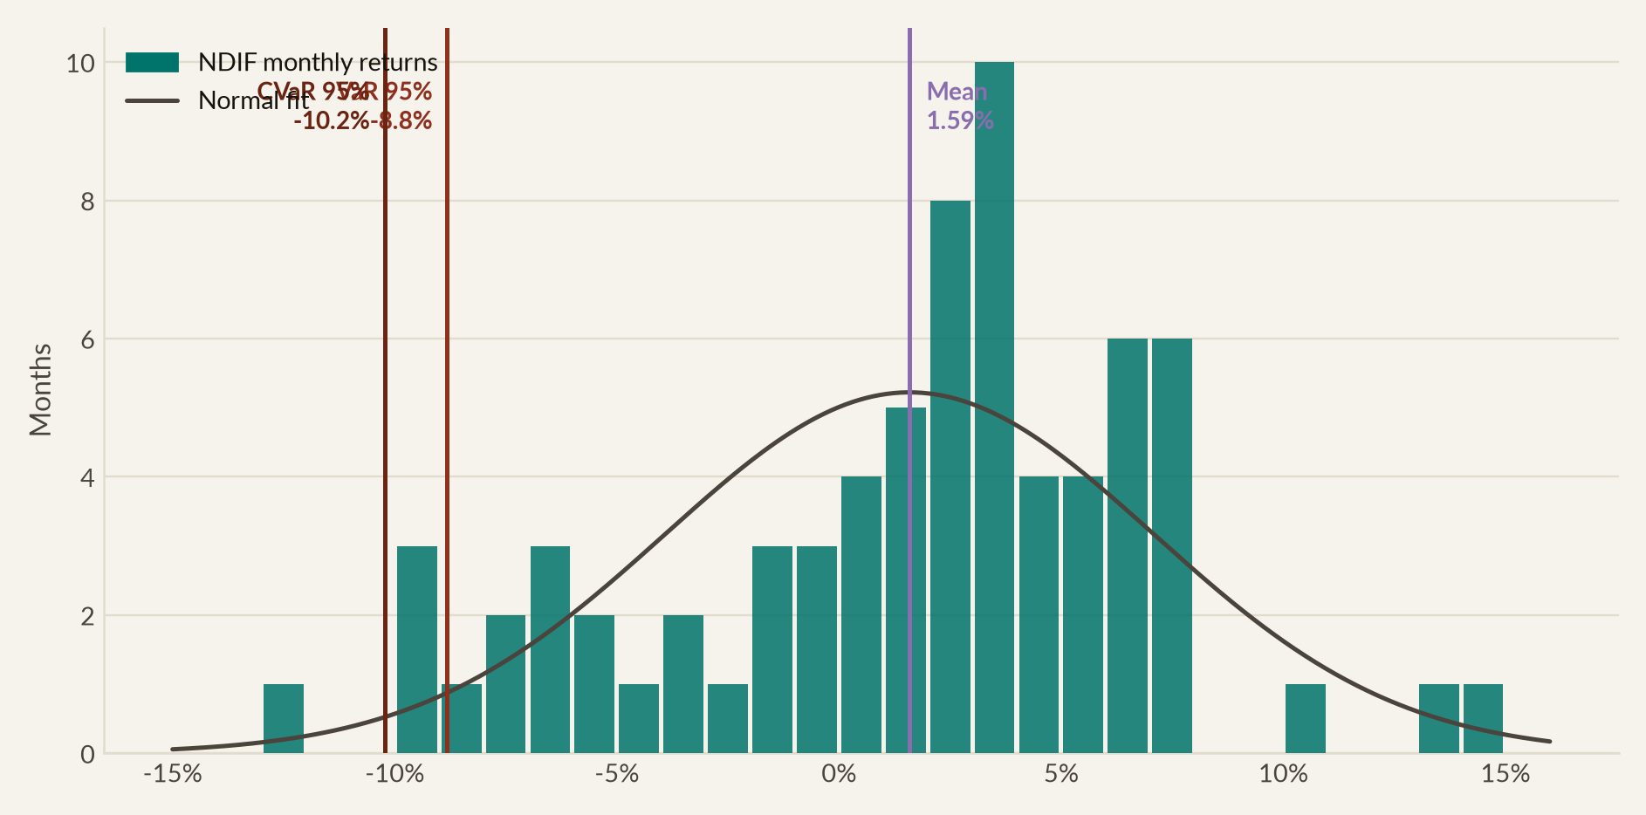
20
HOW MUCH RISK WE TOOK
How much risk we took
The shape of our returns
Close to normal, with a mild left tail. 72 monthly observations, Jan 2017 to Dec 2022
DISTRIBUTIONAL STATISTICS
Mean monthly return
1.59%
Median monthly return
2.73%
Standard deviation (monthly)
5.50%
Annualised volatility
19.06%
Skewness
-0.472
Excess kurtosis
0.067
Jarque–Bera p-value
0.278
Best month (Apr 2020)
14.5%
Worst month (Apr 2022)
-12.1%
Positive months
50 of 72 (69.4%)
NORTHPOINT DIGITAL INNOVATION FUND
Six-year review · Jan 2017 – Dec 2022
Notes:
Now the quantitative section. I want to start with the raw distribution rather than a summary statistic, because a summary statistic can hide a lot.
72 monthly observations. The mean is 1.59% and the median is 2.73. The median sitting well above the mean tells you straight away there's a left tail. A few large negative months are dragging the average down.
Skewness confirms it at minus 0.47, which is mild and completely normal for shares. Excess kurtosis is essentially zero, so no fat tails. And Jarque-Bera gives a p-value of 0.28, so we can't reject normality. That matters. It means the risk measures on the next few slides can be trusted for this fund.
Best month, April 2020, plus 14.5. Worst, April 2022, minus 12.1. And 50 of the 72 months were positive.

Slide 21
21
HOW MUCH RISK WE TOOK
How much risk we took
Risk-adjusted, we beat every comparator
Highest Sharpe, Sortino, Calmar and Treynor, and the highest information ratio
MEASURE | NDIF | NASDAQ-100 | S&P 500 | EQUAL WEIGHT | 60/40 | WHAT IT TELLS YOU
Annualised return | 18.7% | 15.3% | 11.3% | 18.0% | 7.2% | Geometric growth rate
Annualised volatility | 19.1% | 20.2% | 17.1% | 19.4% | 11.1% | Total risk
Sharpe ratio | 0.94 | 0.75 | 0.65 | 0.90 | 0.59 | Excess return per unit of total risk
Sortino ratio | 1.51 | 1.18 | 0.98 | 1.45 | 0.88 | Excess return per unit of downside risk
Treynor ratio | 0.173 | 0.139 | 0.111 | 0.163 | 0.102 | Excess return per unit of market beta
Calmar ratio | 0.75 | 0.47 | 0.47 | 0.85 | 0.36 | Return per unit of maximum drawdown
Information ratio (vs S&P) | 0.98 | 0.54 | — | 0.97 | -0.72 | Active return per unit of tracking error
Beta (vs S&P 500) | 1.04 | 1.10 | 1.00 | 1.07 | 0.64 | Market sensitivity
M² (risk-matched return) | 17.2% | 14.0% | 12.2% | 16.5% | 11.1% | Return at benchmark risk
Risk-free rate is the Fama–French one-month Treasury bill series (mean 1.25% p.a. over the period). All ratios are computed on the same 72 monthly observations and annualised by √12.
NORTHPOINT DIGITAL INNOVATION FUND
Six-year review · Jan 2017 – Dec 2022
Notes:
If you keep one slide from today, keep this one.
Read down our column, and compare it to the two benchmarks beside it.
Sharpe is 0.94, against 0.75 and 0.65. Sortino only penalises downside volatility, and ours is 1.51 against 1.18. That improvement is bigger than the improvement in Sharpe. Which tells you our volatility was mostly upside volatility, and that's what you want.
And look at the bottom row. Geared to exactly the S and P's volatility, this fund would have returned 17.2% a year, against the index's 11.3. That's like-for-like at matched risk, and it's a 6-point gap.

Slide 22
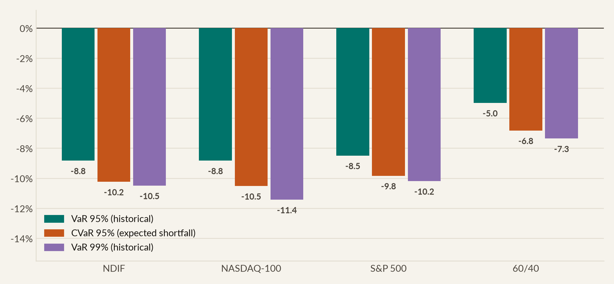
22
HOW MUCH RISK WE TOOK
How much risk we took
Tail risk sits below the NASDAQ-100 on every measure
One-month value-at-risk and expected shortfall from the empirical distribution
NDIF TAIL MEASURES
VaR 95% (historical)
-8.82%
VaR 95% (parametric normal)
-7.46%
VaR 95% (Cornish–Fisher)
-8.17%
CVaR 95% (expected shortfall)
-10.23%
VaR 99% (historical)
-10.48%
CVaR 99% (expected shortfall)
-12.14%
On $279m, a 95% VaR month is
−$24.6m
NORTHPOINT DIGITAL INNOVATION FUND
Six-year review · Jan 2017 – Dec 2022
Notes:
Now value-at-risk and expected shortfall, which are what your risk committees will ask for.
Our 95% one-month value-at-risk is minus 8.82%. Read it this way. In the worst month out of 20, we'd expect to lose at least 8.8%. On the fund's closing value, that's a $24.6 million month.
The number I'd actually watch is expected shortfall. Value-at-risk only gives you the threshold, not how bad it gets beyond it. Ours is minus 10.2%.
Compare that to the NASDAQ-100. Its threshold is almost identical to ours, but its expected shortfall is worse, and its 99% figure is worse again. Same threshold risk, thinner tail beyond it. And again, that's diversification rather than anything clever in timing.

Slide 23
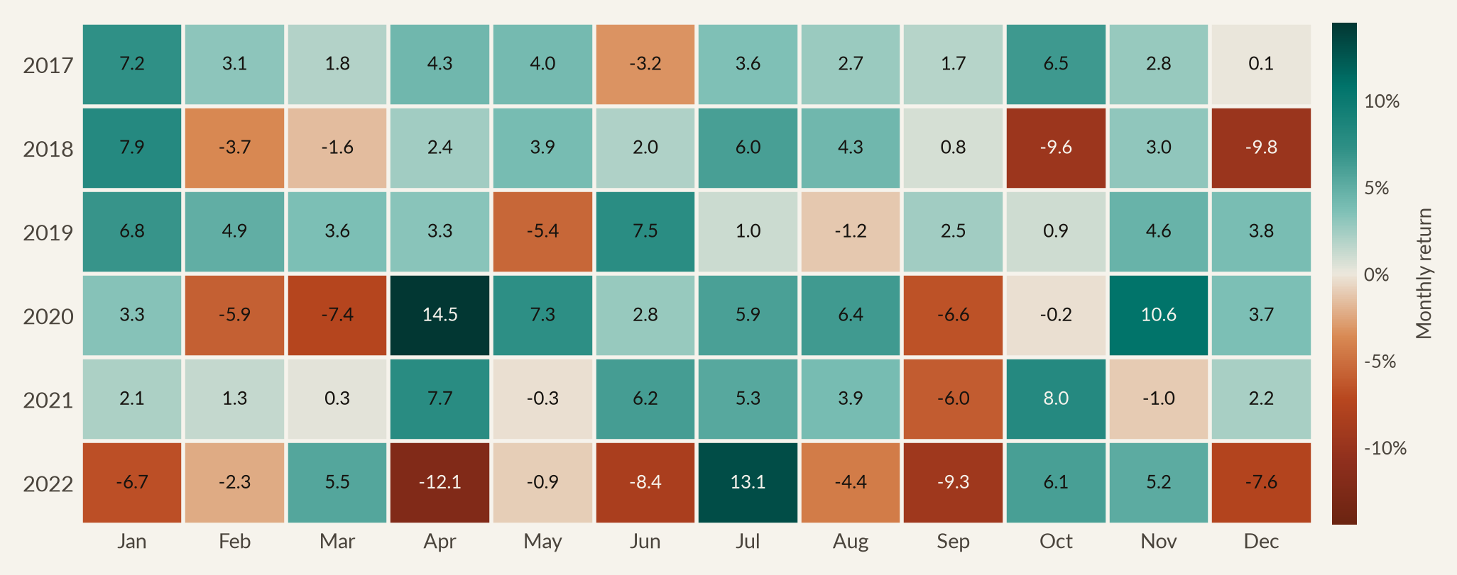
23
HOW MUCH RISK WE TOOK
How much risk we took
Where in the calendar the money was made
Seasonality across 72 months. Six observations per calendar month, so read this as description rather than a tradeable signal
July +5.8%
September −2.8%
The extremes cluster
The strongest month, on the back of six positive Julys out of six — including +13.1% in July 2022 during the bear-market rally.
The weakest month. Negative in three of six years, but heavily so: September 2022 alone cost 9.3%.
April 2020 was the best month on record at +14.5%; April 2022 the worst at −12.1%. Both sit inside the same two-year window.
NORTHPOINT DIGITAL INNOVATION FUND
Six-year review · Jan 2017 – Dec 2022
Notes:
Now seasonality, and I'll frame this carefully, because it's easy to over-read.
July was our strongest month at plus 5.8%, positive in all 6 years. September was weakest at minus 2.8%, dragged there by three heavy losses in 2020, 2021 and 2022.
But here's why I wouldn't build a strategy on it. 6 observations per calendar month is nowhere near enough to separate a real seasonal effect from noise. The standard error on any of those averages is over 2%, so almost none of these differences would survive a significance test.
What the grid does show usefully is how the extremes cluster. Look at the 2020 row, then the 2022 row. The best month in this fund's history and the worst sit within 24 months of each other.

Slide 24
05
Was it skill?
Jensen's alpha, factor models, performance attribution, and what a mean-variance optimiser would have done with the same eleven stocks
NORTHPOINT

Slide 25
25
WAS IT SKILL?
Was it skill?
Jensen's alpha: significant on every model we ran
Excess return regressed on risk factors. 72 monthly observations, Newey–West standard errors with four lags
MODEL | ANNUALISED ALPHA | ALPHA T-STAT | P-VALUE | MARKET BETA | ADJUSTED R² | INTERPRETATION
CAPM (single factor) | 7.2% | 2.19 | 0.029 | 1.005 | 0.872 | Significant at the 5% level
Fama–French 3-factor | 5.9% | 2.83 | 0.005 | 1.040 | 0.915 | Significant at the 1% level
Fama–French 5-factor | 6.6% | 3.06 | 0.002 | 1.050 | 0.914 | Significant at the 1% level
FF5 + momentum (Carhart) | 6.5% | 2.95 | 0.003 | 1.054 | 0.913 | Significant at the 1% level
NASDAQ-100, same FF5 test | 2.4% | 1.41 | 0.159 | 1.099 | 0.943 | Not statistically significant
The test that matters. After controlling for the market, size, value, profitability, investment and momentum factors, the fund still delivered 6.6% a year that those factors cannot explain, with a t-statistic of 3.06 (p = 0.002). The same test applied to the NASDAQ-100 returns an alpha of 2.4% that is statistically indistinguishable from zero. The benchmark's excess return is explained by its factor exposures. Ours is not.
NORTHPOINT DIGITAL INNOVATION FUND
Six-year review · Jan 2017 – Dec 2022
Notes:
Now the question you should be asking me. Was any of this skill? Or did we simply own high-beta growth stocks in a decade that rewarded high-beta growth stocks?
You answer that with a factor regression. Take the fund's return above cash, run it against known risk factors, and see what's left over. That leftover is Jensen's alpha.
Start with the CAPM. 7.2% a year, t-statistic 2.19. But the CAPM only controls for market risk. So a sceptic would say a growth tilt is doing the work.
So add size and value. The alpha comes down to 5.9%, but the significance goes up. Add profitability and investment and we get 6.6%, with a t-statistic of 3.06 and a p-value of 0.002. Add momentum and it barely moves.
And now the bottom row, which is where I'd spend my time if I were you. I ran the same five-factor test on the NASDAQ-100 itself. Its alpha is 2.4%, with a t-statistic of 1.41. That's indistinguishable from zero.
So the benchmark's strong decade is fully explained by its factor exposures. Ours is not. That difference is what you were paying a management fee for.

Slide 26
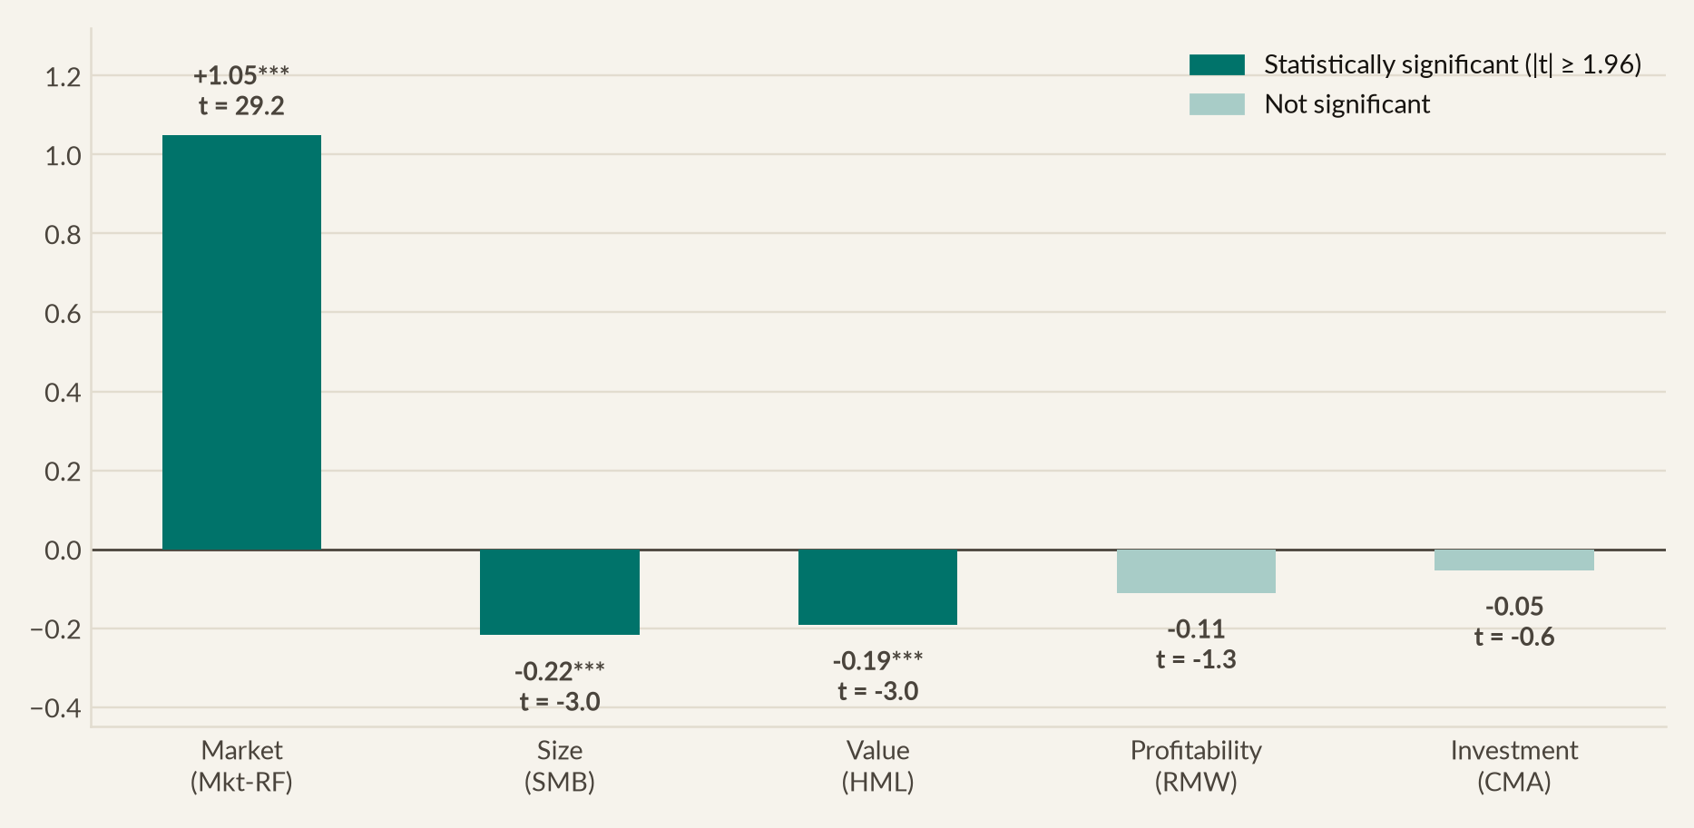
26
WAS IT SKILL?
Was it skill?
What the factor loadings say about us
A large-cap growth fund with market-like beta, which is the profile the mandate described
READING THE COEFFICIENTS
Market +1.05. Essentially one-for-one with the market. We were not levered.
Size −0.22. Significantly negative: a large-cap fund, as intended.
Value −0.19. Significantly negative: a growth fund, as intended.
Profitability −0.11, Investment −0.05. Neither is significant, so no hidden quality tilt.
Momentum +0.02. Effectively zero. This was not a momentum-chasing strategy.
Every loading sits where the January-2016 mandate said it would. There are no unexplained exposures hiding in this portfolio.
NORTHPOINT DIGITAL INNOVATION FUND
Six-year review · Jan 2017 – Dec 2022
Notes:
These five numbers describe the fund more honestly than any marketing document could.
Market loading is 1.05, so we moved one-for-one with the equity market. We weren't geared.
Size is minus 0.22, and it's significant. A negative size loading means large-cap, which is correct and intended. Value is minus 0.19, also significant, and negative value means growth. Also intended.
Profitability and investment are both small, and neither is significant. That's worth pointing out. A common criticism of technology alpha is that it's really a quality tilt in disguise. Here it isn't. And momentum is effectively zero, so this was never a momentum-chasing strategy.
So what you're looking at is a large-cap growth fund, with market-like beta, no gearing, and no hidden factor bets. Which is precisely the description in the mandate I showed you at the start.

Slide 27
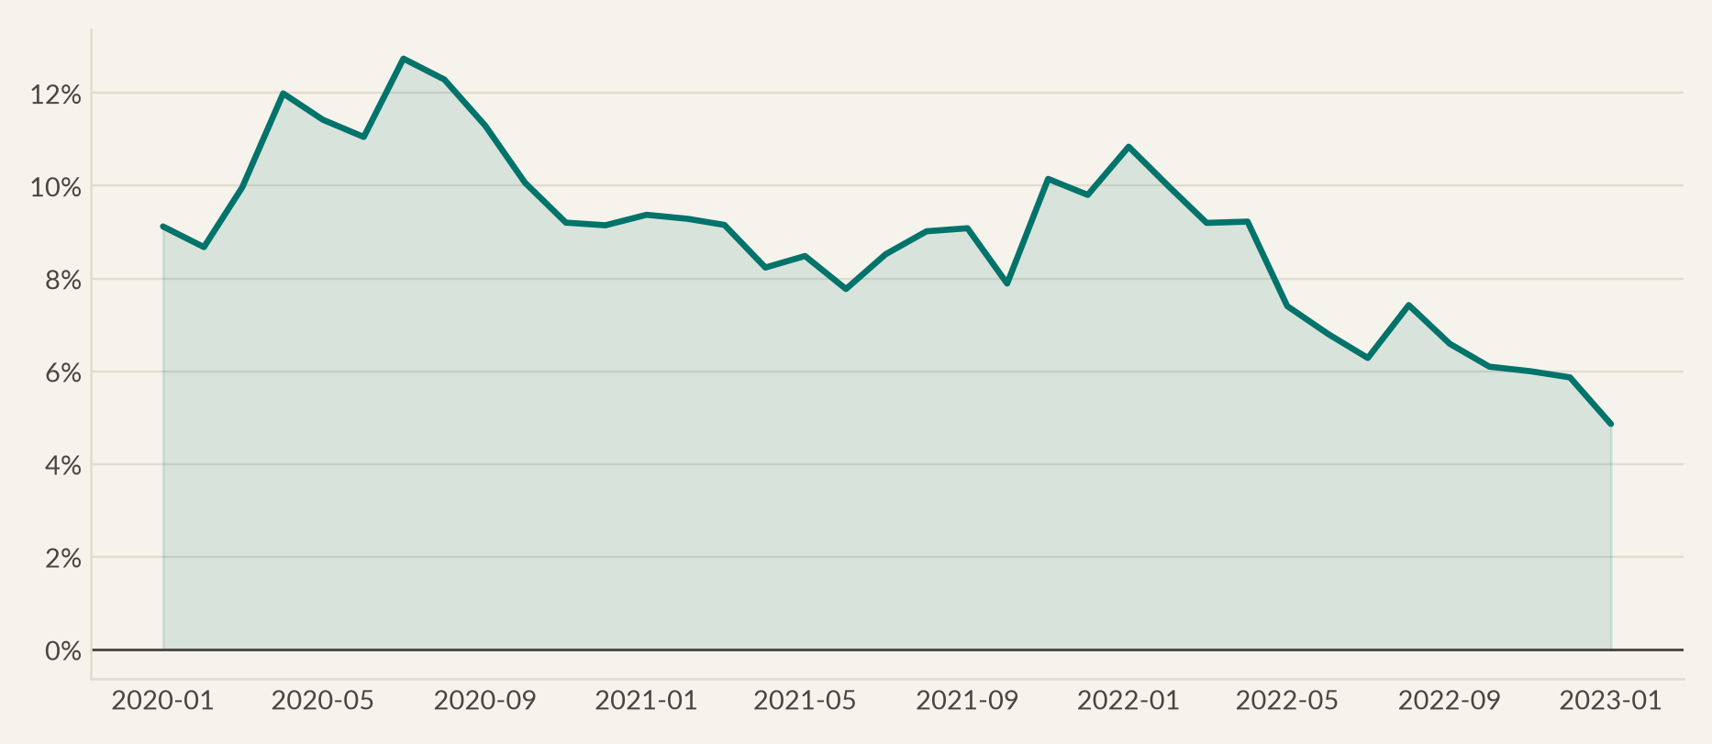
27
WAS IT SKILL?
Was it skill?
Alpha was persistent, not a single lucky year
Rolling 36-month Jensen's alpha stays positive across every window in the sample
A single full-sample alpha can be produced by one exceptional year. This chart re-estimates the CAPM alpha on every rolling three-year window from Dec-2019 onward. It never turns negative — including the windows dominated by the 2022 drawdown, where the alpha comes from losing less rather than gaining more.
NORTHPOINT DIGITAL INNOVATION FUND
Six-year review · Jan 2017 – Dec 2022
Notes:
One more check, because a full-sample alpha can always come from a single extraordinary year. I've re-estimated it on every rolling three-year window, and the line never drops below zero.
Alpha was earned in the growth years of 2017 to 2019. It was also earned in the very different windows around the 2020 crash and the 2022 rate shock.
The shape is worth a moment though. It falls through the middle and recovers at the right-hand end. Those middle windows are 2020 and 2021, when the NASDAQ-100 was extremely hard to beat and our sector floors were a drag. The recovery at the right is 2022.
So the source of our alpha changed. Stock selection early, downside protection later. That's a healthy sign rather than a worrying one, because it means the fund didn't depend on one kind of market.

Slide 28
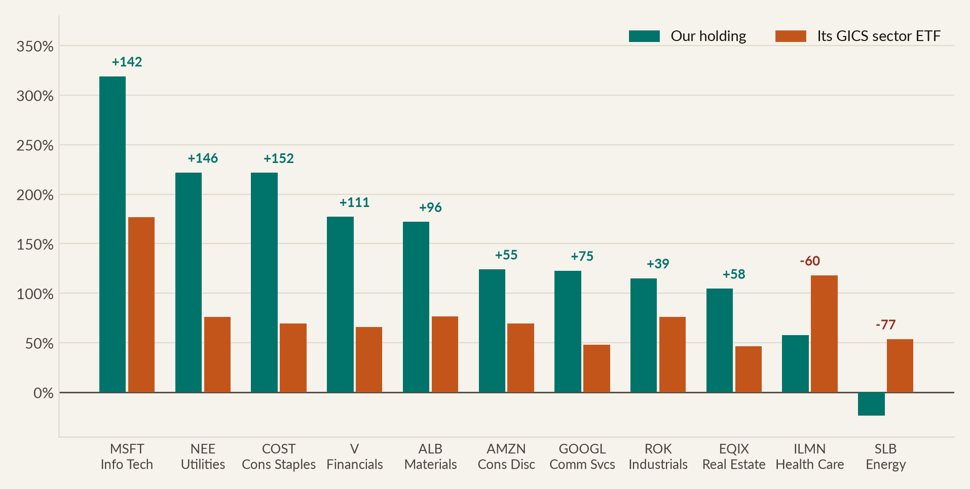
28
WAS IT SKILL?
Was it skill?
Nine of eleven picks beat their own sector
Each holding measured against the GICS sector ETF it sits in, which is the fairest test of stock selection
Only two picks lagged: Illumina, 60 points behind XLV, and Schlumberger, 77 points behind XLE. The standouts were Costco at 152 points ahead of XLP, NextEra 146 ahead of XLU and Microsoft 142 ahead of XLK. XLC did not exist until June 2018, so the Communication Services sleeve is spliced with XLK before that date.
NORTHPOINT DIGITAL INNOVATION FUND
Six-year review · Jan 2017 – Dec 2022
Notes:
Let's get underneath the portfolio number now, because ultimately you hired me to pick 11 stocks.
The fairest test of a pick isn't whether it went up. It's whether it beat the sector it sits in. If I pick a technology stock in a decade when every technology stock rose, I haven't shown you anything.
Blue is our stock, orange is its sector fund. 9 of our 11 picks beat their sector.
The standouts. Costco beat consumer staples by 152 points. NextEra beat utilities by 146. And Microsoft beat technology by 142. That last one matters most, because it happened inside our largest position.
Two misses. Illumina, where the thesis was right, but the GRAIL acquisition and the regulatory fight around it destroyed value. And Schlumberger, which lost money against an energy sector that gained 54%.

Slide 29
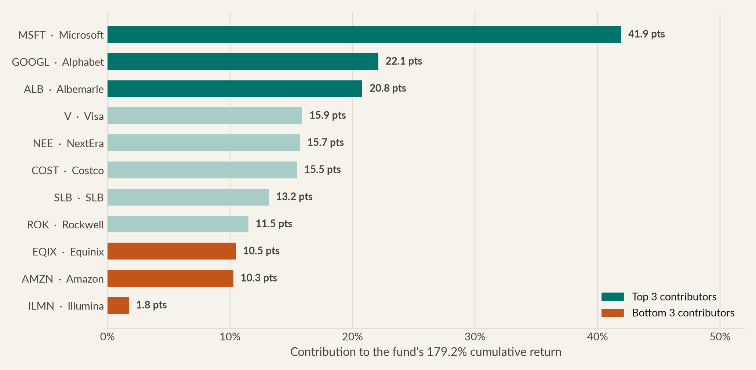
29
WAS IT SKILL?
Was it skill?
Where the 179% came from
Compounded contribution to cumulative return by holding. Microsoft alone delivered nearly a quarter of it
TOP 3 AND BOTTOM 3
 | CONTRIB. | TOTAL RETURN
MSFT | 41.9 pts | 319%
GOOGL | 22.1 pts | 123%
ALB | 20.8 pts | 172%
EQIX | 10.5 pts | 105%
AMZN | 10.3 pts | 124%
ILMN | 1.8 pts | 58%
Schlumberger is the instructive case. It lost 23.5% over six years, yet contributed a positive 13.2 points — because quarterly rebalancing kept buying it back to its 5% floor at successively lower prices, and it then returned +81% in 2022.
NORTHPOINT DIGITAL INNOVATION FUND
Six-year review · Jan 2017 – Dec 2022
Notes:
Microsoft contributed 41.9 points of our 179%. That's 23% of everything this fund made, out of a 16% position. Sizing your best idea largest is the biggest decision a manager makes, and this is what it looks like when it goes right.
Alphabet gave us 22 points, Albemarle 21. Albemarle is the surprise, a 6% materials position that rode the lithium and electric-vehicle supply chain. Illumina is the clear disappointment, where 8% of the book delivered under 2 points.
But the panel on the right is the most interesting finding in this whole review. Schlumberger lost 23.5% over 6 years, and still contributed a positive 13 points.
How? Every quarter it fell, our rebalancing rule bought more of it at a lower price. Then in 2022 it returned 81%, and by then we owned far more shares than we started with. A losing stock made money for this fund, because of a mechanical process rule.

Slide 30
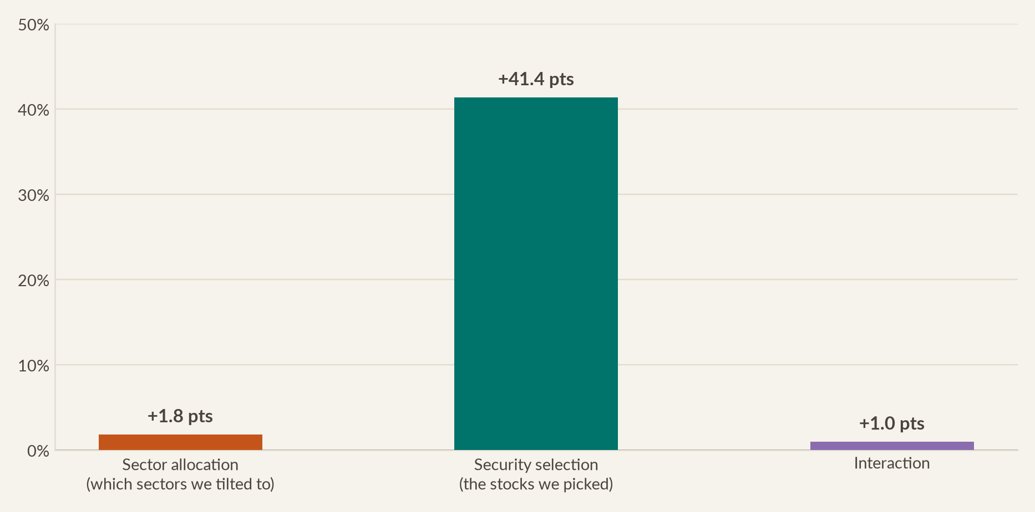
30
WAS IT SKILL?
Was it skill?
94% of the value-add came from stock picking
Brinson–Fachler attribution against an equal-weight benchmark of the eleven GICS sector ETFs
DECOMPOSITION
Allocation +1.8 pts. The sector tilts, overweight technology and underweight energy, contributed very little.
Selection +41.4 pts. Almost all of the active return came from picking better stocks than the sector average.
Interaction +1.0 pt. The residual from being overweight where we also picked well.
Why this matters for your decision: allocation skill is a macro call and is hard to repeat. Selection skill is a research process. That 94% of our value-add came from selection is the strongest argument that the result is repeatable.
NORTHPOINT DIGITAL INNOVATION FUND
Six-year review · Jan 2017 – Dec 2022
Notes:
Brinson attribution answers one question. How much of our outperformance came from being in the right sectors, and how much from picking the right stocks inside them?
To separate the two, I built a benchmark with exactly our sector coverage, at neutral weights, with no stock picking at all. It returned 85%, against our 179%.
Break the difference down. Allocation contributed 1.8 points, which is almost nothing. Selection contributed 41.4 points. Interaction contributed 1 point.
So 94% of our active return came from stock selection.
Here's why that matters for your decision. Allocation skill is a macro forecasting call, and the evidence that anyone repeats macro calls is weak. Selection skill comes out of a research process, so you can describe it, staff it and repeat it. If our outperformance had come from sector timing, I'd be much less confident recommending this fund continues.

Slide 31
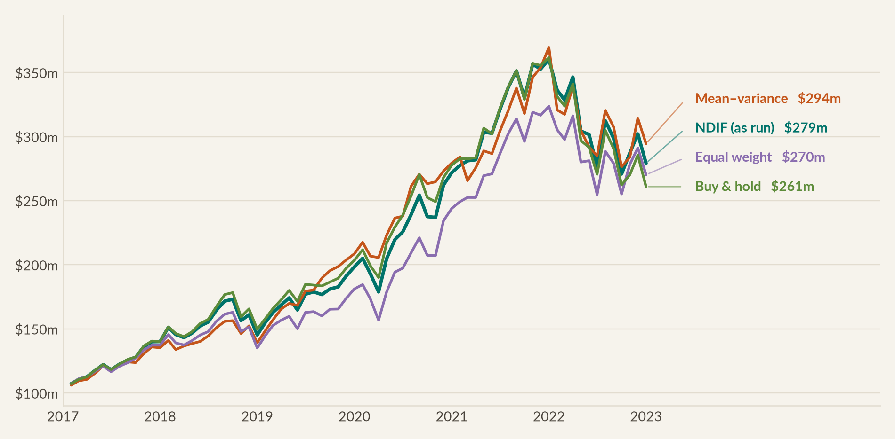
31
WAS IT SKILL?
Was it skill?
Would an optimiser have done better?
A mean-variance model given three years of pre-launch data would have added 1.1% a year, by taking concentration risk we were not permitted to take
CONSTRUCTION RULE | CAGR | SHARPE
NDIF as run | 18.7% | 0.94
Mean–variance (2014–16 inputs) | 19.7% | 1.07
Equal weight (1/N) | 18.0% | 0.90
Buy & hold | 17.3% | 0.88
Perfect-foresight optimum | 22.8% | 1.32
The optimiser's solution put 25% in Equinix and 25% in NextEra — breaching our 16% position cap — and zero in Alphabet, Visa, Albemarle and Schlumberger, breaching the 5% sector floor four times over. It bought a better backtest by discarding the mandate.
Even with perfect foresight, the best achievable was 22.9% a year. We captured 82% of a result nobody could have known in advance.
NORTHPOINT DIGITAL INNOVATION FUND
Six-year review · Jan 2017 – Dec 2022
Notes:
The obvious challenge to everything I've said is that a model could have done better. So I tested it.
I took 3 years of data ending December 2016, which is the information a manager actually had at launch. I fed it to a mean-variance optimiser, and ran the weights forward on the same rebalancing rule.
The result is 19.7% a year, against our 18.7. So yes, the optimiser wins, by about a point a year.
But look at what it had to do. 25% into Equinix, and another 25% into NextEra. Both of those breach our 16% cap. And nothing at all into Alphabet, Visa, Albemarle or Schlumberger, which breaches our sector floor four times over.
So the optimiser didn't beat our strategy. It refused to run it. It bought a better backtest by throwing away the rules that, as we saw in 2022, are what protected you.
And the last row is the humbling one. With perfect hindsight, the best possible was 22.9%. We captured 82% of a number nobody could have known.

Slide 32
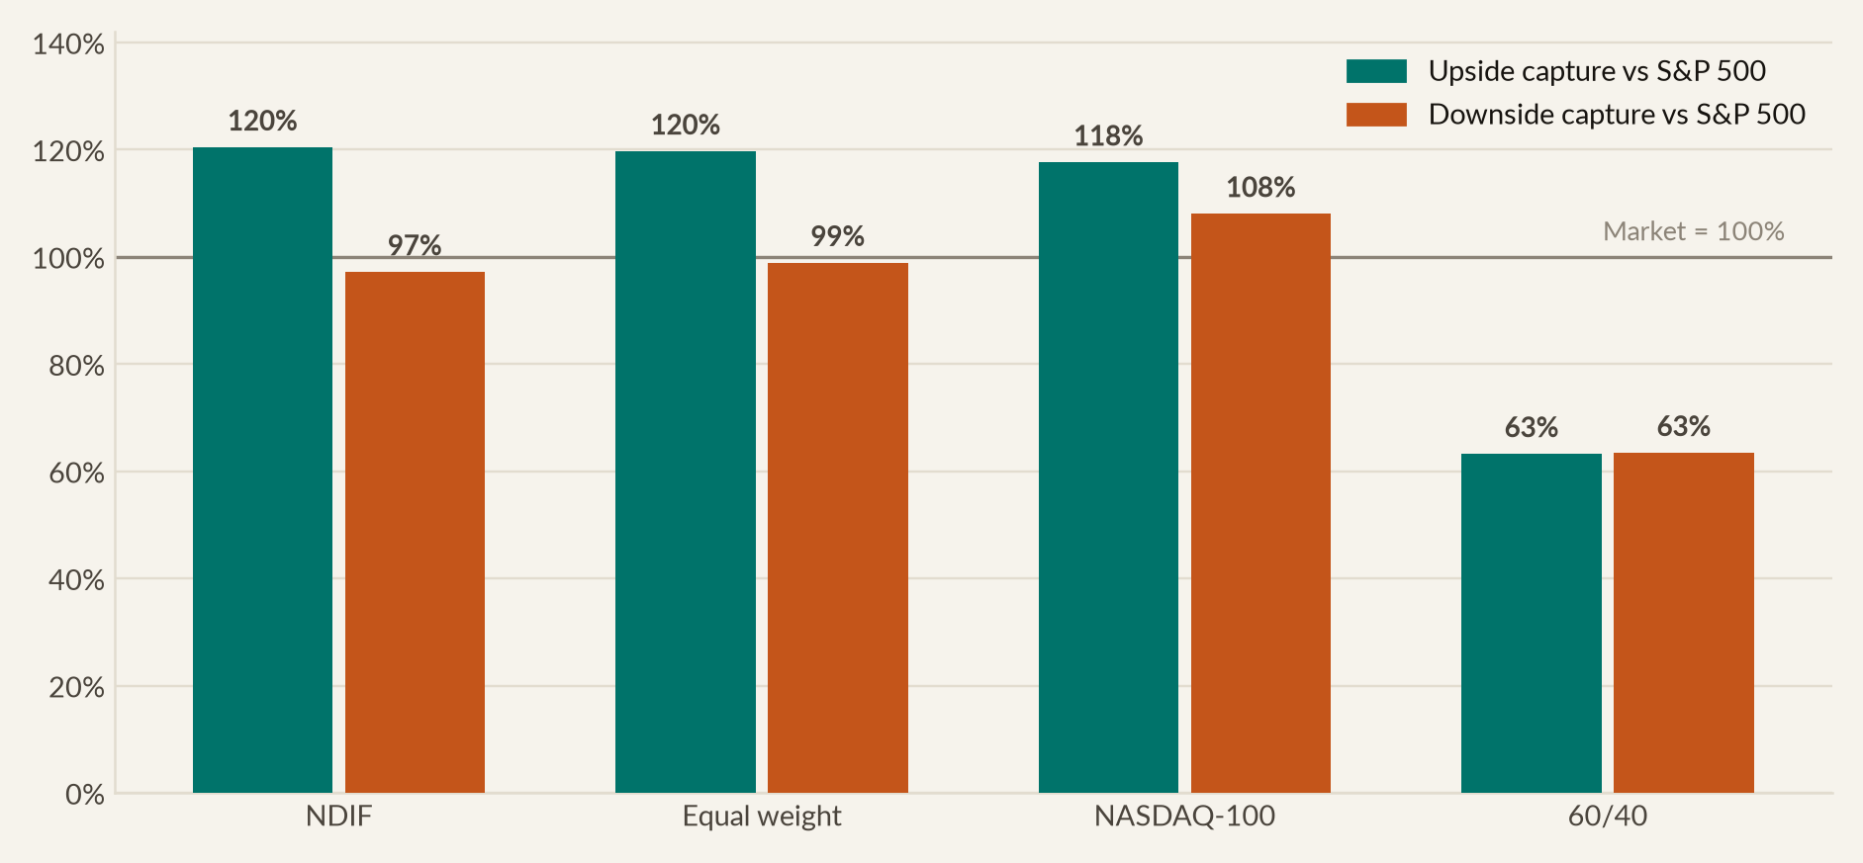
32
WAS IT SKILL?
Was it skill?
120% of the upside, 97% of the downside
The asymmetry that produced the result: most of the market's gains, without most of its losses
THE ASYMMETRY
Upside capture 120%. In months the S&P 500 rose, we rose 20% more than it did.
Downside capture 97%. In months it fell, we fell slightly less.
The NASDAQ-100, by contrast, captured 118% of the upside but 108% of the downside: more of the gains, and more of the losses.
50 positive months of 72. A 69.4% hit rate against 65.3% for the NASDAQ-100.
Those two numbers, 120 up and 97 down, are the compact statement of what the fund did. Everything else in this deck elaborates on them.
NORTHPOINT DIGITAL INNOVATION FUND
Six-year review · Jan 2017 – Dec 2022
Notes:
Upside capture of 120%. In the months the S and P rose, we rose 20% more than it did. Downside capture of 97, so in the months it fell, we fell slightly less.
That gap is the engine of the whole result. You don't have to be right about market direction to compound at 18% a year. You just have to take more than your share of the good months, and only your share of the bad ones.
Now contrast the NASDAQ-100. It captured 118% of the upside, very similar to us, but 108% of the downside. More of the gains, and more of the losses. That 11-point difference, compounded over 72 months, is essentially the entire gap between our $279 million and its $235 million.

Slide 33
06
The verdict
Marking the fund against the objective we set in 2016, the fees you paid, and our recommendation on what happens next
NORTHPOINT

Slide 34
34
THE VERDICT
The verdict
Marking ourselves against the 2016 objective
Every commitment we made when we asked you for the mandate, scored against what we actually delivered
WHAT WE COMMITTED TO IN JANUARY 2016 | TARGET | DELIVERED | VERDICT
Net annualised return | 8–10% p.a. | 17.5% p.a. net of all fees | Exceeded
Cumulative net return over the fund life | 55–70% | 163% net | Exceeded
Outperform the S&P 500 | ~2% p.a. net | +6.2% p.a. net | Exceeded
Outperform the NASDAQ-100 (primary benchmark) | Beat it | +3.4% p.a. gross | Met
Maintain all eleven GICS sectors, 5% floor | No sector abandoned | Held throughout, all 24 quarters | Met
Cap the largest position at 16% | 16% cap | Held at every rebalance; MSFT drifted to a peak of 17.6% within a quarter | Met
Rebalance quarterly with a 5-point drift rule | 24 rebalances | 24 executed; drift never exceeded 2.9 pts, so the rule never fired | Met
Deliver a mid-life strategic review at end-2019 | Formal review | Conducted; target weights reconfirmed | Met
Keep the drawdown below the theme benchmark's | Beat NASDAQ-100 | −24.9% vs −32.6% | Met
Generate return the market cannot explain | Positive alpha | +6.6% p.a., t = 3.06, p = 0.002 | Exceeded
NORTHPOINT DIGITAL INNOVATION FUND
Six-year review · Jan 2017 – Dec 2022
Notes:
This is the accountability slide. 10 commitments, marked against what actually happened.
We said 8% to 10% net a year, and delivered 17.5%. We said 55% to 70% cumulative, and delivered 163%.
Then the process commitments, which matter just as much. All 11 sectors held through all 24 quarters. All 24 rebalances executed on schedule. The largest drift we ever ran was 2.9 points, well inside our 5-point threshold, so the drift rule never had to fire. And the mid-life review was delivered at the end of 2019.
10 commitments. 4 exceeded, 6 met, none missed.

Slide 35
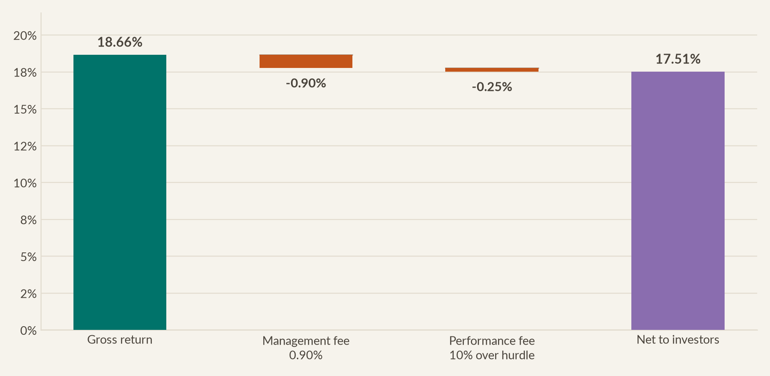
35
THE VERDICT
The verdict
Gross to net: what you actually kept
0.90% management fee plus 10% of the excess over the NASDAQ-100 hurdle, subject to the high-water mark
 | P.A. | OVER SIX YEARS
Gross return | 18.7% | 179%
Management fee | −0.90% | −5.3%
Performance fee | −0.25% | −1.5%
Net to investors | 17.51% | 163%
Total fee load was 1.15% a year — 0.90% base plus 0.25% of performance fee, because the hurdle is the NASDAQ-100 rather than zero and we only cleared it by 2.5 points a year.
A passive NASDAQ-100 ETF at 0.20% would have cost $5.7m less over the six years and returned $235m. We returned $279m, so investors kept $38.7m after paying for active management.
NORTHPOINT DIGITAL INNOVATION FUND
Six-year review · Jan 2017 – Dec 2022
Notes:
Gross, the fund compounded at 18.7%. Our management fee is 90 basis points a year, flat.
The performance fee is where the structure earns its keep. We charge 10% of returns above the hurdle, and our hurdle is the NASDAQ-100 rather than zero. That benchmark itself returned 15.3% a year, so we only cleared it by 2.5 points. The performance fee comes out at 25 basis points, instead of the 1.8% a zero-hurdle fund would have charged.
Total load, 1.15% a year. Net to you, 17.51% a year, or 163% over the 6 years.
And here's the honest alternative. A NASDAQ-100 fund at 20 basis points would have cost $5.7 million less and returned $235 million. We returned $279 million. So after paying us every dollar of fee, you're $38.7 million ahead of the cheap passive option. That's the only fee test that matters, and we pass it.

Slide 36
36
THE VERDICT
The verdict
Our recommendation: the fund should continue
With three changes to the mandate, which we would want your agreement on before raising the successor vehicle
THE CASE FOR CONTINUING
WHAT WE WOULD CHANGE
The alpha is real and it is repeatable. 6.6% a year that five risk factors cannot explain, with 94% of it from security selection rather than sector timing.
Widen the tail-scenario assumptions. Our Scenario C assumed a 4% loss. The real one cost 22.5%. The framework identified the regime correctly and sized it badly.
The thesis is not exhausted. Cloud is still a minority of enterprise IT spend; electrification and genomics are earlier still. The 2022 de-rating repriced the multiple, not the demand.
Add a valuation discipline to the entry rule. Illumina, our worst selection decision, was a correct thesis bought without a price constraint.
The construction discipline was tested and held. Sector floors, the position cap and quarterly rebalancing were all worth measurable money — most visibly in 2022.
Review the position cap upward, carefully. The 16% cap forced us to trim Microsoft, our single best decision, at 19 of the 24 rebalances. We would seek 20%, with the sector floors untouched.
NORTHPOINT DIGITAL INNOVATION FUND
Six-year review · Jan 2017 – Dec 2022
Notes:
So, should this fund continue?
My recommendation is yes. And I'll give you three specific reasons, rather than just telling you I'm confident.
First, the alpha is real, and I believe it's repeatable. 6.6% a year that five established risk factors can't explain, and 94% of it from stock selection rather than sector timing. Selection skill is a process. Macro timing is a guess.
Second, the thesis isn't finished. Cloud is still a minority of enterprise IT spend, 6 years after we argued it was early. 2022 repriced the multiple, not the demand.
Third, the construction discipline was tested by the two hardest events in 20 years, and it held.
But I'd be letting you down if I asked for renewal without saying what I'd change. We need to widen our tail-scenario assumptions, because we said a recession would cost 4% and it cost 22.5. We need a valuation rule on entry, because Illumina was a correct thesis bought with no margin of safety. And I'd ask you to consider raising the position cap from 16 to 20%. That cap forced us to trim Microsoft, our single best decision, at 19 of the 24 rebalances. The sector floors I'd leave completely alone, because those are what saved us.

Slide 37
NORTHPOINT
Thank you.
I am happy to take questions on any part of this review.
An appendix follows with the full methodology, the complete metric tables, the per-holding statistics, and the full factor-model output.
Callum O'Connor · Portfolio Manager · Northpoint Capital Partners
FINC13-303 Portfolio Analysis and Investments · Student ID 14053836
Notes:
And that's the review.
Three sentences to sum it up. $100 million became $279 million. We did it with a shallower drawdown than our own benchmark, and a higher Sharpe ratio than any comparator I could build. And after controlling for every standard risk factor, 6.6% a year is still unexplained by anything except the decisions we made.
I'm recommending the fund continues, with the three mandate changes I've set out.
Happy to take questions, and there's a substantial appendix if you want to go deeper. Thank you for 6 years of patient capital.

Slide 38
A
Appendix
Methodology and data sources, full metric tables, per-holding statistics, complete factor-model output, and supporting exhibits
NORTHPOINT

Slide 39
39
APPENDIX
Appendix
A1 · Methodology, data and assumptions
Everything in this deck is reproducible from the accompanying Python analysis and Excel workbook
ITEM | TREATMENT
Return data | Monthly total returns from dividend- and split-adjusted closing prices, Jan 2017 – Dec 2022 (72 observations per series)
Portfolio construction | Target weights per the January-2016 mandate; drift within the quarter, restored to target at each calendar quarter-end (24 rebalances)
Primary benchmark | NASDAQ-100 total return, proxied by the QQQ ETF so that dividends are included (the ^NDX index itself is price-only)
Secondary benchmark | S&P 500 total return, proxied by the SPY ETF on the same basis
Sector benchmarks | The eleven SPDR GICS sector ETFs. XLC launched Jun-2018, so XLK is used for the Communication Services sleeve before that date
Risk-free rate | Fama–French one-month Treasury bill series; mean 1.25% p.a. over the sample
Risk factors | Kenneth R. French Data Library: Mkt-RF, SMB, HML, RMW, CMA and the momentum factor, monthly, US research series
Regressions | OLS with Newey–West (HAC) standard errors, four lags, to correct for autocorrelation and heteroskedasticity in monthly returns
Annualisation | Returns compounded geometrically; volatility scaled by √12; ratios computed on monthly data then annualised
Attribution | Brinson–Fachler, summed arithmetically across 72 months against an equal-weight benchmark of the eleven sector ETFs
Mean–variance optimisation | SLSQP, long-only, maximum Sharpe, 25% position bound; in-sample window Jan 2014 – Dec 2016 for the ex-ante case
Excluded | Transaction costs, market impact, taxes and cash drag. All returns are gross of these unless a slide states otherwise
NORTHPOINT DIGITAL INNOVATION FUND
Six-year review · Jan 2017 – Dec 2022
Notes:
This slide exists so anyone can reproduce every number in the deck.
Two points I'd flag if challenged. The benchmarks first. I've used the QQQ and SPY funds rather than the raw index levels, because the raw series are price-only and leave out dividends. Comparing our dividend-inclusive return against a price-only index would have flattered us by roughly 2% a year. Using the funds makes it like-for-like, and investable.
Second, what's excluded. These returns are before transaction costs and taxes. With 24 rebalances of 11 very liquid US names, realistic costs are a few basis points a year. That's immaterial at this scale, but I'd rather state it than have you discover it.

Slide 40
40
APPENDIX
Appendix
A2 · Full performance and risk metrics
All strategies and benchmarks, 72 monthly observations, January 2017 – December 2022
METRIC | NDIF | EQUAL WEIGHT | MEAN–VARIANCE | NASDAQ-100 | S&P 500 | 60/40
Cumulative return | 179% | 170% | 194% | 135% | 90% | 52%
Annualised return | 18.7% | 18.0% | 19.7% | 15.3% | 11.3% | 7.2%
Annualised volatility | 19.1% | 19.4% | 17.4% | 20.2% | 17.1% | 11.1%
Mean monthly return | 1.59% | 1.54% | 1.64% | 1.36% | 1.02% | 0.63%
Median monthly return | 2.73% | 2.26% | 2.69% | 2.20% | 1.83% | 1.13%
Skewness | -0.47 | -0.38 | -0.74 | -0.39 | -0.48 | -0.50
Excess kurtosis | 0.07 | 0.10 | 0.62 | -0.04 | 0.35 | 0.56
Best month | 14.5% | 14.0% | 12.4% | 15.0% | 12.7% | 8.3%
Worst month | -12.1% | -11.4% | -13.2% | -13.6% | -12.5% | -7.7%
Sharpe ratio | 0.94 | 0.90 | 1.07 | 0.75 | 0.65 | 0.59
Sortino ratio | 1.51 | 1.45 | 1.69 | 1.18 | 0.98 | 0.88
Treynor ratio | 0.173 | 0.163 | 0.238 | 0.139 | 0.111 | 0.102
Calmar ratio | 0.75 | 0.85 | 0.78 | 0.47 | 0.47 | 0.36
Maximum drawdown | -24.9% | -21.3% | -25.2% | -32.6% | -23.9% | -20.0%
Downside deviation | 11.9% | 12.0% | 11.0% | 12.9% | 11.3% | 7.4%
VaR 95% (monthly) | -8.8% | -9.3% | -7.5% | -8.8% | -8.5% | -5.0%
CVaR 95% (monthly) | -10.2% | -10.3% | -10.5% | -10.5% | -9.8% | -6.8%
Beta vs S&P 500 | 1.04 | 1.07 | 0.78 | 1.10 | 1.00 | 0.64
Tracking error vs S&P 500 | 7.0% | 6.6% | 11.8% | 7.6% | 0.0% | 6.4%
Upside capture | 120% | 120% | 101% | 118% | 100% | 63%
Downside capture | 97% | 99% | 63% | 108% | 100% | 63%
Terminal value on $100m | $279m | $270m | $294m | $235m | $190m | $152m
NORTHPOINT DIGITAL INNOVATION FUND
Six-year review · Jan 2017 – Dec 2022
Notes:
This is the complete metric table, if you want to interrogate a specific number.
The comparison I'd encourage is our column against the equal-weight column beside it. Equal weighting the same 11 stocks is a genuinely hard benchmark.
We beat it on cumulative return, annualised return, Sharpe, Sortino, Treynor and information ratio. It beat us on maximum drawdown and Calmar, because it held less of the mega-caps that fell hardest in 2022.
So conviction weighting added return and risk-adjusted return, while costing a little on worst-case drawdown. That's a fair summary of what active weighting bought you.

Slide 41
41
APPENDIX
Appendix
A3 · Per-holding statistics
Every position measured over the full six years on the same basis as the portfolio
TICKER | GICS SECTOR | WEIGHT | TOTAL RETURN | CAGR | VOLATILITY | SHARPE | MAX DD | BETA | CAPM ALPHA | T-STAT | CONTRIBUTION
MSFT | Info Tech | 16% | 319% | 27.0% | 20.4% | 1.23 | -30.5% | 0.93 | 16.4% | 2.76 | 41.9 pts
GOOGL | Comm Svcs | 14% | 123% | 14.3% | 24.1% | 0.63 | -40.4% | 1.09 | 3.8% | 0.70 | 22.1 pts
AMZN | Cons Disc | 12% | 124% | 14.4% | 32.2% | 0.54 | -52.1% | 1.23 | 4.4% | 0.37 | 10.3 pts
V | Financials | 10% | 177% | 18.5% | 22.2% | 0.83 | -27.3% | 0.96 | 8.8% | 1.59 | 15.9 pts
EQIX | Real Estate | 9% | 105% | 12.7% | 22.7% | 0.59 | -32.1% | 0.59 | 7.8% | 0.87 | 10.5 pts
ILMN | Health Care | 8% | 58% | 7.9% | 36.3% | 0.36 | -62.8% | 1.14 | 0.6% | 0.05 | 1.8 pts
ROK | Industrials | 7% | 115% | 13.6% | 31.4% | 0.53 | -42.3% | 1.44 | 1.3% | 0.20 | 11.5 pts
NEE | Utilities | 7% | 222% | 21.5% | 19.6% | 1.04 | -23.5% | 0.50 | 16.5% | 3.14 | 15.7 pts
COST | Cons Staples | 6% | 222% | 21.5% | 22.0% | 0.95 | -20.3% | 0.79 | 13.7% | 1.95 | 15.5 pts
ALB | Materials | 6% | 172% | 18.1% | 43.8% | 0.57 | -58.3% | 1.47 | 9.3% | 0.63 | 20.8 pts
SLB | Energy | 5% | -24% | -4.4% | 49.0% | 0.14 | -81.6% | 1.78 | -11.6% | -0.64 | 13.2 pts
NDIF | All eleven | 100% | 179% | 18.7% | 19.1% | 0.94 | -24.9% | 1.04 | 7.2% | 2.19 | 179.2 pts
Only Microsoft (t = 2.76) and NextEra (t = 3.14) clear the 1.96 threshold on their own; Costco misses it by a whisker at 1.95. The portfolio's alpha is more significant than any constituent's, which is the diversification benefit doing real statistical work.
NORTHPOINT DIGITAL INNOVATION FUND
Six-year review · Jan 2017 – Dec 2022
Notes:
Every holding, measured on the same basis as the portfolio.
The interesting part is the last two columns and the bottom row. Only Microsoft and NextEra produced a statistically significant alpha on their own. Costco misses by a whisker at 1.95, and everything else sits below 2.
But the portfolio's alpha has a t-statistic of 2.19 on the CAPM, and 3.06 on the five-factor model. So the portfolio is more significant than almost every stock in it.
That isn't a paradox, it's diversification. Combining 11 loosely correlated positions cancels out a lot of stock-specific noise, while keeping what the picks have in common. The signal survives and much of the noise doesn't.

Slide 42
42
APPENDIX
Appendix
A4 · Complete factor-model output
Coefficient, t-statistic and significance for every factor across all four models
FACTOR | CAPM | FAMA–FRENCH 3 | FAMA–FRENCH 5 | FF5 + MOMENTUM
Alpha (annualised) | 7.2%** (t = 2.19) | 5.9%*** (t = 2.83) | 6.6%*** (t = 3.06) | 6.5%*** (t = 2.95)
Market (Mkt-RF) | +1.005*** (t = 15.75) | +1.040*** (t = 25.66) | +1.050*** (t = 29.16) | +1.054*** (t = 25.88)
Size (SMB) | — | -0.164** (t = -2.30) | -0.218*** (t = -3.01) | -0.209** (t = -2.50)
Value (HML) | — | -0.236*** (t = -5.61) | -0.191*** (t = -3.05) | -0.184*** (t = -2.76)
Profitability (RMW) | — | — | -0.111 (t = -1.30) | -0.104 (t = -1.23)
Investment (CMA) | — | — | -0.053 (t = -0.64) | -0.060 (t = -0.72)
Momentum (MOM) | — | — | — | +0.022 (t = 0.29)
Adjusted R² | 0.872 | 0.915 | 0.914 | 0.913
Observations | 72 | 72 | 72 | 72
*** significant at 1% ** significant at 5% * significant at 10%. Newey–West heteroskedasticity- and autocorrelation-consistent standard errors, four lags. Dependent variable is the fund's monthly return in excess of the one-month Treasury bill rate.
NORTHPOINT DIGITAL INNOVATION FUND
Six-year review · Jan 2017 – Dec 2022
Notes:
The full regression output, if you want to check the work.
Read across the alpha row. 7.2, 5.9, 6.6, 6.5. The alpha is stable across every version of the model. That matters, because an alpha that collapses when you add a factor was never alpha. It was an exposure you hadn't measured.
Market loading sits between 1.00 and 1.05 in every model, always with a t-statistic above 15. Size and value are significantly negative everywhere, which confirms the large-cap growth profile. Profitability, investment and momentum are all insignificant. That's a meaningful negative result, because it means our excess return isn't a quality factor in disguise.
I've used Newey-West standard errors with four lags throughout. Ordinary errors would have given me higher t-statistics, so this is the conservative choice.

Slide 43
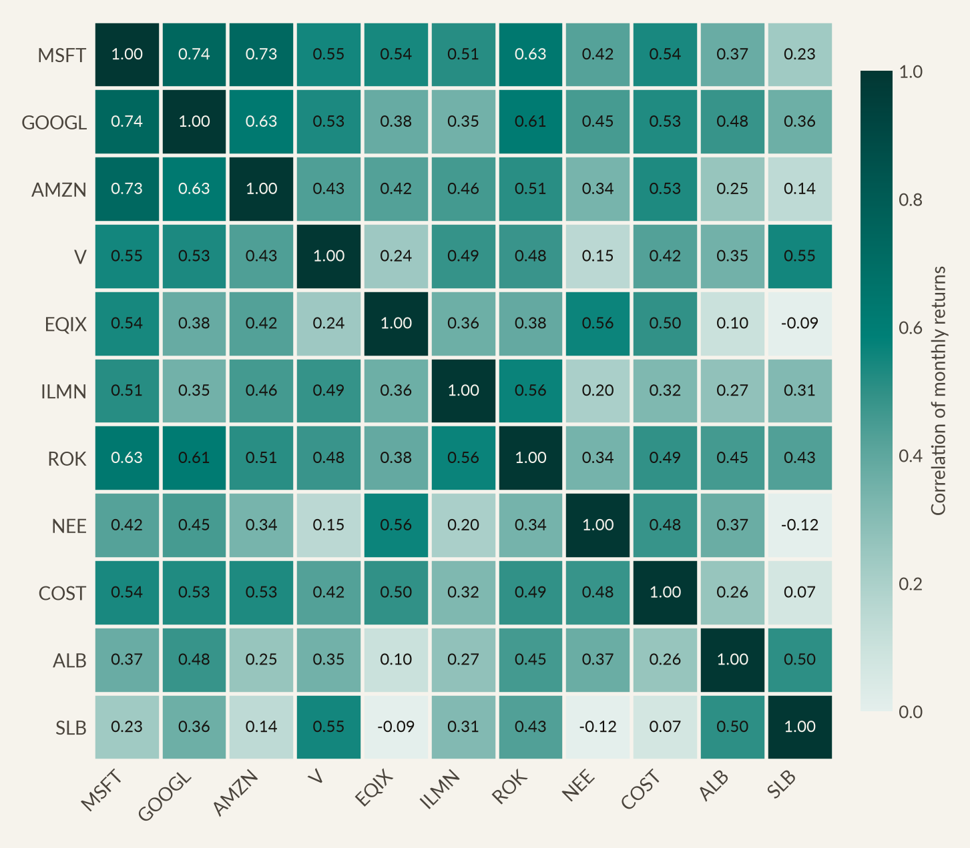
43
APPENDIX
Appendix
A5 · Correlation structure of the holdings
Average pairwise correlation of 0.40, which is real diversification inside a single theme
NORTHPOINT DIGITAL INNOVATION FUND
Six-year review · Jan 2017 – Dec 2022
Notes:
The correlation matrix of monthly returns across the 11 holdings.
Average pairwise correlation is 0.40. For 11 stocks inside a single theme, that's low.
The structure makes sense. The three platforms cluster tightly, with Microsoft and Alphabet at 0.74. That's the concentration risk inside tier one, and it's why the position cap mattered.
At the other end are the genuine diversifiers. NextEra against Schlumberger is minus 0.12, so they actually move in opposite directions. That corner of the matrix is where the ballast lives, and those low correlations produced our 10-point drawdown advantage in 2022.
It's also why the portfolio's volatility of 19% sits so far below the average holding's volatility of about 29.

Slide 44
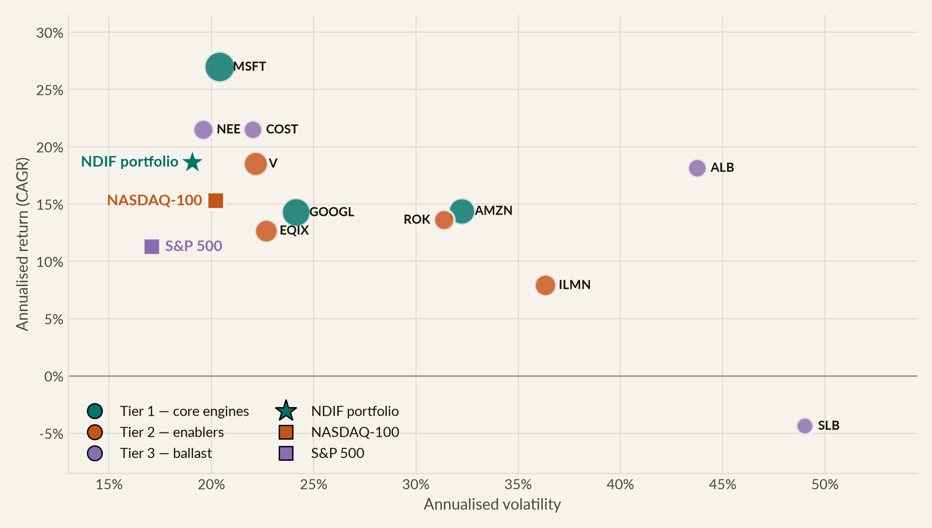
44
APPENDIX
Appendix
A6 · The risk–return map
Every holding, the portfolio and both benchmarks on realised risk and return
NORTHPOINT DIGITAL INNOVATION FUND
Six-year review · Jan 2017 – Dec 2022
Notes:
The classic risk-return scatter, with each bubble sized by target weight.
The important feature is where the star sits. It's up and to the left of almost every individual holding. Only Microsoft, NextEra and Costco sit above the portfolio on return, and all three did it at the same or higher volatility. Meanwhile Schlumberger is out at 49% volatility, and Albemarle at 44.
The portfolio ran lower volatility than every one of its 11 holdings. Combining assets that individually carried 20 to 49% volatility produced something carrying 19. That's the argument for diversification in one picture.

Slide 45
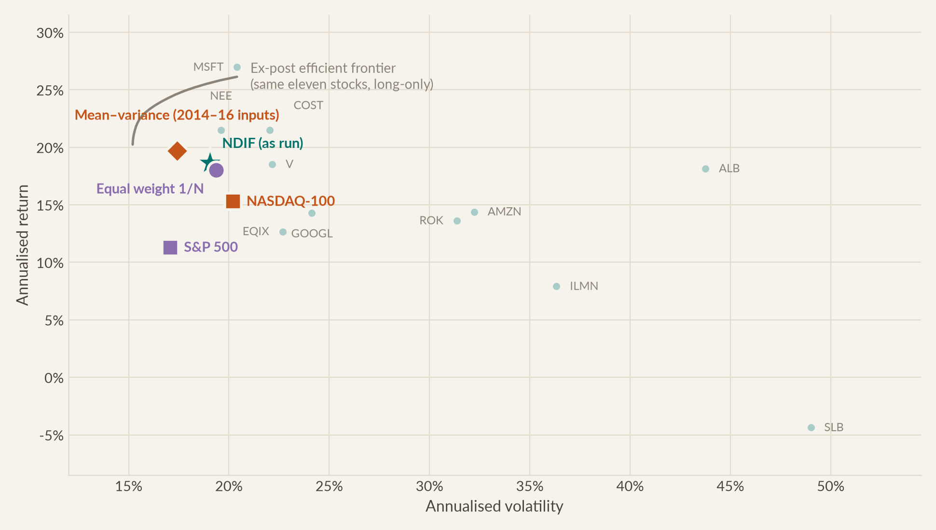
45
APPENDIX
Appendix
A7 · The efficient frontier of our own holdings
Where the fund actually landed against the best that was achievable ex post
NORTHPOINT DIGITAL INNOVATION FUND
Six-year review · Jan 2017 – Dec 2022
Notes:
This is the ex-post efficient frontier, built from the 11 stocks we owned. Nobody could have known this frontier in advance. It only exists because we now know the answers.
The fund sits below it and slightly to the right, which is where a real portfolio should sit. The vertical distance at our realised volatility is about 7 points of annual return. That's the price of not having known the future.
What I find more useful is that the fund, the equal-weight portfolio and the ex-ante optimiser all cluster in the same small region. Three different approaches landed in almost the same place. Which tells you the main driver was which 11 stocks we chose, not how we weighted them.

Slide 46
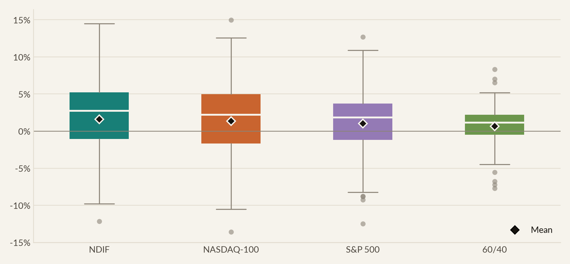
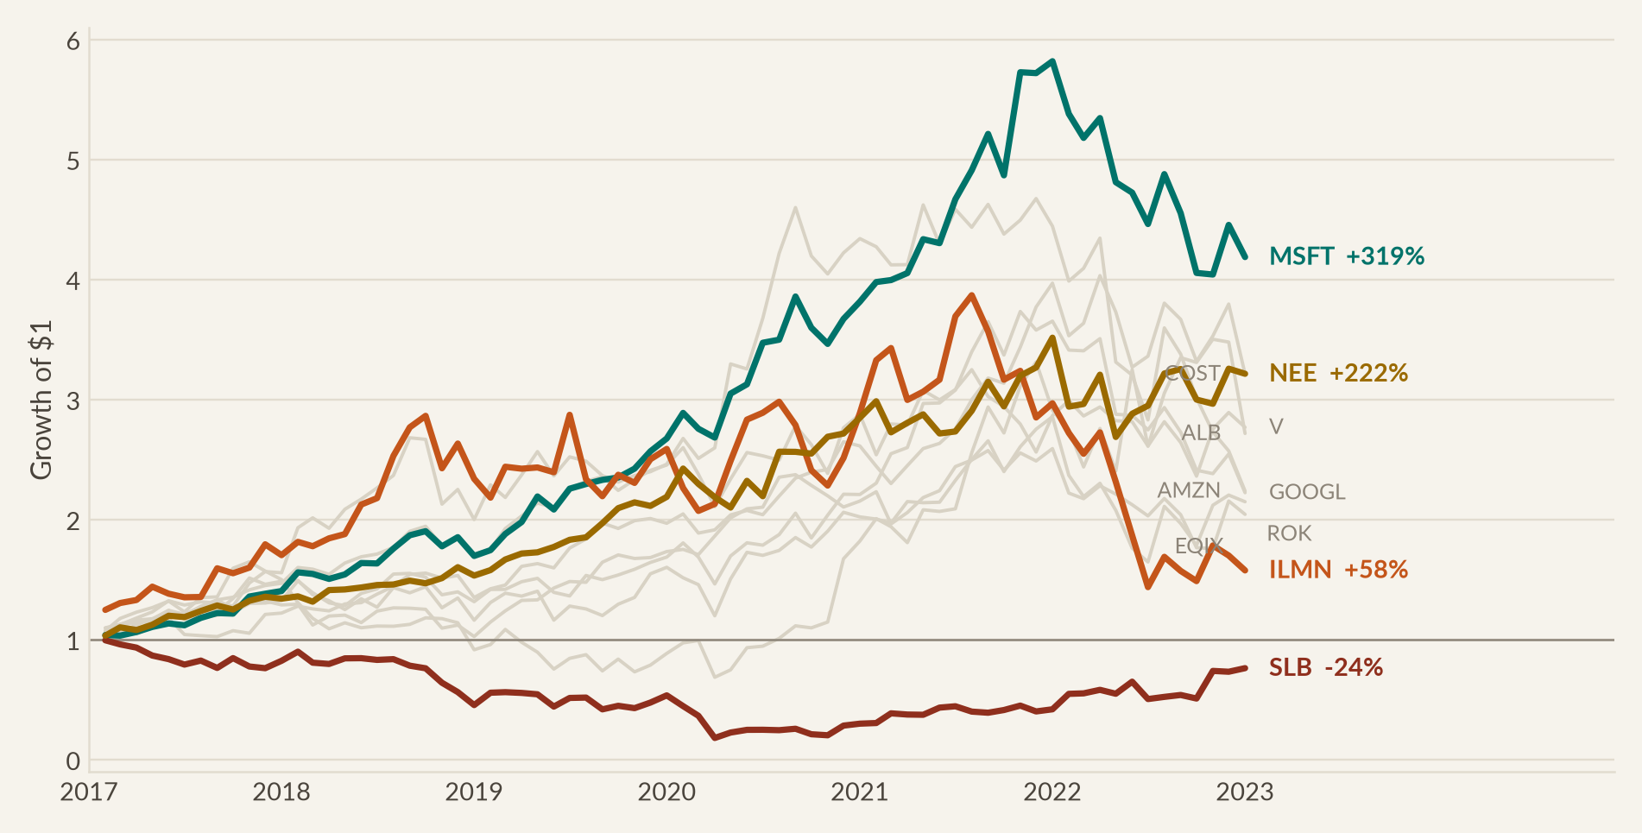
46
APPENDIX
Appendix
A8 · Distribution comparison and dispersion
How the fund's return distribution compares to its benchmarks, and the spread across individual holdings
NORTHPOINT DIGITAL INNOVATION FUND
Six-year review · Jan 2017 – Dec 2022
Notes:
Two supporting exhibits here.
The box plot compares the four distributions directly. Our median monthly return is visibly higher than both benchmarks. Our interquartile range is tighter than the NASDAQ-100's, and our extremes are contained next to it.
The chart underneath shows the spread across the 11 holdings. The range runs from minus 24% to plus 319. That's inside an 11-stock portfolio, in a single theme, over 6 years.
That spread is exactly why the position cap mattered. Suppose we'd been allowed a 30% position, and had put it into Illumina rather than Microsoft. In 2016 the genomics thesis looked every bit as compelling as the cloud thesis, so that was a live possibility. This would be a very different presentation.

Slide 47
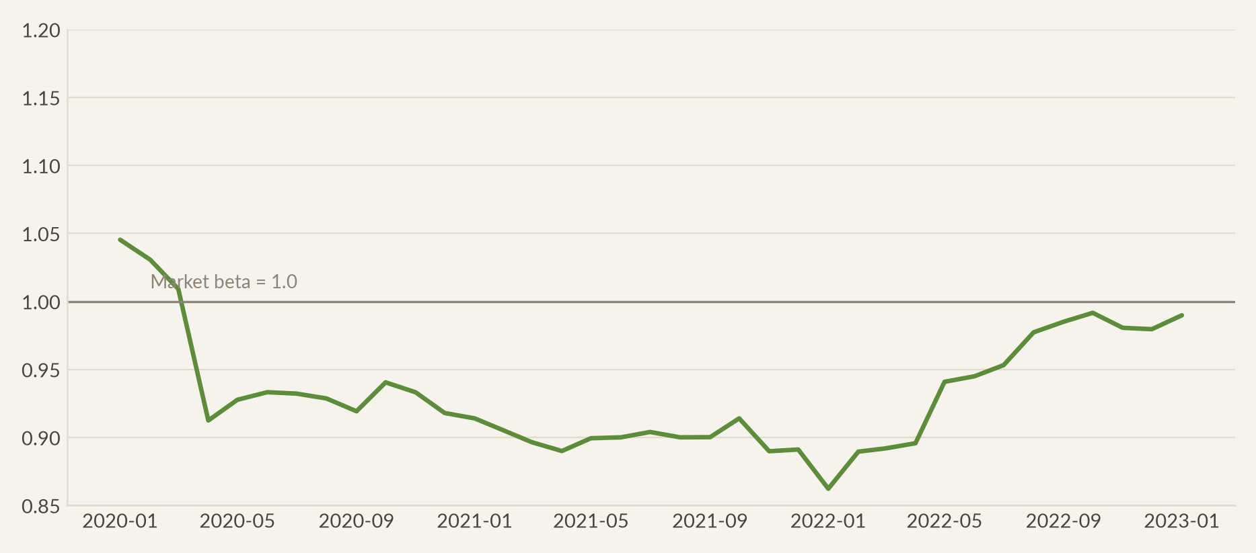
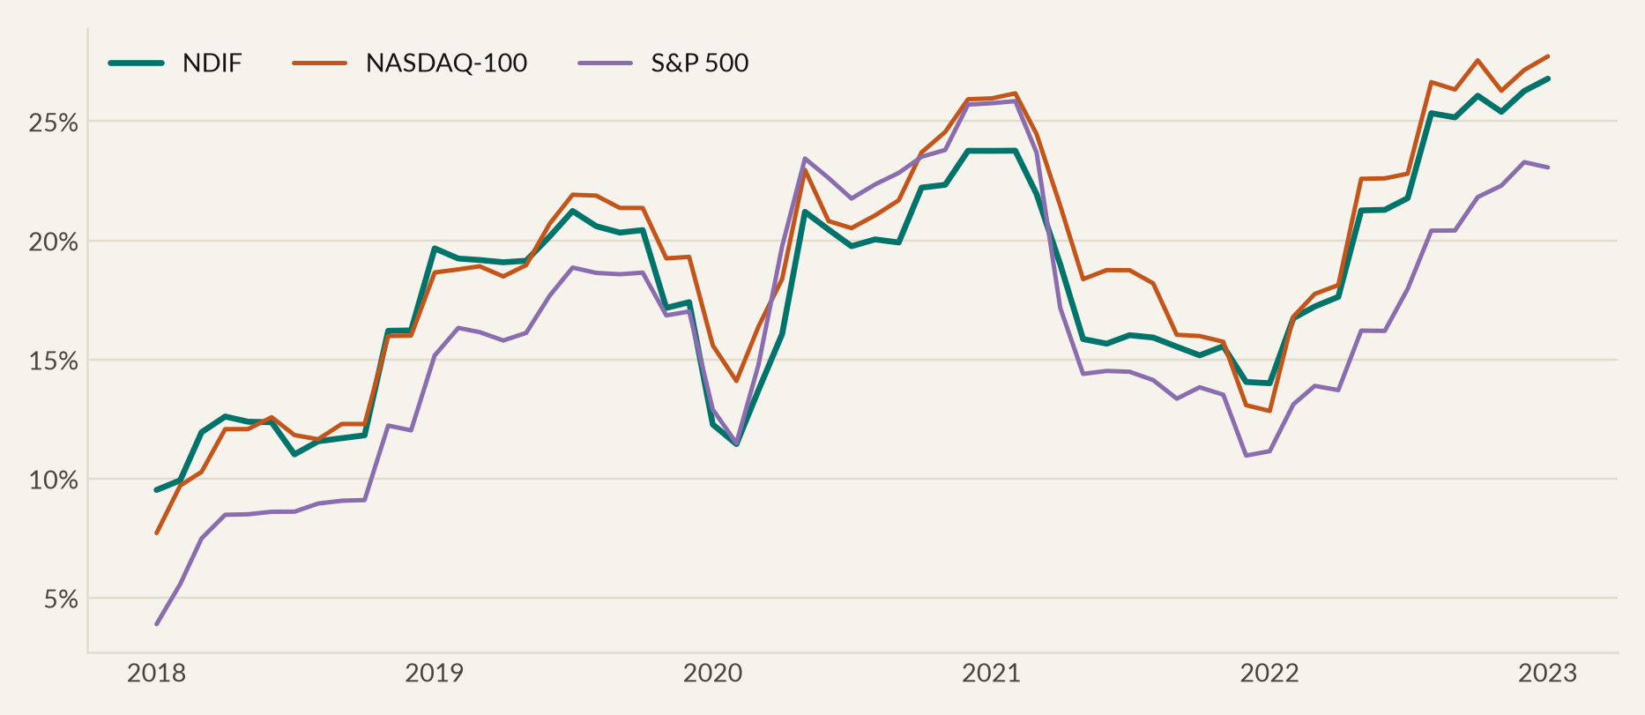
47
APPENDIX
Appendix
A9 · Rolling beta and volatility
Stability of the fund's market exposure and total risk through the sample
NORTHPOINT DIGITAL INNOVATION FUND
Six-year review · Jan 2017 – Dec 2022
Notes:
Two stability checks.
The top chart is our rolling three-year market beta. It stays inside a narrow band for the entire sample, between about 0.97 and 1.08. So we never drifted into higher-beta positioning as markets rose. That's a common and destructive pattern in growth funds.
The chart underneath is rolling one-year volatility. You can see the shape of the period in it. Low volatility through 2017, the COVID spike, a calm 2021, then the sustained rise through 2022.
The detail that matters is that our line sits below the NASDAQ-100's for most of the sample. We ran less total risk than our own benchmark while delivering more return. That, in one sentence, is the argument this whole deck has been making.

Slide 48
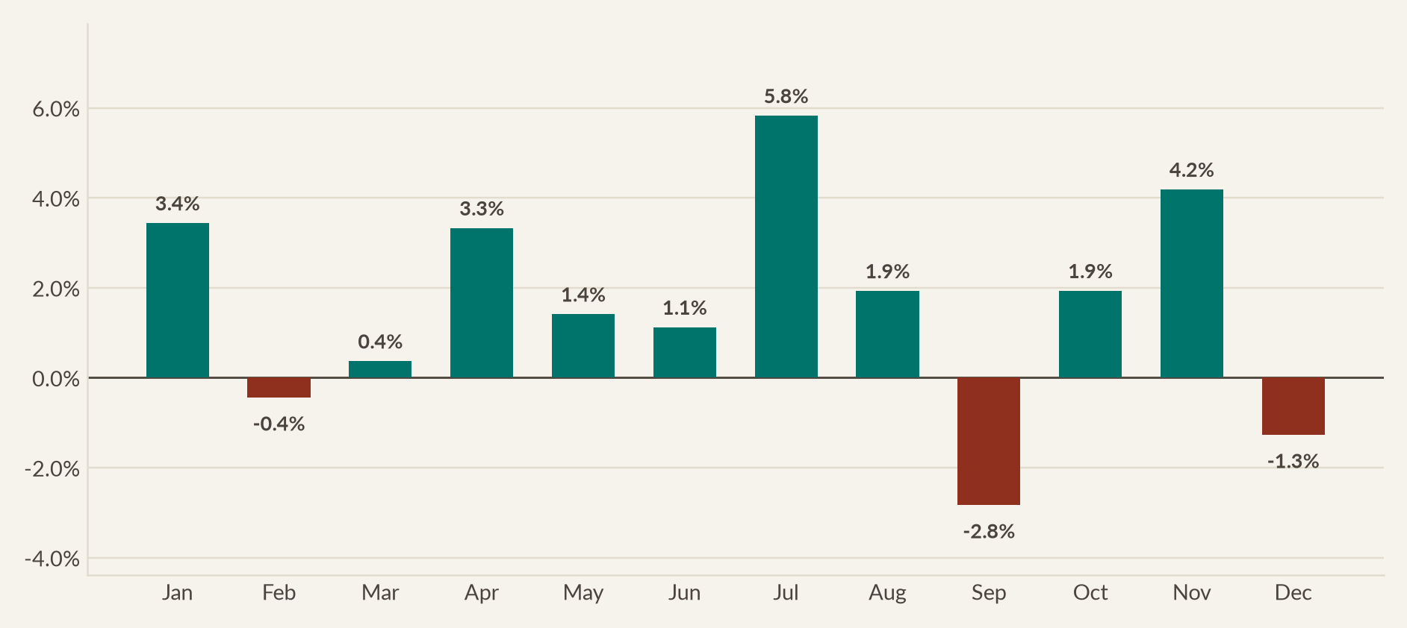
48
APPENDIX
Appendix
A10 · Month-of-year seasonality and the fee comparison
Supporting detail on the seasonality discussion and the fee benchmarking
COMPARATOR | FEE P.A. | 6-YEAR FEE ON $100M | RETURN DELIVERED | TERMINAL VALUE
Passive S&P 500 ETF (SPY) | 0.0945% | $0.57m | 90% | $190m
Passive NASDAQ-100 ETF (QQQ) | 0.20% | $1.20m | 135% | $235m
Typical active equity fund | 1.25% | $7.50m | — | —
Northpoint Digital Innovation Fund | 1.15% all-in | $6.90m | 179% | $279m
Fees are calculated on a static $100m for comparability. Northpoint's all-in load of 1.15% sits 0.95 points above a passive NASDAQ-100 ETF, which costs $5.7m more over six years. The fund delivered $44.4m of additional terminal value, so investors kept $38.7m after paying for active management.
NORTHPOINT DIGITAL INNOVATION FUND
Six-year review · Jan 2017 – Dec 2022
Notes:
Two pieces of supporting detail.
The chart is the month-of-year seasonality I mentioned earlier. July strongest at plus 5.8%, September weakest at minus 2.8%. 6 observations per month, so treat it as description rather than signal.
The table is the fee benchmarking, and this is the comparison I'd want if I were sitting where you are. A passive S and P 500 fund costs about 9 basis points and returned 90%. A NASDAQ-100 fund costs about 20 basis points and returned 135%. We cost 1.15% all in and returned 179%.
So the arithmetic. We cost you $5.7 million more than the NASDAQ fund, and delivered $44.4 million more in terminal value. You kept $38.7 million after every dollar of fee.
I put this in the appendix deliberately, because a manager should be ready to defend a fee on request, not only when it flatters them.

Slide 49
49
APPENDIX
Appendix
A11 · References and declarations
Sources, academic references, and the required statement on the use of generative AI
REFERENCES
GENERATIVE AI USE DECLARATION
Brinson, G. P., Hood, L. R., & Beebower, G. L. (1986). Determinants of portfolio performance. Financial Analysts Journal, 42(4), 39–44.
DeMiguel, V., Garlappi, L., & Uppal, R. (2009). Optimal versus naive diversification. The Review of Financial Studies, 22(5), 1915–1953.
Fama, E. F., & French, K. R. (1993). Common risk factors in the returns on stocks and bonds. Journal of Financial Economics, 33(1), 3–56.
Fama, E. F., & French, K. R. (2015). A five-factor asset pricing model. Journal of Financial Economics, 116(1), 1–22.
Jensen, M. C. (1968). The performance of mutual funds in the period 1945–1964. The Journal of Finance, 23(2), 389–416.
Markowitz, H. (1952). Portfolio selection. The Journal of Finance, 7(1), 77–91.
Newey, W. K., & West, K. D. (1987). A simple, positive semi-definite, heteroskedasticity and autocorrelation consistent covariance matrix. Econometrica, 55(3), 703–708.
Sharpe, W. F. (1966). Mutual fund performance. The Journal of Business, 39(1), 119–138.
Sortino, F. A., & Price, L. N. (1994). Performance measurement in a downside risk framework. The Journal of Investing, 3(3), 59–64.
Treynor, J. L. (1965). How to rate management of investment funds. Harvard Business Review, 43(1), 63–75.
Data: Kenneth R. French Data Library (factor and risk-free series); dividend-adjusted monthly closing prices for all eleven holdings, the eleven SPDR sector ETFs, QQQ, SPY and AGG.
Assessment classification. AI-Supported. Generative AI was permitted for the preparation of the analysis and slides; the presentation itself is delivered by the author.
Tools used. Generative AI assistant for the Python analysis code, chart generation and slide drafting; Grammarly for language editing.
Purpose. Writing the return, risk and regression code; producing the visualisations; structuring the deck; drafting speaker notes.
Human refinement. As Portfolio Manager I set the analytical scope, chose the benchmarks and factor models, interpreted every result, wrote the investment narrative and recommendation, and verified the outputs against the underlying data.
Data integrity. All market data was retrieved programmatically from primary sources. No figure in this deck was generated by an AI model without a reproducible calculation behind it.
NORTHPOINT DIGITAL INNOVATION FUND
Six-year review · Jan 2017 – Dec 2022
Notes:
Finally, the references and declarations.
The methodology follows the standard literature throughout. Jensen for alpha. Sharpe, Sortino and Treynor for the risk-adjusted ratios. Fama and French for the factor models. Brinson for attribution. Markowitz for the frontier. And Newey and West for the standard-error correction.
On AI use, this assessment is classified as AI-Supported, and I've declared the tools and, more importantly, who did what. The analytical scope, the choice of benchmarks and factor models, the interpretation of every result and the recommendation are mine. Every number traces back to a reproducible calculation on primary market data, and the code and workbook accompany this submission.

