Slide 1
Solve Ordinary Differential Equation with Initial Value Problems

Slide 2
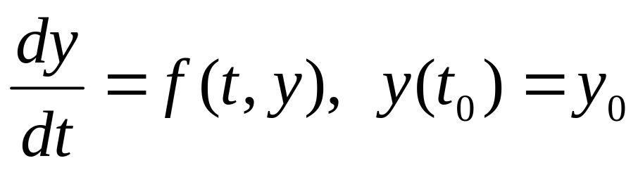
Euler’s Method
We will concentrate on the first order initial value problem
Recall that if f and ∂f /∂y are continuous, then this IVP has a unique solution y = φ(t) in some interval about t₀.

Slide 3
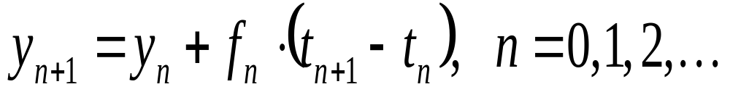
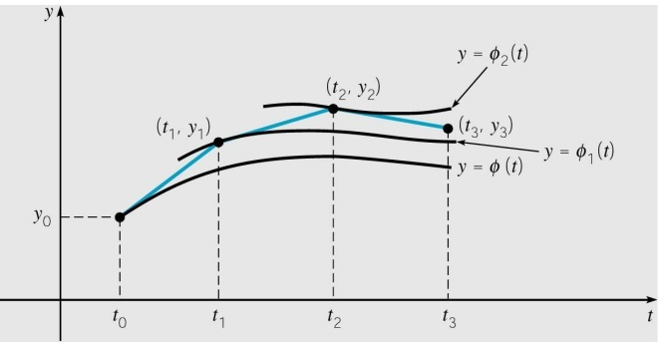
Euler’s method was formulated as
where f_{n} = f (t_{n}, y_{n}).

Slide 4
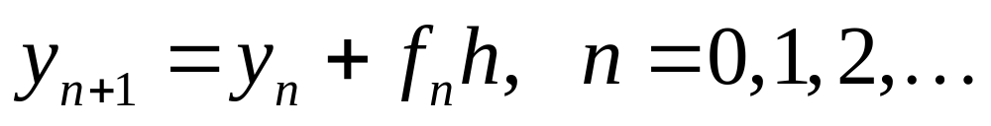
For a uniform step size
h = t_{n} – t_{n-1},
Euler’s method becomes
where f_{n} = f (t_{n}, y_{n}).

Slide 5
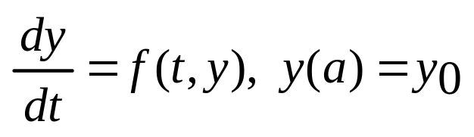
Euler’s Method
Solve
for a≦t≦b
Set h=(b-a)/n,
t_{i}=a+ih, i=0, 1, 2, …, n
y(t_{i+1})=y(t_{i})+h．f(t_{i},y(t_{i}))

Slide 6
Euler’s Method: Programming Outline
  Step 1. Define f (t,y)
  Step 2. Input initial values a and y0
  Step 3. Input step size h and number of steps n
  Step 4. Output t0 and y0
  Step 5. For j from 1 to n do
  Step 6. k1 = f (t,y)
  y = y + h*k1
  t = t + h
  Step 7. Output t and y
  Step 8. End

Slide 7
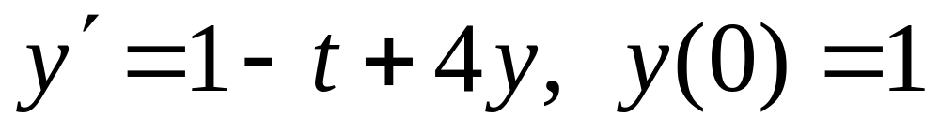
Ex. Solve
0≦t≦2 with h=0.2,0.05,and 0.01.
(Sol.)
Set h=0.2
t_{i}=0.2*i,
y(t_{i+1})=y(t_{i})+h．[4y(t_{i})- t_{i} +1]

Slide 8
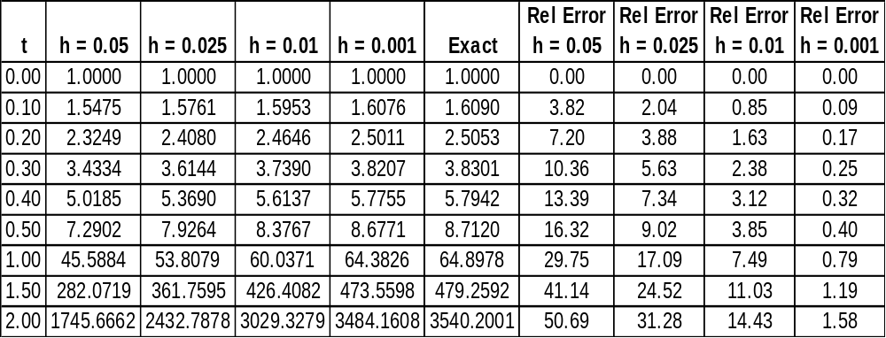
The table below compares the results of Euler’s method, with step sizes h = 0.05, 0.025, 0.01, 0.001, and the exact solution values, on the interval 0 ≤ t ≤ 2.

Slide 9
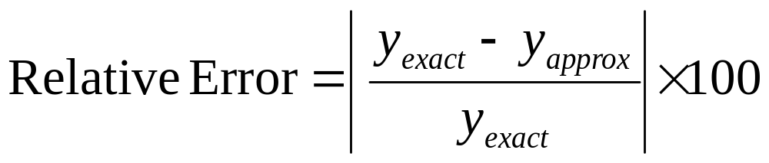
Relative Error
We have used the formula

Slide 10
#include<stdio.h>
#include < stdlib.h >
float func(float t, float w)
{return (1-t+4*w);}
main(){ int i,n;
float t,w,h,a,b;
FILE *f1;
f1=fopen(“Euler.txt","wt") ;
Subroutine
副程式的
部分
Declare variable宣告變數
Open a file 開一個檔案

Slide 11
a=0.0; b=2.0;n=10;
h=0.2;
t=0.0; w=1.0;
for(i=0;i<10;i++)
{ t=a+i*h;
w=w+h*func(t,w);
fprintf(f1,"%f %f \n",t+h ,w);}
fclose(f1);}

Slide 12
Python plot
Anaconda3 >>Spyder
Program:
import numpy as np
import matplotlib.pylab as plt
t,y=np.loadtxt(‘Euler.txt',unpack=True)
plt.figure()
plt.title(“Euler Method")
plt.plot(t, y,'x', t,y,’r-’)
plt.savefig(‘Euler.png')
plt.show()

