Slide 1
Evolution of Microprocessor

Slide 2
Intel 4004
Introduced in 1971
16-pin ceramic dual-in-line package.
2,300 transistors
4 bit architecture
clock frequency : 740KHz.
Used for calculators
Instruction Set : 46
It was able to address 640 bytes of RAM and 4096 bytes of ROM.

Slide 3
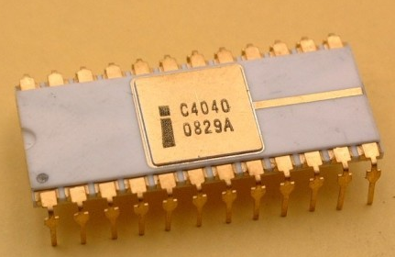
Intel 4040
Introduced in 1974
3000 transistors
Maximum clock frequency of 740KHz.
Instruction set: 60
Program memory : 8KB (13-bit address space).
24-pin dual-in-line package.

Slide 4
Intel 8008
First 8-bit microprocessor
Introduced in 1972.
3500 transistors.
14-bit address bus (16KB)
First commercial non-calculator PC.
18-pin dual-in-line package.
Instruction Set: 48
Clock speed was from 0.2MHz to 0.8MHz.

Slide 5
Intel 8080
Introduced in 1974.
Used same instruction set of 8008
4500 transistors.
40-pin dual-in-line package
16-bit address bus(64KB)
Maximum Clock Frequency : 2MHz.

Slide 6
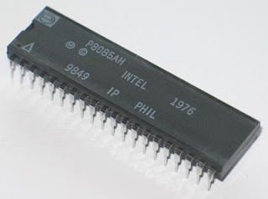
Intel 8085
It was introduced in 1977.
“5” implies +5V power supply.
6500 transistors
40-pin dual-in-line package
16-bit address bus (64KB) and 8-bit data bus.
74 instructions
Clock Speed: 3, 5 and 6MHz

Slide 7
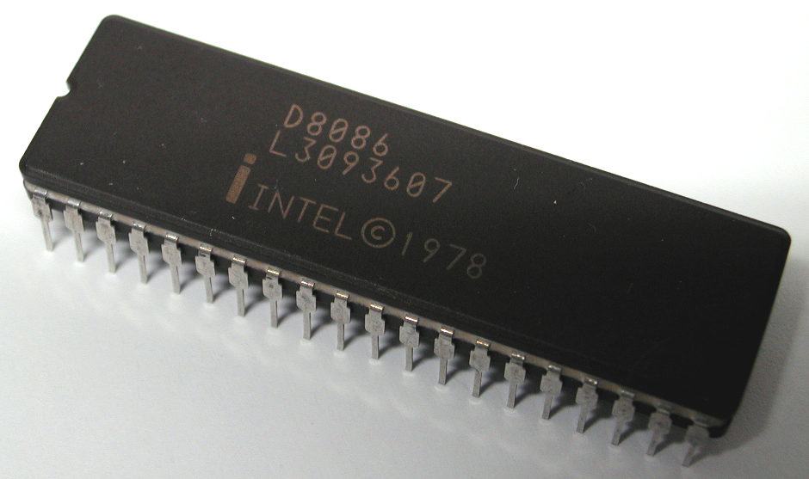
Intel 8086
It was introduced in1978
40-pin dual-in-line package
16-bit microarchitecture
20-bit address bus (1 MB)
16-bit data bus
Instruction set : 117
approximately 20,000 transistors
Clock Speed: 5 to 10MHz

Slide 8
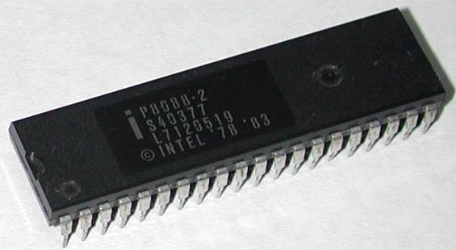
Intel 8088
It was introduced in1979.
40-pin dual-in-line package.
16-bit microarchitecture
20-bit address bus (1 MB)
8-bit data bus
Instruction set : 117
approximately 20,000 transistors
Clock Speed: 5 to 10MHz

Slide 9
Intel 8086/8088

Slide 10
8086
It is a 16-bit microprocessor.
It has a 16 bit data bus (it can read or write data to/from memory and ports either 16 bits or 8 bits at a time)
It has 20 bit address bus ( address 2²⁰ (1MB) locations).
Each memory address represents a byte-wide location.

Slide 11
8086
Memory words is stored in two consecutive locations.
If the first byte of a word is at even address, 8086 can read the entire word in one operation.
If the first byte is at odd address, 8086 will read the first byte in one operation and the second byte in another operation.

Slide 12
8086 Architecture
8086 CPU is divided into two independent functional parts:
Bus Interface Unit (BIU) and
Execution Unit (EU).

Slide 13
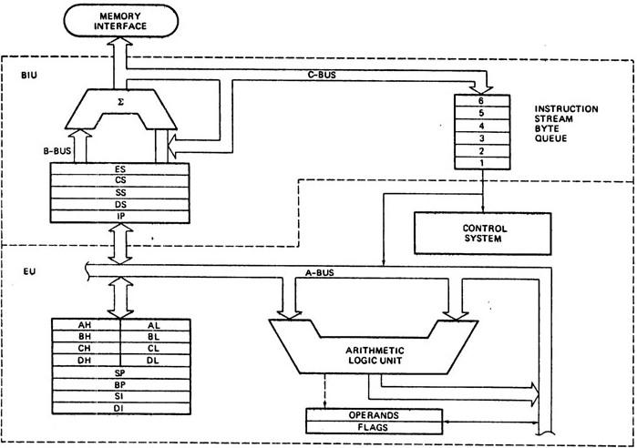

Slide 14
BUS INTERFACE UNIT
It handles all transfers of data and addresses on the buses for execution unit.
BIU
sends out addresses
fetches instruction from memory
reads data from ports and memory and
writes data to ports and memory.
Different parts of BIU are:
Instruction Queue
Segment Registers
Instruction Pointer

Slide 15
Instruction Queue
BIU fetches 6 instruction bytes ahead to speed up the execution.
Prefetched instruction bytes are stored in a FIFO group of registers called an instruction queue.
BIU fetches the instruction while EU decodes them.
Except in the cases of JUMP and CALL instructions, this method reduces the processing time.
This method of fetching the instruction while execution is in progress is called pipelining

Slide 16
Segment Registers
BIU contains four 16-bit segment registers:
code segment (CS) register
stack segment (SS) register
extra segment (ES) register and
data segment (DS) register.
These registers hold the starting addresses of the four memory segments that 8086 is working with at a particular time.

Slide 17
Instruction Pointer (IP)
This register holds the 16 bit address of the next code byte for the code segment.
The value in IP (referred as offset) is added to CS content to produce 20-bit address.
BIU has a dedicated adder for address computation.

Slide 18
EXECUTION UNIT
EU tells BIU where to fetch instructions from as well as decode and execute instructions.
The execution unit includes the following parts.
Control Circuitry
Instruction Decoder
Arithmetic and Logic Unit
Flag Register
General Purpose Registers
Pointer and Index Register

Slide 19
EXECUTION UNIT
Control Circuitry : directs the internal operations of the processor.
Instruction Decoder : It receives the fetched instruction from BIU and converts it into a series of action which the EU can carry out.
Arithmetic and Logic Unit: will do arithmetic and logical operations

Slide 20
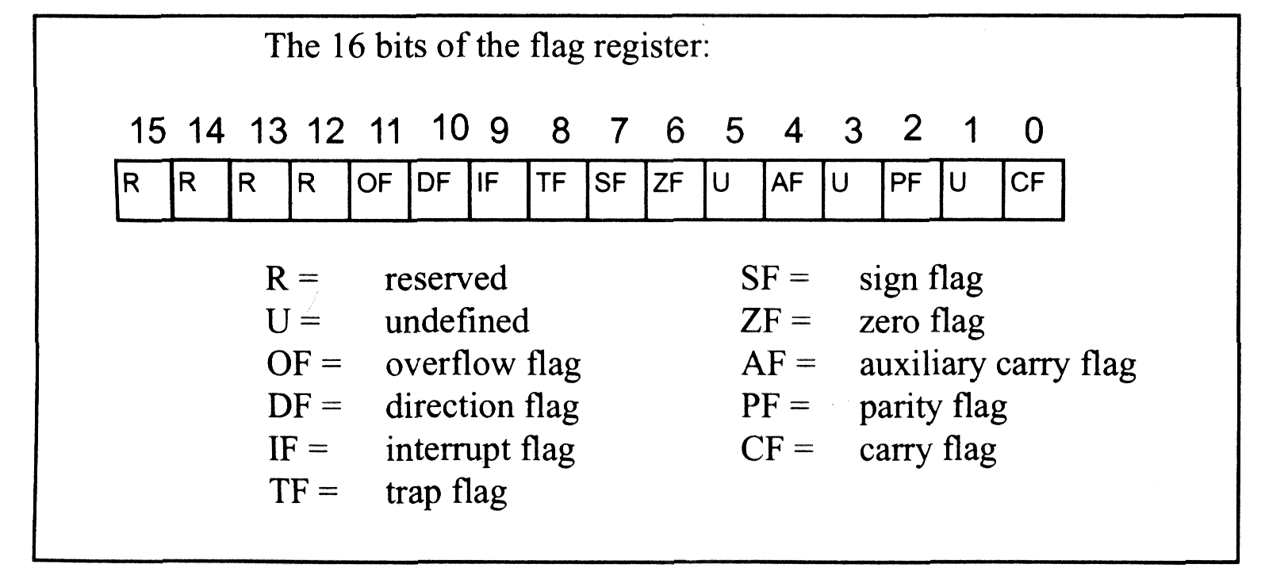
EXECUTION UNIT
Flag Register: It is a flip-flop which indicates some condition produced by the execution of an instruction or controls certain operations of the EU.
There are 6 conditional flags and 3 control flags
The contents of the 16-bit flag are as shown below.

Slide 21
Flag Register
Conditional Flags
reflect the results of previous operation involving ALU.
Flags | If the flag is set,
Carry Flag (CF) | there is a carry out of the MSB in addition operation or borrow is needed in a subtract operation.
Parity Flag (PF) | the result of an arithmetic or logical operation results in an even number of 1s in the binary representation
Auxiliary Carry (AF) | there is a carry out of the bit 3 position in an arithmetic operation
Zero Flag (ZF) | if the result of an arithmetic or logical operation is zero.
Sign Flag (SF) | if a signed arithmetic operation causes the MSB to 1. This implies that the number is negative.
Overflow Flag (OF) | when an arithmetic overflow has occurred. It indicates that the signed operation result will not fit in the destination.

Slide 22
Flag Register
Control flags
control the execution of special functions.
These flags are set or reset with specific instructions used in the program
Flags | If the flag is set,
Direction Flag (DF) | the contents of the index register (SI and DI) will be decremented after each operation.
Interrupt Flag(IF): | the external maskable interrupt(INTR) is allowed to interrupt the program
Trap Flag(TF) | It is used for single stepping through the program. It is mainly used for debugging.

Slide 23
Execution Unit
General Purpose Registers
EU has 4 general purpose registers labeled as AX, BX, CX and DX.
They are used as
operands in most of the instructions
source or destination registers during computation and transfer of data
pointers to memory and
counters.

Slide 24
Execution Unit
Pointer and Index Register
The pointer and index registers are used to hold the offset within a segment.
They are
Stack Pointer (SP) Register
Base Pointer (BP) Register
Source Index (SI) Register
Destination Index (DI) Register.

Slide 25
Operation of 8086/8088
When 8086/8088 is started,
BIU outputs 20 bit address (from CS: IP ) onto the address bus causing the selected byte or word to be read into BIU
IP is incremented by one to prepare for the next instruction fetch.
Once inside BIU, the instruction is passed to Instruction Queue.

Slide 26
Operation of 8086/8088
If the queue is empty, the EU draws this instruction from the queue and begins execution
While EU is executing the instruction, the BIU proceeds to fetch a new instruction.
Depending on the execution time of the first instruction, BIU may fill the queue.
BIU is programmed to fetch a new instruction whenever the queue has room for one or two additional bytes.

Slide 27
3 Conditions when EU has to wait
When an instruction requires access to a memory location not in queue
When the instruction is JUMP
When the instructions are slow to execute
(AAM requires 83 clock cycles while instruction fetch requires 4 clock cycle)

Slide 28
Difference b/w 8086 and 8088
 | 8086 | 8088
Data Bus Path | 16 bit | 8 bit
Instruction Queue Size | 6 bytes | 4 bytes

Slide 29
Memory Segmentation
It is a powerful m/m management mechanism which allows programmers to partition their programs into modules that operate independently of one another.
8086 can access 1MB of memory. At any given time, it can work only with four 64KB segments
Segment register hold the upper 16-bits of the starting address called the segment base.
If CS register contains 1234H, then the code segment will start at 12340H address.

Slide 30
Memory Segmentation
It uses two components to specify a memory location: a segment base and an offset
The offset of 8086 are 16-bit constants.
Size of offset limits the segment size
Physical address is obtained by multiplying segment base by 16 (shifting 4-bit left) and adding the offset address

Slide 31
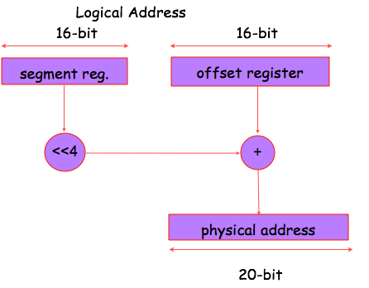
Memory Segmentation

Slide 32
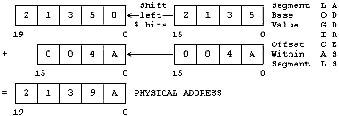
Memory Segmentation: Example

Slide 33
Memory Segmentation

Slide 34
