Slide 1
Distributed Transaction &
Concurrency Control
Chapter 3

Slide 2
OUTLINE
Distributed Transactions:
  Basic Concept of Transaction Management
  State of Transaction
  Introduction to Distributed Transaction Management
  Model for Transaction Management
Distributed Concurrency Control:
  Objective of Distributed Concurrency Control
  Concurrency Control Anomalies
  Distributed Serializability
  Locking Based Algorithm
  Timestamp Based Algorithm

Slide 3
Basic Concept of Transaction Management
-Introduction to Transaction
-ACID Properties of Transaction

Slide 4
What is a Transaction?
A logical unit of work on a database
  An entire program
  A portion of a program
  A single command
The entire series of steps necessary to accomplish a logical unit of work is referred as one transaction
A transaction is a collection of actions that make consistent transformations of system states while preserving system consistency.
Successful transactions change the database from one CONSISTENT STATE to another

Slide 5
Example of Transaction
Amount in stock = X
X = 100
Initial State <Consistent State>
X = X - 50
Transaction A <Modifies database>
X = 50
Final State <Consistent State>

Slide 6
Example of a Transaction in Database
Updating a Record
  Locate the Record on Disk
  Bring record into Buffer
  Update Data in the Buffer
  Writing Data Back to Disk

Slide 7
Properties of Transactions
To ensure data integrity. The database system must maintain the ACID properties.
ATOMICITY
  all or nothing
CONSISTENCY
  no violation of integrity constraints
ISOLATION
  concurrent changes invisible should look like serializable
DURABILITY
  committed updates persist

Slide 8
1.Atomicity
Either all or none of the transaction's operations are performed.
Atomicity requires that if a transaction is interrupted by a failure, its partial results must be undone.
The activity of preserving the transaction's atomicity in presence of transaction aborts due to input errors, system overloads, or deadlocks is called Transaction recovery.
The activity of ensuring atomicity in the presence of system crashes is called Crash recovery.

Slide 9
2. Consistency
Internal Consistency
  A transaction which executes alone against a consistent database leaves it in a consistent state.
  Transactions do not violate database integrity constraints.
Transactions are correct programs
Transaction Consistency can be ensured by using different levels of degrees to avoid dirty data reading & writing

Slide 10
Example: Dirty Read
Sam and Jane both want to buy a copy of the DB text book via. Amazon
There is one copy left
Sam adds book to cart
Jane reads the number of copies and it is 0
Sam’s credit card is rejected, so his purchase is canceled
Where is the dirty read?
  Jane reads the number of copies and it is 0
What is the resulting problem?
  Amazon didn’t sell the book while he could
Is this terrible?
  No. the alternative is worse.

Slide 11
Reading Un-Committed Data
Dirty Data is data that has been written by a transaction that has not yet committed
Dirty Read is a read of dirty data
A dirty read occurs when uncommitted data is read.
Even if only committed changes are read, the result may be different than serial execution

Slide 12
Consistency Degrees
Degree 0
  Transaction T does not overwrite dirty data of other transactions
  Dirty data refers to data values that have been updated by a transaction prior to its commitment
Degree 1
  T does not overwrite dirty data of other transactions
  T does not commit any writes until it completes all its write operations, that is until the end of Transaction (EOT)

Slide 13
Consistency Degrees (cont’d)
Degree 2
  T does not overwrite dirty data of other transactions
  T does not commit any writes before EOT
  T does not read dirty data from other transactions
Degree 3
  T does not overwrite dirty data of other transactions
  T does not commit any writes before EOT
  T does not read dirty data from other transactions
  Other transactions do not dirty any data read by T before T completes.

Slide 14
3. Isolation
The final effects of multiple simultaneous transactions must be the same as if they were executed one right after the other.
Serializability
  If several transactions are executed concurrently, the results must be the same as if they were executed serially in some order.
Incomplete results
  An incomplete transaction cannot reveal its results to other transactions before its commitment.
  Necessary to avoid cascading aborts.

Slide 15
Isolation Example
Consider the following Two Transactions:
T₁: Read(x) T₂: Read(x)
  x ←x+1 x ←x+1
  Write(x) Write(x)
  Commit Commit
Possible Execution Sequences:
T₁: Read(x) T₁: Read(x)
T₁: x ←x+1 T₁: x ←x+1
T₁: Write(x) T₂: Read(x)
T₁: Commit T₁: Write(x)
T₂: Read(x) T₂: x ←x+1
T₂: x ←x+1 T₂: Write(x)
T₂: Write(x) T₁: Commit
T₂: Commit T₂: Commit

Slide 16
SQL-92 Isolation Levels
Phenomena:
Dirty read
  T₁ modifies x which is then read by T₂ before T₁ terminates; T₁ aborts ⇒ T₂ has read value which never exists in the database.
Non-repeatable (fuzzy) read
  T₁ reads x; T₂ then modifies or deletes x and commits. T₁ tries to read x again but reads a different value or can’t find it.
Phantom
  T₁ searches the database according to a predicate while T₂ inserts new tuples that satisfy the predicate.

Slide 17
Example: Dirty Read
Sam and Jane both want to buy a copy of the DB text book via Amazon
There is one copy left
Sam adds book to cart
Jane reads the number of copies and it is 0
Sam’s credit card is rejected, so his purchase is canceled
Where is the dirty read?
  Jane reads the number of copies and it is 0
What is the resulting problem?
  Amazon didn’t sell the book while he could
Is this terrible?
  No. the alternative is worse.

Slide 18
Example: Committed Reads/ Non-Repeated data
Sam and Jane both want to buy a copy of the DB text book via Amazon
Jane checks, and sees that there is one copy left
Sam also checks, and adds book to cart
Sam purchases the book (and his transaction commits)
Jane checks again and sees that there are no copies left
Jane only read committed data. Her read was unrepeatable
Result is not equivalent to running in isolation – why? Is that bad? Here it looks OK, but it might be bad to calculator with a value, while it is changed.

Slide 19
Example: Phantom Tuples
A Phantom Tuple is one that is inserted into the database while a transaction is executing
Suppose the database ensures that the transaction performs only Repeatable reads
Jim goes to a dating site, looking for his destined
He searches for potential available matches
He searches again
  On this search he will find all the previous (i.e., none can become unavailable), but may also find new (phantom) matches

Slide 20
Four Isolation Levels
SQL standard provides 4 isolation levels
  Read Uncommitted
  Read Committed
  Repeatable Read
  Serializable

Slide 21
SQL-92 Isolation Levels (cont’d)
Read Uncommitted
  For transactions operating at this level, all three phenomena are possible.
Read Committed
  Fuzzy reads and phantoms are possible, but dirty reads are not.
Repeatable Read
  Only phantoms possible.
Anomaly Serializable
  None of the phenomena are possible.

Slide 22
Read Uncommitted
Transaction can read rows that have been modified by other transactions but not yet committed
Dirty Reads | Possible
Non-Repeatable Reads | Possible
Phantom Reads | Possible

Slide 23
Read Committed
Transaction cannot read rows that have been modified by other transactions but not yet committed
Dirty Reads | Not Possible
Non-repeatable Reads | Possible
Phantom Reads | Possible

Slide 24
Repeatable Read
Transaction cannot read rows that have been modified by other transactions but not yet committed
No other transactions can modify data that has been read by the current transaction until the current transaction completes
Dirty Reads | Not Possible
Non-repeatable Reads | Not Possible
Phantom Reads | Possible

Slide 25
Serializable
Transaction cannot read rows that have been modified by other transactions but not yet committed
No other transactions can modify data that has been read by the current transaction until the current transaction completes
Other transactions cannot insert new rows that would be returned by select statements in the current transaction until the current transaction completes
Dirty Reads | Not Possible
Non-repeatable Reads | Not Possible
Phantom Reads | Not Possible

Slide 26
4. Durability
Once a transaction commits, the system must guarantee that the results of its operations will never be lost, in spite of subsequent failures.
Database recovery

Slide 27
Example 1: Test of Properties
Assume that there are two concurrent transaction T1 and T2 respectively occurring in a database environment. The transaction T1 is depositing 500 to an account X with an initial value 3000 , while the transaction T2 is withdrawing an amount 1000 from the same account X. Further assume that the transaction T1 is executed first and allows the transaction T2 to read the Uncommitted value 3500 for X but later T1 then aborts. What is this problem called as?
This problem is known as Dirty Read Problem, which is illustrated in the following:
T1: Write(X)= 3000+500=3500
T2: Read(X)= 3500
T1: Abort
Thus, the transaction T2 reads the dirty data of the transaction T1

Slide 28
Example 2: Test of Properties
In a DBMS, Consider a situation when one transaction T1 reads the value of a data item X, While another transaction T2 updates the same data item. Now, if the transaction T1 reads the same data item X again, it will read some different value, because the data item is already manipulated by the transaction T2.
This problem is known as Non- Repeatable or Fuzzy Read Problem, which is illustrated in the following:
T1: Read(X) :X=100
T2: Write(X) : X=100+10
T2: End Transaction
T1: Read(X): X=110
Thus, the transaction T1 has read two different values for X. (i.e. same value is not repeated again, so its non-repeatable)

Slide 29
Example 3: Test of Properties
In a DBMS, When transaction T1 performs an operation depending on a criterion, transaction T2 inserts a new tuple Z satisfying that criterion. Now if the Transaction T1 performs the same operation again, the result will be different. Hence, Z is a “Phantom” data item.
This problem is known as Phantom Read Problem, which is illustrated in the following:
T1: Read range [X-Y]
T2: Insert Z, X<Y<Z
T2: End Transaction
T1: Read Range[X-Z]

Slide 30
States of Transaction

Slide 31
Transaction Management with SQL
SQL Statements → Commit / Rollback
When a transaction sequence is initiated it must continue through all succeeding SQL statements until:
  A Commit Statement is Reached (Commit)
  A Rollback Statement is Reached (Rollback)
  The End of the Program is Reached (Commit i.e. EOT)
  The Program is Abnormally Terminated (Rollback)

Slide 32
State diagram of a Transaction
Read
Write
Partially
Committed
committed
Commit
Begin
Transaction
Active
Abort
Abort
Failed
Aborted
(Terminate)
Roll back
A transaction must be in one of these states.
Because failures occurs, transaction are broken up into states to handle various situation.

Slide 33
States of Transaction
Active, the initial state; the transaction stays in this state while it is executing.
Partially committed, after the final statement has been executed
Failed, after the discovery that normal execution can no longer proceed.
Aborted, after the transaction has been rolled backed and the database has been restored to its state prior to the start of transaction.
Committed, after successful completion
Notes:
Failed กรณีที่มีข้อผิดพลาดเกิดขึ้นกับ transaction

Slide 34
Transaction States (Cont..)
The transaction has committed only if it has entered the committed state.
The transaction has aborted only if it has entered the aborted state.
The transaction is said to have terminated if has either committed or aborted.

Slide 35
Introduction to Distributed Transaction Management
What is Distributed Transaction Management
Objective of Distributed Transaction Management
Classification of Transactions
Issues in Transactions

Slide 36
Transactions
What is a Distributed Transaction?
  A transaction that involves more than one server
  Network can be unreliable, asynchronous
    Need a failure model that is practical
  Objectives: Consistency, Fault-Tolerance, Performance, Availability

Slide 37
Objective of Distributed Transaction Management
CPU and Main Memory Utilization should be improved
Response time should be Minimized
Availability should be Maximized
Communication Cost should be minimized

Slide 38
Objective of Distributed Transaction Management
CPU and Main Memory Utilization should be improved
  Most of the typical dB applications spend much of their time waiting for I/O operations rather than on computations
  In a large system, the concurrent execution of these I/O applications can turn into a bottleneck in main memory or in CPU time Utilization
  To solve this problem, a transaction manager should adopt specialized techniques to deal with specific database applications

Slide 39
Objective of Distributed Transaction Management
Response time should be minimized
  To improve the performance of transaction executions, the response time of each individual transaction must be considered and should be minimized.
  In this case of distributed applications, it is very difficult to achieve an acceptable response time owing to the additional time required to communicate between different sites.

Slide 40
Objective of Distributed Transaction Management
Availability should be maximized
  Although the availability in a distributed system is better than that in a centralized system, it must be maximized for transaction recovery and concurrency control in distributed databases.
  The algorithm implemented by the distributed transaction manager must not block the execution of those transactions that do not strictly need to access a site that is not operational.

Slide 41
Objective of Distributed Transaction Management
Communication Cost should be minimized
  In a distributed system an additional communication cost is incurred for each distributed or global application, because a number of message transfers are required between sites to control the execution of a global application.
  These messages are not only used to transfer data, but are required to control the execution of the application.
  Prevention measures should be adopted by the transaction manager to minimize the communication cost.

Slide 42
Classification of Transactions based on Structure
Flat Transaction
Nested Transaction
  Closed Nested Transaction
  Open Nested Transaction
Workflow Transaction
  Human Oriented Workflows
  System Oriented Workflows
  Transaction Oriented Workflows

Slide 43
Classification of Transactions based on Structure
Flat Transaction
  It has a single start point(begin_Transaction) and a single end point or termination (End_Transaction).
  Consists of a sequence of primitive operations embraced between a begin and end markers.
    Begin_transaction Reservation
      …
    End.
  Most of the typical transaction management database application are characterized by flat transactions.
  Flat transactions are relatively simple and perform well in short activities, but they are not well suited for longer activities.

Slide 44
Classification of Transactions based on Structure
Nested transaction
  It includes other transactions within its own start point and end point; thus several transactions, called Sub Transactions may be nested into one transaction.
  The operations of a transaction may themselves be transactions.
    Begin_transaction Reservation
      …
      Begin_transaction Airline
      …
      end. {Airline}
      Begin_transaction Hotel
        …
      end. {Hotel}
    end. {Reservation}

Slide 45
2. Nested Transactions
Have the same properties as their parents. It may themselves have other nested transactions.
Introduces concurrency control and recovery concepts to within the transaction.
Two Types of Nested Transactions:
  Closed Nesting
    Sub-transactions begin after their parents and finish before them.
    Commitment of a sub-transaction is conditional upon the commitment of the parent (commitment through the root).
  Open Nesting
    Sub-transactions can execute and commit independently.
    Compensation may be necessary.

Slide 46
Workflows
The name of the third category of transactions based on transaction structure is workflow.
A Workflow is defined as “A collection of tasks organized to accomplish some business process.” [D. Georgakopoulos]
3 Different Types of Workflow:
  Human-oriented workflows
    Involve humans in performing the tasks.
    System support for collaboration and coordination; but no system-wide consistency definition
  System-oriented workflows
    Computation-intensive & specialized tasks that can be executed by a computer
    System support for concurrency control and recovery, automatic task execution, notification, etc.
  Transactional workflows
    Combination of previous two; may involve humans, require access to heterogeneous, autonomous and/or distributed systems, and provide support for coordinating execution of multiple tasks and selective use of transactional Properties for individual tasks or entire workflows.

Slide 47
Workflow Example
T₃
T₁: Customer request obtained
T₂: Airline reservation performed
T₃: Hotel reservation performed
T₄: Transport reservation performed
T₅: Bill generated
T₁
T₂
T₅
T₄
Customer
Database
Customer
Database
Customer
Database
In this airline reservation transaction, there is a serial dependency of
T2 on T1;
T3, T4 on T2;
T5 on T3, T4.
Whereas T3 and T4 are executed in parallel. And T5 waits until their completion.

Slide 48
Transaction Processing Issues
Transaction Structure (usually called transaction model)
  Flat (simple), nested
Internal Database Consistency
  Semantic data control (integrity enforcement) algorithms
Reliability Protocols
  Atomicity & Durability
  Local recovery protocols
  Global commit protocols

Slide 49
Transaction Processing Issues
Concurrency Control algorithms
  How to synchronize concurrent transaction executions (correctness criterion)
  Intra-transaction consistency, Isolation
Replica Control Protocols
  How to control the Mutual Consistency of replicated data
  One copy equivalence and ROWA

Slide 50
Model for Transaction Management

Slide 51
Distributed Transactions
In a Distributed System, Transactions are classified into two categories: Local Transactions & Global Transactions.
If the data requirement of a transaction can be fulfilled from the local site, it is called as a Local Transaction.
  Local transactions access data only from local sites
On the other hand, Transactions accessing data from remote site or multiple sites are called as Global Transactions.
It is obvious that the transaction management in a distributed DBMS is more complicated than in a centralized DBMS.
  As it must ensure the atomicity of the global transaction as well as of each component of sub-transaction executed at the local sites

Slide 52
Distributed Transactions
This complicated task is performed by four high level interconnected modules of the DBMS.
  These are Transaction Manager, Concurrency Control Manager, Recovery Manager, and Buffer Manager.
Transaction Manager: It coordinates transaction on behalf of application programs by communicating with the scheduler and implements a particular strategy for concurrency control.
Concurrency Control Manager: Its responsibility is to maximize concurrency, without allowing concurrently executing transactions to interfere with one another.
  thereby maintain consistency and isolation of transaction
Recovery Manager: It preserves the database in a consistent state in case of failures
Buffer Manager: It manages the efficient transfer of data between disk storage and main memory.

Slide 53
Distributed Transactions
In a distributed DBMS, all these modules exist in each local DBMS.
In addition, a global transaction manager or transaction coordinator is required at each site to control the execution of global transactions as well as of local transactions initiated at that site.
Therefore, an abstract model of transaction management at each site of distributed system consists of two different sub modules: the Transaction Manager and the Transaction Coordinator.

Slide 54
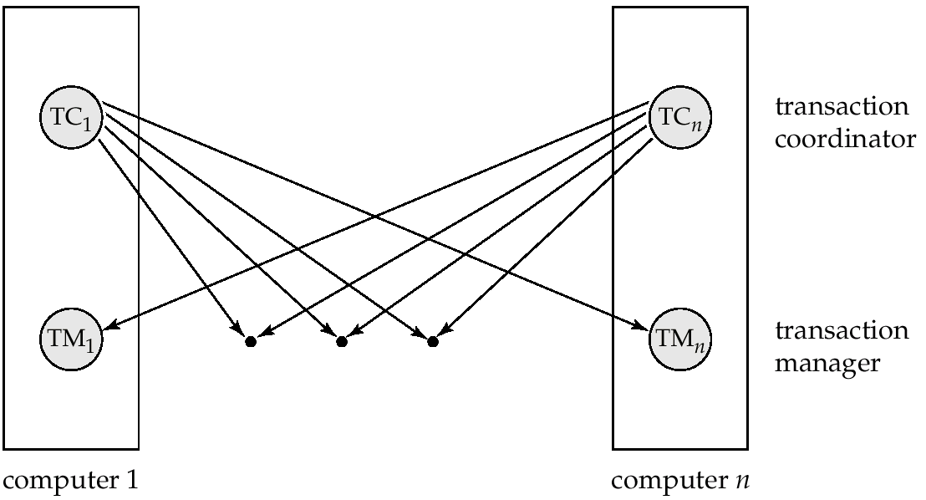
Transaction System Architecture
Fig: A model for Transaction Management at each Site in a DDBMS.

Slide 55
Distributed Transactions- Transaction Manager
The Transaction Manager at each site manages the execution of the transactions that access data stored at that local site.
Each such transaction may be local transaction or part of a global transaction.
The structure of the transaction manager is similar to that of its counterpart in a centralized system.
Each site has a local transaction manager responsible for:
  Maintaining a log for recovery purposes in each case of failure
  Participating in coordinating the concurrent execution of the transactions executing at that site.

Slide 56
Distributed Transactions- Transaction Coordinator
The Transaction Coordinator at each site in a distributed system coordinates the execution of both local and global transactions initiated at that site.
This component or module is not required in centralized DBMSs, as there is only one site in a centralized system.
Each site has a transaction coordinator, which is responsible for:
  Starting the execution of transactions that originate at the site.
  Distributing sub transactions at appropriate sites for execution.
  Coordinating the termination of each transaction that originates at the site, which may result in the transaction being committed at all sites or aborted at all sites.

Slide 57
Distributed Concurrency Control
-Objectives of Distributed Concurrency Control
-Concurrency Control Anomalies

Slide 58
Objectives of Distributed Concurrency Control
Concurrency Control is the activity of coordinating concurrent accesses to a database in a multi user system, while preserving the “Consistency” of the data.
A Good concurrency control mechanism for a DDBMS has the following Objectives:
  It must be robust to site and communication failures
  It should permit parallel execution of transactions to achieve maximum concurrency, thus satisfying performance requirements.
  Its computational methods and storage mechanisms should be modest to minimize overhead
  It should perform satisfactorily in a network environment taking into consideration that it involves significant communication delay.
  It must impose few constraints on the structure of atomic actions of transactions.

Slide 59
Concurrency Control Anomalies
The goal of Concurrency Control is to prevent interference among users who are simultaneously accessing a database.
But there are different anomalies that can arise owing to concurrent accesses of data in a multi-user database environment.
5 different Concurrency Control Anomalies are:
  Lost update anomaly
  Uncommitted dependency or dirty read anomaly
  Inconsistent analysis anomaly
  Non-repeatable or fuzzy read anomaly
  Phantom read anomaly

Slide 60
Lost Updates
    The effects of some transactions are not reflected on the database.
    This anomaly can occur when an apparently successful completed update operation made by one user(transaction) is overridden by another user(transaction)

Slide 61
1.Lost Updates: Example1
Time | Jack’s Trans | Jill’s Trans | Balance
T1 | Begin
T2 | Read Balance | Begin | 1000
T3 |  | Read Balance | 1000
T4 | Bal = Bal – 50 (950) |  | 1000
T5 | Write Bal (950) | Bal = Bal + 100 (1100) | 950
T6 | Commit |  | 950
T7 |  | Write Bal (1100) | 1100
T8 |  | Commit | 1100

Slide 62
Uncommitted Dependency or Dirty Read Anomaly
    When one transaction allows other transactions to read its data before it has committed and then decides to abort.
    Reading such Un Committed data is called as Dirty Read.

Slide 63
2. Uncommitted Data- Example1
Time | Deposit | Interest | Bal
T1 | Begin Transaction |  | 1000
T2 | Read Bal (1000) |  | 1000
T3 | Bal = Bal + 1000 (2000) |  | 1000
T4 | Write Bal (2000) | Begin Transaction | 2000
T5 |  | Read Bal (2000) | 2000
T6 |  | Bal = Bal*1.05 (2100) | 2000
T7 | Rollback |  | 1000
T8 |  | Write Bal (2100) | 2100
T9 |  | Commit | 2100

Slide 64
Inconsistent Analysis
The problem of Inconsistent Analysis occurs when a transaction reads several values from the database but a second transaction updates some of them during the execution of the first.

Slide 65
3. Inconsistent Analysis- Example
Time | SumBal | Transfer | Bal A | Bal B | Bal C | Sum
T1 | Begin Trans |  | 5000 | 5000 | 5000
T2 | Sum = 0 | Begin Trans | 5000 | 5000 | 5000
T3 | Read Bal A (5000) |  | 5000 | 5000 | 5000
T4 | Sum = Sum + BalA (5000) | Read BalA (5000) | 5000 | 5000 | 5000
T5 | Read BalB (5000) | BalA = BalA -1000 (4000) | 5000 | 5000 | 5000
T6 | Sum = Sum+BalB (10000) | Write BalA (4000) | 4000 | 5000 | 5000
T7 |  | Read BalC | 4000 | 5000 | 5000
T8 |  | BalC =BalC + 1000 (6000) | 4000 | 5000 | 5000
T9 |  | Write BalC (6000) | 4000 | 5000 | 6000
T10 | Read BalC | Commit | 4000 | 5000 | 6000
T11 | Sum=Sum + BalC (16000) |  | 4000 | 5000 | 6000
T12 | Write Sum (16000) |  | 4000 | 5000 | 6000 | 16000
T13 | Commit |  | 4000 | 5000 | 6000 | 16000
Notes:
SumBal finds the sum of the balances of all three accounts – it does NOT UPDATE the account, but reads them
Transfer will transfer 1000 from Account A to Account C
Transfer Transaction executes correctly, however, the SumBal adds the same $1000 twice – once in A and Once in C

Slide 66
Non Repeatable or Fuzzy Read
The problem of Fuzzy Read occurs when one transaction reads the value of a data item that is subsequently modified or deleted by another transaction.
If the first transaction attempts to re-read the data item either that data item may not be found or it may read a different value.

Slide 67
4. Non Repeatable or Fuzzy Read Example
Time | Deposit | Interest | Bal
T1 | Begin Transaction |  | 1000
T2 | Read Bal (1000) | Begin Transaction | 1000
T3 |  | Read Bal (1000) | 1000
T4 |  | Bal = Bal + 1000 (2000) | 1000
T5 |  | Write Bal (2000) | 2000
T6 |  | Commit | 2000
T7 | Read Bal (2000) |  | 2000

Slide 68
Phantom Read Anomaly with Example
In a DBMS, When transaction T1 performs an operation depending on a criterion, transaction T2 inserts a new tuple Z satisfying that criterion. Now if the Transaction T1 performs the same operation again, the result will be different. Hence, Z is a “Phantom” data item.
This problem is known as Phantom Read Problem, which is illustrated in the following:
T1: Read range [X-Y]
T2: Insert Z, X<Y<Z
T2: End Transaction
T1: Read Range[X-Z]

Slide 69
Distributed Concurrency Control
-Serializability in Distributed System

Slide 70
Serial Execution of Transactions
  Finish one transaction before starting another
Serial Execution of transaction means that the transactions are performed one after another.
No interaction between transactions - No Concurrency Problems
Serial Execution will never leave the database in an inconsistent state → Every Serial Execution is considered correct (Even if a different order would cause different results)

Slide 71
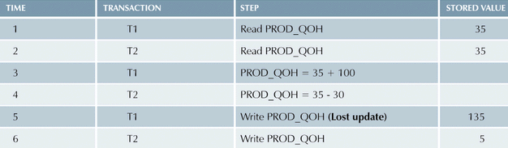
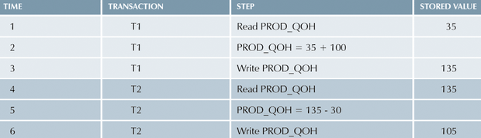
Solution to Lost Updates- Serial Execution

Slide 72
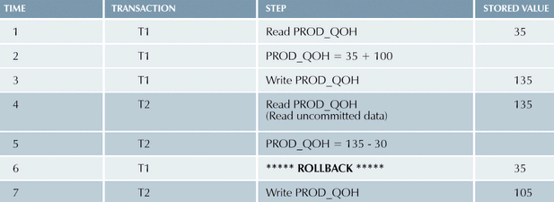
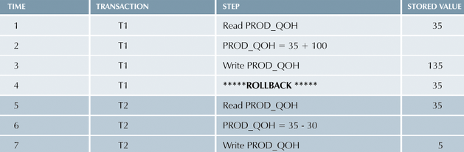
Solution to Uncommitted Data- Serial Execution

Slide 73
SCHEDULE AND ITS TYPES
Definition: A schedule is the chronological order in which instructions are executed in a system.
Types of Schedules:
  Serial Schedule
  Interleaved Schedule

Slide 74
1. Serial Schedule
A Schedule in which transactions executed in a serial order i.e. after finishing T1 start executing T2.
T1
-----------------
read(A)
A:=A-50
write(A) (50)
read(B)
B:= B+ 50
write(B) (200)
T2
-----------------
read(A) (50)
temp: A * 0.1 (5)
A: A-temp (45)
write (A) (45)
read(B) (200)
B:=B +temp
write(B) (205)
Value of A=100
Value of B=150
T1 are grouped and run together. Then all the instructions of T2 are grouped and run together. This type of schedules are called Serial.
Fig: Schedule 1- Serial

Slide 75
2.Interleaved Schedule
Concurrent transactions do not have to run serially as in this example.
Value of A=100
Value of B=150
T1
-----------------
read(A)
A:=A-50
write(A) (50)
read(B)
B:= B+ 50
Write(B) (200)
T2
-----------------
read(A) (50)
temp: A * 0.1 (5)
A: A-temp (45)
write (A) (45)
read(B)
B:=B +temp (200+5)
write(B) (205)
Result of Schedule 1 & Schedule 2 are same
Fig: Schedule 2- Interleaved

Slide 76
Schedule Equivalence
Definition: A schedule whose effect on the DB “state” is the same as that of some serial schedule then those schedules is considered as Serializable schedules.
All serial schedules are serializable, but the reverse may not be true.
Solution to the problems of Concurrent execution is Serialization.
There are two types of Serializability:
  Conflict Serializability
  View Serializability

Slide 77
1. Conflict Serializabilty
Conflict: A Pair of Consecutive database actions( reads, writes) is in conflict if changing their order would change the result of at least one of the transactions.(Transformations: swap non-conflicting actions)
Ti= Read(D)/Write(D), Tj=Read(P)/Write(P), then no Conflict as reading / writing different data.
 | Transaction Tj
Transaction Ti |  | Read(D) | Write (D)
 | Read(D) | No Conflict | Conflict
 | Write(D) | Conflict | Conflict
Order of Execution unimportant

Slide 78
Transformation: Example
r1(A) w1(A) r2(A) w2(A) r1(B) w1(B) r2(B) w2(B)
r1(A) w1(A) r2(A) r1(B) w2(A) w1(B) r2(B) w2(B)

Slide 79
Conflict Equivalence
Two schedules are conflict equivalent if they can be turned into one another by a sequence of non conflicting swaps of adjacent actions.
T1
-----------------
read(A)
A:=A-50
write(A)
read(B)
B:= B+ 50
write(B)
T2
-----------------
read(A)
temp: A * 0.1
A: A-temp
write (A)
read(B)
B:=B +temp
write(B)
T1
-----------------
read(A)
A:=A-50
write(A)
read(B)
B:= B+ 50
Write(B)
T2
-----------------
read(A)
temp: A * 0.1
A: A-temp
write (A)
read(B)
B:=B +temp
write(B)
Schedule 1- Serial
Schedule 2- concurrent

Slide 80
CONFLICT SERIALIZABLE
If a concurrent schedule is conflict equivalent to a serial schedule of same transactions then it is Conflict Serializable.
  So schedule 2 is conflict serializable to serial schedule 1.

Slide 81
2. View Serializability
View Equivalence is same as conflict equivalence based on only read & write operations.
S1 & S2 are view equivalent if Condition satisfied:
  If Ti reads initial value of P in S1,then Ti also reads initial value of P in S2.
  If Ti reads value of P written by Tj in S1,then Ti also reads value of P written by Tj in S2.
  If Ti writes final value of P in S1, then Ti also writes final value of P in S2.

Slide 82
Example of View Serializablity
Schedule S1
T1 | T2 | T3
Read (A)
 | Write(A)
 | Read(B)
 | Write (B)
 |  | Read(A)
 |  | Write(A)
Schedule S2
T1 | T2 | T3
Read (A)
 | Write(A)
 | Read(B)
 |  | Read(A)
 | Write (B)
 |  | Write(A)
Blind Writes
Serial Schedule
Concurrent Schedule
If a concurrent schedule is view equivalent to a serial schedule of same transactions then it is View Serializable.
  So schedule 2 is View Serializable to serial schedule 1.

Slide 83
RECOVERABILITY

Slide 84
Why Recovery Is Needed?
There are several possible reasons for a transaction to fail:
  A computer failure : A hardware, software, or network error occurs in the computer system during transaction execution.
  A transaction or system error : Some operations in the transaction may cause it to fail.
  Local errors or exception conditions detected by the transaction.
IS 533 - Transactions

Slide 85
Why Recovery Is Needed?
  Concurrency control enforcement : The concurrency control method may decide to abort the transaction.
  Disk failure : all disk or some disk blocks may lose their data.
  Physical problems : Disasters, theft, fire, etc.
The system must keep sufficient information to recover from the failure.

Slide 86
Recoverable Schedules
Recoverable Schedule : If Conditions satisfies then
  If a transaction T2 reads a data items previously written by a transactionT1.
  The commit operation of T1 appears before the commit operation of T2.
Schedule S2
T1 | T2
Read (P)
Write(P)
 | Read (P)
 | Commit
Read(Q)
Rollback
Schedule S1
T1 | T2
Read (P)
Write(P)
 | Read (P)
commit
 | commit
If T1 fails, it has to be rolled back. But T2 is already committed, So cannot be roll backed.
Recoverable
Non- Recoverable

Slide 87
Characterizing Schedules based on Recoverability
  Cascade less Schedule : If every transaction in the schedule reads only items that were written by committed transactions.
Schedule S1
T1 | T2
Read (P)
Write(P)
commit
 | Read (P)
 | commit
Cascade Less Schedule

Slide 88
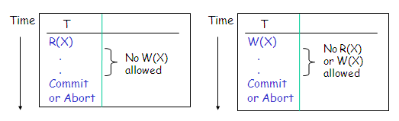
Characterizing Schedules based on Recoverability
Strict schedule:
  Once a transaction reads a value, then before it commits/aborts, no other transactions are allowed to write the value;
  Once a transaction writes a value, then before it commits or aborts, no other transactions are allowed to read or write the value

Slide 89
SERIALIZABILITY IN DISTRIBUTED DATABASE

Slide 90
Serializability in Distributed System
In distributed system, transaction run on one or more sites.
Therefore the global schedule consists of a collection of local schedules-
  Each site involved has a local schedule that may or may not be Serializable.
As long as local schedules are serializable the global schedule is serializable,
  But when we replicate database in a distributed system, we need to maintain mutual consistency of the database
The issue with replication and mutual consistency is that just because local schedules are serializable, the global schedule is not always serializable.

Slide 91
Example 1
Suppose we have a db for a company whose headquarters is in LA while their development department is in NY. Smith is a developer who makes $1000 monthly.
The distributed database has two copies, one in LA and one in NY. There is an increase in smith’s salary.
The equity adjustment transaction (i.e. increase of $200 as bonus to smith salary), T1 enters into the system in NY while the raise Transaction (i.e. 10% yearly increment to smith salary) T2 enters in LA. Assuming X represents smith's salary, Transaction T1 and T2 re written as:
BEGIN_TRAN T1:
R(X)
X=X+200
W(X)
END_TRAN END T1;
BEGIN_TRAN T2:
R(X)
X=X*1.1
W(X)
END_TRAN END T2;
Each Transaction runs at the site where it has entered the system, and then moves to the other site, and then runs there.

Slide 92
Example 1
NEWYOK
BEGIN_TRAN T1:
R(X)
X=X+200
W(X)
END_TRAN END T1;
LA
BEGIN_TRAN T2:
R(X)
X=X*1.1
W(X)
END_TRAN END T2;
Each Transaction runs at the site where it has entered the system, and then moves to the other site, and then runs there.
Therefore, T1 runs in NY first and then in LA, while T2 runs in LA first and then in NY.
If these two transactions start at almost the same time, we would have the following two local schedules:
Local Schedule at NY: S1= R1(X), W1(X), R2(X), W2(X)
Local Schedule at LA: S2= R2(X), W2(X), R1(X), W1(X)
Both Schedules are serial schedules and are consistent!!
At both sites, local schedulers would allow the schedules to be executed.

Slide 93
Example 1
NEWYOK
BEGIN_TRAN T1:
R(X)
X=X+200
W(X)
END_TRAN END T1;
LA
BEGIN_TRAN T2:
R(X)
X=X*1.1
W(X)
END_TRAN END T2;
Local Schedule at NY: S1= R1(X), W1(X), R2(X), W2(X)
1000, 1200, 1100, 1300
Local Schedule at LA: S2= R2(X), W2(X), R1(X), W1(X)
1000, 1100, 1200, 1320
Globally the database is inconsistent because after both schedules complete the salary for smith in LA is $1320 but in NY it is $1300

Slide 94
Serializability in Distributed & Replicated DBMS
To consider mutual consistency in a replicated database, we need to extend the local serializability definition.
In replicated database, Schedule S is globally serializable:
  If and only if all local schedules are serializable
  The order of commitment for two conflicting transactions is the same at every site where two transactions are running.
  In Our example, Conflicting transactions T1 and T2, at the LA site the commitment order is “T1->T2”, but in NY the commitment order is “T2->T1”.
  Since order is different, the database is in inconsistent state.

Slide 95
Classification of Concurrency Control Techniques
Concurrency Control in a distributed system involves the activity of controlling the relative order of conflicting operations and thereby ensuring database consistency.
Concurrency Control techniques are divided into two broad categories based on the synchronization techniques:
  Pessimistic Concurrency Control Mechanisms- It synchronize the concurrent execution of transactions early in their execution life cycle.
  Optimistic Concurrency Control Mechanisms- It delays the synchronization of transactions until transactions are near to their completion.

Slide 96
Pessimistic Vs. Optimistic Concurrency Control Technique
Pessimistic Technique | Optimistic Technique
It synchronize the concurrent execution of transactions early in their execution life cycle. | It delays the synchronization of transactions until transactions are near to their completion.
In this technique, the synchronization of transactions is achieved earlier before the starting of transaction executions. | These techniques are based on the assumption that a conflict is rare and it is more efficient to allow transactions to proceed without delays.
They are neither deadlock free nor does they have non blocking property. | Have desirable properties as: non blocking and deadlock free.
Further classified as: Locking based Algorithm Timestamp based Algorithm Hybrid Algorithm | Further classified as: Locking based Algorithm Timestamp based Algorithm

Slide 97
Concurrency Control Algorithms
Pessimistic
  Locking Based Algo- Two-Phase Locking-based (2PL)
    Centralized (primary site) 2PL
    Primary copy 2PL
    Distributed 2PL
    Majority Locking Protocol
  Timestamp Ordering (TO)
    Basic TO
    Multiversion TO
    Conservative TO
  Hybrid Algo
Optimistic
  Locking-based
  Timestamp ordering-based

Slide 98
LOCK BASED PROTOCOL

Slide 99
Lock-Based Protocols
A lock is a mechanism to control concurrent access to a data item.
Data items can be locked in two modes :
1. Exclusive (X) mode. Data item can be both read as well as written. X-lock is requested using lock-X instruction.
2. Shared (S) mode. Data item can only be read. S-lock is requested using lock-S instruction.

Slide 100

Lock-Based Protocols (Cont.)
Lock-Compatibility Matrix
A transaction may be granted a lock on an item if the requested lock is compatible with locks already held on the item by other transactions
Any number of transactions can hold shared locks on an item,
  but if any transaction holds an exclusive on the item no other transaction may hold any lock on the item.

Slide 101
Working of Locking Protocol
Lock requests are made to concurrency-control manager, Whenever any data D is need to be accessed. (Issuing Locking Request)
A Lock manager receives Locking Request messages and sends response accordingly.
  Lock Granted: Transaction can proceed only after request is Granted.
  Lock Rejected: If a lock cannot be granted, the requesting transaction is made to wait till all incompatible locks held by other transactions have been released. The lock is then granted.
  Deadlock: If deadlock then rollback transactions
  Acknowledgement: On unlock just an acknowledgement is sent.

Slide 102
The Two-Phase Locking Protocol
2PL synchronizes reads and writes by explicitly detecting and preventing conflicts between concurrent operations.
This is a protocol which ensures Conflict- Serializable schedules.
  Before reading data D: A transaction must “Own” a read lock on D.
  Before writing data D: A transaction must “Own” a write lock on D.
Ownership of Lock is governed by 2 rules:
  Different Transactions cannot simultaneously own conflicting locks (i.e. WR) ---(Compatibility Matrix)
  Once a transaction surrenders ownership of a lock, it may never obtain additional locks. ---(2 phase manner)

Slide 103
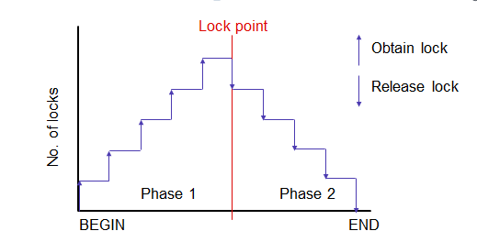
Working of 2 phase protocol:
Phase 1: Growing Phase
  transaction may obtain locks
  transaction may not release locks
Phase 2: Shrinking Phase
  transaction may release locks
  transaction may not obtain locks
The point at which transaction obtains final (last lock) that point is called as Lock Point.
Growing Phase
Shrinking Phase

Slide 104
Main Idea behind 2PL
A Transaction locks an object before using it.
When an object is locked by another transaction, the requesting transaction must wait.
When a transaction releases a lock, it may not request another lock.

Slide 105
Advantages & Disadvantages
Advantage:
  Ensures Conflict Serializability.
Disadvantages:
  Deadlock may Occur
  Due to Starvation, Cascaded rollback may occur. It means roll back of one transaction leads to roll back of other dependent transaction.

Slide 106
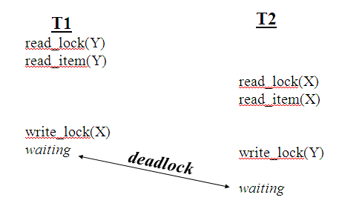
Pitfalls of Lock-Based Protocols (Cont.)
“Deadlock” occurs when two or more transactions are in a simultaneous wait state, each one waiting for one of the others to release a lock.

Slide 107
Pitfalls of Lock-Based Protocols (Cont.)
“Starvation” is also possible if concurrency control manager is badly designed. For example:
  A transaction may be waiting for an X-lock on an item, while a sequence of other transactions request and are granted an S-lock on the same item.
  The same transaction is repeatedly rolled back due to deadlocks.
Concurrency control manager can be designed to prevent starvation.

Slide 108
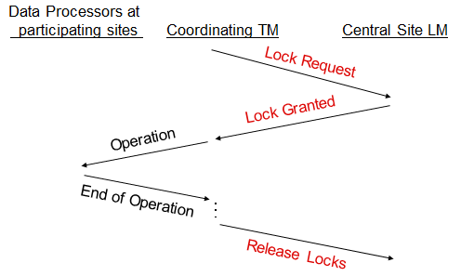
Locking Protocols
Can employ one of the following 4 protocols (based on 2PL) to ensure serializability for DDBMSs…
Centralized 2PL: Single site maintains all locking information.
  Local TMs involved in global T: request and release locks from lock manager.
  Or, T-Controller can make all locking requests on behalf of local TMs.
  Advantage: Easy to implement.
  Disadvantages: Bottlenecks and Lower reliability.

Slide 109
Locking Protocols
Primary Copy 2PL: Lock managers distributed to a number of sites.
Each lock manager responsible for managing locks for set of data items.
For replicated data items, one copy is chosen as primary copy, others are slave copies
Only need to Write-Lock Primary Copy of data item that is to be updated.
Once primary copy has been updated, the change is propagated to the slaves
Advantages: Lower communication costs and faster than centralized 2PL.
Disadvantages: Deadlock handling more complex; still rather centralized

Slide 110
Locking Protocols
Distributed 2PL: Lock managers distributed to every site.
  Each lock manager responsible for locks for data at that site.
  If data not replicated, equivalent to Primary copy 2PL.
  Otherwise, implements a Read-One-Write-All (ROWA) replica control protocol.
  Using ROWA protocol:
      A transaction may read any of the replicated copies of item x, by obtaining a read lock on one of the copies of x.
      Writing into x requires obtaining write locks for all copies of x.
  Disadvantages: Deadlock handling more complex; Communication costs is higher

Slide 111
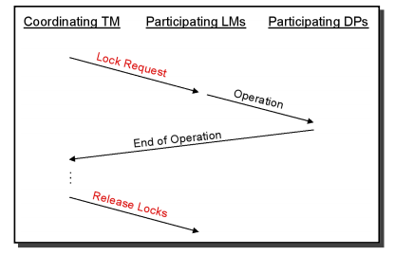
Communication Structure of Distributed 2PL
The coordinating TM sends the lock request to the lock managers of all participating sites
The LMs pass the operations to the data processors
The end of the operation is signaled to the coordinating TM

Slide 112
Locking Protocols
Majority Locking: Extension of distributed 2PL.
  To read or write data item replicated at n sites, sends a lock request to more than half the n sites where item is stored.
  Transaction cannot proceed until majority of locks obtained.
  Overly strong in case of read locks.

Slide 113
Locking Protocols
Biased Protocol: Replica Control Approach
  Assigns more preference to requests for shared locks on data items than to requests for exclusive locks.
  Like in majority Locking Protocol, in biased protocol a lock manager is implemented at each site to manage locks for all data item stored at that site.
    When a transaction requires to read a data item that is replicated at m sites, the transaction coordinator simply sends a lock request to the lock manager of one site that contains a replica of that data item.
    Similarly, When a transaction needs to lock a data item in exclusive mode, the transaction coordinator sends lock requests to lock manager at all sites that contain a replica of that data item.
    Advantage: It imposes less overhead on read operations than the Majority Locking Protocol. Beneficial for transactions where the frequency of read operations is much higher than the frequency of Write operations.
    Disadvantages: Deadlock handling more complex;

Slide 114
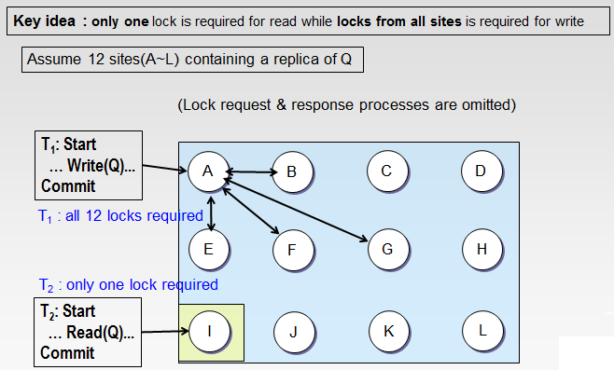
Biased Locking Protocol

Slide 115
Locking Protocols
Quorum Consensus Protocol: A generalization of both majority and biased protocols
Each site is assigned a weight.
  Let S be the total of all site weights
Choose two values read quorum Q_{r} and write quorum Q_{w}
  Such that Q_{r} + Q_{w} > S and 2 * Q_{w} > S
  Quorums can be chosen (and S computed) separately for each item
Each read must lock enough replicas that the sum of the site weights is ≥ Q_{r}
Each write must lock enough replicas that the sum of the site weights is ≥ Q_{w}
    In both case, the protocol ensures that locks are achieved on a majority of the replicas of the data item P stored at different sites before executing a read or a write operation on P.

Slide 116
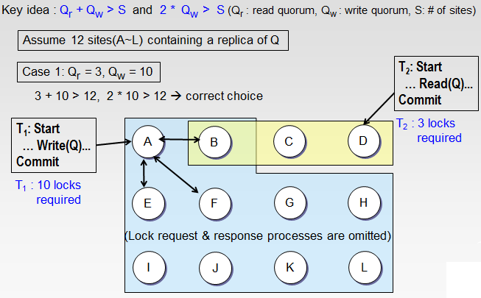
Quorum Consensus Locking Protocol

Slide 117
Quorum Consensus Locking Protocol

Slide 118
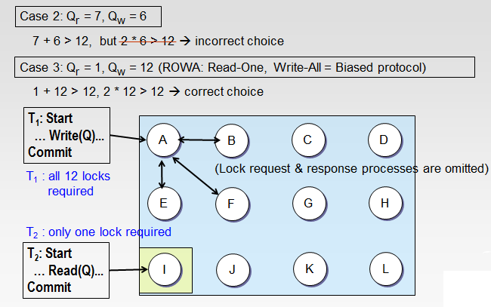
Quorum Consensus Locking Protocol

Slide 119
Locking Protocols Contd..
Advantage: Reduces cost of Read and Write Operations. For E.g.: A read operation on a data item with a small read quorum requires reading of fewer replicas of data item.
Dis-Advantage:
  Write quorum of a data item may be higher , so as to perform a write operation we need to obtain locks on more replicas of data item that are available.
  Complexity in Deadlock Handling.

Slide 120
TIMESTAMP ORDERING PROTOCOL

Slide 121
Timestamp-Based Protocols
Each transaction is issued a globally unique timestamp when it enters the system.
If an old transaction T_{i} has time-stamp TS(T_{i}), a new transaction T_{j} is assigned time-stamp TS(T_{j}) such that TS(T_{i}) <TS(T_{j}). [Ex: 100<101]
The protocol manages concurrent execution such that the time-stamps determine the Serializability order.
In order to assure such behavior, the protocol maintains for each data Q two timestamp values:
  W-timestamp(Q) [wts] is the largest time-stamp of any transaction that executed write(Q) successfully.
  R-timestamp(Q) [rts] is the largest time-stamp of any transaction that executed read(Q) successfully.

Slide 122
Timestamp-Based Protocols
There are three different methods of Timestamp based Protocol:
  Basic Timestamp Ordering (TO) Algorithm
  Conservative TO Algorithm
  Multiversion TO Algorithm

Slide 123
Basic Timestamp-Based Protocols
The timestamp ordering protocol ensures that any conflicting read and write operations are executed in timestamp order.
Case1: Suppose a transaction T_{i} issues a Read(X)
  If TS(T_{i}) ≤ W-timestamp(X), then T_{i} needs to read a value of X that will be overwritten.
    Hence, the Read Operation is Rejected, and T_{i} is rolled back.
TS | T i | TX
148 | Read(X) | …………
149 | ………… | Write(X)
Reading a value which
is going to be updated
for R_{i}(x)
if ts(T_{i}) < wts(x)
then reject R_{i}(x)
else accept R_{i}(x)
rts(x) ←ts(T_{i})

Slide 124
Basic Timestamp-Based Protocols
Case2: Suppose that transaction Ti issues Write(X)
  If TS(T_{i}) < R-timestamp(X), then the value of X that T_{i} is producing was needed previously, and the system assumed that value would never be produced.
    Hence, the Write Operation is Rejected, and T_{i} is rolled back.
  If TS(Ti) < W-timestamp(X), then T_{i} is attempting to write an obsolete value of X.
    Hence, this Write Operation is Rejected, and T_{i} is rolled back.
TS | T i | TX
149 | WRITE(X) | …………
150 | …………. | …………
151 | ………… | READ(X)
Long Writes would be avoided
TS | T i | TX
149 | WRITE(X) | …………
150 | …………. | …………
151 | ………… | WRITE(X)
Obsolete data

Slide 125
Procedure for Basic TO
for R_{i}(x)
if ts(T_{i}) < wts(x)
then reject R_{i}(x)
else accept R_{i}(x)
rts(x) ←ts(T_{i})
for W_{i}(x)
if ts(T_{i}) < rts(x) and ts(T_{i}) < wts(x)
then reject W_{i}(x)
else accept W_{i}(x)
wts(x) ← ts(T_{i})
Observation of Basic Timestamp Ordering Protocol: Transaction with Smaller Timestamp will be rejected

Slide 126
Conservative Timestamp Ordering
Basic timestamp ordering tries to execute an operation as soon as it receives it
  Progressive
  too many restarts since there is no delaying (bcoz of rollback)
Conservative time stamping delays each operation until there is an assurance that it will not be restarted
Assurance?
  No other operation with a smaller timestamp can arrive at the scheduler
  Note that the delay may result in the formation of deadlocks
For this, the operations of each transaction are buffered until an ordering can be established so that rejections are not possible
If this condition can be guaranteed, the scheduler will never reject an operation!!!

Slide 127
Working of Conservative Timestamp Ordering
In Conservative TO Algorithm, Each Scheduler maintains one queue for each Transaction Manager.
Whenever an operation is received by a timestamp ordering scheduler: it buffers the operation according to the increasing order of timestamp values in the appropriate queue for the corresponding transaction manager.
For Instance, the timestamp ordering scheduler at site p stores all the operations that it has received from the transaction manager of site q in a Queue Qpq.
The Scheduler at each site passes a read or write operation with the smallest timestamp value from these queues to the data processor for execution.

Slide 128
Problems of Conservative Timestamp Ordering
Problem 1: If some transaction manager never send any operations to a scheduler, the scheduler will get stuck and stop outputting.
  Solution: It is necessary that each transaction manager communicate regularly with every scheduler in the system, which is infeasible in large network.

Slide 129
Problems of Conservative Timestamp Ordering
Problem 2: Although it reduces the number of restarts of the transactions, it is not guaranteed that they will be eliminated completely.
  For Example: Timestamp Scheduler at site S1 has chosen an operation with the smallest timestamp (t1), and passed it to data processor for execution. It may happen that the site S2 has sent an operation to the scheduler of site 1 with a timestamp value less than the t1. When it reaches the site S1, it will be rejected, bcoz it violates TO rule.
  Solution: Each scheduler chooses an operation for execution and passes it to the data processor only when there is at least one operation in each queue.
  In absence of real traffic, when a transaction manager does not have any operations to execute, it will send a null operation to each timestamp scheduler in the system periodically.
  Thus the null operations are sent periodically to ensure that the operations that will be sent to schedulers in future will have higher timestamp values than the null Operations.
  This approach is more restrictive and is called as Extremely Conservative TO Algorithm.

Slide 130
Multi-version Timestamp Ordering
Multi Version TO Algorithm is another timestamp based protocol that reduces restart overhead of transactions.
In this protocol, Write operations do not modify the DB; instead, a new version of the data item is created while retaining the old version.
When a transaction requires reading a data item, the system selects one of the versions that ensures serializability.

Slide 131
Working of Multi-version Timestamp Ordering
For each data item P in the system, the dB holds a number of versions such as P1,P2, P3…Pn respectively.
For each version of the data item P, the system Stores 3 values: the value of version Pi, read_timestamp(Pi) [largest timestamp value of all transactions that have successfully read the version Pi] and Write_timestamp(Pi) [timestamp value of transactions that created the version Pi]
The existence of versions of data item is transparent to the users.
The TM assigns a timestamp value to each transaction, which is used to keep track of the timestamp value of each versions.

Slide 132
Working of Multi-version Timestamp Ordering
When a transaction T with a timestamp value ts(T) attempts to perform a read or write operation on the data item P, the multi version TO Uses the following 2 rules to ensure Serializability:
Rule 1: To read data item P, a version Pj is chosen that has the largest Write_timestamp value that is less than ts(T):
  WTS(Pj)< ts(T)
  In this case, the read operation is sent to the data processor for execution and the value of RTS(Pj) is rest as ts(T).
Rule 2: To perform a write operation on data item P, it must ensure that data item P has not already read by some other transaction whose timestamp value is greater than ts(T):
    RTS(Pj)< ts(T)
    If operation is permitted, a new version of P say Pk is created RTS(Pk)=WTS(Pk)=ts(T)

Slide 133
Advantages & Disadvantages
Advantage:
  Ensures Conflict Serializability, as conflicting operations are processed in order of timestamp of operation.
Disadvantages:
  Requires more storage space to store the values of different versions of data items w.r.t time. (To save storage space, older versions of data items can be deleted if they are no longer required)

Slide 134
OPTIMISTIC CONCURRENCY CONTROL TECHNIQUE:
VALIDATION BASED PROTOCOL

Slide 135
Introduction
When maximum numbers of transaction are read only then the rate of conflicting transactions are low as many transactions can read data simultaneously.
It may increase the overhead, to reduce this overhead scheme for monitoring the system is required, which will give knowledge of conflicting transactions
This method is also called as Optimistic Concurrency Control Or Optimistic methods for concurrency control.

Slide 136
Optimistic Concurrency Control Algorithms
Pessimistic execution
Validate
Read
Compute
Write
Optimistic execution
Read
Compute
Validate
Write

Slide 137
Working :Validation-Based Protocol
Execution of transaction T_{i} is done in three phases.
1.Read phase:
  Transaction reads values of data item & stores them in local variable.
  T_{i} writes only to temporary local values not on actual database.
2.Validation phase:
  Transaction T_{i} performs a ``validation test'' to determine if local variables can be written to database without violating serializability.
3.Write phase:
  If T_{i} is validated, the updates are applied to the database; otherwise, T_{i} is rolled back.

Slide 138
Working :Validation-Based Protocol (contd..)
The three phases of concurrently executing transactions can be interleaved, but each transaction must go through the three phases in that order.
  Assume for simplicity that the validation and write phase occur together, atomically and serially
    i.e. only one transaction executes validation/write at a time.
Also called as Optimistic Concurrency Control since transaction executes fully in the hope that all will go well during validation.

Slide 139
Validation-Based Protocol (Cont.)
Each transaction T_{i} has 3 timestamps:
  Start(T_{i}) : the time when T_{i} started its execution
  Validation(T_{i}): the time when T_{i} entered its validation phase( i.e. finished read phase & started validation phase)
  Finish(T_{i}) : the time when T_{i} finished its write phase
This protocol is useful and gives greater degree of concurrency if probability of conflicts is low.
  because the serializability order is not pre-decided, and
  relatively few transactions will have to be rolled back.

Slide 140
Example 1: Optimistic CC Validation Test
Rule 1: If all transactions T_{k} where ts(T_{k}) < ts(T_{ij}) have completed their write phase before T_{ij} has started its read phase, then validation succeeds
  Transaction executions in serial order
T_{k}
R
V
W
R
V
W
T_{ij}

Slide 141
Example 2: Optimistic CC Validation Test
Rule 2: If there is any transaction T_{k} such that ts(T_{k})<ts(T_{ij}) and which completes its write phase while T_{ij} is in its read phase, then validation succeeds if WS(T_{k}) ∩ RS(T_{ij}) = Ø
  Read and write phases overlap, but T_{ij} does not read data items written by T_{k}
T_{k}
R
V
W
R
V
W
T_{ij}

Slide 142
Example 3: Optimistic CC Validation Test
Rule 3: If there is any transaction T_{k} such that ts(T_{k})< ts(T_{ij}) and which completes its read phase before T_{ij} completes its read phase, then validation succeeds if WS(T_{k}) ∩ RS(T_{ij}) = Ø and WS(T_{k}) ∩ WS(T_{ij}) = Ø
  They overlap, but don't access any common data items.
T_{k}
R
V
W
R
V
W
T_{ij}

Slide 143
END OF CHAPTER

