Slide 1

-Prajyoti Lopes

Slide 2

Network Definition
Network Applications
Network Hardware
Network Software
Reference Models
    OSI
    TCP/IP

Slide 3

What is a network?
  A network is a set of devices (often referred to as nodes) connected by communication links
What is a computer network?
  A computer network is a telecommunications network that allows computers to exchange data
  The term telecommunication, which includes telephony, telegraphy, and television, means communication at a distance
  The connection need not be via a copper wire, fiber optics, microwaves, infrared, communication satellites can also be used

Slide 4
What is a distributed system
  Collection of independent computers appear to its users as single coherent system
  Eg: world wide web
Difference between computer networks and distributed system?
Difference between Internet and world wide web?
Internet is not a network? Why

Slide 5

Business Applications
Home Applications
Mobile Users
Social Issues

Slide 6
Business applications:
  Resource sharing
  Organization where data needs to be accessed remotely
  Client –Server model
  Voice over IP (VoIP)
  Communication medium(eg:E-mails)
  E-commerce

Slide 7
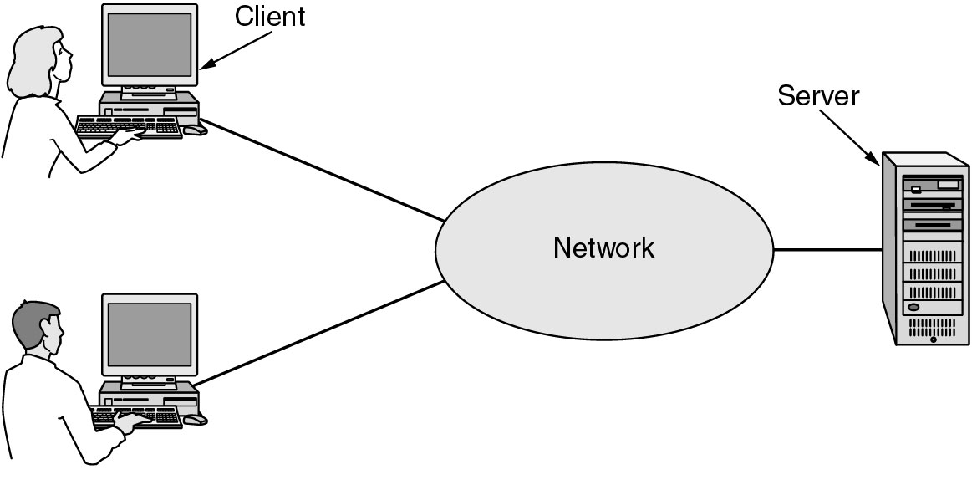
A network with two clients and one server.

Slide 8
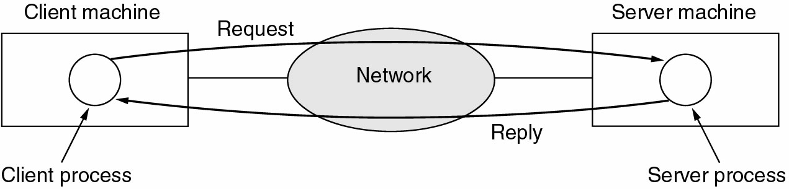
The client-server model involves requests and replies.

Slide 9
Home Network Applications:
  Access to remote information(using Internet)
  Person-to-person communication(peer-to-peer)
  Instant messaging, chat rooms
  Interactive entertainment
  Electronic commerce

Slide 10
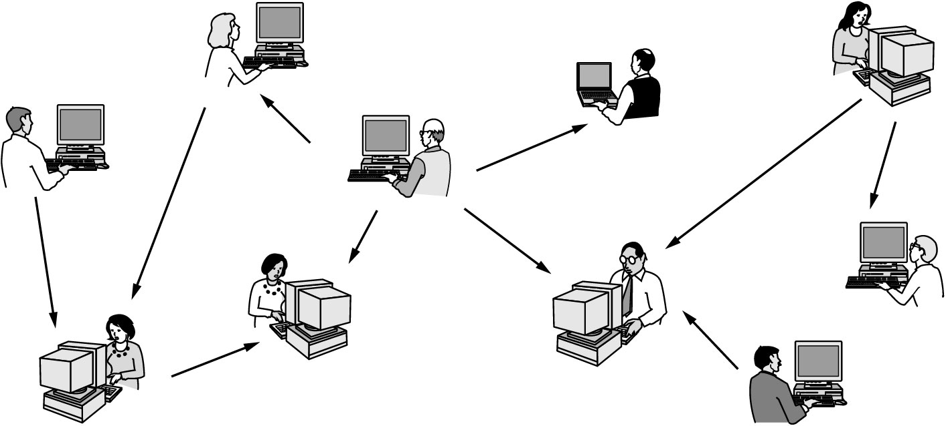
In peer-to-peer system there are no fixed clients and servers.

Slide 11
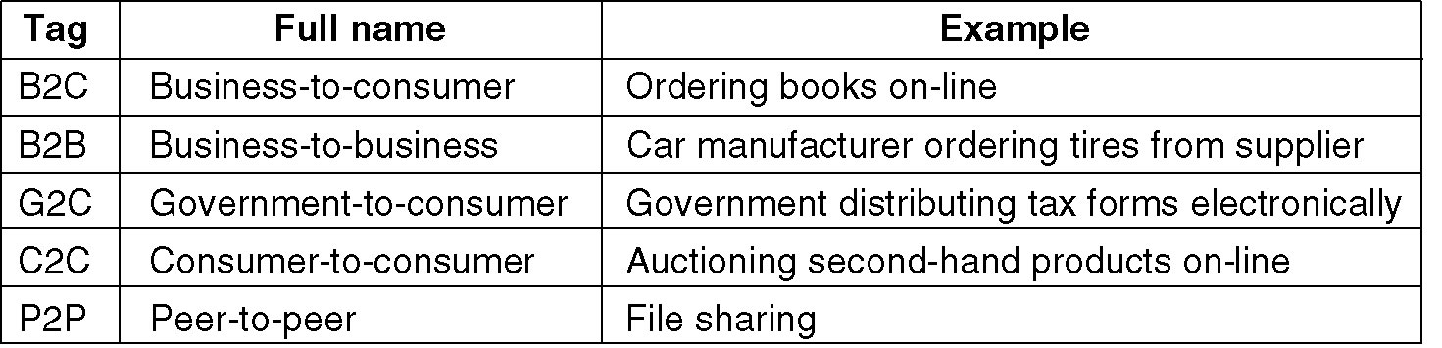

E-commerce activities:
  Online shopping
  Access to financial institutions(bank accounts and electricity bills)
  E-flea(auctions of second hand goods)

Slide 12
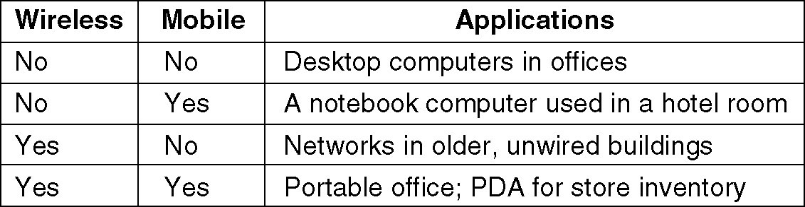
  Mobile Network Users
Combinations of wireless networks and mobile computing.

Slide 13
Social issues:
  A famous proverb “Along with the good comes the bad”
  Social networks, and a host of other applications allow people to share their views
  The trouble comes with topics like politics, religion, or sex
  eg: verbal attacks on particular countries or religions, pornography etc
  Privacy issues
  profiling users(making use of cookies)
  location privacy issues
  Phishing attacks

Slide 14
Certain measures that can be taken :
  Encryption and authentication
  Avoiding pirated softwares
  Updating antiviruses
  CAPTCHAs

Slide 15

Two important dimensions:
  Transmission technology
  Scale
Types of transmission technology
  Broadcast links
    Multicast links
  Point-to-point links

Slide 16
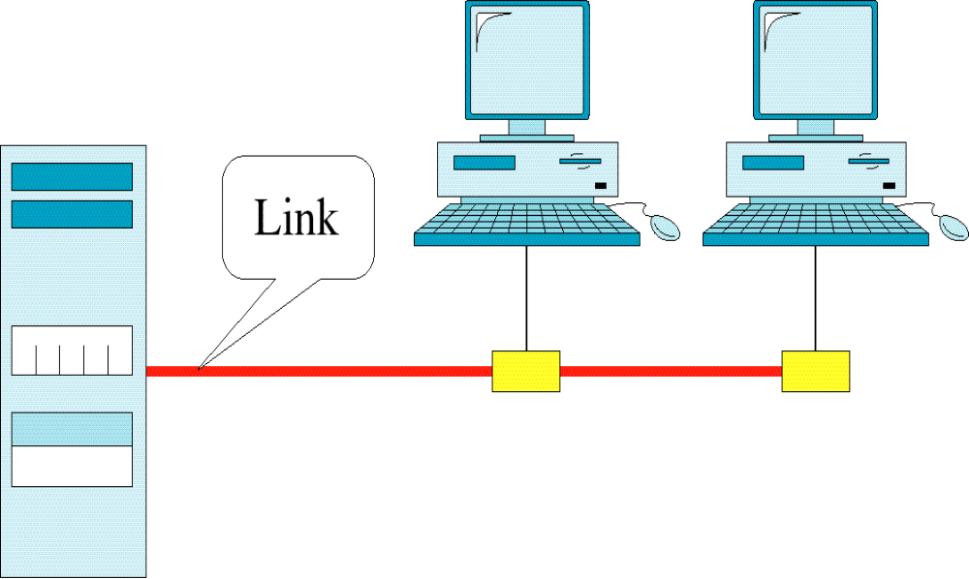
Multipoint(broadcast) Line Configuration

Slide 17
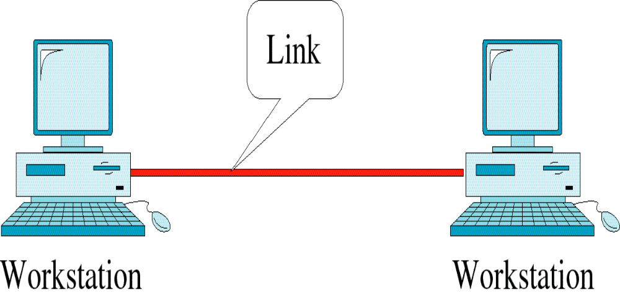
Point-to-Point Line Configuration

Slide 18

Topology refers to the way in which a network is laid out physically
Geometric representation of the relationship of all the links and linking devices to one another
Following are various topologies

Slide 19
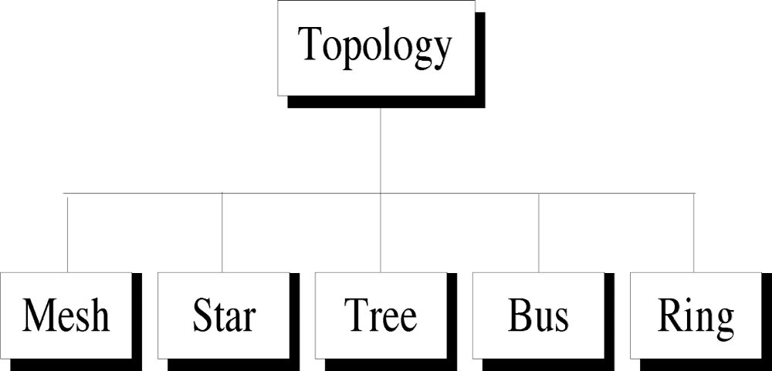

Slide 20
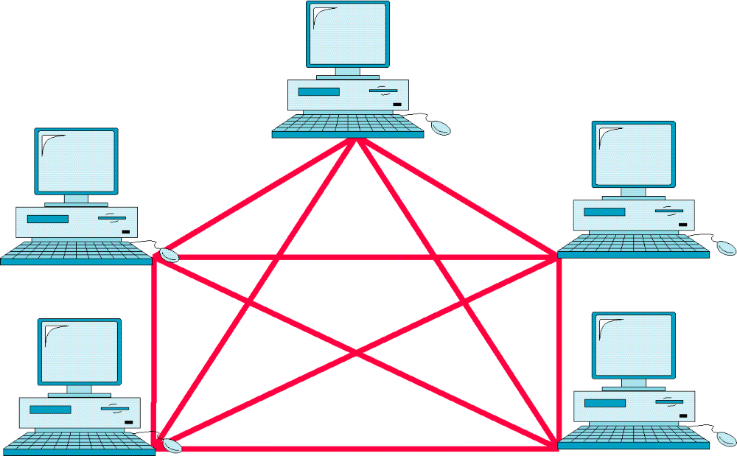
Mesh Topology

Slide 21
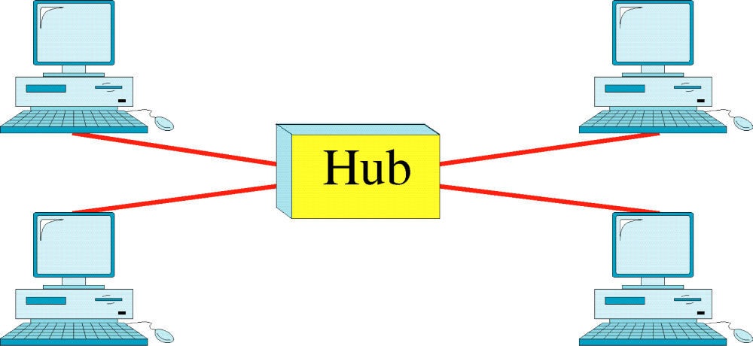
Star Topology

Slide 22
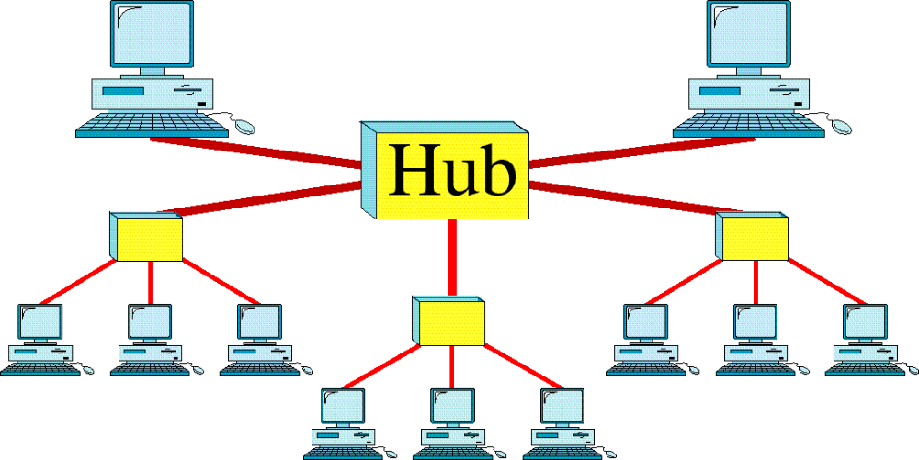
Tree Topology

Slide 23
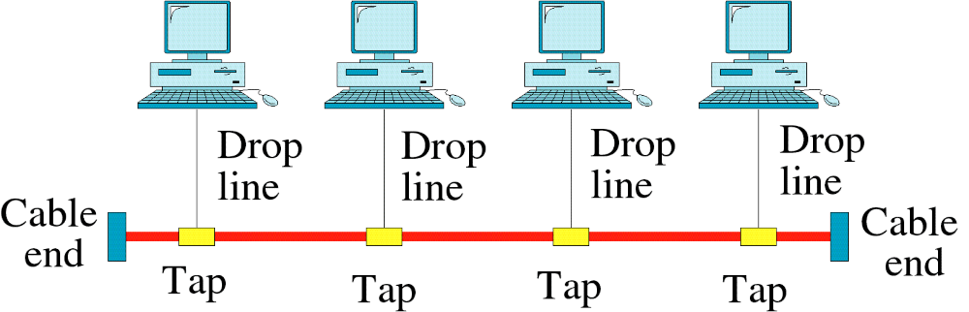
Bus Topology

Slide 24
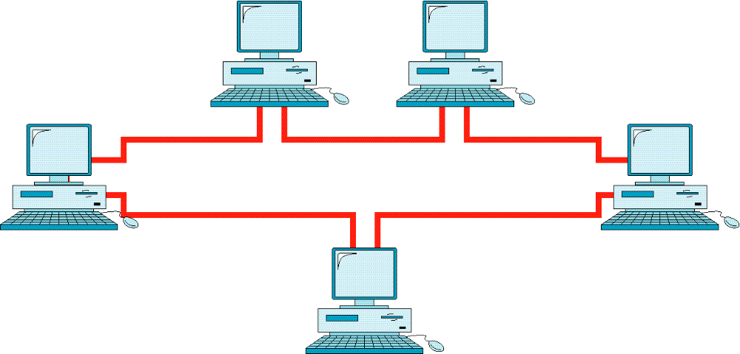
Ring Topology

Slide 25
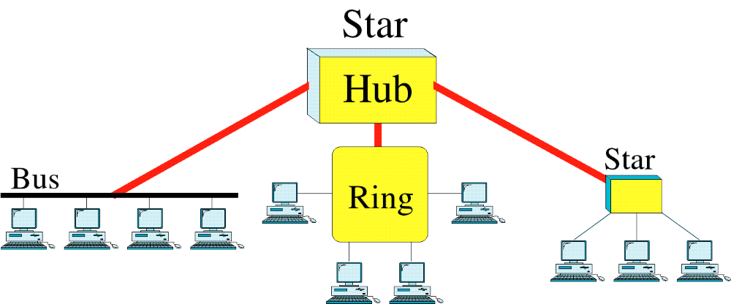
Hybrid Topology

Slide 26

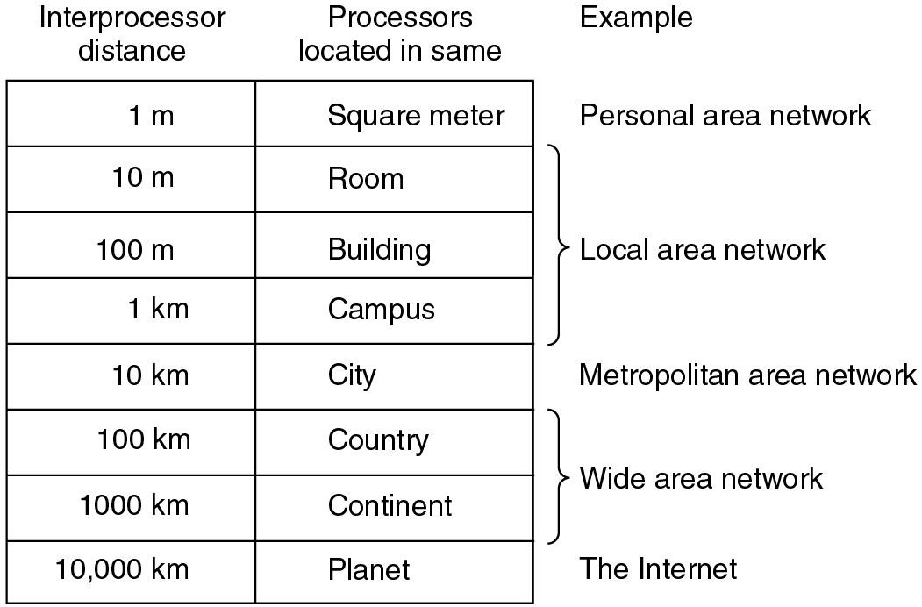
Classification of interconnected processors by scale.

Slide 27

NETWORK
LAN
MAN
WAN
WIRELESS
HOME
INTERNETWORKS

Slide 28

Privately owned network
Operates within and nearby a single building like a home, office or factory
Shares resources and information exchange
Designed to provide local interconnectivity
Three important characteristics:
  Size(limited)
  Transmission technology(cables to which devices attached)
  Topology(bus and ring)

Slide 29
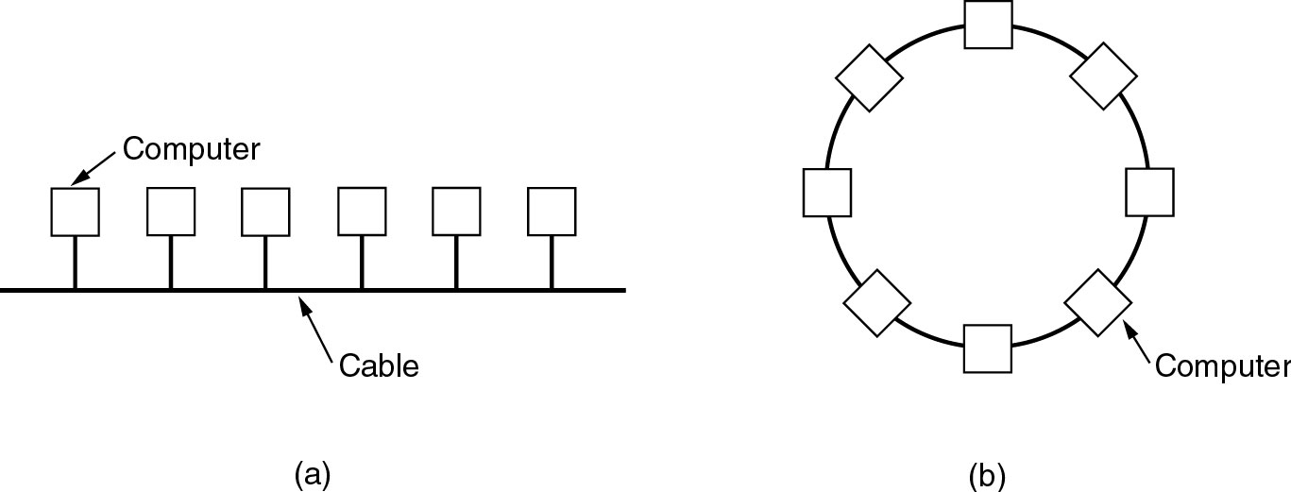
Two broadcast networks
(a) Bus
(b) Ring

Slide 30
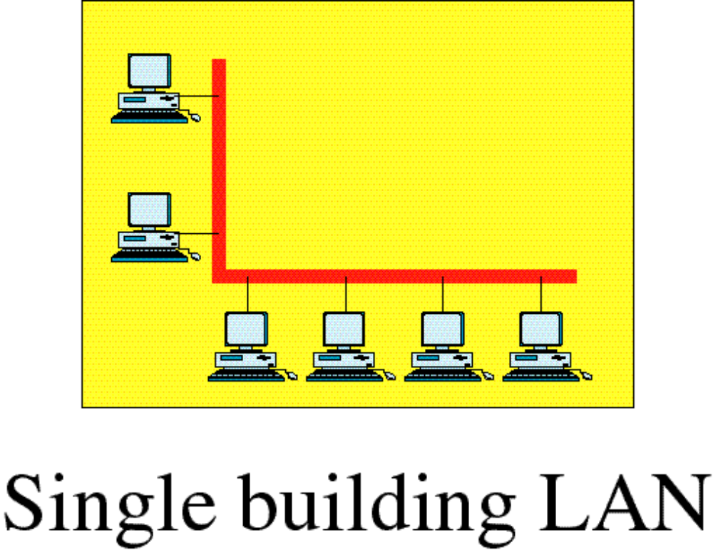

Slide 31
Wireless LANs are very popular these days
Especially in homes, older office buildings, where it is too much trouble to install cables
There is a standard for wireless LANs called IEEE 802.11, popularly known as WiFi
In these systems, every computer has a radio modem and an antenna that it uses to communicate with other computers
They are called an AP(Access Point), wireless router, or base station

Slide 32
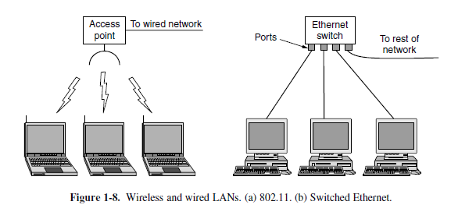

Slide 33
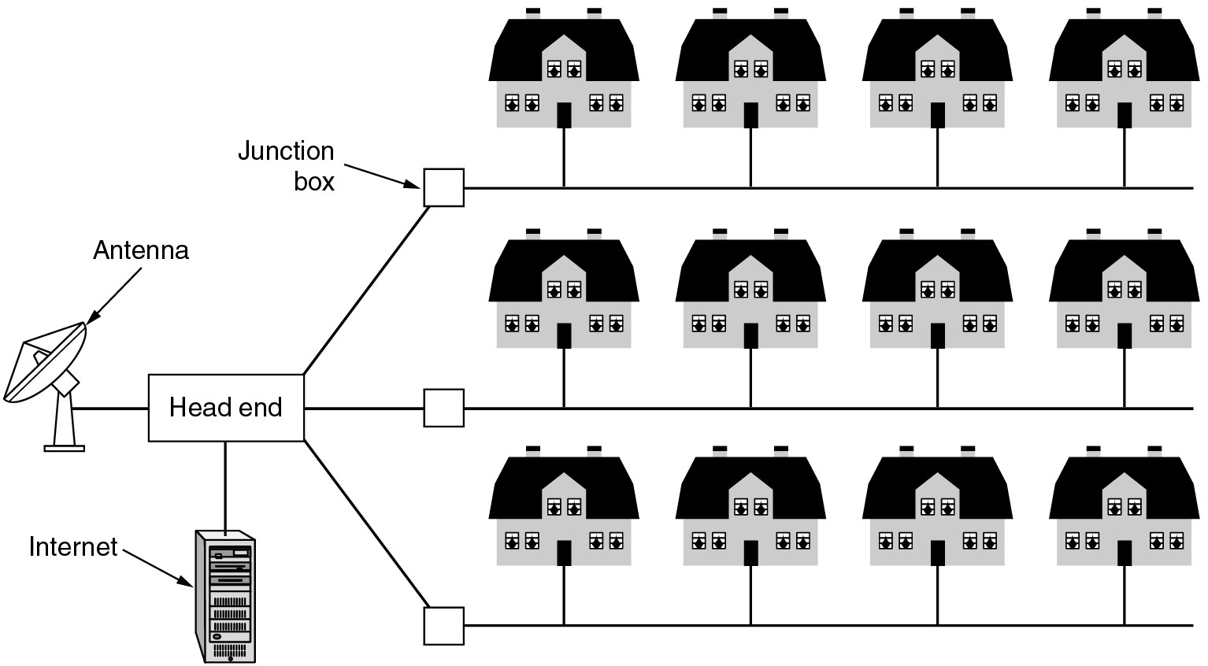
Covers a city
Eg:Cable television networks
A metropolitan area network based on cable TV.

Slide 34

Spans a large geographical area, often a country or continent
Collection of machines running user programs called as hosts
Rest of the network that connects these hosts is then called the communication subnet
Hosts owned by customers, subnet owned by service providers
Subnet carries messages from one host to another

Slide 35
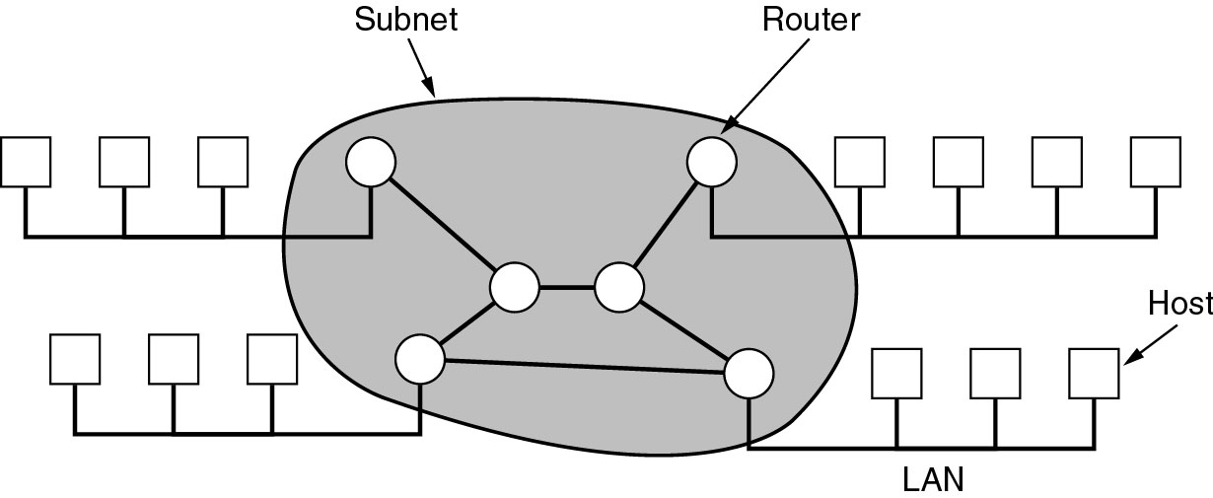
Subnet consists of two distinct components
  Transmission lines
  Switching elements(common name router)
Relation between hosts on LANs and the subnet.

Slide 36
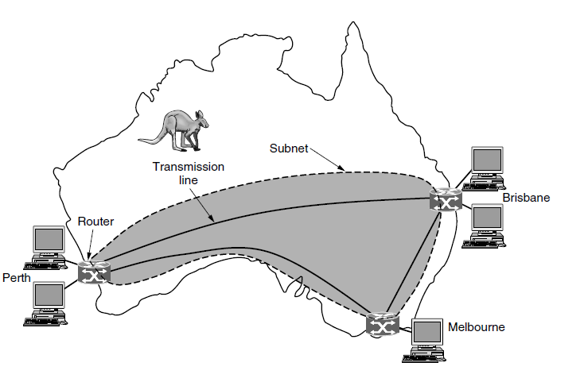
WAN that connects three branch offices in Australia

Slide 37
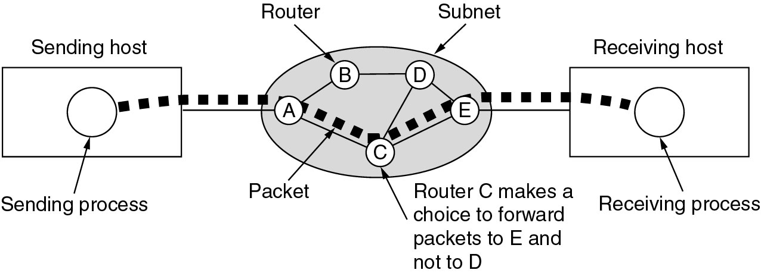
What if two hosts or routers that do not share a transmission line wish to communicate?
They make use of intermediate routers
Packet-switching (store-and-forward)
A stream of packets from sender to receiver.

Slide 38

Fundamental idea is that every device in the home is capable of communicating with every other device and all of them will be accessible over internet
Home Network Categories:
  Computers (desktop PC, PDA, shared peripherals)
  Entertainment (TV, DVD, VCR, camera, stereo, MP3)
  Telecomm (telephone, cell phone, intercom, fax)
  Appliances (microwave, fridge, clock, furnace, airco,lights)
  Telemetry (utility meter, burglar alarm, babycam)

Slide 39
Home networking should have following fundamental properties:
  Network and devices have to be easy to install
  Network and devices have to be foolproof in operation
  Low cost
  Stable interface
  Security and reliability

Slide 40

Collection of interconnected networks is called an internetwork or internet
Eg: Organization having multiple offices at different locations
To create a backbone WAN for connecting these three entities(two LANs and the president's computer),a switched WAN(operated by a service provider such as a telecom company)has been leased

Slide 41
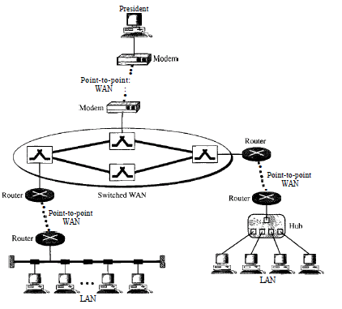


Slide 42

Major focus of computer network initially was network hardware however this no longer exist
Networking software is now highly structured
Network software includes the following:
  Protocol Hierarchies
  Design Issues for the Layers
  Connection-Oriented and Connectionless Services
  Service Primitives(self-study)
  The Relationship of Services to Protocols(self-study)

Slide 43

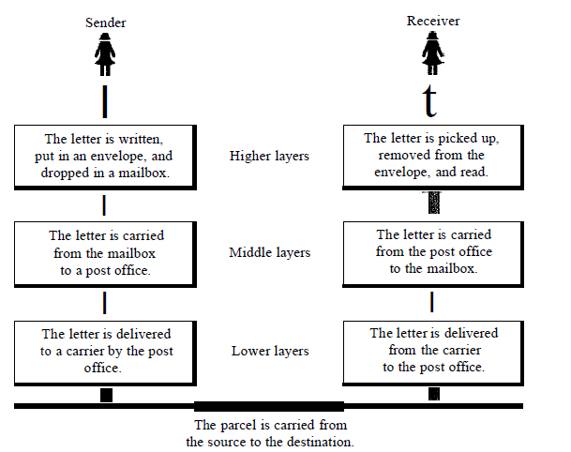

Slide 44

Layers or levels:
  To reduce design complexity network are arranged as set of layers
  Number , name, contents of layers differ from network to network
  Higher layer uses the services of lower layer
Protocol :
  It is an agreement between the communicating parties on how communication is to proceed
  A list of the protocols used by a certain system, one protocol per layer, is called a protocol stack

Slide 45
Physical medium:
  No data are directly transferred from layer n on one host to layer n on another host
  Each layer passes data and control information to the layer immediately below it, until the lowest layer is reached
  Physical medium is through which actual communication occurs
Interface:
  Defines which primitive operations and services the lower layer makes available to the upper one
  Defined between the layers
  Each layer should perform a specific collection of well-understood functions
  Minimizing the amount of information that must be passed between layers

Slide 46
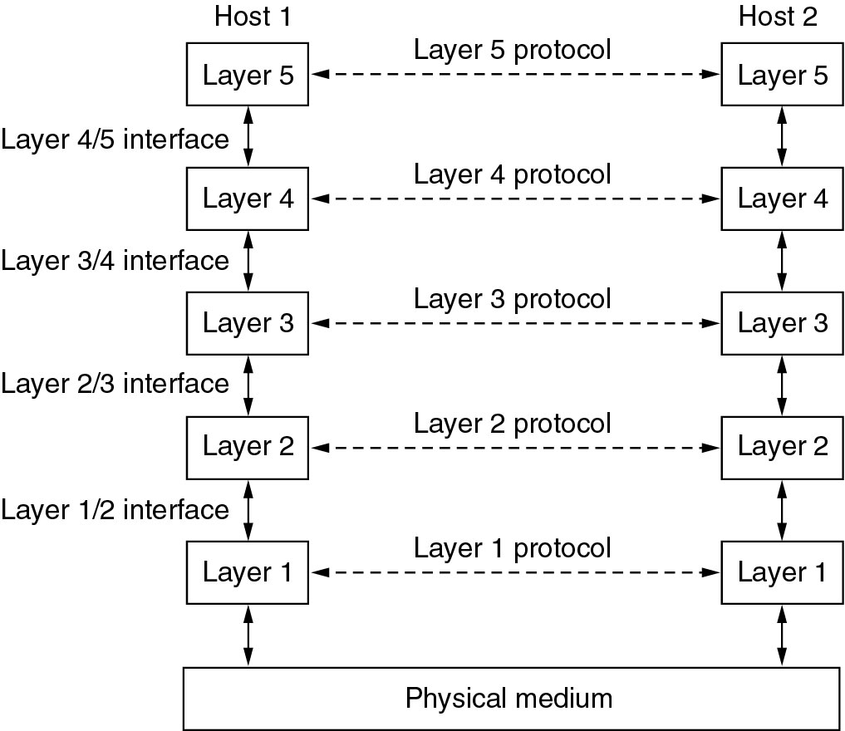
Layers, protocols, and interfaces.

Slide 47
Network architecture :
  A set of layers and protocols is called a network architecture
  Neither the details of the implementation nor the specification of the interfaces is part of the architecture(why?)
  Because these are hidden away inside the machines and not visible from the outside

Slide 48

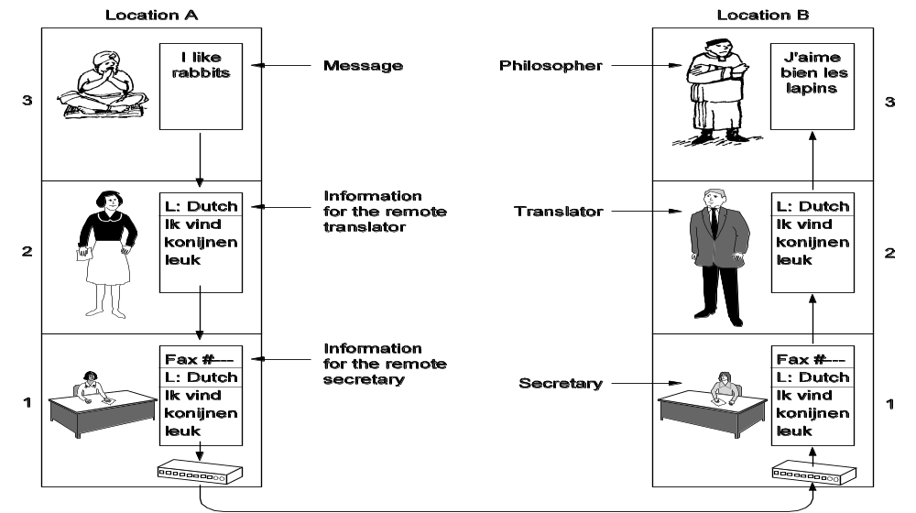
The philosopher-translator-secretary architecture.

Slide 49
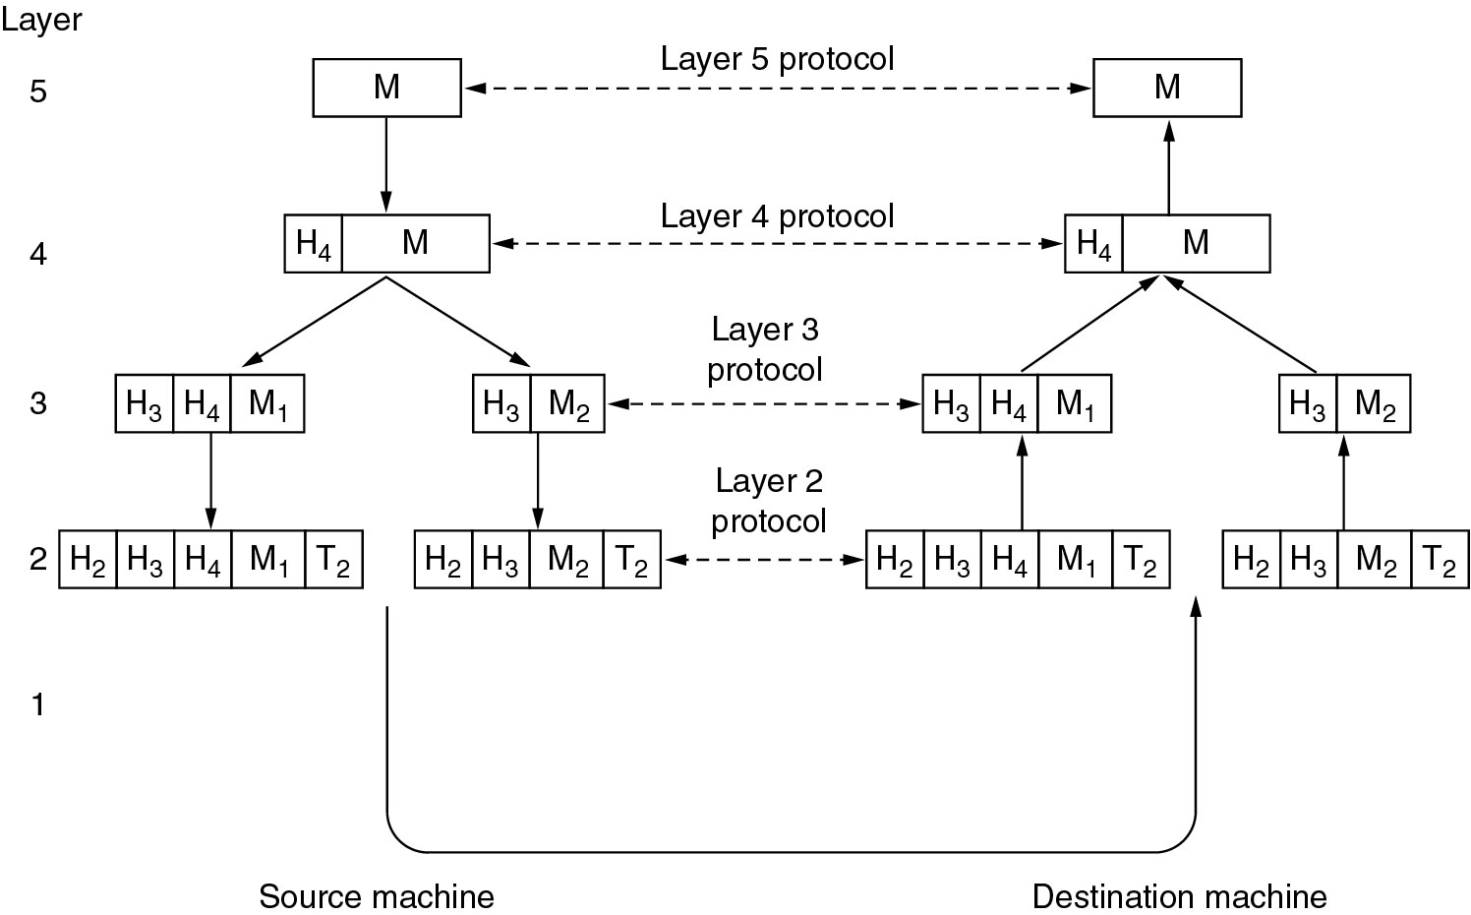
Example information flow supporting virtual communication in layer 5.

Slide 50
Design issues for the layers:
  Addressing(specific destination required)
  Error Control(error detection and correction agreed upon standards)
  Flow Control(feedback mechanism about receivers current situation)
  Multiplexing(combine several message into single one and then transmit)
  Routing(selection of paths when multiple paths available)

Slide 51

Connection oriented
  Establish connection
  Use connection
  Release connection
  eg: telephone system
Connection-less service
  eg: postal service
  Carries full address of the destination
  Message routed independently from source to destination

Slide 52
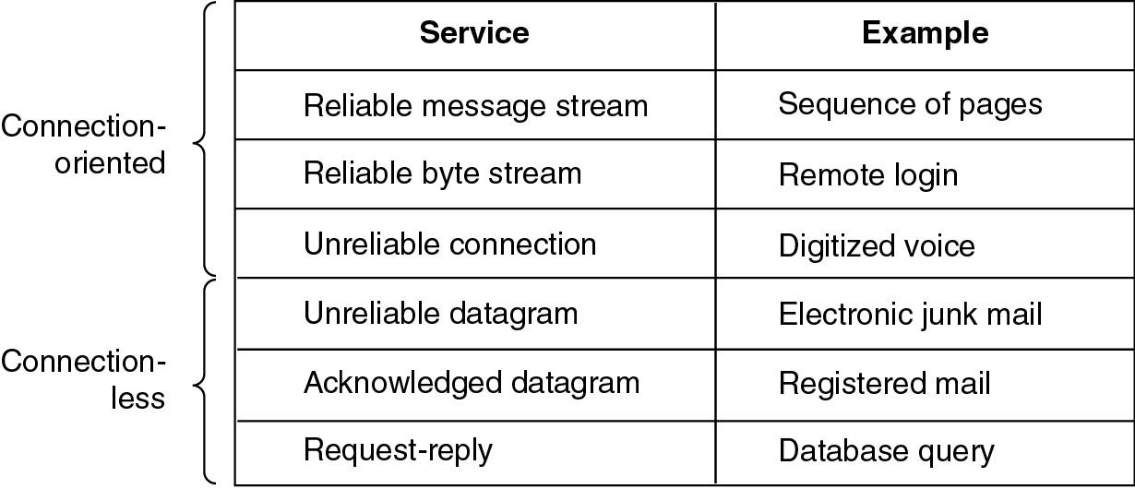
Quality of service :
  Reliable
  Unreliable
Six different types of service.

Slide 53

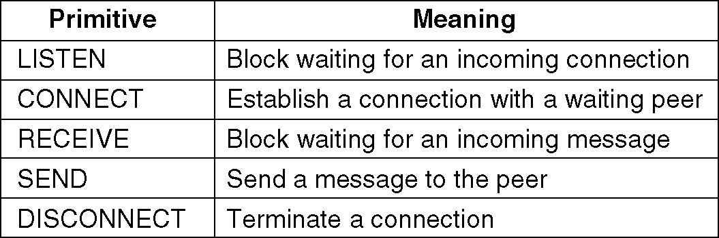
Primitives means operation
Service has set of operations
Five service primitives for implementing a simple connection-oriented service.

Slide 54
Two important reference model:
The OSI Reference Model
The TCP/IP Reference Model
A Comparison of OSI and TCP/IP

Slide 55

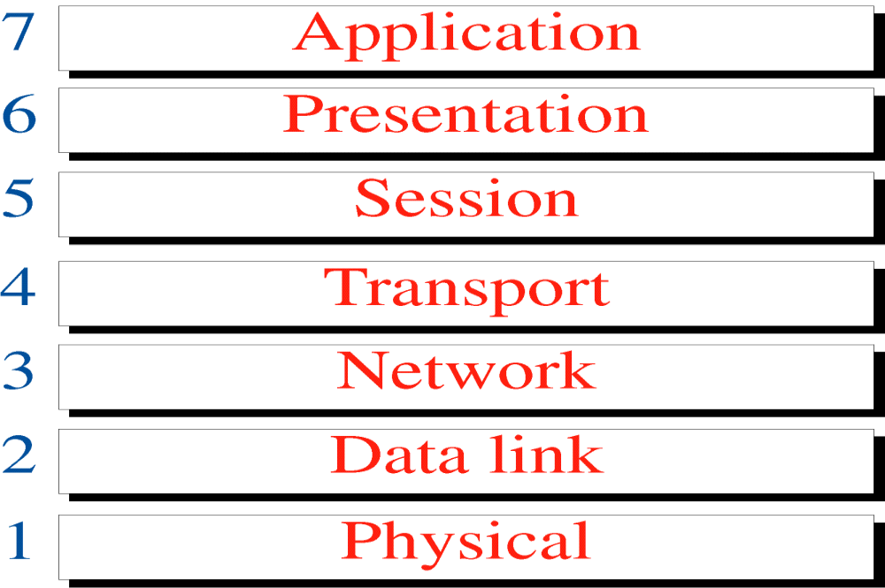
It has seven layers
Given by ISO(international standardization)

Slide 56
Level | Name of layer | Functions
1 | Physical | Make break connections Convert data bits to electrical signals Determine whether transmission is simplex,duplex
2 | Data Link | Synchronization Error detection and correction Assemble outgoing messages into frames
3 | Network | Routing of signals
4 | Transport | Transmission should be parallel or single path Splitting or segmenting of data
5 | Session | Synchronize conversation Controls logging on and off User identification and session management
6 | Presentation | Translating layer
7 | Application | Login,password checking, retransferring files of information

Slide 57

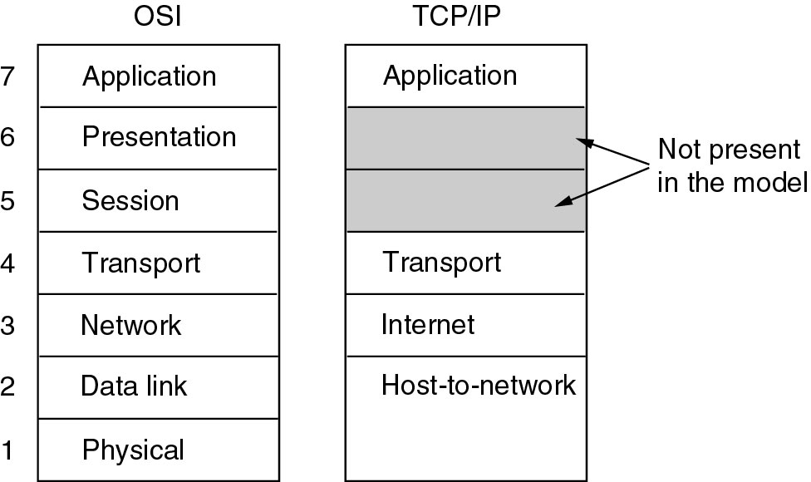
The TCP/IP reference model.

Slide 58
 | Layer | Functions/features
 | Internet | Holds whole architecture Allows host to insert packets into network and makes them travel independently over network Defines packet format and protocol Routing and congestion control
 | Transport | Peer entities carry on the conversation Two major protocols TCP and UDP TCP connection oriented protocol , more reliable UDP connectionless protocol ,unreliable
 | Application | Contains high level protocol TELNET, FTP,SMTP,DNS(mapping host names to network address)
 | Host-to-network | Differs from host-to-host and network-to-network Use of some protocol to send IP packets

Slide 59

OSI | TCP/IP
Has 7 layers | Has 4 layers
Horizontal approach | Vertical approach
Separate session layer | No session layer , characteristics are provided by transport layer
Separate presentation layer | No presentation layer,characteristics are provided by application layer
Network layer provides both connectionless and connection oriented services | Provides only connectionless services
Clear distinction between services, interfaces and protocols | No clear distinction
Protocols are better hidden and can easily replaced | No easy to replace

Slide 60
THANKYOU

