Slide 1
Web Engineering

Slide 2
Content….
-For web based application:-attributes, analysis and design , testing
-Security Engineering
-Service oriented software engineering
-Test driven Development
-Software engineering with aspects

Slide 3
Web-Based Systems
In the early days of the Web, we built systems using informality, urgency, intuition, and art
  Informality leads to an easy work environment—one in which you can do your own thing.
  Urgency leads to action and rapid decision making.
  Intuition is an intangible quality that enables you to “feel” your way through complex situations.
  Art leads to aesthetic form and function—to something that pleases those who encounter it.
Problem is—this approach can and often does lead to problems

Slide 4
But Why?
As WebApps become larger and more complex,
  Informality remains, but some degree of requirements gathering and planning are necessary
  Urgency remains, but it must be tempered by a recognition that decisions may have broad consequences
  Intuition remains, but it must be augmented by proven management and technical patterns
  Art remains, but it must be complemented with solid design
Bottom line—we must adapt the old-school approach to the realities of a Web 2.0 world

Slide 5
And What’s the Response?
Web Engineering

Slide 6
The Web
An indispensable technology
  In virtually every aspect of modern living
A transformative technology
  Changes the way we do things
  Changes the way we acquire and disseminate information
An evolving technology
Bottom line—high impact on everyone in the modern world

Slide 7
WebApps
The term Web application (WebApp) encompasses:
  everything from a simple Web page that might help a consumer compute an automobile lease payment to a comprehensive website that provides complete travel services for business people and vacationers.
  Included within this category are complete websites, specialized functionality within websites, and information-processing applications that reside on the Internet or on an Intranet or Extranet.

Slide 8
WebApp Attributes
Network intensiveness
Concurrency
Unpredictable load
Performance
Availability
Data driven
Content sensitive
Continuous evolution
Immediacy
Security
Aesthetics

Slide 9
WebApp Types
Informational
Download
Customizable
Interaction
User input
Transaction-oriented
Service-oriented
Portals
Database access
Data warehousing
(see http://digitalenterprise.org/models/models.html for examples)

Slide 10
Chapter 2: Web Engineering
We define it this way:
  an agile, yet disciplined framework for building industry-quality WebApps.
We must understand the meaning of:
  Agile
  Disciplined framework
  Industry quality

Slide 11
Why Agility?
Business strategies and rules change rapidly
Management demands near-instantaneous responsiveness (even when such demands are completely unreasonable
Stakeholders often don’t understand the consequences of the Web and keep changing their mind even as they demand rapid delivery
An agile approach helps cope with this fluidity and uncertainty.

Slide 12
What is an Agile Process?
Agile Web engineering combines a philosophy and a set of development guidelines. The philosophy encourages:
  customer satisfaction
  early incremental delivery of the WebApp
  small, highly motivated project teams
  informal methods
  minimal work products
  overall development simplicity.
An agile process stresses delivery over analysis and design (although these activities are not discouraged), and active and continuous communication between developers and customers.

Slide 13
What is a WebE Framework?
A framework is a set of activities that will always be performed for every Web engineering project – though the nature of the activities might vary to suit the project.
Each framework activity is composed of a set of actions
Actions encompass
  work tasks
  work products
  quality assurance points, and
  project milestones
A framework also has a set of “umbrella activities”

Slide 14
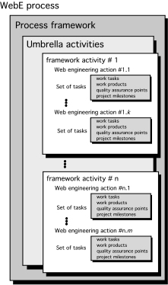
A Generic Framework

Slide 15
The WebE Framework: Activities
Communication. Involves heavy interaction and collaboration with the customer (and other stakeholders) and encompasses requirements gathering and other related activities.
Planning. Establishes an incremental plan for the WebE work.
Modeling. Encompasses the creation of models that assist the developer and the customer to better understand WebApp requirements and the design
Construction. Combines both the generation of HTML, XML, Java, and similar code with testing that is required to uncover errors in the code.
Deployment. Delivers a WebApp increment to the customer who evaluates it and provides feedback based on the evaluation.

Slide 16
Adapting the Framework
Adapt to the problem, to the project, to the team, and to the organizational culture
    And continue to adapt throughout the project as circumstances change!
Adaptation leads to:
    Overall flow of activities, actions, and tasks and the interdependencies among them
    Degree to which work tasks are defined within each framework activity
    Degree to which work products are identified and required
    Manner in which quality assurance activities are applied
    Manner in which project tracking and control activities are applied
    Overall degree of detail and rigor with which the process is described
    Degree to which customers and other stakeholders are involved with the project
    Level of autonomy given to the software project team
    Degree to which team organization and roles are prescribed

Slide 17
Underlying Agility Principles - I
Our highest priority is to satisfy the customer through early and continuous delivery of valuable software.
Welcome changing requirements, even late in development. Agile processes harness continuous change for the customer's competitive advantage.
Deliver working software increments frequently, from as often as every few days to every few months, with a preference to the shorter timescales.
Business people and developers must work together daily throughout the project.
Build projects around motivated people. Give them the environment and support they need, and trust them to get the job done.
The most efficient and effective method of conveying information to and within a development team is face-to-face conversation.

Slide 18
Underlying Agility Principles - II
Working software is the primary measure of progress.
Agile processes promote sustainable development. The sponsors, developers, and users should be able to maintain a constant pace indefinitely.
Continuous attention to technical excellence and good design enhances agility.
Simplicity—the art of maximizing the amount of work not done—is essential.
The best architectures, requirements, and designs emerge from self-organizing teams.
At regular intervals, the team reflects on how to become more effective, then tunes and adjusts its behavior accordingly.

Slide 19

The Influence of Software Engineering
Quality: foster a continuous process improvement culture
Process: the glue that holds the technology layers together
Methods: provide the technical how-to’s
Tools: support for the process and the methods

Slide 20
WebE Methods
Communication methods
Requirements analysis methods
Design methods
Construction methods
Testing methods

Slide 21
What about Tools and Technology?
… tools and technology are very important, but they’ll work well only if they’re used within the context of an agile framework for Web engineering and in conjunction with proven methods for understanding the problem, designing a solution, and testing it thoroughly.

Slide 22
WebE Best Practices
Take the time to understand business needs and product objectives, even if the details of the WebApp are vague.
Describe how users will interact with the WebApp using a scenario-based approach.
Always develop a project plan, even if it’s very brief.
Spend some time modeling what it is that you’re going to build.
Review the models for consistency and quality.
Use tools and technology that enable you to construct the system with as many reusable components as possible.
Don’t reinvent when you can reuse.
Don’t rely on early users to debug the WebApp—design and use comprehensive tests before releasing the system.

Slide 23
Chapter 3: The WebE Process
The process must be agile and adaptable, but it must also be incremental
Why incremental?
  Requirements evolve over time
  Changes will occur frequently (and always at inconvenient times
  Time lines are short
Incremental delivery allows you to manage this change!

Slide 24
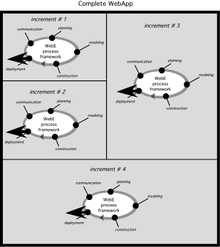
Incremental Delivery
Repeat the development cycle for each increment!

Slide 25
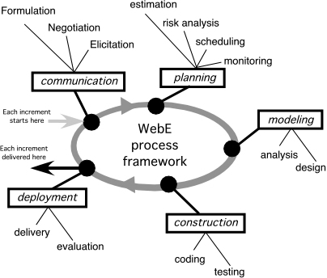
WebE Process Activities & Actions

Slide 26
Conducting Framework Activities-I
The first iteration
  define business context
  establish overall requirements
  create a set of usage scenarios
  negotiate conflicting needs among stakeholders, and
  from this information derive the set of WebApp increments that is to be delivered.
Develop a broad outline of all components, recognizing that it will change

Slide 27
Conducting Framework Activities-II
The second iteration
  You’ve learned that the first increment is an informational WebApp and it must be delivered in one week!
  You meet with stakeholders and later review your notes:
    Logo and graphics—need aesthetic design.
    One- or two-paragraph introduction.
    CPI mission statement (file exists)
    A word to visitors (someone will write this tomorrow)
    Basic navigation bar will look like …
    About the company
    Our offerings
    Home security products (hierarchical at next level)
    Monitoring services (a list)
    Our Technology (the new sensor)
    Contact us
    Other issues:
    Informational content will change over time.
      This “home page” will be the navigation starting point for content and functions required for subsequent increments.

Slide 28
Conducting Framework Activities-III
The second iteration
  You spend a few minutes developing a plan
    Day 1: Create a prototype layout (a model) of the WebApp.
    Collect and review all existing CPI content and graphics.
    Get stakeholder feedback on prototype, if possible.
    Day 2: Using the prototype as a guide, begin construction of the increment.
    Build navigation bar.
    Lay out content areas.
    Integrate graphics, links, etc.
    Test all links for validity.
    Review all content for completeness and correctness.
    Day 3: FTP all files to (an existing) domain.
    Perform navigation tests.
    Deployment: Inform selected stakeholders that the increment is available.
    Day 4: Poll stakeholders for feedback.
    Make modifications based on stakeholder feedback.

Slide 29
Conducting Framework Activities-IV
The next iteration
  You’ve deployed the informational WebApp
the communication activity during this second iteration will identify the requirements (including content and functionality)
  assume that the second increment delivers the capability to select and download product specifications and related information
the process flow is restarted at the beginning, performing the communication activity for this increment.
The tasks you select to populate each framework activity for the increment may differ from the tasks performed for the preceding increment, but the overall process flow remains the same

Slide 30
Revisiting the Framework Activities
WEPA pp. 32 - 42 presents a breakdown of the generic actions and tasks for each of the five framework activities
Recognize that a WebE team must refine and adapt these generic tasks to the problem at hand
  And continue to refine them throughout the project

Slide 31
Umbrella Activities
Background activities which occur in parallel with the main development activities
Equally important to the success of a project
  And so should be considered explicitly.
Many umbrella activities can be defined
  But only four are crucial for a successful Web engineering project:

Slide 32
Umbrella Activities
Change management. Manages the effects of change as each increment is engineered, integrating tools that assist in the management of all WebApp content
Quality assurance. Defines and conducts those tasks that help ensure that each work product and the deployed increment exhibits quality
Risk management. Considers project and technical risks as an increment is engineered
Project management. Tracks and monitors progress as an increment is engineered

Slide 33
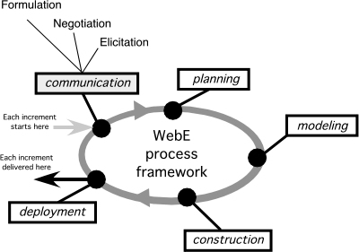
Chapter 4: Communication
Understand the problem before you begin to solve it, and be sure that the solution you conceive is one that people really want
To do this, you’ll need to:
  Formulate
  Elicitate
  Negotiate

Slide 34
Formulation
Focuses on defining the project needs and scope
  begins with the identification of a business need
  moves into a description of WebApp objectives
  defines major WebApp features, and
  establishes a basis for the elicitation action that follows.
  allows stakeholders and the WebE team to establish a common set of goals and objectives for the creation of each WebApp increment
  identifies the scope of the development effort and provides a means for determining a successful outcome

Slide 35
What Questions Do We Ask?
What is the main motivation (business need) for the WebApp?
What are the objectives that the WebApp must fulfill?
Who will use the WebApp?
Note that:
  Every stakeholder has a different view of the WebApp, achieves different benefits when the WebApp is successfully deployed, and is open to different risks if the development effort should fail.
  As information from multiple viewpoints is collected, emerging requirements may be inconsistent or may conflict with one another.
  Your job during formulation and elicitation is to categorize all stakeholder information (including inconsistent and conflicting requirements) in a way that will set the stage for the last WebE action, negotiation.

Slide 36
Elicitation
The intent is to gather detailed requirement collaboratively with all stakeholders
To do this:
    A meeting (either physical or virtual) is conducted and attended by all stakeholders.
    Rules for preparation and participation are established.
    An agenda is suggested that is formal enough to cover all important points but informal enough to encourage the free flow of ideas.
    A facilitator (can be a customer, a Web engineer, or an outsider) controls the meeting.
    A definition mechanism (can be work sheets, flip charts, or wall stickers or an electronic bulletin board, chat room, or virtual forum) is used.

Slide 37
Elicitation Tasks
Define user categories, and develop descriptions for each category.
Define content and functionality using the lists each person prepared.
Consider specific constraints and performance issues.
Write user scenarios for each user class.

Slide 38
User Descriptions
What is the user’s overall objective when using the WebApp?
What is the user’s background and sophistication level relative to the content and functionality of the WebApp?
How will the user arrive at the WebApp?
What generic WebApp characteristics does the user like and dislike?

Slide 39
Content and Functionality
Each stakeholder has begun this work by preparing lists of content objects and WebApp functions.
Once the meeting begins these lists can be:
  displayed on large sheets of paper pinned to the walls of the room
  displayed on adhesive-backed sheets stuck to the walls, or
  written on a whiteboard.
  posted on an electronic bulletin board, at an internal website, or posted in a chat room environment for review prior to the meeting.
Ideally, each listed entry should be capable of being manipulated separately so that lists can be combined, entries can be deleted, and additions can be made. At this stage, critique and debate are strictly prohibited.

Slide 40
Constraints and Performance
Internal constraints are best understood by thinking about the technical environment in which the WebApp will reside and the project environment in which the WebApp will be built.
  technical environment—specialized database protocols, the vagaries of different Web browsers, operating system characteristics, and client-server issues
  project environment—available WebE tools, development hardware, software standards, and staff skill levels with various WebE technologies.
External constraints can be enumerated by considering the business and usage environment for the WebApp.
  Business rules, end-user idiosyncrasies, security demands, privacy issues, run-time performance, interoperability requirements, legal restrictions, and government regulations are but a few of possible external constraints

Slide 41
Capturing Interaction: Use Cases
Use cases describe how a specific user category (called an actor) will interact with the WebApp to accomplish a specific action.
Use cases are developed iteratively. Only those use cases necessary for the increment to be built are developed during the communication activity for the increment.
Use cases enable you to:
    provide the detail necessary for effective planning and modeling activities.
    help you to understand how users perceive their interaction with the WebApp.
    help to compartmentalize Web engineering work because they can be organized into WebApp increments.
    provide important guidance for those who must test the WebApp.

Slide 42
From Use Cases to Increments
A stack of “cards” that contains one usage scenario or use case per card
  Each card contains the name of the use case, a brief description, and an effort indicator—usually a number between 1 and 4
The cards are:
  shuffled into random order
  distributed to selected stakeholders who are asked to arrange the cards into groupings that reflect how they would like content and functionality (implied by the usage scenarios) to be delivered
The manner in which cards are grouped is constrained by an effort maximum M.
  No grouping of cards can have a cumulative effort indicator value that is greater than M, where M is defined by the WebE team and is a function of available resources and the desired delivery time for each increment.

Slide 43
Negotiation
Ideally, requirements are defined in sufficient detail to proceed
BUT, in reality, requirements are often contradictory or infeasible (within the context of real-world constraints, such as cost or time).
Negotiation involves working with the stakeholders to balance functionality, performance, and other product or system characteristics against cost and delivery time.
The best negotiators strive for a win-win result.
  it’s a good idea to determine each of the stakeholders’ “win conditions”.

Slide 44
Negotiation
Recognize that it’s not a competition. To be successful, both parties have to feel they’ve won or achieved something. Both will have to compromise.
Map out a strategy. Decide what you’d like to achieve, what the other party wants to achieve, and how you’ll go about making both happen.
Listen actively. Don’t work on formulating your response while the other party is talking. Listen. It’s likely you’ll gain knowledge that will help you to better negotiate your position.
Focus on the other party’s interests. Don’t take hard positions if you want to avoid conflict.
Don’t let it get personal. Focus on the problem that needs to be solved.
Be creative. Don’t be afraid to think outside of the box if you’re at an impasse.
Be ready to commit. Once an agreement has been reached, don’t waffle; commit to it and move on.

Slide 45
Chapter 5: Planning
Planning is a key activity
  But the scope of planning activities varies among people involved in a WebE project.
    A team leader plans, monitors, and coordinates the combined work of a WebE team.
    A Web engineer manages day-to-day work—planning, monitoring, and controlling technical tasks.
Take an agile approach to planning
  Adapt effort and time spent on planning to the complexity of the WebApp increment

Slide 46
Planning guidelines
Understand scope before you define work tasks or schedule for an increment
Refine framework actions and tasks
Be sure you have the right team
Evaluate risks
Define a schedule
Identify quality filters
Identify how you’ll manage change

Slide 47
WebApp Project Scope
To plan effectively, you need to understand project scope
To establish scope be sure you understand:
  Context.
    How does the WebApp fit into a business context, and what constraints are imposed as a result of the context?
  Information objectives.
    What customer-visible content objects are used by the WebApp increment?
  Functionality.
    What functions are initiated by the end user or invoked internally by the WebApp to meet the requirements defined in usage scenarios?
  Constraints and performance.
    What technical and environmental constraints are relevant?
    What special performance issues (including security and privacy issues) will require design and construction effort?

Slide 48
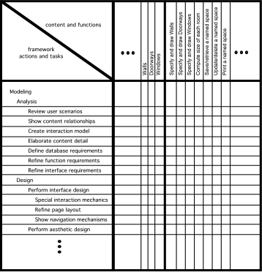
Refining Actions and Tasks

Slide 49
The Team
Interestingly, people working together with good communication and interaction can operate at noticeably higher levels than when they use their individual talents. We see this time and again in brainstorming and joint problem-solving sessions. Therefore, agile project teams [WebE teams] focus on increasing both individual competencies and collaboration levels. Cockburn and Highsmith
But how do successful teams conduct their business?
  A set of team guidelines should be established.
  Strong leadership is a must.
  Respect for individual talents is critical.
  Every member of the team should commit.
  It’s easy to get started, but it’s very hard to sustain momentum.

Slide 50
Managing Risk
Many problems can arise during a project
Risk management focuses on understanding and managing these problems
  Identify the risk; Assess its probability of occurrence; Estimate its impact; Establish a contingency plan
Considers risk at two different levels of granularity
  (1) the impact of risk on the entire WebApp project, and
  (2) the impact of risk on the current WebApp increment
Typical risks:
  Is the time timeframe defined and reasonable?
  Will the increments provide ongoing value for end users
  How will requests for change impact delivery schedules?
  Is the available technology appropriate for the job?
  Does the team have the right mix of skills to build this increment

Slide 51
Identifying Risks
Address the fundamental question: “What can go wrong?”
Each team member is asked to make a list of risks
  People risks: potential problems that can be directly traced to some human action or failing.
  Product risks: potential problems associated with WebApp content, functions, constraints, or performance.
  Process risks: problems that are tied to the framework actions and tasks that have been chosen by the team

Slide 52
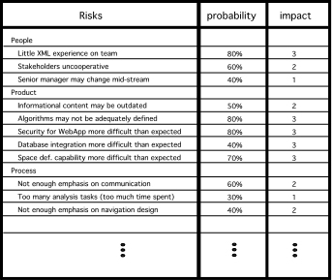
Risk Analysis

Slide 53
Risk Contingency Planning
Development time spans are short, so contingency plans are usually not formally documented.
    Document as information notes by the team leader
Consider each risk that falls above the cutoff line in the risk table and answer three questions:
  1. How can we avoid the risk altogether?
  2. What factors can we monitor to determine whether the risk is becoming more or less likely?
  3. Should the risk become a reality, what are we going to do about it?

Slide 54
Developing a Schedule
How do projects fall behind schedule?
  One day at a time, Fred Brooks
Approach:
  List all WebE actions and tasks for an increment
  Build a network that depicts interdependencies
  Identify tasks that are criticalT
  Track progress (especially critical tasks)
The WebApp schedule evolves over time.
During the first iteration a macroscopic schedule is developed.
  Identify all increments and dates on which each will be deployed.
For each subsequent increment
  The entry for the increment on the macroscopic schedule is refined into a detailed schedule.

Slide 55
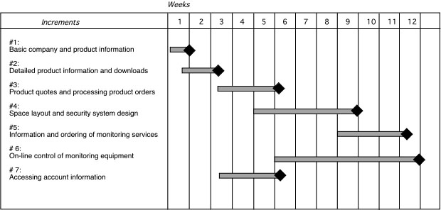
The Schedule

Slide 56
Estimating Time and Effort
Two viable (and quick) approaches to detailed estimation
Usage scenario–based estimation
  Examines the usage scenarios for the increment, compares them to previous data on average effort (E_{avg}) for previous increments.
  Adjust estimates based on perceived complexity
Product-process table
  First column lists, for all major WebE actions, content objects and functions for an increment
  Subsequent columns lists estimates of effort (in person-days) required to perform each of the main WebE actions for each content object and function.
Warning! The relationship between effort, people and time is NOT linear.

Slide 57
Managing Quality
What Quality Assurance Mechanisms Can the Team Use?
  A thoughtful, thorough communication activity
  Careful requirements gathering
  Pair walkthroughs to assess the quality of all work products
  Create a generic checklist that you can use to assess models
  Use tests to evaluate quality

Slide 58
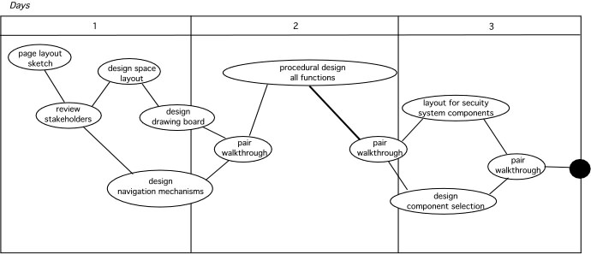
Quality Filters
Quality filters

Slide 59
Pair Walkthrough
Review the product, not the producer.
Set an agenda and maintain it. One of the key maladies of meetings of all types is drift. A walkthrough should be kept on track and on schedule.
Limit debate and rebuttal. When an issue is raised by a reviewer, there may not be agreement on its impact. Rather than spending time debating the question, the issue should be recorded for resolution later.
Enunciate problem areas, but don't attempt to solve every problem noted. A walkthrough is not a problem-solving session.
Take written notes. Notes may be entered directly into a notebook computer.
Spend enough time to uncover quality problems, but not one minute more. In general, a team walkthrough should be completed within 60 to 90 minutes at the most.

Slide 60
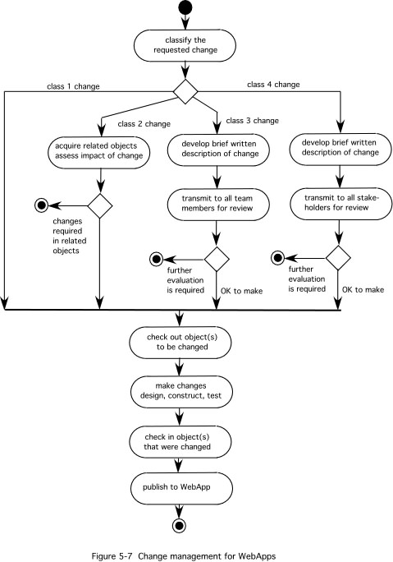
Change Management

Slide 61
Chapter 6: The Modeling Activity
All models are wrong, but some models are useful,
George Box
We model our perception of reality so that we can understand and change it, but our models of reality are not perfect.
Analysis modeling helps you to understand the nature of the problem being addressed and the “shape” of the WebApp that will allow you to address that problem
Design modeling is about understanding the internal structure of the WebApp being developed and how this creates the shape of the WebApp that was identified by the analysis model.

Slide 62
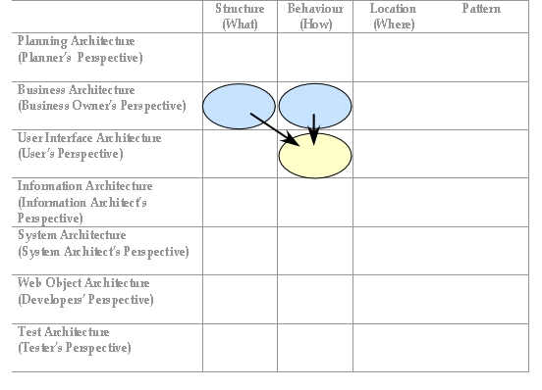
WAAF Modeling - Example

Slide 63
Modeling Languages
A modeling language (ML) incorporates a set of notations, terms, and/or symbols, as well as the rules for establishing associations between them
A modeling language often has a formally structured representation as well as a set of graphical elements
Some MLs are general purpose (e.g., UML) and others are more specific (e.g., WebML)

Slide 64
Modeling Languages
What Capabilities Should Exist to Model Functionality?
  Ability to model integration and connectivity.
  Ability to support pattern modeling.
  Ability to represent concepts in a technology-neutral fashion.
  Ability to model sophisticated system functionality.
What Capabilities Should Exist to Model Information Content?
  Ability to model presentation-level concepts.
  Ability to model navigational structure and behavior.
  Ability to model user interactions with the information.
  Ability to model user roles and user groups.
  Ability to model content.
What Generic Capabilities Should Exist in a Modeling Language?
  Ability to model business domain concepts.
  Ability to link business models with the technical architecture.
  Ability to link information with functionality.
  Ability to maintain system integrity.
  Ability to support understanding and communication.
  Ability to support Web system life cycle management.

Slide 65
Chapter 7 Analysis Modeling
Analysis modeling helps you to understand the detailed requirements that will allow you to satisfy user needs
Analysis models look at content, interaction, function and behavior, and the WebApp configuration
To determine the how much analysis modeling to do, examine the:
    Size and complexity of the WebApp increment
    Number of stakeholders (analysis can help to identify conflicting requirements coming from different sources)
    Size of the WebE team
    Degree to which members of the WebE team have worked together before (analysis can help develop a common understanding of the project)
    Degree to which the organization’s success is directly dependent on the success of the WebApp

Slide 66
Analysis Outputs
Interaction model. Describes the manner in which users interact with the WebApp.
Information model. Identifies the full spectrum of content to be provided by the WebApp. Content includes text, graphics and images, and video and audio data.
Functional model. Defines the operations that will be applied to WebApp content and describes other processing functions that are independent of content but necessary to the end user.
Configuration model. Describes the environment and infrastructure in which the WebApp resides.

Slide 67
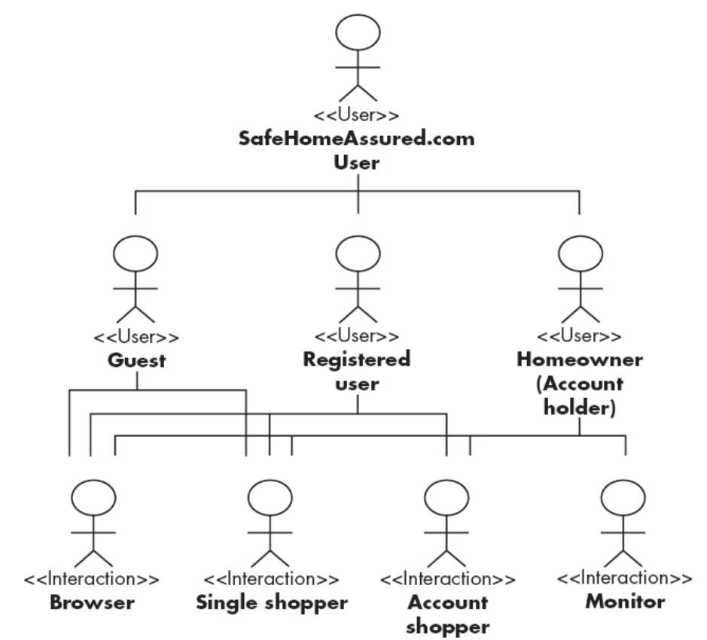
Understanding Users
Crucial to understand your users!
For each user class:
  What is the user’s overall objective?
  What is the user’s background?
  How will the user arrive at the WebApp?
  What characteristics does the user like and dislike?

Slide 68
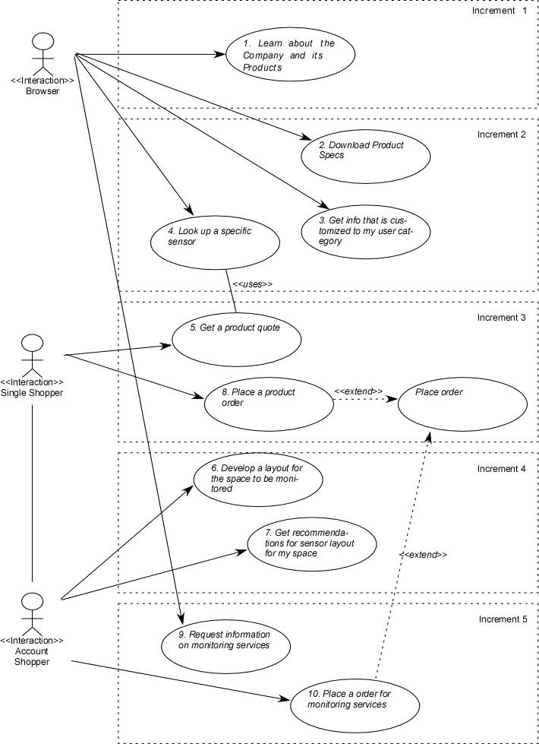
Revisiting Use Cases
Analyse and elaborate where necessary
  Find gaps, missing details
Identify overlaps and possible optimizations
  Allows design simplification
  E.g. often “view” task can be seen as a specialization of an “edit” task.

Slide 69
The Content Model
Identify content objects:
  External entities (e.g., other systems, databases, people) that produce or consume information to be used by the WebApp
  Things (e.g., reports, displays, video images) that are part of the information domain for the problem
  Occurrences or events (e.g., a quote or an order) that occur within the context of a user’s interaction with a WebApp
  Roles (e.g., retail purchasers, customer support, salesperson) played by people who interact with the WebApp
  Organizational units (e.g., division, group, team) that are relevant to an application
  Places (e.g., manufacturing floor or loading dock) that establish the context of the problem and the overall function of the WebApp
  Structures (e.g., sensors, monitoring devices) that define a class of objects or related classes of objects

Slide 70
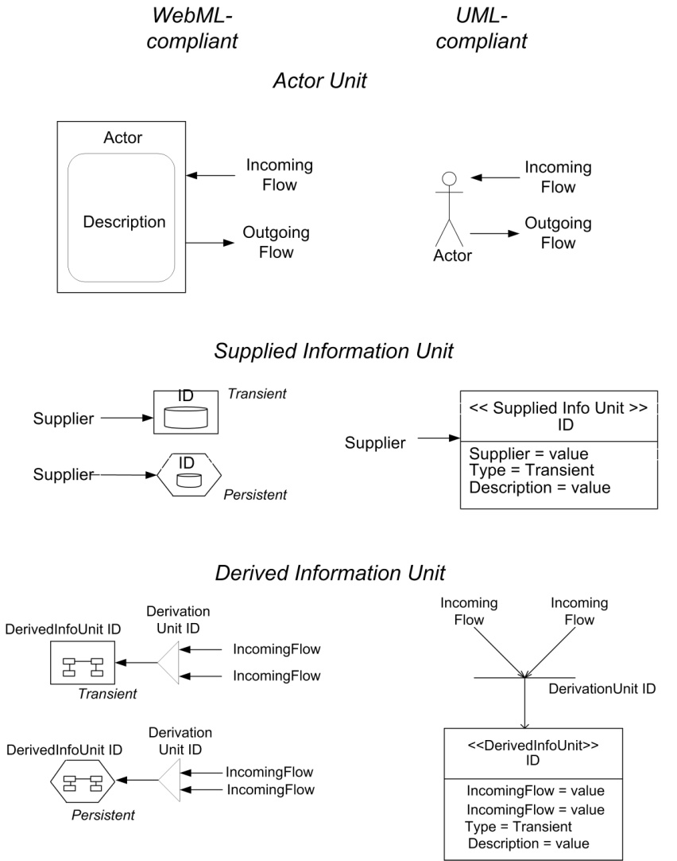
Web Info. Exchange - Notation

Slide 71
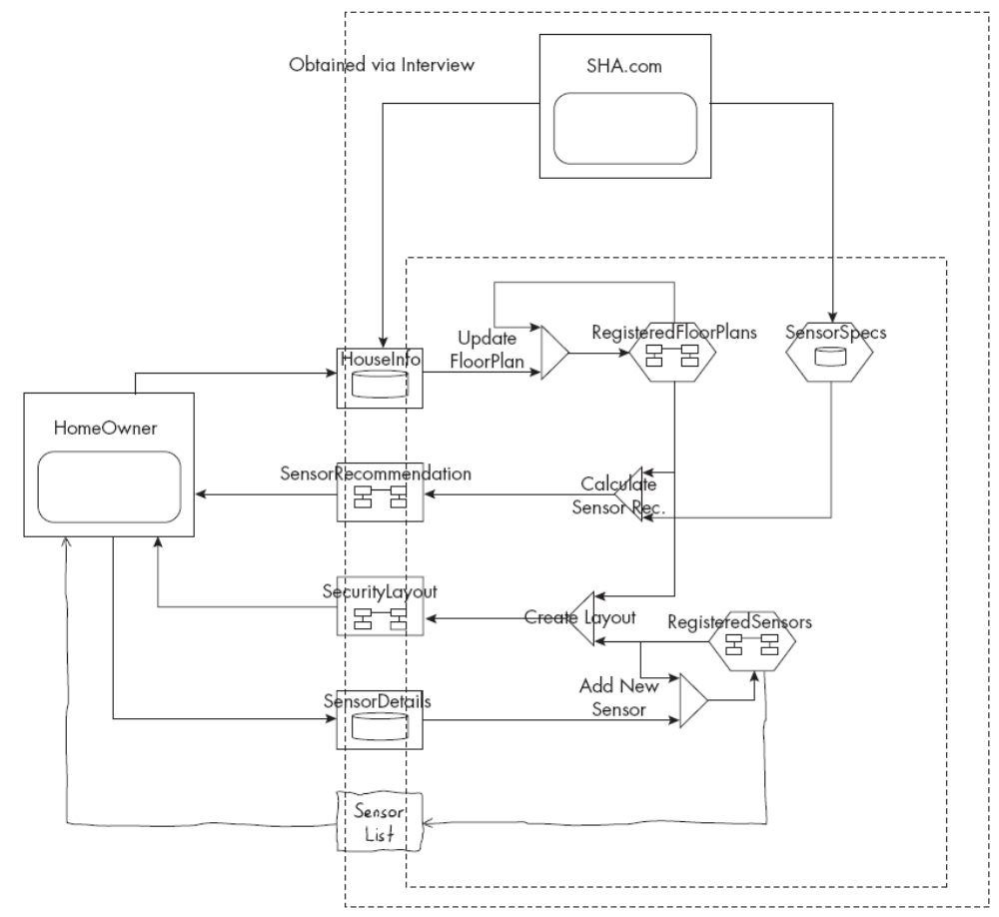
Web Info. Exchange - Example

Slide 72
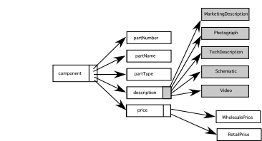
Data Tree
In some cases, the content model may benefit from a richer analysis
Data trees depict the relationships among content objects and/or the hierarchy of content maintained by a WebApp.

Slide 73
The Interaction Model
Can be represented using:
  Use cases
  Sequence diagrams
  State diagrams
  User interface prototypes
In many instances, a set of use cases is sufficient to describe the interaction at an analysis level (further refinement and detail will be introduced during design)
However, when the sequence of interaction is complex and involves multiple analysis classes or many tasks, it is sometimes worthwhile to depict it using a more rigorous diagrammatic form.

Slide 74
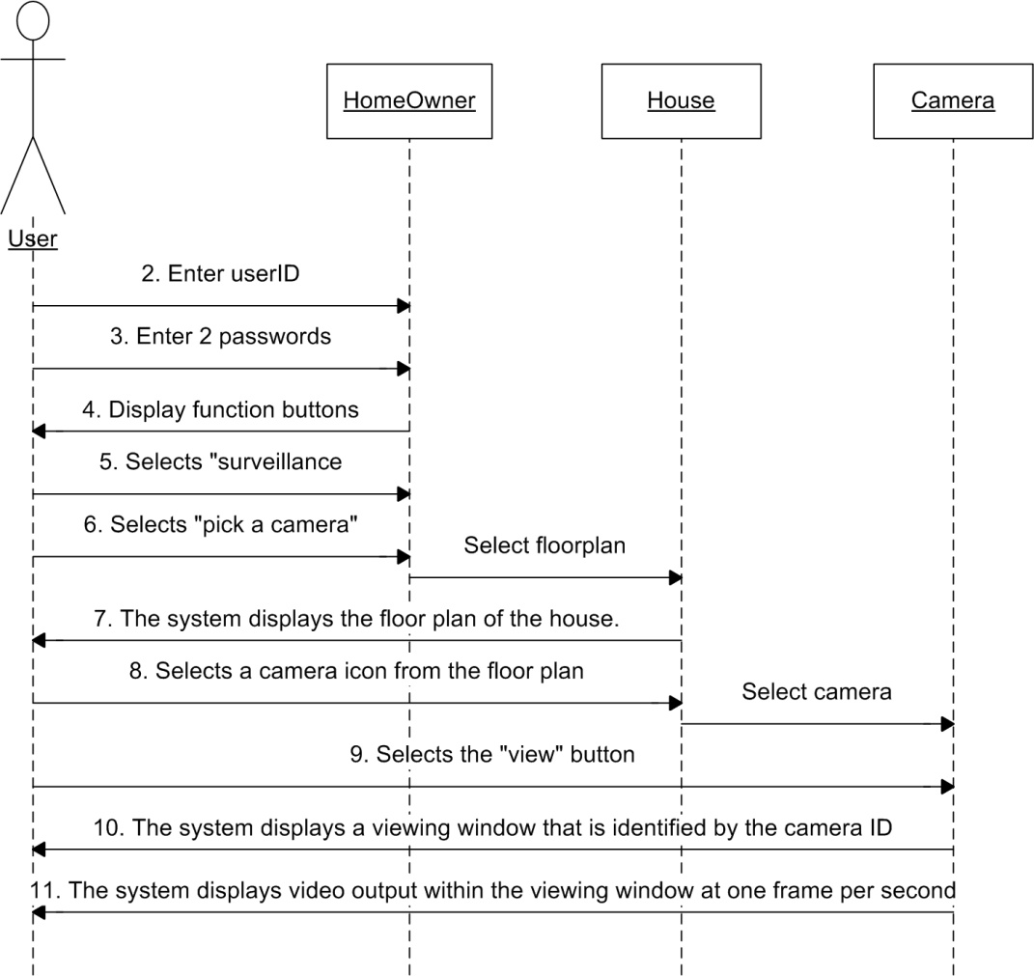
Sequence Diagram
UML sequence diagrams describe how user actions collaborate with analysis classes (the structural elements of a system).

Slide 75
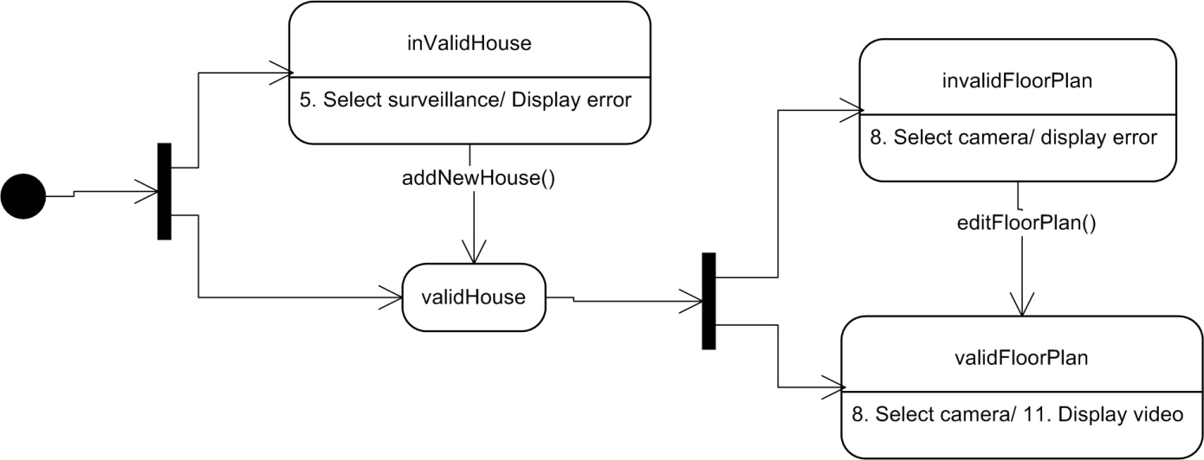
State Diagram
UML state diagrams describe dynamic behavior of the WebApp as an interaction occurs.
State diagrams are most useful when a user interaction triggers a change in the state of the WebApp—and hence changes the way in which it might react to a user.

Slide 76
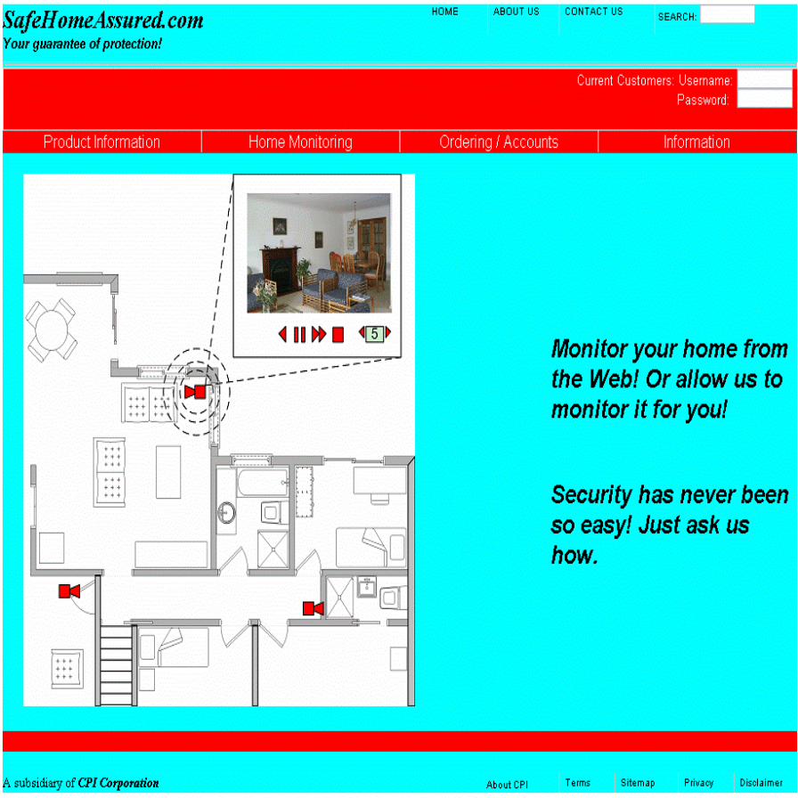
Active Interface Prototype
A prototype shows the layout of the user interface, the content, interaction mechanisms and overall aesthetic
Supports validation with the client of the requirements and analysis

Slide 77
The Functional Model
Addresses two processing elements of the WebApp, each representing a different level of procedural abstraction:
  user-observable functionality that is delivered by the WebApp to end users, and
  the operations contained within analysis classes that implement behaviors associated with the class.
The UML activity diagram can be used to represent processing details

Slide 78
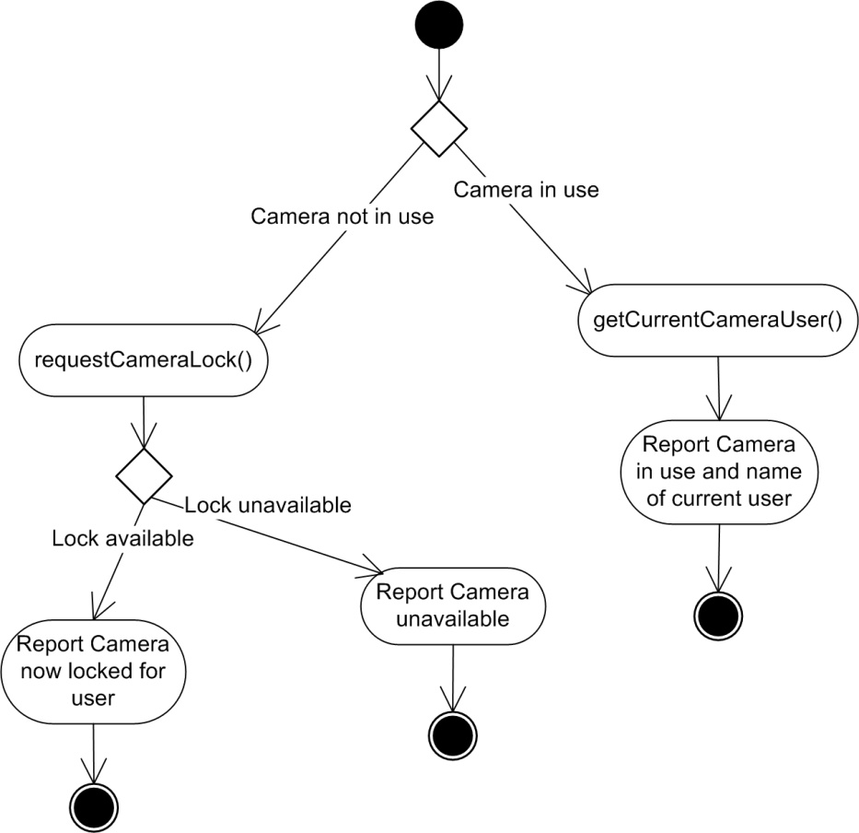
Activity Diagram
Illustrates the processing flow and logical decisions within the flow.
  The construction details indicate how these operations are invoked, and the interface details for each operation are not considered until WebApp design commences.

Slide 79
The Configuration Model
Among the many configuration issues that should be addressed are:
  Server hardware and operating system environments
  Interoperability considerations on the server side (e.g., large database access, other IT applications, specialized communication protocols)
  On the client side:
    Local OS
    Browser software
    Client hardware variations

Slide 80
Relation-Navigation Analysis
Relationship-navigation analysis (RNA) provides a series of analysis steps that strive to identify relationships among the elements uncovered as part of the creation of the analysis model
The RNA approach is organized into five steps:
  Stakeholder analysis. Identifies the various user categories, and establishes an appropriate stakeholder hierarchy
  Element analysis. Identifies the content objects and functional elements that are of interest to end users
  Relationship analysis. Describes the relationships that exist among the WebApp elements
  Navigation analysis. Examines how users might access individual elements or groups of elements
  Evaluation analysis. Considers pragmatic issues (e.g., cost-benefit) associated with implementing the relationships defined earlier

Slide 81
Chapter 8 WebApp Design
Jakob Nielsen [Nie00] states: “There are essentially two basic approaches to design: the artistic ideal of expressing yourself and the engineering ideal of solving a problem for a customer.”
Even today, some proponents of agile software development use WebApps as poster children for the development of applications based on “limited design.”
  However --
    When content and function are complex
    when the size of the WebApp encompasses hundreds of content objects, functions, and analysis classes
    when multiple people become involved in the design; and
    when the success of the WebApp will have a direct impact on the success of the business,
    design cannot and should not be taken lightly.

Slide 82
WebApp Design
The design model encompasses content, aesthetics, architecture, interface, navigation, and component-level design issues.
The design model provides sufficient information for the WebE team to construct the final WebApp
alternative solutions are considered, and the degree to which the current design model will lead to an effective implementation is also assessed

Slide 83
Design Goals - I
Simplicity. Although it may seem old-fashioned, the aphorism “all things in moderation” applies to WebApps. Rather than feature-bloat, it is better to strive for moderation and simplicity.
Consistency.
  Content should be constructed consistently
  Graphic design (aesthetics) should present a consistent look
  Architectural design should establish templates that lead to a consistent hypermedia navigation
  Navigation mechanisms should be used consistently
Identity. The aesthetic, interface, and navigational design of a WebApp must be consistent with the application domain for which it is to be built.

Slide 84
Design Goals - II
Robustness. The user expects robust content and functions that are relevant to the user’s needs.
Navigability. users should be able to understand how to move about the WebApp without having to search for navigation links or instructions.
Visual appeal. design characteristics (e.g., the look and feel of content, interface layout, color coordination, the balance of text, graphics and other media, and navigation mechanisms) contribute to visual appeal.
Compatibility. Most WebApps will be used in a variety of environments (e.g., different hardware, Internet connection types, operating systems, and browsers) and must be designed to be compatible with each

Slide 85
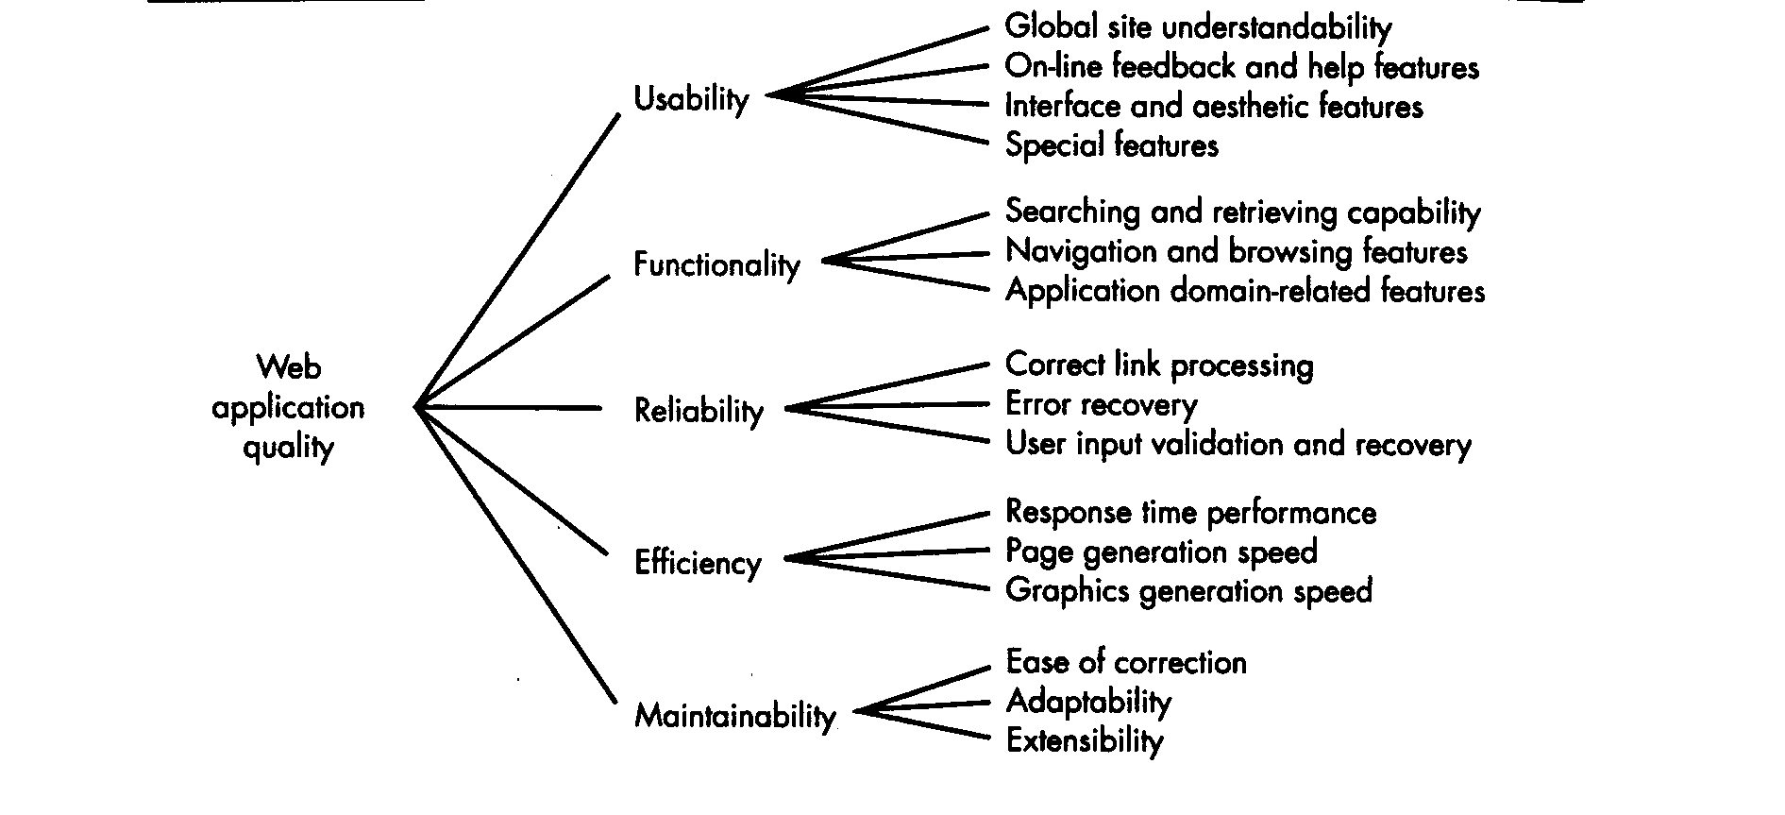
Design & WebApp Quality
Try using the design IQ checklist!

Slide 86
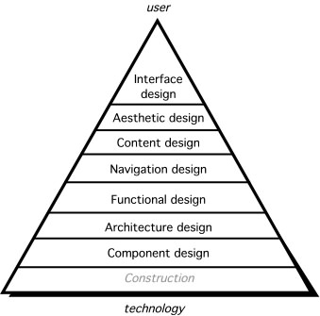
Design Actions

Slide 87
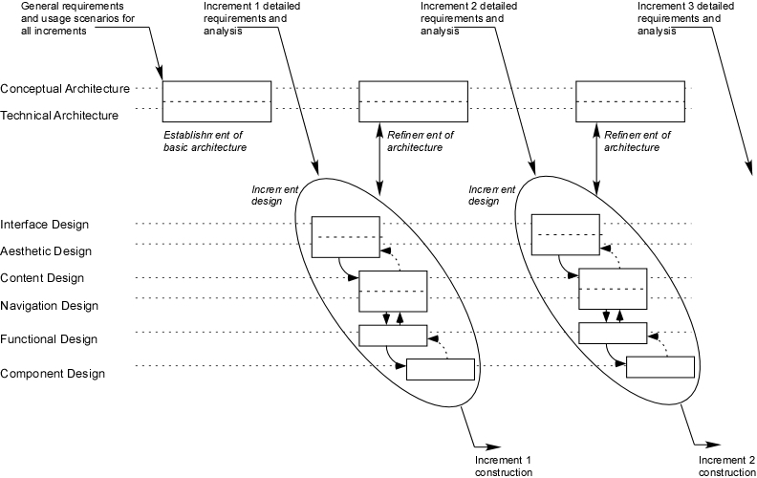
The Design Process

Slide 88
Conceptual Architecture
Provides an overall structure for the WebApp design
  Affects all later increments – so important for it to developed in the context of the full set of likely increments
Represents the major functional and information components for the WebApp and describes how these will fit together
  Depends on the nature of the WebApp, but in every case, it should ensure a sound integration between the WebApp information and the WebApp functionality.

Slide 89
Developing the architecture-I
How do we achieve an effective balance between information and functionality in the conceptual architecture?
A good place to start is with workflows or functional scenarios (which are an expression of the system functionality) and information flows
As a simple example, consider the following set of key functionalities for SafeHomeAssured.com
    Provide product quotation
    Process security system order
    Process user data
    Create user profile
    Draw user space layout
    Recommend security system for layout
    Process monitoring order
    Get and display account info
    Get and display monitoring info
    Customer service functions (to be defined later)
    Tech support functions (to be defined later)

Slide 90
Developing the architecture-II
From these key functionalities we can identify the following partial list of functional subsystems:
    UserManagement. Manages all user functions, including user registration, authentication and profiling, user-specific content, and interface adaptation and customization.
    ProductManagement. Handles all product information, including pricing models and content management.
    OrderHandling. Supports the management of customers’ orders.
    AccountAdministration. Manages customers’ accounts, including invoicing and payment.
    SecuritySystemSupport. Manages users’ space layout models and recommends security layouts.
    SecuritySystemMonitoring. Monitors customers’ security systems and handles security events.
And, of course, there are overall management subsystems:
    ClientInterface. Provides the interface between users and the other subsystems, as required to satisfy users needs.
    SystemMaintenance. Provides maintenance functionality, such as database cleaning.

Slide 91
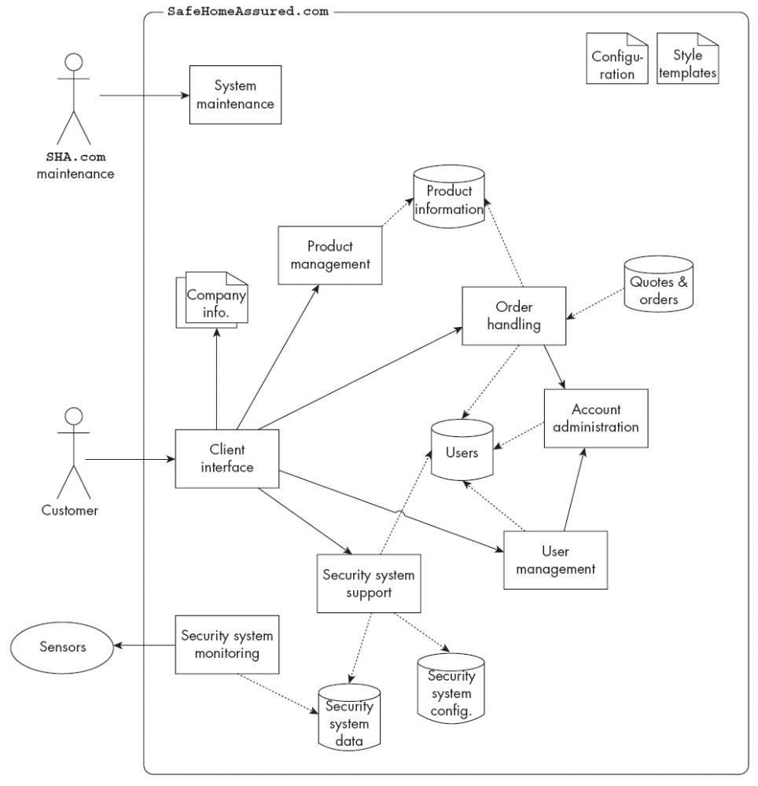
Architecture

Slide 92
Technical Architecture
Shows how the conceptual architecture can be mapped into specific technical components
Any decision made about how one component might map into the technical architecture will affect the decisions about other components
    For example, the WebE team may choose to design SafeHomeAssured.com in a way that stores product information as XML files. Later, the team discovers that the content management system doesn’t easily support access to XML content, but rather assumes that the content will be stored in a conventional relational database. One component of the technical architecture conflicts with constraints imposed by another component.

Slide 93
Chapter 9 Interaction Design
Design an interface to answer three generic questions:
    Where am I? The interface should (1) provide an indication of the WebApp that has been accessed and (2) inform users of their location in the content hierarchy.
    What can I do now? The interface should always help users understand their current options—what functions are available, what links are live, what content is relevant?
    Where have I been, where am I going? The interface must facilitate navigation. Hence, it must provide a “map” (implemented in a way that is easy to understand) of where users have been and what paths they may take to move elsewhere within the WebApp.

Slide 94
Design Principles (Tognozzi) - I
Anticipation. Designed so that it anticipates the user’s next move.
Communication. The interface should communicate the status of any activity initiated by the user.
Consistency. The use of navigation controls, menus, icons, and aesthetics (e.g., color, shape, layout) should be consistent throughout the WebApp.
Controlled autonomy. The interface should facilitate user movement throughout the WebApp, but it should do so in a manner that enforces navigation conventions that have been established for the application.
Efficiency. The design of the WebApp and its interface should optimize the user’s work efficiency, not the efficiency of the Web engineer who designs and builds it or the client-server environment that executes it.
Flexibility. The interface should be flexible enough to enable some users to accomplish tasks directly and others to explore the WebApp in a somewhat random fashion.
Focus. The WebApp interface (and the content it presents) should stay focused on the user task(s) at hand.

Slide 95
Design Principles (Tognozzi) - II
Fitt’s law. “The time to acquire a target is a function of the distance to and size of the target”
User Interface Objects. A vast library of reusable human interface objects (and patterns) has been developed for WebApps.
Latency reduction. Rather than making the user wait for some internal operation to complete (e.g., downloading a complex graphical image), the WebApp should use multitasking in a way that lets the user proceed with work as if the operation has been completed.
Learnability. A WebApp interface should be designed to minimize learning time and, once learned, to minimize relearning required when the WebApp is revisited.
Metaphors. An interface that uses an interaction metaphor is easier to learn and easier to use, as long as the metaphor is appropriate for the application and the user.

Slide 96
Design Principles (Tognozzi) - III
Maintain work product integrity. A work product (e.g., a form completed by the user, a user-specified list) must be automatically saved so that it will not be lost if an error occurs.
Readability. All information presented through the interface should be readable by young and old.
Track state. When appropriate, the state of user interactions should be tracked and stored so that users can log off and return later to pick up where they left off.
Visible navigation. A well-designed WebApp interface provides “the illusion that users are in the same place, with the work brought to them”

Slide 97
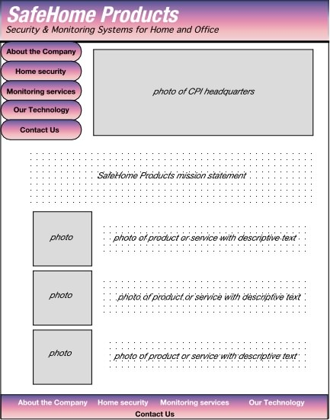
Preliminary Page Layout

Slide 98
Pragmatic Design Guidelines
Reading speed on a computer monitor is approximately 25 percent slower than reading speed for hard copy. Therefore, do not force the user to read voluminous amounts of text
Avoid “under construction” signs —they raise expectations and cause an unnecessary link that is sure to disappoint or frustrate users.
Users prefer not to scroll. Important information should be placed within the dimensions of a typical browser window.
Navigation menus and head bars should be designed consistently and should be available on all pages that are available to the user. The design should not rely on browser functions (e.g., the back arrow) to assist in navigation.
Aesthetics should never supersede functionality. For example, a simple button might be a better navigation option than an aesthetically pleasing, but vague image or icon whose intent is unclear.
Navigation options should be obvious, even to the casual user. The user shouldn’t have to search the screen to determine how to link to other content or services.

Slide 99
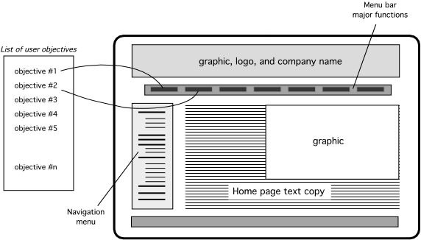
Interface Design Workflow - I
Review user characteristics and categories, user tasks, use cases, and related information contained in the analysis model and refine as required.
Develop a rough design prototype of the WebApp interface layout.
Map user objectives into specific interface actions.

Slide 100
Interface Design Workflow - II
Define a set of user tasks that are associated with each action.
Develop screen images for each interface action.
Refine interface layout and screen images using input from aesthetic design.
Identify user interface objects that are required to implement the interface.
Develop a procedural representation of the user’s interaction with the interface.
Develop a behavioral representation of the interface.
Describe the interface layout for each state.
Pair walkthroughs (Chapter 5) should be conducted throughout all these design tasks and should focus on usability.

Slide 101
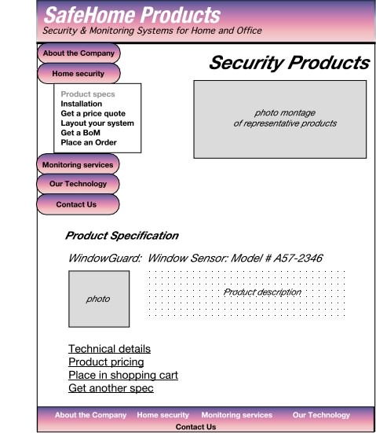
Elaborate the design

Slide 102
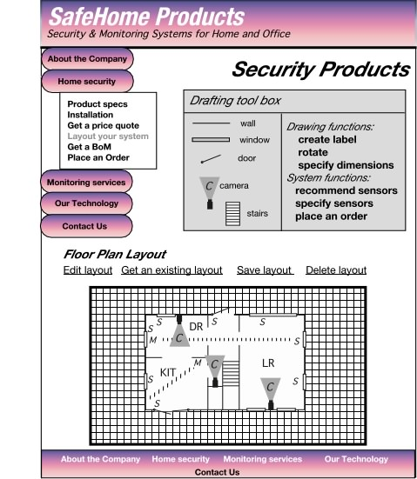
Elaborate the Design

Slide 103
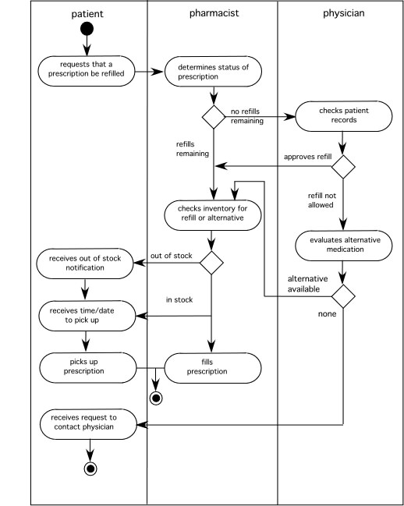
Different Users in Different Roles
The swimlane diagram:
Captures workflows and shows interactions between different users

Slide 104
Translating Actions and Objects
From the use case on pp. 213 - 214
  Accesses the SafeHome system
  Enters an ID and Password to allow remote access
  Displays FloorPlan and SensorLocations
  Displays VideoCameraLocations on floor plan
  Selects VideoCamera for viewing
  Views VideoImages (four frames per second)
  Pans or zooms the VideoCamera
Based on these actions and objects we create a design layout -->

Slide 105
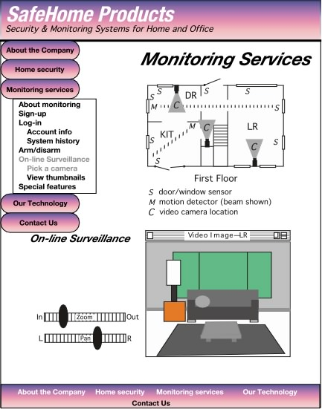
Design Layout

Slide 106
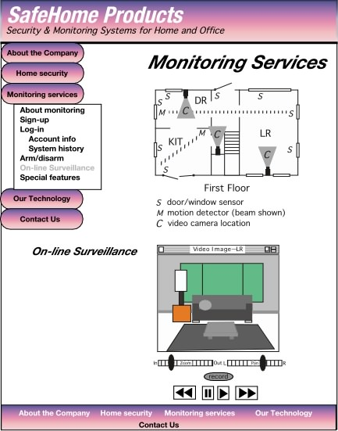
Revising the Layout

Slide 107
Aesthetic Design - I
Don’t be afraid of white space.
Emphasize content.
Organize layout elements from top-left to bottom-right.
Don’t extend your real estate with the scrolling bar.
Consider resolution and browser window size when designing the layout.
Design the layout for freedom of navigation.
Don’t assume that the layout will be consistent across different display devices and browsers.
If you use photos, make them small format with the option to enlarge.
If you want a cohesive layout, look, and feel across all WebApp pages, use a cascading style sheet (CSS).

Slide 108
Usability
    Is the WebApp usable without continual help or instruction?
    Do the rules of interaction and navigation help a knowledgeable user work efficiently?
    Do interaction and navigation mechanisms become more flexible as users become more knowledgeable?
    Has the WebApp been tuned to the physical and social environment in which it will be used?
    Are users aware of the state of the WebApp? Do users know where they are at all times?
    Is the interface structured in a logical and consistent manner?
    Are interaction and navigation mechanisms, icons, and procedures consistent across the interface?
    Does the interaction anticipate errors and help users correct them?
    Is the interface tolerant of errors that are made?
    Is the interaction simple?

Slide 109
Other Design Issues
Response time
“Help” facilities
Error handling
Accessibility
Internationalization

