Slide 1
Chapter 1
Concept and Overview Distributed Database system
By, Safa Hamdare

Slide 2
Outline:
What is Distributed Database System (DDBS)
Features of DDBS
Date’s twelve rules for a DDBS
Advantage & Disadvantage of DDBS
Promises of DDBS
Design issue in DDBS
Distributed DBMS Architecture:
Client/server System,
Peer-to-Peer
Multi-Database system

Slide 3
What is a Distributed Database System?
A Distributed Database (DDB) is a collection of multiple, logically interrelated databases distributed over a computer network.
A Distributed Database Management System (D–DBMS) is the software that manages the DDB and provides an access mechanism that makes this distribution transparent to the users.
Distributed database system (DDBS) = DDB + D–DBMS
Fundamental Principle: Make Distribution Transparent to User.

Slide 4
DISTRIBUTED DATABASES
WHAT IS A DISTRIBUTED DATABASE?
A distributed database system is a collection of
logically related databases that co-operate in a
transparent manner.
‘Transparent’ implies that each user within the
system may access all of the data within all of the
databases as if they were a single database
There should be ‘location independence’ i.e.- as
the user is unaware of where the data is located it
is possible to move the data from one physical
location to another without affecting the user.

Slide 5
DISTRIBUTED DATABASE ARCHITECTURE
CLIENT
CLIENT
CLIENT
CLIENT
CLIENT
LAN
DBMS
DBMS
CLIENT
CLIENT
CLIENT
CLIENT
WIDE AREA NETWORK
Mumbai
Pune
CLIENT
CLIENT
CLIENT
CLIENT
CLIENT
LAN
DBMS
DBMS
CLIENT
CLIENT
CLIENT
CLIENT
Baroda
Goa

Slide 6
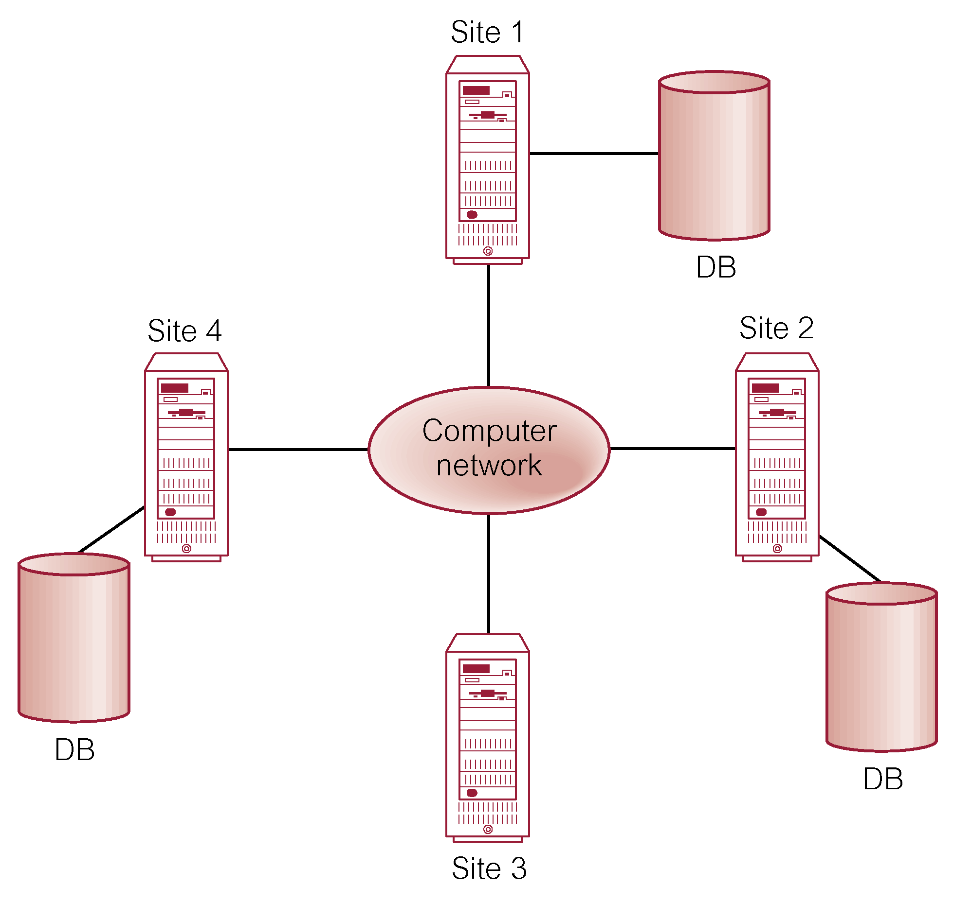
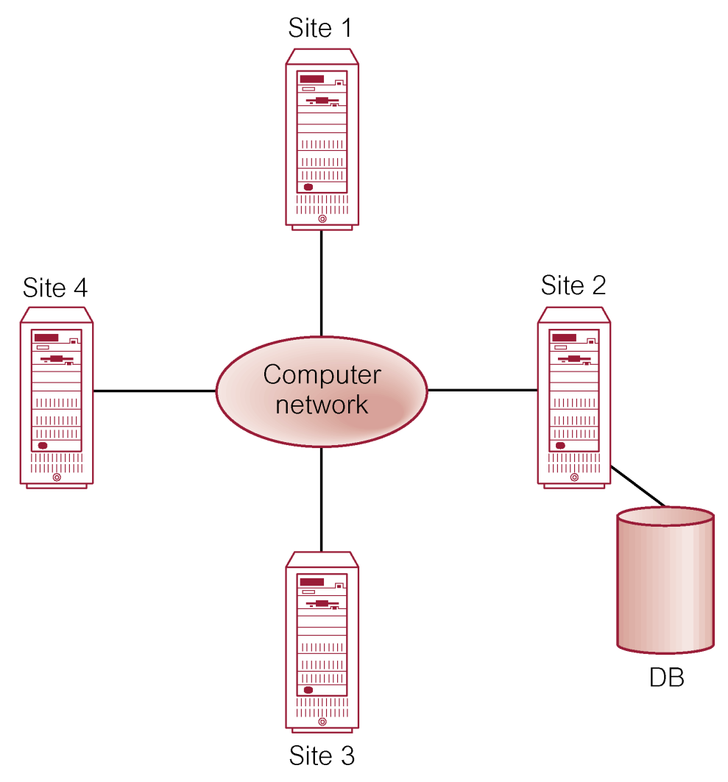
Important difference between DDBMS and Centralized DBMS!
12.3 Introduction
Distributed processing of centralised DBMS
DDBMS

Slide 7
Centralized DBMS on a Network
Site 1
Site 2
Site 5
Communication
Network
Site 4
Site 3
A database system which resides at one of the nodes of a network of computers - this is a centralized database on a network node

Slide 8
Distributed DBMS Environment
Site 1
Site 2
Site 5
Communication
Network
Site 4
Site 3
A Distributed Database System consists of loosely coupled sites that share no physical component. Database systems that run on each site are independent of each other. Transactions may access data at one or more sites

Slide 9
Implicit Assumptions
Data stored at a number of sites ⇦ each site logically consists of a single processor.
Processors at different sites are interconnected by a computer network ⇦ no multiprocessors
Distributed database is a database, not a collection of files ⇦ data logically related as exhibited in the users’ access patterns
It is same as a relational data model
D-DBMS is a full-fledged DBMS
not remote file system, not a Transaction Processing System

Slide 10
Applications
A distributed database system allows applications to access various data items from local and remote database.
Applications are classified into two categories depending on whether the transactions access data from local site or remote site.
Local Applications: These applications require access to local data only and do not require data from more than one site.
Example: Manufacturing department, College Portal
Global Applications: These applications require access to data from other remote sites in the distributed system.
Example: Hotel Chains, Military Command and Control, Airlines

Slide 11
Features of DDBMS:
12.3 Introduction
A Distributed DBMS may have a number of local applications, but it has at least one global application. Thus a distributed DBMS has the following Features:
It is a Collection of logically-related shared data.
Data in DDBMS is split into number of fragments or partitions.
Fragments may be replicated in a distributed system.
Fragments/replicas allocated to different sites.
In a distributed system, the Sites are linked by a communication network.
The Data at each site is under the control of a DBMS.
The DBMSs at each site has its own right, that is, it can handle local applications independently.
Each DBMS in a distributed system participates in at least one global application.

Slide 12
Fundamental Principal for designing a Distributed Databases:
DATE’S TWELVE RULES FOR A DDBMS
A distributed system looks exactly like
a non-distributed system to the user!
Local autonomy
No reliance on a central site
Continuous operation
Location independence
Fragmentation independence
Replication independence
Distributed query independence
Distributed transaction processing
Hardware independence
Operating system independence
Network independence
Database independence

Slide 13
Date's 12 Rules for DDBs
Local Autonomy / Local Site Independence: Each site in the DDB should act independently with respect to vital DBM functions.
It means that all operation of a site (X) are controlled by itself. No other site(Y) depends on some other site for its successful operation.
Local data is locally owned and managed with local accountability.
All sites are treated equally.

Slide 14
Date's 12 Rules for DDBs
2. Central site independence: Each site in the DDB should act independently with respect to
The central site &
All other remote sites
Note:
Centralized query processing and other such operations should not rely on central site.
This may cause bad performance if central site undergoes bottleneck and vulnerable.

Slide 15
Date's 12 Rules for DDBs
3. Failure Independence/ Continuous Operation: The DDBMS should be unaffected by the failure of a node or nodes; the rest of the nodes, and the DDBMS as a whole, should continue to work.
Note:
In similar fashion, the DDBMS should continue to work if new nodes are added.
Reliability & Availability are the two important aspects of Continuous
Operation which are the added advantage of distributed system.

Slide 16
Date's 12 Rules for DDBs
4. Location Independence/ Transparency:
Users should not have to know the physical location of a data where it is stored in order to retrieve it.
Thus it behaves logically as the data is stored in their local own site.

Slide 17
Date's 12 Rules for DDBs
5.Fragmentation Independence/Transparency:
The user should be unaffected by, and not even notice, any fragmentation of the DDB.
The user can retrieve data without regard to the fragmentation of the DDB.
It allows the data to be defragmented at any time in response to change performance requirement without affecting any user activities.

Slide 18
Date's 12 Rules for DDBs
6. Replication Independence/ Transparency:
User is allowed to make replicas to be created and destroyed at any time with reference to requirements.
The user should be able to use the DDB without being concerned in any way with the replication of the data in the DDB.
Performance & Availability are the two important aspects of Replication Independence which are the added advantage of distributed system.

Slide 19
Date's 12 Rules for DDBs
7. Distributed Query Processing:
A query should be capable of being executed at any node in the DDBMS that contains data relevant to the query.
Many nodes may participate in the response to the user's query without the user's being aware of such participation.

Slide 20
Date's 12 Rules for DDBs
8. Distributed Transaction Processing/ Management:
A transaction may access and modify data at several different sites in the DDB without the user's being aware that multiple sites are participating in the transaction.

Slide 21
Date's 12 Rules for DDBs
9. Hardware Independence:
The DDB and its associated DDBMS should be capable of being implemented on any suitable platform, i.e., on any computer with appropriate hardware resources regardless of what company manufactured the computer.
Note: A User is presented with a Single System Image.

Slide 22
Date's 12 Rules for DDBs
10. Operating System Independence:
The DDB and its associated DDBMS should be capable of being implemented on any suitable operating system, i.e., on any operating system capable of handling multiple users.
Note: At present this means Windows NT and 2000, and the various varieties of Unix including Linux.

Slide 23
Date's 12 Rules for DDBs
11. Network Independence:
The DDB and its associated DDBMS should be capable of being implemented on any suitable network platform.
Note: At present, this goal means that the DDBMS should to support different Communication Network along with different hardware and different O.S.

Slide 24
Date's 12 Rules for DDBs
12. Database Independence:
All DDBMS at different sites support the same interface.
So that it is not necessary to have copies of same DBMS Software at different Sites.
Note: In terms of logical design, this goal is currently often achieved, even though actual implementations rarely use more than one or two DDBMSs.

Slide 25
Summary of Date’s 12 Rules
Date's 12 Rules emphasize the following Goals:
Independence of individual sites within the system from other sites and non-dependence of the system on any one site (independence of the system internally): Rules 1-3
Transparency, to users, of the operations of the system and the distribution of the data: Rules 4-6
Distributed nature of query and transaction processing: Rules 7-8
Independence of the system with respect to hardware, operating systems, network software, and particular database-management systems (independence of the system with respect to its external environment): Rules 9-12

Slide 26
Advantage of Distributed databases
Reduced Communication Overhead
Most data access is local so its fast, less expensive and performs better.
Improved Query Processing Power
Instead of one server handling the full database, we now have a collection of machines handling the same database.
If a query involves data stored at several sites, it may be possible to split the query into number of sub queries that can be executed in parallel.
Removal of Reliance on a Central Site
If a server fails, then the only part of the system that is affected is the relevant local site. The rest of the system remains functional and available. Increased Availability!!

Slide 27
Advantage of Distributed databases
Expandability
It is easier to accommodate increasing the size of the global (logical) database.
Local Autonomy
The database is brought nearer to its users. This can effect a cultural change as it allows potentially greater control over local data .
Increased Reliability
As data is replicated, a single data item may exist at several sites. If one site fails, a transaction requiring a particular data item from that site may access it from other sites. So failure doesn’t lead to data inaccessible; thus reliability increases.

Slide 28
Advantage of Distributed databases
Sharing Information
Major advantage in distributed database is the provision of sharing information. Users at one site in a distributed system may be able to access data residing at other sites.
Integration of Existing database
When several database already exist in an organization and the necessity of performing global applications arises, then distributed dBs is a natural solution.
Processor Independence
A distributed system may contain multiple copies of a particular item. Thus in a DDS system, users can access any available copy of the data item, and user request can be processed by the processor at the data location. Hence data request doesn’t depend on a specific processor.

Slide 29
Disadvantage of Distributed databases
Complexity- In managing and Controlling data across multiple sites
Cost- More expensive if many remote calls are made
Security- As data are located at multiple sites
Integrity Control More Difficult- Maintaining Consistency of data at different site is often unmanageable.
Lack of Standards- No Standard Communication Protocols are used.
Lack of Experience
Database Design More Complex

Slide 30
Distributed DBMS Promises
Transparent management of distributed, fragmented, and replicated data
Improved reliability/availability through distributed transactions
Improved Performance
Easier and More economical system expansion

Slide 31
Distributed DBMS Issues
Distributed Database Design
How to distribute the database, how to replicate & non-replicate database distribution; Problem in Directory management
Query Processing
Convert user transactions to data manipulation instructions; optimization problem as Cost given by: min{cost = data transmission + local processing}
Concurrency Control
Synchronization of concurrent accesses; consistency and isolation of transactions' effects and deadlock management
Reliability
How to make the system resilient to failures ; atomicity and durability

Slide 32
Relationship Between Issues in Distributed Database:
Directory
Management
Query
Processing
Distribution
Design
Reliability
Concurrency
Control
Deadlock
Management

Slide 33
Distribution Design Issues
Why fragment at all?
How to fragment?
How much to fragment?
How to test correctness?
How to allocate?
Information requirements?

Slide 34
Distributed DBMS Design Problems
In the general setting:
Making decisions about the placement of data and programs across the sites of a computer network as well as possibly designing the network itself.
In Distributed DBMS, the placement of applications entails
Placement of the distributed DBMS software; and
Placement of the applications that run on the database

Slide 35
Types of DDBMS:
Homogeneous System: means its a system copy with all the database tables from one system to another system of same kind, like same OS/Db on both system.
Heterogeneous System: means copy from one system to another system of a different kind, like different OS/Db in either of those.

Slide 36
Features of Homogeneous DDBMS
All sites use same DBMS product.
Much easier to design and manage.
Approach provides incremental growth and allows increased performance.
All access is through one, global schema.
The global schema is the union of all the local schema.

Slide 37
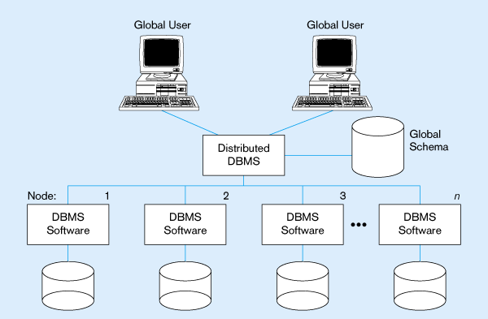
Homogeneous Database
Identical DBMSs

Slide 38
Features of Heterogeneous DDBMS
Sites may run different DBMS products, with possibly different underlying data models.
Occurs when sites have implemented their own databases and integration is considered later.
Translations required to allow for:
Different hardware.
Different DBMS products.
Different hardware and different DBMS products.
Local access is done using the local DBMS and schema
Remote access is done using the global schema

Slide 39
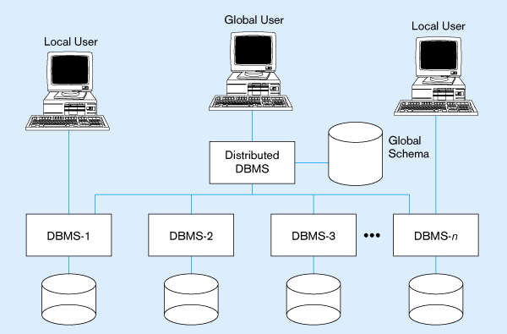
Typical Heterogeneous Environment
Non-identical DBMSs

Slide 40
Distributed DBMS Architecture

Slide 41
ANSI/SPARC Architecture
External View:
which is that of the user, who might be a programmer
basically concerned with how users view the data.
Conceptual View:
that of the enterprise
Internal View:
that of a system or a machine,
deals with the physical definition and organization of data.
Users
External View
Conceptual View
Internal View

Slide 42
Possible ways to put together multiple databases:
Autonomy of Local Systems
Refers to distribution of control.
Indicates degree of independence of individual databases.
Alternatives to Autonomy
Tight Integration
Single image of entire db, is available for any user who wants to share the info, which may reside in multiple db.
Semi-Autonomous Systems
Consists of DBMSs that can operate independently, but have decided to participate in a group.
Total Isolation
Stand Alone DBMs

Slide 43
DISTRIBUTED DBMSs Architecture
Distributions refers to the distributions of data. Of course, we are considering the physical distribution of data over multiple sites; the user sees the data as one logical pool.
Three alternatives:
Client / Server distribution: Communication duties are shared between the client machines and Servers
Peer-to-Peer distribution (Full distribution): No distinction of client machines versus Servers
Multi-Database System distribution: Non Distributed System

Slide 44
DISTRIBUTED DBMSs Architecture: 1. Client Server Architecture
Client / server distribution:
The Client / Server distribution concentrates data management duties at servers while the clients focus on providing the application environment including the user interface.
The communication duties are shared between the client machines and servers.
Client / server DBMSs represent the first attempt at distributing functionality.

Slide 45
DISTRIBUTED DBMSs Architecture: 1. Client Server Architecture
Client / Server 2 level Architecture:
This provides two-level architecture which make it easier to manage the complexity of modern DBMSs and the complexity of distribution.
The server does most of the data management work (query processing and optimization, transaction management, storage management).
The client is the application and the user interface (management of the data that is cached to the client, management of the transaction locks).

Slide 46
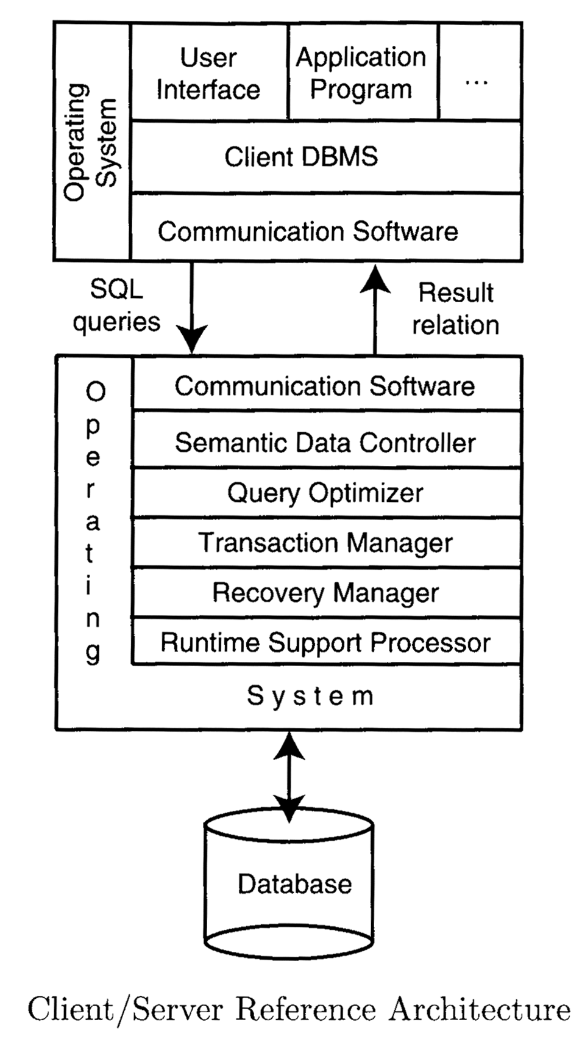
DISTRIBUTED DBMSs Architecture: 1. Client Server Architecture
This architecture is quite common in relational systems where the communication between the clients and the server(s) is at the level of SQL statements.

Slide 47
DISTRIBUTED DBMSs Architecture: 1. Client Server Architecture
Distinguish the functionality and divide these functions into two classes, server functions and client functions.
Server does most of the data management work
query processing
data management
Optimization
Transaction management etc
Client performs
Application
User interface
DBMS Client model
Multiple Client – Multiple Server
Multiple Servers accessed by multiple clients
2 Alternate Management Strategies:
Heavy Client Systems
Each client manages its own connection to the appropriate server.
Simplifies server code
Loads client machines with additional responsibilities
Light Client Systems
Each client knows of only its “home server” which then communicates with other servers as required.
Concentrates on data management functionality at the servers.
Multiple Client - Single Server
Single Server accessed by multiple clients

Slide 48
DISTRIBUTED DBMSs Architecture: 1. Client Server Architecture
Multiple client - single server
From a data management perspective, this is not much different from centralized databases since the database is stored on only one machine (the server) which also hosts the software to manage it.
However, there are some differences from centralized systems in the way transactions are executed and caches are managed.
Multiple client - multiple server
In this case, two alternative management strategies are possible:
Either each client manages its own connection to the appropriate server or each client knows of only its “home server” which then communicates with other servers as required.

Slide 49
DISTRIBUTED DBMSs Architecture: 2. Peer-to-Peer Architecture
Schemas Present: The physical data organization on each machine may be different.
Individual internal schema definition at each site, local internal schema.
Local organization of data at each site is describe in the local conceptual schema.
Enterprise view of data is described the global conceptual schema.
User applications and user access to the database is supported by external schemas.
Local conceptual schemas are mappings of the global schema onto each site.
Databases are typically designed in a top-down fashion, and, therefore all external view definitions are made globally.
Major Components of a Peer-to-Peer System
User Processor
Data processor

Slide 50
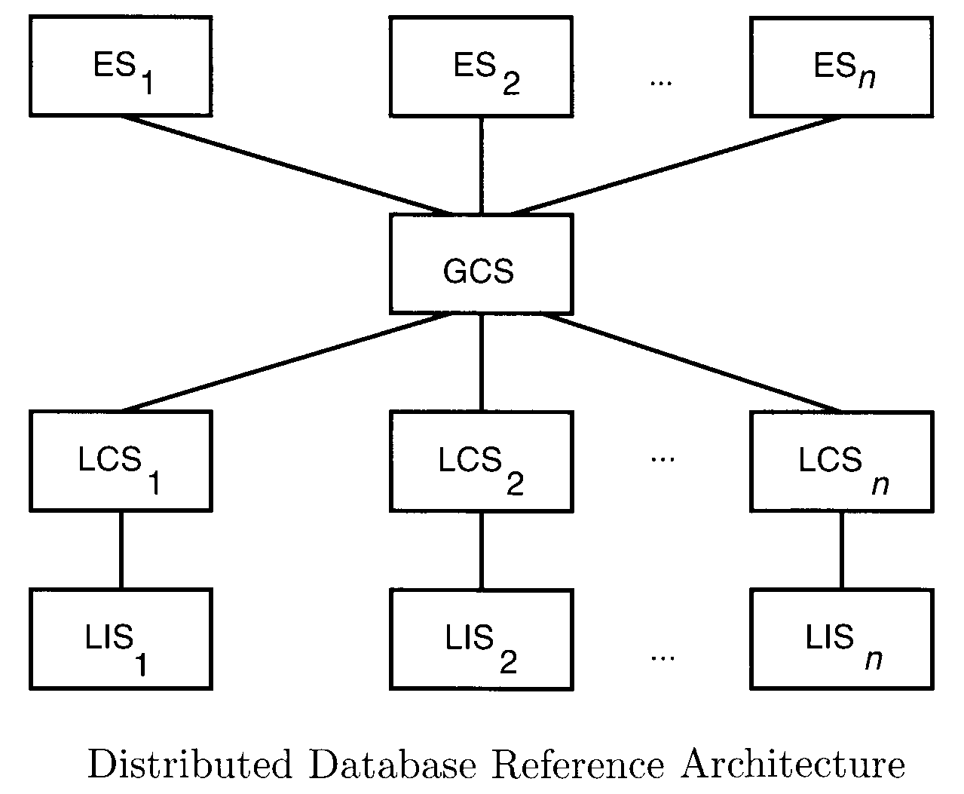
DISTRIBUTED DBMSs Architecture: 2. Peer-to-Peer Architecture

Slide 51
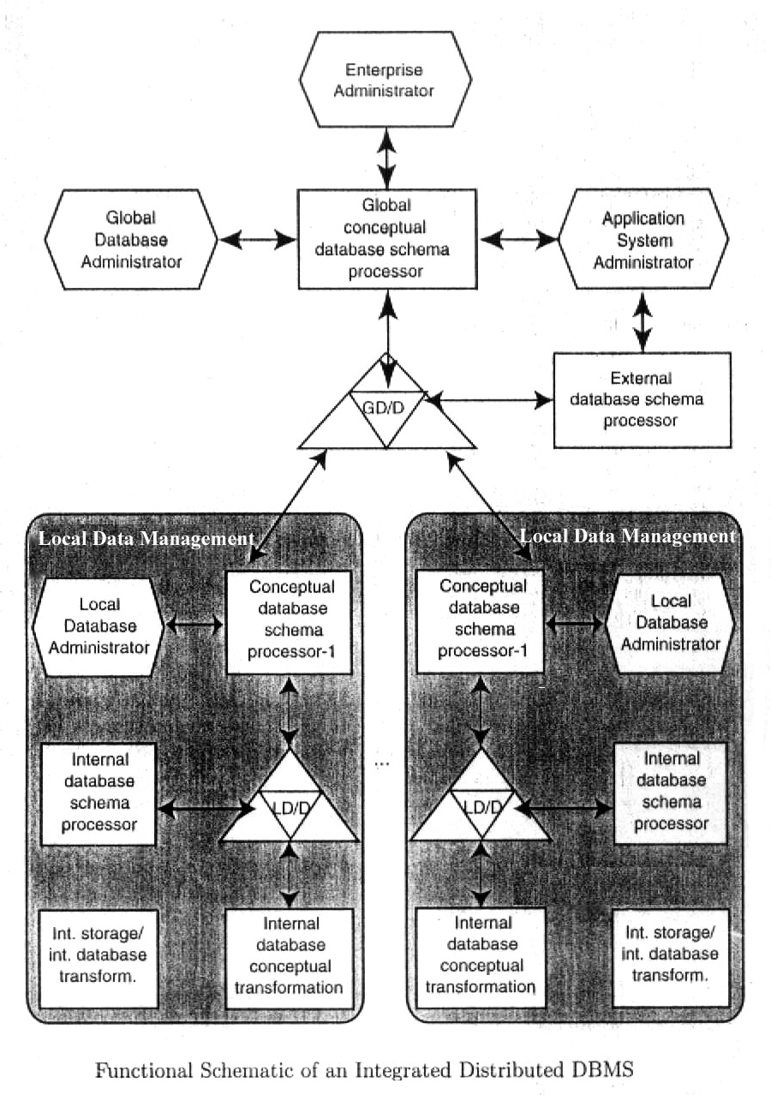
DISTRIBUTED DBMSs Architecture: 2. Peer-to-Peer Architecture
In these case, the ANSI/SPARC model is extended by the addition of global directory / dictionary (GD/D) to permits the required global mappings. The local mappings are still performed by local directory / dictionary (LD/D). The local database management components are integrated by means of global DBMS functions. Local conceptual schemas are mappings of global schema onto each site.

Slide 52
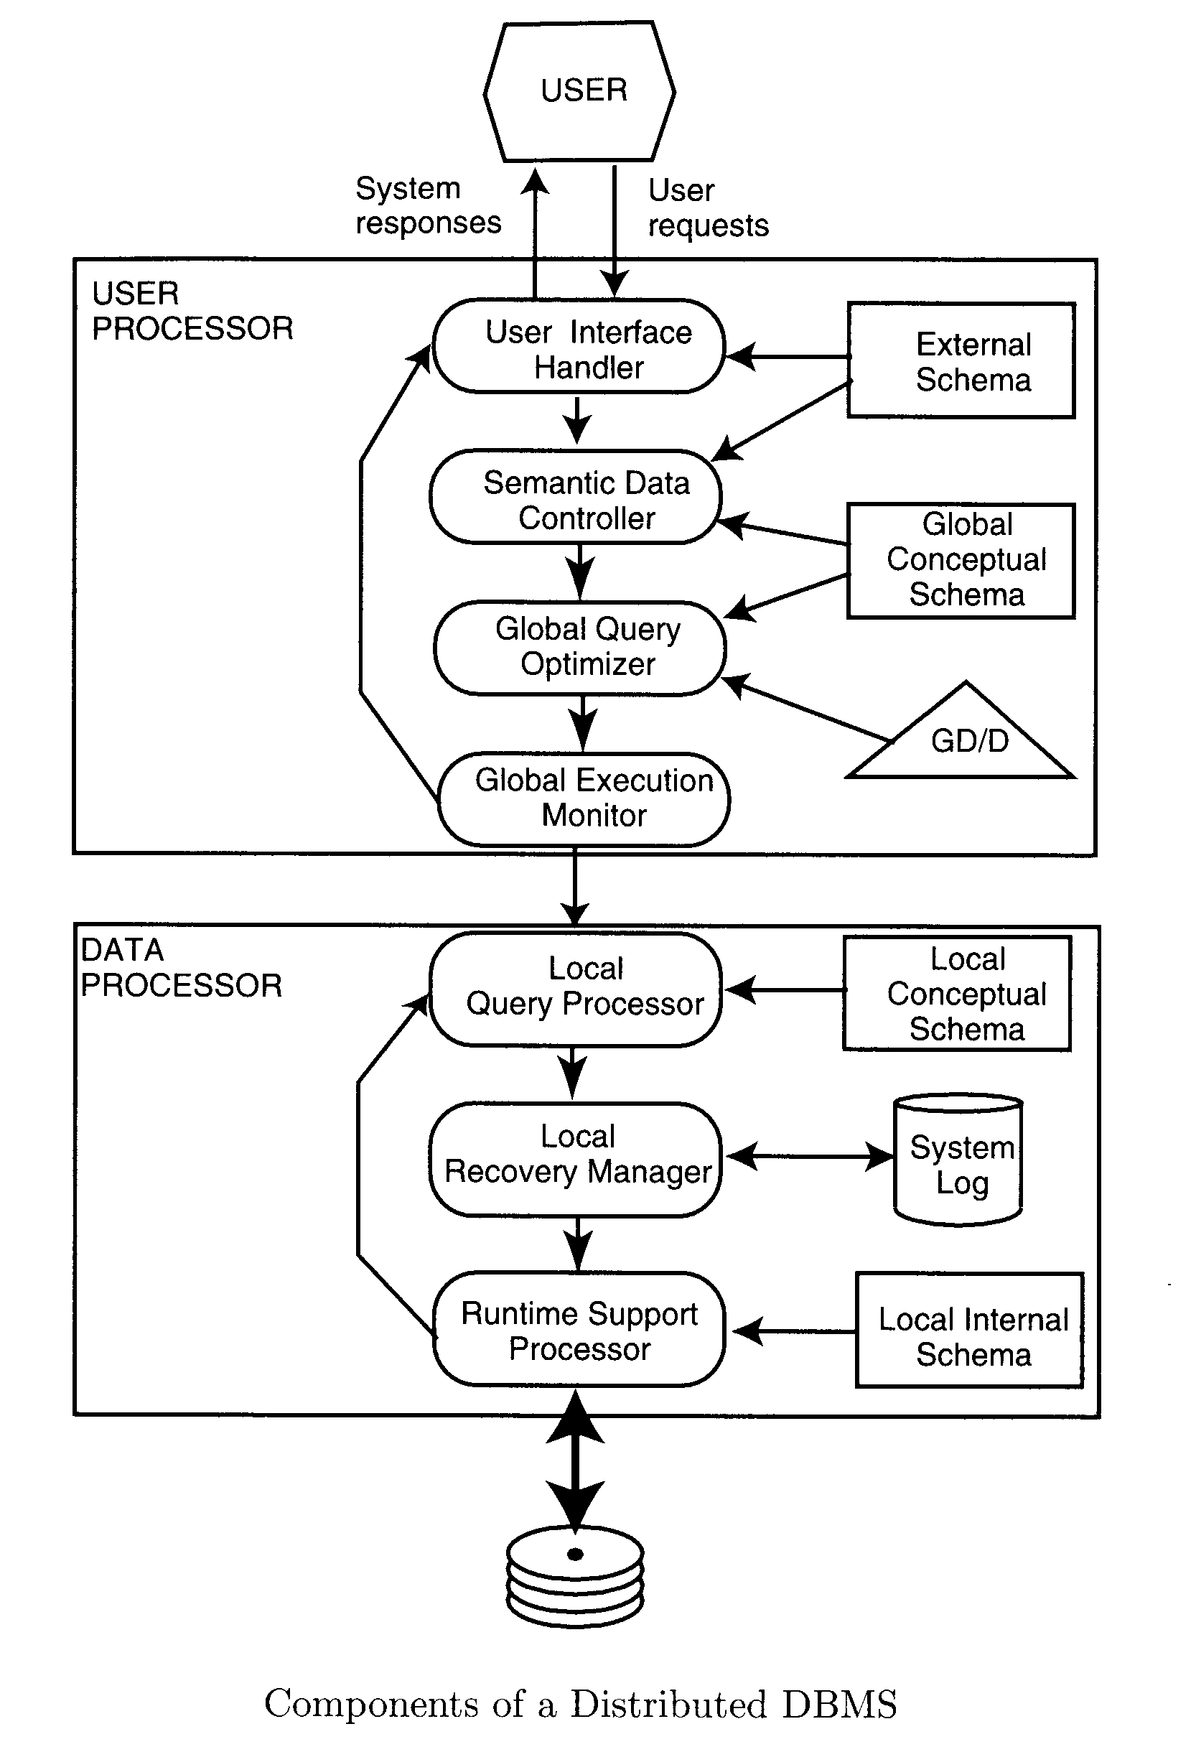
DISTRIBUTED DBMSs Architecture: 2. Peer-to-Peer Architecture
The detailed components of a distributed DBMS. Two major components: User processor & Data processor

Slide 53
DISTRIBUTED DBMSs Architecture: 2. Peer-to-Peer Architecture
User Processor
User-interface handler: responsible for interpreting user commands, and formatting the result data.
Semantic data controller: uses the integrity constraints and authorizations that are defined as part of the global conceptual schema to check if the user query can be processed.
Global Query optimizer and decomposer: determines an execution strategy to minimize a cost function and translates global queries into local one.
Global Execution Monitor: Coordinates the distributed execution of the user request.
Data processor
Local query optimizer: Acts as the access path selector. Responsible for choosing the best access path
Local Recovery Manager: Makes sure local database remains consistent.
Run-time support processor
physically accesses the database according to the physical commands in the schedule generated by the query optimizer.
Is the interface to the operating system and contains the database buffer
Responsible for maintaining the main memory buffers and managing the data access.

Slide 54
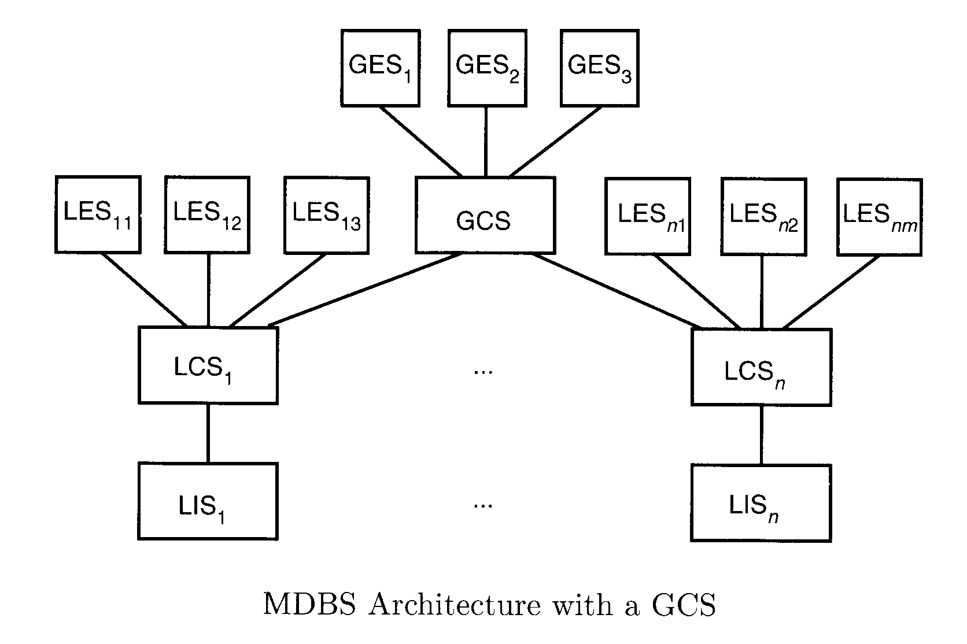
DISTRIBUTED DBMSs Architecture: 3. MDBS Architecture- Model using GCS
GCS is defined by integrating either the external schemas of local autonomous databases or parts of their local conceptual schema.
Users of a local DBMS define their own views on the local database.
If heterogeneity exists in the system, then two implementation alternatives exist: Unilingual and Multilingual

Slide 55
DISTRIBUTED DBMSs Architecture: 3. MDBS Architecture- Model using GCS
A unilingual multi-DBMS requires the users to utilize possibly different data models and languages when both a local database and the global database are accessed.
Any application that accesses data from multiple databases must do so by means of an external view that is defined on the global conceptual schema.
One application may have a local external schema (LES) defined on the local conceptual schema as well as a global external schema (GES) defined on the global conceptual schema.
GCS in multi-DBMS
Mapping is from local conceptual schema to a global schema. Bottom-up design

Slide 56
DISTRIBUTED DBMSs Architecture: 3. MDBS Architecture- Model using GCS
Another alternative is multilingual architecture, where the basic philosophy is to permit each user to access the global database by means of an external schema, defined using the language of the user’s local DBMS.
The multilingual approach obviously makes querying the databases easier from the user’s perspective. However, it is more complicated because we must deal with translation of queries at run time.
GCS in Logically integrated distributed DBMS
Mapping is from global schema to local conceptual schema. Top-down procedure

Slide 57
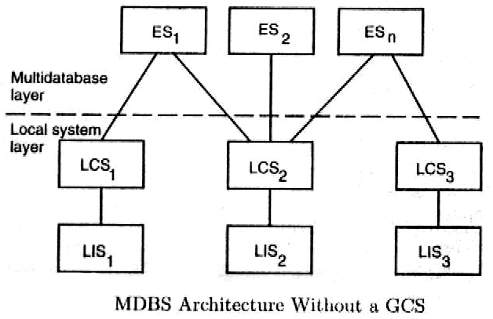
DISTRIBUTED DBMSs Architecture: 3. MDBS Architecture- Model without GCS

Slide 58
DISTRIBUTED DBMSs Architecture: 3. MDBS Architecture- Model without GCS
The architecture identifies two layers: the local system layer and the multi-database layer on top of it.
The local system layer consists of a number of DBMSs, which present to the multi-database layer the part of their local database they are willing to share with users of the other databases. This shared data is presented either as the actual local conceptual schema or as a local external schema definition.
The multi-database layer consist of a number of external views, which are constructed where each view may be defined on one local conceptual schema or on multiple conceptual schemas. Thus the responsibility of providing access to multiple databases is delegated to the mapping between the external schemas and the local conceptual schemas.

Slide 59
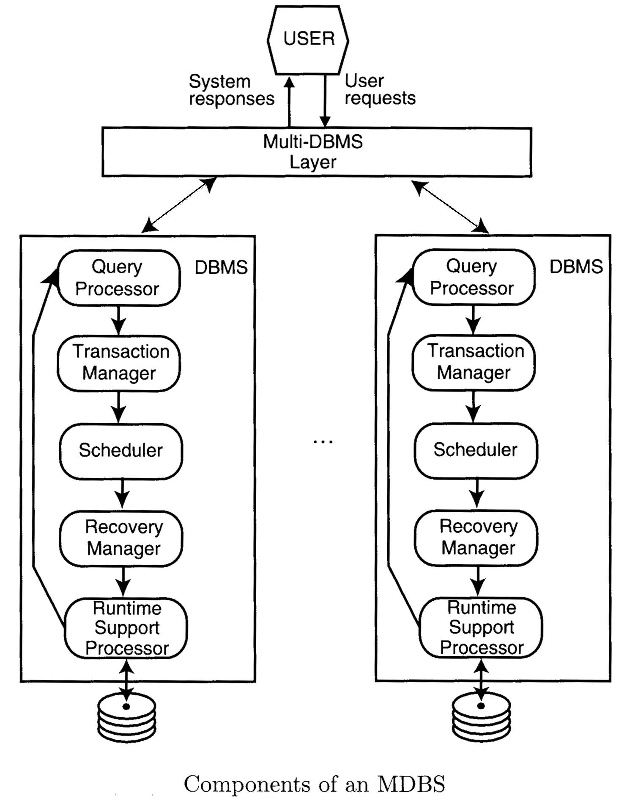
DISTRIBUTED DBMSs Architecture: 3. MDBS Architecture- Model without GCS
The MDBS provides a layer of software that runs on top of these individual DBMSs and provides users with the facilities of accessing various databases.
Fig. represents a non-distributed multi-DBMS. If the system is distributed, we would need to replicate the multi-database layer to each site where there is a local DBMS that participates in the system.

Slide 60
Assignment Question from Chapter 1
What is Distributed Database System? Different Features, Its advantages and Dis advantages of DDBS.
Explain Peer-to-Peer Distributed DBMSs Architecture in detail?

Slide 61
Thank You

