Slide 1
Chapter 2
Distributed Database Design
By: Safa Hamdare

Slide 2
Outline:
Distributed Database Design Concept
Objective of Data Distribution
Data Fragmentation
Allocation of Fragment
Transparencies in Distributed Database Design

Slide 3
Distributed Database Design Concept
Dimensions of the Problem
Distributed Design: Top Down & Bottom Up
Distributed Design Strategies

Slide 4
Dimensions of the Problem
Access pattern behavior
dynamic
static
Partial
information
data
Level of knowledge
data +
program
Complete
information
Level of sharing

Slide 5
Organization of Distributed systems
Three Orthogonal Dimensions:
Level of sharing
No sharing, each application and data execute at one site
Data sharing, all the programs are replicated at other sites but not the data.
Data-plus-program sharing, both data and program can be shared
Behavior of access patterns
Static
Does not change over time
Very easy to manage
Dynamic
Most of the real life applications are dynamic
Level of knowledge on access pattern behavior.
No information
Complete information
Access patterns can be reasonably predicted
No deviations from predictions
Partial information
Deviations from predictions

Slide 6
Distribution Design
Top-down
mostly in designing systems from scratch
mostly in homogeneous systems
Bottom-up
when the databases already exist at a number of sites
The databases should be connected to solve common task

Slide 7
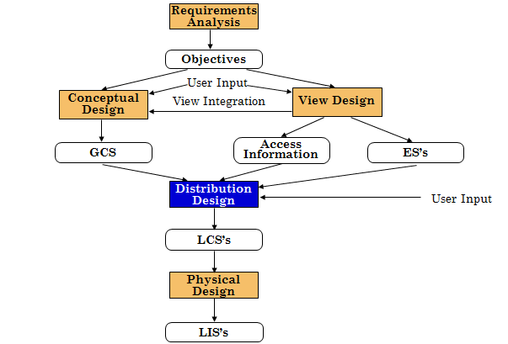
Top-Down Design

Slide 8
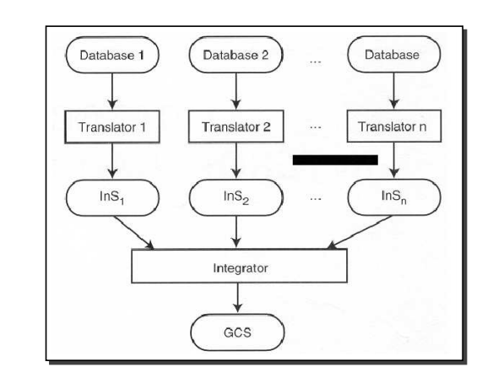
Bottom-Up Design

Slide 9
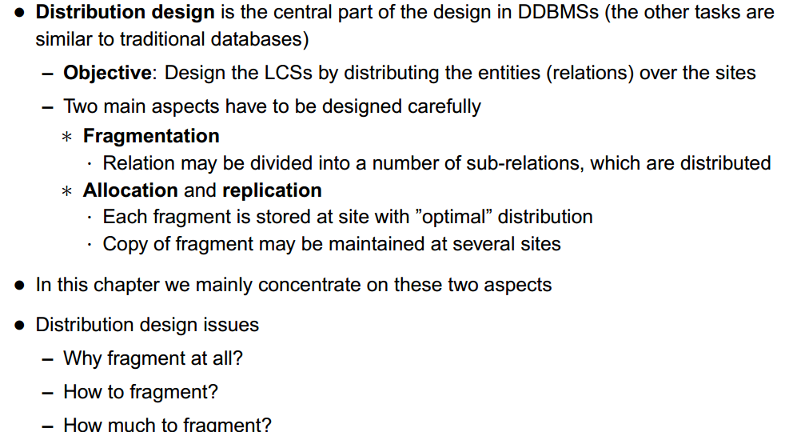
Distributed Design Strategies:

Slide 10
Distributed Database Design Issues
Fragmentation
Allocation
Replication

Slide 11
Distributed Database Design
Three key issues:
Fragmentation
Allocation
Replication

Slide 12
Distributed Database Design
Fragmentation
Relation may be divided into a number of sub-relations, which are then distributed.
Allocation
Each fragment is stored at site with “optimal” distribution.
Replication
Copy of fragment may be maintained at several sites.

Slide 13
Fragmentation
Definition and allocation of fragments carried out strategically to achieve:
Locality of Reference
Improved Reliability and Availability
Improved Performance
Balanced Storage Capacities and Costs
Minimal Communication Costs.
Involves analyzing most important applications, based on quantitative/qualitative information.
Notes:
September 98
28
Chapter Name

Slide 14
Fragmentation
Quantitative information may include:
Frequency with which an application is run;
Site from which an application is run;
Performance criteria for transactions and applications.
Qualitative information may include:
Transactions that are executed by application, type of access (read or write), and predicates of read operations.
Notes:
September 98
29
Chapter Name

Slide 15
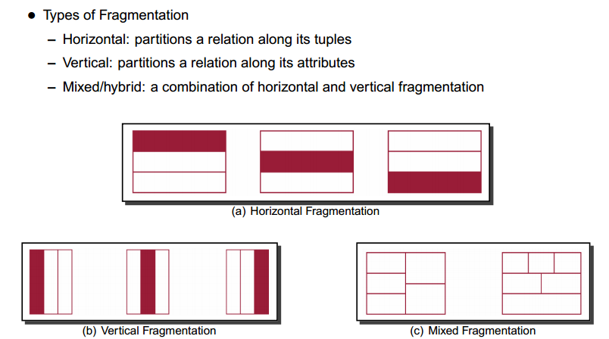
Types of Fragmentation

Slide 16
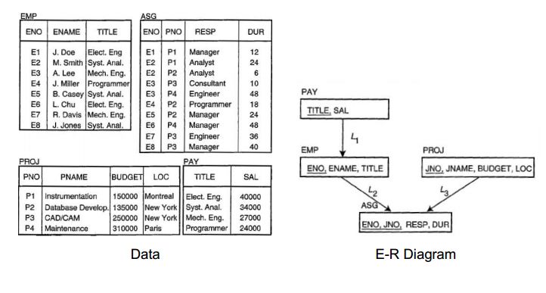
Example: Employee-Project

Slide 17
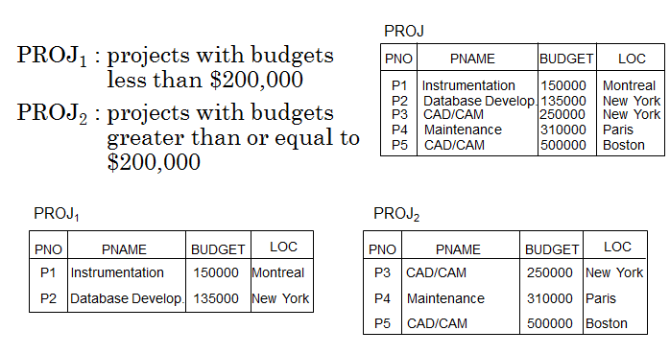
Horizontal Fragmentation

Slide 18
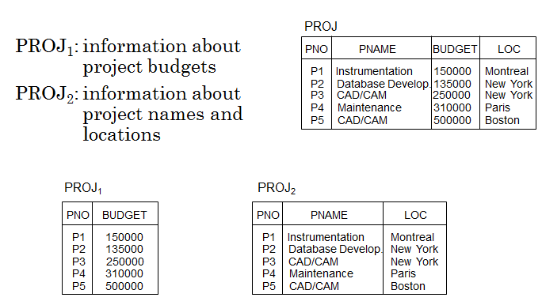
Vertical Fragmentation

Slide 19
Degree of Fragmentation
Finite number of alternatives
tuples
Relations
or
attributes
Finding the suitable level of partitioning within this range

Slide 20
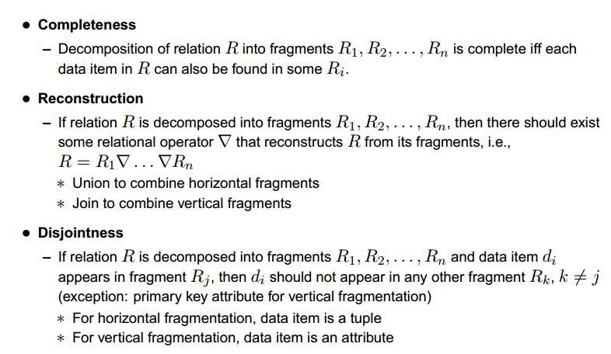
Correctness of Fragmentation

Slide 21
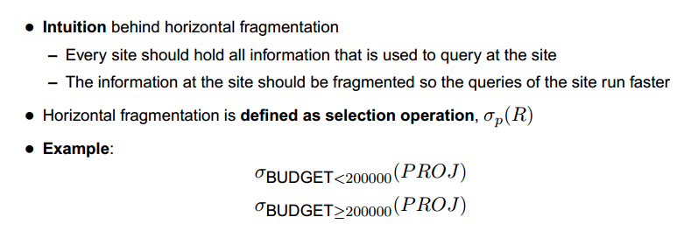
Horizontal Fragmentation

Slide 22
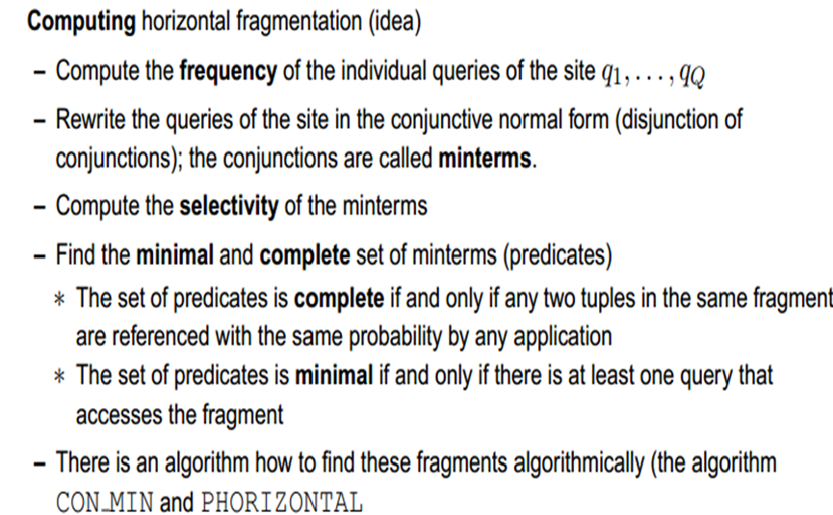
Horizontal Fragmentation

Slide 23
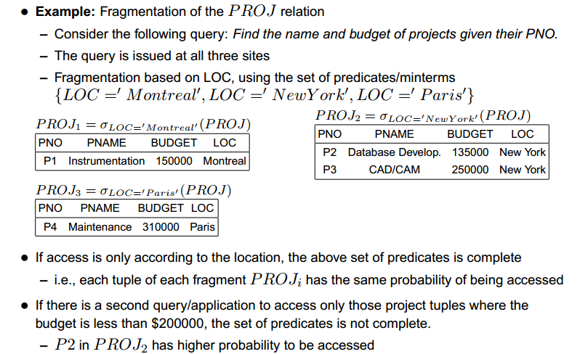
Horizontal Fragmentation

Slide 24
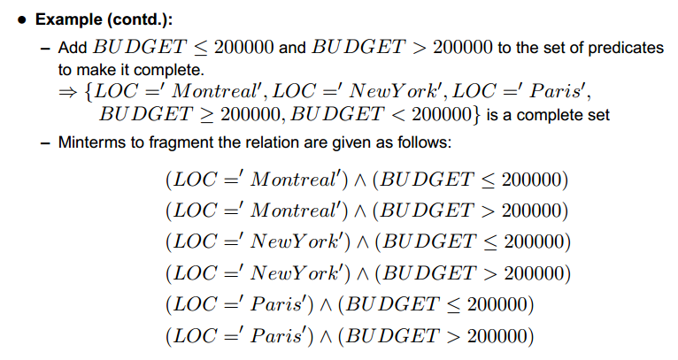
Horizontal Fragmentation

Slide 25
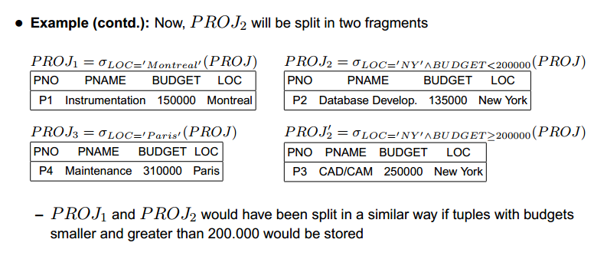
Horizontal Fragmentation

Slide 26
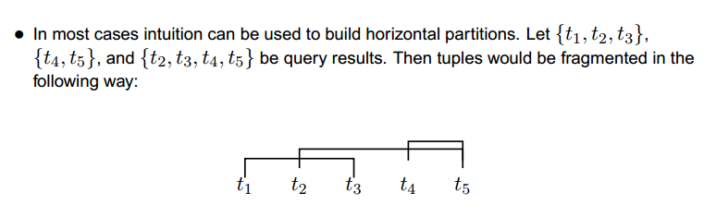
Horizontal Fragmentation

Slide 27
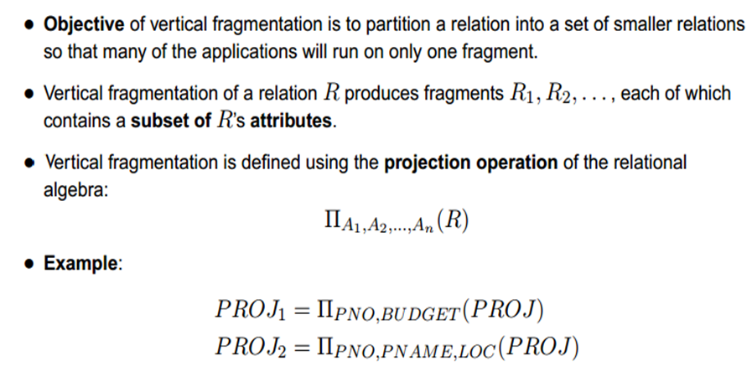
Vertical Fragmentation

Slide 28
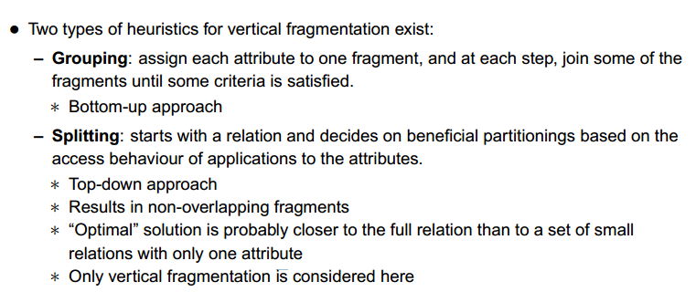
Vertical Fragmentation

Slide 29
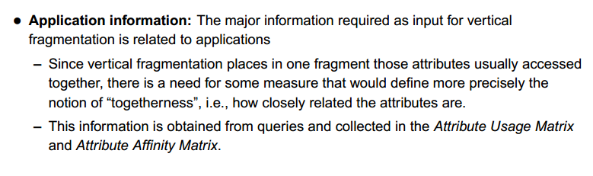
Vertical Fragmentation

Slide 30
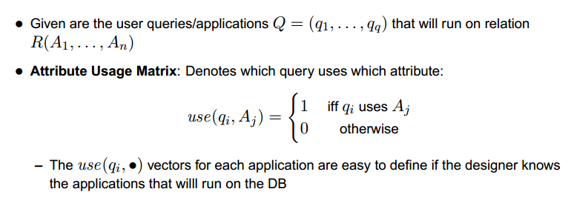
Vertical Fragmentation

Slide 31
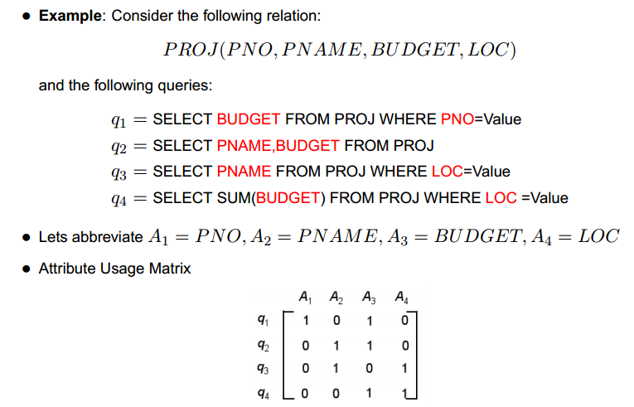
Vertical Fragmentation

Slide 32
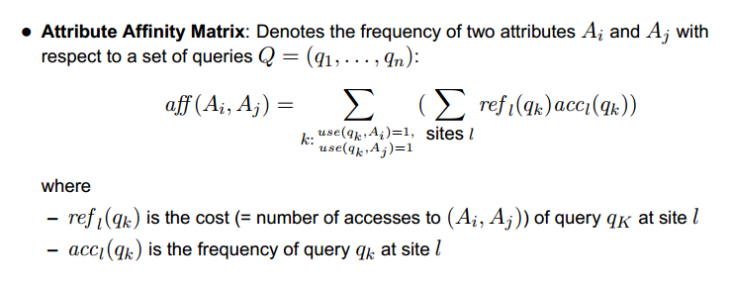
Vertical Fragmentation

Slide 33
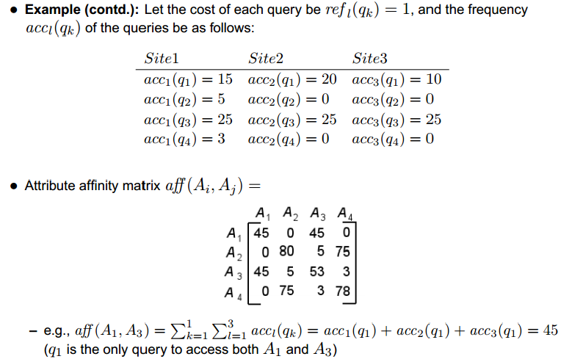
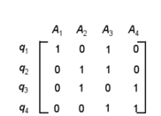
Vertical Fragmentation
Sum of Query
45
5
75
3

Slide 34
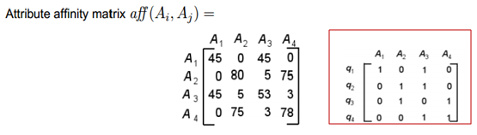
How to get the Attribute Affinity Matrix:
(A1, A1)= accessed only by q1= 45
(A1, A2)= accessed by none of the queries=0
(A2, A1)= accessed by none of the queries=0
(A1, A3)= accessed only by q1= 45
(A1, A4)= accessed by none of the queries=0
(A2, A2)= accessed by queries q2 and q3=75+5=80
(A3, A3)= accessed by queries q1, q2, and q4=45+5+3=53
(A4, A4)= accessed by queries q3 and q4=75+3=78

Slide 35
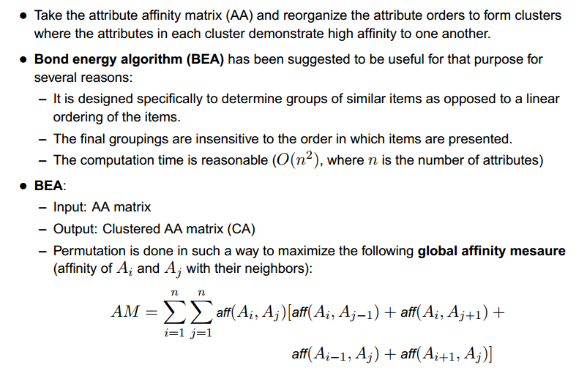
Vertical Fragmentation

Slide 36
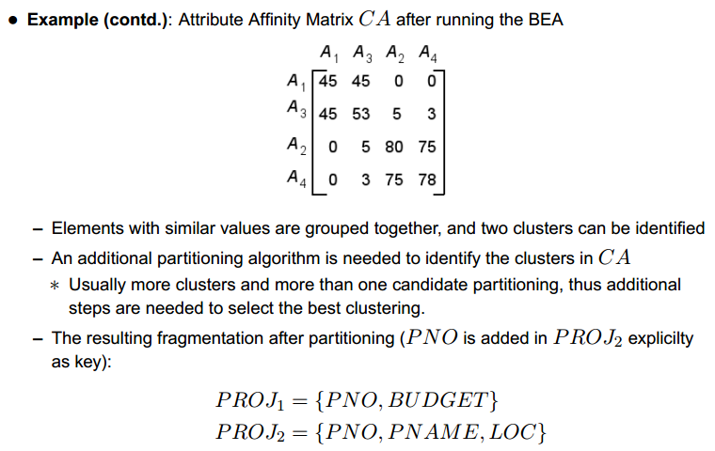
Vertical Fragmentation

Slide 37
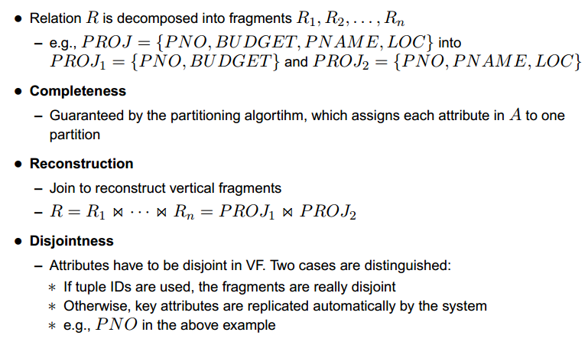
Correctness of Vertical Fragmentation

Slide 38
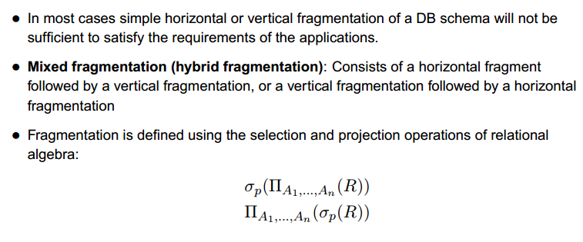
Mixed Fragmentation

Slide 39
Examples to Solve: (Horizontal Fragmentation)
EmpID | Name | Loc | Sal | DOB | Dept
E001 | Joe | LA | 25,000 | 2/6/43 | Maintenance
E002 | Larry | New York | 35,200 | 12/3/52 | Payroll
E003 | Moe | LA | 43,000 | 7/12/56 | Maintenance
E004 | Sam | New York | 53,500 | 8/30/47 | Production
E005 | Steve | UK | 67,000 | 5/14/78 | Management
E006 | Jack | New York | 55,000 | 5/30/67 | Production
E007 | Saeed | UK | 34,000 | 4/27/59 | Management
Application 1: Queries EMP Table looking for those employees who work in Los Angeles(LA). The set “Pr={P1:Loc=“LA”}” shows all the required simple predicates used by AP1. therefore, the set “M={m1: Loc=“LA”, m2: Loc<> “LA”}” is a minimal and Complete set of min-term predicates for AP1. Also in addition AP1 should exclude employees whose salary is less than or equal to 30000.

Slide 40
Examples to Solve: (Horizontal Fragmentation)
Fragment F1: Create table LA_EMPS as (Select * from EMP where Loc=“LA”);
Fragment F2: Create table Non_LA_EMPS as (Select * from EMP where Loc<>“LA”);
EmpID | Name | Loc | Sal | DOB | Dept
E001 | Joe | LA | 25,000 | 2/6/43 | Maintenance
E003 | Moe | LA | 43,000 | 7/12/56 | Maintenance
EmpID | Name | Loc | Sal | DOB | Dept
E002 | Larry | New York | 35,200 | 12/3/52 | Payroll
E004 | Sam | New York | 53,500 | 8/30/47 | Production
E005 | Steve | UK | 67,000 | 5/14/78 | Management
E006 | Jack | New York | 55,000 | 5/30/67 | Production
E007 | Saeed | UK | 34,000 | 4/27/59 | Management
This Set is complete and minimal, but after including the condition stated in next half of the AP1, the set is no longer minimal and complete.

Slide 41
Examples to Solve: (Horizontal Fragmentation)
This Additional check would mean that rows in F1 would be accessed by AP1 differently depending upon the salary of each employee having “<30000”.
Applying the minimal rule, we would need to further fragment the Emp table fragments.
This new simple predicates for AP1 would require changing Pr and M to the following:
Pr= { P1: Loc=“LA”, P2: Salary >30000}
M= {m1: Loc=“LA” ^ Sal>30000,
m2: Loc=“LA” ^ Sal<=30000,
m3: Loc<>“LA” ^ Sal>30000,
m4: Loc<>“LA” ^ Sal<=30000}

Slide 42
Final Fragments (HF)
LA-EMPS1 {LA with Sal>30000}
EmpID | Name | Loc | Sal | DOB | Dept
E003 | Moe | LA | 43,000 | 7/12/56 | Maintenance
LA-EMPS2 {LA with Sal<=30000}
EmpID | Name | Loc | Sal | DOB | Dept
E001 | Joe | LA | 25,000 | 2/6/43 | Maintenance
Non_LA-EMPS2 {Non LA with Sal>30000}
EmpID | Name | Loc | Sal | DOB | Dept
E002 | Larry | New York | 35,200 | 12/3/52 | Payroll
E004 | Sam | New York | 53,500 | 8/30/47 | Production
E005 | Steve | UK | 67,000 | 5/14/78 | Management
E006 | Jack | New York | 55,000 | 5/30/67 | Production
E007 | Saeed | UK | 34,000 | 4/27/59 | Management

Slide 43
Examples to Solve: (Horizontal Fragmentation)
Hint to Find Min-terms Combination: (3 predicates make use of 2³=8 combinations)
P1: Loc=“NY”
P2: Loc=“UK”
P3: Loc=“LA”
Possible combination of Min-Terms:
M1={Loc=<> “NY” ^ Loc=<> “UK”^ Loc=<> “LA”}
M2={Loc=<> “NY” ^ Loc=<> “UK”^ Loc=“LA”}
M3={Loc=<> “NY” ^ Loc= “UK”^ Loc=<> “LA”}
M4={Loc=<> “NY” ^ Loc=“UK”^ Loc= “LA”}
M5={Loc=“NY” ^ Loc=<> “UK”^ Loc=<> “LA”}
M6={Loc=“NY” ^ Loc=<> “UK”^Loc=“LA”}
M7={Loc=“NY” ^ Loc=“UK”^Loc=<> “LA”}
M8={Loc=“NY” ^ Loc=“UK”^Loc= “LA”}
So acceptable combinations are M2, M3 and M5 for which we need to make fragments.
M | P1 | P2 | P3
M1 | 0 | 0 | 0
M2 | 0 | 0 | 1
M3 | 0 | 1 | 0
M4 | 0 | 1 | 1
M5 | 1 | 0 | 0
M6 | 1 | 0 | 1
M7 | 1 | 1 | 0
M8 | 1 | 1 | 1

Slide 44
Assignment Question on Horizontal Fragmentation:
Given the relation Project perform horizontal Fragmentation given the Application 1 as Queries Project Table looking for those projects which are located work in NY and UK. The set “Pr= {P1: Loc=“NY”, P2: Loc=“UK”}” shows all the required simple predicates used by AP1. Therefore the min terms set is: M= {m1: Loc=“NY”, m2: Loc<> “NY”, m3: Loc=“UK”, m4: Loc<> “UK”, m5= “<=30000”, m6= “>30000”}”. Provide all possible combinations to get a minimal and complete set of min-term predicates for AP1. Also in addition AP1 should include Projects whose funds is less than or equal to 30000 i.e “Pr= {P3: Funds= “<=30000”}”.
Hint to Find Min-terms Combination: (3 predicates make use of 2³=8 combinations)
PNo | PName | Funds | Dno | Loc
P1 | Requirements | 235,000 | D002 | NY
P2 | Design | 410,000 | D003 | NY
P3 | Code | 300,000 | D001 | UK
P4 | Testing | 350,000 | D001 | UK

Slide 45
Examples to Solve: (Vertical Fragmentation)
EmpID | Name | Sal | Dept
E001 | Joe | 25,000 | Maintenance
E002 | Larry | 35,200 | Payroll
E003 | Moe | 43,000 | Maintenance
E004 | Sam | 53,500 | Production
E005 | Steve | 67,000 | Management
E006 | Jack | 55,000 | Production
E007 | Saeed | 34,000 | Management
Application 1: Above is the relation with set of queries as Follows:
Q1= Select Empid from Emp where dept=“Maintenance”;
Q2=Select Name from Emp where Sal>30000;
Q3= Select Sal from Emp where EmpID>‘E005’;
Q4= Select Empid where Sal<=30000 and dept=“Maintenance”;
Find Attribute Usage Matrix and Attribute affinity Matrix, and state the possible fragments using Bond Energy Algorithm.

Slide 46
Examples to Solve: (Vertical Fragmentation)
Application Access Frequency at different sites given as follows:
Attribute Usage Matrix:
 | A1 | A2 | A3 | A4
Q1 | 1 | 0 | 0 | 1
Q2 | 0 | 1 | 1 | 0
Q3 | 0 | 1 | 1 | 0
Q4 | 1 | 0 | 1 | 1
 | S1 | S2 | S3 | Sum
Q1 | 10 | 20 | 0 | 30
Q2 | 5 | 0 | 10 | 15
Q3 | 0 | 35 | 5 | 40
Q4 | 0 | 10 | 0 | 10
Attribute Affinity Matrix:
Clustered Attribute Affinity Matrix:
 | A1 | A2 | A3 | A4
A1 | 40 | 0 | 10 | 40
A2 | 0 | 55 | 55 | 0
A3 | 10 | 55 | 65 | 10
A4 | 40 | 0 | 10 | 40
 | A1 | A4 | A2 | A3
A1 | 40 | 40 | 0 | 10
A4 | 40 | 40 | 0 | 10
A2 | 0 | 0 | 55 | 55
A3 | 10 | 10 | 55 | 65

Slide 47
Examples to Solve: (Vertical Fragmentation)
Based on Bond Energy Algorithm (BEA) we achieve the Clustered Attribute Affinity Matrix:
This shows that A1 and A4 have higher affinity of being together and A2 and A3 are most likely to appear together.
So the vertical fragmentation are as follows:
Emp1: {EmpId, Dept}
Emp2: {EmpId, Name, Sal}

Slide 48
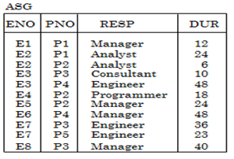
Assignment Question on Vertical Fragmentation:
For the following relation Asg:
Given is the set of queries as Follows
Q1= Select PNO from ASG where Dur>24;
Q2=Select ENo from ASG where Resp=”Engineer”;
Q3= Select Resp from ASG where ENO in (E1, E2, E3, E4, E5);
Q4= Select ENO, PNO from ASG where Dur<24;
Find Attribute Usage Matrix and Attribute affinity Matrix, and state the possible fragments using Bond Energy Algorithm.
Given- Application Access Frequency at different sites given as follows:
 | S1 | S2 | S3 | Sum
Q1 | 10 | 20 | 0 | 30
Q2 | 5 | 0 | 10 | 15
Q3 | 0 | 35 | 5 | 40
Q4 | 0 | 10 | 0 | 10

Slide 49
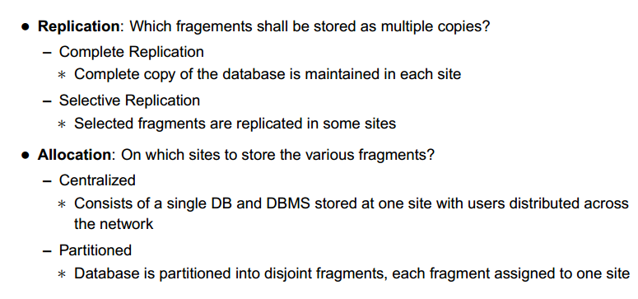
Replication & Allocation

Slide 50
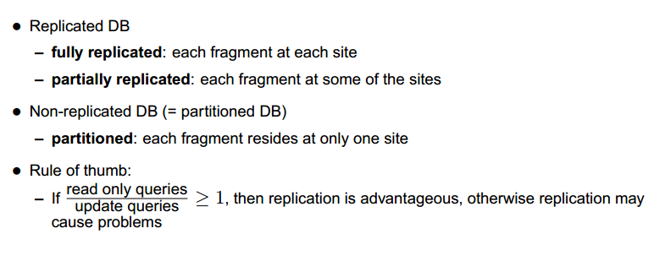
Replication & Allocation

Slide 51
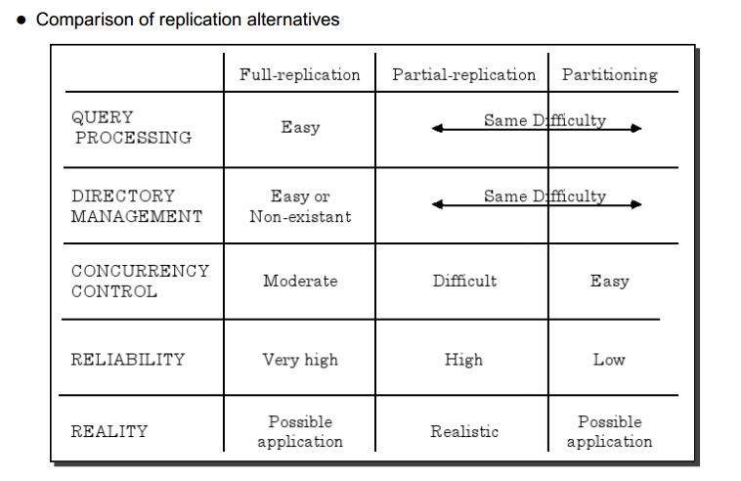
Replication Alternatives

Slide 52
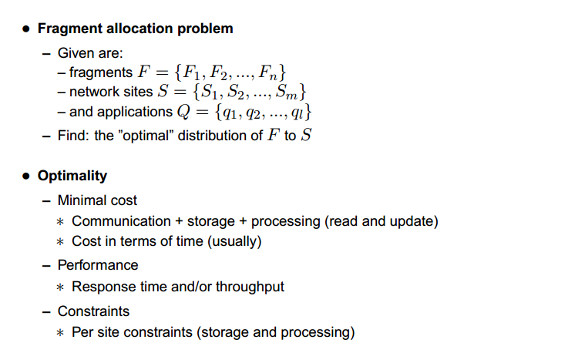
Fragment Allocation

Slide 53
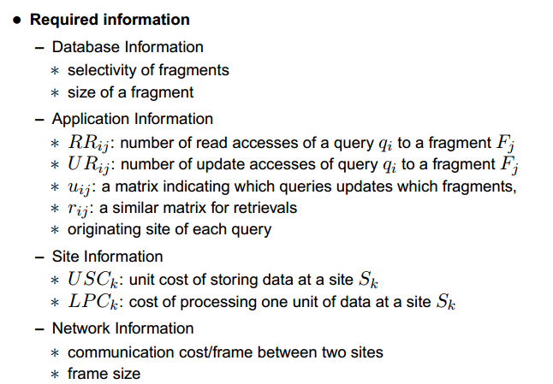
Fragment Allocation

Slide 54
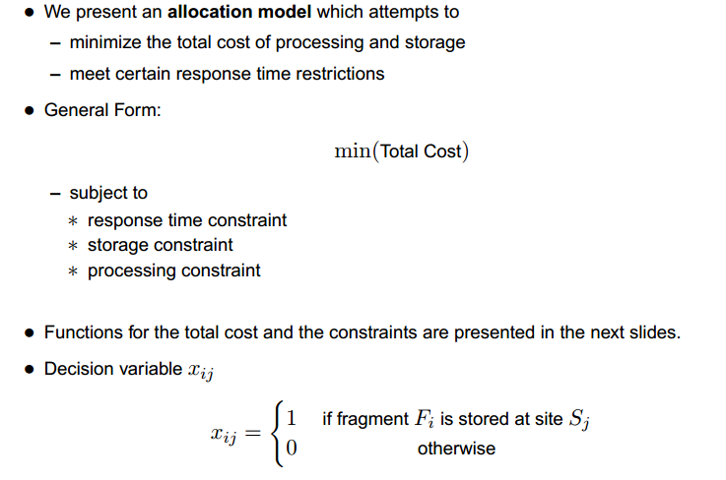
Fragment Allocation

Slide 55
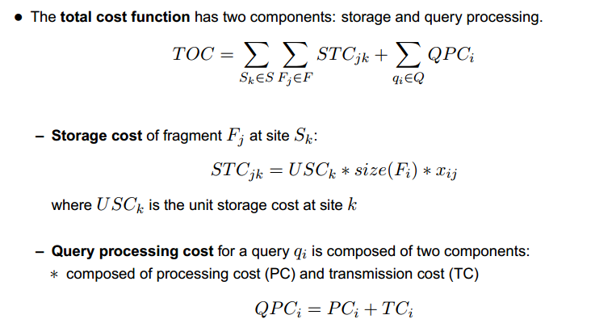
Fragment Allocation

Slide 56
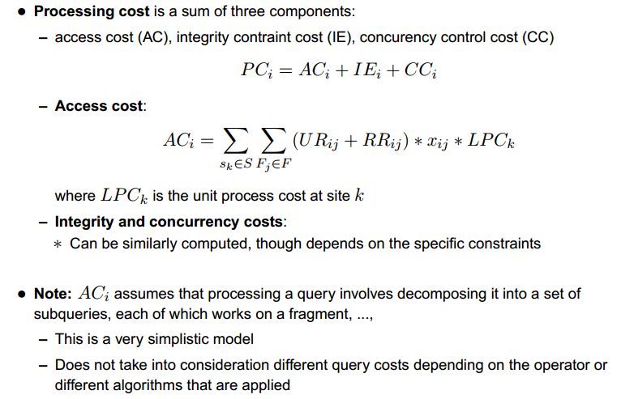
Fragment Allocation

Slide 57
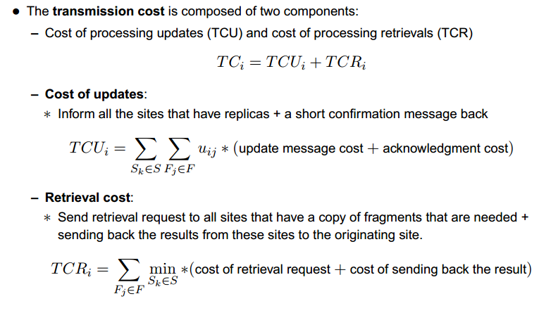
Fragment Allocation

Slide 58
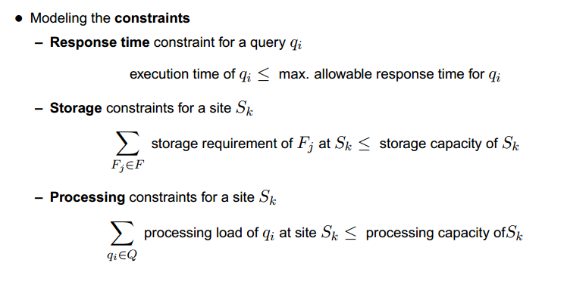
Fragment Allocation

Slide 59
Transparency in Distributed Database Design
Distribution Transparency
Transaction Transparency
Performance Transparency
DBMS Transparency

Slide 60
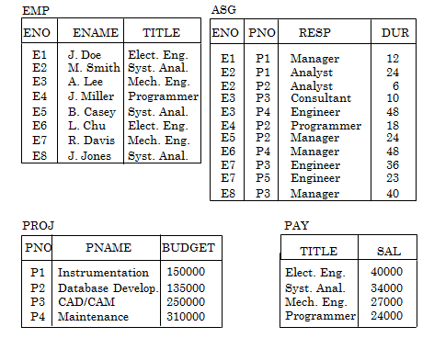
Example:

Slide 61
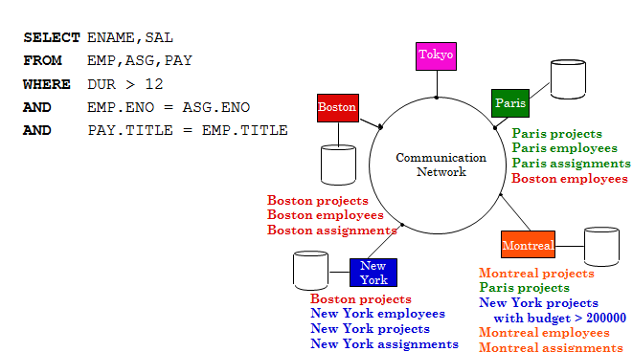
Transparent Access

Slide 62
Transparencies in Distribute Database Design:
Transparency refers to the separation of the higher level semantics of a system from the lower level implementation issues.
In a distributed system, transparency hides the implementation details from users of the system.
User believes that he or she is working with a centralized database system and that all complexities of a distributed database are either hidden or transparent to the user.
A Distributed DBMS may have various levels of transparency. It is categorized as:
Distribution Transparency
Transaction Transparency
Performance Transparency
DBMS Transparency

Slide 63
Data Distribution Transparency
It allows the user to perceive the database as a single, logical entity.
In other words, distribution transparency refers to the degree or extent to which details of Fragmentation (Fragmentation Transparency), Replication (Replication Transparency) and distribution (Location Transparency) are hidden from the users.
Data Distribution Transparency is further categorized as follows:
Fragmentation Transparency
Location Transparency
Replication Transparency
Local Mapping Transparency
Naming Transparency

Slide 64
Fragmentation Transparency
Fragmentation Transparency hides the fact from users that the data are fragmented. This is the highest level of distribution transparency.
If a distributed system has fragmentation transparency, then the user must be not aware of regarding fragmentation of data.
Example: Employee (Emp_id,Emp_name, Designation, Salary, Emp_branch, Project_no) is fragmented and stored on different sites. Therefore to retrieve the names of all employees of branch number 10 from employee relation, the user will write the following SQL Statement:
Select Emp_name from Employee where Emp-branch=10;

Slide 65
Location Transparency
With Location Transparency, the user is aware how the data are fragmented but still does not have any idea regarding the location of the fragment.
To retrieve data from a distributed database with location transparency, the end user has to specify the database fragment names but need not specify where these fragments are located in the distributed system.
Example: Assume that tuples of the above Employee relation is horizontally partitioned into two fragments EMP1 and EMP2 depending on the selection predicates “emp-id=100”and “emp-id>100”. Hence the user is aware that the Employee relation is horizontally fragmented into two relations, but they have no idea in which sites these relations are stored. Thus user write SQL statement as follows “To retrieve all employees of branch number 10”:
Select Emp_name from Emp1 where Emp-branch=10;
Union
Select Emp_name from Emp2 where Emp-branch=10;

Slide 66
Replication Transparency
Replication Transparency means that the user is unaware of the fact that the fragments of relations are replicated and stored in different sites of the distributed system.
Replication Transparency is closely related to location transparency.
Example: Assume that the horizontal fragments EMP1 And EMP2 of the Employee relation are replicated and stored in different sites. In this case if user wants to “Retrieve the names of all employees of branch number 20 whose salary is greater than 50,000” then the SQL statement is written as follows:
Select Emp_name from Emp1 where Emp-branch=20 and Salary>50,000;
Union
Select Emp_name from Emp2 where Emp-branch=20 and Salary>50,000;

Slide 67
Replication Transparency:
Distributed system without replication transparency, considering no. of replicas of fragments EMP1 and EMP2 of employee relation:
Select Emp_name from Copy 1 of Emp1 where Emp-branch=20 and Salary>50,000;
Union
Select Emp_name from Copy 3 of Emp2 Emp1 where Emp-branch=20 and Salary>50,000;
Distributed system with replication transparency which does not exhibit Location Transparency:
Select Emp_name from Emp1 at site 1 where Emp-branch=20 and Salary>50,000;
Union
Select Emp_name from Emp2 at site 3 where Emp-branch=20 and Salary>50,000;

Slide 68
Local Mapping Transparency
Local Mapping Transparency is the lowest level of distribution transparency.
Local Transparency refers that users are aware regarding both fragment names and the location of fragments, taking into account that any replication of the fragments may exist.
For such transparency, user has to explicitly mention both fragment name and the location for data access.
Example: Assume that the horizontal fragments EMP1 And EMP2 of the Employee relation are replicated and stored in different sites. In this case if user wants to “Retrieve the names of all employees of branch number 20 whose salary is greater than 50,000” then the SQL statement is written as follows:
Select Emp_name from Copy 1 of Emp1 at site 1 where Emp-branch=20 and Salary>50,000;
Union
Select Emp_name from Copy 3 of Emp2 at site 3 where Emp-branch=20 and Salary>50,000;

Slide 69
Naming Transparency
Naming Transparency means that the users are not aware of the actual name of the database objects in the system.
Each item in a DDB must have a unique name.
DDBMS must ensure that no two sites create a database object with same name.
One solution is to create central name server. However, this results in:
Loss of some local autonomy;
Central site may become a bottleneck;
Low availability; if the central site fails, remaining sites cannot create any new objects.

Slide 70
Naming Transparency
Alternative Solution - Prefix object with identifier of site that created it.
For Example, Branch Created at site S1 might be named S1.BRANCH.
Also need to identify each fragment and its copies.
Thus, copy 2 of fragment 3 of Branch created at site S1 might be referred to as S1.BRANCH.F3.C2.
However, this results in loss of distribution transparency.

Slide 71
Transaction Transparency
Transaction Transparency in distributed DBMS, ensures that all distributed transactions maintain distributed database’s Integrity and Consistency.
Distributed transaction accesses data stored at more than one location.
Each transaction is divided into number of sub-transactions, one for each site that has to be accessed.
Transaction Transparency ensures that the distributed transaction will be successfully completed only if all sub transactions executing in different sites associated with the transaction are completed successfully.
DDBMS must ensure the indivisibility of both the global transaction and each of the sub-transactions.

Slide 72
Concurrency Transparency
All transactions must execute independently and be logically consistent with results obtained if transactions executed one at a time, in some arbitrary serial order.
Same fundamental principles as for centralized DBMS.
DDBMS must ensure both global and local transactions do not interfere with each other.
Similarly, DDBMS must ensure consistency of all sub-transactions of global transaction.
For Example: If a copy of a replicated data item is updated, then the update must be propagated eventually to all copies.

Slide 73
Failure Transparency
Failure Transparency in a distributed DBMS promises that the System will continue its normal execution in the event of failure and it must maintain the atomicity of the global transaction.
The atomicity of global transaction ensures that sub transactions of global transaction are either all committed or all aborted.
Thus, the distributed DBMS must synchronize the global transaction to ensure that all sub transactions have completed successfully before recording a final commit for the global transaction.

Slide 74
Performance Transparency
Performance Transparency in a distributed DBMS ensures that it performs its task as centralized DBMS.
DDBMS should not suffer any performance degradation due to distributed architecture.
DDBMS should determine most cost-effective strategy to execute a request.
The distributed Query Processor has to take decision regarding the following issues:
To perform a data request as to which fragment to access.
If the fragment is replicated, which copy of the fragment to use.
Which data location should be used to perform a data request?

Slide 75
DBMS Transparency
DBMS Transparency in a distributed environment hides the knowledge that the local DBMSs may be different and is, therefore, only applicable to heterogeneous distributed database.
This also know as Heterogeneity Transparency, Which allows the integration of several different local DBMS (Relational, Network and Hierarchical model) under a common global Schema.
It is responsibility of DDBMS is to translate the data requests from the global Schema to local DBMS schemas to provide DBMS Transparency.

Slide 76
Examples to Solve: (Transparencies)
Assume that the relational scheme:
Employee(EID, EName, Designation, Salary, EBranch, ProjectNo) is Fragmented as follows, these fragments are the first copy created at Site 1 and site 2 :
Emp1:σ Salary>30,000 (Employee)
Emp2:σ Salary<=30,000 (Employee)
Consider an retrieve request is generated in the distributed system to retrieve all employee details where employee salary is between 25,000 to 35,000. Provide SQL Queries for different levels of Transparency such as Fragmentation, Location, Replication and Local Mapping Transparency.

Slide 77
Examples to Solve: (Transparencies)
Assume that the relational scheme:
Employee(EID, EName, Designation, Salary, EBranch, ProjectNo) is Fragmented as follows, these fragments are the first copy created at Site 1 and site 2 :
Emp1:σ Salary>30,000 (Employee)
Emp2:σ Salary<=30,000 (Employee)
Fragmentation Transparency:
Select * from Employee where Salary between 25,000 And 35000;
Location Transparency:
Select * from Emp1 where Salary between 25,000 And 30000
Union
Select * from Emp2 where Salary between 25,000 And 30000;
Replication Transparency:
Select * from Emp1 at site 1 where Salary between 25,000 And 30000
Union
Select * from Emp2 at site 2 where Salary between 25,000 And 30000;

Slide 78
Examples to Solve: (Transparencies)
Assume that the relational scheme:
Employee(EID, EName, Designation, Salary, EBranch, ProjectNo) is Fragmented and allocated to Site 1 and site 2 as follows:
Emp1:σ Salary>30,000 (Employee)
Emp2:σ Salary<=30,000 (Employee)
Local Mapping Transparency:
Select * from copy 1 of Emp1 at site 1 where Salary between 25,000 And 30000
Union
Select * from copy 1 of Emp2 at site 2 where Salary between 25,000 And 30000;

Slide 79
Assignment Question on Transparencies:
Assume that the relational scheme:
Project (Pno, PName, Budget, Loc) is Fragmented as follows, where F1 is the first copy created at Site 1, F2 is the second copy created at Site 2 and F3 is the first copy created at Site 3:
F1:Proj1:σ _{Loc=’NY’} (Employee)
F2:Proj2:σ _{Loc=’UK’} (Employee)
F3:Proj3:σ _{Loc=’INDIA’} (Employee)
Consider a retrieve request is generated in the distributed system to retrieve all project details where budget is greater than equal to 50000. Provide SQL Queries for different levels of Transparency such as Fragmentation, Location, Replication and Local Mapping Transparency.

Slide 80
Thank You

