Slide 1
Chapter 4
Distributed Deadlock & Recovery

Slide 2
Recovery System: Outline
Introduction to Deadlock
Distributed Deadlock Prevention
Distributed Deadlock Avoidance
Distributed Deadlock Detection & Recovery
Two Phase Commit Protocol
Three Phase Commit Protocol

Slide 3
Introduction to Deadlock

Slide 4
Deadlock
A transaction is deadlocked if it is blocked and will remain blocked until there is intervention.
Locking-based CC algorithms may cause deadlocks.
TO-based algorithms that involve waiting may cause deadlocks.
Wait-for graph
  If transaction T_{i} waits for another transaction T_{j} to release a lock on an entity, then T_{i} → T_{j} in WFG.
T_{i}
T_{j}

Slide 5
Local versus Global WFG
Assume T₁ and T₂ run at site 1, T₃ and T₄ run at site 2. Also assume T₃ waits for a lock held by T₄ which waits for a lock held by T₁ which waits for a lock held by T₂ which, in turn, waits for a lock held by T₃.
Local WFG
Site 1
Site 2
T₁
T₄
T₂
T₃
Global WFG
T₁
T₄
T₂
T₃

Slide 6
Deadlock Management
Ignore
  Let the application programmer deal with it, or restart the system
Prevention
  Guaranteeing that deadlocks can never occur in the first place. Check transaction when it is initiated. Requires no run time support.
Avoidance
  Detecting potential deadlocks in advance and taking action to insure that deadlock will not occur. Requires run time support.
Detection and Recovery
  Allowing deadlocks to form and then finding and breaking them. As in the avoidance scheme, this Requires run time support.

Slide 7
Deadlock Management- Prevention
All resources which may be needed by a transaction must be pre-declared.
  The system must guarantee that none of the resources will be needed by an ongoing transaction.
  Resources must only be reserved, but not necessarily allocated a priori
  Unsuitability of the scheme in database environment
  Suitable for systems that have no provisions for undoing processes.
Evaluation:
  Reduced concurrency due to pre-allocation
  Evaluating whether an allocation is safe leads to added overhead.
  Difficult to determine (partial order)
  No transaction rollback or restart is involved.

Slide 8
Deadlock Management- Avoidance
Transactions are not required to request resources a priori.
Transactions are allowed to proceed unless a requested resource is unavailable.
In case of conflict, transactions may be allowed to wait for a fixed time interval.
Order either the data items or the sites and always request locks in that order.
More attractive than prevention in a database environment.

Slide 9
Deadlock Avoidance – 1.Wait-Die
Each transaction Ti is given a timestamp when it starts, denoted ts(Ti)
Suppose Ti requests a lock currently held by Tj
if ts(Ti)< ts(Tj)
then Ti waits for Tj (here ti is older waits for younger tj
else Ti dies (aborts) (younger tj dies)
If Ti dies then it later restarts with the same timestamp
Wait-Die is an Non-Preemptive: As Ti never preempts or blocks Tj
Wait Die always prefers Younger Transaction [As older waits]

Slide 10
Example:
T1
(ts =10)
T2
(ts =20)
T3
(ts =25)
wait
wait?
No.
wait

Slide 11
Algorithm: Wait-Die (Ta and Tb as input)
/* Ta is requested a lock already held by Tb*/
If (ts(Ta) < ts(Tb)) // i.e. Ta :Older and Tb: Younger
  Then
  Ta waits for Tb to finish or abort; //As Ta is older, it waits for Tb
  Else
  Ta Dies; //Because Ta is younger, Ta dies; Ta is reborn later with the same timestamp
  End if;

Slide 12
Example 1:Wait Die- Scenario
Lets assume that transaction Ta arrives at Site K, where it needs to lock data item X. By the time Ta gets to Site K, suppose transaction Tb has already locked X exclusively at that site. When the conflict happens Ta’s age is compared to Tb’s age. The action to be taken depends on which transaction is older and which one is an younger. Keep in mind that even though Ta and Tb have a conflict at site K, Tb might be active at some other site and therefore not be active at Site K.

Slide 13
Example 1:Wait Die- Case 1
Case 1: Ta is older than Tb
Ta
(ts =10)
Tb
(ts =20)
wait
As Ta is older, Ta will wait for Tb to either successfully commit, abort or decide to die.
How does Ta know How long to wait?
  Ta will wait at Site K until the Site receives a message that indicates the termination of Tb either successful or Unsuccessful.

Slide 14
Example 1:Wait Die- Case 2
Case 2: Ta is younger than Tb
Ta
(ts =20)
Tb
(ts =10)
Dies
As Ta is younger, Ta will have to die
How would Ta die?
  Concurrency control at Site K kills Ta and sends a message to all of the sites that Ta has already visited, telling them to also kill Ta. Once Ta has successfully died at all sites, the user is notified.

Slide 15
Deadlock Avoidance – 2.Wound-Wait
Each transaction Ti is given a timestamp when it starts, denoted ts(Ti)
Suppose Ti requests a lock currently held by Tj
If ts(Ti)< ts(Tj)
then Ti wounds Tj (younger yields lock to older)
else Ti waits (younger waits for older)
“Wound”: Tj Rolls back and gives lock to Ti
If Tj dies then later it restarts with the same timestamp
Wound-Wait is a preemptive: As Ti preempts (blocks) Tj if it is younger
Wound Wait always prefers older transactions [As younger is waiting]

Slide 16
Example:
T1
(ts =25)
T2
(ts =20)
T3
(ts =10)
wait
wait?
No.
wait
(Note that timestamps are different than in previous example)

Slide 17
Algorithm: Wound- Wait (Ta and Tb as input)
/* Ta is requested a lock already held by Tb*/
If (ts(Ta) < ts(Tb)) // i.e. Ta :Older and Tb: Younger
  Then
  Ta wounds Tb; //As Ta is older, it wounds Tb to either finish or abort
  Else
  Ta Waits; //Because Ta is younger, Ta Waits;
  End if;

Slide 18
Example 1:Wound- Wait- Scenario
Lets assume that transaction Ta arrives at Site K, where it needs to lock data item X. By the time Ta gets to Site K, suppose transaction Tb has already locked X exclusively at that site. When the conflict happens Ta’s age is compared to Tb’s age. The action to be taken depends on which transaction is older and which one is an younger. Keep in mind that even though Ta and Tb have a conflict at site K, Tb might be active at some other site and therefore not be active at Site K.
Same Scenario is taken

Slide 19
Example 1:Wound-Wait-Case 1
Case 1: Ta is younger than Tb
Ta
(ts =20)
Tb
(ts =10)
wait
As Ta is younger, Ta will wait for Tb to either successfully commit, abort or decide to die.
How does Ta know How long to wait?
  Ta will wait at Site K until the Site receives a message that indicates the termination of Tb either successful or Unsuccessful.

Slide 20
Example 1: Wound-Wait- Case 2
Case 2: Ta is older than Tb
Ta
(ts =10)
Tb
(ts =20)
Tb Dies
As Ta is older, Ta will wound Tb
What happens next depends on where Tb is active?
  There are 3 possible Scenarios:
    Tb is also active at Site K.
    Tb has left Site K and is active at some other site L.
    Tb has left Site K but is waiting (blocked) at some other site say Site N as it needs a resource held by another transaction.

Slide 21
Wound-Wait- Scenario for Wound Rule
There are 3 possible Scenarios:
Tb is also active at Site K- Concurrency Control at Site K will give Tb a wound period of time to finish. If Tb does not finish within the specified period of time, then site K will roll back Tb locally and then broadcast to all the other sites Tb has visited. Each of these sites will roll back Tb locally, Once they receive this message from Site K.
Tb has left Site K and is active at some other site L- As Tb is not active at Site K but it is active at Site L. In this case, the Concurrency Control at Site K broadcasts the fact that Tb has been wounded to all sites.
  When site L receives the wound message, that site carries out the wound rule. If Tb doesn’t finish within the time period specified by the wound process, then site L Kills Tb Locally and broadcasts the wound-rollback message to all other site else sends committed message to all other Sites.

Slide 22
Wound-Wait- Scenario for Wound Rule
There are 3 possible Scenarios:
Tb has left Site K but is waiting (blocked) at some other site say Site N as it needs a resource held by another transaction- This Scenario is same as Scenario 2 but there is just a minor difference. Since Tb is blocked at Site N, Site N will carry out the wound Rule rather than Site L, and there is a very little chance of Tb committing during the wound period.
Note: When a wound message is broadcast for a given transaction, the site at which Tb is active or is blocked has the responsibility of carrying out the wound process.
According to our processing model, Tb cannot be both active at one site and blocked at another site.

Slide 23
Wait Die Vs Wound Wait
It is wiser to give priority to old processes because
  They have run longer so the system have larger investment on these processes.
  They are likely to hold more Resources.
  A young process that is killed off will eventually age until it is the oldest one in the system, and that eliminates starvation.

Slide 24
Wait Die Vs Wound Wait
Sr. No | Wait Die | Wound Wait
1 | In Wait-Die a younger transaction die when it requests for a resource held by an older transaction. | In Wound-wait , a younger transaction waits when it requests for a resource held by an older transaction.
2 | In Wait-Die an older transaction waits when it requests for a resource held by an younger transaction. | In Wound-wait an older transaction wounds younger transaction when it requests for a resource held by an younger transaction.
3 | Younger transactions are preferred as older waits | Older transactions are preferred as younger waits

Slide 25
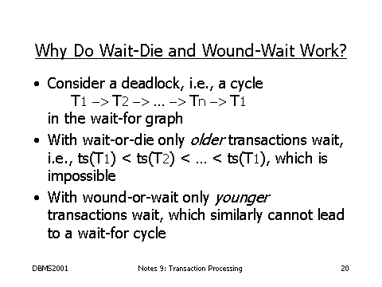
Is Deadlock Avoided with Wait-Die and Wait-Wound methods:

Slide 26
Deadlock Detection
Here the system allows processes to request resources and to wait for each other in an uncontrollable manner.
It examines the state of the system to determine whether deadlock has occurred.
When detected, the system takes action to recover from deadlock.
Based on the formation of a resource allocation graph and searching for a cycle/knot in the graph depending on whether the system has a single/multiple instances of each resource we try to detect a deadlock in the system.

Slide 27
Deadlock Detection
Necessary conditions for deadlock to Occur
Mutual Exclusion – Resources being held must be in non-shareable mode.
Hold n Wait – A Process is holding one resource and is waiting for another, which is held by another process.
No Preemption – Resource cannot be preempted even if it is being requested.
Circular Wait – Presence of a cycle of waiting processes.
All 4 conditions must simultaneously hold in a system for a deadlock to occur
If any one of the condition is absent , then no deadlock can occur!!!

Slide 28
Deadlock Detection
Assumption : Single instance of each resource . Hence search for cycles in the WFG.
Steps for constructing a WFG for a Distributed System:
Construct a separate resource allocation graph for each site of the system.
Convert the resource allocation graph to the corresponding WFG.
Take the union of the WFGs of all sites and construct a single global WFG.

Slide 29
Deadlock Detection
Example 1: System is comprised of only 2 sites (S1 and S2)
S1 has 2 resources R1 and R2.
S2 has one resources R3.
  There are 3 processes competing for the 3 resource :
  T1 is holding R1 and requesting for R3.
  T2 is holding R2 and requesting for R1.
  T3 is holding R3 and requesting for R2.

Slide 30
Deadlock Detection
Step 1 : Construct resource allocation graph for each site
T1
T3
T1
R3
T3
R1
R2
Site S2
T2
Site S1

Slide 31
Deadlock Detection
Step 2 : Construct WFG for each site
T1
T3
T1
T3
T2
Site S1
Site S2

Slide 32
Deadlock Detection
Step 3 : Construct a global WFG
T1
T3
T2
Conclusion : System is in a state of deadlock

Slide 33
Deadlock Management- Detection
Transactions are allowed to wait freely.
How to maintain Wait-for graphs and cycles.
  3 Commonly used Techniques for deadlock detection algorithms
    Centralized
    Distributed
    Hierarchical

Slide 34
Deadlock Detection(Centralized)
A local coordinator for each site maintains a local WFG for the site.
There is a central coordinator (centralized deadlock detector) that is responsible for constructing the union of all individual WFGs.
The central coordinator constructs the global WFG from the information received the local WFGs of all the sites
Working:
  If a cycle is found in the local WFG - a local deadlock is detected, to be resolved locally by the local coordinator.
  Cycle found in the global WFG - a distributed deadlock is detected, to be resolved by the central coordinator.

Slide 35
Deadlock Detection(Centralized)
Local coordinators send local state information to the central coordinator in the form of messages.
One of the following method is used to transfer information from local coordinators to the central coordinator :
  1. Continuous transfer : A local coordinator sends a message whenever a new edge is added to or deleted from it.
  2. Periodic transfer: To reduce a no. of messages , a local coordinator periodically( when a no. of changes have occurred in its local WFG)) sends a list of edges added to or deleted from its WFG since the previous message was sent.
  3. Transfer on request : Only when the central coordinator makes a request, local coordinator sends the information.

Slide 36
Drawbacks of Deadlock Detection(Centralized)
Single point failure.
Centralized coordinator becomes a performance bottleneck in a system having many sites.
Centralized coordinator may detect false deadlocks (phantom deadlock)
Significant time and message overhead involved in assembling all the local WFGs at the central coordinator.
To minimize communication costs, deadlocks should be detected by a site located as close as possible to the sites involved in the cycle, which is not possible in the centralized approach.
Hierarchical approach overcomes these drawbacks.

Slide 37
Deadlock Detection(Centralized)
Method to overcome false deadlocks :
E.g.: System is comprised of only 2 sites (S1 and S2)
S1 has 2 resources R1 and R2.
S2 has one resources R3.
There are 3 processes competing for the 3 resource:
Step1 : P1 requests for R1 and R1 is allocated to it.
Step2 : P2 requests for R2 and R2 is allocated to it.
Step3 : P3 requests for R3 and R3 is allocated to it.
Step4 : P2 requests for R1 and waits for it.
Step5 : P3 requests for R2 and waits for it.
Step6 : P1 releases R1 and R1 is allocated to P2.
Step7 : P1 requests for R3 and waits for it.

Slide 38
Deadlock Detection(Centralized)
Assume continuous transfer method is employed, the following sequence of messages are sent to the central coordinator.
m1: from site S1 to add the edge (R1,P1)
m2: from site S1 to add the edge (R2,P2)
m3: from site S2 to add the edge (R3,P3)
m4: from site S1 to add the edge (P2,R1)
m5: from site S1 to add the edge (P3,R2)
m6: from site S1 to delete edges (R1,P1) and (P2,R1), and add edge (R1,P2)
m7: from site S2 to add the edge (P1,R3)

Slide 39
Deadlock Detection(Centralized)
RAG of S1 RAG of S2 RAG of CC
after Step 5
P1
P3
R3
P1
P3
R1
R2
R3
P3
R1
R1
R2
P2
P2

Slide 40
Deadlock Detection(Centralized)
RAG of S1 RAG of S2 RAG of CC
after Step 7
NO CYCLES IN GRAPH OF CENTRAL COORDINATOR HENCE NO DEADLOCK
P3
P1
R3
P3
R1
R2
P1
R3
P3
R1
R2
P2
P2

Slide 41
Deadlock Detection(Centralized)
However if m7 from S2 is received before m6 from site S1----→
The CC will incorrectly conclude that a deadlock has occurred.
R3
P1
P3
R1
R2
P2

Slide 42
Deadlock Detection(Centralized)
One possible way to prevent false deadlock is to use the Lamport’s algorithm to provide global timestamp with each message.
Here m7 will have a later timestamp than m6 since P1 first releases R1 and then request for R3.
Now if m7 is received before m6…..
The coordinator gets a message that leads to a suspect deadlock:
  It send everybody a message saying “I just received a message with a timestamp T which leads to deadlock. If anyone has a message for me with an earlier timestamp, please send it immediately”
  On receiving the message, if a site has a message with timestamp earlier than T, it immediately sends it to the CC or sends a negative reply.
  After receiving replies ,CC updates the global WFG and if the cycle detected still exists, it concludes the the deadlock is a read one and initiates recovery.

Slide 43
Deadlock Detection (Hierarchical)
Hierarchical Deadlock Detection method reduces the communication overhead of centralized deadlock detection method.
With this approach, all sites in a distributed database system are organized into a hierarchy and a complete tree of deadlock detectors is constructed instead of a single centralized deadlock detector.
Based on logical hierarchy (tree) of deadlock detectors.
  Leaf Controllers manage Resources
  Other Controllers detect deadlocks
These deadlock detectors are called as controllers.

Slide 44
Deadlock Detection (Hierarchical)
Each controller is responsible for detecting only those deadlocks that involve the sites falling within its range in the hierarchy.
Hence, unlike the centralized approach, where the entire global WFG is maintained at a single site, in hierarchical approach, it is distributed over a number of different controllers.
Each site has its own local controller that maintains its own local graph.

Slide 45
Hierarchical Deadlock Detection
Build a hierarchy of detectors
A global detector exists at the root of the tree that would detect the occurrence of
Global deadlock situations
DD_{ox}
Site 7
Site 6
Site 5
DD₁₁
DD₁₄
Site 1
Site 2
Site 3
Site 4
DD₂₁
DD₂₂
DD₂₃
DD₂₄
Local deadlock detection is performed at leaf nodes site 1, site 2, site 3 and site 4.
The deadlock detector at site 5 (DD11) is responsible for detecting any deadlock
situation involving its child nodes site 1 and site 2.
Similarly, Site 3 and Site 4 sends their LWFG to site 6 and then DD14 searches
  for any deadlock involving its adjacent child node.

Slide 46
Deadlock Detection(Hierarchical)
In the tree representing the hierarchy of controllers, the WFG to be maintained by a particular controller is decided according to the following rules:
  Each controller that forms the leaf of the hierarchy tree maintains the local WFG of a single site.
  Each non leaf controller maintains a WFG that is the union of the WFGs of its immediate children in the hierarchy tree.
The lowest level controller that finds a cycle in its WFG detects a deadlock & takes necessary action to resolve it.
Hence, the WFG that contains a cycle will never be passed as it is to a higher level controller.

Slide 47
Hierarchical Approach
P4
P5
Controller G
P7
P6
P1
P3
P4
P5
P5
P6
P7
P2
P7
Controller E
Controller F
P1
P3
P1
P3
P1
P3
P1
R3
P3
R3
R1
P4
R4
P5
P6
R7
P7
R1
R2
P4
R4
P5
P5
R6
P6
R2
P2
P2
R5
P7
R5
P7
Site s1
Site s2
Site s3
Site s4
Controller A
Controller B
Controller C
Controller D

Slide 48
Deadlock Detection(Hierarchical)
Controllers A B C D maintain the local WFGs of sites S1, S2 ,S3 and S4 respectively. They form the leaves of the controllers’ hierarchy tree.
Controller E maintains the union of the WFGs of controllers A and B.
Similarly F maintains the union of the WFGs of C and D .
Finally G maintains the union of the WFGs of controllers E and F.
Deadlock cycle (P1,P2,P3,P1) gets reflected in the WFG of controller E and hence E detects deadlock and initiates recovery action. Though this cycle is not shown in G as it is resolved by E.
Deadlock cycle (P4,P5,P6,P7,P4) is reflected in G and hence G initiates a recovery action and resolves it

Slide 49
Deadlock Detection (Fully distributed)
Each site of the system shares equal responsibility for deadlock detection.
In this method, each site has the same amount of responsibility, and there is no distinction as local or global deadlock detector.
Two such algorithms:-
  WFG based Distributed algorithm for deadlock detection (Obermarck’s Path-Pushing Algorithm)- most well known and simplified version
  Probe based Algorithm

Slide 50
Deadlock Detection
(Fully distributed-WFG based)
1. WFG-based distributed algorithm for DD
Each site maintains its own local WFG
Here, an extra node Pex is added to the local WFG of each site
This node is connected to the WFG of the corresponding site in the following manner:
  An edge (Pi, Pex) is added if process Pi is waiting for a resource in another site being held by any process
  An edge (Pex, Pj) exists if Pj is a process of another site that is waiting for a resource currently being held by a process of this site.

Slide 51
Deadlock Detection
(Fully distributed-WFG based)
P3
P1
P1
P3
P5
P4
P2
Site 2
Site S1
P_{ex}
P_{ex}
P1
P3
P1
P3
P5
P4
P2
Site S1
Site 2

Slide 52
Deadlock Detection
(Fully distributed) -WFG based
The modified WFGs are used to detect the deadlocks in the following manner:
  If a local WFG contains a cycle, not involving Pex, a deadlock involving only local processes of the site has been detected.
  Such a deadlock can be resolved locally.
And, if the local WFG contains a cycle involving node Pex, there is a possibility of a distributed deadlock involving processes from multiple sites.
To confirm the deadlock, a distributed deadlock detection algorithm is invoked by the site, whose WFG contains a cycle involving node Pex.

Slide 53
Deadlock Detection
(Fully distributed) -WFG based
Suppose that a cycle involving node Pex is detected in the WFG of site Si.
This cycle is of the form
(Pex, Pi,Pj, ….Pk,Pex)
  Which means that Pk is waiting for an external resource that belongs to some other site Sj
Hence, Si sends a deadlock detection message to Sj.
This message doesn’t contain entire WFG, but the part of the WFG containing cycle.

Slide 54
Deadlock Detection (Fully distributed-WFG based)
  In our E.g. if S1 detects the cycle first, it sends a message (Pex,P3,P2,P1,Pex) to site S2 , as P1 is waiting for a resource in site S2.
  On receiving this message, Sj updates its local WFG by adding those edges of the cycle that do not involve Pex to its WFG
  In our E.g. edges (P3,P2) and (P2,P1) are added to local WFG of site S2, resulting in a new WFG.
P_{ex}
P_{ex}
P1
P3
P1
P3
P5
P4
P2
Site S1
Site 2

Slide 55
Deadlock Detection (Fully distributed-WFG based)
P_{ex}
P_{ex}
P1
P3
P1
P3
P5
P4
P2
Site S1
Site 2
P_{ex}
  By adding those edges of the cycle at site 2 that do not involve Pex to its WFG.
P1
P3
P5
P2
Site 2

Slide 56
Deadlock Detection
(Fully distributed-WFG based)
Now if the newly constructed WFG of site Sj contains a cycle that does not involve node Pex, a deadlock exists & recovery is needed
  In our E.g. newly constructed WFG of site S2 contains a cycle (P1,P3,P2,P1) not having node Pex.
  Hence Deadlock detected and resolved locally by site 2.
  If a cycle containing Pex is found in the newly constructed WFG of site Sj, Sj sends a deadlock detection message to the appropriate site.

Slide 57
Deadlock Detection (Fully distributed-WFG based)
  In our E.g. (Pex →P1 →P3 →Pex) is the cycle at site 2.
  This local WFG is transmitted to the site 1 where P3 is waiting i.e. S1. S1 the entire procedure repeats again.
  Hence local WFG of S1 is extended and becomes-----→
  Since site S1 contains a cycle not involving Pex deadlock is detected and resolved.
  If S1 contained a cycle involving Pex then again a deadlock detection message would have been sent to the appropriate site and so on..
P_{ex}
P1
P3
P4
P2
Site S1

Slide 58
DEADLOCK RECOVERY

Slide 59
Failure Classification
Transaction failure :
  Logical errors: transaction cannot complete due to some internal error condition (bad input, data not found etc.)
  System errors: the database system must terminate an active transaction due to an error condition (e.g., deadlock)
System crash: a power failure or other hardware or software failure causes the system to crash.
Disk failure: a head crash or similar disk failure destroys all or part of disk storage

Slide 60
Storage Structure
Volatile storage:
  does not survive system crashes
  Examples: main memory, cache memory
Nonvolatile storage:
  survives system crashes
  Examples: disk, tape, flash memory, non-volatile (battery backed up) RAM
Stable storage:
  a mythical form of storage that survives all failures
  approximated by maintaining multiple copies on distinct nonvolatile media
  Example: Optical disk (Blue Ray)

Slide 61
Steps followed after a failure:
All transactions affected by failure must be aborted
Broadcast message to other sites, so that no other site will try to access the failed site
Periodic checking of the failed site
On restart the failed site must initiate a recovery procedure to abort all partial transactions that were active at the time of failure
After recovery the failed site must update its data to preserve data consistency

Slide 62
Local Recovery Protocols
Recovery protocols deals with the failures that result in the loss of volatile storage (Main memory, Cache memory)
These volatile pages are brought in and out of main memory using LRU (Least Recently Used) algorithm
Recovery protocols are classified based on updating operations:
  In-place Updating: Updating values in stable storage-Immediate modification technique (Log Based Method)
  Out-place Updating: Stores new values separately-Shadow paging

Slide 63
Immediate Database Modification
The Immediate Database Modification scheme allows database updates of an uncommitted transaction to be made as the writes are issued.
  Since undoing may be needed, update logs must have both old value and new value.
Update log record must be written before database item is written.
Output of updated blocks can take place at any time before or after transaction commit.
Order in which blocks are output can be different from the order in which they are written.

Slide 64
Immediate Database Modification Example
Log Write Output
<T₀ start>
<T₀, A, 1000, 950>
T_{o}, B, 2000, 2050
A = 950
B = 2050
<T₀ commit>
<T₁ start>
<T₁, C, 700, 600>
C = 600
B_{B}, B_{C}
<T₁ commit>
B_{A}
Note: B_{X} denotes block containing X.
x₁

Slide 65
Use of Write ahead log protocol(WAL) in Immediate Database Modification:
Log buffers are written into the stable storage before the corresponding write to permanent database
This helps in recovery
How consistency is maintained in WAL?
  Any transaction has both a transaction start and transaction commit information in the log must be redone
  Any transaction that has a start record but no transaction commit has to be undone.

Slide 66
Immediate Database Modification (Cont.)
Recovery procedure has two operations instead of one:
  Undo(T_{i}) restores the value of all data items updated by T_{i} to their old values, going backwards from the last log record for T_{i}
  Redo(Ti) sets the value of all data items updated by T_{i} to the new values, going forward from the first log record for T_{i}
When recovering after failure: (Use WAL Protocol)
  Transaction Ti needs to be undone if the log contains the record <Ti start>, but does not contain the record <Ti commit>.
  Transaction Ti needs to be redone if the log contains both the record <Ti start> and the record <Ti commit>.
Undo operations are performed first, then redo operations.

Slide 67

Immediate DB Modification Recovery Example:
Below we show the log as it appears at three instances of time.
Recovery actions in each case above are:
Undo (T₀): B is restored to 2000 and A to 1000.
Undo (T1) and Redo (T0): C is restored to 700, and then A and B are set to 950 and 2050 respectively.
Redo (T0) and Redo (T1): A and B are set to 950 and 2050 respectively. Then C is set to 600

Slide 68
Shadow Paging
Shadow paging is an alternative to log-based recovery (Immediate DB Modification) ; this scheme is useful if transactions execute serially.
Idea: maintain two page tables during the lifetime of a transaction –the current page table, and the shadow page table
Store the shadow page table in nonvolatile storage, such that state of the database prior to transaction execution may be recovered.
  Shadow page table is never modified during execution

Slide 69

Sample Page Table- Pages in page table

Slide 70
Shadow Paging
To start with, both the page tables are identical. Only current page table is used for data item accesses during execution of the transaction.
Whenever any page is about to be written for the first time
  A copy of this page is made onto an unused page.
  The current page table is then made to point to the copy
  The update is performed on the copy

Slide 71

Example of Shadow Paging: Shadow and current page tables after write to page 4

Slide 72
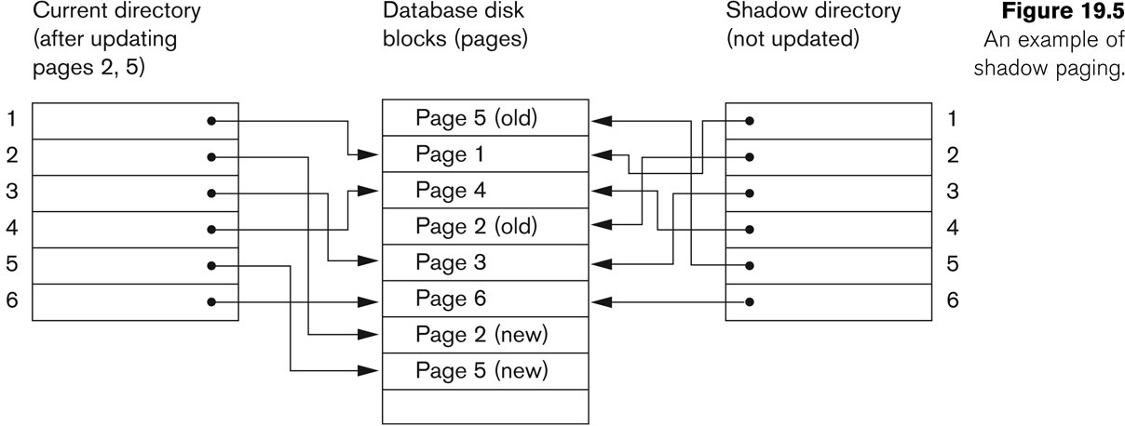
Example:

Slide 73
Shadow Paging (Cont.)
To commit a transaction:
1. Flush all modified pages in main memory to disk
2. Output current page table to disk
3. Make the current page table the new shadow page table, as follows:
  keep a pointer to the shadow page table at a fixed (known) location on disk.
  to make the current page table the new shadow page table, simply update the pointer to point to current page table on disk
Once pointer to shadow page table has been written, transaction is committed.
No recovery is needed after a crash — new transactions can start right away, using the shadow page table.
Pages not pointed to from current/shadow page table should be freed (garbage collected).

Slide 74
Cold restart
Some catastrophic failure may cause the loss of log information on stable storage
It’s not possible to reconstruct the current consistent state of database
Cold restart is required to restore the database to previous consistent state
In distributed database cold restart is much more complicated than in a centralized dbms!!!

Slide 75
How cold restarts are performed in distributed database?
One solution is to handle this situation:
  Store an archive copy of both the database and the log on a different storage medium.
  When loss-of-log failures occur the database is recovered from the archive copy by redoing and undoing the transactions as stored in the archive log
Another solution is to have local logs, local dumps and global checkpoint.

Slide 76
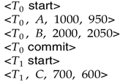
Checkpoints
Problems in recovery procedure as discussed earlier :
  Searching the entire log is time-consuming
  We might unnecessarily redo transactions which have already output their updates to the database.
Streamline recovery procedure by periodically performing Check pointing.
  Output all log records currently residing in main memory onto stable storage.
  Output all modified buffer blocks to the disk.
  Write a log record < checkpoint> onto stable storage.

Slide 77
Checkpoints (Cont.)
During recovery we need to consider only the most recent transaction T_{i} that started before the checkpoint, and transactions that started after T_{i}.
  Scan backwards from end of log to find the most recent <checkpoint> record
  Continue scanning backwards till a record <T_{i} start> is found.
  Need only consider the part of log following above start record. Earlier part of log can be ignored during recovery, and can be erased whenever desired.
  For all transactions (starting from T_{i} or later) with no <T_{i} commit>, execute undo(T_{i}). (Done only in case of immediate modification.)
  Scanning forward in the log, for all transactions starting from T_{i} or later with a <T_{i} commit>, execute redo(T_{i}).

Slide 78
Example of Checkpoints
T_{c}
T_{f}
T₁
T₁ can be ignored (updates already output to disk due to checkpoint)
T₂ and T₃ redone.
T₄ undone
T₂
T₃
T₄
checkpoint
system failure

Slide 79
Distributed Recovery Protocols
In DDBMS until all the sub transactions have successfully committed or aborted the global transaction is not committed or aborted.
Distributed recovery protocols must have the capability to deal with different types of failures like site failures, communication link failures and network partitions.
Termination protocols are unique in DDBMS
Non blocking protocols leave the operational sites unblocked
Non-blocking Recovery Protocols
  2PC- 2 Phase Commit Protocol
  3PC- 3 Phase Commit Protocol

Slide 80
Two-Phase Commit (2PC)
Phase 1 : The coordinator gets the participants ready to write the results into the database
Phase 2 : Everybody writes the results into the database
  Coordinator :The process at the site where the transaction originates and which controls the execution
  Participant :The process at the other sites that participate in executing the transaction
Global Commit Rule:
  The Coordinator Aborts a Transaction if and only if at least one participant votes to abort it.
  The Coordinator Commits a Transaction if and only if all of the participants vote to commit it.

Slide 81
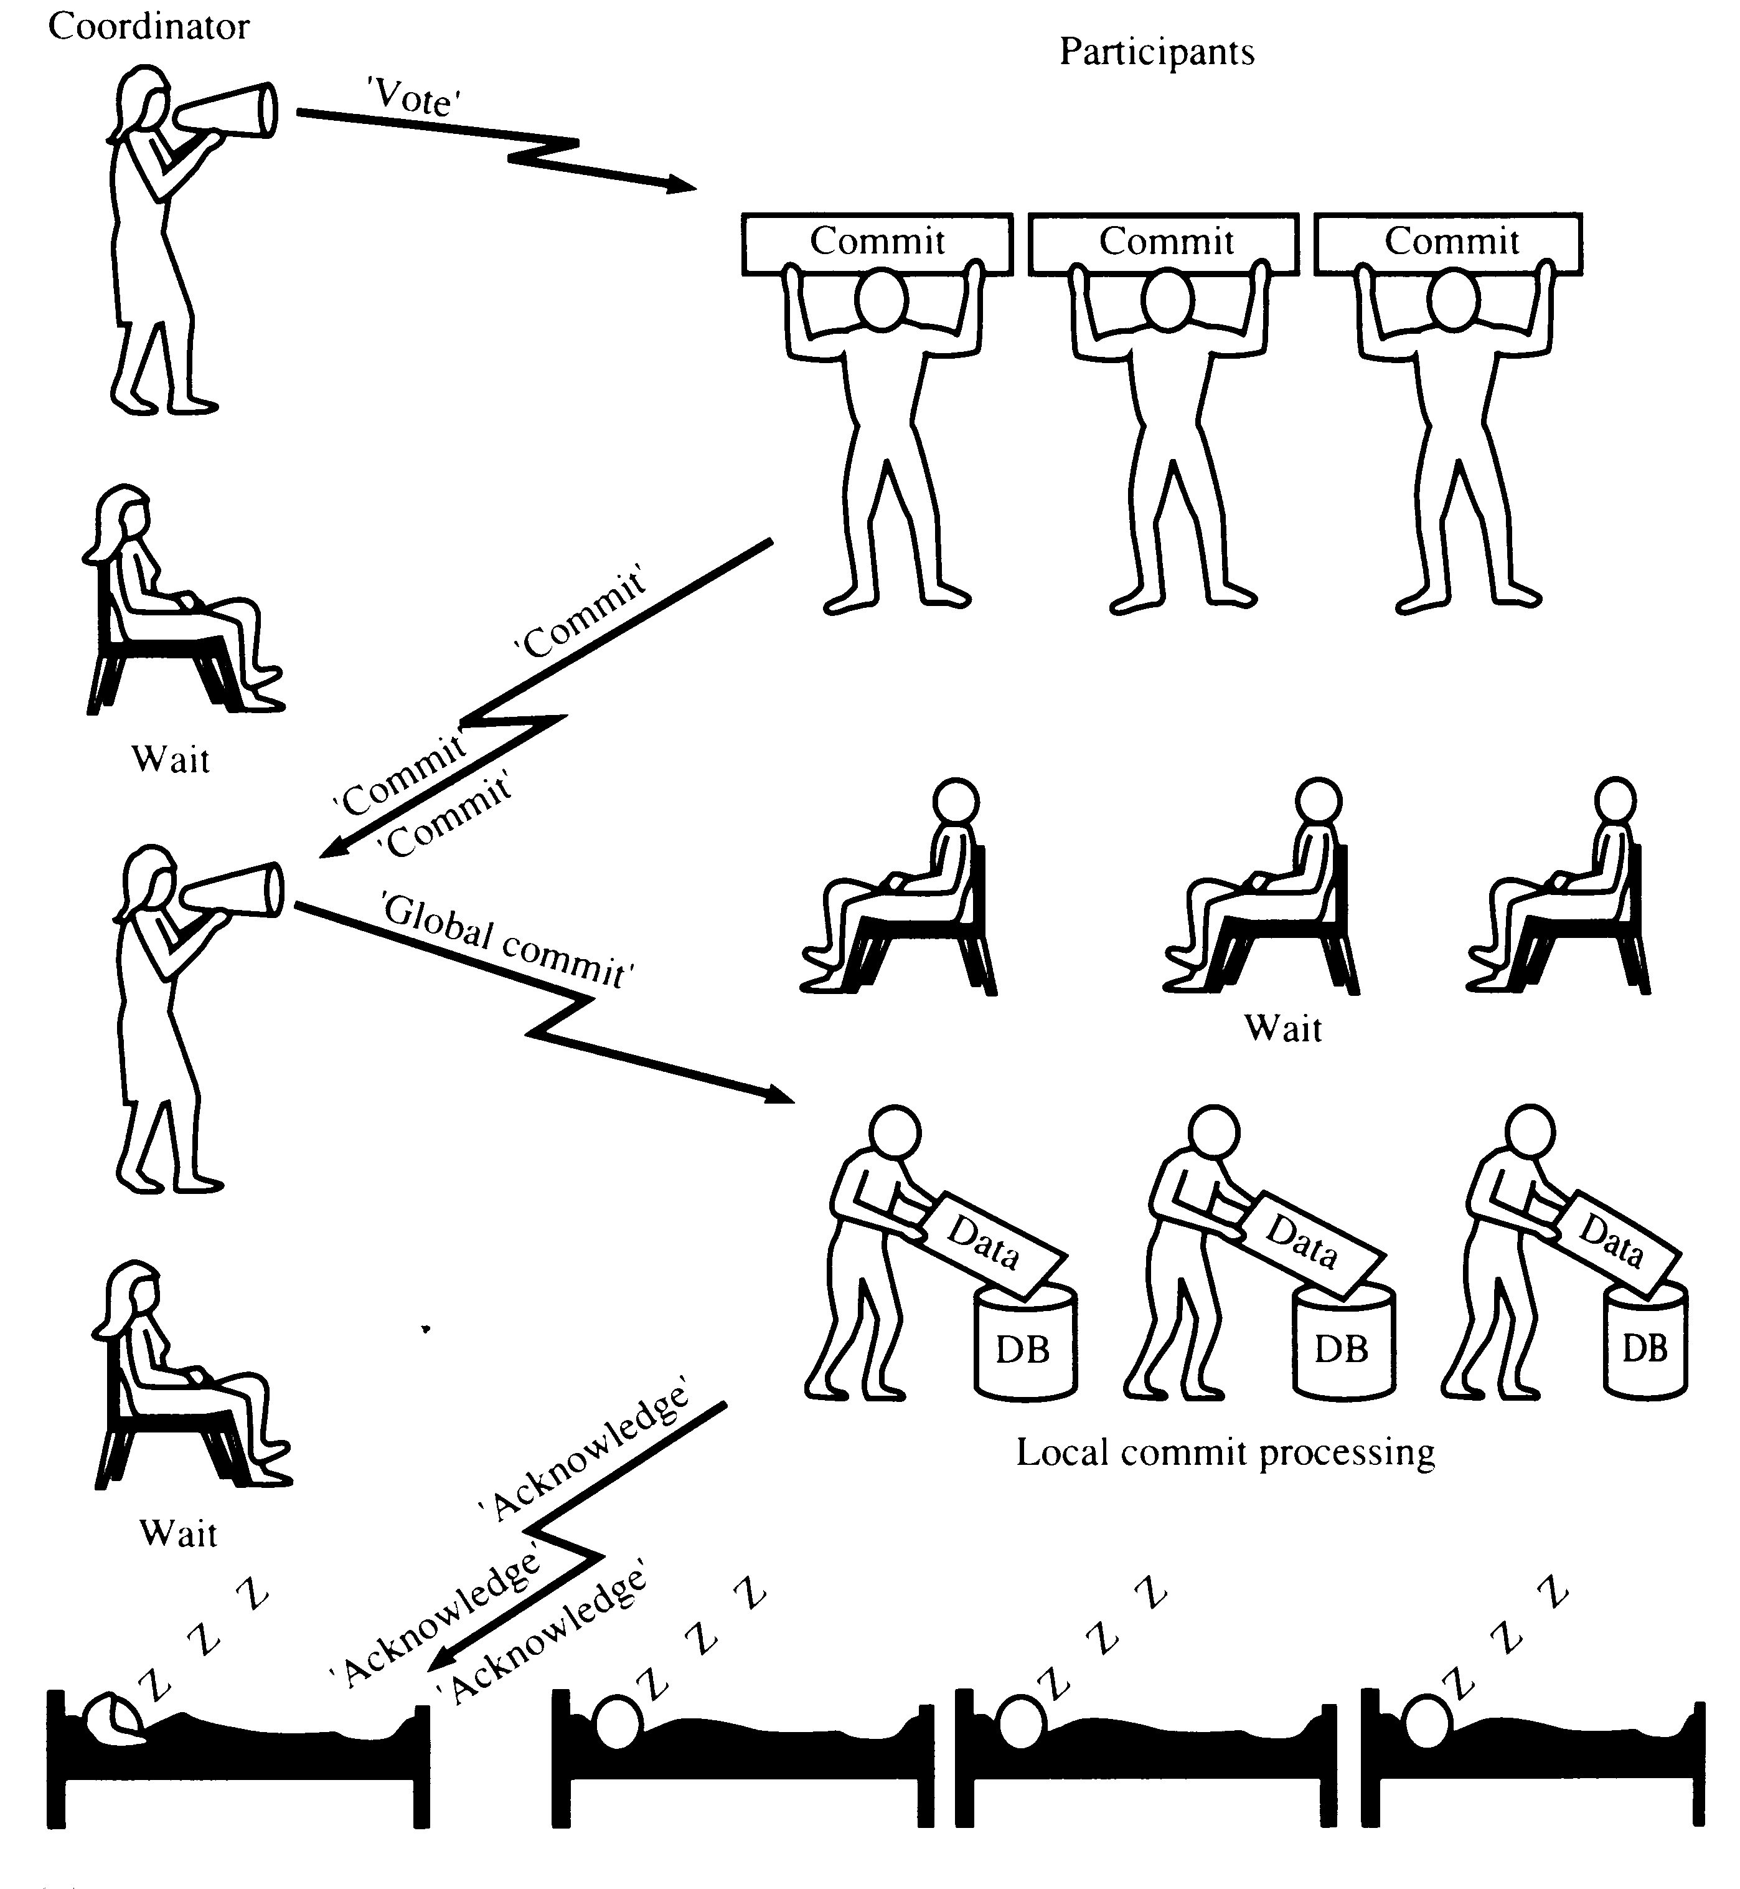
TWO-PHASE COMMIT (2PC) - OK
<prepare T>
yes
<Ready T>

Slide 82
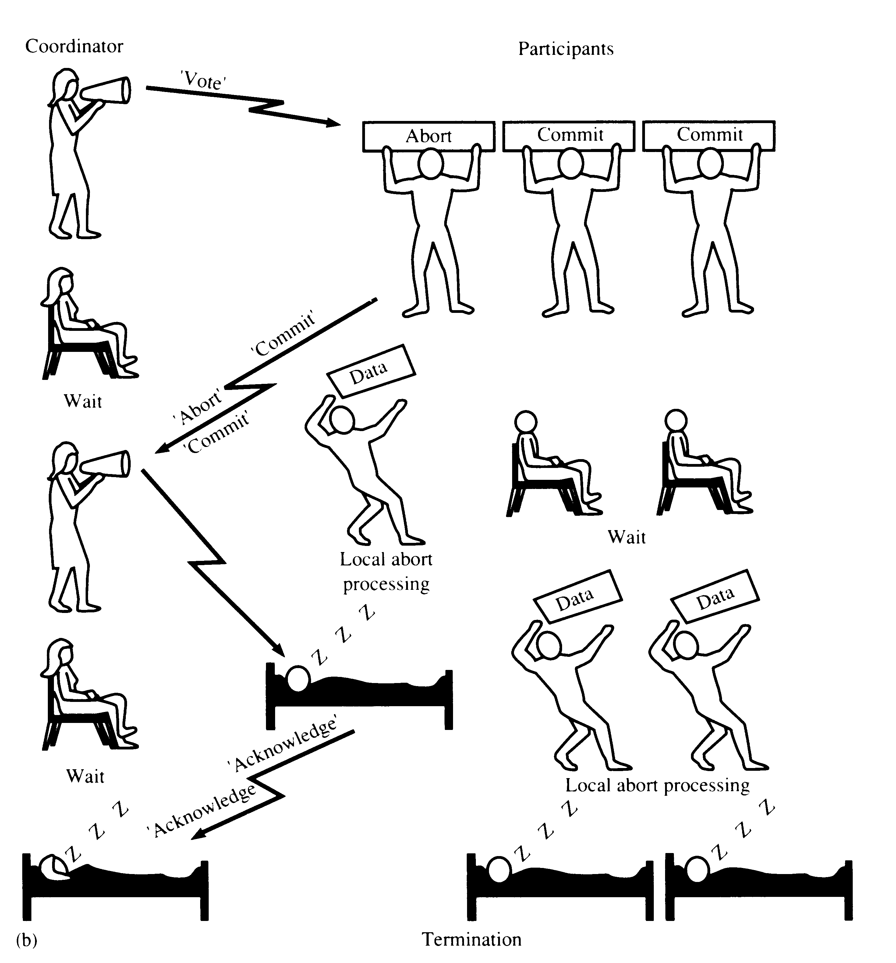
TWO-PHASE COMMIT (2PC) - ABORT
‘Global Abort’

Slide 83
The Commit Protocol
Phase 1
  Ci adds <Prepare T> to log, forces to stable storage
  Sends prepare T to all sites where T executed
  TM at that sites determines whether it is willing to commit its portion of T
  If No it adds a record <No T> to log and responds Ci with a abort signal
  If Yes it adds <Ready T> to log and responds Ci with a ready signal

Slide 84
The Commit Protocol
Phase 2
  T can be committed if Ci received a <Ready T> message from all the participating sites
  Else T must be aborted
  Accordingly either a <commit T> or a <abort T> is added to the log and the log is forced onto stable storage.
  This is followed by coordinator sending either a commit T or abort T message to all subordinates
  Subordinator on receiving the message records the message in the log
  A site sends an acknowledge T message to coordinator at the end of second phase
  Ci completes the transaction by a <complete T> to the log.

Slide 85
State Transitions in 2PC
INITIAL
INITIAL
Commit command
Prepare
Prepare
Prepare
Vote-commit
Vote-abort
WAIT
READY
Vote-abort
Vote-commit (all)
Global-abort
Global-commit
Global-abort
Global-commit
Ack
Ack
ABORT
COMMIT
ABORT
COMMIT
Coordinator
Participants

Slide 86
Termination protocols for 2PC
Invoked when a Coordinator or Participant fails to receive a message within the time limit
The action depends on which has failed and has timeout:
  Failure at Coordinator
  Failure at Participant

Slide 87
Timeouts of Coordinator/ Participants
Coordinator Timeouts can be in wait state and commit/abort state
  Time outs in Wait State:- Sends a global-abort/global-commit message to all participants
  Time outs in Commit or Abort state:- Sends global-commit or global abort message to participants who have not acknowledged
Participants timeout occurs in initial and ready state
  Timeout in Initial State:- participant is waiting for prepare message and timeout occurs
  Timeout in Ready State:- In this case the coordinator should have failed and the participant cant take an unilateral decision.

Slide 88
Site Failure of Coordinator - 2PC Recovery
Failure in initial state:- Starts commit procedure on recovery
Failure in wait state:- After prepare message if the coordinator has failed, on recovery it sends the prepare message to all participants once more
Failure in commit or abort state:- on recovery if the coordinator has all acknowledgements it completes successfully, else it will initiate termination protocol
COORDINATOR
INITIAL
Commit command
Prepare
WAIT
Vote-abort
Vote-commit
Global-abort
Global-commit
ABORT
COMMIT

Slide 89
Site Failure of Participant - 2PC Recovery
Failure in INITIAL
  As participants has not yet voted to commit, so they can go for Unilaterally abort upon recovery
Failure in READY
  The coordinator has been informed about the local decision, based on that participant has sent its vote.
  So invoke the termination protocol on recovery
Failure in ABORT or COMMIT
  As participant has completed the transaction so Nothing special needs to be done after restart.
PARTICIPANTS
INITIAL
Prepare
Prepare
Vote-abort
Vote-commit
READY
Global-abort
Global-commit
Ack
Ack
ABORT
COMMIT

Slide 90
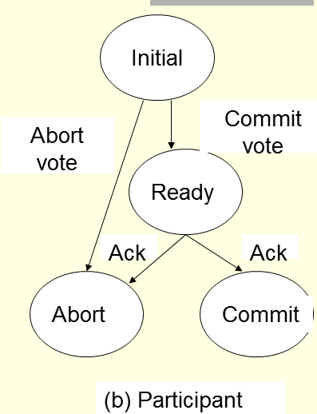
Failure of a Participating Site
If subordinator fails then Ci takes these actions
  Before <Ready T> then Ci assumes that it is abort.
  After <Ready T> then Ci executes in the normal fashion
When subordinator recovers it determines its fate from the log
  If log contains a <commit T> record then site does redo(T)
  If log contains a <abort T> record then site executes a undo(T)
  If log contains <ready T> then subordinator should consult Ci
  If Ci itself has failed then subordinator consults other sites by sending a <querystatus> message to all sites to know its plight
  If log contains no control records concerning T then subordinate executes undo(T)

Slide 91
Communication Schemes for 2PC
Centralized 2PC
Linear 2PC
Distributed 2PC

Slide 92
Centralized 2PC
P
P
P
P
C
C
C
P
P
P
P
ready?
<Prepare>
commited/aborted
ACK
yes/no
commit/abort?
Phase 1
Phase 2

Slide 93
Linear 2PC
Commit vote/
Abort vote
Commit vote/
Abort vote
Prepare
Phase 1- Voting Phase
C
P1
P2
P3
Global Commit /
Global Abort
Global Commit /
Global Abort
Global Commit /
Global Abort
Phase 2- Decision Phase
Note: Low response time performance of this method
Forward chain of Communication from the Coordinator to the participant in Voting phase and backward chain of communication from participant to coordinator in Decision phase

Slide 94
Distributed 2PC
Coordinator
Participants
Participants
global-commit/
global-abort
vote-abort/
decision made
prepare
vote-commit
independently
Phase 1
Note: No decision phase is required in this case

Slide 95
Problem With 2PC
Blocking
  Ready implies that the participant waits for the coordinator
  If Coordinator fails, site is blocked until recovery
  Blocking reduces availability
Independent recovery is not possible
  Independent recovery protocols exist only for single site failures; no independent recovery protocol exists which is resilient to multiple-site failures.
So we search for these protocols – 3PC

Slide 96
Three-Phase Commit
3PC is non-blocking.
Requirement for 3PC Protocol are as follows:
  Network Partition should not occur
  All sites should not fail simultaneously, that is, at least one site must be available always
  At most k sites can fail simultaneously, where k is less than the total number of sites in the system.

Slide 97
Three-Phase Commit
In 3 P: A new phase is introduced, known as Pre-commit Phase
  In between the Voting and Global decision phase, for eliminating the uncertainty period for participants that have voted commit and are waiting for the global decision from the coordinator.
  In 3 PC, if all participants vote for commit, the coordinator sends a “Global-Precommit” message to all participants.
  If participants receive this “Precommit” message and has not failed will definitely commit by itself.
  Each Participants acknowledges the receipt of “Precommit” message to the coordinator and after receiving all acknowledgements the coordinator sends a “global commit” message to all participants.

Slide 98
State Transitions in 3PC
Coordinator
Participants
INITIAL
INITIAL
Commit command
Prepare
Prepare
Prepare
Vote-commit
Vote-abort
WAIT
READY
Vote-abort
Vote-commit
Global-abort
Prepared-to-commit
Global-abort
Prepare-to-commit
Ack
Ready-to-commit
ABORT
PRE-
COMMIT
ABORT
PRE-
COMMIT
Ready-to-commit
Global commit
Global commit
Ack
COMMIT
COMMIT

Slide 99
Communication Structure
P
P
P
P
P
P
C
C
C
C
P
P
P
P
P
P
pre-commit/
ready?
yes/no
pre-abort?
yes/no
commit/abort
ack
Phase 1
Phase 2
Phase 3

Slide 100
Site Timeout of Coordinator –3PC Termination
Coordinator
INITIAL
Timeout in INITIAL
Who cares
Timeout in WAIT
Performs global abort for all participants
Timeout in PRECOMMIT
It doesn't know the status of participant for not being responding as Participants may not be in PRE-COMMIT, but at least in READY
Sends all the participants a “Prepare-to-Commit” message to move them to Commit State
Terminate by globally committing and sending a global commit message.
Commit command
Prepare
WAIT
Vote-abort
Vote-commit
Global-abort
Prepare-to-commit
ABORT
PRE-
COMMIT
Ready-to-commit
Global commit
COMMIT

Slide 101
Site Timeout of Coordinator -3PC Termination
Coordinator
INITIAL
Timeout in ABORT or COMMIT
Coordinator waiting for an acknowledgment from the participants.
Just ignore and treat the transaction as completed
participants are either in PRECOMMIT or READY state and can follow their termination protocols
Commit command
Prepare
WAIT
Vote-abort
Vote-commit
Global-abort
Prepare-to-commit
ABORT
PRE-
COMMIT
Ready-to-commit
Global commit
COMMIT

Slide 102
Site Timeout of Participants –
3PC Termination
Participants
Timeout in INITIAL
  Coordinator must have failed in INITIAL state
  Unilaterally abort
Timeout in READY
  Voted to commit, but does not know the coordinator's decision
  Elect a new coordinator and terminate using a special protocol
Timeout in PRECOMMIT
  Handle it the same as timeout in READY state
INITIAL
Prepare
Prepare
Vote-commit
Vote-abort
READY
Global-abort
Prepared-to-commit
Ack
Ready-to-commit
ABORT
PRE-
COMMIT
Global commit
Ack
COMMIT

Slide 103
Site Failures of Coordinator – 3PC Recovery
Coordinator
Failure in INITIAL
  start commit process upon recovery
Failure in WAIT
  the participants may have elected a new coordinator and terminated the transaction
  the new coordinator could be in WAIT or ABORT states ⇦ transaction aborted
  ask around for the fate of the transaction
Failure in PRECOMMIT
  ask around for the fate of the transaction
INITIAL
Commit command
Prepare
WAIT
Vote-abort
Vote-commit
Global-abort
Prepare-to-commit
ABORT
PRE-
COMMIT
Ready-to-commit
Global commit
COMMIT

Slide 104
Site Failures of Coordinator – 3PC Recovery
Coordinator
INITIAL
Failure in COMMIT or ABORT
  Nothing special if all the acknowledgements have been received; otherwise the termination protocol is involved
Commit command
Prepare
WAIT
Vote-abort
Vote-commit
Global-abort
Prepare-to-commit
ABORT
PRE-
COMMIT
Ready-to-commit
Global commit
COMMIT

Slide 105
Site Failures of Participants– 3PC Recovery
Participants
INITIAL
Failure in INITIAL
  unilaterally abort upon recovery
Failure in READY
  the coordinator has been informed about the local decision
  upon recovery, ask around
Failure in PRECOMMIT
  ask around to determine how the other participants have terminated the transaction
Failure in COMMIT or ABORT
  no need to do anything
Prepare
Prepare
Vote-commit
Vote-abort
READY
Global-abort
Prepared-to-commit
Ack
Ready-to-commit
ABORT
PRE-
COMMIT
Global commit
Ack
COMMIT

Slide 106
End Chapter

