Slide 1
Chapter 7
XML

Slide 2
Outline
XML for Data Integration
Structure of XML
  Structured, Semi structured, & Unstructured Data
XML Document Schema
XML Querying and Transformation
Storage of XML Data
XML Application

Slide 3
Introduction: XML
XML = eXtensible Markup Language
  “… the universal format for structured documents and data on the Web.”
    www.w3c.org/XML
  “… simple, very flexible text format derived from SGML (ISO 8879).”
  Originally designed to meet challenges of large-scale electronic publishing
  Increasingly important role for exchanging a wide variety of data on the Web (and not on the Web)

Slide 4
What is XML-based Data Integration?
XML-based Data Integration or
Enterprise Information Integration (EII):
  Create aggregated views using XQuery
  Get information from diverse sources in XML
  Consume synthesized information

Slide 5

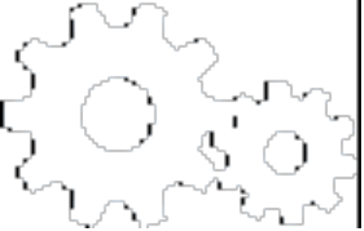
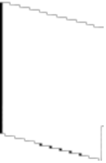





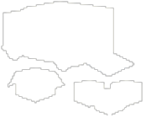
XML Data Integration Example
XQuery Engine
Order Tracking
Synthesized Information
J2EETM CA
EIS
JDBC
HTTP
Shipment Tracking
Parts Inventory
Database
Web Service
Notes:
Get XML data from various J2EE data sources
Using XQuery to join, filter and transform those data together
Using XML Database as an optional data cache and accelerated query engine
Present query results to users

Slide 6

Technologies Involved
Why XML?
  Different data formats
Why XQuery ?
  Declarative way to query XML documents
Why J2EETM ?
  Standards-based infrastructure platform
Why XML Database ?
  Native XML storage
  XML data management
  Performance optimizations
XML-based Data Integration
J2EETM Platform
XQuery Engine
XML
Database

Slide 7
Advantages of XML
XML is text (Unicode) based.
  Takes up less space.
  Can be transmitted efficiently.
One XML document can be displayed differently in different media.
  Html, video, CD, DVD,
  You only have to change the XML document in order to change all the rest.
XML documents can be modularized.
  Parts can be reused.

Slide 8
Structured vs. Semi structured Data
Structured Data:
  Information stored in databases; all records have the same format as defined in the relational schema.
  The DBMS then checks to ensure that all data follows the structures and constraints specified in the schema.
Semi structured data:
  In some applications, data is collected in an ad-hoc manner before it is known how it will be stored and managed.
  It may have a certain structure but no all the information collected will have identical structure.

Slide 9
Semi Structured Data
Semi-structured data may be displayed as a directed graph, as shown.
The labels or tags on the directed edges represent the schema names—the names of attributes, object types (or entity types or classes), and relationships.
The internal nodes represent individual objects or composite attributes.
The leaf nodes represent actual data values of simple (atomic) attributes.

Slide 10
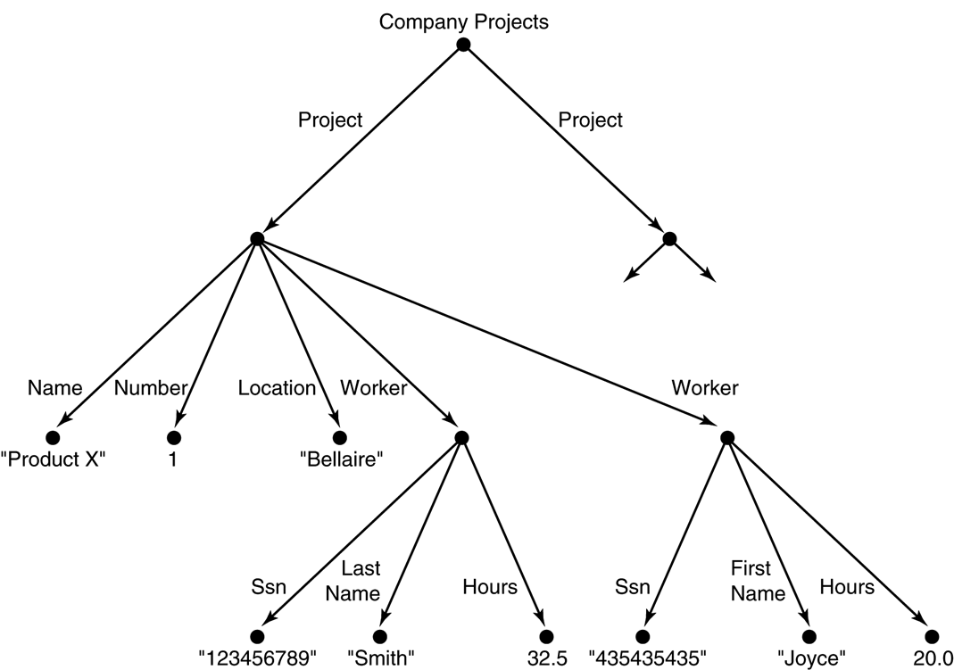
Representing semi structured data as a graph.
  In semi-structured data, the schema information is mixed in with the data values, since each data object can have different attributes that are not known in advance. Hence, this type of data is sometimes referred to as self-describing data.

Slide 11
Unstructured Data
A third category is known as unstructured data, because there is very limited indication of the type of data.
A typical example would be a text document that contains information embedded within it.
Web pages in HTML that contain some data are considered as unstructured data.

Slide 12
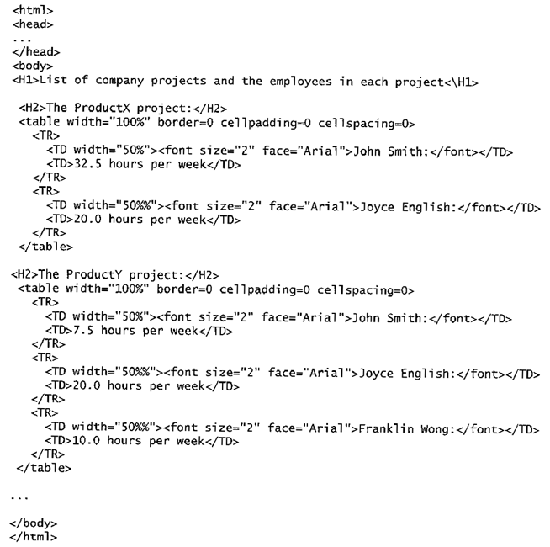
FIGURE 2.
Part of an HTML document representing unstructured data
(c.f., the company database schema)

Slide 13
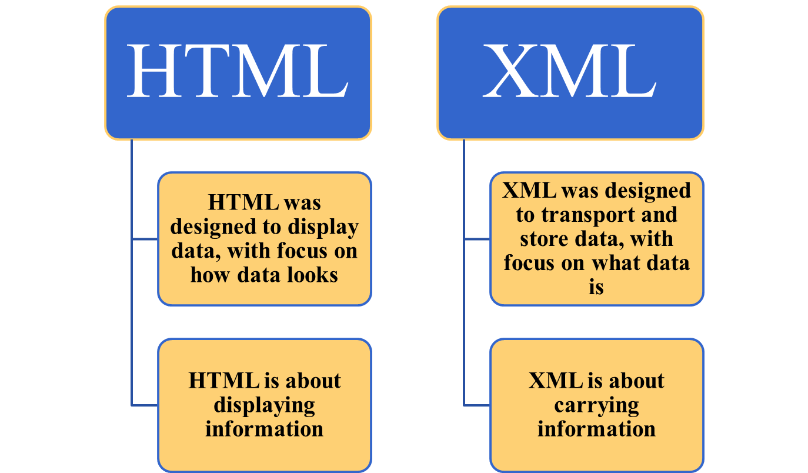
Difference between HTML & XML

Slide 14

Comparisons
XML
HTML
Extensible set of tags
Content orientated
Standard Data infrastructure
Allows multiple output forms
Fixed set of tags
Presentation oriented
No data validation capabilities
Single presentation

Slide 15
XML Hierarchical (Tree) Data Model
Problem with HTML document:
  Difficult to interpret automatically by programs because they do not include schema information about the type of data in the document.
  Inappropriate as intermediate Web documents to be exchanged among various computer sites.
Solution → XML documents:
  Two main structuring concepts: elements, attributes
In XML, tag names are defined to describe the meaning of the data elements, rather than to describe how the text is to be displayed (as in HTML).

Slide 16
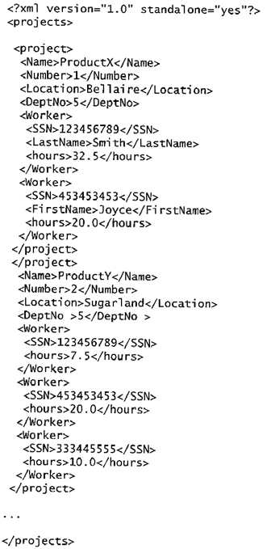
FIGURE
A complex XML element called <projects>.
Standalone=“yes”
- schema less
Root Element: <projects>
Complex elements: <project>, <Worker>
Simple elements: <Name>, <Number>, <SSN>, …

Slide 17
XML DOCUMENTS, DTD, AND XML SCHEMA

Slide 18
XML Documents, DTD, and XML Schema
A well-formed XML document is one that follows a few conditions:
  Start with an XML declaration (<?xml version=“1.0” standalone=“no”?>)
  Tree model-- In the tree representation, internal nodes represent complex elements, whereas leaf nodes represent simple elements. That is why the XML model is called a tree model or a hierarchical model.
  A single root element--- <Projects>
  Matching start and end tags for an element must be within the tags of the parent element.
  Syntactically correct

Slide 19
XML Documents and DTD
A valid XML document is well formed.
In addition the element names used in the start and end tag pairs must follow the structure specified in a separate XML DTD (Document Type Definition) file or XML schema file.
Based on this DTD is classified into 2 types:
    Internal DTD- If the DTD is declared inside the XML file.
    External DTD- If the DTD is declared as an external file.

Slide 20
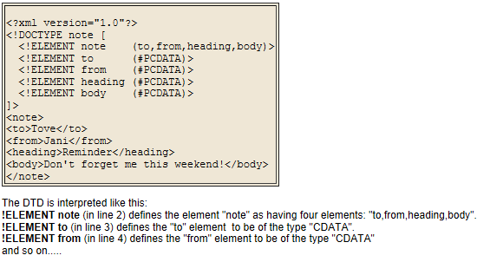
Internal DTD
If the DTD is declared inside the XML file, it should be wrapped in a DOCTYPE definition with the following syntax:
< !DOCTYPE root-element [element-declarations]>
.XML File

Slide 21
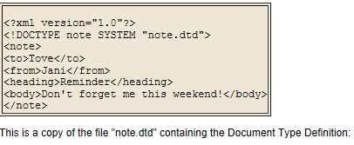
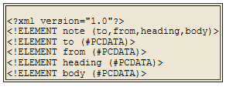
External DTD
If the DTD is declared in an external file, it should be wrapped in a DOCTYPE definition with the following syntax:
< !DOCTYPE root-element SYSTEM "filename">
.XML File
.DTD File

Slide 22
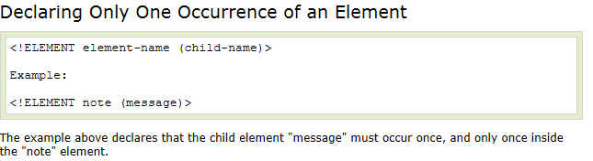
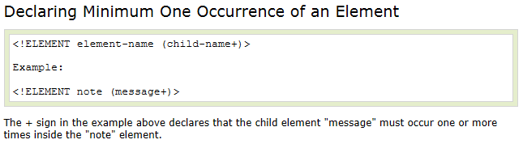
Occurrence of Element

Slide 23
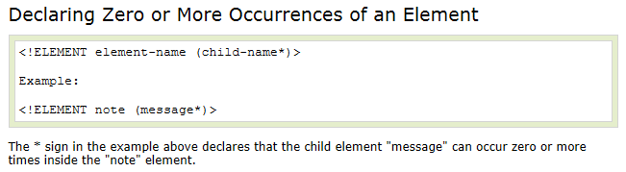
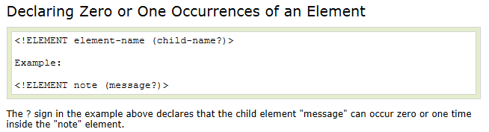
Occurrence of Element

Slide 24
DTD-Attributes
An Attribute must have a Type Declaration and a Default Declaration.
  Type Declaration
    CDATA
    ID
    IDREF
    IDREFS
Default Declaration
  #REQUIRED
  #IMPLIED
  #FIXED

Slide 25
DTD-Attributes (Type Declaration)
The type value can be one of the following:
  CDATA: Any character data
  ID: Provides a unique identifier for the element. At most one attribute of an element can be of type ID
  IDREF: An attribute of this type is a reference to an element and must contain a value that appears in the ID attribute of some element.
<!ATTLIST person number CDATA #REQUIRED>
<person number=“P001”>
<!ATTLIST Customer Cust_id ID #REQUIRED>
<customer Cust_id=“C001”>
<!ATTLIST Account Cust_id IDREF #REQUIRED>
<Account Cust_id=“C001”>

Slide 26
  IDREFS: Allows a list of references to be stored.
<!ATTLIST Account Cust_id IDREFS #REQUIRED>
<Account Cust_id=“C001 C002”>

Slide 27
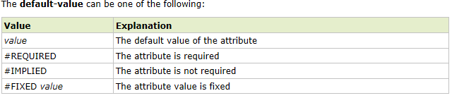
DTD-Attributes (Default Declaration)

Slide 28
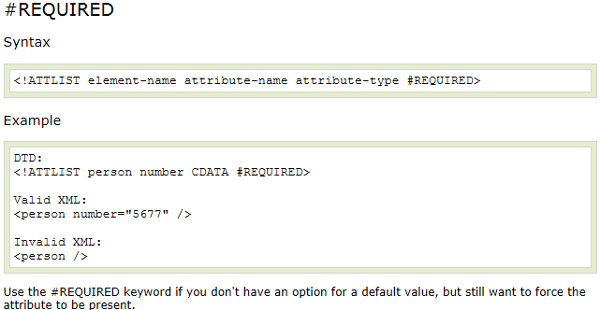

Slide 29
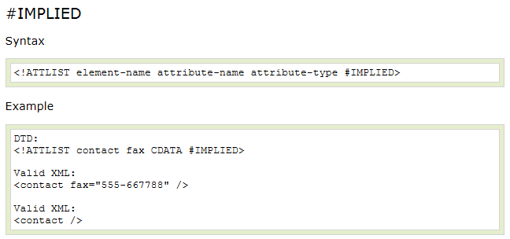

Slide 30
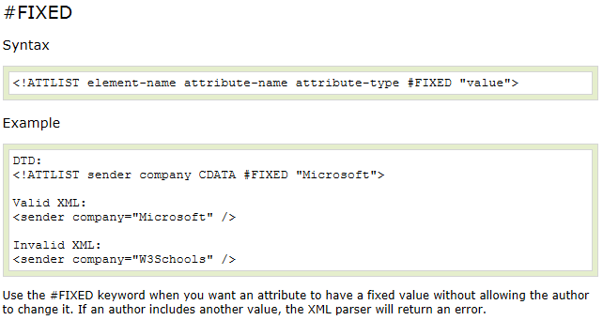

Slide 31
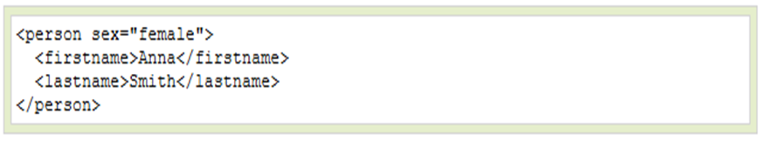
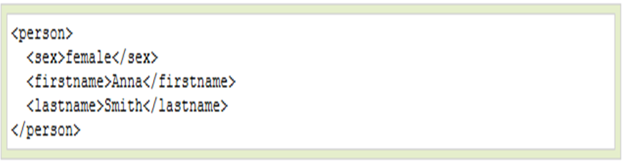
Use of Elements vs. Attributes
Some of the problems with using attributes are:
Attributes cannot contain multiple values (elements can)
Attributes cannot contain tree structures (elements can)
Attributes are not easily expandable (for future changes)

Slide 32
Example to Solve on DTD
Give the DTD for an XML representation of the following nested relational Schema Projects.
Each Projects relation must have 1 or more project in it. For every project there can be one deptNo available else no need to specify it. For every project there can be 0 or more worker associated with it. If Lname and Fname for worker present then must be specified else don’t specify it.
  Project= (Name, Number, Location, DeptNo, Workerset setoff (Workers))
  Workers= (SSN, LastName, FirstName, hours)

Slide 33
Tree structure of Example

Slide 34
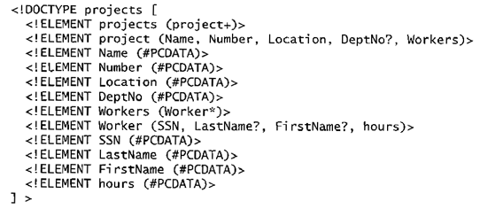
FIGURE. An XML DTD file called projects

Slide 35
DTD Limitations
Data types in DTD are not very general. Has its own special syntax and thus requires specialized processors.
Individual elements and attributes cannot be further typed.
All DTD elements are always forced to follow the specified ordering of the documents, so unordered elements are not permitted.
Solution →A more sophisticated schema language is developed, called XML Schema.

Slide 36
XML SCHEMA
XML Schema is an XML-based alternative to DTD.
An XML schema describes the structure of an XML document.
The XML Schema language is also referred to as XML Schema Definition (XSD).

Slide 37
What is an XML Schema?
The purpose of an XML Schema is to define the legal building blocks of an XML document, just like a DTD.
An XML Schema:
Defines Elements That Can Appear In A Document
Defines Attributes That Can Appear In A Document
Defines Which Elements Are Child Elements
Defines The Order Of Child Elements
Defines The Number Of Child Elements
Defines Whether An Element Is Empty Or Can Include Text
Defines Data Types For Elements And Attributes
Defines Default And Fixed Values For Elements And Attributes

Slide 38
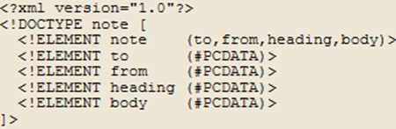
A Reference to an XML Schema
The following example is an XML Schema file called "note.xsd" that defines the elements of the XML document:
<?xml version="1.0"?>
<xs:schema xmlns:xs="XMLSchema"
elementFormDefault="qualified">
<xs:element name="note">
<xs:complexType>
<xs:sequence>
<xs:element name="to" type="xs:string"/>
<xs:element name="from" type="xs:string"/>
<xs:element name="heading" type="xs:string"/>
<xs:element name="body" type="xs:string"/>
</xs:sequence>
</xs:complexType>
</xs:element>
< /xs:schema>

Slide 39
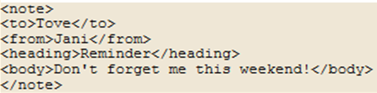
This note.xml document has a reference to an XML Schema
“note.xsd”:
<?xml version="1.0"?>
<note
xmlns:xsi="XMLSchema-instance"
xsi:schemaLocation=“note.xsd">
<to>Tove</to>
<from>Jani</from>
<heading>Reminder</heading>
<body>Don't forget me this weekend!</body>
</note>
The note element is a complex type because it contains other elements. The other elements (to, from, heading, body) are simple types because they do not contain other elements.

Slide 40
Defining a Simple Element in XSD
The syntax for defining a simple element is:
where xxx is the name of the element and yyy is the data type of the element.
XML Schema has a lot of built-in data types. The most common types are:
  xs:string
  xs:decimal
  xs:integer
  xs:boolean
  xs:date
  xs:time

Slide 41
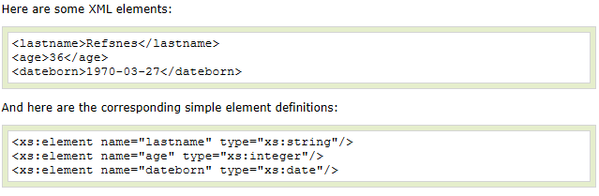
Examples of data types:

Slide 42
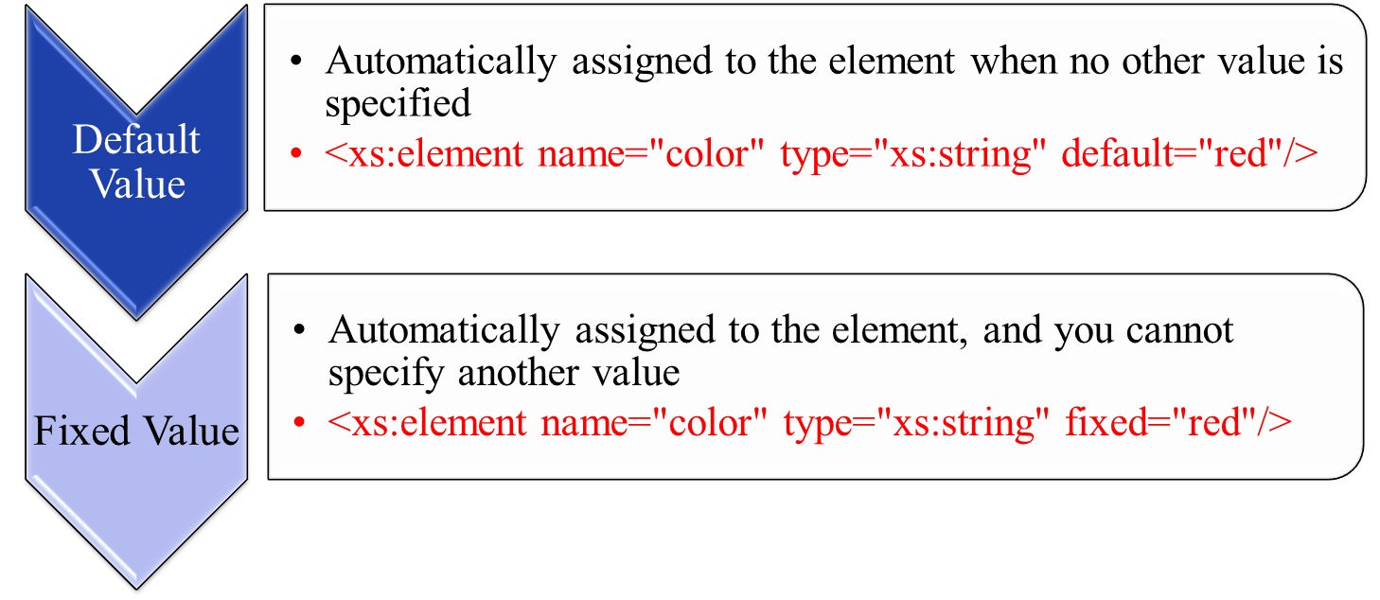
Default and Fixed Values for Simple Elements
Simple elements may have a
  Default value
  Fixed value

Slide 43
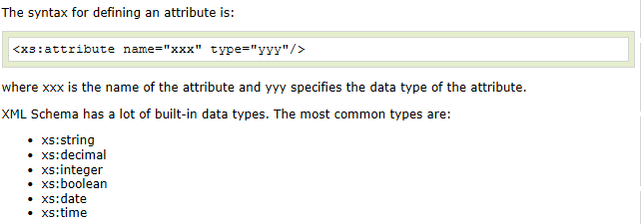
How to Define an Attribute in XSD?
Simple elements cannot have attributes. If an element has attributes, it is considered to be of a complex type.

Slide 44
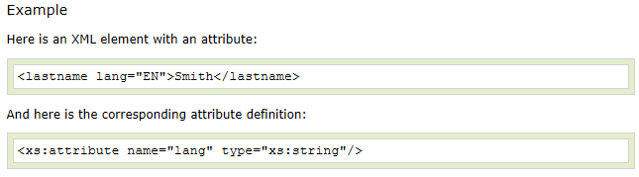
Some Examples of Attribute

Slide 45
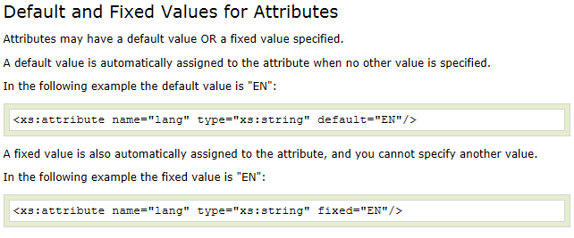
Types of Attribute:

Slide 46
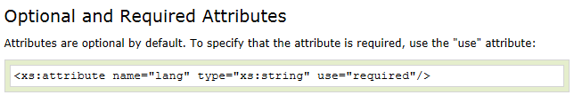
Use of Attribute

Slide 47
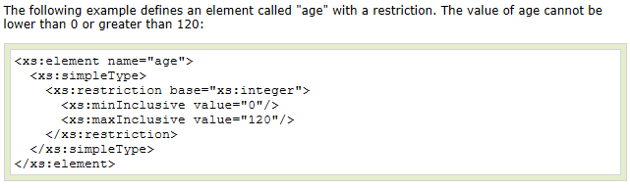
Restriction on values in XSD:
Restrictions are used to define acceptable values for XML elements or attributes. Restrictions on XML elements are called facets.

Slide 48
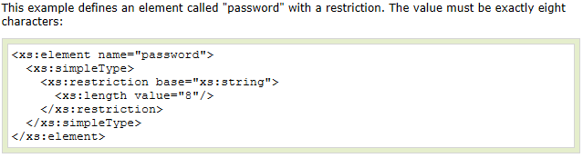
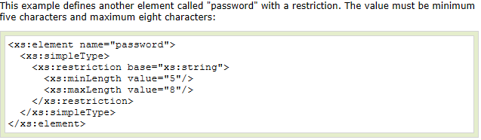
Restrictions on Length
To limit the length of a value in an element, we would use the length, maxLength, and minLength constraints.

Slide 49
An XML Instance Document Example
<?xml version="1.0"?>
<book xmlns: xsi="XMLSchema-instance” xsi:schemaLocation =“book.xsd” isbn="0836217462">
<title> Being a Dog Is a Full-Time Job</title>
<author>Charles M. Schulz</author> <qualification> extroverted beagle</qualification>
<dateofPub> 01/02/2013</dateofPub>
</book>
Here , ISBN attribute value must be provided. Also use facet for Date of Publication, where date is in the range 01/01/2011 to 01/01/2015.

Slide 50
The Example’s Schema
book.xsd
<?xml version="1.0" encoding="utf-8"?>
<xs:schema xmlns:xs="http://www.w3.org/2001/XMLSchema">
<xs:element name="book">
<xs:attribute name=“ISBN” type=“xs:string” use=“required”/>
<xs:complexType>
<xs:sequence>
<xs:element name="title" type="xs:string"/>
<xs:element name="author" type="xs:string"/>
<xs:element name=“qualification“ type=“xs:string”/>
<xs:element name=“dateofPub” type=“xs:string”>
<xs:simpleType>
  <xs:restriction base=“xs:date”>
  <xs:minInclusive value=“01/01/2011”/>
  <xs:maxInclusive value=“01/01/2015”/>
  </xs:restriction>
  </xs:SimpleType>
  </xs:element>
</xs:sequence>
</xs:complexType>
</xs:element>
</xs:schema>

Slide 51
DTD versus Schema
Limitations of DTD
  No constraints on character data
  Not using XML syntax
  No support for namespace
  Very limited for reusability and extensibility
Advantages of Schema
  Syntax in XML Style
  Supporting Namespace and import/include
  More data types
  Able to create complex data type by inheritance
  Inheritance by extension or restriction
  More …

Slide 52
XML QUERY

Slide 53
XML Query
XML querying tools are used to extract information from a large XML document as output of an XML Query.
  XPath: Specifying Path Expressions in XML. A path expression in Xpath is a sequence of location steps separated by “/”.
  XQuery: A query Language for XML. Specifying Queries in XML.

Slide 54
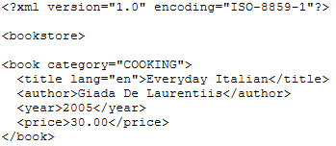
Xpath
XQuery uses path expressions to navigate through elements in an XML document.
The following path expression is used to select all the title elements in the "books.xml" file:
doc("books.xml")/bookstore/book/title
Element
doc("books.xml")/bookstore/book/title/text()
Element Value
doc("books.xml")/bookstore/book[price=30]
Predicates
doc("books.xml")/bookstore/book/@ category
Attribute

Slide 55
Xpath Examples
<Bank>
<Customer>
<name>John</name>
<Account acc_no=“A001”>
<balance>100000</balance>
</Account>
</Customer>
</Bank>
Retrieve customer name element
/bank/customer/name
2. Retrieve customer name value
/bank/customer/name/text()
Retrieve account no of customer
/bank/customer/account/@acc_no
4. Retrieve account no of customer
where balance is 1 lakh.
/bank/customer/account[balance=100000]/@acc_no

Slide 56
What is XQuery?
Query XML Documents
FLWOR expression:
  For: binds a variable to an item
  Let: declaring a variable
  Where: similar to SQL “where” clause
  Order by: similar to SQL for sorting
  Return: similar to SQL “select” clause
Operations
  Filtering
  Transformation
  Joining
Notes:
Anyone has heard of XQuery before this presentation? Anyone has read books about XQuery or used XQuery?

Slide 57
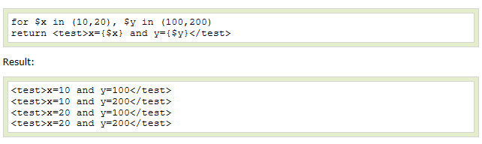
XQuery
FLWOR is an acronym for "For, Let, Where, Order by, Return".
  for - (optional) binds a variable to each item returned by the in expression

Slide 58
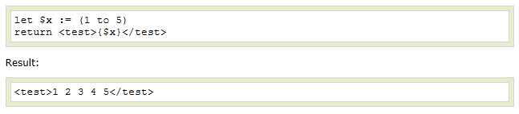
  2. let - (optional) allows variable assignments and it avoids repeating the same expression many times
  3. where - (optional) specifies used to specify one or more criteria for the result

Slide 59
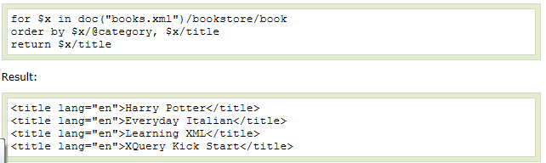
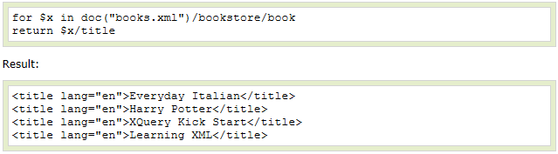
  4. order by - (optional) specifies the sort-order of the result
  5. return - specifies what to return in the result

Slide 60

XQuery Example
  The for clause selects all book elements under the bookstore element into a variable called $x.
  The where clause selects only book elements with a price element with a value greater than 30.
  The order by clause defines the sort-order. Will be sort by the title element.
  The return clause specifies what should be returned. Here it returns the title elements.

Slide 61
Advantages of XQuery
Declarative view definition
  Less programming
Query optimization
  Just like SQL, XQuery engine optimizes queries
Lower cost of code maintenance
  Less code when compared to DOM or SAX
Notes:
changing the join and filter condition does not require major rewrite your logic (similar to SQL)

Slide 62
XML Application
Storing data with complex structure
  User Preference stored by a browser
  Xml representations are mostly used to store documents and spreadsheets.
Standardized Data Exchange Formats
  Specialized applications such as banking and shipping to scientific application.
  In shipping industry, requires to store data such as shipment of goods, from whom and to where these goods are sent, to whom and to which place they are being shipping, so on.

Slide 63
XML Application
Web Services
  When a person needs information from outside or inside the organization, organization facilitate web based forms where users can provide inputs and get the required information in form of HTML.
Data Mediation
  Best example of data mediation application is comparison shopping in which the information about items, pricing, and shipping costs are obtained from different websites offering a particular item for sale. This aggregated information is quite valuable than the individual information given by a single site.

Slide 64
END OF CHAPTER

