Slide 1
Chapter 5
Distributed Query Processing and Optimization
By Safa Hamdare

Slide 2
Outline:
Concepts of Query Processing
Objectives of Distributed Query Processing
Phases in Distributed Query Processing
Join Strategies in Fragmented Relations
Global Query Optimization Algorithms

Slide 3
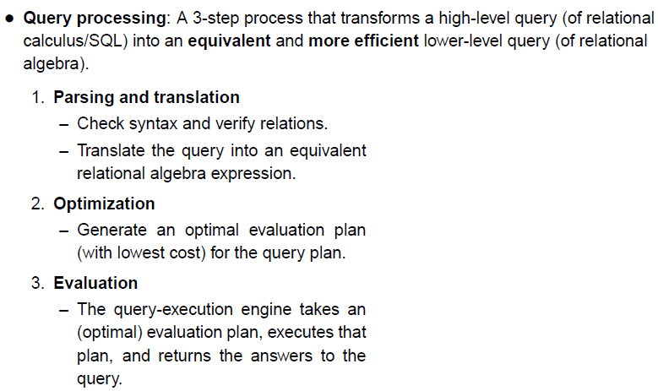
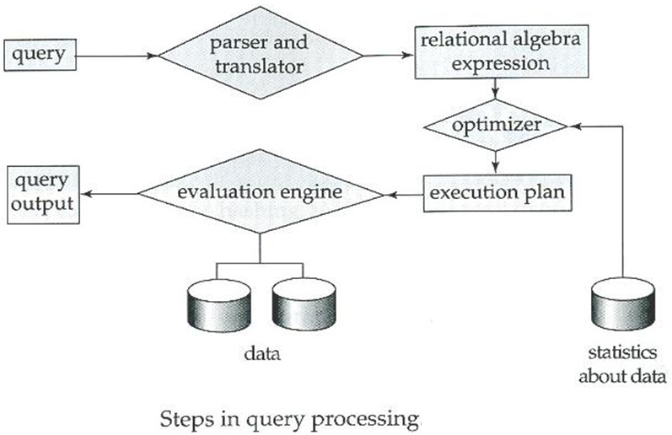
Concepts of Query Processing

Slide 4
Distributed Query Processing
Definition: Transforms a high-level query (of Relational Calculus/SQL) on a distributed database (i.e. a set of global relations) into an equivalent and Efficient Lower level Query (of Relational Algebra) on Relation Fragments.
Distributed Query Processing is more complex
Fragmentation/Replication is more complex
Additional Communication costs
Parallel execution

Slide 5
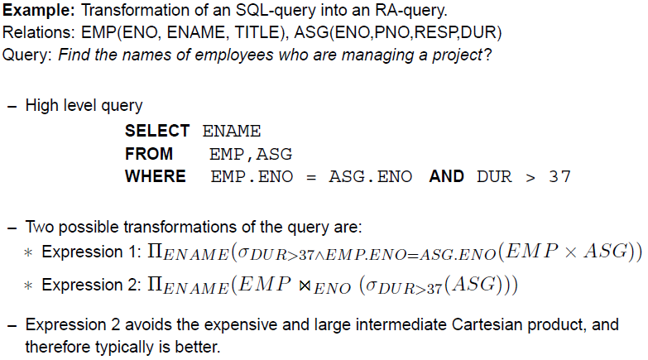
Query Processing Example:

Slide 6
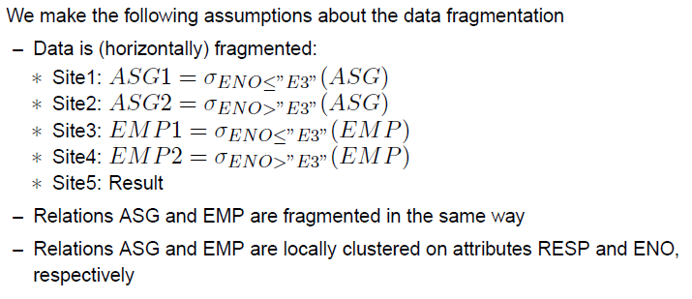
Query Processing Example:

Slide 7
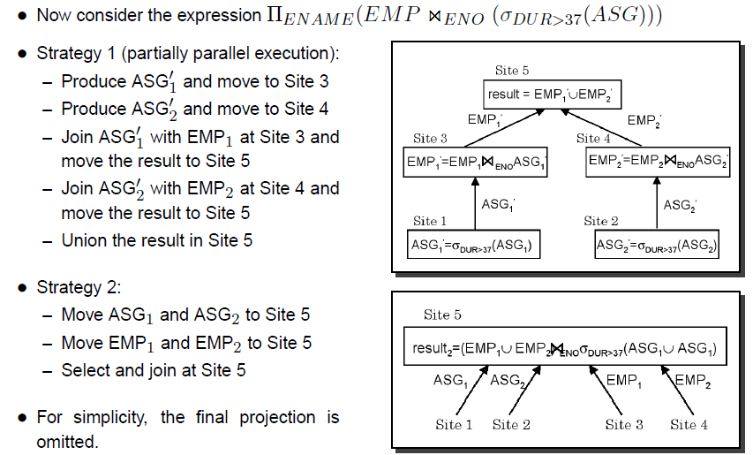
Query Processing Example:

Slide 8
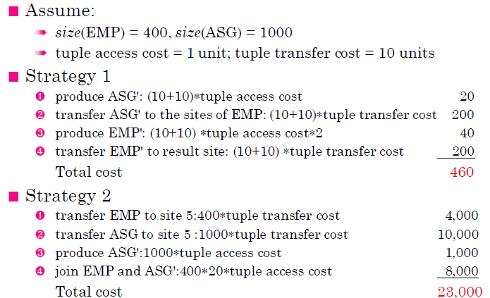
Cost of Alternatives

Slide 9
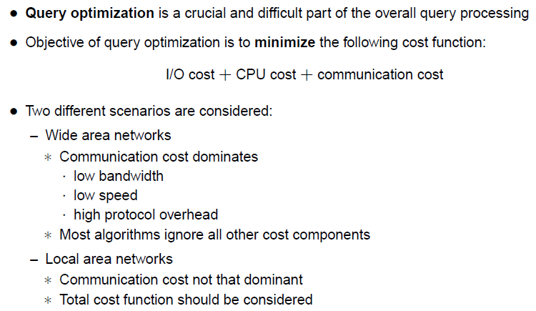
Query Optimization

Slide 10
Objectives of Distributed Query Processing
It involves the retrieving of data from physically distributed databases that provide the view of a single logical dB to the users.
To translate a high-level language query on a single logically distributed dB into low level language queries on physically distributed local dBs‘
To select an efficient execution strategy for execution of a distributed query that minimizes the consumption of computing resources
To minimize the total execution cost of the query which includes total processing cost + communication cost
To maximize the parallel execution of operations of a given distributed query so that the response time is significantly less than the total cost time

Slide 11
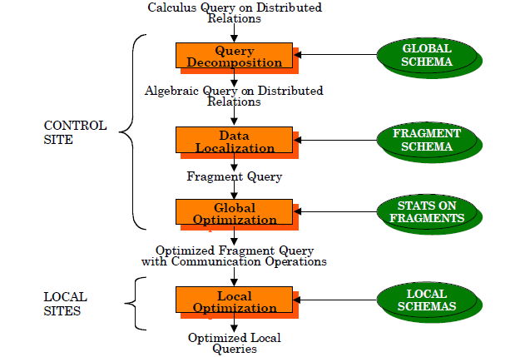
Phases in Distributed Query Processing
/Distributed Query generated site

Slide 12
Phases in Distributed Query Processing
Phase-1: Query Decomposition:
Normalization
Semantically Analyze the normalized query to eliminate incorrect queries.
Simplify the correct query by removing redundant predicates.
Restructure the algebraic query into a “better” algebraic specification.
Phase-2: Data Localization:
Determine which fragments are involved and transform the global query into fragment queries.
Phase-3: Global Query Optimization:
Find the “best” ordering of fragment queries and specifies the communication operations.
Phase-4: Local Query Optimization:
Each site determines the access methods for the local fragment queries using the local schema.

Slide 13
Step-1: Query Decomposition
The objective of this phase is to transform a query in a high-level language on global relations into a relational algebraic query on global relations.
The information required for the transformation is available in the global conceptual schema describing the global relations
In this phase, the syntactical and semantic correctness of the query is also checked.
The four successive steps of query decomposition are:
Normalization
Analysis
Simplification
Query Restructuring

Slide 14
Step 1 - Query Decomposition (cont.)
1) Normalization
The calculus query is written in a normalized form (CNF or DNF) for subsequent manipulation
2) Analysis
To reject normalized queries for which further processing is either impossible or unnecessary (type incorrect or semantically incorrect)
3) Simplification
Redundant predicates are eliminated to obtain simplified queries
4) Restructuring
The calculus query is translated to optimal algebraic query representation
More than one translation is possible

Slide 15
Step 1: Query Decomposition - Normalization
In Normalization step, the query is converted into a normalized from to facilitate further processing in an easier way.
In this step, the complex query is generally converted into one of the two possible normal forms by using a few transformations rules, as follows:
P1 ∧ P2 ⇔ P2 ∧ P1
P1 ∨ P2 ⇔ P2 ∨ P1
P1 ∧ (P2 ∧ P3) ⇔ (P1 ∧ P2) ∧ P3
P1 ∨ (P2 ∨ P3) ⇔ (P1 ∨ P2) ∨ P3
P1 ∧ (P2 ∨ P3) ⇔ (P1 ∧ P2) ∨ (P1 ∧ P3 )
P1 ∨ (P2 ∧ P3) ⇔ (P1 ∨ P2) ∧ (P1 ∨ P3 )
¬ (P1 ∧ P2) ⇔ ¬ P1 ∨ ¬ P2
¬ (P1 ∨ P2) ⇔ ¬ P1 ∧ ¬ P2
¬ (¬ P1) ⇔ P1

Slide 16
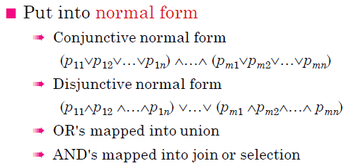
Step 1: Query Decomposition - Normalization
The two possible Normal Forms are Conjunctive Normal Form and Disjunctive Normal From.

Slide 17
Step 1: Query Decomposition - Example of Normalization
Consider the following 2 relations stored in distributed dB
Employee(Empid, Ename, Salary, Designation, Deptno)
Department(Deptno, Dname, Location)
And the following query for Normalization is:
Retrieve the names of all employees whose designation is ‘Manager’ and department name is ‘Production’ or ‘Printing’.
In SQL, the above query can be represented as:
Select ename from Employee, Department where designation=‘Manager’ and Employee.deptno= department.deptno and dname=‘Production’ or dname=‘Printing’.
The Conjunctive Normal Form of this Query is as follows:
(designation=‘Manager’ ∧ Employee.deptno= department.deptno) ∧ dname=‘Production’ ∨ dname=‘Printing’.
The Disjunctive Normal Form of this Query is as follows:
(designation=‘Manager’ ∧ Employee.deptno= department.deptno ∧ dname=‘Production’ ) ∨ (designation=‘Manager’ ∧ Employee.deptno= department.deptno ∧ dname=‘Printing’).
In the below disjunctive normal from, each disjunctive connected by ∨ (OR) Operator can be processed as independent conjunctive sub queries

Slide 18
Step 1: Query Decomposition - Analysis
The objective of the analysis step is to reject normalized queries that are incorrectly formulated or contradictory
In this step, the query is lexically and syntactically analyzed by using the compiler of high level query language in which the query is expressed.
It verifies whether the relations and attributes specified in the query are defined in the global conceptual schema or not.
It also checks whether operations on database objects specified in the given query are correct or not.
The semantic incorrectness in the query is detected based on the corresponding Query graph or Relational connection graph.

Slide 19
2) Analysis (cont.)- Syntactic Incorrectness
Type incorrect example
SELECT E#
FROM EMP
WHERE ENAME>200
! Undefined attribute
Type incorrect
if any of its attribute or relation names is not defined in the global schema;
if operations are applied to attributes of the wrong type
! Type mismatch

Slide 20
2) Analysis (cont.)
Semantically Incorrect
Components do not contribute in any way to the generation of the result
For only those queries that do not use disjunction (∨) or negation (¬), semantic correctness can be determined by using query graph

Slide 21
Step 1: Query Decomposition - Analysis
The Query graph or Relational connection graph can be constructed as follows:
A Node is created in the query graph for the result and for each base relation specified in the query.
An edge between two nodes is drawn in the query graph for each join operation and for each project operation in the query.
An edge between two nodes that are not result nodes represents a join operation, whereas an edge whose destination node is the result node represents a project operation.
A node in the query graph that is not the result node is labeled by a select operation or a self join operation specified in the query.
This graph is used to check the semantic correctness of the subset of the queries, such a graph is semantically incorrect , if the graph is not connected.

Slide 22
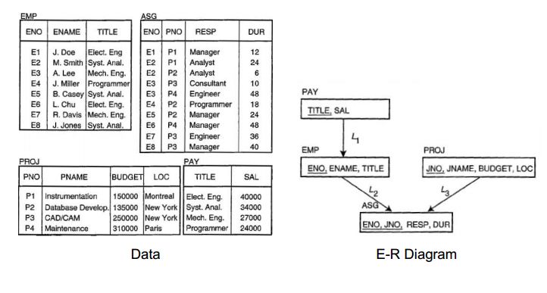
Example: Employee-Project

Slide 23
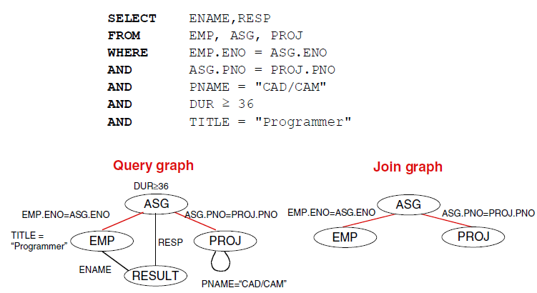
Step 1: Query Decomposition - Example Analysis

Slide 24
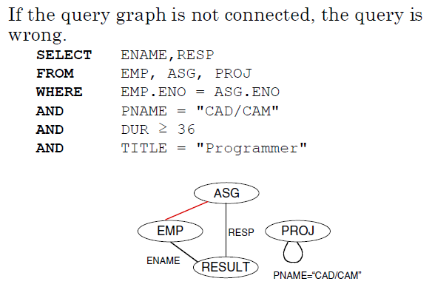
Step 1: Query Decomposition - Example Analysis

Slide 25
Step 1: Query Decomposition - Simplification
In this step, all redundant predicates in the query are detected and the common sub expressions are eliminated to transform the query into a simpler and efficient computable form.
To eliminate redundancy from the given query, the well known idempotency rules of Boolean Algebra used are:
P ∧ P ⇔ P
P ∨ P⇔ P
P ∧ True ⇔ P
P ∧ False ⇔ False
P ∨ True ⇔ True
P ∨ False ⇔ P
P ∧ ¬ P ⇔ False
P ∨ ¬ P ⇔ True
P∧ (P ∨ Q) ⇔ P
P ∨ (P ∧ Q) ⇔ P

Slide 26
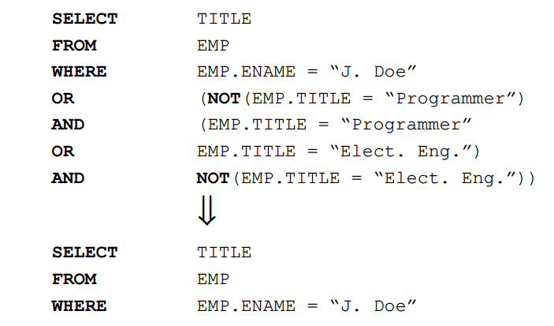
Step 1: Query Decomposition - Example Simplification
P ∨ (Q ∧ ¬ Q) ∨ (S ∧ ¬ S)
P ∨ (False) ∨ (False)
P

Slide 27
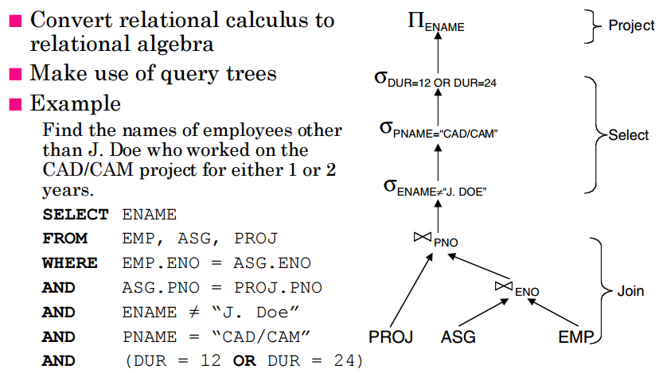
Step 1: Query Decomposition -Query Restructuring

Slide 28
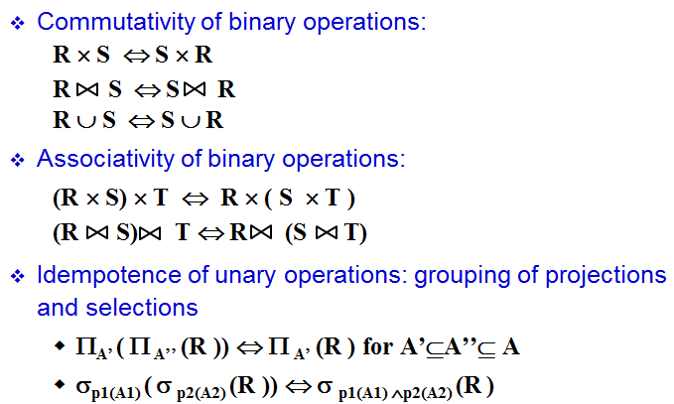
Step 1: Query Decomposition Query Restructuring- Transformation Rules

Slide 29
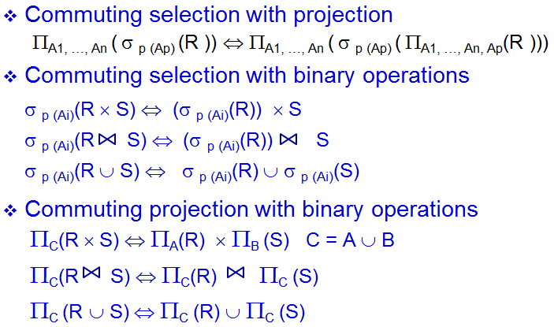
Step 1: Query Decomposition Query Restructuring- Transformation Rules

Slide 30
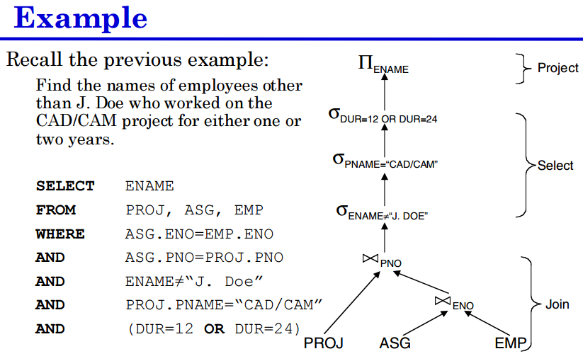
Step 1: Query Decomposition -Query Restructuring

Slide 31
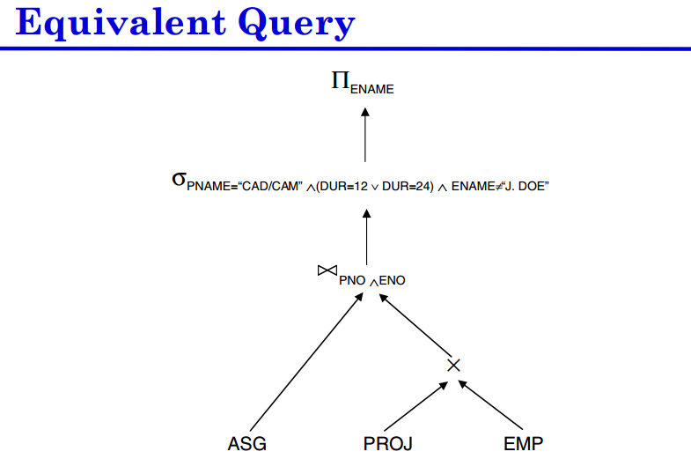
Step 1: Query Decomposition -Query Restructuring

Slide 32
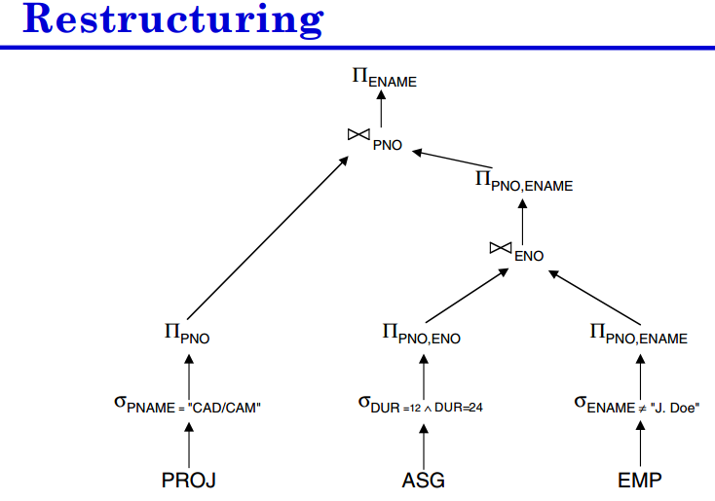
Step 1: Query Decomposition -Query Restructuring

Slide 33
Example on Step 1: Query Decomposition
Given Relation:
Emp (Eno, Ename, Title)
Asg (Eno, Pno, Resp, 7dur)
Proj (Pno, Pname, Budget, Loc)
Query: Perform Query Decomposition on the following Example
Retrieve names of employee and representatives for project “CAD/CAM” and duration of projects greater than or equal to 36 months and title of employee is either Mech Engg. Or not a Mech Engg.
Select Ename, Resp
from Emp, Asg, Proj
where Emp.Eno=Asg.Eno AND
Asg.Pno=Proj.Pno AND
Proj. Pname=“CAD/CAM” AND
Asg.Dur>=36 AND
Emp.Title=“Mech Engg” OR Not (Emp.Tilte=“Mech Engg.”);

Slide 34
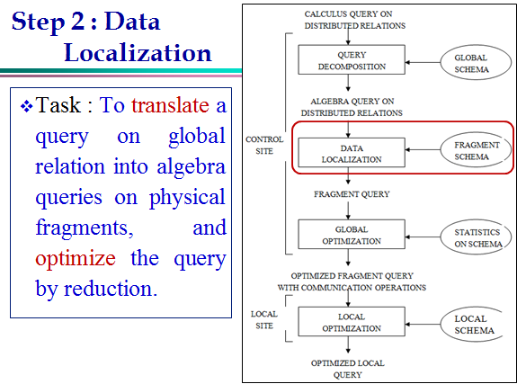

Slide 35
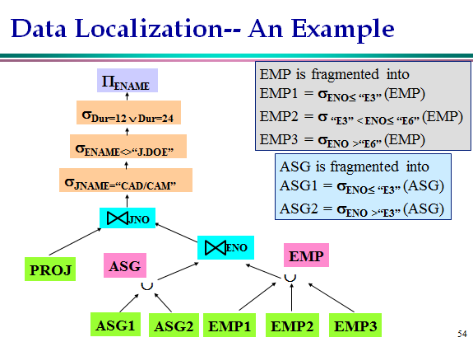

Slide 36
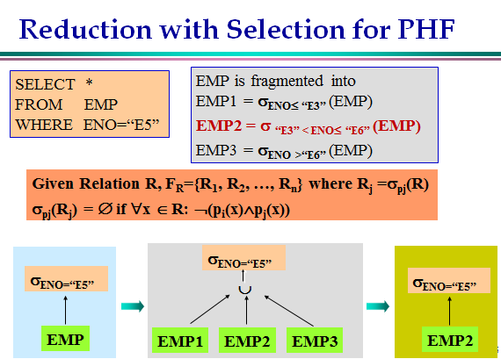
Generic Query Tree
Reduced
Query Tree

Slide 37
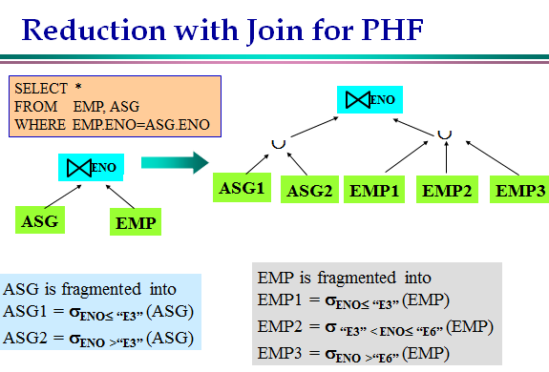
Generic Query Tree

Slide 38
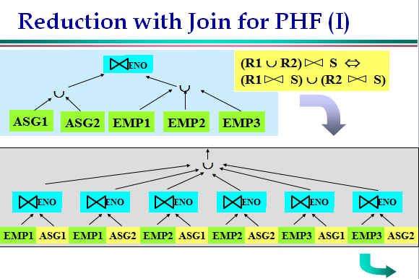

Slide 39
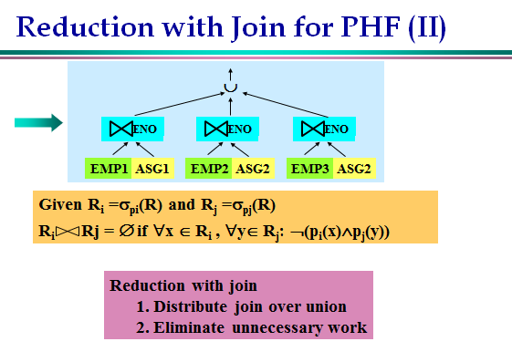
Reduced
Query Tree

Slide 40
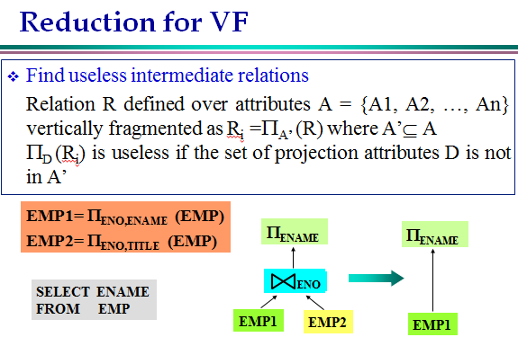
Generic Query
Tree
Reduced
Query Tree

Slide 41
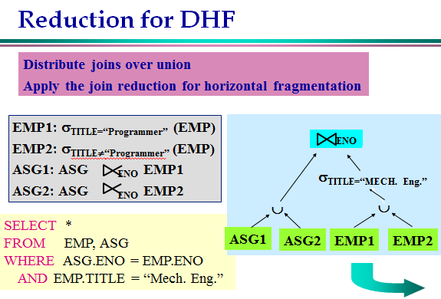
Generic Query
Tree

Slide 42
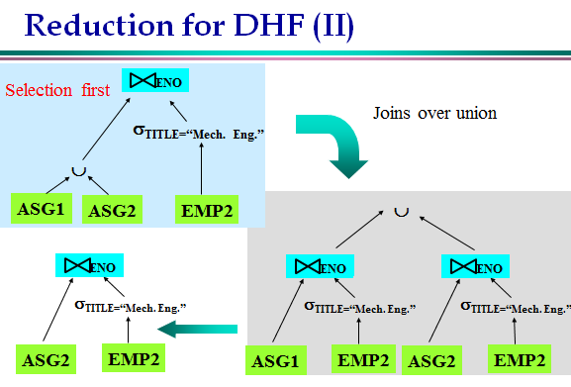
Reduced
Query Tree

Slide 43
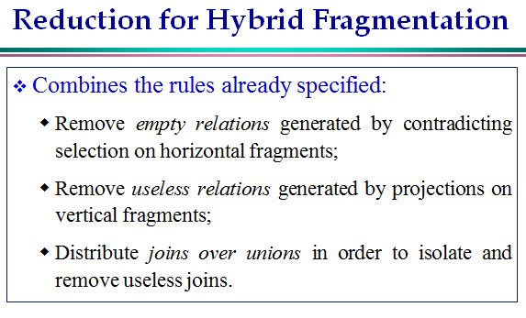

Slide 44
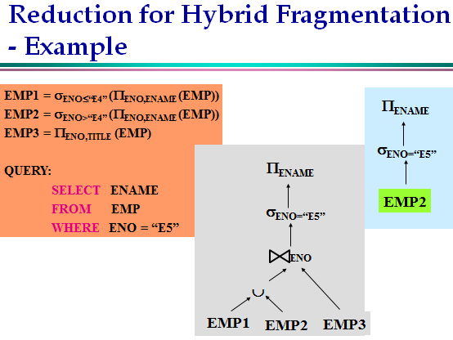

Slide 45
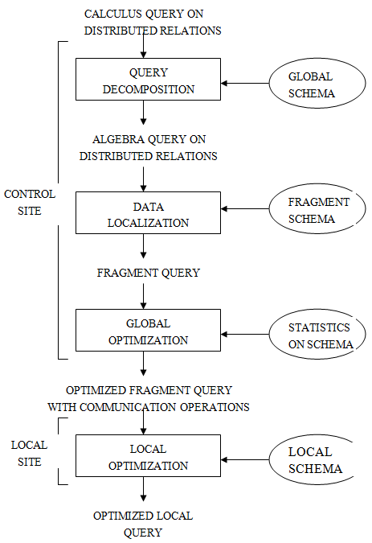

Slide 46
Step 3 – Global Query Optimization
Input: Fragment Query
Query Optimization is the activity of choosing an efficient execution strategy among several alternatives for processing a query.
Same for both centralized and distributed dB System.
The selected query execution strategy must minimize the cost of query processing.
In distributed DBMS, the query execution cost is expressed as:
Total of Local Processing cost(I/O cost and CPU Cost) + Communication Cost
The Optimal Query execution strategy is selected by a software module known as Query Optimizer, which is represented by 3 components: Search Space, Optimization Strategy and Cost Model

Slide 47
Query Optimization Process
Input Query
Search Space
Generation
1
Transformation
Rules
Equivalent QEP
Search
Strategy
3
2
Cost Model
Best QEP

Slide 48
a)Search Space
The Search Space is defined as the set of equivalent query trees for a given query that can be generated by using transformation rules.
In Query Optimization, Join trees are particularly important, because they determine the join order of relations involved in a given query, which affects the performance of query Processing.
If a given query involves many operators and many relations then the search space is very large, because it contains a large number of equivalent query trees for the given query.
Hence, the query optimization process becomes more expensive than the actual execution, and therefore query optimizers typically impose some restrictions on the size of the search space to be considered.

Slide 49
a) Search Space
a)
Search space characterized by alternative execution plans
SELECT ENAME,RESP
FROM EMP, ASG, PROJ
WHERE EMP.ENO=ASG.ENO
AND ASG.PNO=PROJ.PNO
_{PNO}
_{ENO}
PROJ
EMP
ASG
b)
_{ENO}
_{PNO}
EMP
PROJ
ASG
Join tree (c) which starts with a Cartesian product may have a much higher cost than other join trees.
c)
_{ENO,PNO}
×
ASG
PROJ
EMP

Slide 50
a)Search Space
Restrict by means of heuristics
Perform unary operations before binary operations
Restrict the shape of the join tree
Consider only linear trees, ignore bushy ones
A linear tree – at least one operand of each operand node is a base relation.
A bushy tree is more general and may have operators whose both operands are intermediate operators.
Linear Join Tree
Bushy Join Tree
R₄
R₃
R₁
R₂
R₁
R₂
R₃
R₄

Slide 51
b) Optimization Strategy
There are 2 different kinds of optimization strategies, known as:
Dynamic Optimization Strategy and
Randomized Optimization Strategy
Deterministic/ Dynamic
Start from base relations and build plans by adding one relation at each step until the complete plan is obtained.
Advantage: it is comprehensive and ensures the best plan
Disadvantage: Performance of query is affected, because the query has to be parsed, validated and optimized each time before execution.
Suitable when no. of relations involved in query is less.
Randomized
In this strategy, one or more start plans are built by a greedy strategy and then it tries to improve the start plan by visiting its neighbor.
Advantage: Performance is better than other strategy
Disadvantage: Does not ensure the best execution plan
Suitable when no. of relations involved in query is more..

Slide 52
Optimization Search Strategies
Deterministic
R₄
R₃
R₃
R₁
R₂
R₁
R₂
R₁
R₂
Randomized: One typical example where exchanging 2 randomly chosen operand relations of the plan to get a next improved plan.
R₃
R₂
R₁
R₂
R₁
R₃

Slide 53
c) Distributed Cost Model
An optimizer‘s cost model includes:
Cost functions to predict the cost of operators
Statistics and base data and formulas to evaluate the sizes of intermediate results.
Cost Functions can be expressed with respect to either the total time or the response time.
The TOTAL TIME is the sum of all time (cost) components,
The RESPONSE TIME is the elapsed time from the initiation to the completion of the query.
Total_time = T_{CPU} * #insts + T_{I/O} * #I/Os + T_{MSG} * #msgs + T_{TR} * #bytes
T_{CPU} – the time of a CPU instruction
T_{I/O} - the time of a disk I/O
T_{MSG} - the fixed time of initiating and receiving a message
T_{TR} - the time it takes to transmit a data unit from one site to another

Slide 54
Cost Function (cont.)
When the response time of the query is the objective function of the optimizer, parallel local processing and parallel communications must also be considered.
Response_time = T_{CPU} * seq_#insts + T_{I/O} * seq_#I/Os + T_{MSG} * seq_#msgs + T_{TR} * seq_#bytes
Example:
Site 1
x units
Site 3
Site 2
y units
Most early distributed DBMSs designed for wide area networks have ignored the local processing cost and concentrate on minimizing the communication cost.
Total_time = 2 * T_{MSG} + T_{TR} * (x +y)
Respone_time = max { T_{MSG} + T_{TR} * x, T_{MSG} + T_{TR} * y }
since the transfers can be done in parallel.
Notes:
objective function = Zielfunktion

Slide 55
Cost Function (cont.)
Minimizing response time is achieved by increasing the degree of parallel execution.
This does not imply that the total time is also minimized.
On contrary, it can increase the total time, for example by having more parallel local processing (often includes synchronization overhead) and transmissions.
Minimizing the total time implies that the utilization of the resources improves, thus increasing the system throughput.
In practice, a compromise between the total and response times is desired.
Notes:
hroughput – Durchlaufleistung; Durchsatz

Slide 56
Step 4 – Local Query Optimization
Input: Best Global Execution Schedule
Select the Best Access Path
Local Query Optimization is the utmost important because the distributed query is fragmented into several sub queries each of which is processed at local site in a centralized way.
Use the Centralized Optimization Techniques- INGRES Algorithm

Slide 57
INGRES – General Strategy
Decompose a Multivariable query into a sequence of Mono-variable queries with a common variable
Process each by an one variable query processor
Choose an initial execution plan (heuristics)
Order the rest by considering intermediate relation sizes
No statistical information is maintained.

Slide 58
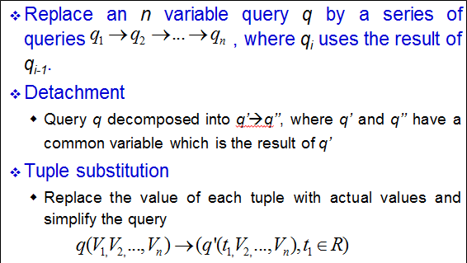
INGRES - Decomposition

Slide 59
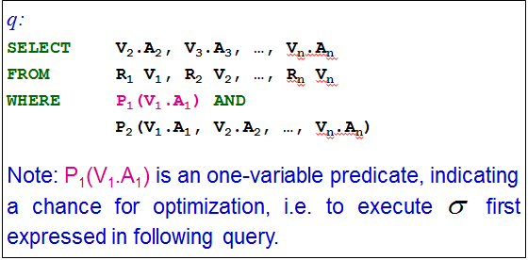
INGRES – Detachment

Slide 60
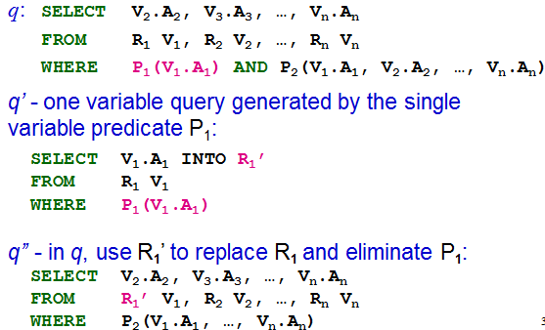
INGRES – Detachment (cont.)

Slide 61
INGRES – Detachment (cont.)
Note:
Query q is decomposed into q’ → q’’
It is an optimized sequence of query execution

Slide 62
INGRES – Detachment Example
Original query q₁
SELECT E.ENAME
FROM EMP E, ASG G, PROJ J
WHERE E.ENO=G.ENO AND
J.PNO=G.PNO AND
J.PNAME=“CAD/CAM”
q₁ can be decomposed into q₁₁→q₁₂→q₁₃

Slide 63
INGRES – Detachment Example (cont.)
First use the one variable predicate to get
q₁₁ and q’ such that q = q₁₁→ q’
q_{11:}
SELECT J.PNO INTO JVAR
FROM PROJ J
WHERE PNAME=“CAD/CAM”
q’:
SELECT E.ENAME
FROM EMP E, ASG G, JVAR
WHERE E.ENO=G.ENO
AND G.PNO=JVAR.PNO

Slide 64
INGRES – Detachment Example (cont.)
Then q’ is further decomposed into q₁₂→q₁₃
SELECT G.ENO INTO GVAR
FROM ASG G, JVAR
WHERE G.PNO=JVAR.PNO
SELECT E.ENAME
FROM EMP E, GVAR
WHERE E.ENO=GVAR.ENO
q₁₂
q₁₃
q11 is a mono-variable query
q12 and q13 are subject to tuple substitution

Slide 65
Tuple Substitution
Assume GVAR has two tuples only: <E1> and <E2>, then q₁₃ becomes:
q₁₃₁
SELECT EMP.ENAME
FROM EMP
WHERE EMP.ENO = “E1”
SELECT EMP.ENAME
FROM EMP
WHERE EMP.ENO = “E2”
q₁₃₂

Slide 66
Example on INGRESS Algorithm : (Centralized)
Given the Relational Schema:
Student(sreg_no, sname, street, city, course_id)
Course (Course_id, cname, duration, fees)
Teacher (T_id, Tname, designation, salary, Course_id)
SQL Query:
Select Sname, Tname
From Student S, Course C, Teacher T
Where S.course_id=C.Course_id AND
C.course_id=T.course_id AND
C.Duration=4;

Slide 67
Example on INGRESS Algorithm : (Centralized)- Detachment Step
Select s.sname, t.tname from student s, course c, teacher t where s.course-id=c.course-id and c.course-id=t.course-id and c.duration=4;
Q1: select c.course-id into cvar from course where c.duration=4;
Q2: select s.sname, t.tname from student s, cvar, teacher t where s.course-id=cvar.course-id and cvar.course-id=t.course-id;
Q21: selecct t.tname, t.course-id into tvar from teacher, cvar where t.course-id=cvar.course-id;
Q22: select s.sname from student s, tvar where s.course-id=tvar.course-id;

Slide 68
Example on INGRESS Algorithm : (Centralized)- Tuple Substitution
Q22: select s.sname from student s, tvar where s.course-id=tvar.course-id;
For three courses, if Course-id given as C01,C02,C03
Select sname from student where student.course-id=“C01”;
Select sname from student where student.course-id=“C02”;
Select sname from student where student.couse-id=“C03”;

Slide 69
Thank you

