Slide 1
Chapter 6
Heterogeneous Database

Slide 2
Outline
Architecture of Heterogeneous Database
Database Integration
Schema Translation and
Schema Integration
Query Processing Issues in Heterogeneous Database

Slide 3
Introduction to Types of Database

Slide 4
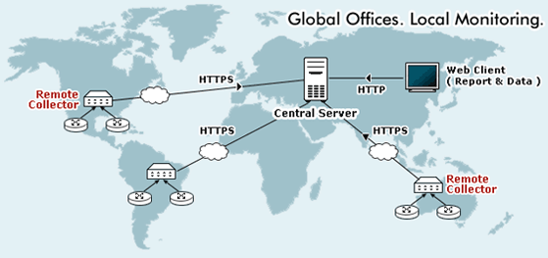
Centralized Database
A centralized database (sometimes abbreviated CDB) is a database that is located,
stored, and maintained in a single location. This location is most often a central computer or database system, for example a desktop or server CPU, or a mainframe computer.

Slide 5
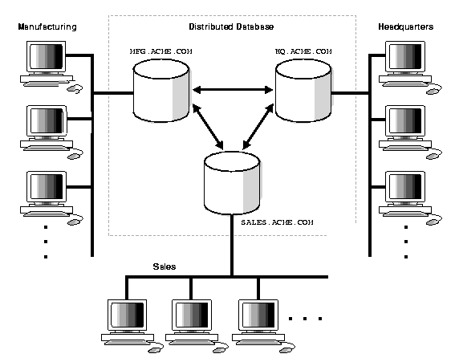
Distributed Database
A distributed database is a database that is under the control of a central database management system (DBMS) in which storage devices are not all attached to a common CPU. It may be stored in multiple computers located in the same physical location, or may be dispersed over a network of interconnected computers.

Slide 6
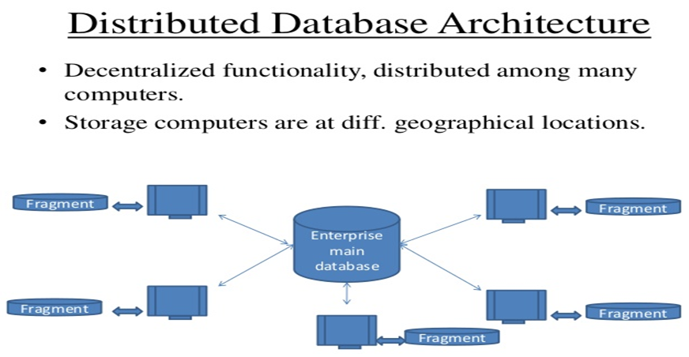
Distributed Database Architecture
A distributed database consists of a single logical database that is split into a number of partitions and fragments. Each Partitions is stored on one or more computers under the control of a separate DBMS, with computer connected by a communication network.
Fragmentation

Slide 7
Distributed DBMS Design Problems
In the general setting:
Making decisions about the placement of data and programs across the sites of a computer network as well as possibly designing the network itself.
In Distributed DBMS, the placement of applications entails
Placement of the distributed DBMS software; and
Placement of the applications that run on the database

Slide 8
Types of Distributed DBMS:
Homogeneous System: means its a system copy with all the database tables from one system to another system of same kind, like same OS/Db on both system.
Heterogeneous System: means copy from one system to another system of a different kind, like different OS/Db in either of those.

Slide 9
Features of Homogeneous DDBMS
All sites use same DBMS product.
Much easier to design and manage.
Approach provides incremental growth and allows increased performance.
All access is through one, global schema.
The global schema is the union of all the local schema.

Slide 10
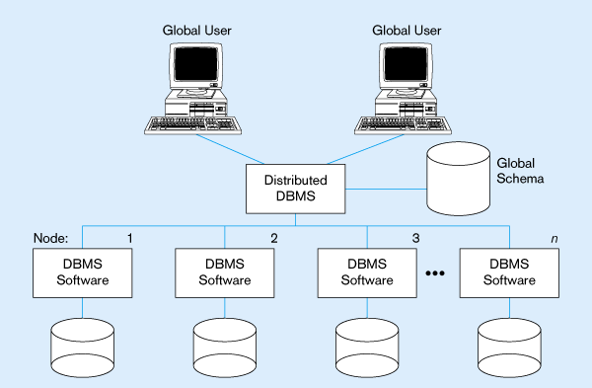
Homogeneous Database
Identical DBMSs

Slide 11
Features of Heterogeneous DDBMS
Sites may run different DBMS products, with possibly different underlying data models.
Occurs when sites have implemented their own databases and integration is considered later.
Translations required to allow for:
Different hardware.
Different DBMS products.
Different hardware and different DBMS products.
Local access is done using the local DBMS and schema
Remote access is done using the global schema

Slide 12
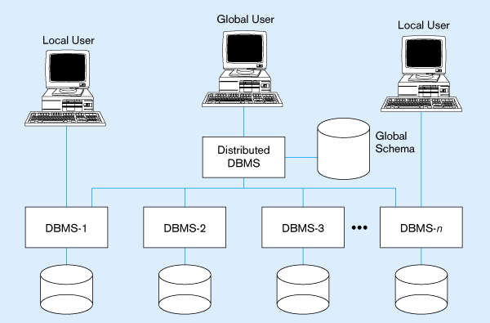
Typical Heterogeneous Environment
Non-identical DBMSs

Slide 13
Difference between Homogeneous & Heterogeneous Database System.
Homogeneous System: means its a system copy with all the database tables from one system to another system of same kind, like same OS/Db on both system.
Heterogeneous System: means copy from one system to another system of a different kind, like different OS/Db in either of those.

Slide 14
Homogeneous System | Heterogeneous System
In homogeneous DDBMS, all sites use the same DBMS product | In heterogeneous DDBMS, all sites may run different DBMS products, which need not to be based on the same underlying data model and so the system may be composed of RDBMS, ORDBMS and OODBMS products.
In homogeneous DDBMS, the query processing and Query Evaluation are fast. | As various sites use different versions of a database, the query processing and query evaluation tasks consume more time in comparison with the homogenous database systems. Due to the difference in the architecture of DBMS, you need to transform a request to the format that is required by a system. This result into the increase in the overhead cost and the performance of DBMS may also decreases. An alternative to solve such a problem is to use gateways.
Homogenous DDBMS is implemented in a planned manner in which the site is implemented and integrated to create DDBMS at the same time. | In heterogeneous database, site establishment is done first followed with integration.
Various commercial products are available in the market. | Such database are used as a Research Protocol in the market.

Slide 15
Database Integration

Slide 16
Schema Integration
When two database schemas are designed by different designers using different user requirement, the resulting Schemas will often present contrasting views of the same data.
This situation might occur in an organization that allows different departments to have different rules as to how employees are allocated to projects.
For example, in one department employees may be assigned to projects while in another department employees may not be considered to be directly related to a project.

Slide 17
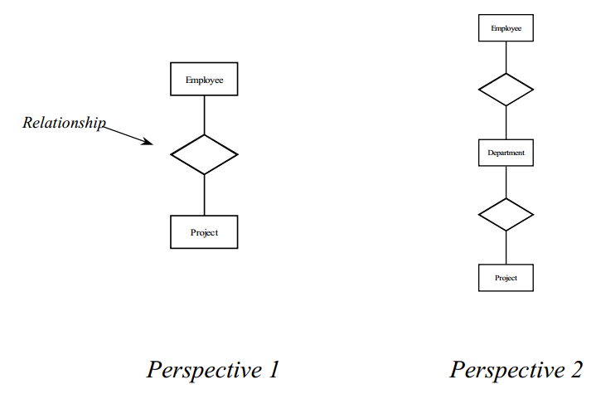
Schema Integration Example
In the example above, the relationship between employee and project in one database is represented as a relationships between employee, department and project in another database.

Slide 18
Query Processing Issues in Heterogeneous Database
Several issues in query processing in a heterogeneous database
Schema translation
Write a wrapper for each data source to translate data to a global schema
Wrappers must also translate updates on global schema to updates on local schema
Limited query capabilities
Some data sources allow only restricted forms of selections
E.g. web forms, flat file data sources
Queries have to be broken up and processed partly at the source and partly at a different site
Removal of duplicate information when sites have overlapping information
Decide which sites to execute query
Global query optimization

Slide 19
Thank You

