Slide 1
Aspect-oriented Software Development 2

Slide 2
Concern-oriented requirements engineering
An approach to requirements engineering that focuses on customer concerns is consistent with aspect-oriented software development.
Viewpoints (discussed in Chapter 7) are a way to separate the concerns of different stakeholders.
Viewpoints represent the requirements of related groups of stakeholders.
Cross-cutting concerns are concerns that are identified by all viewpoints.

Slide 3
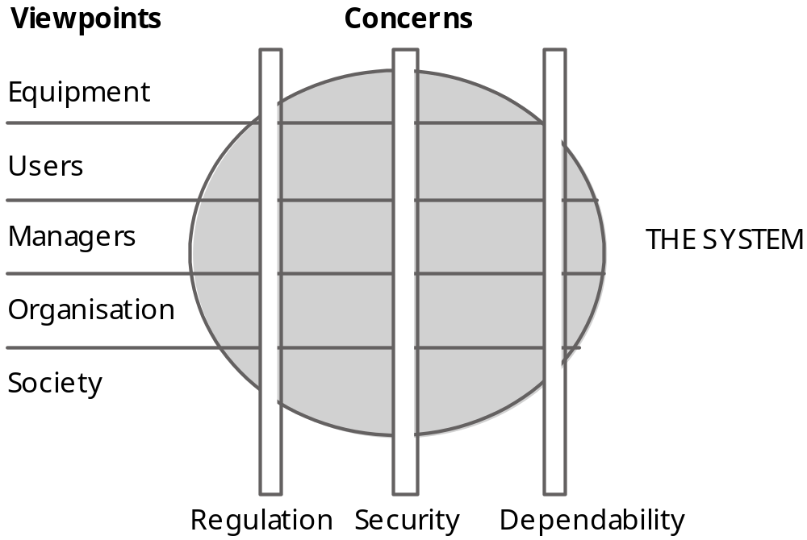
Viewpoints and Concerns

Slide 4
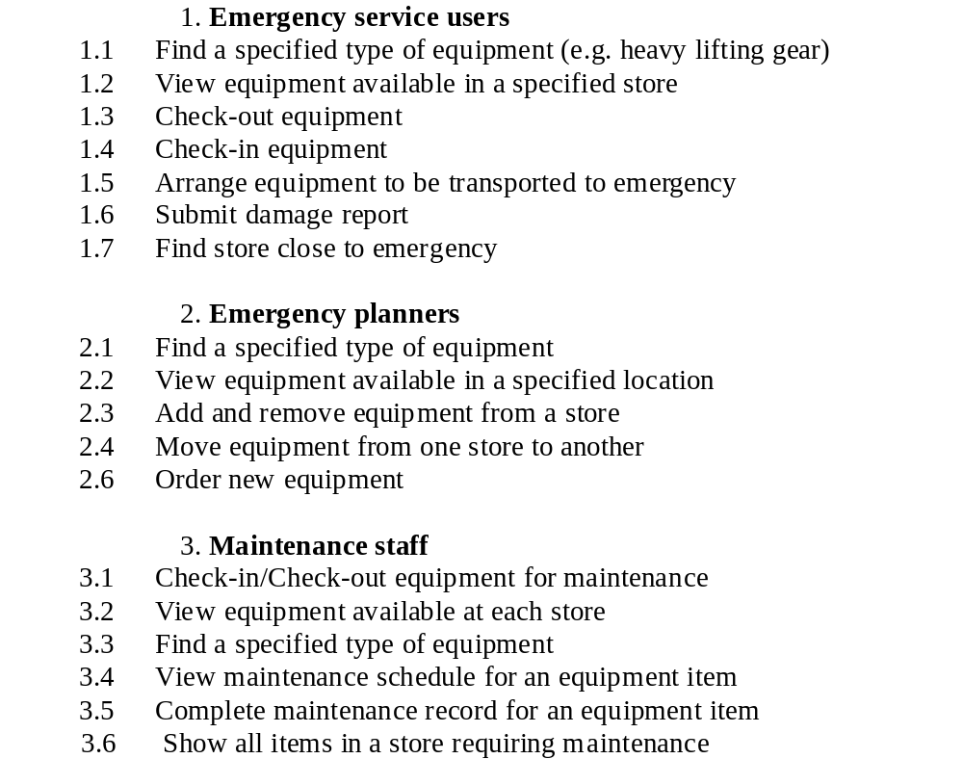
Viewpoints on an inventory system

Slide 5
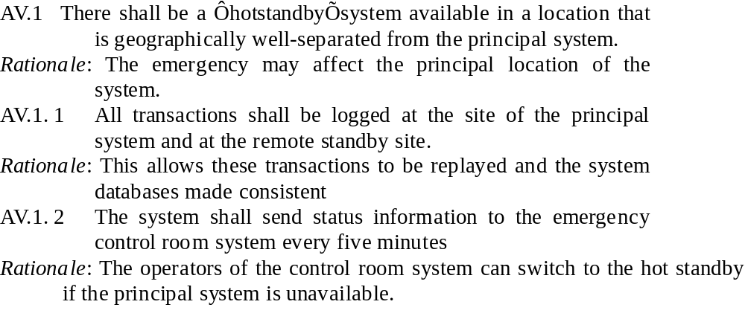
Availability requirements

Slide 6
Inventory system - core requirements
C.1 The system shall allow authorised users to view the description of any item of equipment in the emergency services inventory.
C.2 The system shall include a search facility to allow authorised users to search either individual inventories or the complete inventory for a specific item or type of equipment.

Slide 7
Inventory system - extension requirements
E1.1 It shall be possible for authorised users to place orders with accredited suppliers for replacement items of equipment.
E1.1.1 When an item of equipment is ordered, it should be allocated to a specific inventory and flagged in that inventory as ‘on order’.

Slide 8
Aspect-oriented design/programming
Aspect-oriented design
  The process of designing a system that makes use of aspects to implement the cross-cutting concerns and extensions that are identified during the requirements engineering process.
Aspect-oriented programming
  The implementation of an aspect-oriented design using an aspect-oriented programming language such as AspectJ.

Slide 9
Use-cases
A use-case approach can serve as a basis for aspect-oriented software engineering.
Each use case represents an aspect.
  Extension use cases naturally fit the core + extensions architectural model of a system
Jacobsen and Ng develop these ideas of using use-cases by introducing new concepts such as use-case slices and use case modules.

Slide 10
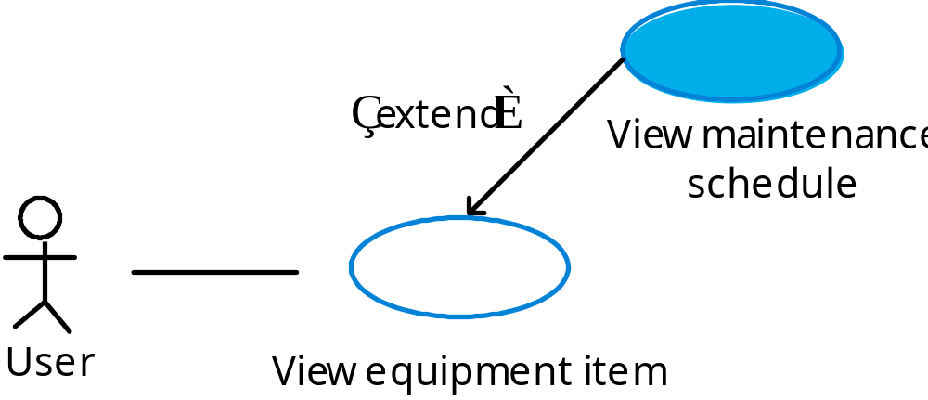
An extension use case

Slide 11
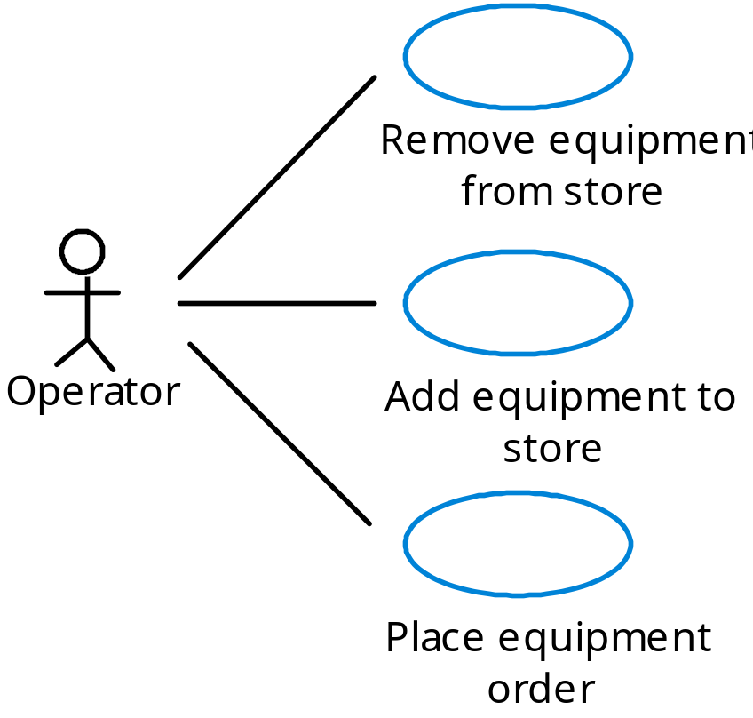
Inventory use cases

Slide 12
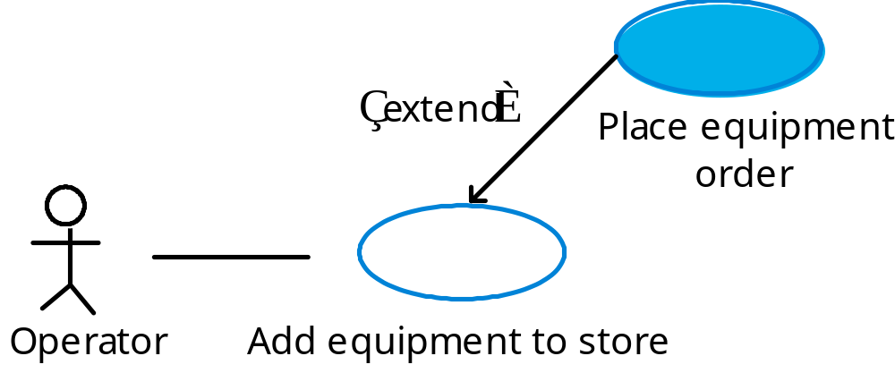
Inventory extension use-case

Slide 13
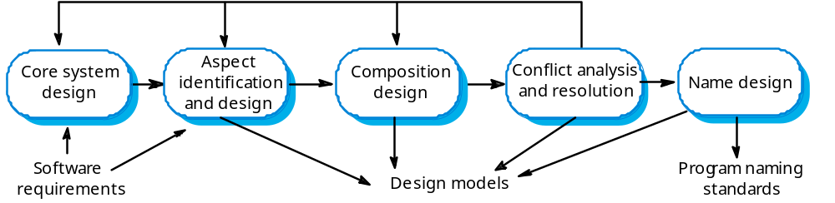
An AOSD process

Slide 14
UML extensions
Expressing an aspect oriented design in the UML requires:
  A means of modelling aspects using UML stereotypes.
  A means of specifying the join points where the aspect advice is to be composed with the core system.

Slide 15
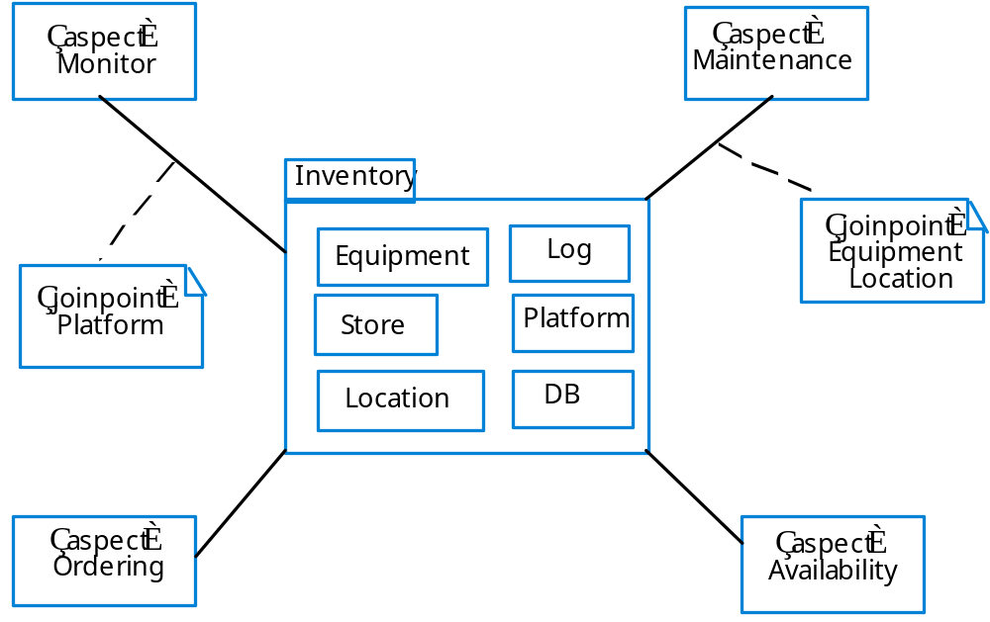
An aspect-oriented design model

Slide 16
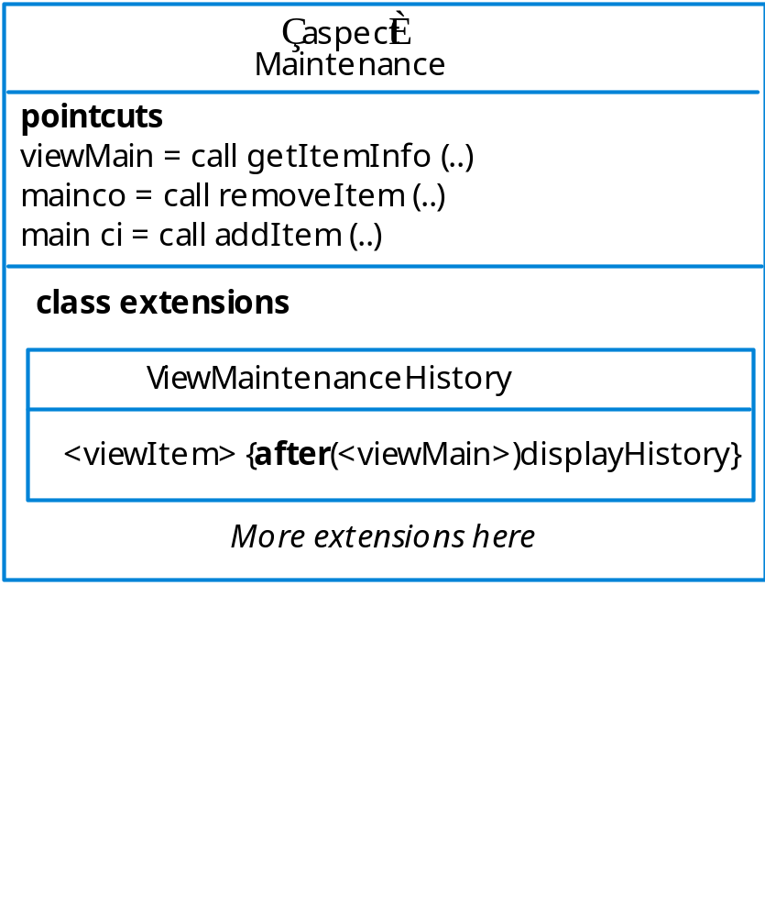
A partial model of an aspect

Slide 17
Verification and validation
The process of demonstrating that a program meets it specification (verification) and meets the real needs of its stakeholders (validation)
Like any other systems,aspect-oriented systems can be tested as black-boxes using the specification to derive the tests
However, program inspections and ‘white-box’ testing that relies on the program source code is problematic.
Aspects also introduce additional testing problems

Slide 18
Testing problems with aspects
How should aspects be specified so that tests can be derived?
How can aspects be tested independently of the base system?
How can aspect interference be tested?
How can tests be designed so that all join points are executed and appropriate aspect tests applied?

Slide 19
Program inspection problems
To inspect a program (in a conventional language) effectively, you should be able to read it from right to left and top to bottom.
Aspects make this impossible as the program is a web rather than a sequential document. You can’t tell from the source code where an aspect will be woven and executed.
Flattening an aspect-oriented program for reading is practically impossible.

Slide 20
White box testing
The aim of white box testing is to use source code knowledge to design tests that provide some level of program coverage e.g. each logical branch in a program should be executed at least once.
Aspect problems
  How can source code knowledge be used to derive tests?
  What exactly does test coverage mean?

Slide 21
Aspect problems
Deriving a program flow graph of a program with aspects is impossible. It is therefore difficult to design tests systematically that ensure that all combinations of base code and aspects are executed.
What does test coverage mean?
  Code of each aspect executed once?
  Code of each aspect exeucted once at each join point where aspect woven?
  ???

Slide 22
Key points
To identify concerns, you may use a viewpoint-oriented approach to requirements engineering.
The transition from requirements to design may be made using use-cases where each use-case represents a stakeholder concern.
The problems of inspecting and deriving tests for aspect-oriented programs are a significant barrier to the adoption of AOSD.

