Slide 1
Service-centric Software Engineering 1

Slide 2
Objectives
To explain the notion of a reusable service, based on web service standards, that provides a mechanism for inter-organisational computing;
To describe the service engineering process that is intended to produce reusable web services;
To introduce service composition as a means of application development;
To show how business process models may be used as a basis for the design of service-oriented systems.

Slide 3
Service-oriented architectures
A means of developing distributed systems where the components are stand-alone services
Services may execute on different computers from different service providers
Standard protocols have been developed to support service communication and information exchange

Slide 4
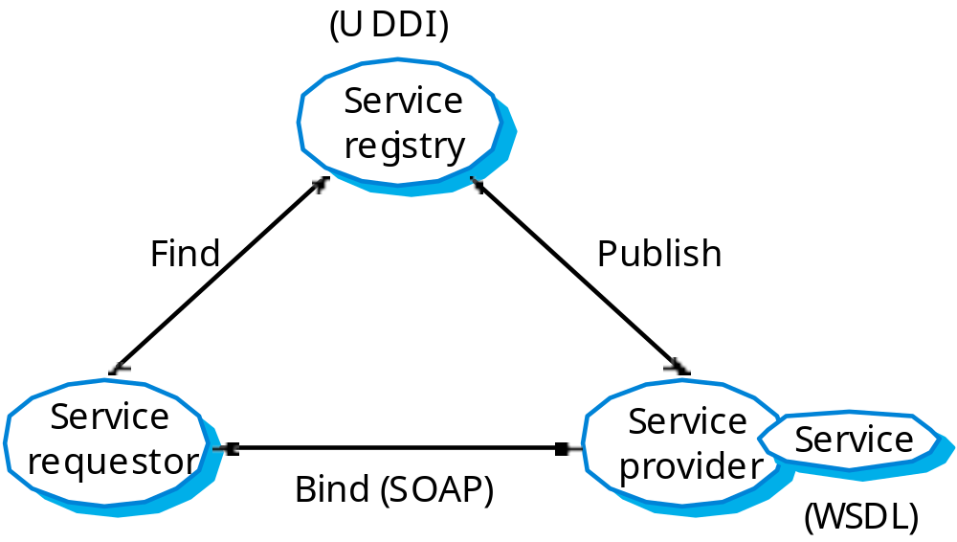
Service-oriented architectures

Slide 5
Benefits of SOA
Services can be provided locally or outsourced to external providers
Services are language-independent
Investment in legacy systems can be preserved
Inter-organisational computing is facilitated through simplified information exchange

Slide 6
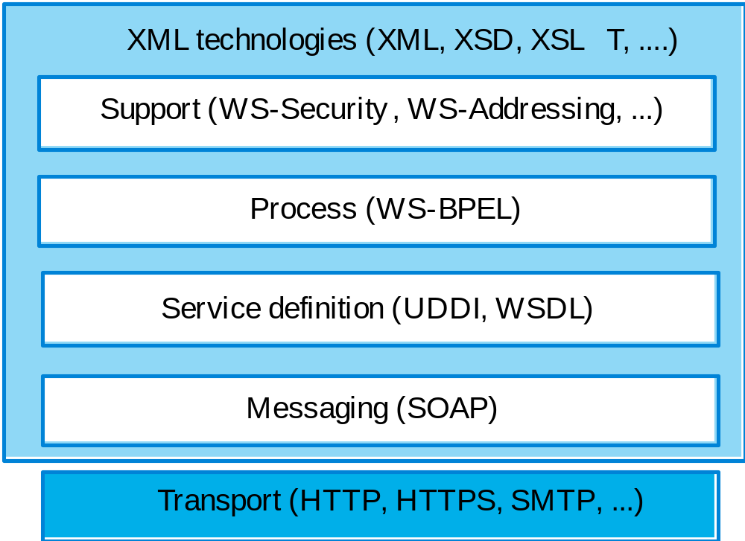
Web service standards

Slide 7
Key standards
SOAP
  A message exchange standard that supports service communication
WSDL (Web Service Definition Language)
  This standard allows a service interface and its bindings to be defined
UDDI
  Defines the components of a service specification that may be used to discover the existence of a service
WS-BPEL
  A standard for workflow languages used to define service composition

Slide 8
Service-oriented software engineering
Existing approaches to software engineering have to evolve to reflect the service-oriented approach to software development
  Service engineering. The development of dependable, reusable services
    Software development for reuse
  Software development with services. The development of dependable software where services are the fundamental components
    Software development with reuse

Slide 9
Services as reusable components
A service can be defined as:
  A loosely-coupled, reusable software component that encapsulates discrete functionality which may be distributed and programmatically accessed. A web service is a service that is accessed using standard Internet and XML-based protocols
A critical distinction between a service and a component as defined in CBSE is that services are independent
  Services do not have a ‘requires’ interface
  Services rely on message-based communication with messages expressed in XML

Slide 10
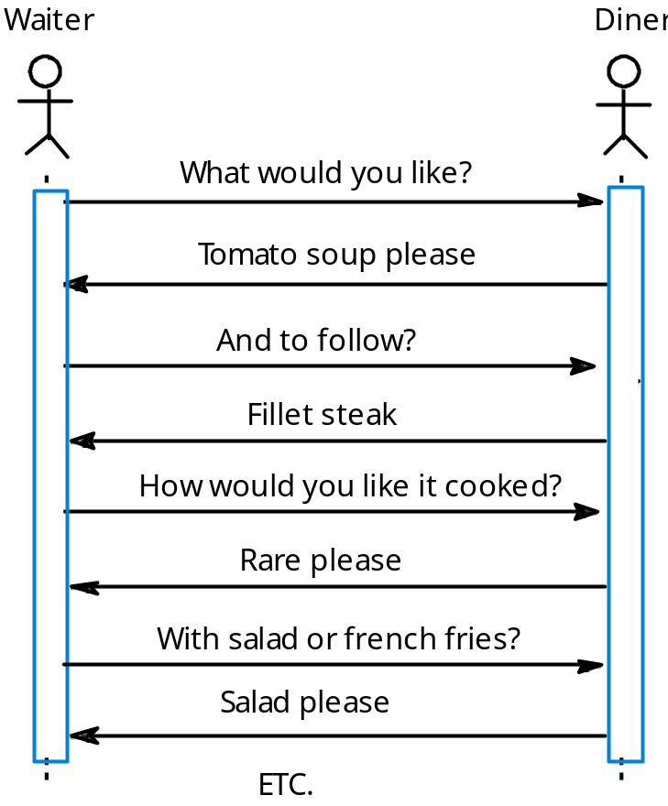
Synchronous interaction

Slide 11
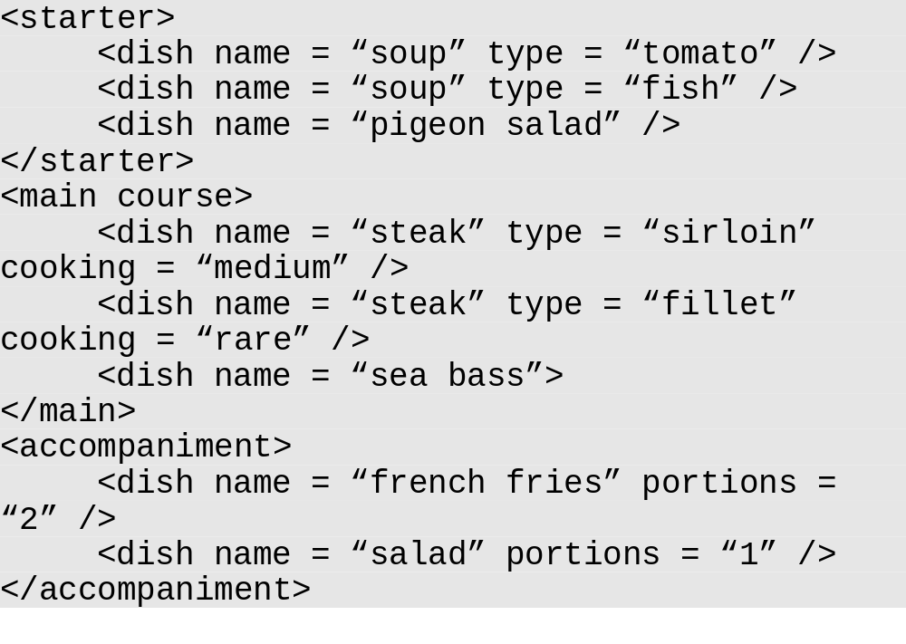
An order as an XML message

Slide 12
Web service description language
The service interface is defined in a service description expressed in WSDL. The WSDL specification defines
  What operations the service supports and the format of the messages that are sent and received by the service
  How the service is accessed - that is, the binding maps the abstract interface ontoa concrete set of protocols
  Where the service is located. This is usually expressed as a URI (Universal Resource Identifier)

Slide 13
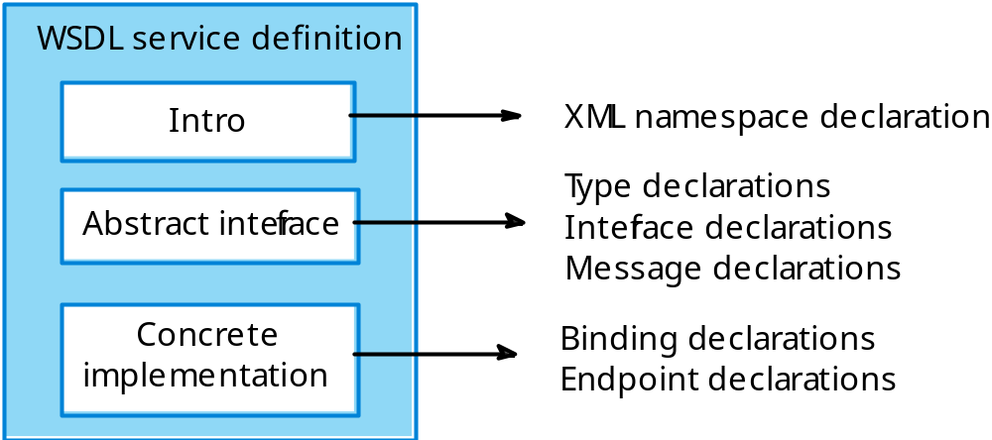
Structure of a WSDL specification

Slide 14
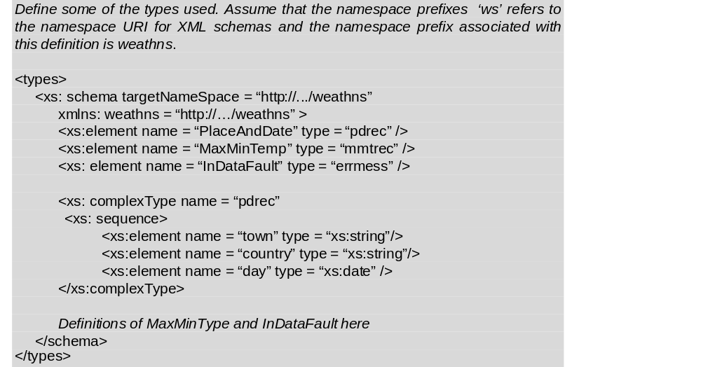
A WSDL description fragment

Slide 15
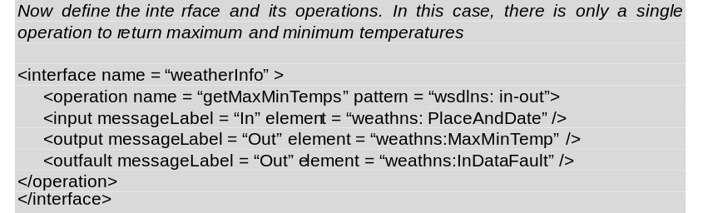
A WSDL description fragment 2

Slide 16
Service engineering
The process of developing services for reuse in service-oriented applications
The service has to be designed as a reusable abstraction that can be used in different systems
Involves
  Service candidate identification
  Service design
  Service implementation

Slide 17
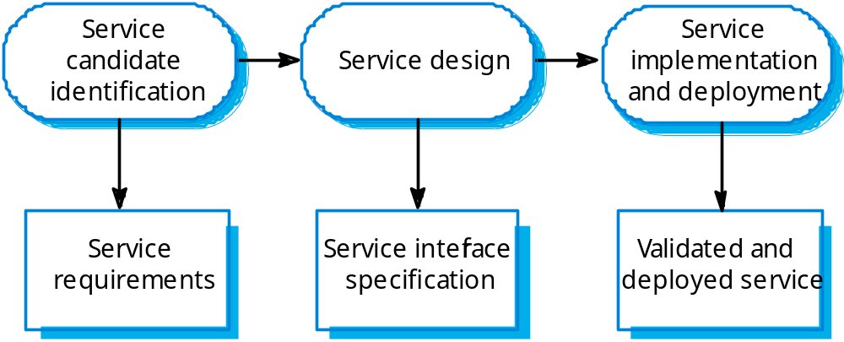
The service engineering process

Slide 18
Service candidate identification
Three fundamental types of service
  Utility services that implement general functionality used by different business processes
  Business services that are associated with a specific business function e.g., in a university, student registration
  Coordination services that support composite processes such as ordering

Slide 19
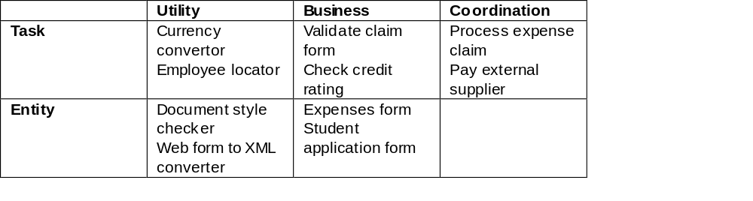
Service classification

Slide 20
Key points
Service-oriented software engineering is based on the notion that programs can be constructed by composing independent services which encapsulate reusable functionality.
Service interfaces are defined in WSDL. A WSDL specification includes a definition of the interface types and operations, the binding protocol used by the service and the service location.
Services may be classified as utility services, business services or coordination services.
The service engineering process involves identifying candidate services for implementation, defining the service interface and implementing, testing and deploying the service.

