Slide 1
Module 1
Introduction to Mobile Computing
Wireless Communication,
Applications,
Cellular Systems,
Antennas,
satellite system, GEO, LEO, MEO,
GPRS:-Architecture, Network nodes, GPRS support nodes.
1.<number>

Slide 2
Computers for the next decades?
Computers are integrated
  small, cheap, portable, replaceable - no more separate devices
Technology is in the background
  computer are aware of their environment and adapt (“location awareness”)
  computer recognize the location of the user and react appropriately (e.g., call forwarding, fax forwarding, “context awareness”))
Advances in technology
  more computing power in smaller devices
  flat, lightweight displays with low power consumption
  new user interfaces due to small dimensions
  more bandwidth per cubic meter
  multiple wireless interfaces: wireless LANs, wireless WANs, regional wireless telecommunication networks etc. („overlay networks“)
1.<number>

Slide 3
Mobile communication
Two aspects of mobility:
  user mobility: users communicate (wireless) “anytime, anywhere, with anyone”
  device portability: devices can be connected anytime, anywhere to the network
Wireless vs. mobile Examples
✗ ✗ stationary computer
✗ ✓ notebook in a hotel
✓ ✗ wireless LANs in historic buildings
✓ ✓ Personal Digital Assistant (PDA)
The demand for mobile communication creates the need for integration of wireless networks into existing fixed networks:
  local area networks: standardization of IEEE 802.11,
  ETSI (HIPERLAN)
  Internet: Mobile IP extension of the internet protocol IP
  wide area networks: e.g., internetworking of GSM and ISDN
1.<number>

Slide 4
Applications I
Vehicles
  transmission of news, road condition, weather, music via DAB
  personal communication using GSM
  position via GPS
  local ad-hoc network with vehicles close-by to prevent accidents, guidance system, redundancy
  vehicle data (e.g., from busses, high-speed trains) can be transmitted in advance for maintenance
Emergencies
  early transmission of patient data to the hospital, current status, first diagnosis
  replacement of a fixed infrastructure in case of earthquakes, hurricanes, fire etc.
  crisis, war, ...
1.<number>

Slide 5
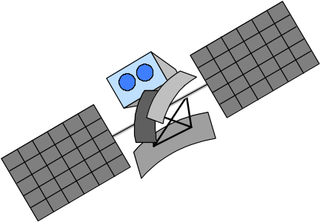
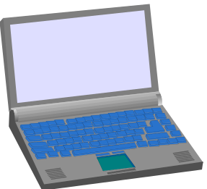

Typical application: road traffic
UMTS, WLAN,
DAB, DVB, GSM,
cdma2000, TETRA, ...
ad hoc
Personal Travel Assistant,
PDA, Laptop,
GSM, UMTS, WLAN,
Bluetooth, ...
1.<number>

Slide 6







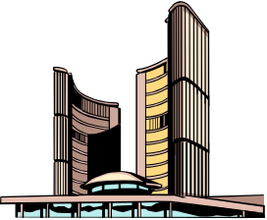
Mobile and wireless services – Always Best Connected
UMTS, GSM
115 kbit/s
LAN
100 Mbit/s,
WLAN
54 Mbit/s
DSL/ WLAN
3 Mbit/s
GSM/GPRS 53 kbit/s
Bluetooth 500 kbit/s
UMTS
2 Mbit/s
GSM/EDGE 384 kbit/s,
DSL/WLAN 3 Mbit/s
UMTS, GSM
384 kbit/s
GSM 115 kbit/s,
WLAN 11 Mbit/s
1.<number>

Slide 7

Applications II
Travelling salesmen
  direct access to customer files stored in a central location
  consistent databases for all agents
  mobile office
Replacement of fixed networks
  remote sensors, e.g., weather, earth activities
  flexibility for trade shows
  LANs in historic buildings
Entertainment, education, ...
  outdoor Internet access
  intelligent travel guide with up-to-date
  location dependent information
  ad-hoc networks for
  multi user games
History
Info
1.<number>

Slide 8
Location dependent services
Location aware services
  what services, e.g., printer, fax, phone, server etc. exist in the local environment
Follow-on services
  automatic call-forwarding, transmission of the actual workspace to the current location
Information services
  „push“: e.g., current special offers in the supermarket
  „pull“: e.g., where is the Black Forrest Cherry Cake?
Support services
  caches, intermediate results, state information etc. „follow“ the mobile device through the fixed network
Privacy
  who should gain knowledge about the location
1.<number>

Slide 9



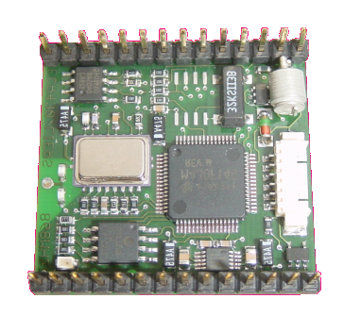
Mobile devices
Pager
receive only
tiny displays
simple text
messages
PDA
graphical displays
character recognition
simplified WWW
Laptop/Notebook
fully functional
standard applications
Sensors,
embedded
controllers
Mobile phones
voice, data
simple graphical displays
Palmtop
tiny keyboard
simple versions
of standard applications
www.scatterweb.net
performance
1.<number>

Slide 10
Effects of device portability
Power consumption
  limited computing power, low quality displays, small disks due to limited battery capacity
  CPU: power consumption ~ CV²f
    C: internal capacity, reduced by integration
    V: supply voltage, can be reduced to a certain limit
    f: clock frequency, can be reduced temporally
Loss of data
  higher probability, has to be included in advance into the design (e.g., defects, theft)
Limited user interfaces
  compromise between size of fingers and portability
  integration of character/voice recognition, abstract symbols
Limited memory
  limited value of mass memories with moving parts
  flash-memory or ? as alternative
1.<number>

Slide 11
Wireless networks in comparison to fixed networks
Higher loss-rates due to interference
  emissions of, e.g., engines, lightning
Restrictive regulations of frequencies
  frequencies have to be coordinated, useful frequencies are almost all occupied
Low transmission rates
  local some Mbit/s, regional currently, e.g., 53kbit/s with GSM/GPRS
Higher delays, higher jitter
  connection setup time with GSM in the second range, several hundred milliseconds for other wireless systems
Lower security, simpler active attacking
  radio interface accessible for everyone, base station can be simulated, thus attracting calls from mobile phones
Always shared medium
  secure access mechanisms important
1.<number>

Slide 12
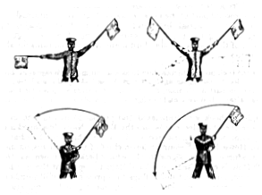
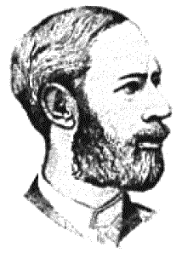
Early history of wireless communication
Many people in history used light for communication
  heliographs, flags („semaphore“), ...
  150 BC smoke signals for communication;
  (Polybius, Greece)
  1794, optical telegraph, Claude Chappe
Here electromagnetic waves are
of special importance:
  1831 Faraday demonstrates electromagnetic induction
  J. Maxwell (1831-79): theory of electromagnetic Fields, wave equations (1864)
  H. Hertz (1857-94): demonstrates
  with an experiment the wave character
  of electrical transmission through space
  (1888, in Karlsruhe, Germany, at the
  location of today’s University of Karlsruhe)
1.<number>

Slide 13
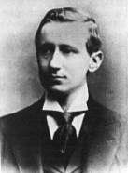
History of wireless communication I
1896 Guglielmo Marconi
  first demonstration of wireless
  telegraphy (digital!)
  long wave transmission, high
  transmission power necessary (> 200kw)
1907 Commercial transatlantic connections
  huge base stations
  (30 100m high antennas)
1915 Wireless voice transmission New York - San Francisco
1920 Discovery of short waves by Marconi
  reflection at the ionosphere
  smaller sender and receiver, possible due to the invention of the vacuum tube (1906, Lee DeForest and Robert von Lieben)
1926 Train-phone on the line Hamburg - Berlin
  wires parallel to the railroad track
1.<number>

Slide 14
History of wireless communication II
1928 many TV broadcast trials (across Atlantic, color TV, TV news)
1933 Frequency modulation (E. H. Armstrong)
1958 A-Netz in Germany
  analog, 160MHz, connection setup only from the mobile station, no handover, 80% coverage, 1971 11000 customers
1972 B-Netz in Germany
  analog, 160MHz, connection setup from the fixed network too (but location of the mobile station has to be known)
  available also in A, NL and LUX, 1979 13000 customer in D
1979 NMT at 450MHz (Scandinavian countries)
1982 Start of GSM-specification
  goal: pan-European digital mobile phone system with roaming
1983 Start of the American AMPS (Advanced Mobile Phone System, analog)
1984 CT-1 standard (Europe) for cordless telephones
1.<number>

Slide 15
History of wireless communication III
1986 C-Netz in Germany
  analog voice transmission, 450MHz, hand-over possible, digital signaling, automatic location of mobile device
  Was in use until 2000, services: FAX, modem, X.25, e-mail, 98% coverage
1991 Specification of DECT
  Digital European Cordless Telephone (today: Digital Enhanced Cordless Telecommunications)
  1880-1900MHz, ~100-500m range, 120 duplex channels, 1.2Mbit/s data transmission, voice encryption, authentication, up to several 10000 user/km², used in more than 50 countries
1992 Start of GSM
  in D as D1 and D2, fully digital, 900MHz, 124 channels
  automatic location, hand-over, cellular
  roaming in Europe - now worldwide in more than 200 countries
  services: data with 9.6kbit/s, FAX, voice, ...
1.<number>

Slide 16
History of wireless communication IV
1994 E-Netz in Germany
  GSM with 1800MHz, smaller cells
  As Eplus in D (1997 98% coverage of the population)
1996 HiperLAN (High Performance Radio Local Area Network)
  ETSI, standardization of type 1: 5.15 - 5.30GHz, 23.5Mbit/s
  recommendations for type 2 and 3 (both 5GHz) and 4 (17GHz) as wireless ATM-networks (up to 155Mbit/s)
1997 Wireless LAN - IEEE802.11
  IEEE standard, 2.4 - 2.5GHz and infrared, 2Mbit/s
  already many (proprietary) products available in the beginning
1998 Specification of GSM successors
  for UMTS (Universal Mobile Telecommunication System) as European proposals for IMT-2000
Iridium
  66 satellites (+6 spare), 1.6GHz to the mobile phone
1.<number>

Slide 17
History of wireless communication V
1999 Standardization of additional wireless LANs
  IEEE standard 802.11b, 2.4-2.5GHz, 11Mbit/s
  Bluetooth for piconets, 2.4Ghz, <1Mbit/s
Decision about IMT-2000
  Several “members” of a “family”: UMTS, cdma2000, DECT, …
Start of WAP (Wireless Application Protocol) and i-mode
  First step towards a unified Internet/mobile communicaiton system
  Access to many services via the mobile phone
2000 GSM with higher data rates
  HSCSD offers up to 57,6kbit/s
  First GPRS trials with up to 50 kbit/s (packet oriented!)
UMTS auctions/beauty contests
  Hype followed by disillusionment (50 B$ payed in Germany for 6 licenses!)
2001 Start of 3G systems
  Cdma2000 in Korea, UMTS tests in Europe, Foma (almost UMTS) in Japan
1.<number>

Slide 18
Wireless systems: overview of the development
cellular phones
satellites
cordless
phones
wireless LAN
1980:
CT0
1981:
NMT 450
1982:
Inmarsat-A
1983:
AMPS
1984:
CT1
1986:
NMT 900
1987:
CT1+
1988:
Inmarsat-C
1989:
CT 2
1991:
CDMA
1991:
D-AMPS
1991:
DECT
1992:
GSM
1992:
Inmarsat-B
Inmarsat-M
199x:
proprietary
1993:
PDC
1994:
DCS 1800
1997:
IEEE 802.11
1998:
Iridium
1999:
802.11b, Bluetooth
analogue
2000:
GPRS
2000:
IEEE 802.11a
2001:
IMT-2000
digital
200?:
Fourth Generation
(Internet based)
4G – fourth generation: when and how?
1.<number>

Slide 19

Foundation: ITU-R - Recommendations for IMT-2000
M.687-2
  IMT-2000 concepts and goals
M.816-1
  framework for services
M.817
  IMT-2000 network architectures
M.818-1
  satellites in IMT-2000
M.819-2
  IMT-2000 for developing countries
M.1034-1
  requirements for the radio interface(s)
M.1035
  framework for radio interface(s) and radio sub-system functions
M.1036
  spectrum considerations
M.1078
  security in IMT-2000
M.1079
  speech/voiceband data performance
M.1167
  framework for satellites
M.1168
  framework for management
M.1223
  evaluation of security mechanisms
M.1224
  vocabulary for IMT-2000
M.1225
  evaluation of transmission technologies
. . .
http://www.itu.int/imt
1.<number>

Slide 20
Simple reference model used here
Application
Application
Transport
Transport
Network
Network
Network
Network
Data Link
Data Link
Data Link
Data Link
Physical
Physical
Physical
Physical
Radio
Medium
1.<number>

Slide 21
Influence of mobile communication to the layer model
Application layer
Transport layer
Network layer
Data link layer
Physical layer
  service location
  new applications, multimedia
  adaptive applications
  congestion and flow control
  quality of service
  addressing, routing,
  device location
  hand-over
  authentication
  media access
  multiplexing
  media access control
  encryption
  modulation
  interference
  attenuation
  frequency
1.<number>

Slide 22




Overlay Networks - the global goal
integration of heterogeneous fixed and
mobile networks with varying
transmission characteristics
regional
vertical
handover
metropolitan area
campus-based
horizontal
handover
in-house
1.<number>

Slide 23
Cell structure
Implements space division multiplex: base station covers a certain transmission area (cell)
Mobile stations communicate only via the base station
Advantages of cell structures:
  higher capacity, higher number of users
  less transmission power needed
  more robust, decentralized
  base station deals with interference, transmission area etc. locally
Problems:
  fixed network needed for the base stations
  handover (changing from one cell to another) necessary
  interference with other cells
Cell sizes from some 100 m in cities to, e.g., 35 km on the country side (GSM) - even less for higher frequencies
2.<number>

Slide 24
Frequency planning I
Frequency reuse only with a certain distance between the base stations
Standard model using 7 frequencies:
Fixed frequency assignment:
  certain frequencies are assigned to a certain cell
  problem: different traffic load in different cells
Dynamic frequency assignment:
  base station chooses frequencies depending on the frequencies already used in neighbor cells
  more capacity in cells with more traffic
  assignment can also be based on interference measurements
f₃
f₅
f₂
f₄
f₆
f₅
f₁
f₄
f₃
f₇
f₁
f₂
2.<number>

Slide 25
Frequency planning II
f₃
f₃
f₃
f₂
f₂
f₁
f₁
f₁
f₂
f₃
f₇
f₃
f₃
3 cell cluster
f₅
f₂
f₂
f₂
f₂
f₄
f₆
f₅
f₁
f₁
f₁
f₄
f₃
f₃
f₃
f₃
f₇
f₁
f₂
f₃
f₆
f₅
f₂
7 cell cluster
f₁
f₂
f₁
f₂
f₁
f₂
f₃
h₁
h₂
f₃
h₁
h₂
f₃
3 cell cluster
with 3 sector antennas
g₁
g₂
h₃
g₁
g₂
h₃
g₁
g₂
g₃
g₃
g₃
2.<number>

Slide 26
Cell breathing
CDM systems: cell size depends on current load
Additional traffic appears as noise to other users
If the noise level is too high users drop out of cells
2.<number>

Slide 27
Antennas: isotropic radiator
Radiation and reception of electromagnetic waves, coupling of wires to space for radio transmission
Isotropic radiator: equal radiation in all directions (three dimensional) - only a theoretical reference antenna
Real antennas always have directive effects (vertically and/or horizontally)
Radiation pattern: measurement of radiation around an antenna
z
y
z
y
x
ideal
isotropic
radiator
x
2.<number>

Slide 28
Antennas: simple dipoles
Real antennas are not isotropic radiators but, e.g., dipoles with lengths λ/4 on car roofs or λ/2 as Hertzian dipole
➔ shape of antenna proportional to wavelength
Example: Radiation pattern of a simple Hertzian dipole
Gain: maximum power in the direction of the main lobe compared to the power of an isotropic radiator (with the same average power)
λ/4
λ/2
y
y
z
simple
dipole
x
z
x
side view (xy-plane)
side view (yz-plane)
top view (xz-plane)
2.<number>

Slide 29
Antennas: directed and sectorized
Often used for microwave connections or base stations for mobile phones (e.g., radio coverage of a valley)
y
y
z
directed
antenna
x
z
x
side view (xy-plane)
side view (yz-plane)
top view (xz-plane)
z
z
sectorized
antenna
x
x
top view, 3 sector
top view, 6 sector
2.<number>

Slide 30
Antennas: diversity
Grouping of 2 or more antennas
  multi-element antenna arrays
Antenna diversity
  switched diversity, selection diversity
    receiver chooses antenna with largest output
  diversity combining
    combine output power to produce gain
    cophasing needed to avoid cancellation
λ/2
λ/2
λ/4
λ/2
λ/4
λ/2
+
+
ground plane
2.<number>

Slide 31
Signal propagation ranges
Transmission range
  communication possible
  low error rate
Detection range
  detection of the signal
  possible
  no communication
  possible
Interference range
  signal may not be
  detected
  signal adds to the
  background noise
sender
transmission
distance
detection
interference
2.<number>

Slide 32




Signal propagation
Propagation in free space always like light (straight line)
Receiving power proportional to 1/d² in vacuum – much more in real environments
(d = distance between sender and receiver)
Receiving power additionally influenced by
fading (frequency dependent)
shadowing
reflection at large obstacles
refraction depending on the density of a medium
scattering at small obstacles
diffraction at edges
shadowing
reflection
refraction
scattering
diffraction
2.<number>

Slide 33
satellite system
Applications
Traditionally
  weather satellites
  radio and TV broadcast satellites
  military satellites
  satellites for navigation and localization (e.g., GPS)
Telecommunication
  global telephone connections
  backbone for global networks
  connections for communication in remote places or underdeveloped areas
  global mobile communication
➔ satellite systems to extend cellular phone systems (e.g., GSM or AMPS)
replaced by fiber optics
5.<number>

Slide 34



Classical satellite systems
Inter Satellite Link (ISL)
Mobile User Link (MUL)
Gateway Link (GWL)
MUL
GWL
small cells (spotbeams)
base station
or gateway
footprint
ISDN
PSTN
GSM
PSTN: Public Switched
Telephone Network
User data
5.<number>
Notes:
Universität Karlsruhe
Institut für Telematik
Mobilkommunikation
SS 1998
Prof. Dr. Dr. h.c. G. Krüger
E. Dorner / Dr. J. Schiller

Slide 35
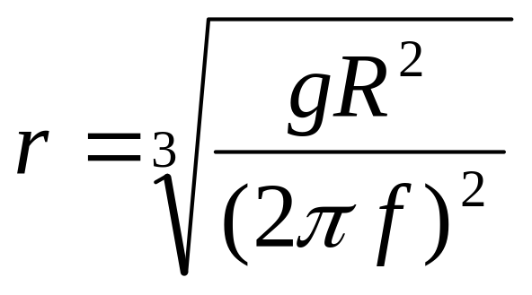
Basics
Satellites in circular orbits
  attractive force F_{g} = m g (R/r)²
  centrifugal force F_{c} = m r ω²
  m: mass of the satellite
  R: radius of the earth (R = 6370 km)
  r: distance to the center of the earth
  g: acceleration of gravity (g = 9.81 m/s²)
  ω: angular velocity (ω = 2 π f, f: rotation frequency)
Stable orbit
  F_{g} = F_{c}
5.<number>

Slide 36
Basics
elliptical or circular orbits
complete rotation time depends on distance satellite-earth
inclination: angle between orbit and equator
elevation: angle between satellite and horizon
LOS (Line of Sight) to the satellite necessary for connection
  ➔ high elevation needed, less absorption due to e.g. buildings
Uplink: connection base station - satellite
Downlink: connection satellite - base station
typically separated frequencies for uplink and downlink
  transponder used for sending/receiving and shifting of frequencies
  transparent transponder: only shift of frequencies
  regenerative transponder: additionally signal regeneration
5.<number>

Slide 37
Inclination
plane of satellite orbit
satellite orbit
perigee
δ
inclination δ
equatorial plane
5.<number>

Slide 38
Elevation
Elevation:
angle ε between center of satellite beam
and surface
minimal elevation:
elevation needed at least
to communicate with the satellite
ε
footprint
5.<number>

Slide 39
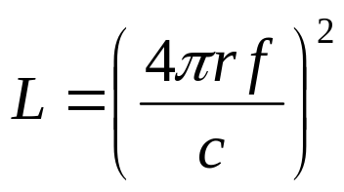
Link budget of satellites
Parameters like attenuation or received power determined by four parameters:
sending power
gain of sending antenna
distance between sender
and receiver
gain of receiving antenna
Problems
varying strength of received signal due to multipath propagation
interruptions due to shadowing of signal (no LOS)
Possible solutions
Link Margin to eliminate variations in signal strength
satellite diversity (usage of several visible satellites at the same time) helps to use less sending power
L: Loss
f: carrier frequency
r: distance
c: speed of light
5.<number>

Slide 40
Orbits I
Four different types of satellite orbits can be identified depending on the shape and diameter of the orbit:
GEO: geostationary orbit, ca. 36000 km above earth surface
LEO (Low Earth Orbit): ca. 500 - 1500 km
MEO (Medium Earth Orbit) or ICO (Intermediate Circular Orbit): ca. 6000 - 20000 km
HEO (Highly Elliptical Orbit) elliptical orbits
5.<number>

Slide 41
Orbits II
GEO (Inmarsat)
HEO
MEO (ICO)
LEO
(Globalstar,
Irdium)
inner and outer Van
Allen belts
earth
1000
10000
Van-Allen-Belts:
ionized particles
2000 - 6000 km and
15000 - 30000 km
above earth surface
35768
km
5.<number>

Slide 42
Geostationary satellites
Orbit 35,786 km distance to earth surface, orbit in equatorial plane (inclination 0°)
➔ complete rotation exactly one day, satellite is synchronous to earth rotation
fix antenna positions, no adjusting necessary
satellites typically have a large footprint (up to 34% of earth surface!), therefore difficult to reuse frequencies
bad elevations in areas with latitude above 60° due to fixed position above the equator
high transmit power needed
high latency due to long distance (ca. 275 ms)
➔ not useful for global coverage for small mobile phones and data transmission, typically used for radio and TV transmission
5.<number>

Slide 43
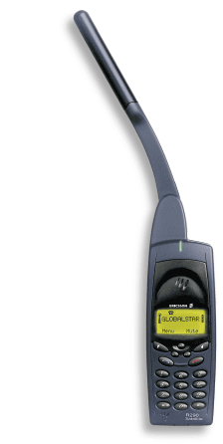

LEO systems
Orbit ca. 500 - 1500 km above earth surface
visibility of a satellite ca. 10 - 40 minutes
global radio coverage possible
latency comparable with terrestrial long distance
connections, ca. 5 - 10 ms
smaller footprints, better frequency reuse
but now handover necessary from one satellite to another
many satellites necessary for global coverage
more complex systems due to moving satellites
Examples:
Iridium (start 1998, 66 satellites)
  Bankruptcy in 2000, deal with US DoD (free use,
  saving from “deorbiting”)
Globalstar (start 1999, 48 satellites)
  Not many customers (2001: 44000), low stand-by times for mobiles
5.<number>

Slide 44
MEO systems
Orbit ca. 5000 - 12000 km above earth surface
comparison with LEO systems:
slower moving satellites
less satellites needed
simpler system design
for many connections no hand-over needed
higher latency, ca. 70 - 80 ms
higher sending power needed
special antennas for small footprints needed
Example:
ICO (Intermediate Circular Orbit, Inmarsat) start ca. 2000
  Bankruptcy, planned joint ventures with Teledesic, Ellipso – cancelled again, start planned for 2003
5.<number>

Slide 45
Routing
One solution: inter satellite links (ISL)
reduced number of gateways needed
forward connections or data packets within the satellite network as long as possible
only one uplink and one downlink per direction needed for the connection of two mobile phones
Problems:
more complex focusing of antennas between satellites
high system complexity due to moving routers
higher fuel consumption
thus shorter lifetime
Iridium and Teledesic planned with ISL
Other systems use gateways and additionally terrestrial networks
5.<number>

Slide 46
Localization of mobile stations
Mechanisms similar to GSM
Gateways maintain registers with user data
  HLR (Home Location Register): static user data
  VLR (Visitor Location Register): (last known) location of the mobile station
  SUMR (Satellite User Mapping Register):
    satellite assigned to a mobile station
    positions of all satellites
Registration of mobile stations
  Localization of the mobile station via the satellite’s position
  requesting user data from HLR
  updating VLR and SUMR
Calling a mobile station
  localization using HLR/VLR similar to GSM
  connection setup using the appropriate satellite
5.<number>

Slide 47
Handover in satellite systems
Several additional situations for handover in satellite systems compared to cellular terrestrial mobile phone networks caused by the movement of the satellites
  Intra satellite handover
    handover from one spot beam to another
    mobile station still in the footprint of the satellite, but in another cell
  Inter satellite handover
    handover from one satellite to another satellite
    mobile station leaves the footprint of one satellite
  Gateway handover
    Handover from one gateway to another
    mobile station still in the footprint of a satellite, but gateway leaves the footprint
  Inter system handover
    Handover from the satellite network to a terrestrial cellular network
    mobile station can reach a terrestrial network again which might be cheaper, has a lower latency etc.
5.<number>
Notes:
Universität Karlsruhe
Institut für Telematik
Mobilkommunikation
SS 1998
Prof. Dr. Dr. h.c. G. Krüger
E. Dorner / Dr. J. Schiller

Slide 48
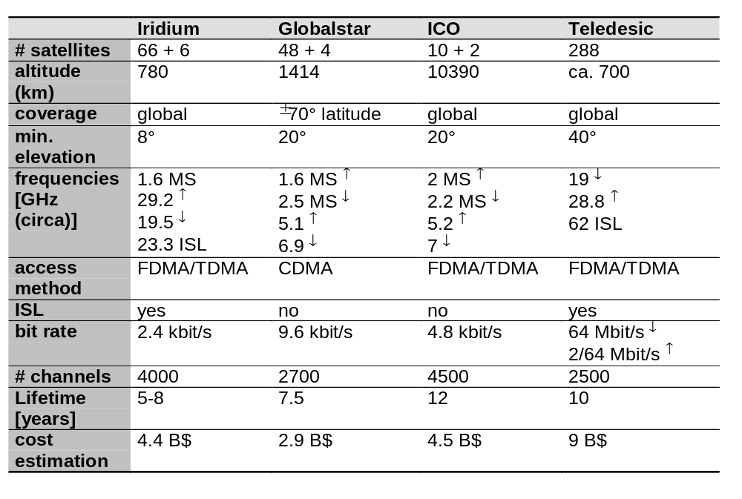
Overview of LEO/MEO systems
5.<number>

Slide 49
GPRS
Overview
GPRS Functional Groups
GPRS Architecture
GPRS Terms
GPRS Network Node
GPRS Interface

Slide 50
Overview
Standardization
  ETSI/SMG in 1994
One to eight time slots
Various radio channel coding schemes : 9~150 Kbps
GPRS fast reservation
GPRS security functionality
  GSM security

Slide 51
GPRS Functional Groups(1/2)
Network access
  Registration
  Authentication and authorization
  Admission control
  Message screening
  Packet terminal adaptation
  Charging information collection
Packet routing and transfer
  Relay function
  Routing
  Address translation and mapping
  Encapsulation and tunneling
  Compression and ciphering
  Domain name service

Slide 52
GPRS Functional Groups(2/2)
Logical link management
  Establishment
  Maintenance
  Release
Radio resource management
  Um management
  Cell selection
  Um-tranx
  Path management
Mobility management
Network management

Slide 53
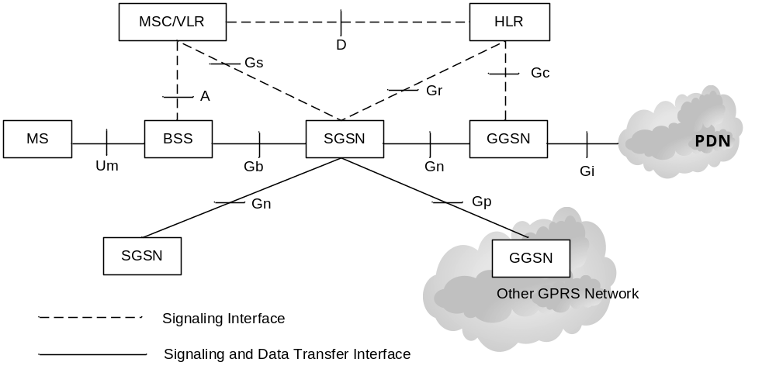
GPRS Architecture(1/3)
GPRS architecture
BSS: Base Station System
GGSN: Gateway GPRS Support Node
HLR: Home Location Register
MS: Mobile Station
MSC: Mobile Switching Center
SGSN: Serving GPRS Support Node
PDN: Packet Data Network
VLR: Visitor Location Register

Slide 54
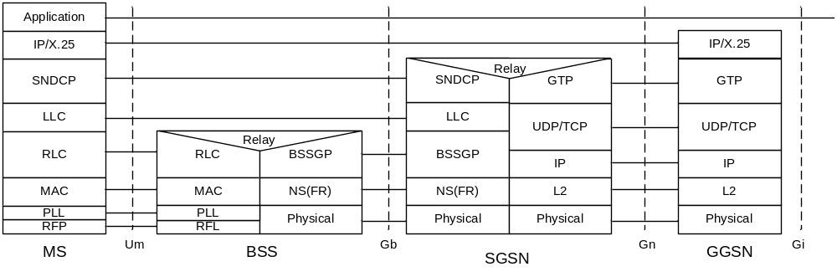
GPRS Architecture(2/3)
GPRS transmission plane
BSSGP: BSS GPRS Protocol
FR: Frame Relay
GTP: GPRS Tunneling Protocol
LLC: Logical Link Protocol
MAC: Medium Access Control
NS: Network Service
RFL: Radio Physical Layer
PLL: Physical Link Layer
RLC: Radio Link Control
SNDCP: SubNetwork Dependent Convergence
UDP: User Datagram Protocol
TCP: Transmission Control Protocol

Slide 55
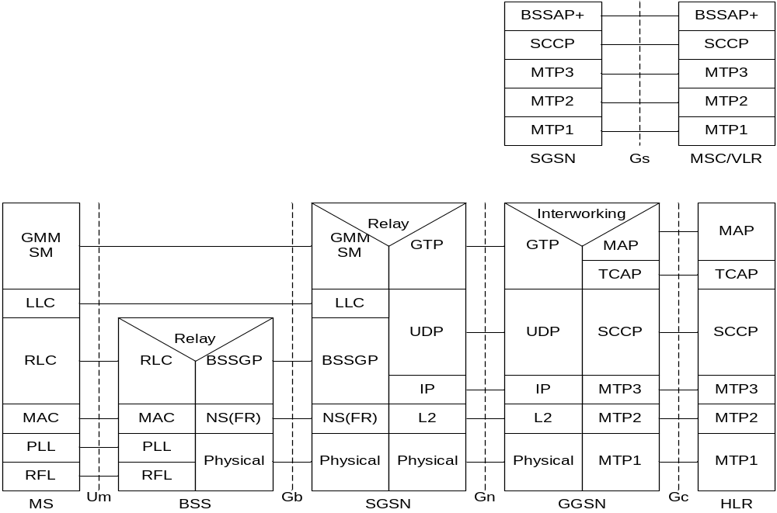
GPRS Architecture(3/3)
GPRS signaling plane
BSSAP+: Base Station System Application Part+
GMM: GPRS Mobility Management
MAP: Mobile Application Part
MTP: Message Transfer Part
SCCP: Signaling Connection Control Part
SM: Session Management
TCAP: Transaction Capabilities Application Part

Slide 56
GPRS Terms
Mobility management (MM) context
  MM state and other MM-related information
PDP context
  Mapping and routing information
QoS profile
  Precedence class
  Delay class
  Reliability class
  Peak throughput
  Mean throughput

Slide 57
GPRS Network Nodes
MS
BSS
SGSN and GGSN
HLR and VLR

Slide 58
Mobile Station(1/2)
MT (Mobile Terminal) and TE (Terminal Equipment)
MS operation mode
  Class A mode :Simultaneous circuit-switched and packet-switched service
  Class B mode :Automatic choice of circuit-switched or packet-switched service
  Class C mode :Only packet-switched data
Some of the MM context fields stored in a GPRS-aware
  IMSI (International Mobile Subscriber Identity)
  P-TMSI (Packet Temporary Mobile Subscriber Identity)
  Address of the routing area where the MS resides
  Current ciphering key, K_{c}, and its CKSN (Ciphering Key Sequence Number)

Slide 59
Mobile Station(2/2)
Some of non-SIM-related fields
  MM state (either IDLE, STANDBY, or READY)
  Identity of the cell where the MS resides
  Ciphering algorithm defined in the GSM 01.61 specification
  Radio access classmark for the radio capabilities
  SGSN classmark for network related capabilities
PDP contexts
  PDP type
  PDP address
  PDP state
  Dynamic-Address-Allowed
  Requested and negotiated QoS profiles

Slide 60
Base Station System
BTS (Base Transceiver Station) :new GPRS channel coding schemes
BSC (Base Station Controller) :forward circuit-switched calls to the MSC and packet-switched data to the SGSN
PCU (Packet Control Unit)
  Packet data services
  Co-location with the BTS or remotely location in the BSC
  Medium access control and radio link control layer functions

Slide 61
GPRS Support Node(1/2)
SGSN (Serving GPRS Support Node)
  The same as MSC/VLR in GSM network
  Ciphering, mobility management, charging, statistics collection
  MM context
    IMSI, P-TMSI, MSISDN
    MM state
    Routing area identity and cell identity
    Address of the VLR currently serving the MS
    IP address of the new SGSN where the buffered packets should be forwarded
    Authentication and ciphering parameters
    Current ciphering key Kc and the selected ciphering algorithm
    MS radio access capabilities and GPRS network access capabilities
    MNRG (Mobile Station Not Reachable for GPRS flag) indicating whether activity from the MS should be reported to the HLR
    NGAF (non-GPRS Alert flag) indication whether activity from the MS should be reported to the VLR
    PPF (Paging Proceed flag) indication whether paging for GPRS and non-GPRS services can be initiated

Slide 62
GPRS Support Node(2/2)
SGSN (con’t)
  PDP contexts (a partial list)
    PDP context identifier, PDP type, PDP address, and PDP state
    Access point name to the external data network
    Subscribed, requested and negotiated QoS profiles
    IP address of the GGSN currently used by the activated PDP context
    Identifier of the charging records generated by SGSN and GGSN
GGSN (Gateway GPRS Support Node)
  Traditional gateway functionality : DNS, DHCP….
  The information items (a partial list)
    IMSI
    PDP type and PDP address
    Dynamic address indication
    QoS profile negotiated
    IP address of the SGSN currently serving this MS
    Access point name of the external data network
    Charging ID
    MNRG flag, which indicates whether the MS is marked as not reachable for GPRS at the HLR

Slide 63
HLR and VLR
To accommodate GPRS subscription and routing information
HLR
  IMSI and MSISDN, which serves the MS
  SS7 address of the SGSN, which serves the MS
  IP address of the SGSN, which serves the MS
  MS Purged for GPRS flag, which indicates whether the MM and PDP contexts of the MS are deleted from the SGSN
  MNRG, which indicates whether the MS is not reachable for GPRS service
  GGSN-list, which provides a GGSN IP address list to be contacted for MS activity when MNRG is set
MSC/VLR
  SGGN number : Indication the SGSN currently serving the MS
  Contact SGSN to request location information or paging for voice calls

Slide 64
GPRS Interfaces
Um Interface
Gb Interface
Gn and Gp Interface
Gs Interface
Gi Interface

Slide 65
Um Interface(1/3)
Between the MS and the BTS
Um channel structure
  PDTCH (packet data traffic channel)
  PCCCH (packet common control channel): uplink is only PRACH
    Packet paging channel
    Packet access grant channel
    Packet notification channel
    Packet broadcast control channel
  Packet-dedicated control channel
    PACCH (Packet associated control channel)
    PTCCH/U (Packet timing advance control channel in the uplink direction)
  GPRS channel management
    Master-slave
    Capacity-on-demand

Slide 66
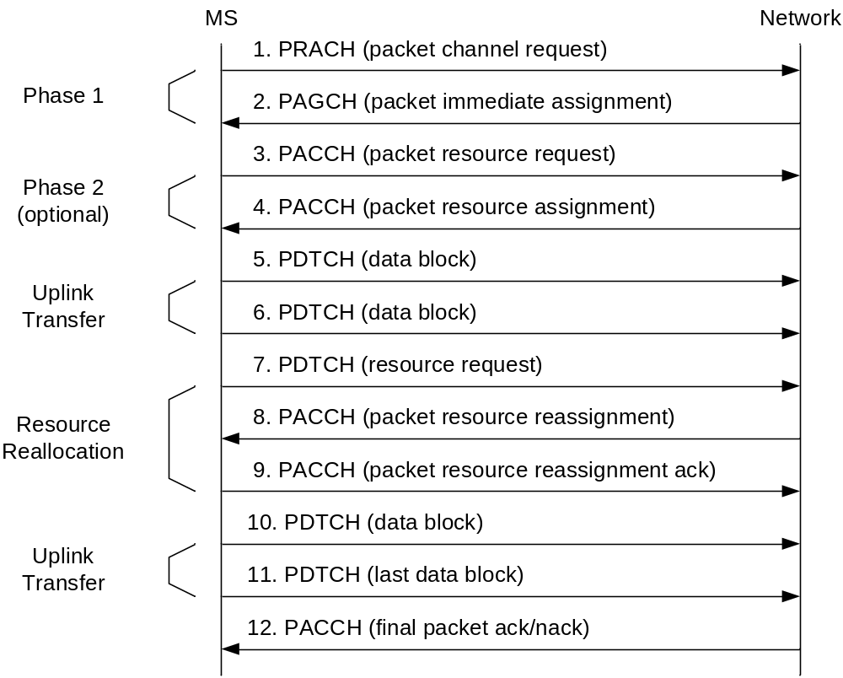
Um Interface(2/3)
GPRS uplink packet transfer

Slide 67
Um Interface(3/3)
Um protocol layers
  RF layer
  PLL
  RLC/MAC
  Coding schemes-CS1, CS2, CS3 and CS4
Enhanced data rates for GSM evolution (EDGE)
  EDGE LQL (link quality control) scheme : link adaptation and incremental redundancy

Slide 68
Gb Interface(1/2)
Connection the BSS and the SGSN
Allocation resources to a user during the periods when data are actually delivered
LLC
  Convey information
  Logical link connection with sequence control, flow control, detection of transmission, format….
  Maintain ciphered data link
  GPRS Mobility Management
SNDCP
  Multiplexing of data coming from the different sources to be sent across LLC
  Segmentation and reassembly and compression of redundant protocol information and user data

Slide 69
Gb Interface(2/2)
NS layer
  Deliver encapsulated packets between the SGSN and BSS
  Perform load sharing to distribute the packet traffic among the unblocked NS-VCs (Network Service Virtual Connections)
BSS GPRS Protocol
  Provides the radio-related QoS and routing information required to transmit user data
  Node management control functions
  Three service models
    BSSGP/RL
    GMM
    NM

Slide 70
Gn and Gp Interface
Utilize the GPRS Tunneling Protocol (GTP)
GTP tunnel management
  Create, update and delete tunnels
GTP mobility management
  GPRS attach, GPRS routing area update, and activation of PDP contexts

Slide 71
Gs Interface
Connection the database in the MSC/VLR and the SGSN
Base Station System Application Part+(BSSAP+)
Gs procedures
  Paging, suspend, resume, and location update procedures

Slide 72
Gi Interface
Interwork with PSDN and PDN through Gi interface
PSDN : X.25 and X.75
PDN : IP and PPP
Transparent Internet access and nontransparent access to an intranet or ISP

Slide 73
GPRS Procedures
GPRS Attach Procedure
GPRS Detach Procedure
PDP Context Procedure
RA/LA Update Procedure
GPRS Billing
Evolving from GSM to GPRS

Slide 74
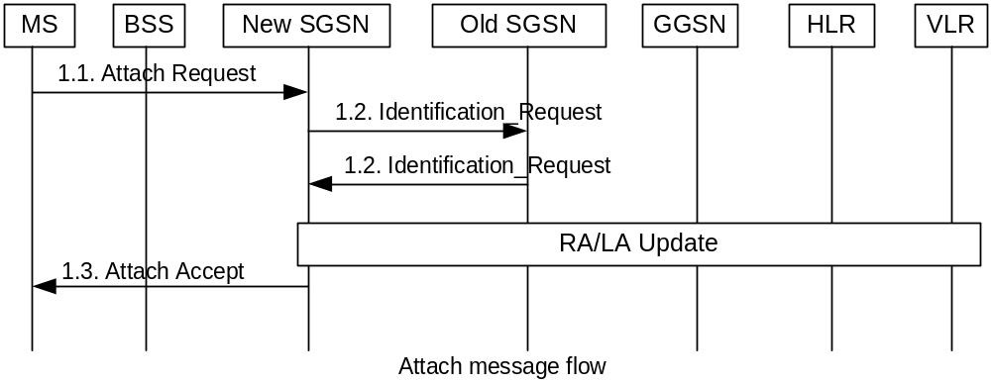
GPRS Procedures : Attach
Attach : register with a SGSN before using services

Slide 75
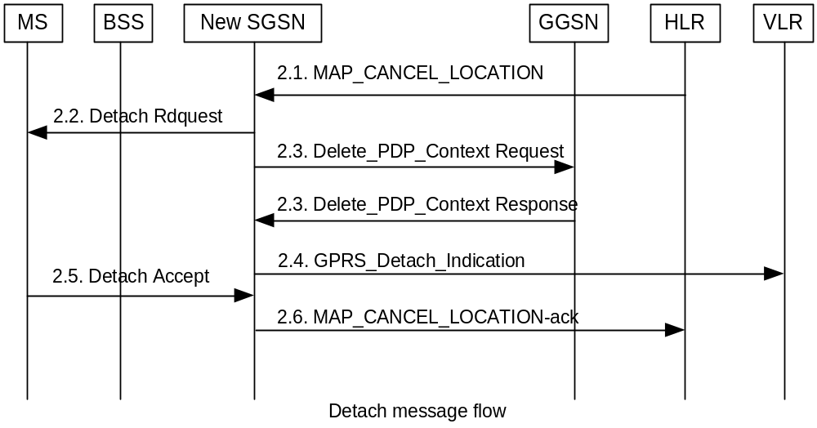
GPRS Procedures : Detach
Detach : disconnect the GPRS network

Slide 76
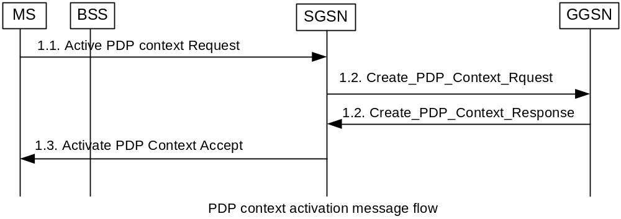
PDP Context Procedures : Activation

Slide 77
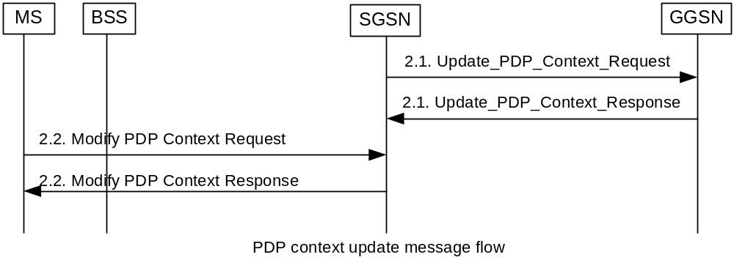
PDP Context Procedures : Update

Slide 78
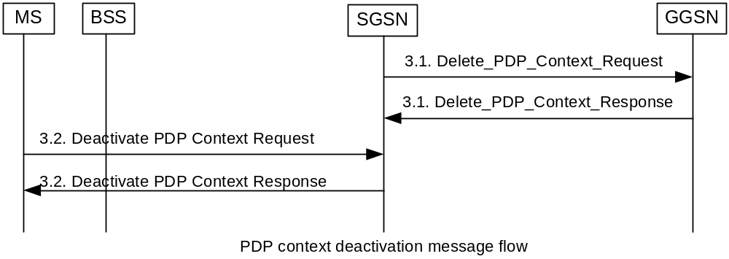
PDP Context Procedures : Deactivation

Slide 79
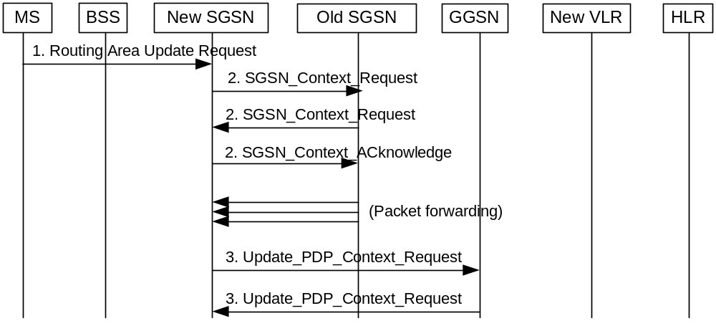
RA/LA Update (1/2)

Slide 80
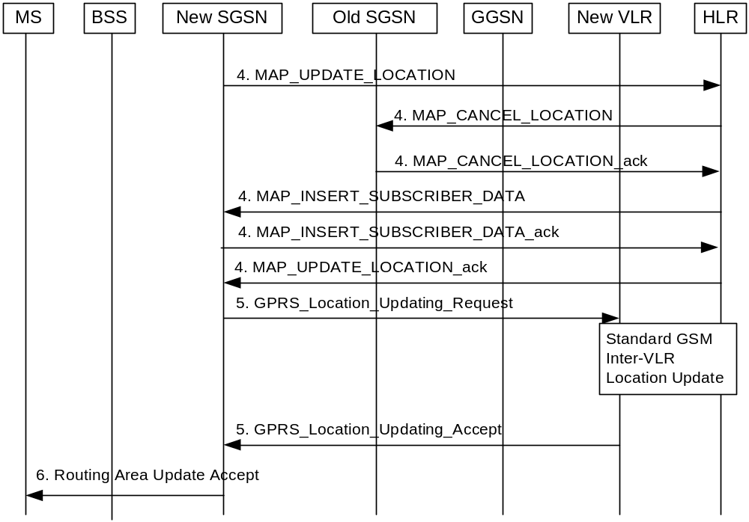
RA/LA Update (2/2)

Slide 81
Evolving from GSM to GPRS
ELEMENT | SOFTWARE | HARDWARE
MS | Upgrade required | Upgrade required
BTS | Upgrade required | No change
BSC | Upgrade required | PCU interface
TRAU | No change | No change
MSC/VLR | Upgrade required | No change
HLR | Upgrade required | No change
SGSN | New | New
GGSN | New | New

Slide 82
Two Phases in GPRS (1/2)
Phase 1 : implements basic GPRS features
  Standard packet services delivery ; that is , point-to-point packet bearer service
  Support for CS-1 and CS-2 channel coding schemes
  GPRS internal network interfaces such as Gn, Gb, Gp, and Gs
  Flexible radio resource allocation
  Support for Classes B and C MSs
  GPRS charging
  GSM-based services, such as SMS over GPRS
  IP and X.25 interfaces to packet data network
  Static and dynamic IP address allocation
  Anonymous access
  Security ; authentication and ciphering

Slide 83
Two Phases in GPRS (2/2)
Phase 2
  Enhanced QoS support in GPRS
  Unstructured octet stream GPRS PDP type
  Access to ISPs and intranets
  GPRS prepaid
  GPRS advice of charge
  Group call
  Point to multipoint services

Slide 84
Consider a mobile user who is migrating from a place to another place provide him a seamless service by satellite system, also sketch the architecture.
A certain city has an area of 1300 square miles and is covered by a cellular system using a seven cell reuse pattern, each cell has a radius of 4 miles and the city has 40MHz spectrum with a full duplex channel bandwidth of 60KHz. Find :
  the number of cell in the service area
  The number of channels per cell
  Total number of subscribers that can be served.
What are various types of satellites are used? Describe there functionality and also explain the concept of localization , routing, and handover in them.
Write about types of antennas and their radiation pattern.
What are the modifications require to an existing GSM network to be upgraded to GPRS: Explain with the help of diagram
Describe how data encryption is done in GSM system. With diagram explain the role of SIM ,A3,A5 and A8 algorithm.
1.<number>

Slide 85
Draw and explain GSM, GPRS system and protocol architecture.
2) List and explain GSM services.
3) Draw a neat diagram of GSM system architecture and explain with different types of interfaces.
4) Describe the call initiation and call termination procedure in GSM system.
5) Explain the GSM protocol architecture.
6) What is the use of HLR and VLR registers in mobile computing?
7) What are the general problems of satellite signals travelling from a satellite to a receiver ?
8) Sketch and explain the functional architecture of a GSM system.
9) Explain the role of SUMR register in satellite roaming.
1.<number>

Slide 86
Describe the call initation and call termination procedure in GSM system.
List and explain GSM services.
1.<number>

