Slide 1
GSM cellular telephony-architecture and system aspects
Introduction, Basic GSM architecture,
Basic radio transmission parameters of the GSM system,
Logical channel description,
GSM time hierarchy, GSM burst structures,
Description of the call set-up procedure, Handover, Ensuring privacy and authentication of a user,
Modifications and derivatives of GSM
1.<number>

Slide 2
GSM: Overview
GSM
  formerly: Groupe Spéciale Mobile (founded 1982)
  now: Global System for Mobile Communication
  Pan-European standard (ETSI, European Telecommunications Standardisation Institute)
  simultaneous introduction of essential services in three phases (1991, 1994, 1996) by the European telecommunication administrations (Germany: D1 and D2)
  ➔ seamless roaming within Europe possible
  today many providers all over the world use GSM (more than 200 countries in Asia, Africa, Europe, Australia, America)
  more than 1.2 billion subscribers in more than 630 networks
  more than 75% of all digital mobile phones use GSM (74% total)
  over 200 million SMS per month in Germany, > 550 billion/year worldwide
  (> 10% of the revenues for many operators)
  [be aware: these are only rough numbers…]
4.<number>
Notes:
Universität Karlsruhe
Institut für Telematik
Mobilkommunikation
SS 1998
Prof. Dr. Dr. h.c. G. Krüger
E. Dorner / Dr. J. Schiller

Slide 3
Performance characteristics of GSM (wrt. analog sys.)
Communication
  mobile, wireless communication; support for voice and data services
Total mobility
  international access, chip-card enables use of access points of different providers
Worldwide connectivity
  one number, the network handles localization
High capacity
  better frequency efficiency, smaller cells, more customers per cell
High transmission quality
  high audio quality and reliability for wireless, uninterrupted phone calls at higher speeds (e.g., from cars, trains)
Security functions
  access control, authentication via chip-card and PIN
4.<number>
Notes:
Universität Karlsruhe
Institut für Telematik
Mobilkommunikation
SS 1998
Prof. Dr. Dr. h.c. G. Krüger
E. Dorner / Dr. J. Schiller

Slide 4
Disadvantages of GSM
There is no perfect system!!
no end-to-end encryption of user data
no full ISDN bandwidth of 64 kbit/s to the user, no transparent B-channel
reduced concentration while driving
electromagnetic radiation
abuse of private data possible
roaming profiles accessible
high complexity of the system
several incompatibilities within the GSM standards
4.<number>
Notes:
Universität Karlsruhe
Institut für Telematik
Mobilkommunikation
SS 1998
Prof. Dr. Dr. h.c. G. Krüger
E. Dorner / Dr. J. Schiller

Slide 5
GSM: Mobile Services
GSM offers
  several types of connections
    voice connections, data connections, short message service
  multi-service options (combination of basic services)
Three service domains
  Bearer Services
  Telematic Services
  Supplementary Services
bearer services
MS
GSM-PLMN
transit
network
(PSTN, ISDN)
source/
destination
network
TE
MT
TE
R, S
U_{m}
(U, S, R)
tele services
4.<number>
Notes:
Universität Karlsruhe
Institut für Telematik
Mobilkommunikation
SS 1998
Prof. Dr. Dr. h.c. G. Krüger
E. Dorner / Dr. J. Schiller

Slide 6
Bearer Services
Telecommunication services to transfer data between access points
Specification of services up to the terminal interface (OSI layers 1-3)
Different data rates for voice and data (original standard)
  data service (circuit switched)
    synchronous: 2.4, 4.8 or 9.6 kbit/s
    asynchronous: 300 - 1200 bit/s
  data service (packet switched)
    synchronous: 2.4, 4.8 or 9.6 kbit/s
    asynchronous: 300 - 9600 bit/s
Today: data rates of approx. 50 kbit/s possible – will be covered later!
4.<number>
Notes:
Universität Karlsruhe
Institut für Telematik
Mobilkommunikation
SS 1998
Prof. Dr. Dr. h.c. G. Krüger
E. Dorner / Dr. J. Schiller

Slide 7
Tele Services I
Telecommunication services that enable voice communication via mobile phones
All these basic services have to obey cellular functions, security measurements etc.
Offered services
  mobile telephony
  primary goal of GSM was to enable mobile telephony offering the traditional bandwidth of 3.1 kHz
  Emergency number
  common number throughout Europe (112); mandatory for all service providers; free of charge; connection with the highest priority (preemption of other connections possible)
  Multinumbering
  several ISDN phone numbers per user possible
4.<number>
Notes:
Universität Karlsruhe
Institut für Telematik
Mobilkommunikation
SS 1998
Prof. Dr. Dr. h.c. G. Krüger
E. Dorner / Dr. J. Schiller

Slide 8
Tele Services II
Additional services
  Non-Voice-Teleservices
    group 3 fax
    voice mailbox (implemented in the fixed network supporting the mobile terminals)
    electronic mail (MHS, Message Handling System, implemented in the fixed network)
    ...
    Short Message Service (SMS)
    alphanumeric data transmission to/from the mobile terminal (160 characters) using the signaling channel, thus allowing simultaneous use of basic services and SMS
    (almost ignored in the beginning now the most successful add-on!)
4.<number>
Notes:
Universität Karlsruhe
Institut für Telematik
Mobilkommunikation
SS 1998
Prof. Dr. Dr. h.c. G. Krüger
E. Dorner / Dr. J. Schiller

Slide 9
Supplementary services
Services in addition to the basic services, cannot be offered stand-alone
Similar to ISDN services besides lower bandwidth due to the radio link
May differ between different service providers, countries and protocol versions
Important services
  identification: forwarding of caller number
  suppression of number forwarding
  automatic call-back
  conferencing with up to 7 participants
  locking of the mobile terminal (incoming or outgoing calls)
  ...
4.<number>
Notes:
Universität Karlsruhe
Institut für Telematik
Mobilkommunikation
SS 1998
Prof. Dr. Dr. h.c. G. Krüger
E. Dorner / Dr. J. Schiller

Slide 10
Architecture of the GSM system
GSM is a PLMN (Public Land Mobile Network)
  several providers setup mobile networks following the GSM standard within each country
  components
    MS (mobile station)
    BS (base station)
    MSC (mobile switching center)
    LR (location register)
  subsystems
    RSS (radio subsystem): covers all radio aspects
    NSS (network and switching subsystem): call forwarding, handover, switching
    OSS (operation subsystem): management of the network
4.<number>
Notes:
Universität Karlsruhe
Institut für Telematik
Mobilkommunikation
SS 1998
Prof. Dr. Dr. h.c. G. Krüger
E. Dorner / Dr. J. Schiller

Slide 11
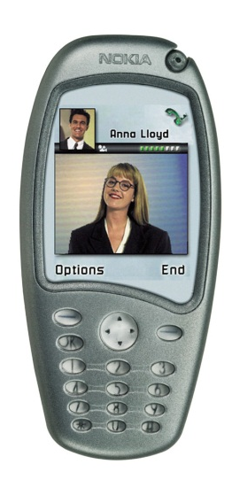
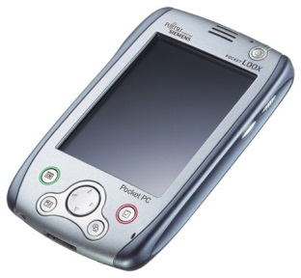
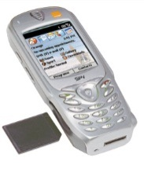
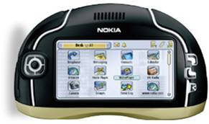
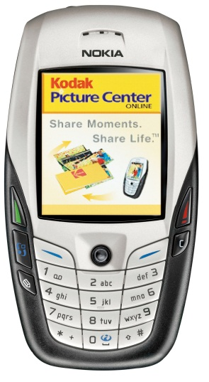
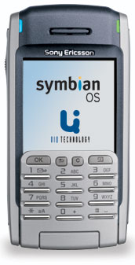

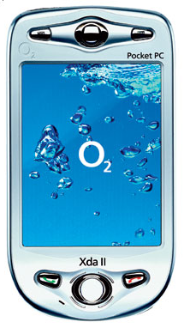
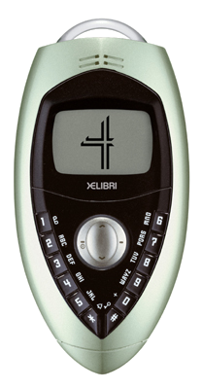
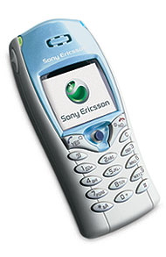
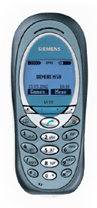
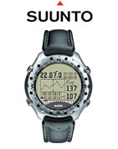
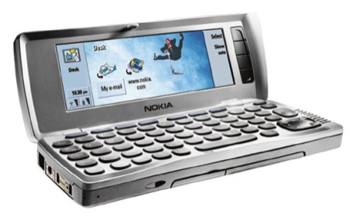
Ingredients 1: Mobile Phones, PDAs & Co.
The visible but smallest
part of the network!
4.<number>

Slide 12
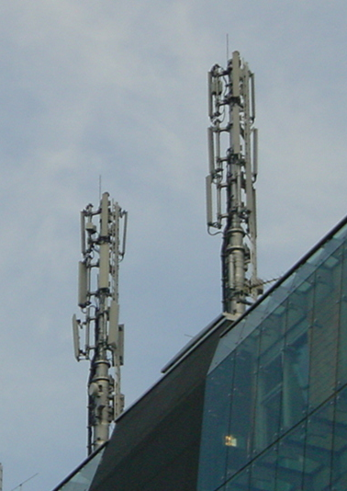
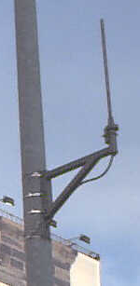
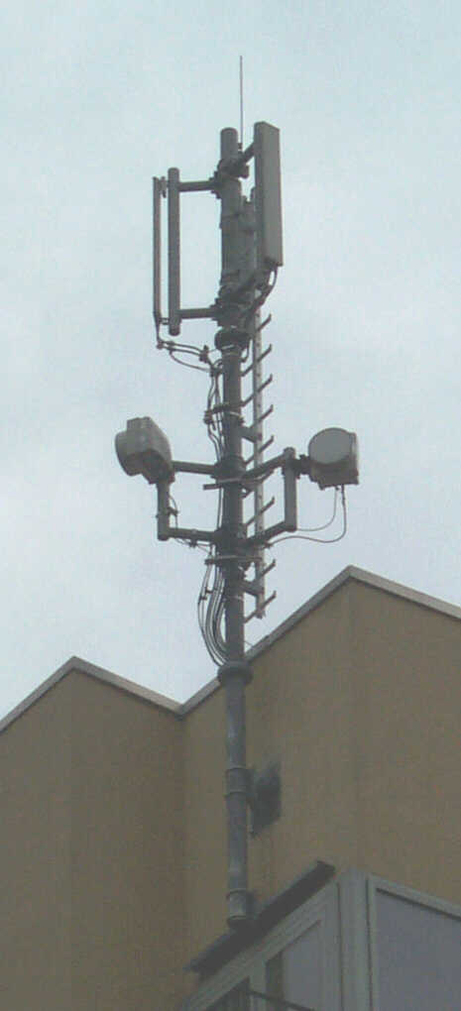
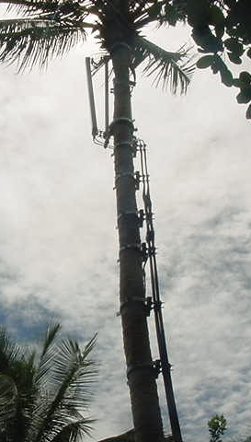
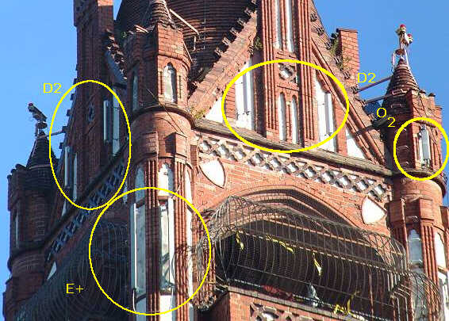
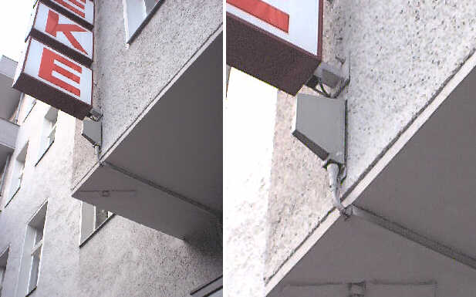
Ingredients 2: Antennas
Still visible – cause many discussions…
4.<number>

Slide 13
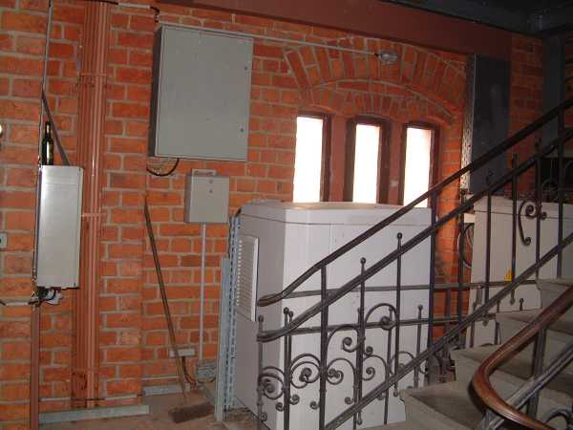
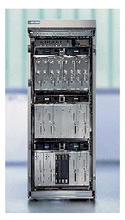
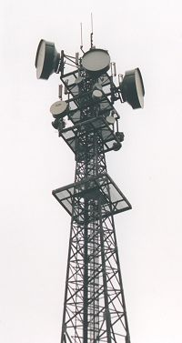
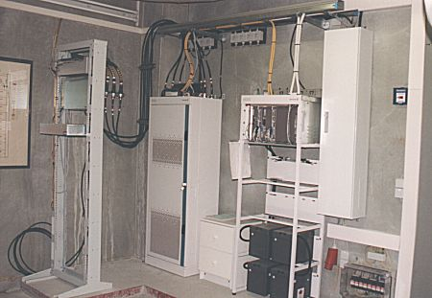
Ingredients 3: Infrastructure 1
Base Stations
Cabling
Microwave links
4.<number>

Slide 14
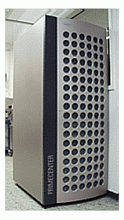
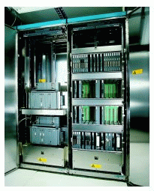
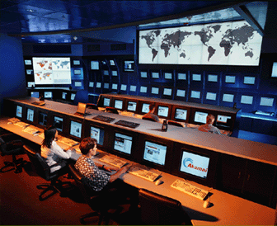
Ingredients 3: Infrastructure 2
Not „visible“, but comprise the major part of the network (also from an investment point of view…)
Management
Data bases
Switching units
Monitoring
4.<number>

Slide 15
GSM: overview
OMC, EIR,
AUC
HLR
fixed network
GMSC
NSS
with OSS
VLR
MSC
VLR
MSC
BSC
BSC
RSS
4.<number>
Notes:
Universität Karlsruhe
Institut für Telematik
Mobilkommunikation
SS 1998
Prof. Dr. Dr. h.c. G. Krüger
E. Dorner / Dr. J. Schiller

Slide 16
GSM: elements and interfaces
radio cell
MS
MS
BSS
U_{m}
radio cell
RSS
BTS
MS
BTS
A_{bis}
BSC
BSC
A
MSC
MSC
NSS
VLR
VLR
signaling
HLR
GMSC
ISDN, PSTN
IWF
PDN
O
OSS
EIR
AUC
OMC
4.<number>
Notes:
Universität Karlsruhe
Institut für Telematik
Mobilkommunikation
SS 1998
Prof. Dr. Dr. h.c. G. Krüger
E. Dorner / Dr. J. Schiller

Slide 17
GSM: system architecture
radio
subsystem
network and switching subsystem
fixed
partner networks
MS
MS
ISDN
PSTN
U_{m}
MSC
BTS
A_{bis}
BSC
EIR
BTS
SS7
HLR
BTS
VLR
BSC
ISDN
PSTN
BTS
A
MSC
BSS
IWF
PSPDN
CSPDN
4.<number>
Notes:
Universität Karlsruhe
Institut für Telematik
Mobilkommunikation
SS 1998
Prof. Dr. Dr. h.c. G. Krüger
E. Dorner / Dr. J. Schiller

Slide 18
System architecture: radio subsystem
radio
subsystem
network and switching
subsystem
MS
MS
Components
  MS (Mobile Station)
  BSS (Base Station Subsystem):
  consisting of
    BTS (Base Transceiver Station):
    sender and receiver
    BSC (Base Station Controller):
    controlling several transceivers
Interfaces
  U_{m} : radio interface
  A_{bis} : standardized, open interface with
  16 kbit/s user channels
  A: standardized, open interface with
  64 kbit/s user channels
U_{m}
BTS
A_{bis}
BSC
MSC
BTS
A
BTS
MSC
BSC
BTS
BSS
4.<number>
Notes:
Universität Karlsruhe
Institut für Telematik
Mobilkommunikation
SS 1998
Prof. Dr. Dr. h.c. G. Krüger
E. Dorner / Dr. J. Schiller

Slide 19
System architecture: network and switching subsystem
network
subsystem
fixed partner
networks
Components
  MSC (Mobile Services Switching Center):
  IWF (Interworking Functions)
  ISDN (Integrated Services Digital Network)
  PSTN (Public Switched Telephone Network)
  PSPDN (Packet Switched Public Data Net.)
  CSPDN (Circuit Switched Public Data Net.)
Databases
  HLR (Home Location Register)
  VLR (Visitor Location Register)
  EIR (Equipment Identity Register)
ISDN
PSTN
MSC
EIR
SS7
HLR
VLR
ISDN
PSTN
MSC
IWF
PSPDN
CSPDN
4.<number>
Notes:
Universität Karlsruhe
Institut für Telematik
Mobilkommunikation
SS 1998
Prof. Dr. Dr. h.c. G. Krüger
E. Dorner / Dr. J. Schiller

Slide 20
Radio subsystem
The Radio Subsystem (RSS) comprises the cellular mobile network up to the switching centers
Components
  Base Station Subsystem (BSS):
    Base Transceiver Station (BTS): radio components including sender, receiver, antenna - if directed antennas are used one BTS can cover several cells
    Base Station Controller (BSC): switching between BTSs, controlling BTSs, managing of network resources, mapping of radio channels (U_{m}) onto terrestrial channels (A interface)
    BSS = BSC + sum(BTS) + interconnection
  Mobile Stations (MS)
4.<number>
Notes:
Universität Karlsruhe
Institut für Telematik
Mobilkommunikation
SS 1998
Prof. Dr. Dr. h.c. G. Krüger
E. Dorner / Dr. J. Schiller

Slide 21
GSM: cellular network
segmentation of the area into cells
possible radio coverage of the cell
idealized shape of the cell
cell
  use of several carrier frequencies
  not the same frequency in adjoining cells
  cell sizes vary from some 100 m up to 35 km depending on user density, geography, transceiver power etc.
  hexagonal shape of cells is idealized (cells overlap, shapes depend on geography)
  if a mobile user changes cells
  ⬇ handover of the connection to the neighbor cell
4.<number>
Notes:
Universität Karlsruhe
Institut für Telematik
Mobilkommunikation
SS 1998
Prof. Dr. Dr. h.c. G. Krüger
E. Dorner / Dr. J. Schiller

Slide 22
GSM frequency bands
Type | Channels | Uplink [MHz] | Downlink [MHz]
GSM 850 (Americas) | 128-251 | 824-849 | 869-894
GSM 900 classical extended | 0-124, 955-1023 124 channels +49 channels | 876-915 890-915 880-915 | 921-960 935-960 925-960
GSM 1800 | 512-885 | 1710-1785 | 1805-1880
GSM 1900 (Americas) | 512-810 | 1850-1910 | 1930-1990
GSM-R exclusive | 955-1024, 0-124 69 channels | 876-915 876-880 | 921-960 921-925
Additionally: GSM 400 (also named GSM 450 or GSM 480 at 450-458/460-468 or 479-486/489-496 MHz
Please note: frequency ranges may vary depending on the country!
Channels at the lower/upper edge of a frequency band are typically not used
4.<number>

Slide 23
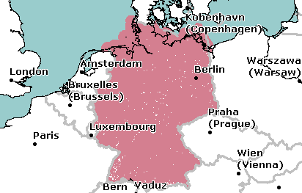
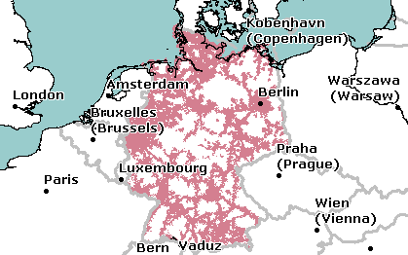
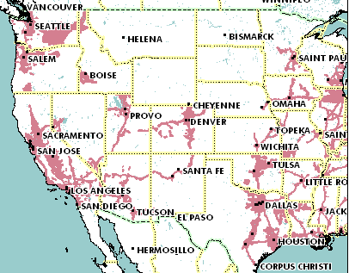
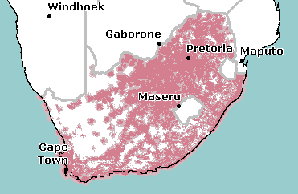
Example coverage of GSM networks (www.gsmworld.com)
T-Mobile (GSM-900/1800) Germany
O₂ (GSM-1800) Germany
AT&T (GSM-850/1900) USA
Vodacom (GSM-900) South Africa
4.<number>
Notes:
Universität Karlsruhe
Institut für Telematik
Mobilkommunikation
SS 1998
Prof. Dr. Dr. h.c. G. Krüger
E. Dorner / Dr. J. Schiller

Slide 24
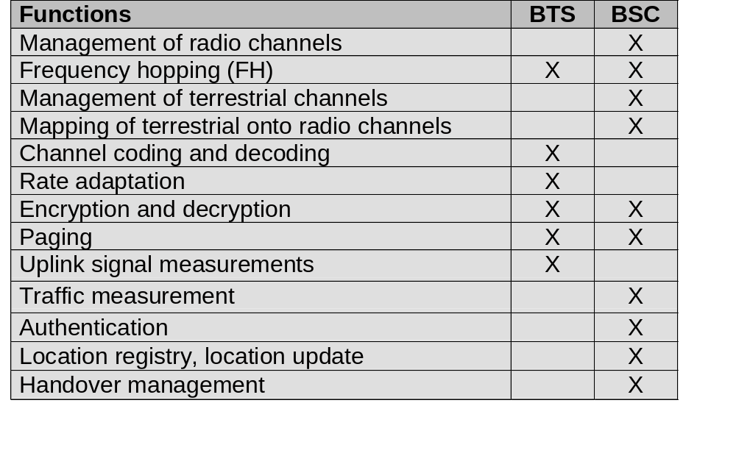
Base Transceiver Station and Base Station Controller
Tasks of a BSS are distributed over BSC and BTS
BTS comprises radio specific functions
BSC is the switching center for radio channels
4.<number>
Notes:
Universität Karlsruhe
Institut für Telematik
Mobilkommunikation
SS 1998
Prof. Dr. Dr. h.c. G. Krüger
E. Dorner / Dr. J. Schiller

Slide 25
Mobile station
Terminal for the use of GSM services
A mobile station (MS) comprises several functional groups
  MT (Mobile Terminal):
    offers common functions used by all services the MS offers
    corresponds to the network termination (NT) of an ISDN access
    end-point of the radio interface (U_{m})
  TA (Terminal Adapter):
    terminal adaptation, hides radio specific characteristics
  TE (Terminal Equipment):
    peripheral device of the MS, offers services to a user
    does not contain GSM specific functions
  SIM (Subscriber Identity Module):
    personalization of the mobile terminal, stores user parameters
TE
TA
MT
R
S
U_{m}
4.<number>
Notes:
Universität Karlsruhe
Institut für Telematik
Mobilkommunikation
SS 1998
Prof. Dr. Dr. h.c. G. Krüger
E. Dorner / Dr. J. Schiller

Slide 26
Network and switching subsystem
NSS is the main component of the public mobile network GSM
  switching, mobility management, interconnection to other networks, system control
Components
  Mobile Services Switching Center (MSC)
  controls all connections via a separated network to/from a mobile terminal within the domain of the MSC - several BSC can belong to a MSC
  Databases (important: scalability, high capacity, low delay)
    Home Location Register (HLR)
    central master database containing user data, permanent and semi-permanent data of all subscribers assigned to the HLR (one provider can have several HLRs)
    Visitor Location Register (VLR)
    local database for a subset of user data, including data about all user currently in the domain of the VLR
4.<number>
Notes:
Universität Karlsruhe
Institut für Telematik
Mobilkommunikation
SS 1998
Prof. Dr. Dr. h.c. G. Krüger
E. Dorner / Dr. J. Schiller

Slide 27
Mobile Services Switching Center
The MSC (mobile switching center) plays a central role in GSM
  switching functions
  additional functions for mobility support
  management of network resources
  interworking functions via Gateway MSC (GMSC)
  integration of several databases
Functions of a MSC
  specific functions for paging and call forwarding
  termination of SS7 (signaling system no. 7)
  mobility specific signaling
  location registration and forwarding of location information
  provision of new services (fax, data calls)
  support of short message service (SMS)
  generation and forwarding of accounting and billing information
4.<number>
Notes:
Universität Karlsruhe
Institut für Telematik
Mobilkommunikation
SS 1998
Prof. Dr. Dr. h.c. G. Krüger
E. Dorner / Dr. J. Schiller

Slide 28
Operation subsystem
The OSS (Operation Subsystem) enables centralized operation, management, and maintenance of all GSM subsystems
Components
  Authentication Center (AUC)
    generates user specific authentication parameters on request of a VLR
    authentication parameters used for authentication of mobile terminals and encryption of user data on the air interface within the GSM system
  Equipment Identity Register (EIR)
    registers GSM mobile stations and user rights
    stolen or malfunctioning mobile stations can be locked and sometimes even localized
  Operation and Maintenance Center (OMC)
    different control capabilities for the radio subsystem and the network subsystem
4.<number>
Notes:
Universität Karlsruhe
Institut für Telematik
Mobilkommunikation
SS 1998
Prof. Dr. Dr. h.c. G. Krüger
E. Dorner / Dr. J. Schiller

Slide 29
Basic radio transmission parameters of the GSM system
Two bands, each 25 MHz wide, have been assigned to the GSM system. The frequency band between 890 and 915 MHz is used for transmission by mobile stations to base stations (Uplink)
whereas the band between 935 and 960 MHz is used for transmission
from the base stations to mobile stations (Downlink).
124 frequency intervals of 200 kHz each with carrier frequencies in their
centers.
Time along each carrier is divided into 8 slots. Thus, multiple access is realized through assigning the connection a particular carrier frequency (or a sequence of them if frequency hopping is performed) and a selected time slot. As a result, the GSM can be treated as a system with TDMA/FDMA multiple access scheme.
physical channel is a sequence of time slots (denoted by the assigned slot number) which are placed on the selected carrier. Physical channels are arranged in pairs. Each pair consists of one physical channel in each direction (uplink and downlink). They are marked with the same time slot number and their carriers differ by 45 MHz.
1.<number>

Slide 30
Basic radio transmission parameters of the GSM system
f
960 MHz
124
935.2 MHz
1
200 kHz
20 MHz
915 MHz
124
890.2 MHz
1
t
3.<number>

Slide 31
TDD/TDMA - general scheme, example DECT
417 µs
1
2
3
11
12
1
2
3
11
12
t
downlink
uplink
3.<number>

Slide 32
Logical channel description
The physical channel assigned to a connection is used for transmission of data packets.
They have a different time structure and meaning. They implement particular logical channels arranged to organize the information exchange.
Broadcast Control Channel (BCCH) — used for transmission of information that controls the network, a particular cell and the neighboring cells,
• Frequency Correction Channel (FCCH) — applied by the mobile station for tuning their reference carrier frequency,
• Synchronization Channel (SCH) — used for frame synchronization and identifica-tion of the base transceiver station, in whose service area the mobile station islocated,
• Common Control Channel (CCCH) — serves for call set-up and other information exchange procedures. It consists of the following logical channels:
— Random Access Channel (RACH) — used by mobile stations on the uplink carrier containing the control time slots to declare their need to be connected
with the base station,
— Access Granted Channel (AGCH) — serves to inform a particular mobile
station on the downlink carrier that access to the system is allowed and will
be performed,
- Paging Channel (PACH) — used to call a particular mobile station in the set
of neighboring cells called Location Area.
1.<number>

Slide 33
Transmission of user information and control information associated with it is performed using the following logical channels both in downlinks and uplinks:
• Traffic Channel (TCH) — applied to transmit the user data characterizing speech or data; there are Full Rate Traffic Channels (TCH/F) and Half-Rate Traffic Channels (TCH/H),
• Slow Associated Control Channel (SACCH) — used for transmission of control data and commands associated with a particular traffic channel. Examples of such commands are: change the power emitted by the mobile station, prepare for handover and send reports on measurements done by the mobile station.
• Fast Associated Control Channel (FACCH) — used to send urgent messages associated with a particular link realized on the traffic channel.
Before traffic channels in downlink and uplink are assigned to the call to be realized, a Dedicated Control Channel (DCCH) is implemented. It consists of the following logical channels:
• Stand-Alone Dedicated Control Channel (SDCCH) - used for information ex-
change preceding a connection, such as user's authentication, localization update
and traffic channel assignment,
• Non-associated version of FACCH used for transmission of short messages.
1.<number>

Slide 34

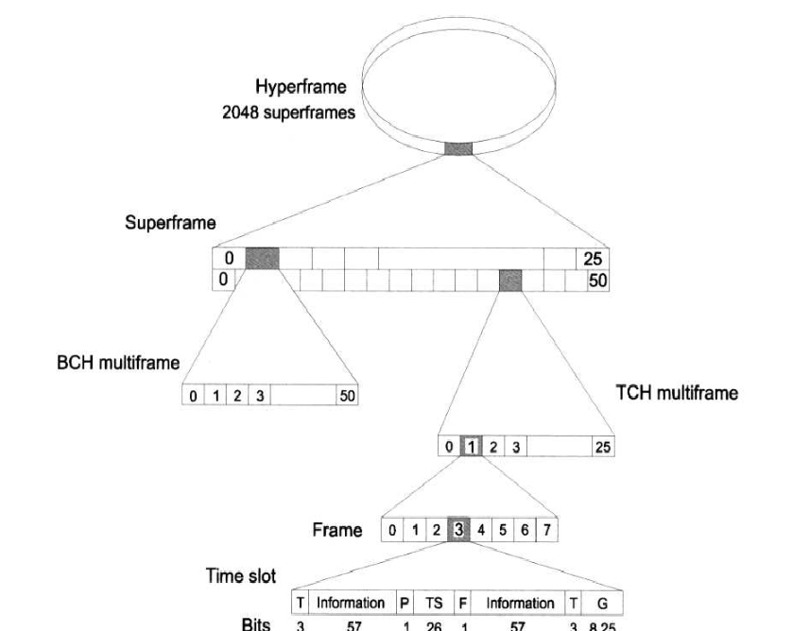
GSM time hierarchy
1.<number>

Slide 35
GSM - TDMA/FDMA
935-960 MHz
124 channels (200 kHz)
downlink
frequency
890-915 MHz
124 channels (200 kHz)
uplink
higher GSM frame structures
time
GSM TDMA frame
1
2
3
4
5
6
7
8
4.615 ms
GSM time-slot (normal burst)
guard
space
guard
space
tail
user data
S
Training
S
user data
tail
3 bits
57 bits
1
26 bits
1
57 bits
3
546.5 µs
577 µs
4.<number>
Notes:
Universität Karlsruhe
Institut für Telematik
Mobilkommunikation
SS 1998
Prof. Dr. Dr. h.c. G. Krüger
E. Dorner / Dr. J. Schiller

Slide 36
GSM hierarchy of frames
hyperframe
0
1
2
...
2045
2046
2047
3 h 28 min 53.76 s
superframe
0
1
2
...
48
49
50
6.12 s
0
1
...
24
25
multiframe
0
1
...
24
25
120 ms
0
1
2
...
48
49
50
235.4 ms
frame
0
1
...
6
7
4.615 ms
slot
burst
577 µs
4.<number>
Notes:
Universität Karlsruhe
Institut für Telematik
Mobilkommunikation
SS 1998
Prof. Dr. Dr. h.c. G. Krüger
E. Dorner / Dr. J. Schiller

Slide 37
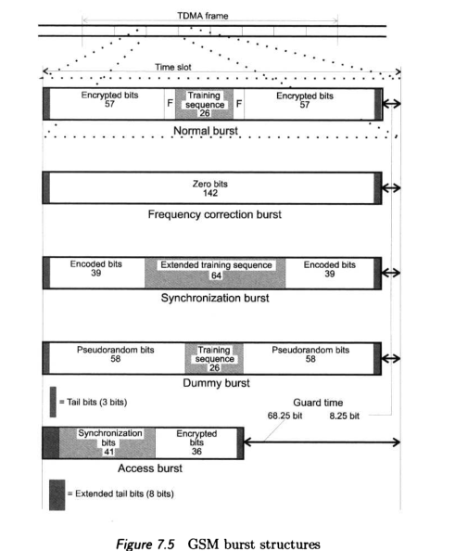
GSM burst structures
1.<number>

Slide 38
GSM protocol layers for signaling
U_{m}
A_{bis}
A
MS
BTS
BSC
MSC
CM
CM
MM
MM
RR
RR’
BTSM
BSSAP
BSSAP
RR’
BTSM
SS7
SS7
LAPD_{m}
LAPD_{m}
LAPD
LAPD
radio
radio
PCM
PCM
PCM
PCM
16/64 kbit/s
64 kbit/s /
2.048 Mbit/s
4.<number>
Notes:
Universität Karlsruhe
Institut für Telematik
Mobilkommunikation
SS 1998
Prof. Dr. Dr. h.c. G. Krüger
E. Dorner / Dr. J. Schiller

Slide 39
Description of the call set-up procedure
1.<number>

Slide 40

Mobile Terminated Call
1: calling a GSM subscriber
2: forwarding call to GMSC
3: signal call setup to HLR
4, 5: request MSRN from VLR
6: forward responsible
MSC to GMSC
7: forward call to
current MSC
8, 9: get current status of MS
10, 11: paging of MS
12, 13: MS answers
14, 15: security checks
16, 17: set up connection
4
HLR
VLR
5
8
9
3
6
14
15
calling
station
7
PSTN
GMSC
MSC
1
2
10
10
13
10
16
BSS
BSS
BSS
11
11
11
11
12
17
MS
4.<number>
Notes:
Universität Karlsruhe
Institut für Telematik
Mobilkommunikation
SS 1998
Prof. Dr. Dr. h.c. G. Krüger
E. Dorner / Dr. J. Schiller

Slide 41
Mobile Originated Call
1, 2: connection request
3, 4: security check
5-8: check resources (free circuit)
9-10: set up call
VLR
3
4
6
5
PSTN
GMSC
MSC
7
8
2
9
1
MS
BSS
10
4.<number>
Notes:
Universität Karlsruhe
Institut für Telematik
Mobilkommunikation
SS 1998
Prof. Dr. Dr. h.c. G. Krüger
E. Dorner / Dr. J. Schiller

Slide 42
MTC/MOC
MS
MTC
BTS
MS
MOC
BTS
paging request
channel request
channel request
immediate assignment
immediate assignment
paging response
service request
authentication request
authentication request
authentication response
authentication response
ciphering command
ciphering command
ciphering complete
ciphering complete
setup
setup
call confirmed
call confirmed
assignment command
assignment command
assignment complete
assignment complete
alerting
alerting
connect
connect
connect acknowledge
connect acknowledge
data/speech exchange
data/speech exchange
4.<number>
Notes:
Universität Karlsruhe
Institut für Telematik
Mobilkommunikation
SS 1998
Prof. Dr. Dr. h.c. G. Krüger
E. Dorner / Dr. J. Schiller

Slide 43
Handover
1.<number>

Slide 44
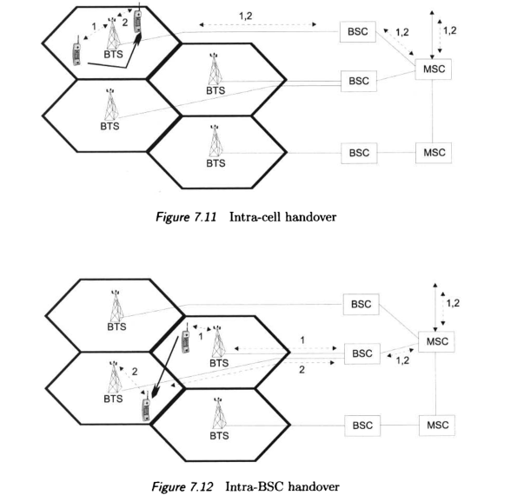
1.<number>

Slide 45
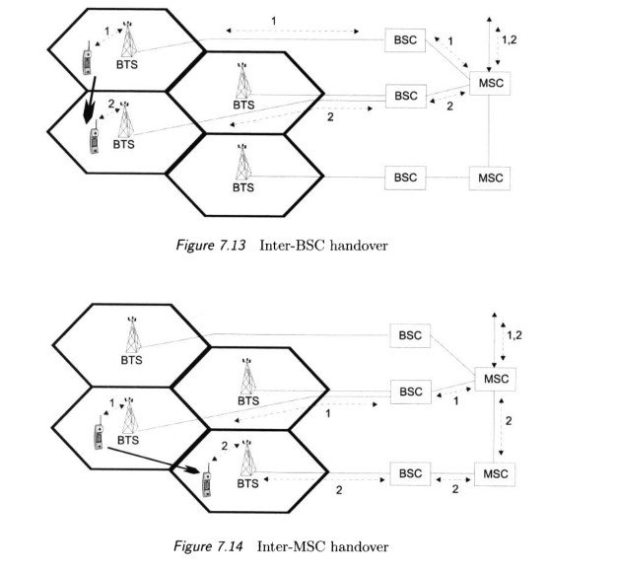
1.<number>

Slide 46
4 types of handover
1
2
3
4
MS
MS
MS
MS
BTS
BTS
BTS
BTS
BSC
BSC
BSC
MSC
MSC
4.<number>
Notes:
Universität Karlsruhe
Institut für Telematik
Mobilkommunikation
SS 1998
Prof. Dr. Dr. h.c. G. Krüger
E. Dorner / Dr. J. Schiller

Slide 47
Handover decision
receive level
BTS_{old}
receive level
BTS_{old}
HO_MARGIN
MS
MS
BTS_{old}
BTS_{new}
4.<number>
Notes:
Universität Karlsruhe
Institut für Telematik
Mobilkommunikation
SS 1998
Prof. Dr. Dr. h.c. G. Krüger
E. Dorner / Dr. J. Schiller

Slide 48
Handover procedure
MS
BTS_{old}
BSC_{old}
MSC
BSC_{new}
BTS_{new}
measurement
report
measurement
result
HO decision
HO required
HO request
resource allocation
ch. activation
HO request ack
ch. activation ack
HO command
HO command
HO command
HO access
Link establishment
HO complete
HO complete
clear command
clear command
clear complete
clear complete
4.<number>
Notes:
Universität Karlsruhe
Institut für Telematik
Mobilkommunikation
SS 1998
Prof. Dr. Dr. h.c. G. Krüger
E. Dorner / Dr. J. Schiller

Slide 49
Ensuring privacy and authentication of a user
The following means have been undertaken in the GSM system to ensure transmission security:
3 RXLEV-U denotes Received Signal Level in the Upper Link, RXQUAL-U - Received Signal Quality in the Upper Link, D at the end of the remaining abbreviations stands for Down Link.
ENSURING PRIVACY AND AUTHENTICATION OF A USER
• access to the network based on the verification of the user's authenticity,
• secrecy of the transmitted data (speech, data, fax and control signals) due to encryption,
• anonymity of the users due to the temporary mobile user identity numbers utilized inside the network.
1.<number>

Slide 50
The NVM of the size 2–3 kB contains individual user's parameters and data, such as:
• K i — user's authentication key,
• IMSI (International Mobile Subscriber Identity) — 15-bit long user's individual identification number consisting of the country code, network code and number of the user,
• TMSI (Temporary Mobile Subscriber Identity) — temporary identification number assigned to the user after each registration in a new VLR,
• LAI (Location Area Identifier),
• PIN (Personal Identification Number) - 4 or 8-digit code identifying the user with respect to the SIM card,
• the personal telephone book — a list of telephone numbers entered by the user,
• the list of foreign cellular networks where roaming is allowed,
• the received short messages (SMS).
1.<number>

Slide 51
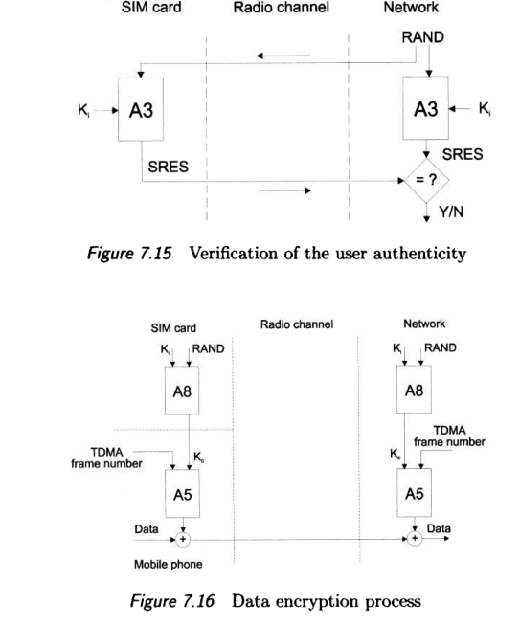
1.<number>

Slide 52
Security in GSM
Security services
  access control/authentication
    user ⬄ SIM (Subscriber Identity Module): secret PIN (personal identification number)
    SIM ⬄ network: challenge response method
  confidentiality
    voice and signaling encrypted on the wireless link (after successful authentication)
  anonymity
    temporary identity TMSI
    (Temporary Mobile Subscriber Identity)
    newly assigned at each new location update (LUP)
    encrypted transmission
3 algorithms specified in GSM
  A3 for authentication (“secret”, open interface)
  A5 for encryption (standardized)
  A8 for key generation (“secret”, open interface)
“secret”:
A3 and A8 available via the Internet
network providers can use stronger mechanisms
4.<number>
Notes:
Universität Karlsruhe
Institut für Telematik
Mobilkommunikation
SS 1998
Prof. Dr. Dr. h.c. G. Krüger
E. Dorner / Dr. J. Schiller

Slide 53
GSM - authentication
mobile network
SIM
RAND
K_{i}
RAND
RAND
K_{i}
AC
128 bit
128 bit
128 bit
128 bit
A3
A3
SIM
SRES* 32 bit
SRES 32 bit
MSC
SRES* =? SRES
SRES
32 bit
SRES
K_{i}: individual subscriber authentication key SRES: signed response
4.<number>
Notes:
Universität Karlsruhe
Institut für Telematik
Mobilkommunikation
SS 1998
Prof. Dr. Dr. h.c. G. Krüger
E. Dorner / Dr. J. Schiller

Slide 54
GSM - key generation and encryption
mobile network (BTS)
MS with SIM
RAND
K_{i}
RAND
RAND
K_{i}
AC
128 bit
128 bit
128 bit
128 bit
SIM
A8
A8
cipher
key
K_{c}
64 bit
K_{c}
64 bit
data
encrypted
data
SRES
BSS
data
MS
A5
A5
4.<number>
Notes:
Universität Karlsruhe
Institut für Telematik
Mobilkommunikation
SS 1998
Prof. Dr. Dr. h.c. G. Krüger
E. Dorner / Dr. J. Schiller

Slide 55
Modifications and derivatives of GSM
system evolution and the process of system specification can
be divided into three phases [7]:
• Phase 1 (1991-1994) - the system was operating in its basic version,
• Phase 2 (1994-1995) — the system specification was verified in order to allow future
gradual modifications,
• Phase 2+ (from
1995) - the modifications are being introduced.
1.<number>

Slide 56
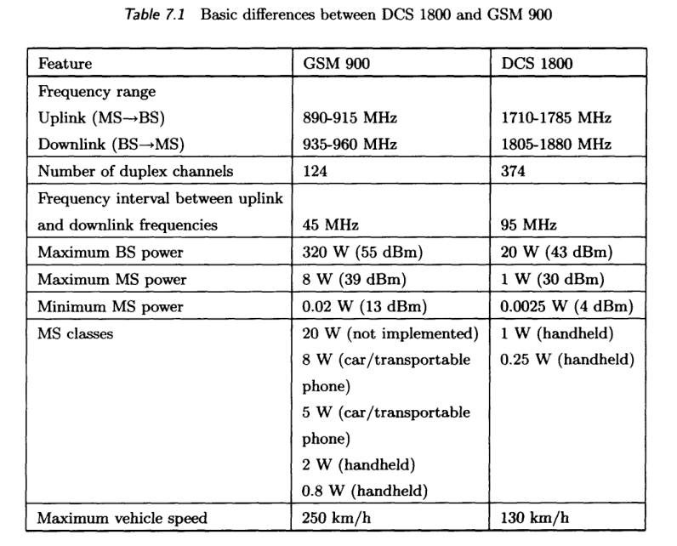
1.<number>

Slide 57
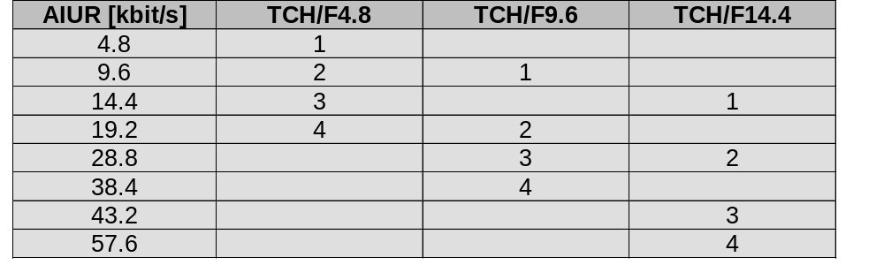
Data services in GSM I
Data transmission standardized with only 9.6 kbit/s
  advanced coding allows 14,4 kbit/s
  not enough for Internet and multimedia applications
HSCSD (High-Speed Circuit Switched Data)
  mainly software update
  bundling of several time-slots to get higher
  AIUR (Air Interface User Rate)
  (e.g., 57.6 kbit/s using 4 slots, 14.4 each)
  advantage: ready to use, constant quality, simple
  disadvantage: channels blocked for voice transmission
4.<number>
Notes:
Universität Karlsruhe
Institut für Telematik
Mobilkommunikation
SS 1998
Prof. Dr. Dr. h.c. G. Krüger
E. Dorner / Dr. J. Schiller

Slide 58
Data services in GSM II
GPRS (General Packet Radio Service)
  packet switching
  using free slots only if data packets ready to send
  (e.g., 50 kbit/s using 4 slots temporarily)
  standardization 1998, introduction 2001
  advantage: one step towards UMTS, more flexible
  disadvantage: more investment needed (new hardware)
GPRS network elements
  GSN (GPRS Support Nodes): GGSN and SGSN
  GGSN (Gateway GSN)
    interworking unit between GPRS and PDN (Packet Data Network)
  SGSN (Serving GSN)
    supports the MS (location, billing, security)
  GR (GPRS Register)
    user addresses
4.<number>
Notes:
Universität Karlsruhe
Institut für Telematik
Mobilkommunikation
SS 1998
Prof. Dr. Dr. h.c. G. Krüger
E. Dorner / Dr. J. Schiller

