Slide 1
Mobile Network
Mobile IP
IP Packet Delivery
Agent Advertisement and Discovery
Registration
Tunneling and Encapsulation
Optimization
Reverse Tunneling,
Mobile TCP
Fast Retransmit / Fast Recovery
Transmission/Timeout Freezing
Selective Retransmission.

Slide 2
Motivation for Mobile IP
Routing
  based on IP destination address, network prefix (e.g. 129.13.42) determines physical subnet
  change of physical subnet implies change of IP address to have a topological correct address (standard IP) or needs special entries in the routing tables
Specific routes to end-systems?
  change of all routing table entries to forward packets to the right destination
  does not scale with the number of mobile hosts and frequent changes in the location, security problems
Changing the IP-address?
  adjust the host IP address depending on the current location
  almost impossible to find a mobile system, DNS updates take to long time
  TCP connections break, security problems

Slide 3
Requirements to Mobile IP (RFC 3344, was: 3220, was: 2002)
Transparency
  mobile end-systems keep their IP address
  continuation of communication after interruption of link possible
  point of connection to the fixed network can be changed
Compatibility
  support of the same layer 2 protocols as IP
  no changes to current end-systems and routers required
  mobile end-systems can communicate with fixed systems
Security
  authentication of all registration messages
Efficiency and scalability
  only little additional messages to the mobile system required (connection typically via a low bandwidth radio link)
  world-wide support of a large number of mobile systems in the whole Internet

Slide 4

IP Packet Delivery Terminology
Mobile Node (MN)
  system (node) that can change the point of connection
  to the network without changing its IP address
Home Agent (HA)
  system in the home network of the MN, typically a router
  registers the location of the MN, tunnels IP datagrams to the COA
Foreign Agent (FA)
  system in the current foreign network of the MN, typically a router
  forwards the tunneled datagrams to the MN, typically also the default router for the MN
Care-of Address (COA)
  address of the current tunnel end-point for the MN (at FA or MN)
  actual location of the MN from an IP point of view
  can be chosen, e.g., via DHCP
Correspondent Node (CN)
  communication partner

Slide 5
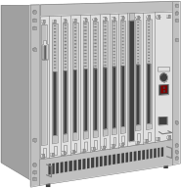


IP Packet Delivery Example network
HA
MN
Internet
router
home network
mobile end-system
(physical home network
for the MN)
FA
foreign
network
router
(current physical network
for the MN)
CN
end-system
router

Slide 6
IP Packet Delivery Data transfer to the mobile system
HA
2
MN
Internet
home network
3
receiver
FA
foreign
network
1. Sender sends to the IP address of MN,
HA intercepts packet (proxy ARP)
2. HA tunnels packet to COA, here FA,
by encapsulation
3. FA forwards the packet
to the MN
1
CN
sender

Slide 7
Data transfer from the mobile system
HA
1
MN
Internet
home network
sender
FA
foreign
network
1. Sender sends to the IP address
of the receiver as usual,
FA works as default router
CN
receiver

Slide 8
IP Packet Delivery
COA
foreign
network
home
network
router
HA
router
FA
MN
Internet
CN
router
3.
foreign
network
home
network
router
HA
router
FA
MN
2.
4.
Internet
1.
CN
router

Slide 9
IP Packet Delivery Network integration
Agent Advertisement
  HA and FA periodically send advertisement messages into their physical subnets
  MN listens to these messages and detects, if it is in the home or a foreign network (standard case for home network)
  MN reads a COA from the FA advertisement messages
Registration (always limited lifetime!)
  MN signals COA to the HA via the FA, HA acknowledges via FA to MN
  these actions have to be secured by authentication
Advertisement
  HA advertises the IP address of the MN (as for fixed systems), i.e. standard routing information
  routers adjust their entries, these are stable for a longer time (HA responsible for a MN over a longer period of time)
  packets to the MN are sent to the HA,
  independent of changes in COA/FA

Slide 10
Agent Advertisement and Discovery : Agent advertisement
0
7
8
15
16
23
24
31
type
code
checksum
#addresses
addr. size
lifetime
router address 1
preference level 1
router address 2
preference level 2
. . .
type = 16
length = 6 + 4 * #COAs
R: registration required
B: busy, no more registrations
H: home agent
F: foreign agent
M: minimal encapsulation
G: GRE encapsulation
r: =0, ignored (former Van Jacobson compression)
T: FA supports reverse tunneling
reserved: =0, ignored
type = 16
length
sequence number
registration lifetime
R
B
H
F
M
G
r
T
reserved
COA 1
COA 2
. . .

Slide 11
Agent Advertisement and Discovery : Registration
MN
FA
HA
MN
HA
registration
request
registration
request
registration
request
registration
reply
registration
reply
t
registration
reply
t

Slide 12
Agent Advertisement and Discovery :Mobile IP registration request
0
7
8
15
16
23
24
31
type = 1
S
B
D
M
G
r
T x
lifetime
home address
home agent
COA
identification
extensions . . .
S: simultaneous bindings
B: broadcast datagrams
D: decapsulation by MN
M mininal encapsulation
G: GRE encapsulation
r: =0, ignored
T: reverse tunneling requested
x: =0, ignored

Slide 13
Agent Advertisement and Discovery : Mobile IP registration reply
0
7
8
15
16
31
type = 3
code
lifetime
home address
home agent
identification
Example codes:
registration successful
0 registration accepted
1 registration accepted, but simultaneous mobility bindings unsupported
registration denied by FA
65 administratively prohibited
66 insufficient resources
67 mobile node failed authentication
68 home agent failed authentication
69 requested Lifetime too long
registration denied by HA
129 administratively prohibited
131 mobile node failed authentication
133 registration Identification mismatch
135 too many simultaneous mobility bindings
extensions . . .

Slide 14
Tunneling and Encapsulation :Encapsulation
original IP header
original data
new IP header
new data
outer header
inner header
original data

Slide 15
Tunneling and Encapsulation : Encapsulation I
Encapsulation of one packet into another as payload
  e.g. IPv6 in IPv4 (6Bone), Multicast in Unicast (Mbone)
  here: e.g. IP-in-IP-encapsulation, minimal encapsulation or GRE (Generic Record Encapsulation)
IP-in-IP-encapsulation (mandatory, RFC 2003)
  tunnel between HA and COA
ver.
IHL
DS (TOS)
length
IP identification
flags
fragment offset
TTL
IP-in-IP
IP checksum
IP address of HA
Care-of address COA
ver.
IHL
DS (TOS)
length
IP identification
flags
fragment offset
TTL
lay. 4 prot.
IP checksum
IP address of CN
IP address of MN
TCP/UDP/ ... payload

Slide 16
Tunneling and Encapsulation : Encapsulation II
Minimal encapsulation (optional)
  avoids repetition of identical fields
  e.g. TTL, IHL, version, DS (RFC 2474, old: TOS)
  only applicable for unfragmented packets, no space left for fragment identification
ver.
IHL
DS (TOS)
length
IP identification
flags
fragment offset
TTL
min. encap.
IP checksum
IP address of HA
care-of address COA
lay. 4 protoc.
S
reserved
IP checksum
IP address of MN
original sender IP address (if S=1)
TCP/UDP/ ... payload

Slide 17
Tunneling and Encapsulation : Generic Routing Encapsulation
original
header
original data
outer header
GRE
header
original
header
original data
RFC 1701
new header
new data
ver.
IHL
DS (TOS)
length
IP identification
flags
fragment offset
TTL
GRE
IP checksum
RFC 2784
IP address of HA
Care-of address COA
C
R
K
S
s
rec.
rsv.
ver.
protocol
C
reserved0
ver.
protocol
checksum (optional)
offset (optional)
checksum (optional)
reserved1 (=0)
key (optional)
sequence number (optional)
routing (optional)
ver.
IHL
DS (TOS)
length
IP identification
flags
fragment offset
TTL
lay. 4 prot.
IP checksum
IP address of CN
IP address of MN
TCP/UDP/ ... payload

Slide 18
Optimization :Optimization of packet forwarding
Triangular Routing
  sender sends all packets via HA to MN
  higher latency and network load
“Solutions”
  sender learns the current location of MN
  direct tunneling to this location
  HA informs a sender about the location of MN
  big security problems!
Change of FA
  packets on-the-fly during the change can be lost
  new FA informs old FA to avoid packet loss, old FA now forwards remaining packets to new FA
  this information also enables the old FA to release resources for the MN

Slide 19
Optimization : Change of foreign agent
CN
HA
FA_{old}
FA_{new}
MN
Data
Data
Data
Update
ACK
Data
Data
MN changes
location
Update
Registration
ACK
Data
Data
Data
Warning
Request
Update
ACK
Data
Data
t

Slide 20
Tunneling and Encapsulation: Reverse tunneling
HA
2
MN
Internet
home network
1
sender
FA
foreign
network
1. MN sends to FA
2. FA tunnels packets to HA
by encapsulation
3. HA forwards the packet to the
receiver (standard case)
3
CN
receiver

Slide 21
Tunneling and Encapsulation : Mobile IP with reverse tunneling
Router accept often only “topological correct“ addresses (firewall!)
  a packet from the MN encapsulated by the FA is now topological correct
  furthermore multicast and TTL problems solved (TTL in the home network correct, but MN is to far away from the receiver)
Reverse tunneling does not solve
  problems with firewalls, the reverse tunnel can be abused to circumvent security mechanisms (tunnel hijacking)
  optimization of data paths, i.e. packets will be forwarded through the tunnel via the HA to a sender (double triangular routing)
The standard is backwards compatible
  the extensions can be implemented easily and cooperate with current implementations without these extensions
  Agent Advertisements can carry requests for reverse tunneling

Slide 22
Mobile IP and IPv6
Mobile IP was developed for IPv4, but IPv6 simplifies the protocols
  security is integrated and not an add-on, authentication of registration is included
  COA can be assigned via auto-configuration (DHCPv6 is one candidate), every node has address autoconfiguration
  no need for a separate FA, all routers perform router advertisement which can be used instead of the special agent advertisement; addresses are always co-located
  MN can signal a sender directly the COA, sending via HA not needed in this case (automatic path optimization)
  „soft“ hand-over, i.e. without packet loss, between two subnets is supported
    MN sends the new COA to its old router
    the old router encapsulates all incoming packets for the MN and forwards them to the new COA
    authentication is always granted

Slide 23
Problems with mobile IP
Security
  authentication with FA problematic, for the FA typically belongs to another organization
  no protocol for key management and key distribution has been standardized in the Internet
  patent and export restrictions
Firewalls
  typically mobile IP cannot be used together with firewalls, special set-ups are needed (such as reverse tunneling)
QoS
  many new reservations in case of RSVP
  tunneling makes it hard to give a flow of packets a special treatment needed for the QoS

Slide 24
Security in Mobile IP
Security requirements (Security Architecture for the Internet Protocol, RFC 1825)
  Integrity
  any changes to data between sender and receiver can be detected by the receiver
  Authentication
  sender address is really the address of the sender and all data received is really data sent by this sender
  Confidentiality
  only sender and receiver can read the data
  Non-Repudiation
  sender cannot deny sending of data
  Traffic Analysis
  creation of traffic and user profiles should not be possible
  Replay Protection
  receivers can detect replay of messages

Slide 25
IP security architecture I
Two or more partners have to negotiate security mechanisms to setup a security association
  typically, all partners choose the same parameters and mechanisms
Two headers have been defined for securing IP packets:
  Authentication-Header
    guarantees integrity and authenticity of IP packets
    if asymmetric encryption schemes are used, non-repudiation can also be guaranteed
  Encapsulation Security Payload
    protects confidentiality between communication partners
IP-Header
IP header
Authentification-Header
authentication header
UDP/TCP-Paket
UDP/TCP data
not encrypted
encrypted
IP header
ESP header
encrypted data

Slide 26
IP security architecture II
Mobile Security Association for registrations
  parameters for the mobile host (MH), home agent (HA), and foreign agent (FA)
Extensions of the IP security architecture
  extended authentication of registration
  prevention of replays of registrations
    time stamps: 32 bit time stamps + 32 bit random number
    nonces: 32 bit random number (MH) + 32 bit random number (HA)
MH-FA authentication
FA-HA authentication
MH-HA authentication
registration request
MH
FA
registration request
HA
registration reply
registration reply

Slide 27
Key distribution
Home agent distributes session keys
foreign agent has a security association with the home agent
mobile host registers a new binding at the home agent
home agent answers with a new session key for foreign agent and mobile node
FA
MH
response:
E_{HA-FA} {session key}
E_{HA-MH} {session key}
HA

Slide 28
DHCP: Dynamic Host Configuration Protocol
Application
  simplification of installation and maintenance of networked computers
  supplies systems with all necessary information, such as IP address, DNS server address, domain name, subnet mask, default router etc.
  enables automatic integration of systems into an Intranet or the Internet, can be used to acquire a COA for Mobile IP
Client/Server-Model
  the client sends via a MAC broadcast a request to the DHCP server (might be via a DHCP relay)
DHCPDISCOVER
DHCPDISCOVER
server
client
client
relay

Slide 29
DHCP - protocol mechanisms
server
(not selected)
client
server
(selected)
initialization
DHCPDISCOVER
DHCPDISCOVER
determine the
configuration
determine the
configuration
DHCPOFFER
DHCPOFFER
collection of replies
time
selection of configuration
DHCPREQUEST
(reject)
DHCPREQUEST
(options)
confirmation of
configuration
DHCPACK
initialization completed
release
DHCPRELEASE
delete context

Slide 30
DHCP characteristics
Server
  several servers can be configured for DHCP, coordination not yet standardized (i.e., manual configuration)
Renewal of configurations
  IP addresses have to be requested periodically, simplified protocol
Options
  available for routers, subnet mask, NTP (network time protocol) timeserver, SLP (service location protocol) directory,
  DNS (domain name system)
Big security problems!
  no authentication of DHCP information specified

Slide 31
Transport Layer
E.g. HTTP (used by web services) typically uses TCP
  Reliable transport between client and server required
TCP
  Steam oriented, not transaction oriented
  Network friendly: time-out
  ➔ congestion
  ➔ slow down transmission
Well known – TCP guesses quite often wrong in wireless and mobile networks
  Packet loss due to transmission errors
  Packet loss due to change of network
Result
  Severe performance degradation
Client
Server
TCP SYN
TCP SYN/ACK
Connection
setup
TCP ACK
HTTP request
Data
transmission
HTTP response
>15 s
no data
GPRS: 500ms!
Connection
release

Slide 32
Motivation I
Transport protocols typically designed for
  Fixed end-systems
  Fixed, wired networks
Research activities
  Performance
  Congestion control
  Efficient retransmissions
TCP congestion control
  packet loss in fixed networks typically due to (temporary) overload situations
  router have to discard packets as soon as the buffers are full
  TCP recognizes congestion only indirect via missing acknowledgements, retransmissions unwise, they would only contribute to the congestion and make it even worse
  slow-start algorithm as reaction

Slide 33
Motivation II
TCP slow-start algorithm
  sender calculates a congestion window for a receiver
  start with a congestion window size equal to one segment
  exponential increase of the congestion window up to the congestion threshold, then linear increase
  missing acknowledgement causes the reduction of the congestion threshold to one half of the current congestion window
  congestion window starts again with one segment
TCP fast retransmit/fast recovery
  TCP sends an acknowledgement only after receiving a packet
  if a sender receives several acknowledgements for the same packet, this is due to a gap in received packets at the receiver
  however, the receiver got all packets up to the gap and is actually receiving packets
  therefore, packet loss is not due to congestion, continue with current congestion window (do not use slow-start)

Slide 34
Influences of mobility on TCP-mechanisms
TCP assumes congestion if packets are dropped
  typically wrong in wireless networks, here we often have packet loss due to transmission errors
  furthermore, mobility itself can cause packet loss, if e.g. a mobile node roams from one access point (e.g. foreign agent in Mobile IP) to another while there are still packets in transit to the wrong access point and forwarding is not possible
The performance of an unchanged TCP degrades severely
  however, TCP cannot be changed fundamentally due to the large base of installation in the fixed network, TCP for mobility has to remain compatible
  the basic TCP mechanisms keep the whole Internet together

Slide 35
Early approach: Indirect TCP I
Indirect TCP or I-TCP segments the connection
  no changes to the TCP protocol for hosts connected to the wired Internet, millions of computers use (variants of) this protocol
  optimized TCP protocol for mobile hosts
  splitting of the TCP connection at, e.g., the foreign agent into 2 TCP connections, no real end-to-end connection any longer
  hosts in the fixed part of the net do not notice the characteristics of the wireless part
mobile host
access point
(foreign agent)
„wired“ Internet
„wireless“ TCP
standard TCP

Slide 36
I-TCP socket and state migration
access point₁
socket migration
and state transfer
Internet
access point₂
mobile host

Slide 37
Indirect TCP II
Advantages
  no changes in the fixed network necessary, no changes for the hosts (TCP protocol) necessary, all current optimizations to TCP still work
  transmission errors on the wireless link do not propagate into the fixed network
  simple to control, mobile TCP is used only for one hop between, e.g., a foreign agent and mobile host
  therefore, a very fast retransmission of packets is possible, the short delay on the mobile hop is known
Disadvantages
  loss of end-to-end semantics, an acknowledgement to a sender does now not any longer mean that a receiver really got a packet, foreign agents might crash
  higher latency possible due to buffering of data within the foreign agent and forwarding to a new foreign agent

Slide 38
Early approach: Snooping TCP I
„Transparent“ extension of TCP within the foreign agent
  buffering of packets sent to the mobile host
  lost packets on the wireless link (both directions!) will be retransmitted immediately by the mobile host or foreign agent, respectively (so called “local” retransmission)
  the foreign agent therefore “snoops” the packet flow and recognizes acknowledgements in both directions, it also filters ACKs
  changes of TCP only within the foreign agent
local retransmission
correspondent
host
foreign
agent
„wired“ Internet
snooping of ACKs
buffering of data
mobile
host
end-to-end TCP connection

Slide 39
Snooping TCP II
Data transfer to the mobile host
  FA buffers data until it receives ACK of the MH, FA detects packet loss via duplicated ACKs or time-out
  fast retransmission possible, transparent for the fixed network
Data transfer from the mobile host
  FA detects packet loss on the wireless link via sequence numbers, FA answers directly with a NACK to the MH
  MH can now retransmit data with only a very short delay
Integration of the MAC layer
  MAC layer often has similar mechanisms to those of TCP
  thus, the MAC layer can already detect duplicated packets due to retransmissions and discard them
Problems
  snooping TCP does not isolate the wireless link as good as I-TCP
  snooping might be useless depending on encryption schemes

Slide 40
Early approach: Mobile TCP
Special handling of lengthy and/or frequent disconnections
M-TCP splits as I-TCP does
  unmodified TCP fixed network to supervisory host (SH)
  optimized TCP SH to MH
Supervisory host
  no caching, no retransmission
  monitors all packets, if disconnection detected
    set sender window size to 0
    sender automatically goes into persistent mode
  old or new SH reopen the window
Advantages
  maintains semantics, supports disconnection, no buffer forwarding
Disadvantages
  loss on wireless link propagated into fixed network
  adapted TCP on wireless link

Slide 41
Fast retransmit/fast recovery
Change of foreign agent often results in packet loss
  TCP reacts with slow-start although there is no congestion
Forced fast retransmit
  as soon as the mobile host has registered with a new foreign agent, the MH sends duplicated acknowledgements on purpose
  this forces the fast retransmit mode at the communication partners
  additionally, the TCP on the MH is forced to continue sending with the actual window size and not to go into slow-start after registration
Advantage
  simple changes result in significant higher performance
Disadvantage
  further mix of IP and TCP, no transparent approach

Slide 42
Transmission/time-out freezing
Mobile hosts can be disconnected for a longer time
  no packet exchange possible, e.g., in a tunnel, disconnection due to overloaded cells or mux. with higher priority traffic
  TCP disconnects after time-out completely
TCP freezing
  MAC layer is often able to detect interruption in advance
  MAC can inform TCP layer of upcoming loss of connection
  TCP stops sending, but does now not assume a congested link
  MAC layer signals again if reconnected
Advantage
  scheme is independent of data
Disadvantage
  TCP on mobile host has to be changed, mechanism depends on MAC layer

Slide 43
Selective retransmission
TCP acknowledgements are often cumulative
  ACK n acknowledges correct and in-sequence receipt of packets up to n
  if single packets are missing quite often a whole packet sequence beginning at the gap has to be retransmitted (go-back-n), thus wasting bandwidth
Selective retransmission as one solution
  RFC2018 allows for acknowledgements of single packets, not only acknowledgements of in-sequence packet streams without gaps
  sender can now retransmit only the missing packets
Advantage
  much higher efficiency
Disadvantage
  more complex software in a receiver, more buffer needed at the receiver

Slide 44
Transaction oriented TCP
TCP phases
  connection setup, data transmission, connection release
  using 3-way-handshake needs 3 packets for setup and release, respectively
  thus, even short messages need a minimum of 7 packets!
Transaction oriented TCP
  RFC1644, T-TCP, describes a TCP version to avoid this overhead
  connection setup, data transfer and connection release can be combined
  thus, only 2 or 3 packets are needed
Advantage
  efficiency
Disadvantage
  requires changed TCP
  mobility not longer transparent

Slide 45
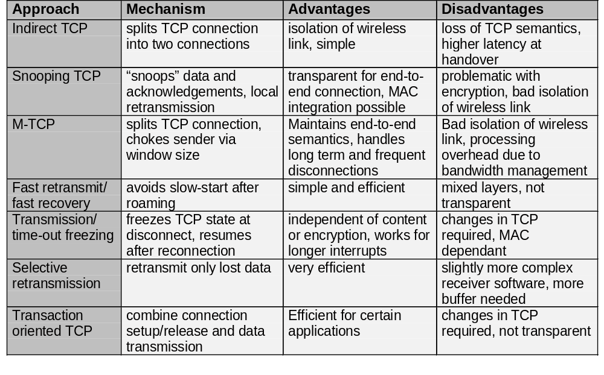
Comparison of different approaches for a “mobile” TCP

Slide 46
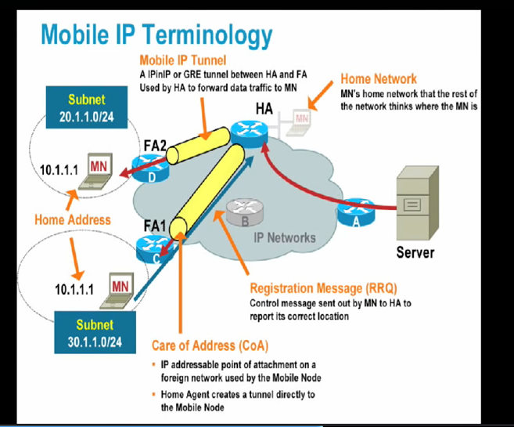

1.<number>

Slide 47
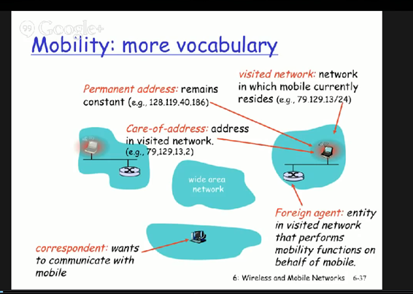
1.<number>

Slide 48
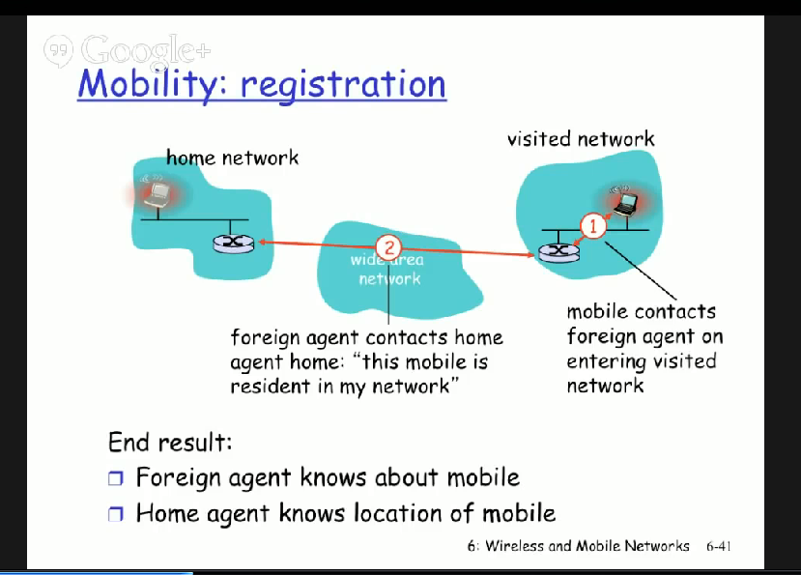
1.<number>

Slide 49
List the entities of mobile IP and describe data transfer from a mobile node to a fixed node and vice versa.
Explain M-TCP in detail.
Explain IP-in-IP , Minimal and Generic Encapsulation. Also discuss their merits and demerits.
Discuss Mobile Transport Layer.
What are the general problems of mobile IP regarding security and support of quality of service?
Explain the following with respect to Mobile IP.
    a. IP Packet delivery
    b. Agent discovery
    c. Registration
    d. Tunneling and encapsulation
1.<number>

Slide 50
Describe the call initation and call termination procedure in GSM system.
List and explain GSM services.
1.<number>

