Slide 1
Third and Fourth Generation Systems
W-CDMA, CDMA 2000; Improvements on Core Networks;
Quality of Services in 3G ;
Wireless Local Loop; Wireless Local Loop Architecture;
Deployment Issues; TR-45 Service Description;
Wireless Local Loop technologies.
TETRA, UMTS and IMT-2000;UMTS Basic Architecture,
UTRA FDD mode, UTRA TDD mode,
4G Architecture, Comparison between 3G and 4G.
1.<number>

Slide 2
W-CDMA CDMA 2000
Improvements on Core Networks
Quality of Services in 3G
4.<number>
Notes:
Universität Karlsruhe
Institut für Telematik
Mobilkommunikation
SS 1998
Prof. Dr. Dr. h.c. G. Krüger
E. Dorner / Dr. J. Schiller

Slide 3
Introduction
Third-generation (3G) mobile communication systems
  Better system capacity
  Higher data transmission speed
  Wireless internet access and wireless multimedia service
1G mobile network
  AMPS
2G mobile network
  ,GSM
2.5G mobile network
  GPRS
3G mobile network
  UMTS, IMT-2000

Slide 4
Paradigm Shifts in Third-Generation System
Concepts of third-generation systems introduce two paradigm shifts
  Shift from voice-centric traffic to data-centric traffic
    Circuit-based infrastructure -> Packet-based infrastructure
    Distance-insensitive communication cost in mobile core network
    Maintaining QoS
    Improving protocols to support streaming traffic
    ->GPRS network architecture
  Data applications continue evolve
    Advanced application protocols, human interface become crucial
    Bandwidth-constrained
    Portable terminals are limited by
      Size, weight, power consumption and delay constraints
    ->WAP, MExE proposed to support wireless data application

Slide 5
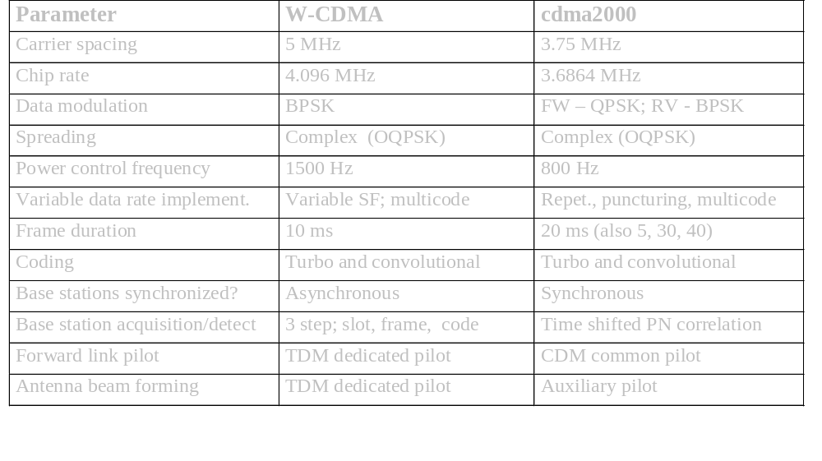

Slide 6
Comparison of W-CDMA and CDMA2000
TECHNOLOGY | W-CDMA | CDMA-2000
Chip rate | 4.096MCps | 3.6864MCps
Forward Link Pilot Structure | Dedicated Pilot with TDM | Common Pilot with CDM
Base Station Timing Synchronization | Asynchronous | Synchronous
Forward Link Modes |  | A multicarrier mode capable of overlay onto IS-95 carriers

Slide 7
Attribute | 3G | 4G
Major Characteristic | Predominantly voice- data as add-on | Converged data and VoIP
Network Architecture | Wide area Cell based | Hybrid – integration of Wireless Lan (WiFi), Blue Tooth, Wide Area
Frequency Band | 1.6 - 2.5 GHz | 2 – 8 GHz
Component Design | Optimized antenna; multi-band adapters | Smart antennas; SW multi-band; wideband radios
Bandwidth | 5 – 20 MHz | 100+ MHz
Data Rate | 385 Kbps - 2 Mbps | 20 – 100 Mbps
Access | WCDMA/CDMA2000 | MC-CDMA or OFDM
Forward Error Correction | Convolution code 1/2, 1/3; turbo | Concatenated Coding
Switching | Circuit/Packet | Packet
Mobile top Speed | 200 kmph | 200 kmph
IP | Multiple versions | All IP (IPv6.0)
Operational | ~2003 | ~2010

Slide 8
W-CDMA and cdma2000 simultaneously adapted for the 3G standard
  Harmonization of two systems become necessary
  Cross-license intellectual property on fair, reasonable, and nondiscriminatory terms (by manufacturing community)
  Cannot be achieved at the physical layer
    Political reason, two chip rate, two synchronous and asynchronous system
  Interoperability at the higher layer protocols
    Result in higher costs with degraded performance

Slide 9
Improvement on Core network
To reduce the international roaming signaling traffic
  3GPP 23.119 spec. GLR (gateway location register)
GLR between VLR/SGSN and the HLR
GLR is treated as the roaming user’s HLR at visited network
Viewpoint of HLR at home network, GLR act as the VLR/SGSN
After the first registration, all subsequence registrations are performed locally

Slide 10
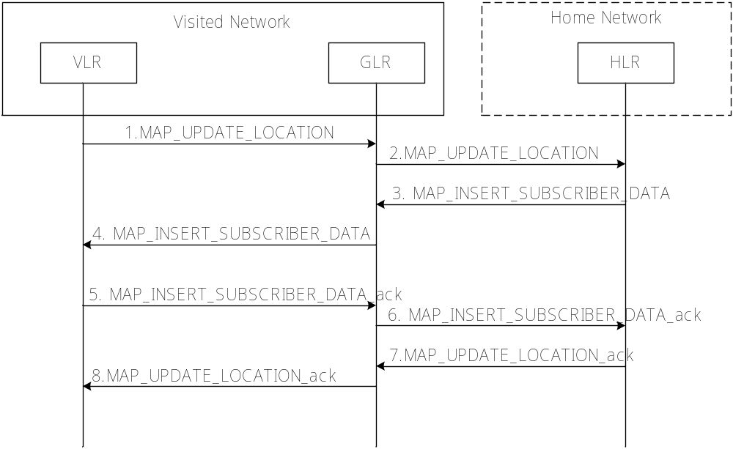
Message flow for the first registration with GLR

Slide 11
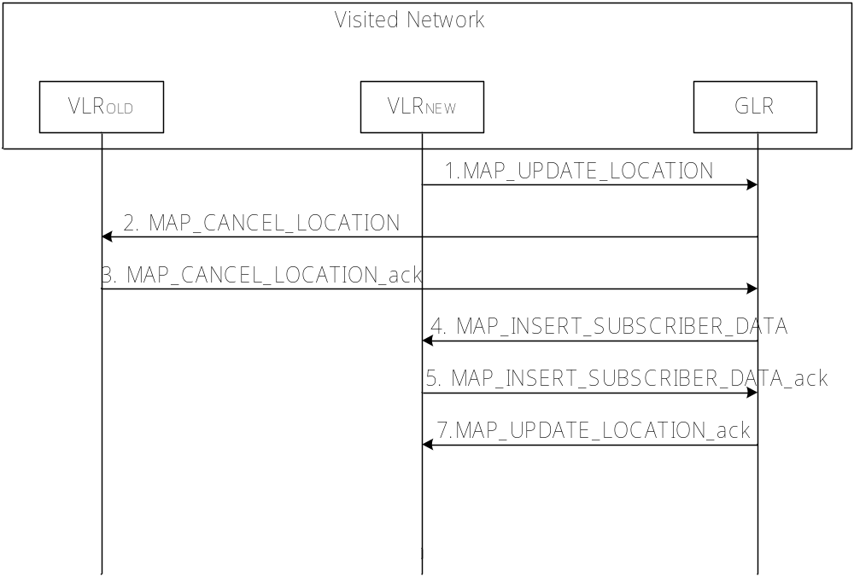
Message flow for a subsequent registration with GLR

Slide 12
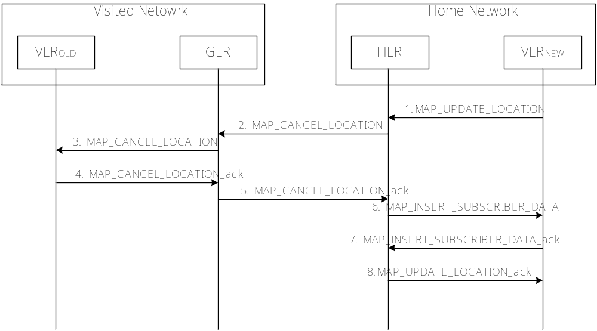
Message flow for the location cancellation with GLR

Slide 13
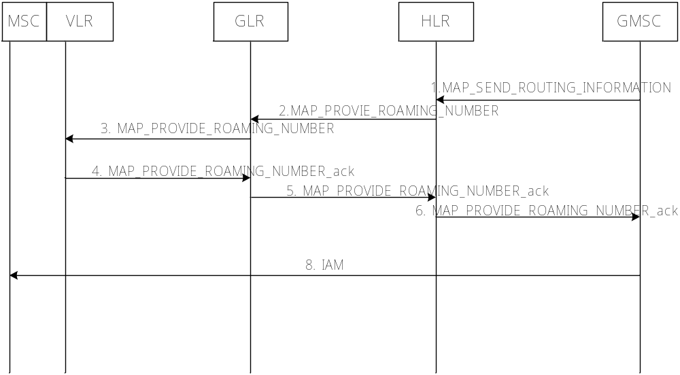
Message flow for the mobile termination call with GLR

Slide 14
Quality of service in 3G
From the viewpoint of end users,
  QoS attributes
    General
    Simple
    Small (number)
From the viewpoint of the network,
  QoS will be defined with a set of parameters
3G QoS control mechanism
  Efficiently utilize resource
  Interwork with current QoS schemes
  Present end-to-end QoS
QoS class for 3G (specifically UMTS) – differ from fixed networks, based on delay sensitivity
  Conversation – voice applications
  Streaming - video on demand
  Interactive - telnet, web browsing
  Background - FTP

Slide 15
Wireless Local Loop
Wireless Local Loop;
Wireless Local Loop Architecture;
Deployment Issues;
TR-45 Service Description;
Wireless Local Loop technologies.

Slide 16
WLL
WLL stands for Wireless Local Loop.
it is basically the use of radio to provide a telephone connection to the home.
It is sometimes called radio in the loop (RITL) or fixed-radio access (FRA).
When WLL connects subscribers to the public switched telephone network (PSTN), radio signals are used as a substitute for copper for all or part of the connection between the subscriber and the switch.
Included in this is: cordless access systems, proprietary fixed radio access, and fixed cellular systems.
1.<number>

Slide 17
Definition
What is WLL?
- WLL is a system that connects subscribers to the local telephone station wirelessly.
Systems WLL is based on:
  Cellular
  Satellite (specific and adjunct)
  Microcellular
Other names
  Radio In The Loop (RITL)
  Fixed-Radio Access (FRA).

Slide 18
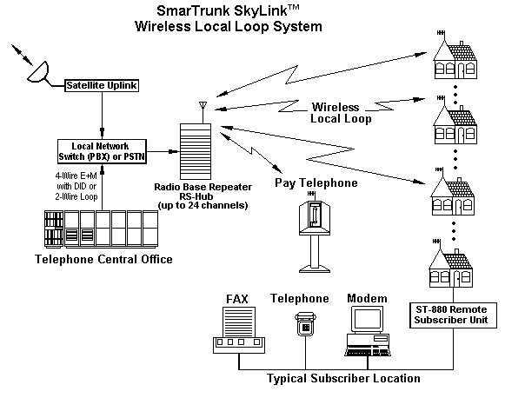
A general WLL setup

Slide 19
WLL services
Desirable:
  Wireless feature should be transparent
  Wireline Custom features
Other:
  Business related
    Hunt groups,
    Call transfers
    Conference calling
  Calling cards, coin phones
  V.29 (9600bps)
  ISDN (64kbps)

Slide 20
WLL should provide…
Toll-quality service
Expand from a central office to about 5 miles
Low license cost
Subscriber costs equivalent or better than copper

Slide 21
Supplement Copper Lines
  Easier third telephone line
  Data service
Fixed Mobile Users
  Take phone wherever you want / charged on 2 levels
  “home” could mean neighborhood
  Charged regular mobile rate if you’re on the road

Slide 22
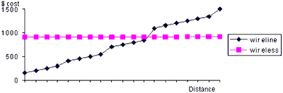
Cost Considerations
Wireless cost is constant over distance for WLL
Wireline depends on distance AND terrain

Slide 23
Situations “made” for WLL
Environments where 3rd line is degraded might be cheaper to go wireless
Where it’s impossible to lay copper (3rd world, small islands)
Business parks, industrial areas
Speedy deployment, stop gap application till wireline is in
  90-120 days for activation

Slide 24
Developed vs. Developing
Developed: Wireline service
  Firmly established, cellular penetration is relatively high
  Incumbent operator would use it to install 2nd, 3rd lines, coverage to rural areas
  2nd or 3rd competitive operator deploy it for fast & cost effective deployment
  Quick way to establish market presence
  cellular complement to their offerings

Slide 25
Developed vs. Developing
Developing
  Quick & easy to deploy in countries with little copper line service, so as to accommodate people on enormous waiting lists for basic service
  Low maintenance costs
  Allows more competition in provider market

Slide 26
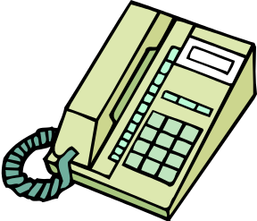
Connection Setup
U_{WLL}
WANU
WASU
Transceiver
Air
Interface
T_{WLL}
PSTN
Trunk
Switch
function
WLL
Controller
AM
HLR
Wireless Access Network Unit(WANU)
  Interface between underlying telephone network and wireless link
  consists of
    Base Station Transceivers (BTS)
    Radio Controller(RPCU)
    Access Manager(AM)
    Home Location Register(HLR)
Wireless Access Subscriber Unit(WASU)
  located at the subscriber
  translates wireless link into a traditional telephone connection

Slide 27
Deployment Issues
Spectrum
Service Quality
Network planning
Economics
1.<number>

Slide 28
TR-45 Service Description
TIA ad hoc group specified standards for WLL in TR -45
interface between radio equipment and the local switching system,
interface to the operating system
the radio air interface between the subscriber unit and the network radio port.
A set of standard services
custom calling features
call waiting, call forward /busy, call forward / default,
call forward/ no answer
custom local area signaling service (CLASS) features
customer-originated trace, automatic recall, automatic callback, calling number delivery and voice mail.
1.<number>

Slide 29
TR-45 Service Description
WLL radio support Centrex business services
Call coverage features: hunt groups, call forward, voice mail service, and attendant service
Call handling features: call transfer, conference calling, and call park
Convenience features: speed calling, automatic dial, ring again, busy override, and calling-line ID.
1.<number>

Slide 30
Capacity comparison for 5 MHz spectrum allocation
Detail | IS-95 CDMA |  | IS-136 TDMA |  | ETSI (GSM)
 | Mobile | WLL | Mobile | WLL | Mobile | WLL
Chan. BW (kHz) | 1250 | 1250 | 30 | 30 | 200 | 200
# channels | 4 | 4 | 167 | 167 | 25 | 25
E_{b}/N₀ | 7 dB | 6dB | 18dB | 14dB | 12dB | 12dB
Freq. Reuse | 1 | 1 | 7 | 4 | 3 | 3
Effective Chan. Per sect. | 4 | 4 | 7.95 | 13.92 | 2.78 | 2.78
Erlangs per cell Per MHz | 38.3 | 48.7 | 9.84 | 19.6 | 9.12 | 9.12

Slide 31
Comparison
WLL | Mobile Wireless | Wireline
Good LOS component | Mainly diffuse components | No diffuse components
Rician fading | Rayleigh fading | No fading
Narrowbeam directed antennas | Omnidirectional antennas | Expensive wires
High Channel reuse | Less Channel reuse | Reuse Limited by wiring
Simple design, constant channel | Expensive DSPs, power control | Expensive to build and maintain
Low in-premises mobility only, easy access | High mobility allowed, easy access | Low in-premises mobility, wiring of distant areas cumbersome
Weather conditions effects | Not very reliable | Very reliable

Slide 32
Wireless Local Loop Technologies
Satellite-Based Systems
Cellular-Based Systems
Low-Tier PCS or Microcellular-Based Systems
Fixed Wireless Access (FWA) Systems

Slide 33
Development of mobile telecommunication systems
CT0/1
FDMA
AMPS
NMT
CT2
IMT-FT
DECT
IS-136
TDMA
D-AMPS
EDGE
IMT-SC
IS-136HS
UWC-136
TDMA
GSM
GPRS
PDC
IMT-DS
UTRA FDD / W-CDMA
HSDPA
IMT-TC
UTRA TDD / TD-CDMA
CDMA
IMT-TC
TD-SCDMA
IS-95
cdmaOne
cdma2000 1X
IMT-MC
cdma2000 1X EV-DO
1X EV-DV
(3X)
1G
2G
2.5G
3G
4.<number>
Notes:
Universität Karlsruhe
Institut für Telematik
Mobilkommunikation
SS 1998
Prof. Dr. Dr. h.c. G. Krüger
E. Dorner / Dr. J. Schiller

Slide 34
TETRA - Terrestrial Trunked Radio
Trunked radio systems
  many different radio carriers
  assign single carrier for a short period to one user/group of users
  taxi service, fleet management, rescue teams
  interfaces to public networks, voice and data services
  very reliable, fast call setup, local operation
TETRA - ETSI standard
  formerly: Trans European Trunked Radio
  point-to-point and point-to-multipoint
  encryption (end-to-end, air interface), authentication of devices, users and networks
  group call, broadcast, sub-second group-call setup
  ad-hoc (“direct mode”), relay and infrastructure networks
  call queuing with pre-emptive priorities
4.<number>
Notes:
Universität Karlsruhe
Institut für Telematik
Mobilkommunikation
SS 1998
Prof. Dr. Dr. h.c. G. Krüger
E. Dorner / Dr. J. Schiller

Slide 35
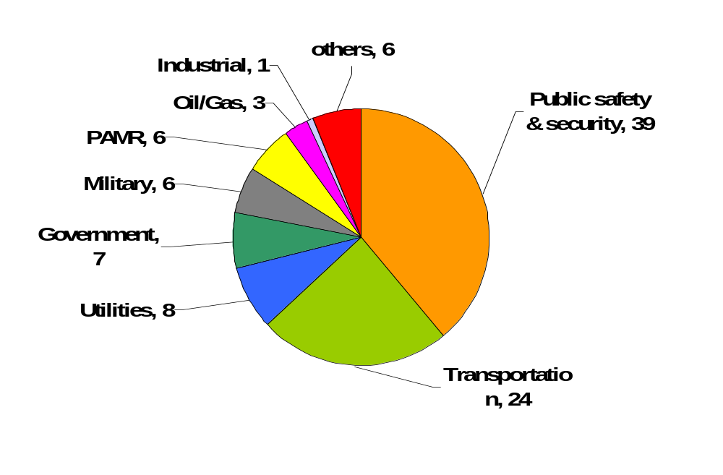
TETRA – Contracts by Sector (percentage)
Used in over 70 countries, more than 20 device manufacturers
4.<number>

Slide 36
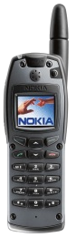

TETRA – Network Architecture
TETRA infrastructure
PSTN, ISDN,
Internet, PDN
switch
NMS
switch
switch
BS
ISI
other TETRA networks
BS
BS
AI
AI: Air Interface
BS: Base Station
DMO: Direct Mode Operation
ISI: Inter-System Interface
NMS: Network Management
System
PEI: Peripheral Equipment
Interface
DMO
PEI
4.<number>

Slide 37
TETRA – Direct Mode I
Direct Mode enables ad-hoc operation and is one of the most important differences to pure infrastructure-based networks such as GSM, cdma2000 or UMTS.
network
Individual Call
“Dual Watch” – alternating participation in
Infrastructure and ad-hoc
network
Authorizing
mobile station
Group Call
Managed Direct Mode
4.<number>

Slide 38
TETRA – Direct Mode II
An additional repeater may increase the transmission range (e.g. police car)
network
Direct Mode with Repeater
Direct Mode with Gateway
network
network
Authorizing
Repeater
Direct Mode with Repeater/Gateway
Managed Repeater/Gateway
4.<number>

Slide 39
TETRA – Technology
Services
  Voice+Data (V+D) and Packet Data Optimized (PDO)
  Short data service (SDS)
Frequencies
  Duplex: FDD, Modulation: DQPSK
  Europe (in MHz, not all available yet)
    380-390 UL / 390-400 DL; 410-420 UL / 420-430 DL, 450-460 UL / 460-470 DL; 870-876 UL / 915-921 DL
  Other countries
    380-390 UL / 390-400 DL; 410-420 UL / 420-430 DL, 806-821 UL / 851-866 DL
4.<number>

Slide 40
TDMA structure of the voice+data system
hyperframe
0
1
2
...
57
58
59
61.2 s
multiframe
0
1
2
...
15
16
17
1.02 s
CF
frame
0
1
2
3
56.67 ms
Control Frame
₀ slot ₅₀₉
14.17 ms
4.<number>
Notes:
Universität Karlsruhe
Institut für Telematik
Mobilkommunikation
SS 1998
Prof. Dr. Dr. h.c. G. Krüger
E. Dorner / Dr. J. Schiller

Slide 41
TETRA – Data Rates
Infrastructure mode, V+D in kbit/s
No. of time slots 1 2 3 4
No protection 7.2 14.4 21.6 28.8
Low protection 4.8 9.6 14.4 19.2
High protection 2.4 4.8 7.2 9.6
TETRA Release 2 – Supporting higher data rates
  TEDS (TETRA Enhanced Data Service)
  up to 100 kbit/s
  backward compatibility
4.<number>

Slide 42
UMTS and IMT-2000
Proposals for IMT-2000 (International Mobile Telecommunications)
  UWC-136, cdma2000, WP-CDMA
  UMTS (Universal Mobile Telecommunications System) from ETSI
UMTS
  UTRA (was: UMTS, now: Universal Terrestrial Radio Access)
  enhancements of GSM
    EDGE (Enhanced Data rates for GSM Evolution): GSM up to 384 kbit/s
    CAMEL (Customized Application for Mobile Enhanced Logic)
    VHE (virtual Home Environment)
  fits into GMM (Global Multimedia Mobility) initiative from ETSI
  requirements
    min. 144 kbit/s rural (goal: 384 kbit/s)
    min. 384 kbit/s suburban (goal: 512 kbit/s)
    up to 2 Mbit/s urban
4.<number>
Notes:
Universität Karlsruhe
Institut für Telematik
Mobilkommunikation
SS 1998
Prof. Dr. Dr. h.c. G. Krüger
E. Dorner / Dr. J. Schiller

Slide 43
Frequencies for IMT-2000
1850
1900
1950
2000
2050
2100
2150
2200
MHz
ITU allocation
(WRC 1992)
IMT-2000
MSS
↑
IMT-2000
MSS
↓
Europe
GSM
1800
DE
CT
T
D
D
UTRA
FDD ↑
MSS
↑
T
D
D
UTRA
FDD ↓
MSS
↓
GSM
1800
IMT-2000
MSS
↑
IMT-2000
MSS
↓
China
Japan
PHS
cdma2000
W-CDMA
MSS
↑
cdma2000
W-CDMA
MSS
↓
North
America
PCS
MSS
↑
rsv.
MSS
↓
1850
1900
1950
2000
2050
2100
2150
2200
MHz
4.<number>
Notes:
Universität Karlsruhe
Institut für Telematik
Mobilkommunikation
SS 1998
Prof. Dr. Dr. h.c. G. Krüger
E. Dorner / Dr. J. Schiller

Slide 44
IMT-2000 family
Interface
for Internetworking
IMT-2000
Core Network
ITU-T
GSM
(MAP)
ANSI-41
(IS-634)
IP-Network
Initial UMTS
(R99 w/ FDD)
Flexible assignment of
Core Network and Radio Access
IMT-DS
(Direct Spread)
UTRA FDD
(W-CDMA)
3GPP
IMT-TC
(Time Code)
UTRA TDD
(TD-CDMA);
TD-SCDMA
3GPP
IMT-MC
(Multi Carrier)
cdma2000
3GPP2
IMT-SC
(Single Carrier)
UWC-136
(EDGE)
UWCC/3GPP
IMT-FT
(Freq. Time)
DECT
ETSI
IMT-2000
Radio Access
ITU-R
4.<number>
Notes:
Universität Karlsruhe
Institut für Telematik
Mobilkommunikation
SS 1998
Prof. Dr. Dr. h.c. G. Krüger
E. Dorner / Dr. J. Schiller

Slide 45
GSM and UMTS Releases
GSM/EDGE Release | 3G Release | Abbreviated name | Spec version number | Freeze date (indicative only)
Phase 2+ Release 6 | Release 6 | Rel-6 | 6.x.y | December 2004 - March 2005
Phase 2+ Release 5 | Release 5 | Rel-5 | 5.x.y | March - June 2002
Phase 2+ Release 4 | Release 4 | Rel-4 | 4.x.y | March 2001
- | Release 2000 | R00 | 4.x.y | Renaming…
Phase 2+ Release 2000 | - |  | 9.x.y
- | Release 1999 | R99 | 3.x.y | March 2000
Phase 2+ Release 1999 | - |  | 8.x.y
Phase 2+ Release 1998 | - | R98 | 7.x.y | early 1999
Phase 2+ Release 1997 | - | R97 | 6.x.y | early 1998
Phase 2+ Release 1996 | - | R96 | 5.x.y | early 1997
Phase 2 | - | Ph2 | 4.x.y | 1995
Phase 1 | - | Ph1 | 3.x.y | 1992
4.<number>

Slide 46
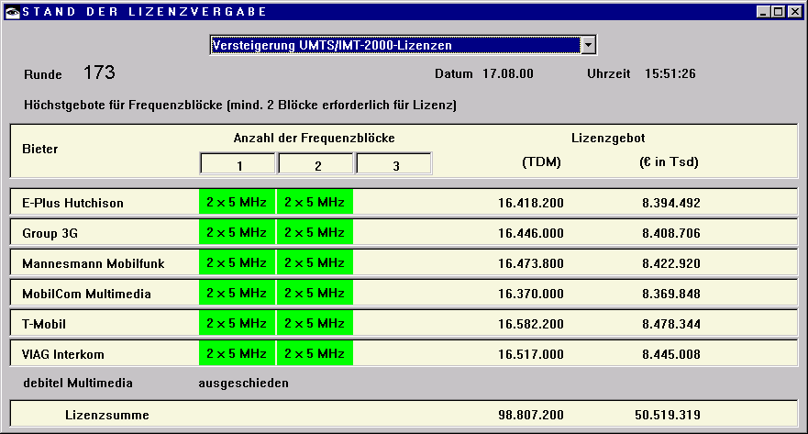
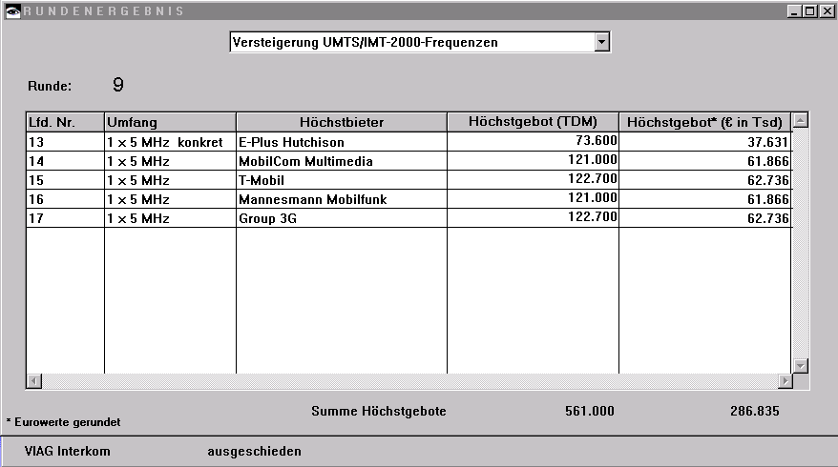
Licensing Example: UMTS in Germany, 18. August 2000
  UTRA-FDD:
    Uplink 1920-1980 MHz
    Downlink 2110-2170 MHz
    duplex spacing 190 MHz
    12 channels, each 5 MHz
  UTRA-TDD:
    1900-1920 MHz,
    2010-2025 MHz;
    5 MHz channels
  Coverage of the population
    25% until 12/2003
    50% until 12/2005
Sum: 50.81 billion €
4.<number>
Notes:
Universität Karlsruhe
Institut für Telematik
Mobilkommunikation
SS 1998
Prof. Dr. Dr. h.c. G. Krüger
E. Dorner / Dr. J. Schiller

Slide 47
UMTS architecture (Release 99 used here!)
UTRAN (UTRA Network)
  Cell level mobility
  Radio Network Subsystem (RNS)
  Encapsulation of all radio specific tasks
UE (User Equipment)
CN (Core Network)
  Inter system handover
  Location management if there is no dedicated connection between UE and UTRAN
U_{u}
I_{u}
UE
UTRAN
CN
4.<number>
Notes:
Universität Karlsruhe
Institut für Telematik
Mobilkommunikation
SS 1998
Prof. Dr. Dr. h.c. G. Krüger
E. Dorner / Dr. J. Schiller

Slide 48
UMTS domains and interfaces I
User Equipment Domain
  Assigned to a single user in order to access UMTS services
Infrastructure Domain
  Shared among all users
  Offers UMTS services to all accepted users
Home
Network
Domain
Z_{u}
C_{u}
U_{u}
I_{u}
Y_{u}
USIM
Domain
Mobile
Equipment
Domain
Access
Network
Domain
Serving
Network
Domain
Transit
Network
Domain
Core Network Domain
User Equipment Domain
Infrastructure Domain
4.<number>
Notes:
Universität Karlsruhe
Institut für Telematik
Mobilkommunikation
SS 1998
Prof. Dr. Dr. h.c. G. Krüger
E. Dorner / Dr. J. Schiller

Slide 49
UMTS domains and interfaces II
Universal Subscriber Identity Module (USIM)
  Functions for encryption and authentication of users
  Located on a SIM inserted into a mobile device
Mobile Equipment Domain
  Functions for radio transmission
  User interface for establishing/maintaining end-to-end connections
Access Network Domain
  Access network dependent functions
Core Network Domain
  Access network independent functions
  Serving Network Domain
    Network currently responsible for communication
  Home Network Domain
    Location and access network independent functions
4.<number>
Notes:
Universität Karlsruhe
Institut für Telematik
Mobilkommunikation
SS 1998
Prof. Dr. Dr. h.c. G. Krüger
E. Dorner / Dr. J. Schiller

Slide 50
Spreading and scrambling of user data
Constant chipping rate of 3.84 Mchip/s
Different user data rates supported via different spreading factors
  higher data rate: less chips per bit and vice versa
User separation via unique, quasi orthogonal scrambling codes
  users are not separated via orthogonal spreading codes
  much simpler management of codes: each station can use the same orthogonal spreading codes
  precise synchronisation not necessary as the scrambling codes stay quasi-orthogonal
data₁
data₂
data₃
data₄
data₅
spr.
code₁
spr.
code₂
spr.
code₃
spr.
code₁
spr.
code₄
scrambling
code₁
scrambling
code₂
sender₁
sender₂
4.<number>
Notes:
Universität Karlsruhe
Institut für Telematik
Mobilkommunikation
SS 1998
Prof. Dr. Dr. h.c. G. Krüger
E. Dorner / Dr. J. Schiller

Slide 51
OSVF coding
1,1,1,1,1,1,1,1
1,1,1,1
...
1,1,1,1,-1,-1,-1,-1
1,1
1,1,-1,-1,1,1,-1,-1
1,1,-1,-1
...
X,X
1,1,-1,-1,-1,-1,1,1
X
1
1,-1,1,-1,1,-1,1,-1
X,-X
1,-1,1,-1
...
1,-1,1,-1,-1,1,-1,1
SF=n
SF=2n
1,-1
1,-1,-1,1,1,-1,-1,1
1,-1,-1,1
...
1,-1,-1,1,-1,1,1,-1
SF=1
SF=2
SF=4
SF=8
4.<number>

Slide 52
UMTS FDD frame structure
W-CDMA
1920-1980 MHz uplink
2110-2170 MHz downlink
chipping rate:
3.840 Mchip/s
soft handover
QPSK
complex power control
(1500 power control
cycles/s)
spreading: UL: 4-256;
DL:4-512
Radio frame
10 ms
0
1
2
...
12
13
14
Time slot
666.7 µs
Pilot
TFCI
FBI
TPC
uplink DPCCH
2560 chips, 10 bits
666.7 µs
Data
uplink DPDCH
2560 chips, 10*2^{k} bits (k = 0...6)
666.7 µs
Data₁
TPC
TFCI
Data₂
Pilot
downlink DPCH
FBI: Feedback Information
TPC: Transmit Power Control
TFCI: Transport Format Combination Indicator
DPCCH: Dedicated Physical Control Channel
DPDCH: Dedicated Physical Data Channel
DPCH: Dedicated Physical Channel
DPDCH
DPCCH
DPDCH
DPCCH
2560 chips, 10*2^{k} bits (k = 0...7)
Slot structure NOT for user separation
but synchronisation for periodic functions!
4.<number>
Notes:
Universität Karlsruhe
Institut für Telematik
Mobilkommunikation
SS 1998
Prof. Dr. Dr. h.c. G. Krüger
E. Dorner / Dr. J. Schiller

Slide 53
Typical UTRA-FDD uplink data rates
User data rate [kbit/s] | 12.2 (voice) | 64 | 144 | 384
DPDCH [kbit/s] | 60 | 240 | 480 | 960
DPCCH [kbit/s] | 15 | 15 | 15 | 15
Spreading | 64 | 16 | 8 | 4
4.<number>

Slide 54
UMTS TDD frame structure (burst type 2)
Radio frame
10 ms
0
1
2
...
12
13
14
Time slot
666.7 µs
Data
1104 chips
Midample
256 chips
Data
1104 chips
GP
Traffic burst
GP: guard period
96 chips
2560 chips
TD-CDMA
2560 chips per slot
spreading: 1-16
symmetric or asymmetric slot assignment to UL/DL (min. 1 per direction)
tight synchronisation needed
simpler power control (100-800 power control cycles/s)
4.<number>
Notes:
Universität Karlsruhe
Institut für Telematik
Mobilkommunikation
SS 1998
Prof. Dr. Dr. h.c. G. Krüger
E. Dorner / Dr. J. Schiller

Slide 55
UTRAN architecture
RNS
RNC: Radio Network Controller
RNS: Radio Network Subsystem
UE₁
Node B
I_{ub}
I_{u}
RNC
CN
UE₂
Node B
Node B
UTRAN comprises several RNSs
Node B can support FDD or TDD or both
RNC is responsible for handover decisions requiring signalingto the UE
Cell offers FDD or TDD
UE₃
I_{ur}
Node B
I_{ub}
Node B
RNC
Node B
Node B
RNS
4.<number>
Notes:
Universität Karlsruhe
Institut für Telematik
Mobilkommunikation
SS 1998
Prof. Dr. Dr. h.c. G. Krüger
E. Dorner / Dr. J. Schiller

Slide 56
UTRAN architecture
RNS
RNC: Radio Network Controller
RNS: Radio Network Subsystem
UE
Node B
I_{ub}
UTRAN comprises several RNSs
Node B can support FDD or TDD or both
RNC is responsible for handover decisions requiring signaling to the UE
Cell offers FDD or TDD
RNC
I_{u}
Node B
Node B
CN
I_{ur}
Node B
I_{ub}
Node B
RNC
Node B
Node B
RNS
4.<number>
Notes:
Universität Karlsruhe
Institut für Telematik
Mobilkommunikation
SS 1998
Prof. Dr. Dr. h.c. G. Krüger
E. Dorner / Dr. J. Schiller

Slide 57
UTRAN functions
Admission control
Congestion control
System information broadcasting
Radio channel encryption
Handover
SRNS moving
Radio network configuration
Channel quality measurements
Macro diversity
Radio carrier control
Radio resource control
Data transmission over the radio interface
Outer loop power control (FDD and TDD)
Channel coding
Access control
4.<number>
Notes:
Universität Karlsruhe
Institut für Telematik
Mobilkommunikation
SS 1998
Prof. Dr. Dr. h.c. G. Krüger
E. Dorner / Dr. J. Schiller

Slide 58
Core network: protocols
VLR
MSC
GMSC
PSTN/
ISDN
RNS
GSM-CS
backbone
HLR
RNS
SGSN
GGSN
PDN (X.25),
Internet (IP)
Layer 3: IP
GPRS backbone (IP)
Layer 2: ATM
SS 7
Layer 1: PDH,
SDH, SONET
UTRAN
CN
4.<number>
Notes:
Universität Karlsruhe
Institut für Telematik
Mobilkommunikation
SS 1998
Prof. Dr. Dr. h.c. G. Krüger
E. Dorner / Dr. J. Schiller

Slide 59
Core network: architecture
VLR
A_{bis}
BSS
BTS
I_{u}
BSC
MSC
GMSC
PSTN
Node B
BTS
  I_{u}CS
AuC
EIR
HLR
GR
Node B
I_{ub}
Node B
RNC
SGSN
GGSN
G_{n}
G_{i}
Node B
Node B
  I_{u}PS
RNS
CN
4.<number>
Notes:
Universität Karlsruhe
Institut für Telematik
Mobilkommunikation
SS 1998
Prof. Dr. Dr. h.c. G. Krüger
E. Dorner / Dr. J. Schiller

Slide 60
Core network
The Core Network (CN) and thus the Interface I_{u}, too, are separated into two logical domains:
Circuit Switched Domain (CSD)
  Circuit switched service incl. signaling
  Resource reservation at connection setup
  GSM components (MSC, GMSC, VLR)
  I_{u}CS
Packet Switched Domain (PSD)
  GPRS components (SGSN, GGSN)
  I_{u}PS
Release 99 uses the GSM/GPRS network and adds a new radio access!
  Helps to save a lot of money …
  Much faster deployment
  Not as flexible as newer releases (5, 6)
4.<number>
Notes:
Universität Karlsruhe
Institut für Telematik
Mobilkommunikation
SS 1998
Prof. Dr. Dr. h.c. G. Krüger
E. Dorner / Dr. J. Schiller

Slide 61
UMTS protocol stacks (user plane)
UE
U_{u}
UTRAN
I_{u}CS
3G
MSC
apps. &
protocols
Circuit
switched
RLC
RLC
SAR
SAR
MAC
MAC
AAL2
AAL2
radio
radio
ATM
ATM
UE
U_{u}
UTRAN
I_{u}PS
3G
SGSN
G_{n}
3G
GGSN
apps. &
protocols
IP, PPP,
…
IP tunnel
IP, PPP,
…
Packet
switched
PDCP
PDCP
GTP
GTP
GTP
GTP
RLC
RLC
UDP/IP
UDP/IP
UDP/IP
UDP/IP
MAC
MAC
AAL5
AAL5
L2
L2
radio
radio
ATM
ATM
L1
L1
4.<number>
Notes:
Universität Karlsruhe
Institut für Telematik
Mobilkommunikation
SS 1998
Prof. Dr. Dr. h.c. G. Krüger
E. Dorner / Dr. J. Schiller

Slide 62
Support of mobility: macro diversity
Multicasting of data via several physical channels
  Enables soft handover
  FDD mode only
Uplink
  simultaneous reception of UE data at several Node Bs
  Reconstruction of data at Node B, SRNC or DRNC
Downlink
  Simultaneous transmission of data via different cells
  Different spreading codes in different cells
UE
Node B
Node B
RNC
CN
4.<number>
Notes:
Universität Karlsruhe
Institut für Telematik
Mobilkommunikation
SS 1998
Prof. Dr. Dr. h.c. G. Krüger
E. Dorner / Dr. J. Schiller

Slide 63
Support of mobility: handover
From and to other systems (e.g., UMTS to GSM)
  This is a must as UMTS coverage will be poor in the beginning
RNS controlling the connection is called SRNS (Serving RNS)
RNS offering additional resources (e.g., for soft handover) is called Drift RNS (DRNS)
End-to-end connections between UE and CN only via I_{u} at the SRNS
  Change of SRNS requires change of I_{u}
  Initiated by the SRNS
  Controlled by the RNC and CN
Node B
SRNC
CN
I_{ub}
I_{u}
UE
I_{ur}
Node B
DRNC
I_{ub}
4.<number>
Notes:
Universität Karlsruhe
Institut für Telematik
Mobilkommunikation
SS 1998
Prof. Dr. Dr. h.c. G. Krüger
E. Dorner / Dr. J. Schiller

Slide 64
Example handover types in UMTS/GSM
UE₁
Node B₁
RNC₁
3G MSC₁
UE₂
I_{u}
Node B₂
I_{ub}
I_{ur}
UE₃
Node B₃
RNC₂
3G MSC₂
UE₄
BTS
BSC
2G MSC₃
A_{bis}
A
4.<number>

Slide 65
Breathing Cells
GSM
  Mobile device gets exclusive signal from the base station
  Number of devices in a cell does not influence cell size
UMTS
  Cell size is closely correlated to the cell capacity
  Signal-to-nose ratio determines cell capacity
  Noise is generated by interference from
    other cells
    other users of the same cell
  Interference increases noise level
  Devices at the edge of a cell cannot further increase their output power (max. power limit) and thus drop out of the cell
  ⇨ no more communication possible
  Limitation of the max. number of users within a cell required
  Cell breathing complicates network planning
4.<number>

Slide 66
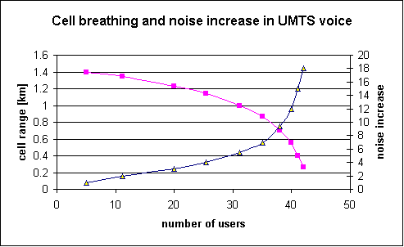
Breathing Cells: Example
4.<number>

Slide 67
UMTS services (originally)
Data transmission service profiles
Virtual Home Environment (VHE)
  Enables access to personalized data independent of location, access network, and device
  Network operators may offer new services without changing the network
  Service providers may offer services based on components which allow the automatic adaptation to new networks and devices
  Integration of existing IN services
Service Profile
Bandwidth
Transport mode
High Interactive MM
128 kbit/s
Circuit switched
Bidirectional, video telephone
High MM
2 Mbit/s
Packet switched
Low coverage, max. 6 km/h
Medium MM
384 kbit/s
Circuit switched
asymmetrical, MM, downloads
Switched Data
14.4 kbit/s
Circuit switched
Simple Messaging
14.4 kbit/s
Packet switched
SMS successor, E-Mail
Voice
16 kbit/s
Circuit switched
4.<number>
Notes:
Universität Karlsruhe
Institut für Telematik
Mobilkommunikation
SS 1998
Prof. Dr. Dr. h.c. G. Krüger
E. Dorner / Dr. J. Schiller

