Slide 1
Module 5
Mobility Management
Co- channel Interference,
Mobility: Types of Handoffs;
Location Management, HLR-VLR scheme, Hierarchical scheme, Predictive Location management schemes,
cellular IP,
PSTN.
1.<number>

Slide 2
Co- channel Interference
Co-channel interference or CCI is crosstalk from two different radio transmitters using the same frequency. There can be several causes of co-channel radio interference; four examples are listed here.
1.<number>

Slide 3
Cellular Mobile Networks: In cellular mobile communication (GSM & LTE Systems, for instance), frequency spectrum is a precious resource which is divided into non-overlapping spectrum bands which are assigned to different cells (In cellular communications, a cell refers to the hexagonal/circular area around the base station antenna). However, after certain geographical distance, the frequency bands are re-used, i.e. the same spectrum bands are reassigned to other distant cells. The co-channel interference arises in the cellular mobile networks owing to this phenomenon of Frequency reuse. Thus, besides the intended signal from within the cell, signals at the same frequencies (co-channel signals) arrive at the receiver from the undesired transmitters located (far away) in some other cells and lead to deterioration in receiver performance.
1.<number>

Slide 4
Adverse weather conditions: During periods of uniquely high-pressure weather, VHF signals which would normally exit through the atmosphere can instead be reflected by the troposphere. This tropospheric ducting will cause the signal to travel much further than intended; often causing interference to local transmitters in the areas affected by the increased range of the distant transmitter.
1.<number>

Slide 5
Poor frequency planning: Poor planning of frequencies by broadcasters can cause CCI, although this is rare. A very localised example is Listowel in the south-west ofIreland. The 2RN UHF television transmitter systems in Listowel and Knockmoyle (near Tralee) are on the same frequencies but with opposite polarisation. However in some outskirts of Listowel town, both transmitters can be picked up causing heavy CCI. This problem forces residents in these areas to use alternative transmitters to receive RTÉ programming.
1.<number>

Slide 6
Overly-crowded radio spectrum: In many populated areas, there just isn't much room in the radio spectrum. Stations will be jam-packed in, sometimes to the point that one can hear loud and clear two, three, or more stations on the same frequency, at once. In the USA, the FCC propagation models used to space stations on the same frequency are not always accurate in prediction of signals and interference. An example of this situation is in some parts of Fayetteville, Arkansas the local 99.5 FM KAKS is displaced by KXBL 99.5 FM in Tulsa, particularly on the west side of significant hills. Another example would be of Cleveland's WKKY 104.7 having interference from Toledo's WIOT104.7 FM on the Ontario shore of Lake Erie, as well as Woodstock's CIHR-FM (on rare occasions), which is also on 104.7 FM, due to the signals travelling very far acrossLake Erie. The interference to WIOT from the operation of W284BQ, translator, has been resolved by the FCC. Effective October 18, 2011 it must cease operation.
1.<number>

Slide 7
Daytime vs Nighttime: In the Medium frequency portion of the radio spectrum where most AM broadcasting is allocated, signals propagate full-time via groundwave and, at nighttime, via skywave as well. This means that during the nighttime hours, co-channel interference exists on many AM radio frequencies due to the medium waves reflecting off the ionosphere and being bounced back down to earth. In the United States, Canada, Mexico, and the Bahamas, there are international agreements on certain frequencies which allocate "clear-channel" broadcasting for certain stations to either have their respective frequencies to themselves at night, or to share their respective frequencies with other stations located over hundreds or even thousands of miles away. On other frequencies, there are "Regional Channels" where most stations on these frequencies either reduce power or change to a directional antenna system at nighttime to help reduce co-channel interference to each other's signals.
1.<number>

Slide 8
Cancellation of signal: In addition, many AM stations, including but not limited to the clear channel stations, often experience cancellation of their own signals within the inner and outer fringes of their normal groundwave coverage areas at nighttime due to the stations' individual skywave signals reaching the listeners' receivers at or near equal strength to the stations' individual groundwave signals; this phenomenon is very similar to the multipath interference experienced on FM Radio in the VHF band within mountainous regions and urban areas due to signals bouncing off of mountains, buildings, and other structures, except that the groundwave-skywave cancellation occurs almost exclusively at nighttime when skywave propagation is present.
1.<number>

Slide 9
Mobility: Types of Handoffs
Types of Handoffs:
handover or handoff refers to the process of transferring an ongoing call or data session from one channel connected to the core network to another channel.
In satellite communications it is the process of transferring satellite control responsibility from one earth station to another without loss or interruption of service.
1.<number>

Slide 10
Purpose of handoff
when the phone is moving away from the area covered by one cell and entering the area covered by another cell the call is transferred to the second cell in order to avoid call termination when the phone gets outside the range of the first cell;
when the capacity for connecting new calls of a given cell is used up and an existing or new call from a phone, which is located in an area overlapped by another cell, is transferred to that cell in order to free-up some capacity in the first cell for other users, who can only be connected to that cell;
in non-CDMA networks when the channel used by the phone becomes interfered by another phone using the same channel in a different cell, the call is transferred to a different channel in the same cell or to a different channel in another cell in order to avoid the interference;
1.<number>

Slide 11
Types of handover
A hard handover is one in which the channel in the source cell is released and only then the channel in the target cell is engaged. Thus the connection to the source is broken before or 'as' the connection to the target is made—for this reason such handovers are also known as break-before-make. Hard handovers are intended to be instantaneous in order to minimize the disruption to the call. A hard handover is perceived by network engineers as an event during the call. It requires the least processing by the network providing service. When the mobile is between base stations, then the mobile can switch with any of the base stations, so the base stations bounce the link with the mobile back and forth. This is called 'ping-ponging'.
1.<number>

Slide 12
A soft handover is one in which the channel in the source cell is retained and used for a while in parallel with the channel in the target cell. In this case the connection to the target is established before the connection to the source is broken, hence this handover is called make-before-break. The interval, during which the two connections are used in parallel, may be brief or substantial. For this reason the soft handover is perceived by network engineers as a state of the call, rather than a brief event. Soft handovers may involve using connections to more than two cells: connections to three, four or more cells can be maintained by one phone at the same time. When a call is in a state of soft handover, the signal of the best of all used channels can be used for the call at a given moment or all the signals can be combined to produce a clearer copy of the signal. The latter is more advantageous, and when such combining is performed both in the downlink (forward link) and the uplink (reverse link) the handover is termed assofter. Softer handovers are possible when the cells involved in the handovers have a single cell site.
1.<number>

Slide 13
Location Management
HLR-VLR scheme
Hierarchical scheme
Predictive Location management schemes
1.<number>

Slide 14

HLR-VLR scheme
1.<number>

Slide 15
cellular IP
1.<number>

Slide 16
PSTN
1.<number>

Slide 17
1.<number>

Slide 18
1.<number>

Slide 19
1.<number>

Slide 20
1.<number>

Slide 21
Location and Handoff Management
Lecture 10

Slide 22
Location and Handoff Management
The current point of attachment or location of a subscriber (mobile unit) is expressed in terms of the cell or the base station to which it is presently connected.
The mobile units (called and calling subscribers) can continue to talk and move around in their respective cells; but as soon as both or any one of the units moves to a different cell, the location management procedure is invoked to identify the new location.

Slide 23
Location and Handoff
Management
The location management performs three fundamental tasks:
  (a) location update,
  (b) location lookup, and
  (c) paging.
In location update, which is initiated by the mobile unit, the current location of the unit is recorded in HLR and VLR databases.
Location lookup is basically a database search to obtain the current location of the mobile unit and through paging the system informs the caller the location of the called unit in terms of its current base station.
These two tasks are initiated by the MSC.

Slide 24
Location and Handoff
Management
The cost of update and paging increases as cell size decreases, which becomes quite significant for finer granularity cells such as micro- or picocell clusters.
The presence of frequent cell crossing, which is a common scenario in highly commuting zones, further adds to the cost.
The system creates location areas and paging areas to minimize the cost.
A number of neighboring cells are grouped together to form a location area, and the paging area is constructed in a similar way.

Slide 25
Mobility Management
Location Management
  Search: find a mobile user’s current location
  Update (Register): update a mobile user’s location
  Location info: maintained at various granularities (cell vs. a group of cells called a registration area)
  Research Issue: organization of location databases
    Global Systems for Mobile (GSM) vs. Mobile IP vs. Wireless Mesh Networks (WMN)
Handoff Management
  Ensuring that a mobile user remains connected while moving from one location (e.g., cell) to another
  Packets or connection are routed to the new location

Slide 26
Handoff Management
Decide when to handoff to a new access point (AP)
Select a new AP from among several APs
Acquire resources such as bandwidth channels (GSM), or a new IP address (Mobile IP)
  Channel allocation is a research issue: goal may be to maximize channel usage, satisfy QoS, or maximize revenue generated
Inform the old AP to reroute packets and also to transfer state information to the new AP
Packets are routed to the new AP

Slide 27
Tradeoff in Location Management
Network may only know approximate location
By location update (or location registration):
  Network is informed of the location of a mobile user
By location search or terminal paging:
  Network is finding the location of a mobile user
A tradeoff exists between location update and search
  When the user is not called often (or if the service arrival rate) is low, resources are wasted with frequent updates
  If not done and a call comes, bandwidth or time is wasted in searching

Slide 28
Registration Area (RA) and the
Basic HLR-VLR Scheme
Current Personal Communication Service (PCS) networks (i.e., cellular networks such as GSM) use RA-based basic HLR-VLR schemes:
  The service coverage area is divided into registration areas (RAs), each with a visitor location register (VLR)
  Each RA covers a group of base stations (cells).
  A user has a permanent home location register (HLR)
  Base stations within the same RA broadcast their IDs
  If ID is sensed different by the mobile terminal then a terminal, location update is sent to the VLR of the current RA.
  When crossing a RA boundary, an update is sent to the HLR.
  A search goes by HLR->VLR->cell->paging (by the base

Slide 29
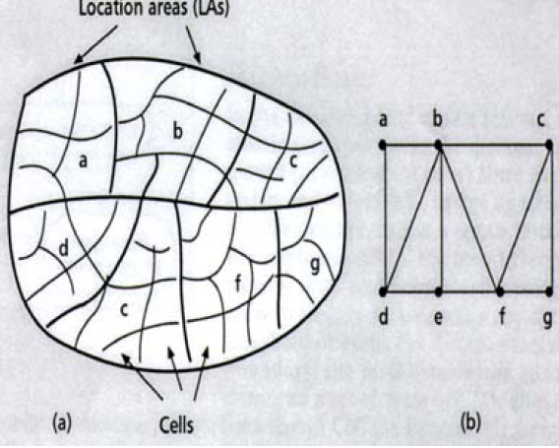
Registration Areas in a PCN
The figure on the right shows a PCS network
  RA topology
  RA graph model

Slide 30
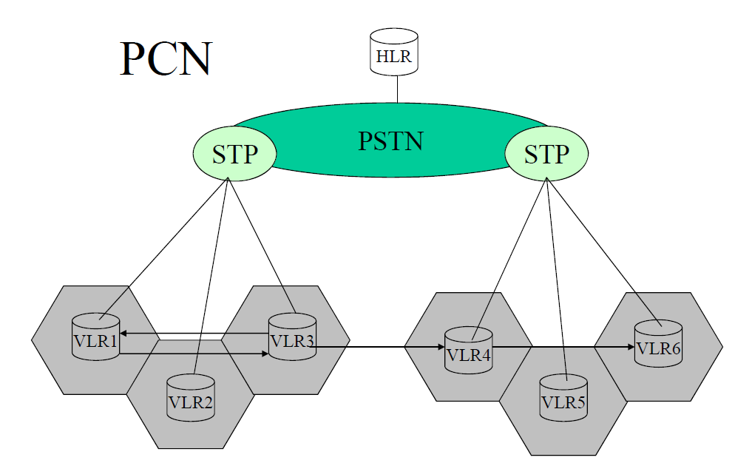
PSTN: Public Switched HLR: Home Location Register
Telephone Network
STP: Service Transfer Point VLR: Visitor Location Register

Slide 31
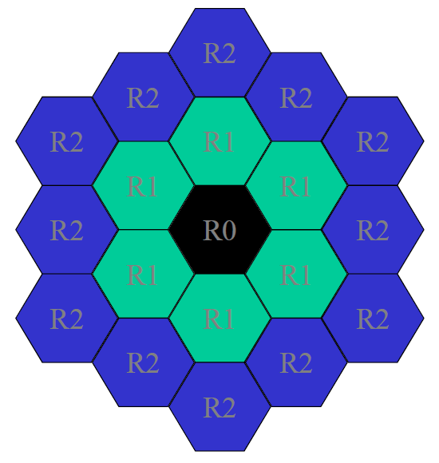
Hexagonal
Network
Coverage
Model for PCN

Slide 32
Forwarding Pointers (Ref [1])
Update (upon crossing a RA boundary)
  When the length of forwarding pointers < K:
  Set up a pointer between the two involving VLRs
  When the length of forwarding pointers = K:
  Update information to the HLR
• Search
– HLR -> VLR0 -> …. -> VLRi -> cell ->paging

Slide 33
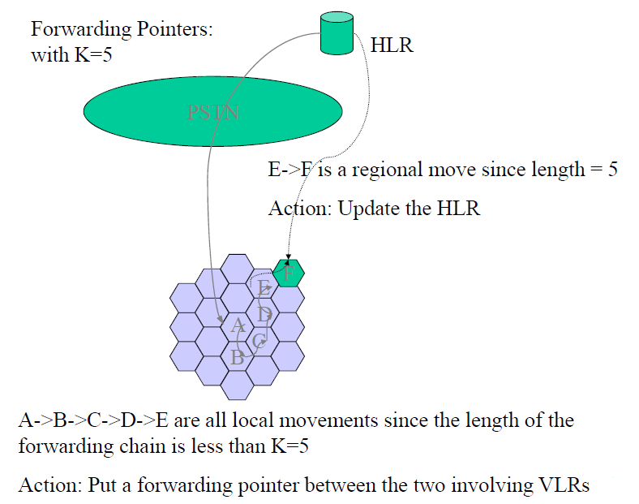

Slide 34
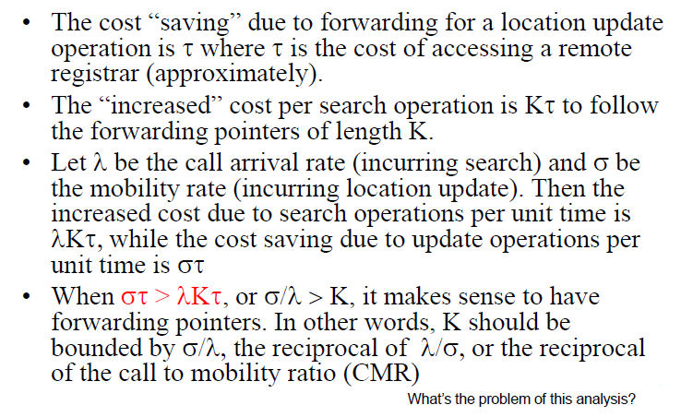
How Big Should K be for
Forwarding Pointers?

Slide 35
Dynamic Location Update
Location update algorithms can be static or dynamic
  With static, an update is triggered because of crossing of RA boundaries, e.g., the basic HLRVLR scheme
  With dynamic, update or not depends on a user’s call and mobility patterns
Dynamic Location update schemes:
  Time-Based, Movement-Based, Distance-Based

Slide 36
Dynamic Location Update Schemes
Time-Based: A mobile terminal updates in every T time units
Movement-Based: A mobile terminal counts the number of boundary crossings and performs the update when a threshold is exceeded (e.g. M=6)
  Forwarding pointers can be considered as a variation of it.
Distance-Based: A mobile terminal tracks the distance (in terms of RAs) it has moved since the last update.
  Update is performed when a distance threshold is exceeded
  Mobile terminal needs some knowledge of the network topology
  Local Anchor can be considered as a variation of it.

Slide 37
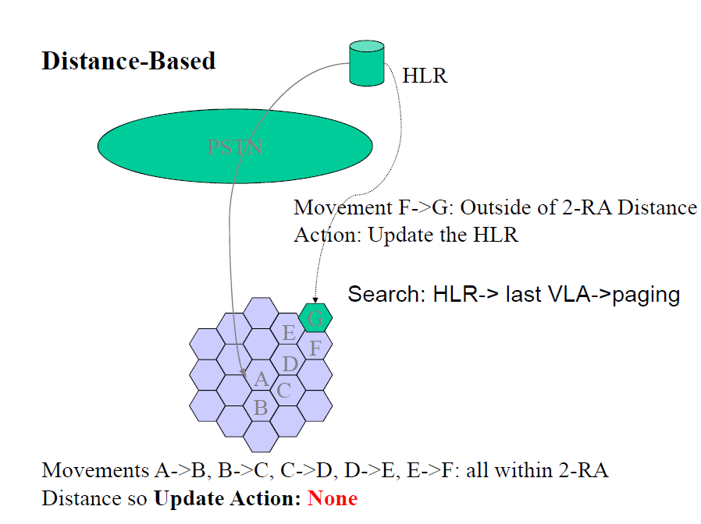

Slide 38
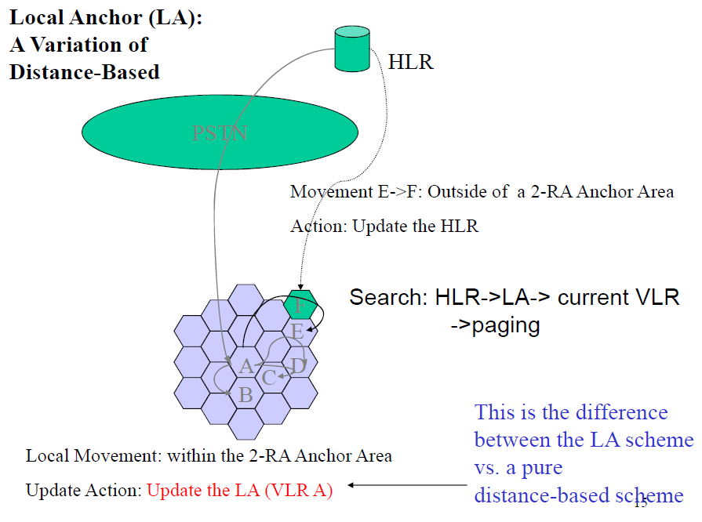

Slide 39
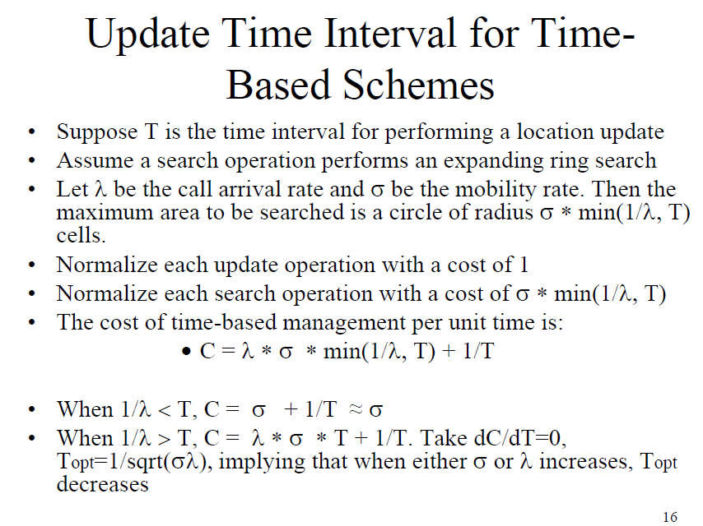

Slide 40
LeZi Update
Based on a compression algorithm by Ziv and Lempel
LeZi is a path-based update algorithm by which the movement history, not just the current location, is sent in an update message from the mobile user to the location database server
  The history has a list of IDs of the zone (LA or cell) the mobile terminal has crossed.
  The location database keeps the history in compact form by means of a search tree structure (called a LeZi trie)
Can be part of the user’s profile
  On a call arrival, prediction of the current cell is given and selective paging is performed

