Slide 1
Android
Layers,
android components,
mapping application to process. Android
development basics. Hardware tools, Software tools, Android SDK features .

Slide 2
Mobile Application Development (MAD)
Intro to Android platform
Platform architecture
Application building blocks
Development tools
Hello Android Live Demo

Slide 3
Few reasons to go MAD…
Smart Phones
  Internet access anywhere
  Social networking
Millions of mobile users
Open standards

Slide 4
Introduction to Android
Open software platform for mobile development
A complete stack – OS, Middleware, Applications
An Open Handset Alliance (OHA) project
Powered by Linux operating system
Fast application development in Java
Open source under the Apache 2 license

Slide 5


Slide 6
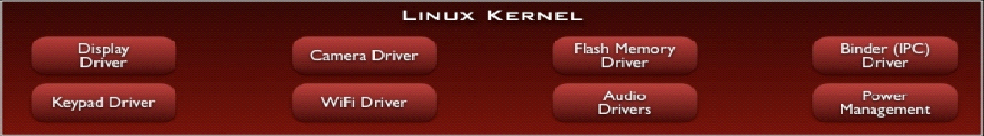
Linux Kernel
Works as a HAL
Device drivers
Memory management
Process management
Networking

Slide 7
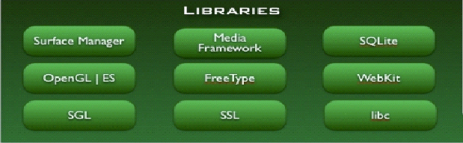
Libraries
C/C++ libraries
Interface through Java
Surface manager – Handling UI Windows
2D and 3D graphics
Media codecs, SQLite, Browser engine

Slide 8
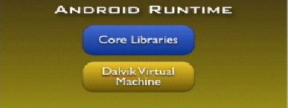
Android Runtime
Dalvik VM
  Dex files
  Compact and efficient than class files
  Limited memory and battery power
Core Libraries
  Java 5 Std edition
  Collections, I/O etc…

Slide 9
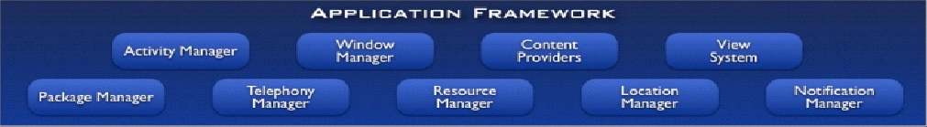
Application Framework
API interface
Activity manager – manages application life cycle.

Slide 10
Applications
Built in and user apps
Can replace built in apps

Slide 11
Application Building Blocks
Activity
IntentReceiver
Service
ContentProvider

Slide 12
Activities
Represents the presentation layer of an Android application, e.g. a screen which the user sees. An Android application can have several activities and it can be switched between them during runtime of the application. But, they can:
  Be faceless
  Be in a floating window
  Return a value

Slide 13
IntentReceivers
Components that respond to broadcast ‘Intents’
Way to respond to external notification or alarms
Apps can invent and broadcast their own Intent

Slide 14
Intents
Think of Intents as a verb and object; a description of what you want done
  E.g. VIEW, CALL, PLAY etc..
System matches Intent with Activity that can best provide the service
Activities and Intent Receivers describe what Intents they can service

Slide 15









Intents
Home
Photo Gallery
Contacts
Picasa
System picks best component for that action
“Pick photo”
GMail
Client component makes a request for a specific action
Chat
Blogger
New components can use existing functionality
Blogger

Slide 16
Services
Faceless components that run in the background
  E.g. music player, network download etc…

Slide 17
ContentProviders
Enables sharing of data across applications
  E.g. address book, photo gallery
Provides uniform APIs for:
  querying
  delete, update and insert.
Content is represented by URI and MIME type

Slide 18
Development Tools
Eclipse
Android SDK 1.0-2.0
  developer.android.com

Slide 19
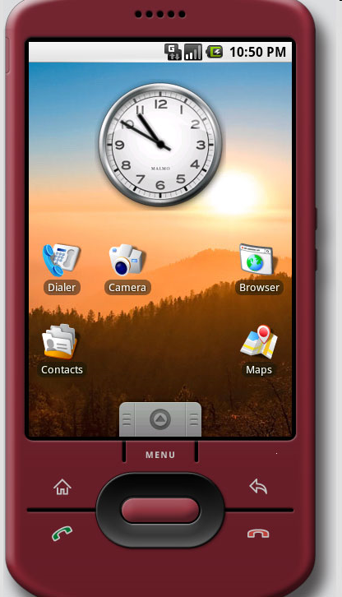
The Emulator
QEMU-based ARM emulator
Runs the same image as the device
Limitations:
  No Camera support
  http://en.wikipedia.org/wiki/QEMU

Slide 20
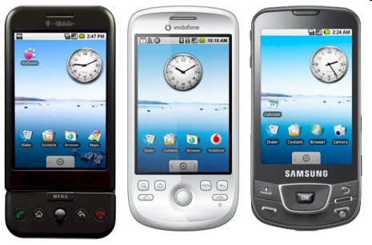
Devices

Slide 21
Hello World
http://developer.android.com/guide/tutorials/hello-world.html
Generating UIs
  Views – building blocks
  E.g. TextView, EditText, Button
  Placed into Layouts
  E.g. LinearLayout, TableLayout, AbsoluteLayout

Slide 22
Application Lifecycle
Application run in their own processes (VM, PID)
Processes are started and stopped as needed to run an application's components
Processes may be killed to reclaim resources

Slide 23
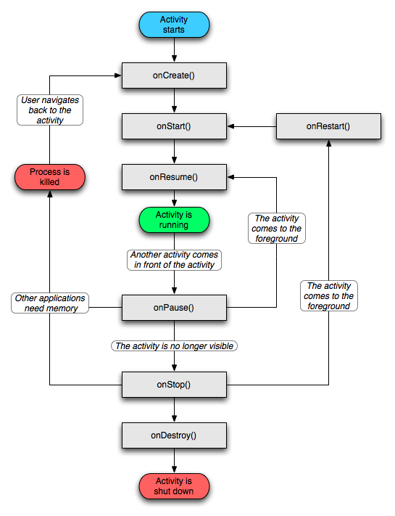

Slide 24
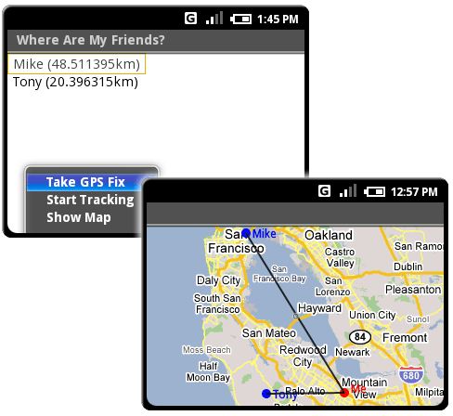
Location Manager

Slide 25
XMPP Services
Allows any app to send device-to-device messages to other android users
Data Messages are Intents with name/value pairs
Works with any gmail account…
Can also build servers to deliver server-to-device messages

Slide 26
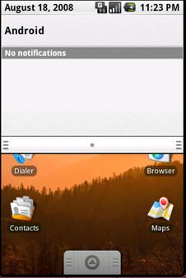
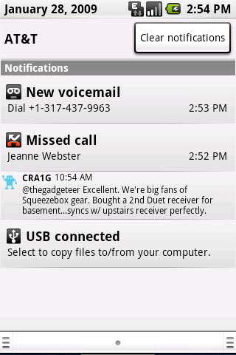
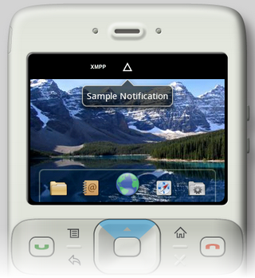
Notification Manager

Slide 27
Notification Manager
How background app interact with users
Consistent notification presentation

Slide 28
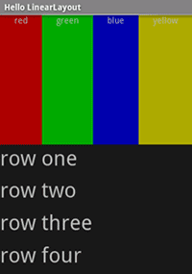
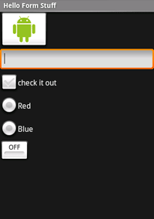
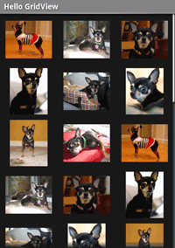
Views

Slide 29
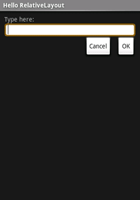
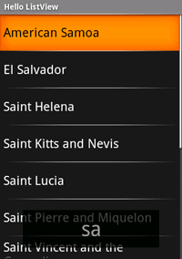
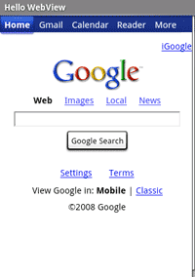
Views

Slide 30
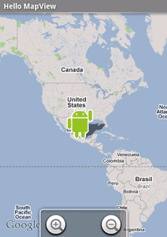
Location Manager

Slide 31
Installing the Developing Environment
Installing Android SDK:
1. Download Eclipse(3.4) from : http://www.eclipse.org/downloads/
2. Install Jdk6 preferably if you don’t have it already installed.
3. Download the Android SDK for your eclipse version and OS from http://developer.android.com/sdk/1.5_r3/index.html
4. Installing the ADT Plugin for Eclipse Android offers a custom plugin for the Eclipse IDE, called Android Development Tools (ADT), that is designed to give you a powerful, integrated environment in which to build Android applications. It extends the capabilites of Eclipse to let you quickly set up new Android projects, create an application UI, add components based on the Android Framework API, and debug using the Android SDK tools.

Slide 32
Eclipse 3.4 (Ganymede)
1. Start Eclipse, then select Help > Software Updates.... 2. In the dialog that appears, click the Available Software tab.
3. Click Add Site...
4. Enter this as the Location: https://dl-ssl.google.com/android/eclipse/ Alternatively, you can use http in the Location URL, if you are having trouble with https http://dl-ssl.google.com/android/eclipse/ Click OK.
5. Back in the Available Software view, you should see the plugin. Select the checkbox next to Developer Tools and click Install...
6. On the subsequent Install window, "Android Developer Tools", and "Android Editors" should both be checked. The Android Editors feature is optional, but recommended. If you choose to install it, you need the WST plugin mentioned earlier in this page. Click Next.

Slide 33
7. Accept the license agreement and click Finish.
Restart Eclipse.
Now, you just need to modify your Eclipse preferences to point to the Android SDK directory:
1. Select Window > Preferences... to open the Preferences panel. (Mac OS X: Eclipse > Preferences)
2. Select Android from the left panel.
3. For the SDK Location in the main panel, click Browse... and locate the SDK directory.
4. Click Apply, and then OK. Done!
5. Hello World for Android: Go through the helloworld(s) give on this page to get a feel of the developing environment. http://developer.android.com/guide/tutorials/hello-world.html
6. Go through
7. http://developer.android.com/guide/tutorials/hello-world.html

Slide 34
References
http://developer.android.com/

Slide 35
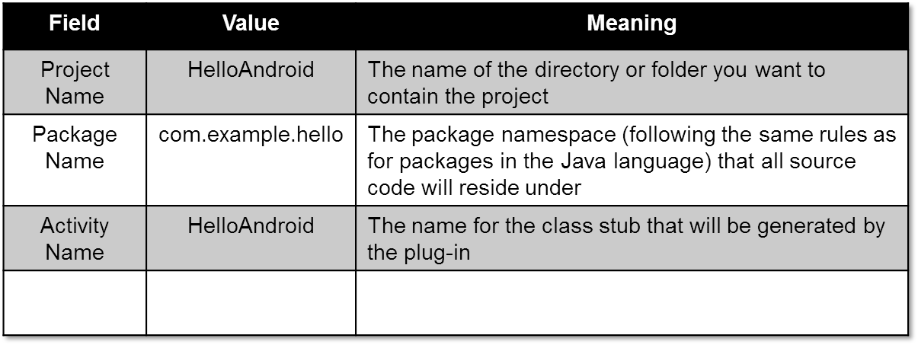
Sample Project - "Hello, Android"
Create "HelloAndroid" project.
  Select the File > New > Project menu item and select "Android Project" and click Next.
  Fill out the project details:

Slide 36
Sample Project - "Hello, Android" (Cont)
Take a look at HelloAndroid.java (HelloAndroid > src > com.android.hello) and modify the code like:
package com.android.hello;
import android.app.Activity;
import android.os.Bundle;
import android.widget.TextView;
public class HelloAndroid extends Activity {
/** Called when the activity is first created. */
@Override
public void onCreate(Bundle savedInstanceState) {
super.onCreate(savedInstanceState);
TextView tv = new TextView(this);
tv.setText("Hello, Android");
setContentView(tv);
}
}

Slide 37
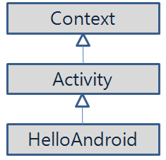
Sample Project - "Hello, Android" (Cont)
Source Description
  Creating a TextView object
  TextView tv = new TextView(this);
    A View (a drawable object) subclass that handles text
    The argument to TextView's constructor: an Android Context instance.

Slide 38
Sample Project - "Hello, Android" (Cont)
Source Description (Cont)
  Tell the TextView object to display a String:
  tv.setText("Hello, Android");
  Connect the TextView object with on-screen display:
  setContentView(tv);

Slide 39
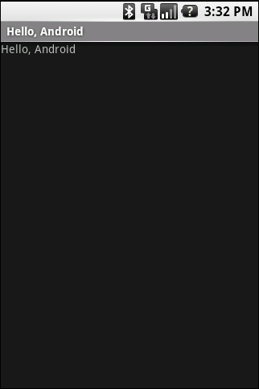
Sample Project - "Hello, Android" (Cont)
Test
  Select the Run > Run Configuration menu entry.
  Highlight the "Android Application" entry, and then click the icons in the top left corner (the one depicting a sheet of paper with a plus sign in the corner) or simply double-click the highlighted entry.
  Change the name "New_configuration" to something like "Hello Android".
  Pick the HelloAndroid project by clicking the "Browse" button.
  Click "Apply" and then "Run".

