Slide 1
Security Issues In Mobile Computing
Security Issues
Authentication,
Encryption,
Cryptographic Tools: Hash, Message Authentication Code (MAC),
Digital Signature, Certificate.
Secure Socket Layer (SSL).
Characteristics of SIM,
Equipment Identification
1.<number>

Slide 2
Security Issues In Mobile Computing
To define three security goals
To define security attacks that threaten security
goals
To define security services and how they are
related to the three security goals
To define security mechanisms to provide security
services
To introduce two techniques, cryptography and
steganography, to implement security mechanisms.
1.<number>
Notes:
1.#

Slide 3
1-1 SECURITY GOALS
This section defines three security goals.
1.1.1 Confidentiality
1.1.2 Integrity
1.1.3 Security
1.<number>
Notes:
1.#

Slide 4
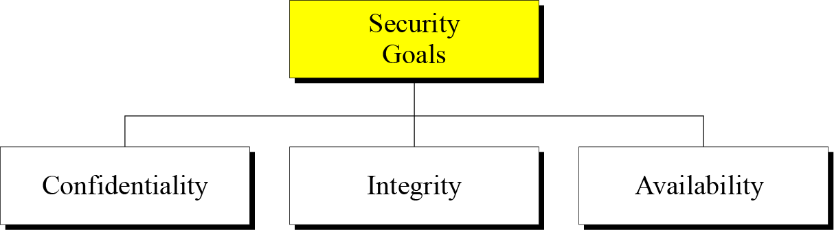
Figure 1.1 Taxonomy of security goals
1.<number>
Notes:
1.#

Slide 5
Confidentiality
Confidentiality is probably the most common aspect of information security. We need to protect our confidential information. An organization needs to guard against those
malicious actions that endanger the confidentiality of its information.
1.<number>
Notes:
1.#

Slide 6
1.1.2 Integrity
Information needs to be changed constantly. Integrity means that changes need to be done only by authorized entities and through authorized mechanisms.
1.<number>
Notes:
1.#

Slide 7
1.1.3 Availability
The information created and stored by an organization needs to be available to authorized entities. Information needs to be constantly changed, which means it must be accessible to authorized entities.
1.<number>
Notes:
1.#

Slide 8
1-2 ATTACKS
The three goals of security⎯confidentiality, integrity, and availability⎯can be threatened by security attacks.
1.2.1 Attacks Threatening Confidentiality
1.2.2 Attacks Threatening Integrity
1.2.3 Attacks Threatening Availability
1.2.4 Passive versus Active Attacks
1.<number>
Notes:
1.#

Slide 9
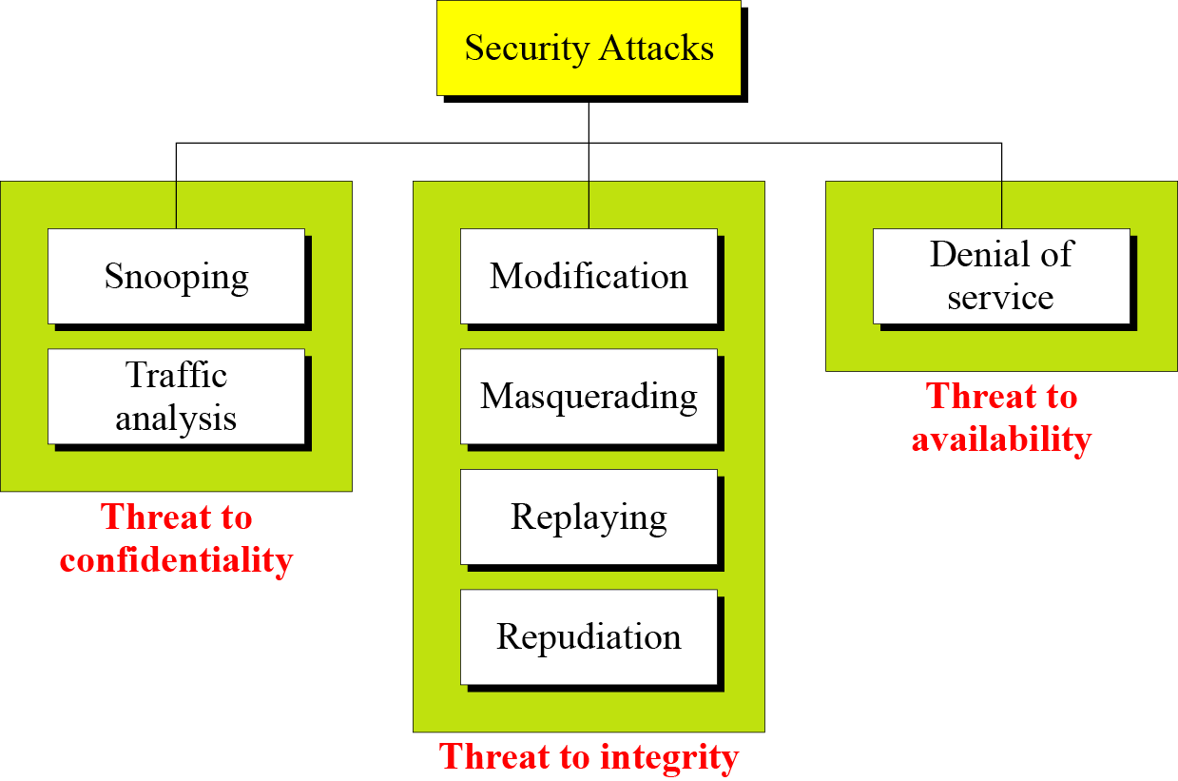
1.2 Continued
Figure 1.2 Taxonomy of attacks with relation to security goals
1.<number>
Notes:
1.#

Slide 10
1.2.1 Attacks Threatening Confidentiality
Snooping refers to unauthorized access to or interception of data.
Traffic analysis refers to obtaining some other type of information by monitoring online traffic.
1.<number>
Notes:
1.#

Slide 11
1.2.2 Attacks Threatening Integrity
Modification means that the attacker intercepts the message and changes it.
Masquerading or spoofing happens when the attacker impersonates somebody else.
Replaying means the attacker obtains a copy
of a message sent by a user and later tries to replay it.
Repudiation means that sender of the message might later deny that she has sent the message; the receiver of the message might later deny that he has received the message.
1.<number>
Notes:
1.#

Slide 12
1.2.3 Attacks Threatening Availability
Denial of service (DoS) is a very common attack. It may slow down or totally interrupt the service of a system.
1.<number>
Notes:
1.#

Slide 13
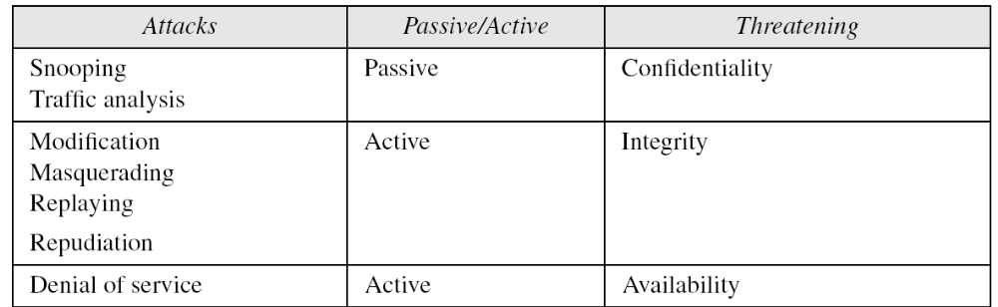
1.2.4 Passive Versus Active Attacks
Table 1.1 Categorization of passive and active attacks
1.<number>
Notes:
1.#

Slide 14
1-3 SERVICES AND MECHANISMS
ITU-T provides some security services and some mechanisms to implement those services. Security services and mechanisms are closely related because a
mechanism or combination of mechanisms are used to provide a service..
Topics discussed in this section:
1.3.1 Security Services
1.3.2 Security Mechanism
1.3.3 Relation between Services and Mechanisms
1.<number>
Notes:
1.#

Slide 15
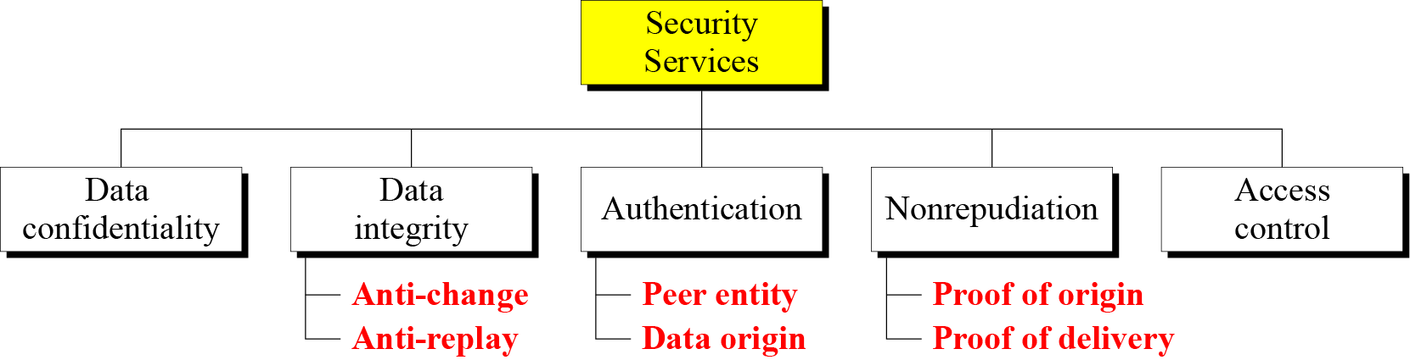
1.3.1 Security Services
Figure 1.3 Security services
1.<number>
Notes:
1.#

Slide 16
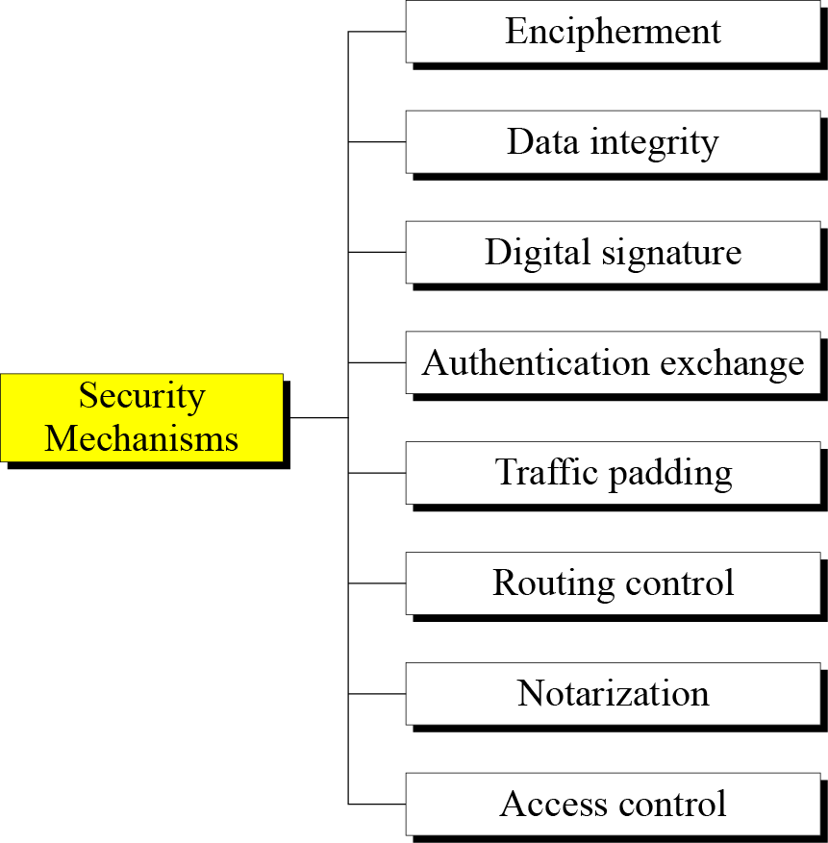
1.3.2 Security Mechanism
Figure 1.4 Security mechanisms
1.<number>
Notes:
1.#

Slide 17
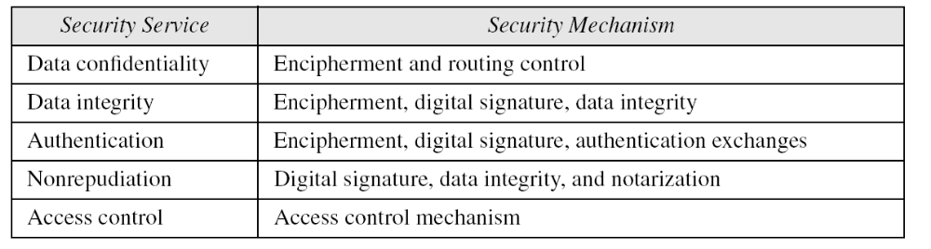
1.3.3 Relation between Services and Mechanisms
Table 1.2 Relation between security services and mechanisms
1.<number>
Notes:
1.#

Slide 18
1-4 TECHNIQUES
Mechanisms discussed in the previous sections are only theoretical recipes to implement security. The actual implementation of security goals needs some techniques. Two techniques are prevalent today: cryptography and steganography.
Topics discussed in this section:
1.4.1 Cryptography
1.4.2 Steganography
1.<number>
Notes:
1.#

Slide 19
1.4.1 Cryptography
Cryptography, a word with Greek origins, means “secret writing.” However, we use the term to refer to the science and art of transforming messages to make them secure and immune to attacks.
1.<number>
Notes:
1.#

Slide 20
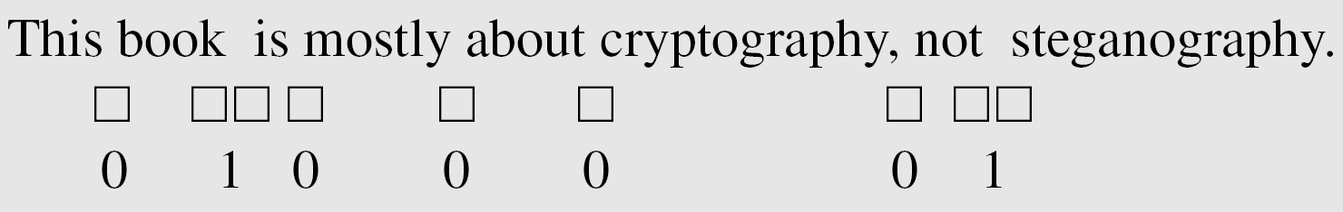
1.4.2 Steganography
The word steganography, with origin in Greek, means “covered writing,” in contrast with cryptography, which means “secret writing.”
Example: covering data with text
1.<number>
Notes:
1.#

Slide 21
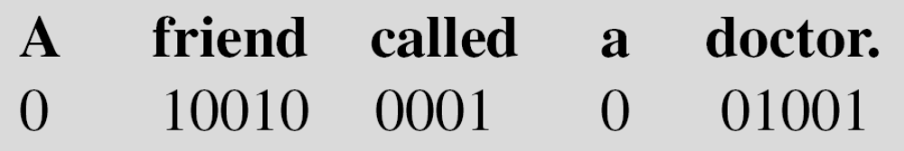
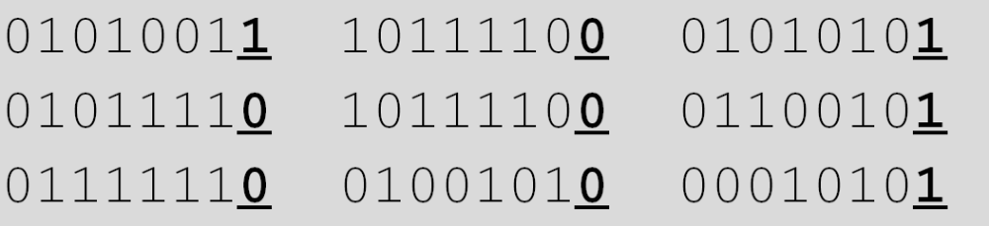
1.4.2 Continued
Example: using dictionary
Example: covering data under color image
1.<number>
Notes:
1.#

Slide 22
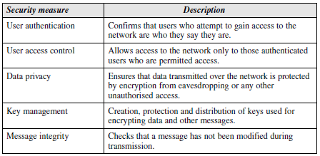
Secure communication within mobile computing network provides the following facilities to users:
Confidentiality, Integrity, authentication and nonrepudiation
Mobile computing security requirements
1.<number>

Slide 23
Solutions to security requirements
REQUIREMENTS | SOLUTIONS
Authentication | Challenge response Digital signature
Confidentiality | Encryption
Integrity | Hash function (MAC)
Nonrepudiation | Time stamping
1.<number>

Slide 24
Security attacks
A useful means of classifying security attacks is in terms of passive attacks and active attacks.
Passive attacks are in the nature of eavesdropping on, or monitoring of, transmissions. The goal of the opponent is to obtain information that is being transmitted.
Active attacks involve some modification of the data stream or the creation of a false stream and can be subdivided into four categories: masquerade, replay, modification of messages, and denial of service.
1.<number>

Slide 25
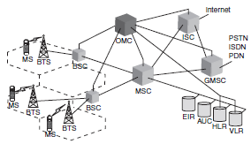
SECURITY IN GSM NETWORKS
Figure 1 is the complete architecture of GSM (2G) networks.
The security mechanisms of GSM are implemented in three different elements;
the Subscriber Identity Module (SIM)
the GSM handset or MS
the GSM network.
1.<number>

Slide 26
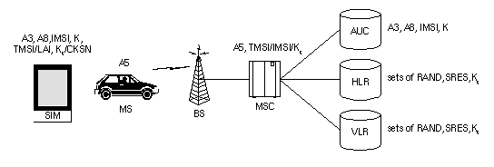
Security features distribution for the three elements in 2G networks is shown in figure 1.2. The distribution of these security credentials provide an additional measure of security both in ensuring the privacy of cellular telephone conversations and prevention of cellular telephone fraud.
1.<number>

Slide 27
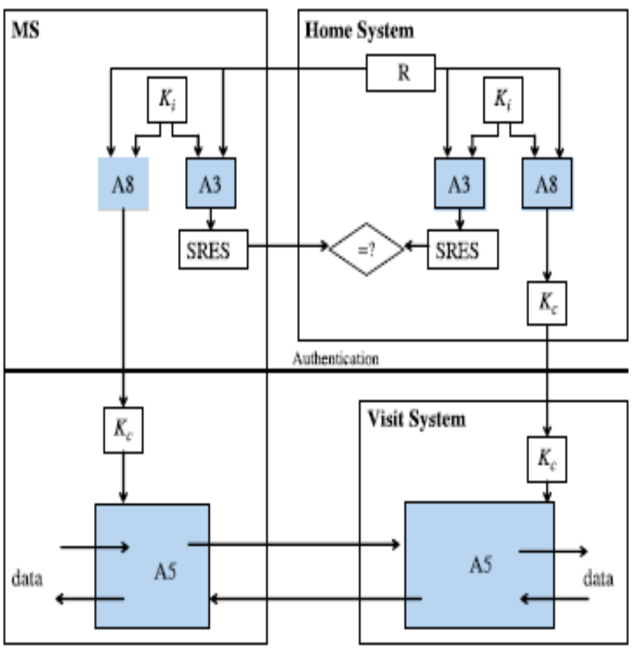
Security in GSM consists of the following aspects: subscriber identity authentication, subscriber identity confidentiality, signaling data confidentiality, and user data confidentiality.
The figure 1.3 gives the distribution of security algorithms and keys in the 2G network.
The SIM contains the IMSI, the individual subscriber authentication key (Ki), the ciphering key generating algorithm (A8), the authentication algorithm (A3), as well as a Personal Identification Number (PIN). The GSM handset contains the ciphering algorithm (A5).
1.<number>

Slide 28
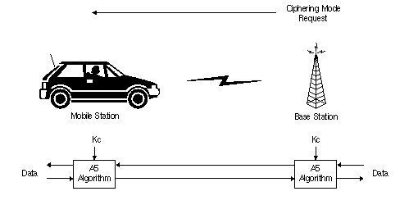
The process of encryption occurs between the BTS and ME without involving the home network. For achieving seamless roaming between different networks all service providers use the same encryption algorithm which is A5 specified by the GSM standard.
In a similar manner to the authentication process, the computation of the ciphering key (Kc) takes place internally within the SIM.
1.<number>

Slide 29
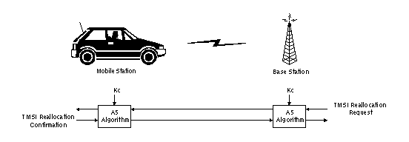
The TMSI is sent to the mobile station after the authentication and encryption procedures have taken place. The mobile station responds by confirming reception of the TMSI. The TMSI is valid in the location area in which it was issued.
1.<number>

Slide 30
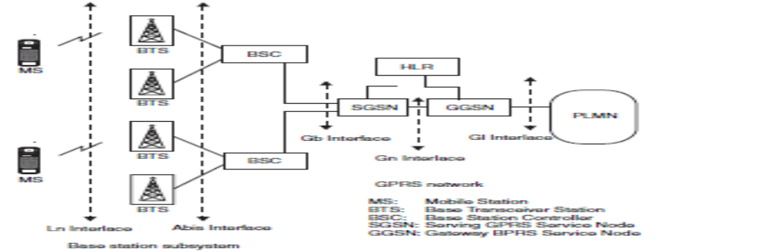
GPRS Security
General Packet Radio Service (GPRS) was basically intended to provide the ME with data-connectivity to various web servers.
GPRS transfers the responsibility of encryption and decryption on the network side from the BTS to the Serving GPRS Service Node (SGSN). The SGSN is the equivalent of the VLR and MSC. This means that the GPRS architecture effectively prevents or protects against eavesdropping on the backbone between the BTS and the SGSN too.
1.<number>

Slide 31
Digital signatures can be used to authenticate a message and prevent attackers from injecting erroneous routing information and data traffic inside the network.
1.<number>

Slide 32
Security Issues
classifications of security issues in communication networks.
There are five fundamental goals of security in information system.
• Confidentiality, preventing unauthorized users from gaining access to critical information of any particular user.
• Integrity, ensures unauthorized modification, destruction or creation of
information cannot take place.
• Availability, ensuring authorized users getting the access they require.
• Legitimate, ensuring that only authorized users have access to services.
• Accountability, ensuring that the users are held responsible for there security- related activities by arranging the user and his/her activities are linked if and when necessary.
The way these goals are achieved depends on the security policy adopted by the service providers.
1.<number>

Slide 33

1.<number>

Slide 34
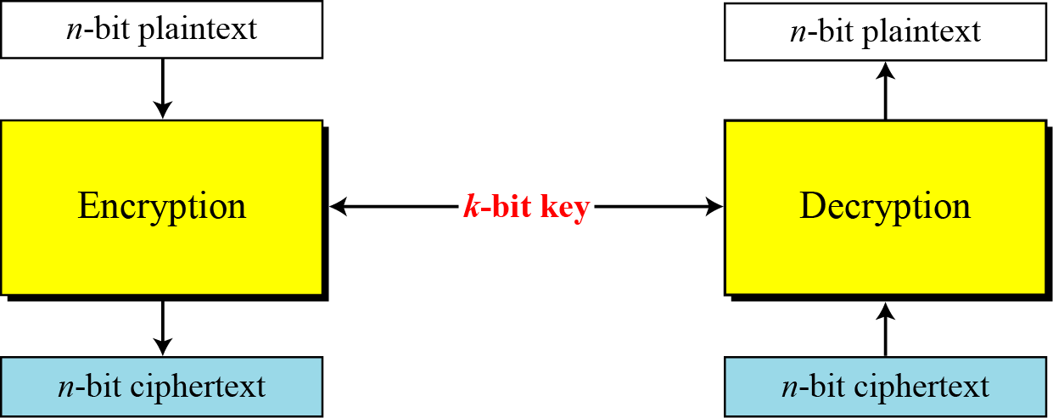
5.<number>

Slide 35
1.<number>

Slide 36
10-1 INTRODUCTION
Symmetric and asymmetric-key cryptography will exist in parallel and continue to serve the community. We actually believe that they are complements of each other; the advantages of one can compensate for the disadvantages of the other.
Topics discussed in this section:
10.1.1 Keys
10.1.2 General Idea
10.1.3 Need for Both
10.1.4 Trapdoor One-Way Function
10.1.5 Knapsack Cryptosystem
10.<number>

Slide 37

10-1 INTRODUCTION
Symmetric and asymmetric-key cryptography will exist in parallel and continue to serve the community. We actually believe that they are complements of each other; the advantages of one can compensate for the disadvantages of the other.
Note
Symmetric-key cryptography is based on sharing secrecy;
asymmetric-key cryptography is based on personal secrecy.
10.<number>

Slide 38
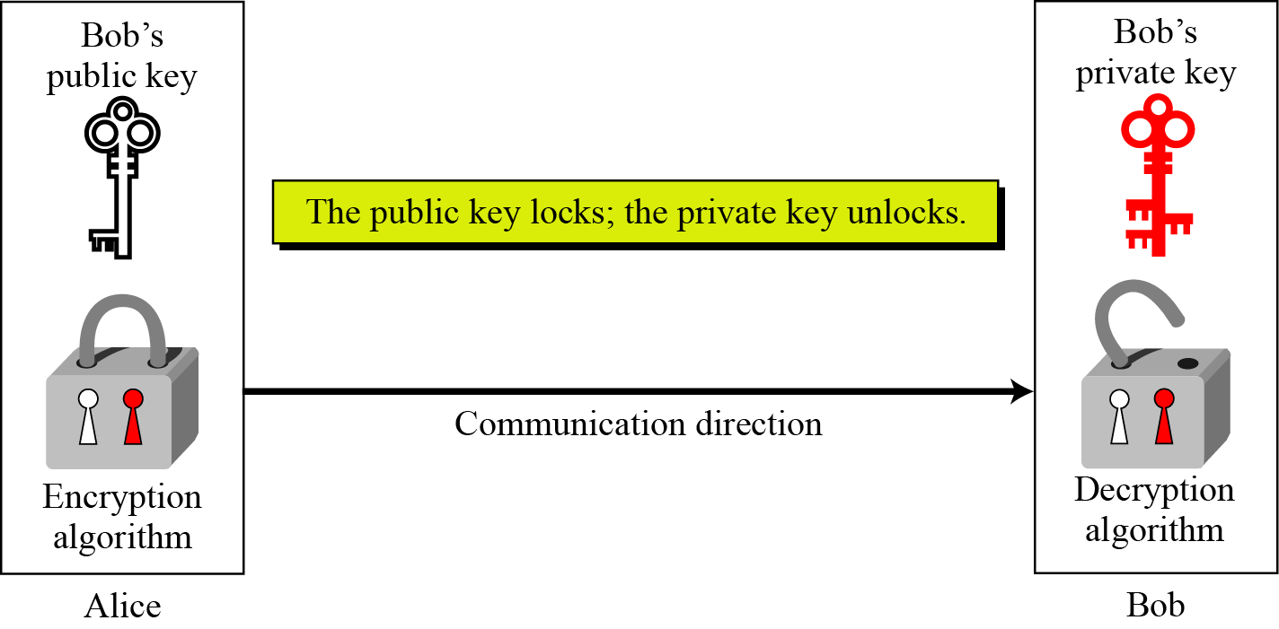
10.1.1 Keys
Asymmetric key cryptography uses two separate keys: one private and one public.
Figure 10.1 Locking and unlocking in asymmetric-key cryptosystem
10.<number>

Slide 39
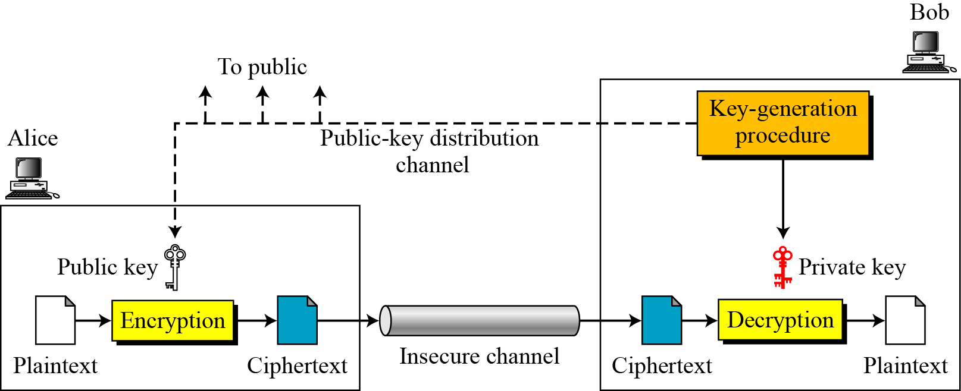
10.1.2 General Idea
Figure 10.2 General idea of asymmetric-key cryptosystem
10.<number>

Slide 40
10.1.2 Continued
Plaintext/Ciphertext
Unlike in symmetric-key cryptography, plaintext and ciphertext are treated as integers in asymmetric-key cryptography.
Encryption/Decryption
C = f (K_{public} , P) P = g(K_{private} , C)
10.<number>

Slide 41
1.<number>

Slide 42
1.<number>

Slide 43
1.<number>

