Slide 1
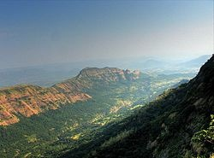
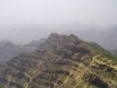

The Peninsular Plateau Region – Deccan…

Slide 2
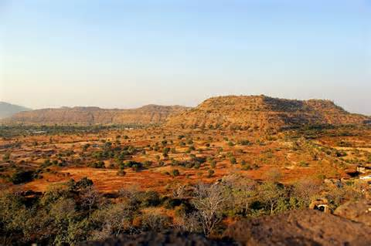
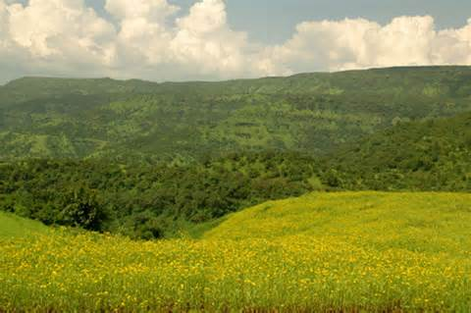

How was it formed?
The volcanic basalt beds of the Deccan were laid down in the massive Deccan Traps eruption ,which occurred between 67 and 66 million years ago.
When the volcanoes became extinct, they left a region of highlands with typically vast stretches of flat areas on top like a table.

Slide 3
Sub-regions of Deccan plateau…
Deccan plateau
Maharashtra plateau
Satpuda and Mahadeo Maikal Plateau
Karnataka- Telangana plateau
Eastern plateau

Slide 4
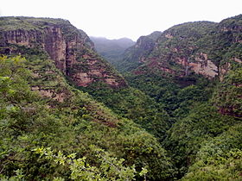
Satpuda-Mahadeo Maikal Plateau…
Satpuda Mahadeo Maikal range is a group of ranges that extend in a east west direction and forms the northern edge of the Deccan plateau.
Satpuda Mahadeo range starts from Eastern Gujarat &extends eastward for a distance of 800 km.

Slide 5
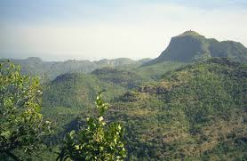
Satpuda and Mahadeo Maikal Range is popularly known as Burhanpur gap.
The three major river systems-Narmada , Mahanadi and Wainganga collect their headwaters from this hill complex.

Slide 6
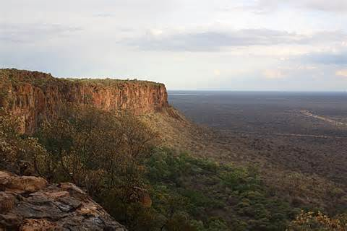
Maharashtra Plateau…
The northwestern part of the Deccan plateau is known as the Maharashtra plateau.
The hilltops of Maharashtra plateau area are generally flat.
The altitude of the plateau ranges from 400m to 600m.

Slide 7
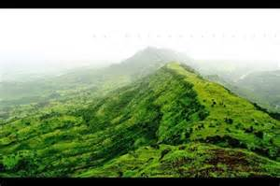
The western limit of this plateau is marked by the Western Ghats.
The northern portion of this plateau is occupied by Tapi basin.
The eastern portion is occupied by Wardha-Wainganga basin.

Slide 8
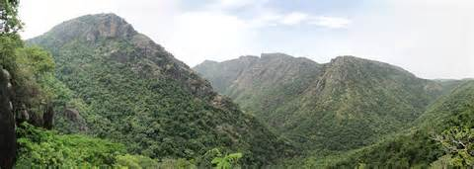
Karnataka-Telangana Plateau…
Karnataka-Telangana plateau is the southernmost part of the Deccan Plateau. The Telangana plateau is located along the eastern and north-eastern side of the Karnataka plateau.
As it covers a large portion of the Deccan plateau it is considered the most important plateau of the Deccan plateau.

Slide 9
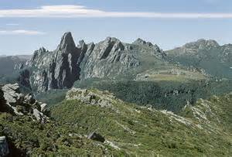

The Karnataka-Telangana plateau is also popularly known as Maidan.
The Karnataka-Telangana plateau is a region of crystalline rocks mainly granite and granitic gneiss as well as metamorphic forms of sedimentary formations.

Slide 10
Eastern plateau… The eastern plateau is divided into three sub-regions.
Eastern plateau
Dandakaranya
Garhjat Hills
Mahanadi Basin

Slide 11


Mahanadi Basin…
Mahanadi basin occupies central part of Chhattisgarh state and western part of Odisha state.
The Mahanadi Basin is relatively low-lying region and it is surrounded by hill ranges or plateaus.

Slide 12


Dandakaranya…
The southern part of Chhattisgarh state and southwestern part of Odisha state is known as Dandakaranya.
The Dandakaranya area is known for it’s rich iron ore deposits.
The plateau is practically divided into two halves by the east-west flowing Indravati river.

Slide 13
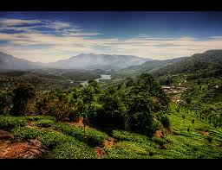
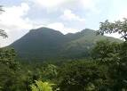
Garhjat Hills…
Garhjat hills occupy the north western part of Odisha .
The region is drained by rivers Brahmani and Baitarni.
Scenic view of the Garhjat Hills

Slide 14
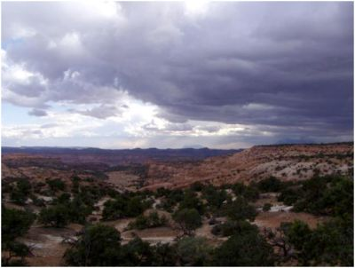
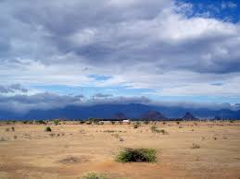
Climate…
The Peninsular plateau region has a large variation in climate due to it’s vast size.
The plateau enjoys tropical wet and dry climate, except a semi-arid region to the east of the Western Ghats.
Winter and early summer have a temperature of 18 degree Celsius.

Slide 15
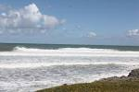
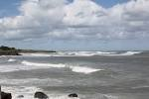
Summers are very hot and the temperature in the interior areas can rise above 45 degree Celsius.
The rainy season is from June to September. The annual rainfall is between 700 mm- 1500 mm.
The months of March to May are hot and dry with mean monthly temperature of around 32 degree Celsius.

Slide 16
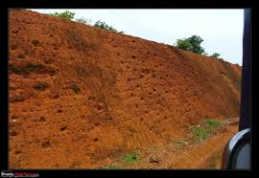
Soils…
Black soil is well developed in the Deccan Plateau region of Maharashtra.
Black soil is very suitable for cotton and sugarcane.
Red soil is found in Tamil Nadu, Andhra Pradesh. Karnataka plateau.

Slide 17
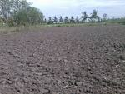
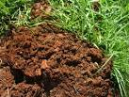
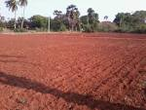
Laterite soils are generally found in the western ghats and are abundant in areas along the edge of the plateau in the east, covering small parts of Tamil Nadu.
Black Soils
Laterite Soils
Red soils

Slide 18



Natural Vegetation…
Varied topography and other physical features of the Deccan plateau have rich variety of forests.
Teak, Sal, Sheesham, Sandalwood, Khair, Hirda and Arjun are some of the trees found in the forests in the Deccan Plateau.
Teak
Arjun
Sandalwood

Slide 19
The forests in the Deccan plateau are further sub-divided into four parts. They are as follows :-
Tropical Evergreen Forests
Tropical Moist Deciduous Forests
Tropical Dry Deciduous Forests
Thorny Scrub Forests

Slide 20
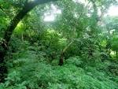


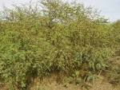
Tropical Evergreen Forest
Tropical Moist Deciduous Forest
Tropical Dry Deciduous Forest
Thorny Scrub Forest

Slide 21
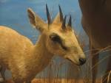
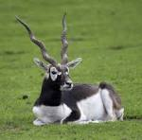
Animal life…
There are a number of varieties of grazing animals from the Four-horned Antelope and Blackbuck to the Gaur and Wild Buffaloes are found in the Deccan plateau.
Other important animals found there are the tigers, wild dog, Sloth Bear and other carnivore animals.
Four Horned Antelope
Blackbuck

Slide 22
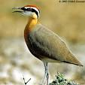
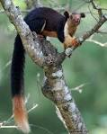
The area is home to many mammals.
The Indian Giant Squirrel found in the Deccan Plateau is endangered due to its rampant hunting.
The 300 species of birds include the globally threatened Jerdon’s Courser.
Jerdon’s Courser
The Indian Giant Squirrel

Slide 23

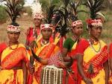
Population and Settlement…
The Deccan plateau is home to many different languages and people.
Bhil and Gond people live in the hills along the northern and north-eastern edges of the plateau and speak various languages.
Hyderabad is an important centre of Urdu language in the Deccan.
Bhil Tribes
Gond Tribes

Slide 24
Marathi is the main language of the north western Deccan in the state of Maharashtra.
Telugu and Kannada are the predominant languages of Andhra Pradesh and Karnataka respectively.
Tamil is the main language of Tamil Nadu to the south of the plateau, and Malayalam that of the hills and coast to the southwest, in the state of Kerala.
In South India ,widely spaced villages are the characteristic feature of the northern Maidan of Karnataka and Rayalaseema area of Andhra Pradesh.
The tract between the Kaveri and Tungabhadra has numerous tanks.

Slide 25
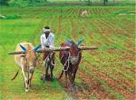

Economical Development…
The economy of the states in the Deccan Plateau mostly depends on agriculture, mining, industries, Transportation and Tourism.
We shall study all of them in detail in the following slides.

Slide 26
Agriculture…
The chief crops of the Deccan Plateau are cotton, Sugarcane and rice.
Cash crops are grown on a large scale in the Deccan Plateau.
Rice is predominantly grown in the eastern part of the Deccan Plateau whereas wheat is produced in the northern part.
Bajra is grown in the northern part of the plateau whereas Jowar, Cotton and Sugarcane are grown mostly in the Maharashtra Plateau.

Slide 27
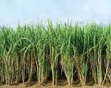
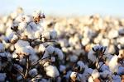

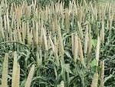
Sugarcane
Cotton
Jowar
Bajra

Slide 28
Irrigation and Dams…
Lakes constitute the backbone of irrigation in Bhandara. It is crucial for sugar and rice cultivation. Bhandaras are check dams or diversion rivers built across rivers.
Tanks, called Kere in Kannada are the predominant traditional method of irrigation in the Central Karnataka Plateau and are fed by channels branching off from streams in valleys.
Since agriculture is the main occupation in the region, irrigation plays a significant role in obtaining increased yields from the land.

Slide 29
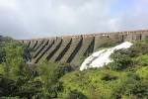
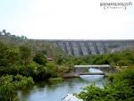


Bhandara Dams
Kere Tanks

Slide 30
Mining…
The Deccan plateau is a storehouse of minerals. Many types of minerals are found in the Deccan Plateau.
The Maharashtra Plateau is richly endowed with various minerals of industrial importance like Manganese, Coal, Iron Ore, Limestone, Copper, Bauxite and Silica.
These minerals are found in substantial quantities in the eastern districts with some deposits in the west.
Bituminous coal is found in the districts of Bhandara, Nagpur and Chandrapur.

Slide 31

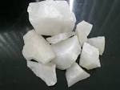

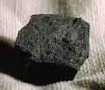
Bauxite
Silica
Manganese
Bituminous Coal

Slide 32
Industries…
Deccan Plateau is an industrially well-developed region.
Maharashtra is one of the most industrialised states in the country. Cotton textile industry is the largest and the oldest industry in the Maharashtra Plateau.
This plateau has many industries like automobiles, sugar, electronics and food processing.
The Deccan Plateau also includes industries like machine tools, electronic products, telecommunication equipment etc.

Slide 33
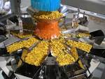



Food Processing Industry
Machine Tools Industry
Automobile Industry
Tele-communication industry

Slide 34


The Karnataka-Telangana plateau is rich in mineral resources.
Important minerals are high grade iron ore, Copper, Manganese, Chromite, China clay and Limestone.
Karnataka is one of the main gold producing states in India.
The state also has rich deposits of Granite.
Bengaluru and Pune have become popular hubs of the IT industry.
Granite
Gold

Slide 35

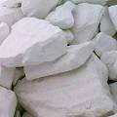

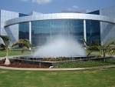
Chromite
China clay
Limestone Industry
Pune IT Industry

Slide 36

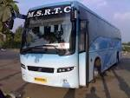
Transportation…
The Deccan Plateau region has a very well developed network of roads and railways.
Railways, Airways and Roadways are the three main types of transport used in the Deccan Plateau.
There are a number of highways which connect this region to other parts of the country.
The Deccan Odyssey train
M.S.R.T.C. Buses

Slide 37
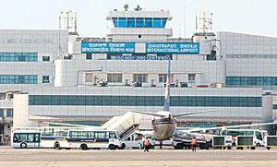

There are many national and international airports in the Deccan Plateau which connect various industrial and commercial centers of the country.
Bengaluru, Hyderabad, Mumbai and Nagpur are the important international airports of the region.
Chhatrapati Shivaji Maharaj
International Airport
The Bengaluru International Airport

Slide 38
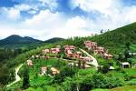
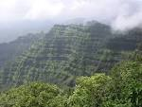
Tourism…
The states in the Deccan plateau earn a lot of income from the tourist centers there.
Deccan Plateau has many places of natural, cultural, historical and religious importance.
Udagamandalam (Ooty) and Mahabaleshwar of Maharashtra are famous hill stations in the Deccan Plateau.
Udagamandalam (Ooty)
Mahabaleshwar Hills

Slide 39
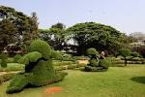
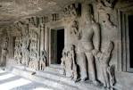
Bengaluru and Hyderabad are famous for their gardens.
There are many historical places like Aurangabad, Bidar, Bijapur, Mysore, Pune etc.
Besides these, there are many pilgrimage centers in the plateau region that attract people from all over the world.
The Bengaluru Botanical Garden
The Caves of Aurangabad

Slide 40

Environmental Problems…
There are always two sides of a coin. As there are a number of good things in the Deccan Plateau, there are also some environmental problems prevailing there.
A large number of industries have come up causing air, water and soil pollution.
Mining activities done on a large scale cause water and air pollution in the Deccan Plateau. After the extraction of minerals, the mining areas become useless for any other purpose.

Slide 41


The western part of the Plateau region is an earthquake prone zone.
The Latur Earthquake which occurred in the year 1993, killed many people and destroyed their properties.
The Koyna region is also prone to a number of earthquakes.
The effects of the Latur Earthquake
The effects of the earthquake
which occurred in Koyna.

Slide 42
Sources
1. Google
2. Wikipedia
3. 10th standard Geography Textbook
Acknowledgements
Thank you Anwar Sir for giving us the opportunity to make a power-point presentation on this topic. Thanks for your support which you gave us.

Slide 43
This power-point presentation was made by :-
1. Naman Agarwal
2. Nitesh Marchande
3. Rishi Shah
4. Atharva Jadhav

Slide 44
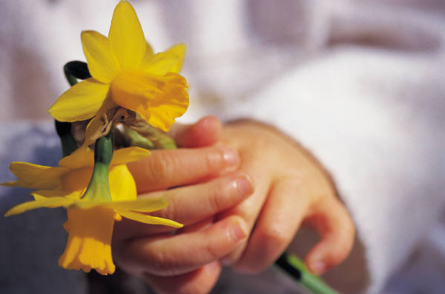
Thank You…

