Slide 1
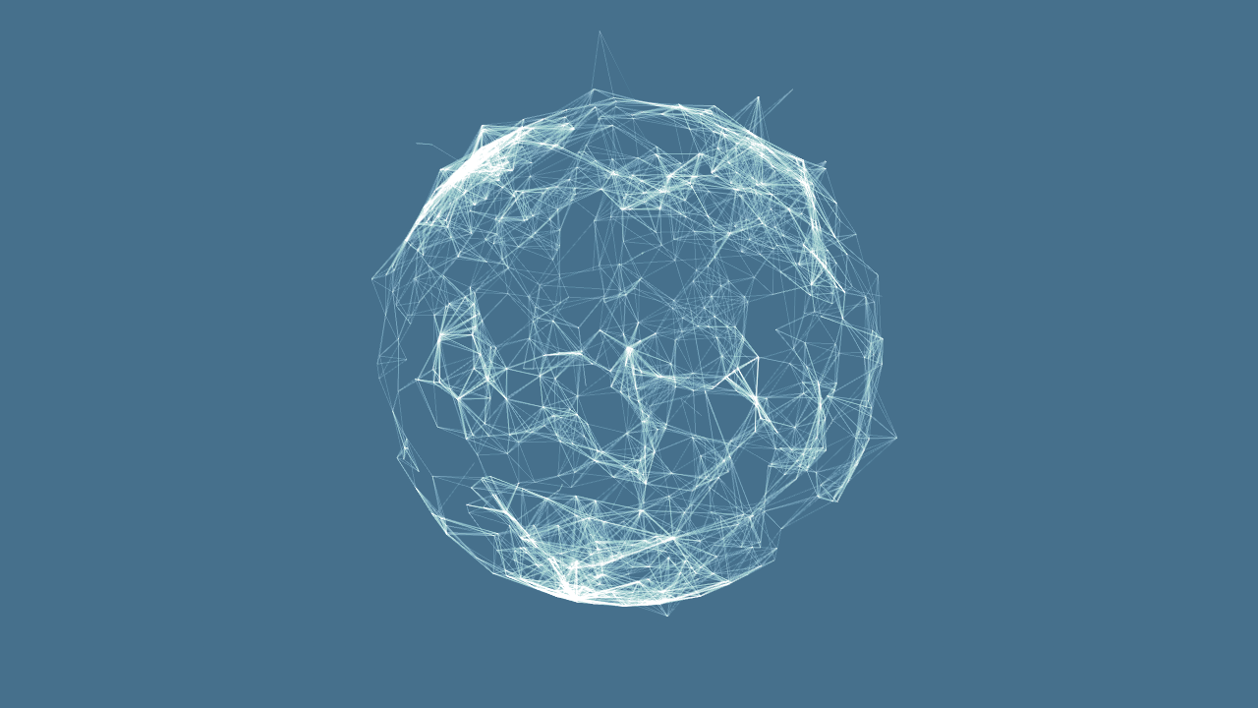
Image Processing
With Python
By 14-095
Juan Lee

Slide 2
INDEX
Image Processing?
Digital Image
cs1media module
Operations
Applications

Slide 3
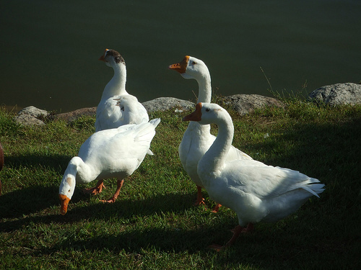
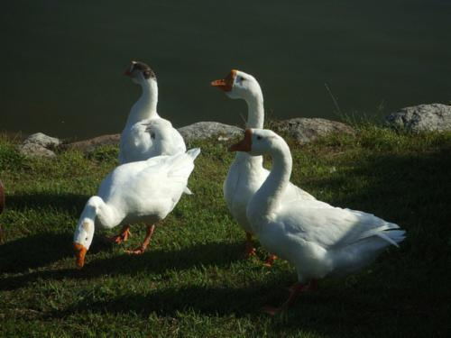
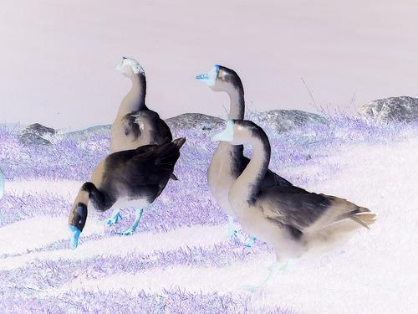
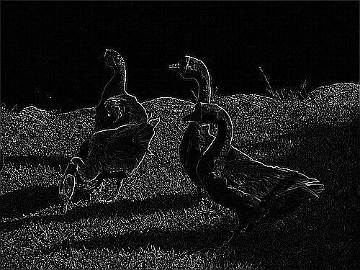
Image Processing?
Image Processing is a processing of images using mathematical operations.
Original
Blurring
Negative
Edge Detection

Slide 4
Digital Image
Element square
contains color information
(0,0)
(1,0)
(2,0)
(3,0)
(4,0)
…
(0,1)
(1,1)
(2,1)
(3,1)
(4,1)
…
h
…
[ color information : RGB]
(0,2)
(1,2)
(2,2)
(3,2)
(4,2)
(red, green, blue)
-1 < value < 256, integer
(0,0,0) is black
(255,255,255) is white
…
…
…
…
…
…
w

Slide 5
cs1media module
Load Image
The very first step of Image Processing is Loading Image.
from cs1media import *
img = load_picture(“./Photo/geowi.jpg”)
img.size()
img.title()
img.show()
Size of Image
Title of File
Show Image using cs1media program
If you cannot remember the name of file, use just load_picture()

Slide 6
cs1media module
Tools for digital image
1. Some Colors are pre-defined.
Color.yellow
Color.chocolate
2. choose_color() method
User can input any color with visual program
3. picture_tool(path) method
User can input sub-area of picture, color of pixel, or coordinate of pixel.

Slide 7
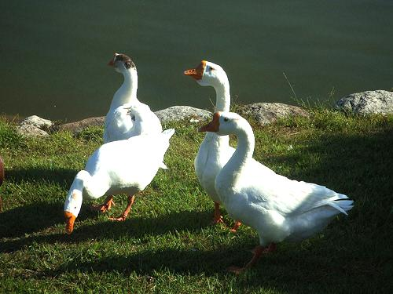
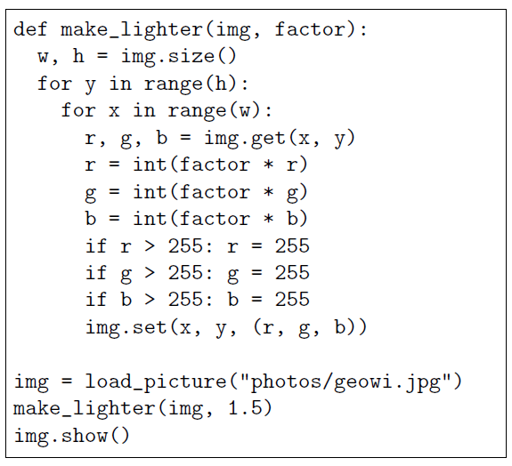
Operations
Color modifications
Let’s make image lighter.
Lighter means the value of RGB is close to white.
Because factor is larger than 1, color will be lighter.
If value is larger than 255,
Make it 255.
If factor is smaller than 1,
color will be darker.

Slide 8
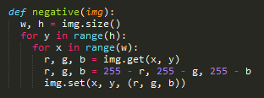
Operations
Color modifications
Let’s make image as negative.
Negative image is programmed as (255-r, 255-g, 255-b)

Slide 9

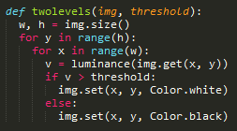
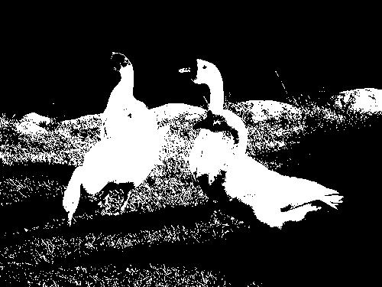
Operations
Color modifications
Let’s make image quantized.
Make an image as graytone which has only gray color, (a,a,a).
To do this, calculate the luminance by below equation.
The constant values are the ratio of the number of cells in eye which accept light.
2. Use threshold. If the luminance is larger than threshold, it’s white.

Slide 10
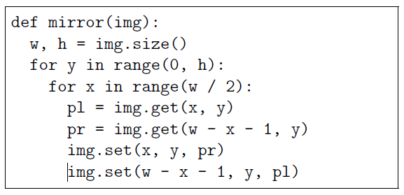
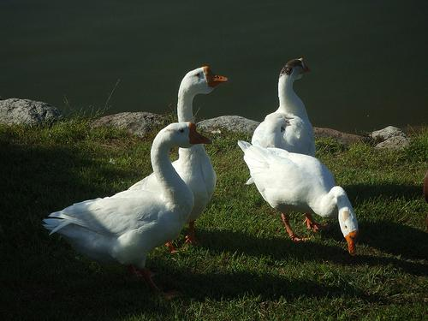
Operations
Reflections
You can reflect an image.
Code just changes two pixels.

Slide 11
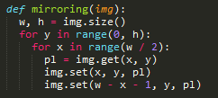
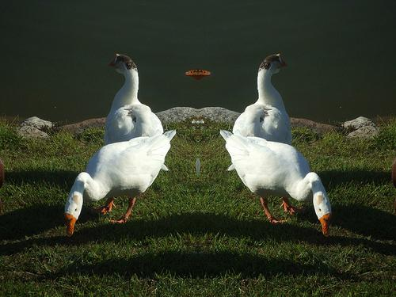
Operations
Reflections
Or, mirroring an image
Code just copies two pixels.

Slide 12
Operations
Pixelations
Pixelations, also called sampling, is a process to lower the resolution.
1. Calculate the average color of step*step pixels.
2. Set all step*step pixels as the average value.
You can calculate r, g, b separately.

Slide 13
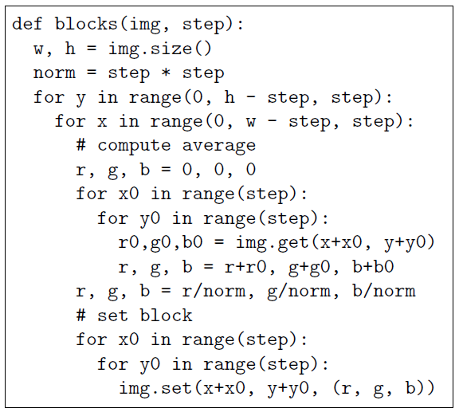
Operations
Pixelations
Calculate the average.

Slide 14
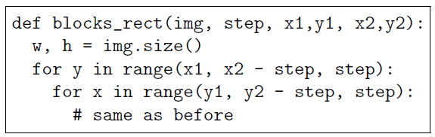
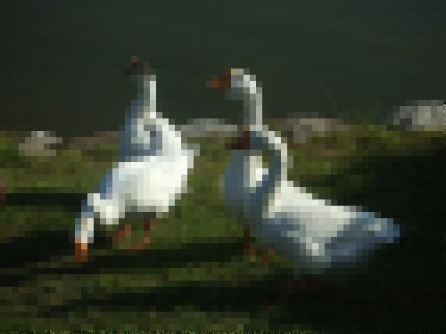

Operations
Pixelations
Or, You can sample just a finite area.

Slide 15
Operations
Blurring
Instead of sampling, you can blur image.
1. Calculate the average color of step*step pixels.
2. Set a center pixel as the average value.
You can calculate r, g, b separately.

Slide 16
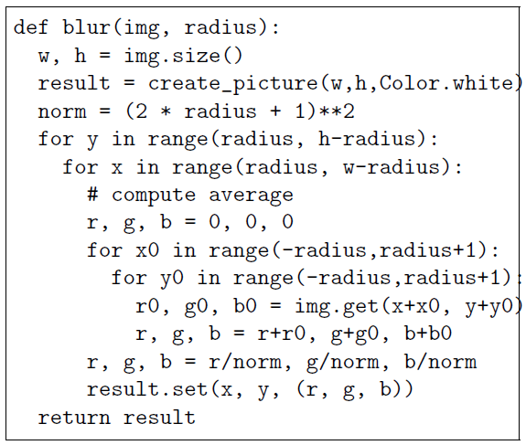
Operations
Blurring
Do not change original.

Slide 17
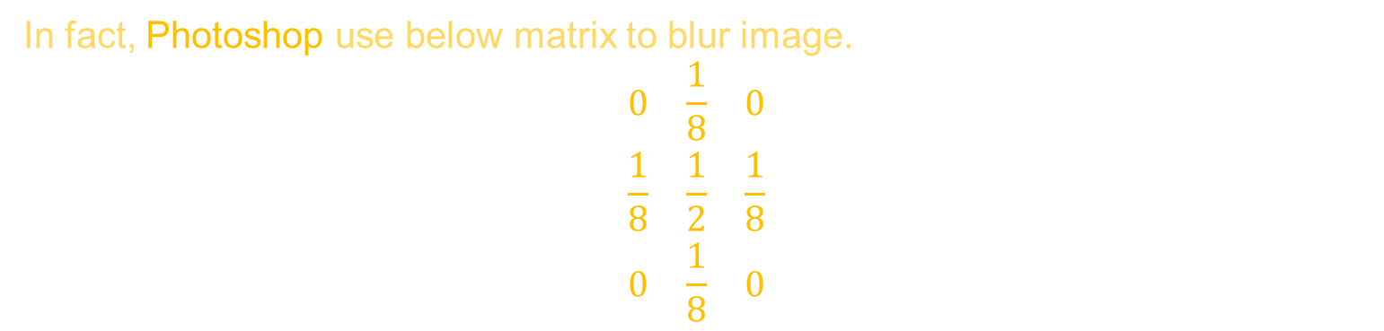
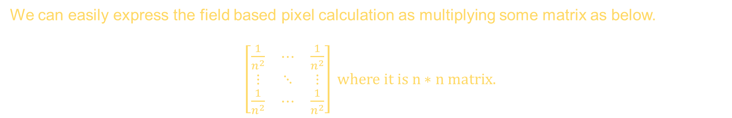
Operations
Blurring
ADVANCE
We can easily express the field based pixel calculation as multiplying some matrix as below.
$\left[\begin{matrix}\frac{1}{n^{2}} & ⋯ & \frac{1}{n^{2}} \\ ⋮ & ⋱ & ⋮ \\ \frac{1}{n^{2}} & ⋯ & \frac{1}{n^{2}}\end{matrix}\right] where it is n∗n matrix.$
It means, we can get difference effects by changing the matrix.
In fact, Photoshop use below matrix to blur image.
$$\begin{matrix}0 & \frac{1}{8} & 0 \\ \frac{1}{8} & \frac{1}{2} & \frac{1}{8} \\ 0 & \frac{1}{8} & 0\end{matrix}$$

Slide 18
Operations
Edge Detection
We can detect edges by detecting the difference of luminance.
If the luminance of pixel, (x,y) differs so much from pixels, (x-1,y) and (x, y-1),
We decide (x,y) is an edge.

Slide 19
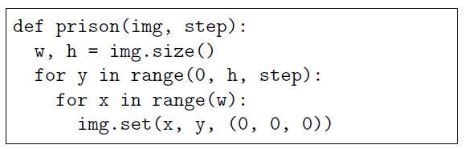
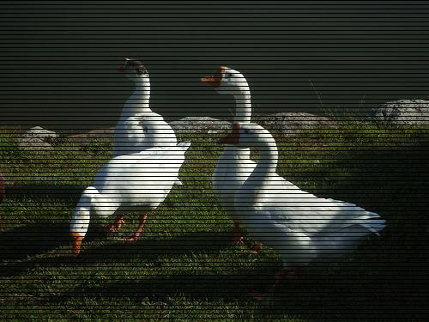
Operations
Artificial Images
We can modify an image artificially.
Add horizontal black lines.

Slide 20
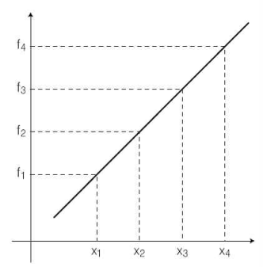
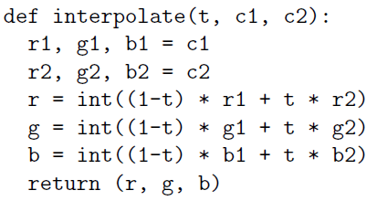
Operations
Artificial Images
Interpolation is a method of constructing new data points within the range of a discrete set of known data points.
Construct an equation of line with two end points.
We can estimate middle points.

Slide 21
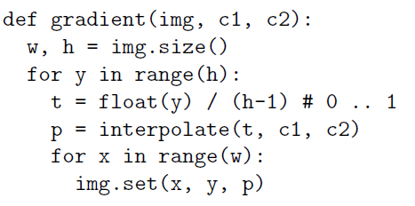

Operations
Artificial Images
We can make gradient image using interpolation.

Slide 22
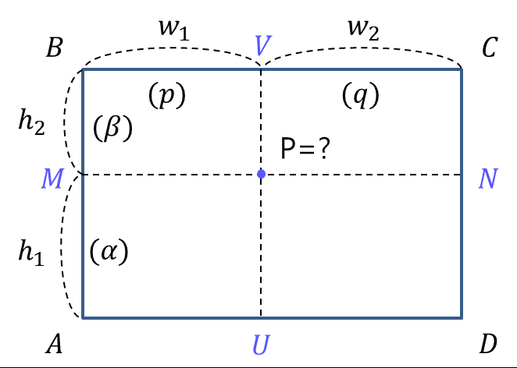

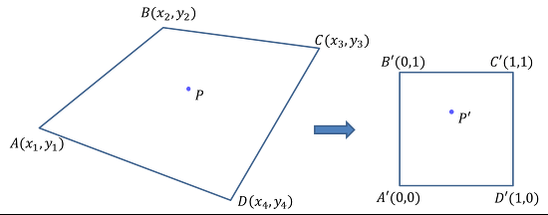
Operations
Artificial Images
ADVANCE – bi-linear Interpolation

Slide 23
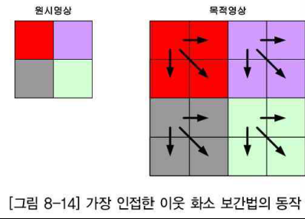
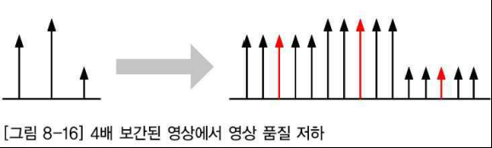
Operations
Artificial Images
ADVANCE – nearest-neighbor interpolation

Slide 24
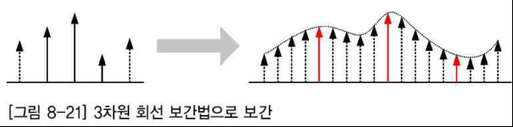
Operations
Artificial Images
ADVANCE – bi-cubic interpolation

Slide 25
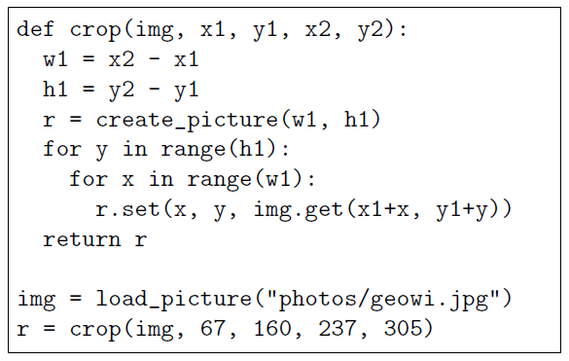
Operations
Cropping
Cropping is a method for cutting out the part of the photo.
Create empty small image.
Just copy it.

Slide 26
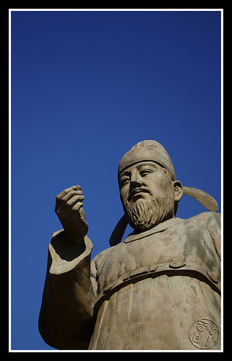
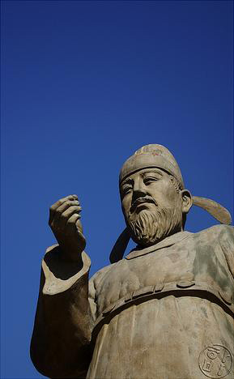
Operations
Cropping
We will create “auto cropping” operation.

Slide 27
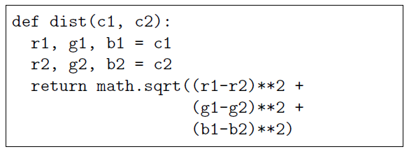
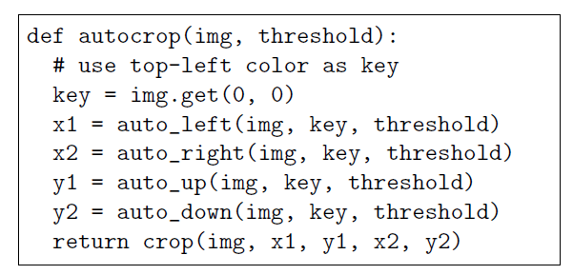
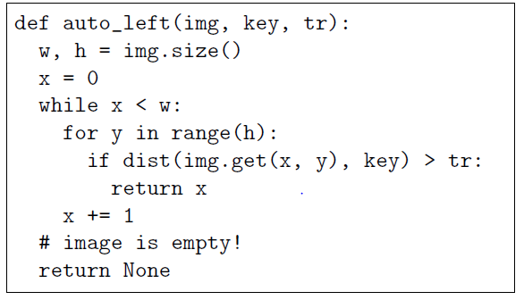
Operations
Cropping

Slide 28
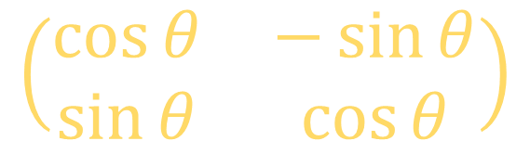
Operations
Rotations
Rotations are operated by mathematical transformation.
As you know…
$$\left(\begin{matrix}\cos{θ} & −\sin{θ} \\ \sin{θ} & \cos{θ}\end{matrix}\right)$$
But! This is OOP class not math class.

Slide 29
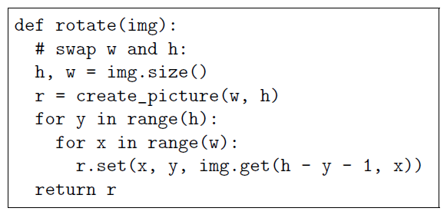
Operations
Rotations
Rotations are operated by mathematical transformation.
Rotation

Slide 30
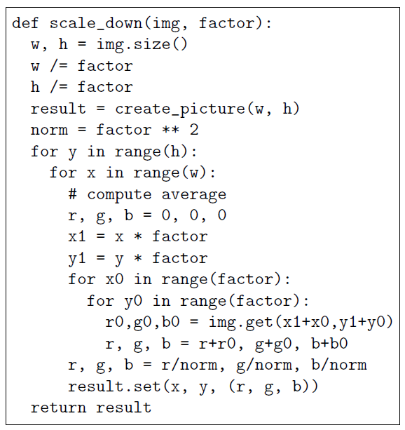

Operations
Scaling
Scale down an image.
Allocate new position.

Slide 31
Operations
Scaling
ADVANCE
If you want to scale up an image, use interpolation.
1. Allocate new position.
2. Estimate color by interpolation.
3. Set estimated color

Slide 32
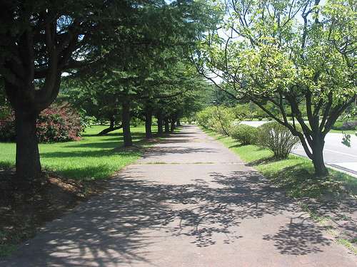

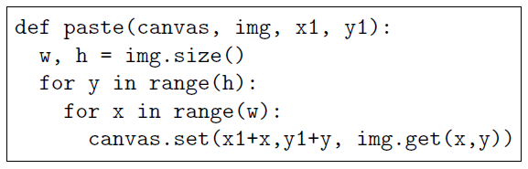
Operations
Collage
Collage is adding an image to other image.

Slide 33
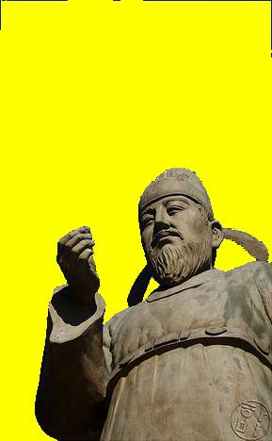
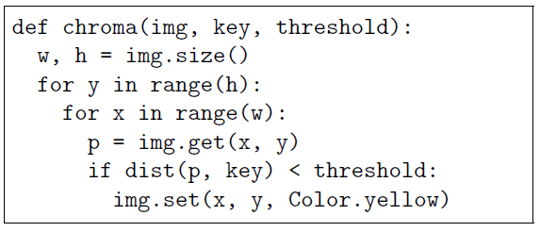
Operations
Chromakey
Chromakey is a technique to overlay one scene on top of another one. It is commonly used for weather maps.
Change color which is close to key color into yellow

Slide 34
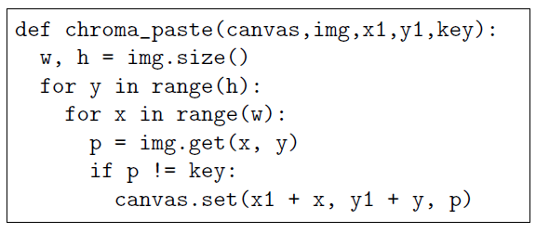
Operations
Chromakey
When you copy operated image, using chroma paste function.
Sometimes we call ‘key’ as a mask.

Slide 35
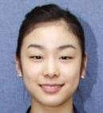
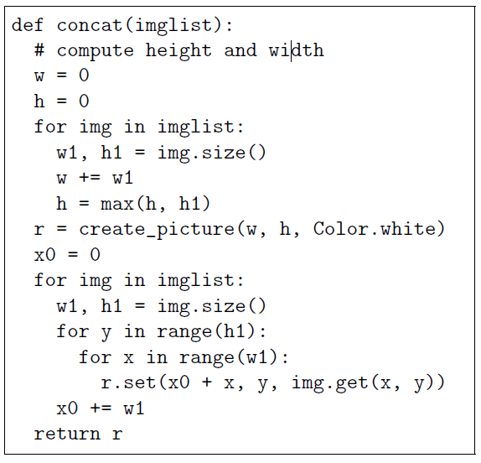
Operations
Concatenating photos
Max h
W = w1 + w2 + w3

Slide 36
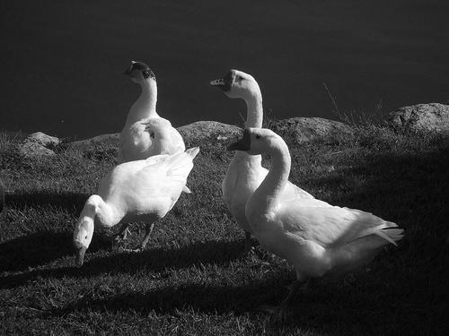
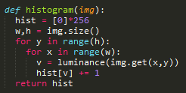
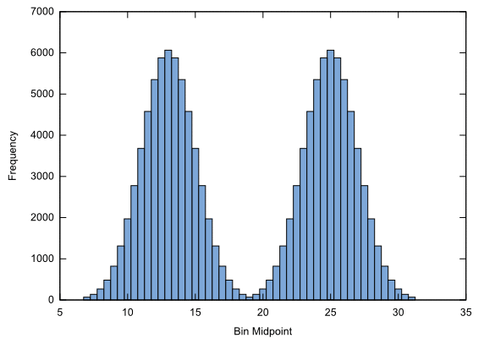
Operations
ADVANCE – how to decide threshold
1. Make an image as a graytone image.
2. Find a histogram

Slide 37
Operations
Threshold is a position which makes sum of both standard deviation minimized.

Slide 38
Applications
Steganography
Steganography is a technique for hiding information in an image.
People cannot distinguish (r,g,b) and (r,g,b+1)
So, set the last bit(1 or 0) as what we want.
Original
Data -> binary data -> set bit -> hiding
Crypt
Get bit -> binary data -> data

Slide 39

Applications
Hide black/white image
You can hide black/white image simply.
People cannot distinguish (r,g,b) and (r+1,g,b) (or other color)
So, use odd/even property.
Original
If black, make r odd, else, make r even
Crypt
If r is odd, make black, else, make white

Slide 40
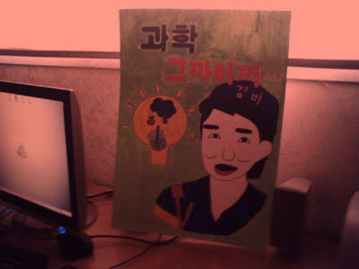


Applications
Sunset effect
You can give a sunset effect to an image.
Multiply factor(0.6~0.7) to green and blue.

Slide 41


Applications
Sunset effect
Sepia is a color-toning technique that makes an ancient photo
1. Make graytone image.
2. If v < 63, r *= 1.1, b *= 0.9
If 62<v<192, r *= 1.15, b *= 0.85
If 191<v, r *= 1.08, b*=0.93

Slide 42





Applications
Blending
Blending is a technique to blend two images.
$$v=αv_{1}+\left(1−α\right)v_{2}$$
img1
img1
img2
This is an example of blending.
In this example, alpha is changed by x or y.
img2

Slide 43




Applications
Posterize
Posterize is a technique to replace the colors in a photo with a rather small set of colors
1. Set some fixed colors(you can user random() function)
2. Replace colors by some rules.
I select the nearest one among the list.

Slide 44
Applications
Morphology
Morphology is a collection of non-linear operations related to the shape or morphology of features in an image
1. Dilation
Dilation is an operation that broaden white pixel area.
2. Erosion
Erosion remove white each pixel adjacent to black.

Slide 45
Applications
Morphology
Original Image
Processed Image
Up
Structuring Element
If Any pixel has the value:
Fill the pixel of the result image
Left
Center
Right
Down

Slide 46
Applications
Morphology
Original Image
Processed Image With Dilated Pixels
Up
Structuring Element
If Any pixel has the value:
Fill the pixel of the result image
Left
Center
Right
Down

Slide 47
Applications
Morphology
Original Image
Processed Image With Eroded Pixels
Up
Structuring Element
If All pixels have the value:
Fill the pixel of the result image
Left
Center
Right
Down

Slide 48
Applications
Morphology
Original Image
Processed Image
Up
Structuring Element
If All pixels have the value:
Fill the pixel of the result image
Left
Center
Right
Down

Slide 49



Applications
Morphology
Make two functions: opening and closing
Original
Opening
Closing
Erosion -> Dilation
Dilation -> Erosion

Slide 50





Applications
Morphology
Examples of functions
Original image
Dilation
Erosion
Opening
Closing

Slide 51
Question?

