Slide 1

E-commerce Analysis Intelligence System
Sales analysis . Customer Segmentation . Business Insights
Presented By: Rashmi.R
Internship Organization : Teknowgrade
Date: Oct 2026

Slide 2
INTRODUCTION
The e-commerce customer intelligence analysis system analyzes e-commerce transaction data to understand sales performance,customer behaviour,and purchasing patterns.
It uses data analysis,visualization,RFM analysis,and k-means clustering to identify meaningful customer segments and business insights

Slide 3

The Problem
it Solves
Large amounts of e-commerce data can be difficult to understand manually.
Businesses need to identify their best and at-risk customers
Sales trend and product performance need to be analysed easily

Slide 4
Objectives
To analyze e-commerce sales and revenue trends
To understand customer purchasing behaviour to Identify best-performing products, categories, and countries
To segment customer based on their purchase patterns and value
To identify high value ,loyal,and at-risk customers using RMF analysis
To apply k-means clustering for customer segmentation

Slide 5

Scope of the Project
Analyze e-commerce transaction data and sales performance
Study products, categories,countries and revenue trends
Understand customer purchasing pattern and behavior
Perform RMF analysis to evaluate customer value
Segment customers into meaningful groups using RMF and K-Means clustering
Visualize data using interaction charts and graphs
Generate business insights t support better marketing and sales decisions

Slide 6






Technologies Used
Main Programming language
Numerical operations
Data Handling and analysis
K-means clustering and data scaling
Development and execution
Interactive charts and visuals

Slide 7
System Modules
Data generation and cleaning
Product and Category Analysis
Customer Analysis
K-Means clustering
Sales Analysis
Business Insights
RMF and customer Segmentation
Interactive Analysis

Slide 8

Dataset/
Data Overview
Dataset :
Synthetic E-commerce Transaction Data
Total Transactions :
10,000
Customers :
1,000
Countries :
India,USA,UK,Germany,Canada,Australia
Main Data :
Customer ID, Product, Category, Quantity, Unit price, Purchase Date, Revenue, Gender
Derived Data :
Year,Month,Month Name,Day, and Weekday

Slide 9
Generate Dataset
Project Methodology
Perform RFM Analysis
Perform RFM Analysis
Create Visualizations
Create Visualizations
Clean & Prepare Data
Analyze Sales & Customers
The project begins by generating and cleaning synthetic e-commerce transaction data. Sales and customer behaviour are analysed using charts and graphs. RFM analysis and K-Means clustering are used to segment customers. Finally, interactive visualization and automatic business insights help identify sale trends and valuable customer groups
Segment Customers
Segment Customers
Apply K-means Clustering
Apply K-means Clustering
Generate Business Insights
Generate Business Insights
Generate Business Insights

Slide 10
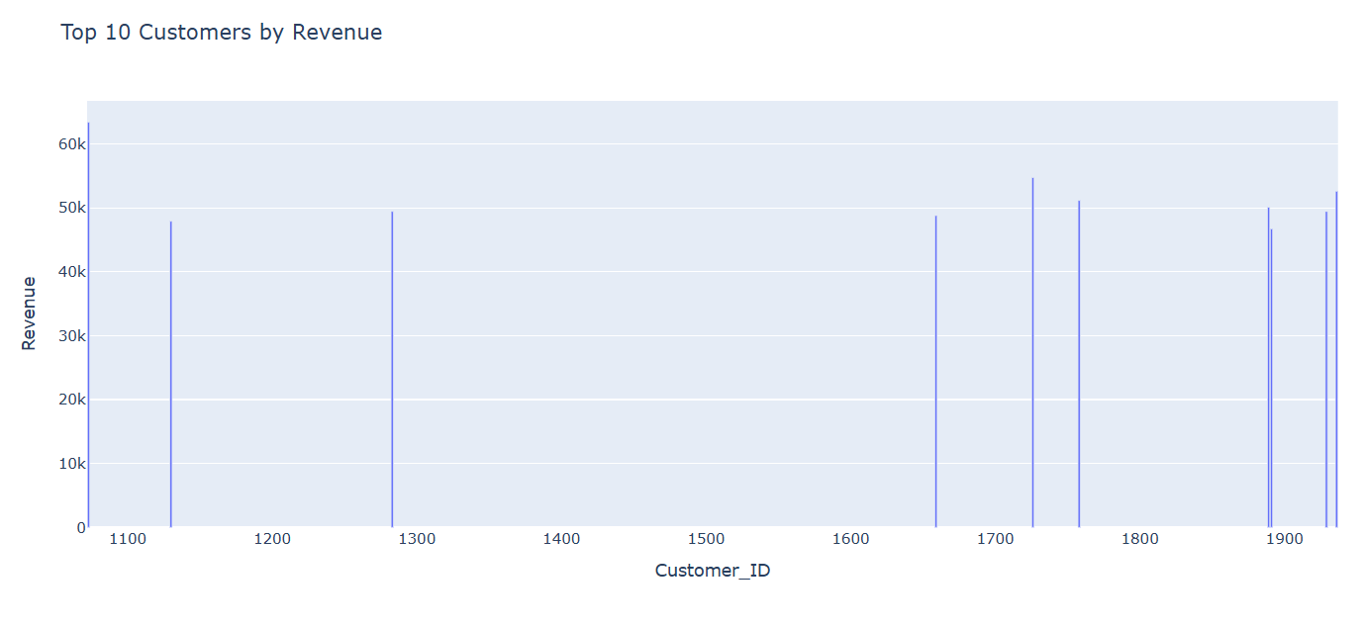
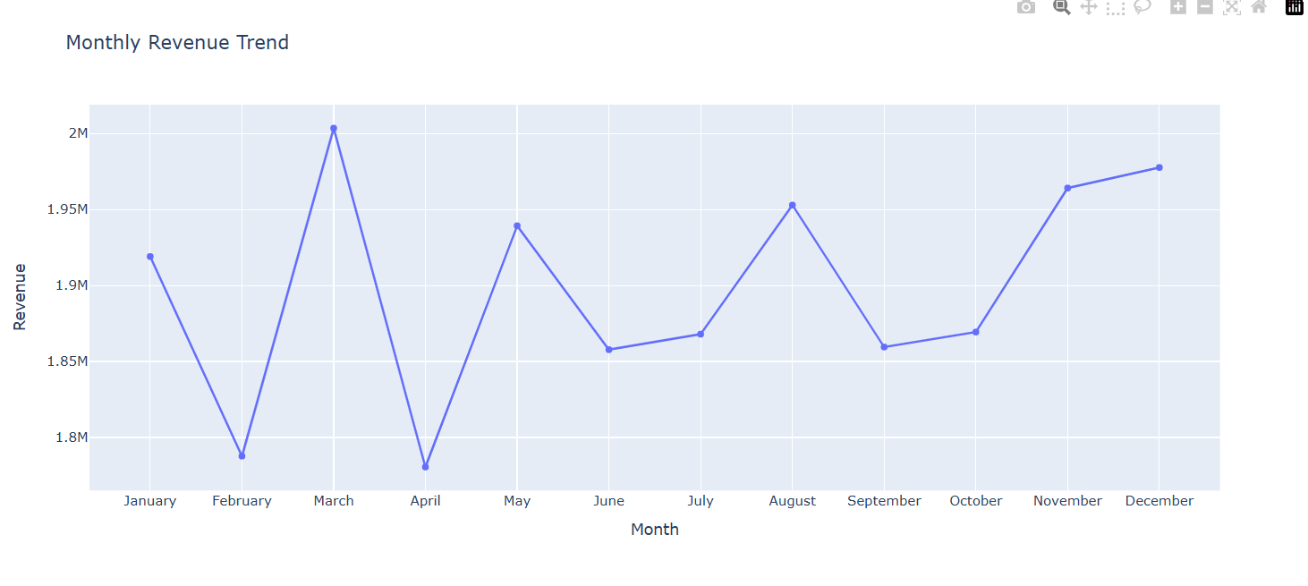
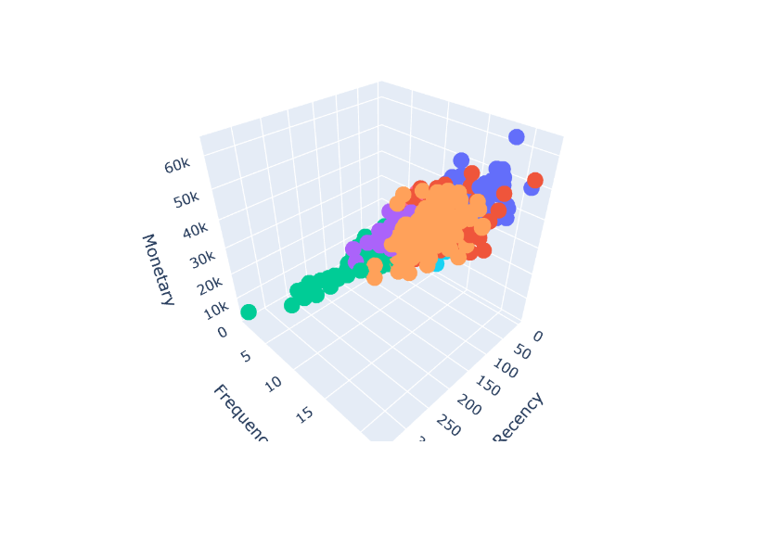
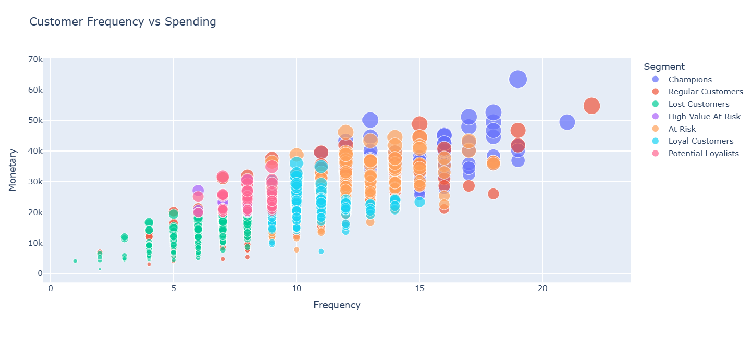
Project Outputs

Slide 11
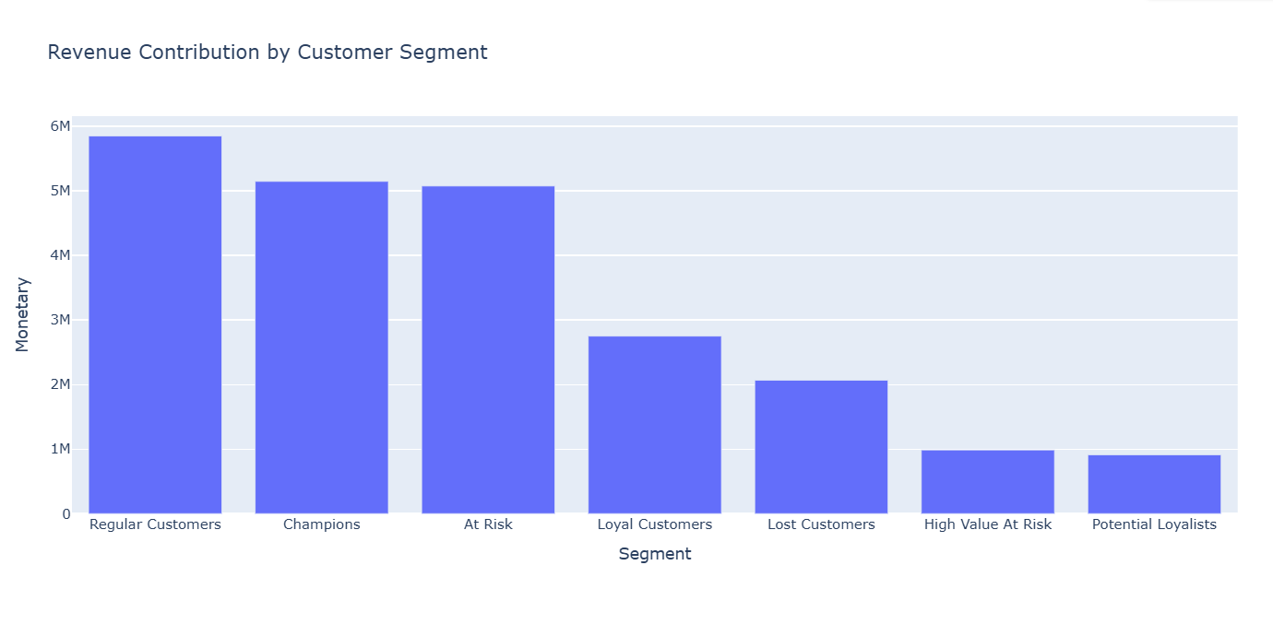
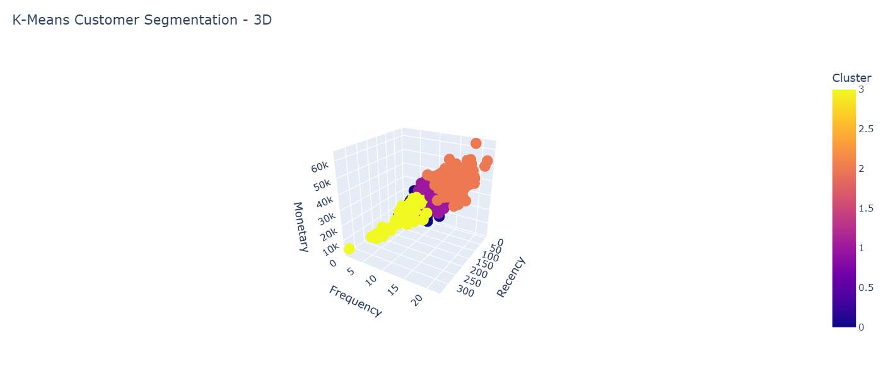
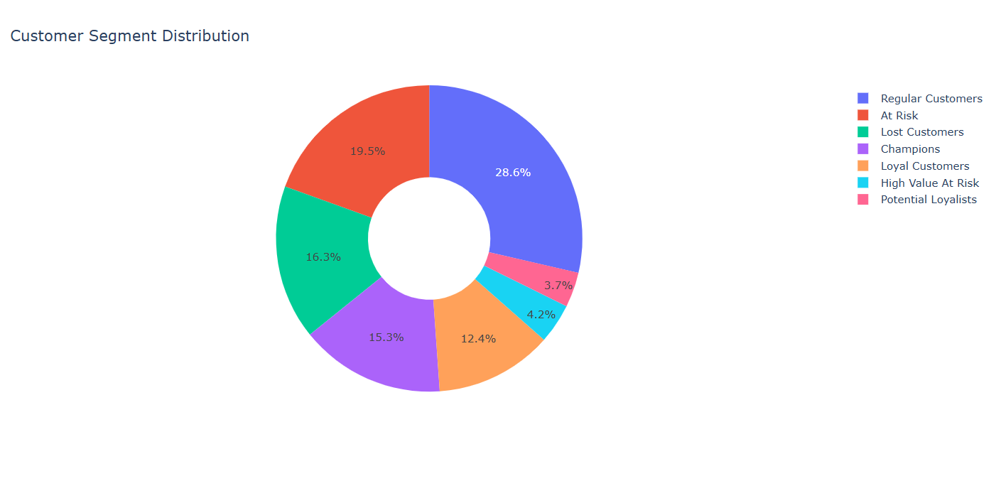
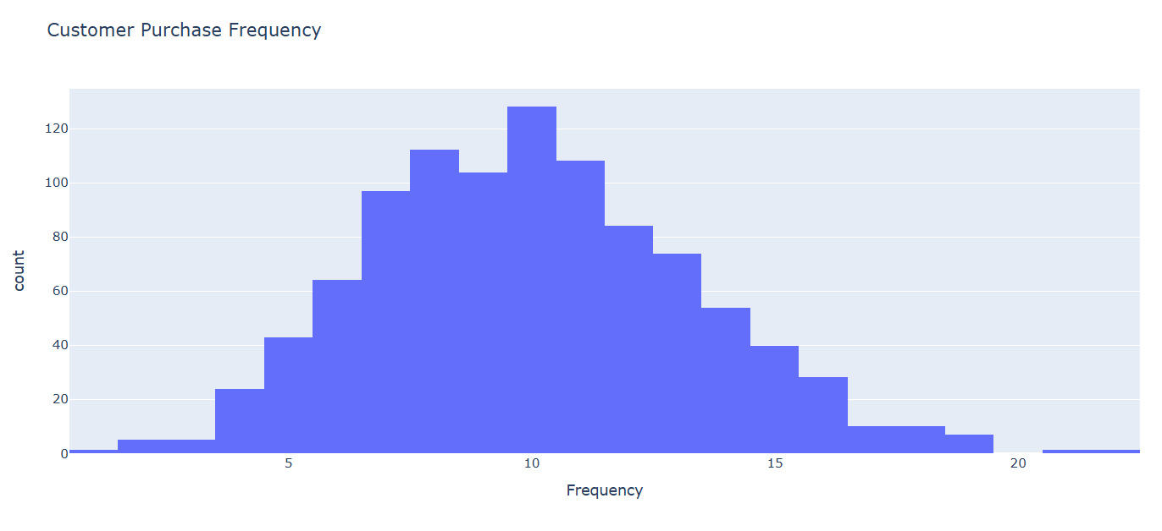
The system generates visual reports and charts to analyze sales performance, customer behavior, and business trends.

Slide 12
Conclusion
The E-commerce Customer Intelligence Analysis System analyzes sales data and customer purchasing behavior using Python. It uses data visualization, RFM analysis, and K-Means clustering to identify sales trends and customer segments. The system generates useful business insights that can support better marketing strategies and decision-making.

Slide 13
Future Scope
Use real-world e-commerce transaction data.
Add sales and customer behavior prediction.
Develop a product recommendation system.
Implement real-time data analysis and dashboards.
Improve customer retention through churn prediction.

Slide 14
THANK YOU
E-commerce Customer Intelligence Analysis System
Presented by: Rashmi.R
Course: AI/DS

